Slide 1
Presenter Notes:
Put the Slide Show into “Presenter Mode”
  Slide Show > From Beginning
Navigate using the hyperlinked image tiles and yellow buttons
  Click the “Start” and “Next” buttons to advance to the next slide
  Click a correct image tile to advance to the Correct answer slide
  Click an incorrect image tile to advance to an Incorrect answer slide
  Click the “Try Again” button to return to the question slide
Please do not make any edits to this presentation

Slide 2
Fidgeting Felix
Table Talk with MDH Project Firstline
Interactive Resources

Slide 3

WHEN HEALTHCARE TASKS TAKE A TURN!
ARE YOU READY FOR THE INFECTION CONTROL CHALLENGE?
You know that being a health care worker means you're always dealing with the unexpected.
How well can you stop infection from spreading when problems come up?
Take the infection control challenge and find out. Select the Start button to begin!
START

Slide 4

FIDGETING FELIX GETS AN IV
A child, Felix, has just been admitted to the hospital. You are about to insert an IV into his arm.
NEXT

Slide 5


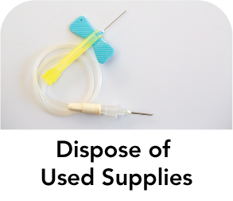
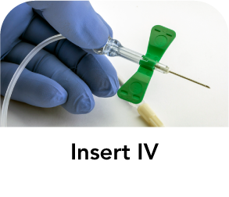




What’s the first thing you should do?
Select the correct option.

Slide 6
INCORRECT 1
TRY AGAIN

Slide 7

CORRECT! 1
Use Hand Sanitizer or Wash Hands with Soap and Water
It's important to clean your hands to remove germs before you insert an IV. Hand sanitizer is slightly better at getting rid of germs, but washing with soap and water is still a good option.
NEXT

Slide 8
Now that your hands are clean, what’s next?
Select the correct option.

Slide 9
INCORRECT 2
TRY AGAIN

Slide 10

CORRECT! 2
Put on Gloves
Inserting an IV can expose you to blood that might have germs in it. That's why you protect your hands by putting on gloves.
NEXT

Slide 11

Now that you have your gloves on, what’s next?
Select the correct option.

Slide 12
INCORRECT 3
TRY AGAIN

Slide 13

CORRECT! 3
Disinfect Felix’s Skin
It is important to kill germs that might be on Felix's skin before you insert the IV, so the needle doesn't push those germs into his body.
NEXT

Slide 14
FIDGETING FELIX 2
As you get the IV ready to insert, you notice Felix rubbing his arm where you just disinfected it.
NEXT

Slide 15
What should you do next?
Select the correct option.

Slide 16
INCORRECT 4
TRY AGAIN

Slide 17
CORRECT! 4
Disinfect Felix’s Skin
Once a disinfected area is touched with something that is not sterile, like Felix's hands, you assume that germs have been spread to that area. That means the area has to be disinfected again before you insert the IV.
NEXT

Slide 18
Great! Now that you have disinfected Felix’s skin again, what’s next?
Select the correct option.

Slide 19
INCORRECT 5
TRY AGAIN

Slide 20
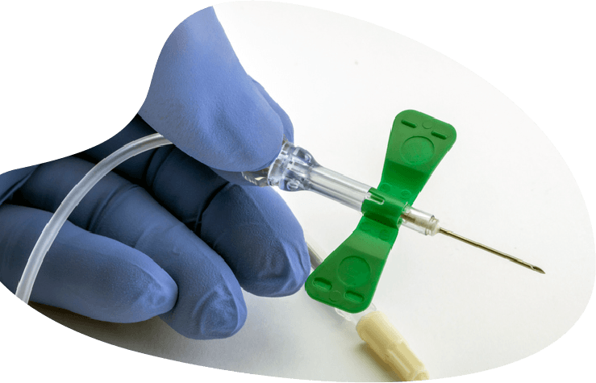
CORRECT! 5
Insert IV
You've killed the germs on Felix's skin, and it's now safe to insert the IV.
NEXT

Slide 21
Great! Now that you have inserted the IV, what’s next?
Select the correct option.

Slide 22
INCORRECT 6
TRY AGAIN

Slide 23
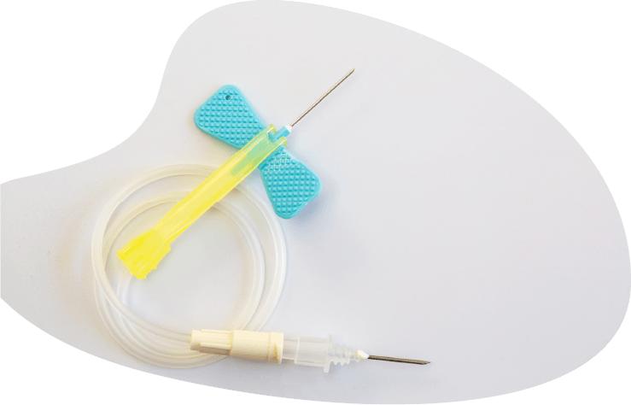
CORRECT! 6
Dispose of Used Supplies
It's important to throw away the used supplies to keep others from being exposed to Felix's blood. Be sure to put the needle and other sharps in the sharps container.
NEXT

Slide 24
Great! Now that you have disposed of the used supplies, what’s next?
Select the correct option.

Slide 25
INCORRECT 7
TRY AGAIN

Slide 26
CORRECT! 7
Remove Gloves
After you throw away the used supplies, it's time to take off your gloves to remove the germs and blood that have gotten on them.
NEXT

Slide 27

Great! Now that you have removed your gloves, what’s next?
Select the correct option.

Slide 28
INCORRECT 8
TRY AGAIN

Slide 29
CORRECT! 8
Use Hand Sanitizer or Wash Hands with Soap and Water
Even if you're careful when you take off your used gloves, you can still get germs on your hands that need to be removed. Hand sanitizer is a good option, but if you see or feel any blood on your skin, you should wash with soap and water.
NEXT

Slide 30
Now that you have cleaned your hands, it's safe to move on to your next task.
Congratulations for completing this infection control challenge.
You are an Infection Control Pro!

Slide 31
Fidgeting Felix Gets an IV Review
Infection Prevention and Control Steps

Slide 32

Questions

Slide 33
Resources
MDH Project Firstline www.health.mn.gov/projectfirstline
CDC Fidgeting Felix Interactive Resource
(optimized for handheld devices)
MDH PFL Germs can live in blood (PDF)
MDH PFL Germs live on the skin (PDF)
CDC Project Firstline | Facebook | Twitter
CDC Germs live in blood Lock Screen (JPG)
Subscribe to CDC Project Firstline e-mails
Subscribe to MDH Project Firstline Mailing List
Minnesota Department of Health (@mnhealth)| Facebook
Minnesota Department of Health (@mnhealth)| Twitter
Minnesota Department of Health (@mnhealth) | LinkedIn
Minnesota Department of Health (@mnhealth)| Instagram

