Slide 1
Presenter Notes:
Put the Slide Show into “Presenter Mode”
  Slide Show > From Beginning
Navigate using the hyperlinked “hot spots” and purple buttons
  Hover over and click on a “hot spot” to advance to that problem’s slide
  On each problem slide:
    Click again to show text box
    Click the “Next” button to return to the main picture slide
  Click the “Finish” button to advance to the reflection slide
Please do not make any edits to this presentation

Slide 2
What’s Wrong with this Picture: Emergency Room
Table Talk with MDH Project Firstline
Interactive Resources

Slide 3
Agenda
Welcome
Welcome and Introductions
What’s Wrong with this Picture: Emergency Room
Conclusion

Slide 4
What’s Wrong with this Picture: Emergency Room

Slide 5
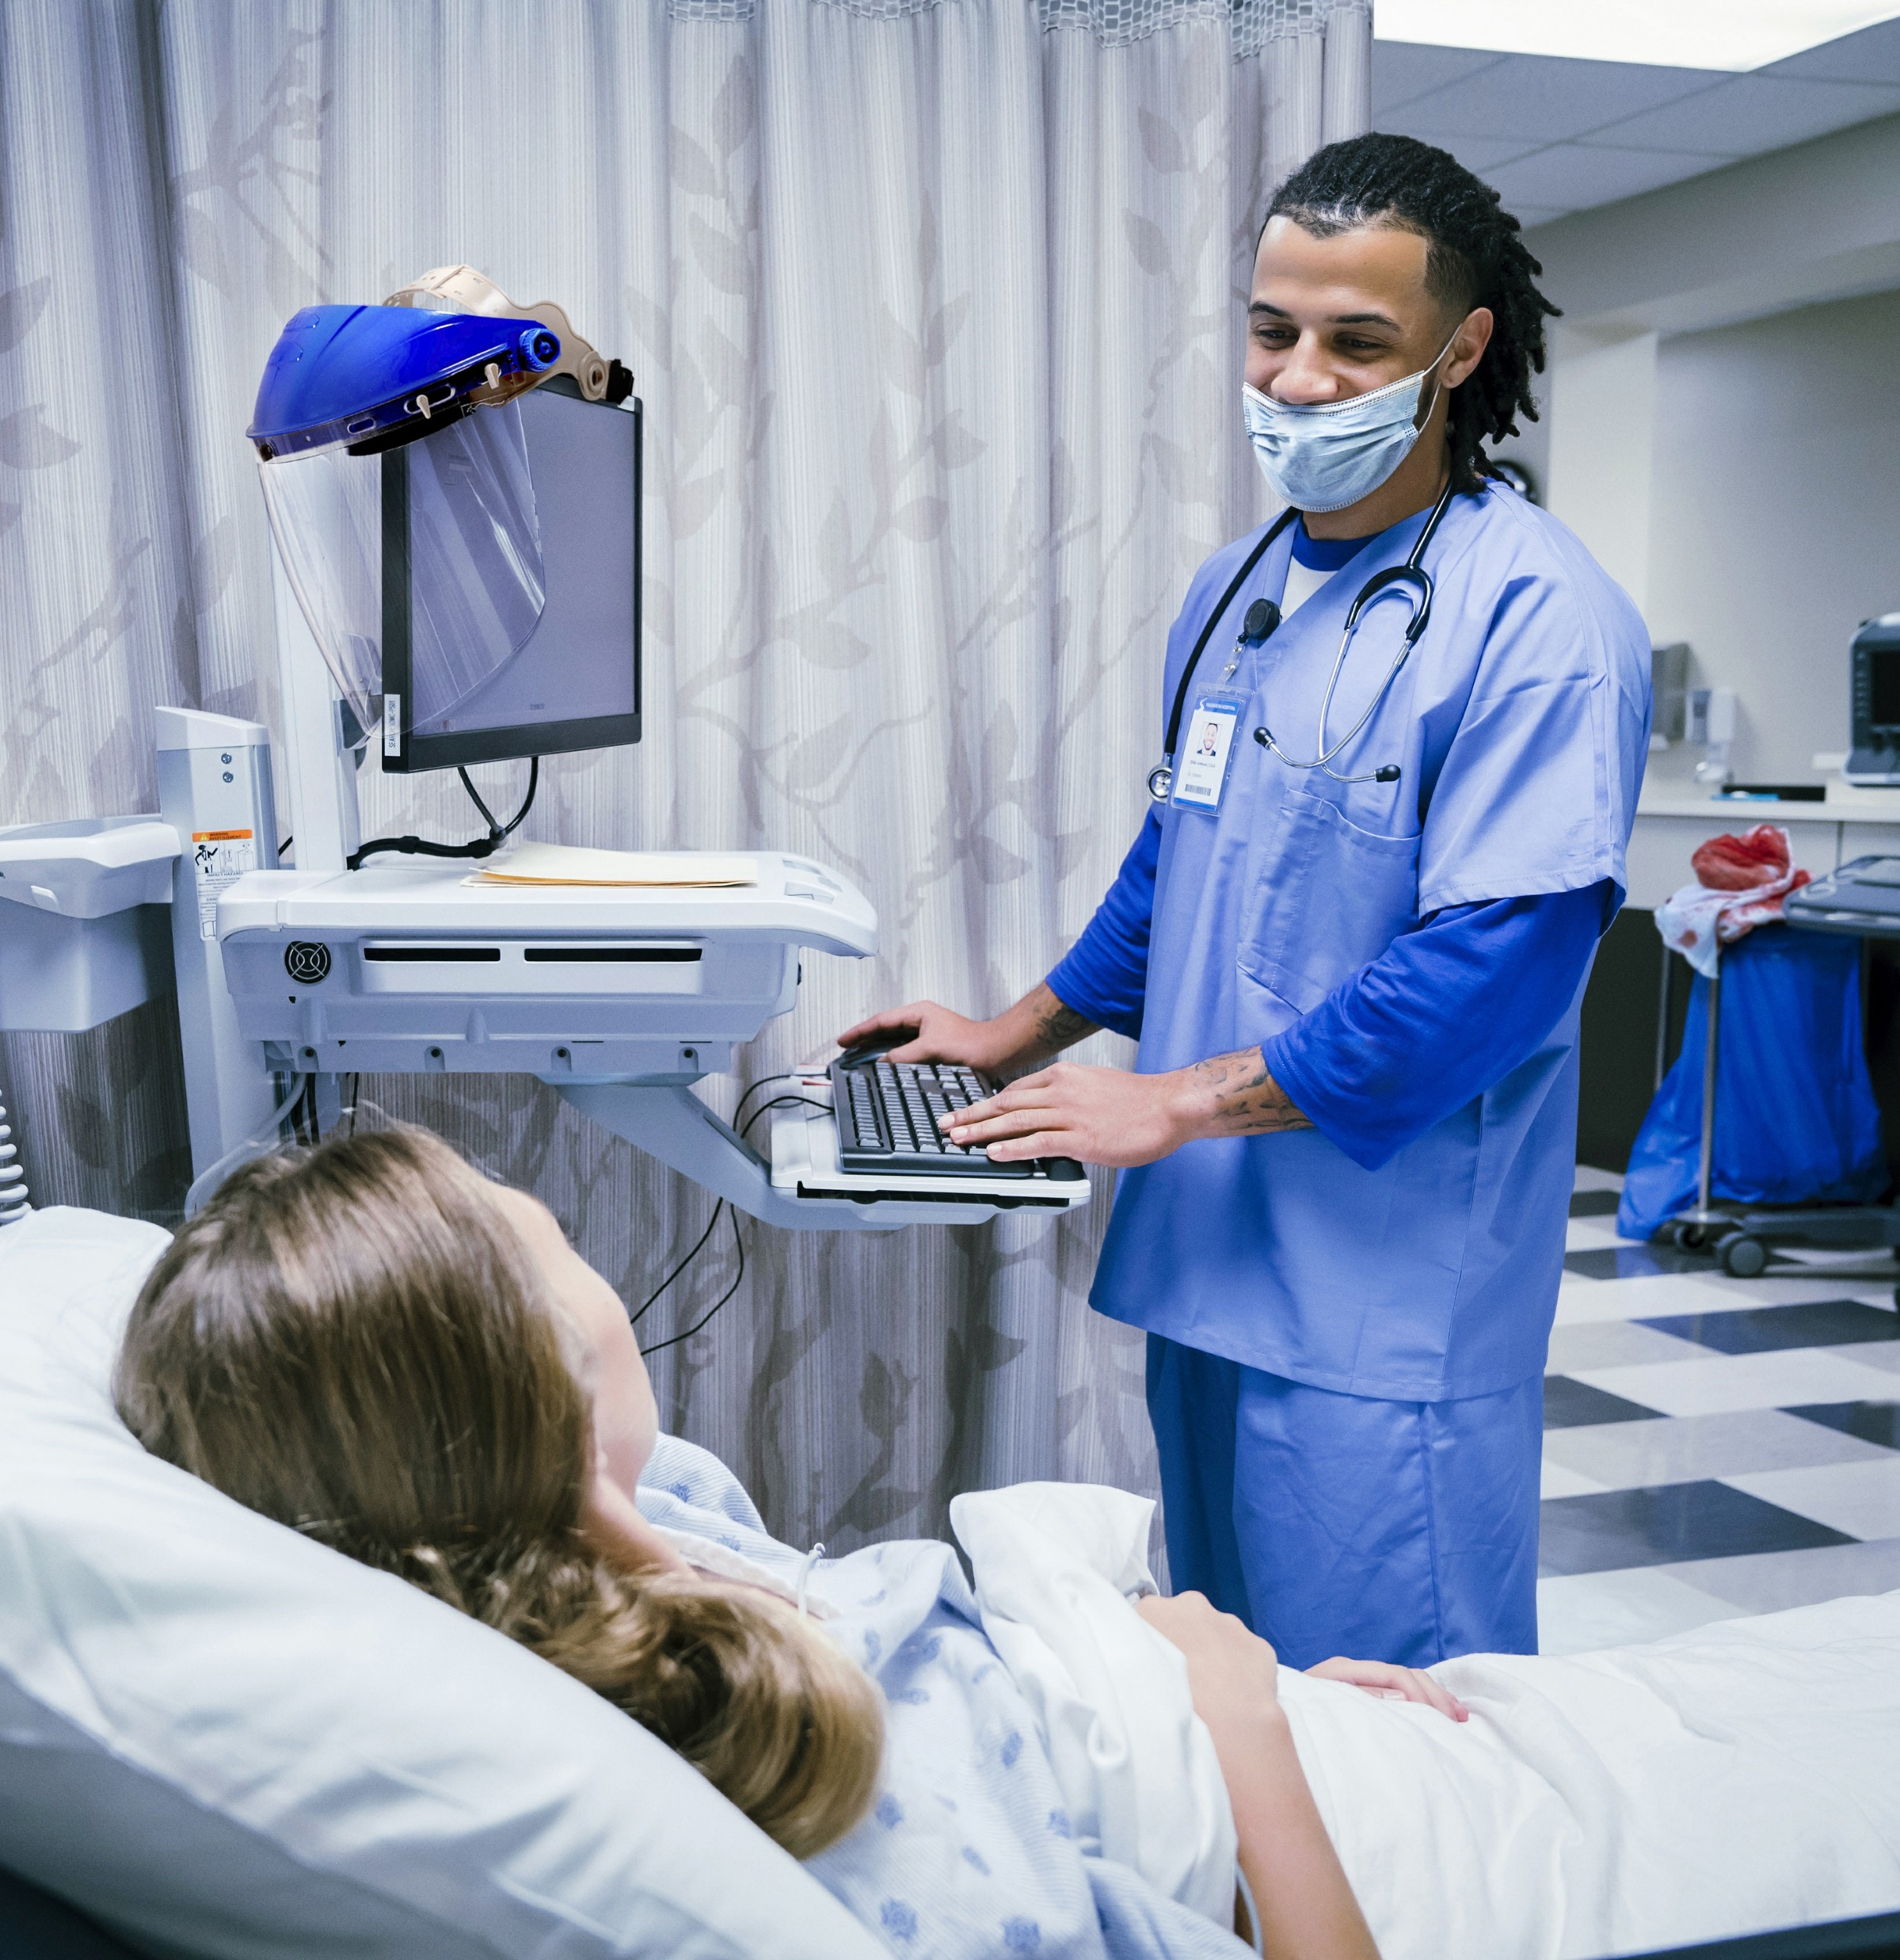
What’s wrong with this picture?
Health care workers need to be extra aware of where germs are found and how they can be spread to surfaces and people.
We can help stop infections when we recognize the risk for germs to spread!
In this image of an emergency department, select three problems that need to be fixed to reduce the spread of germs.
Finish

Slide 6



Overflowing Dirty
Linens Bag
Next
Used linens are covered in germs and should always be placed in a marked bag or bin.
Take the time to make sure the linens are fully inside the container where no one will touch them and spread germs.

Slide 7
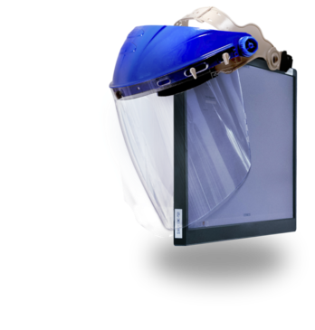
Hanging PPE on a Computer
Next
Clean PPE should be stored in a way so that it's obvious it's clean, for example, in a labeled container or clearly identified area. Used PPE has germs on it and should be thrown away, or, if it's reusable, cleaned and stored.

Slide 8

Not Wearing a Mask Over the Mouth and Nose
Next
Some germs can spread through the respiratory droplets that people make when they breathe. When using a mask for source control, it's important that the mask covers both the mouth and the nose to keep respiratory droplets from reaching others.

Slide 9
Reflection
You did it! Thanks for exploring this common health care setting and identifying infection control problems.
Have you ever encountered them in your workplace?
If so, why do you think they are so common? What could we do to stop them?

Slide 10
Conclusion

Slide 11
Resources
MDH Project Firstline www.health.mn.gov/projectfirstline
CDC PFL Interactive Resources
CDC Interactive Resources: What’s Wrong with This Picture? Emergency Room
CDC Project Firstline (cdc.gov) | Facebook | Twitter
Subscribe to CDC Project Firstline e-mails
Subscribe to MDH Project Firstline Mailing List
Minnesota Department of Health (@mnhealth)| Facebook
Minnesota Department of Health (@mnhealth)| Twitter
Minnesota Department of Health (@mnhealth) | LinkedIn
Minnesota Department of Health (@mnhealth)| Instagram

Slide 12

Questions

