Slide 1
Presenter Notes:
Put the Slide Show into “Presenter Mode”
  Slide Show > From Beginning
Navigate using the hyperlinked image tiles and yellow buttons
  Click the “Start” and “Next” buttons to advance to the next slide
  Click a correct image tile to advance to the Correct answer slide
  Click an incorrect image tile to advance to an Incorrect answer slide
  Click the “Try Again” button to return to the question slide
Please do not make any edits to this presentation

Slide 2
Diarrhea Dilemma
Table Talk with MDH Project Firstline
Interactive Resources

Slide 3

WHEN HEALTH CARE TASKS TAKE A TURN!
ARE YOU READY FOR THE INFECTION CONTROL CHALLENGE?
You know that being a health care worker means you're always dealing with the unexpected.
How well can you stop infection from spreading when problems come up?
Take the infection control challenge and find out. Select the Start button to begin!
START

Slide 4
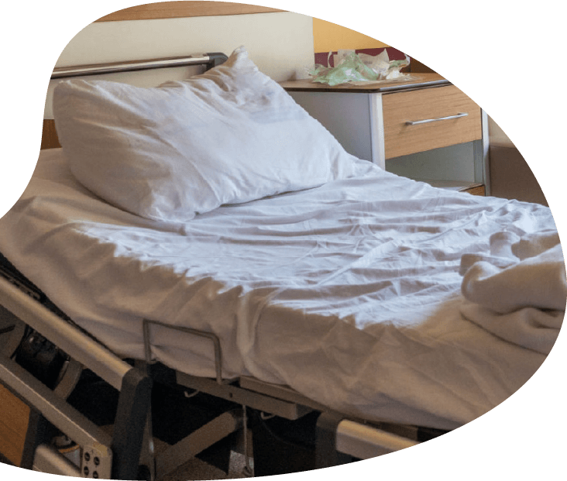

DIARRHEA DILEMMA
You go to change a patient's bed linens. When you pull back the sheets, you notice there's diarrhea on the sheets, and some may have gotten on your hands.
NEXT

Slide 5
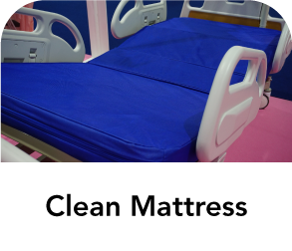


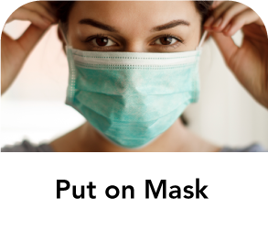
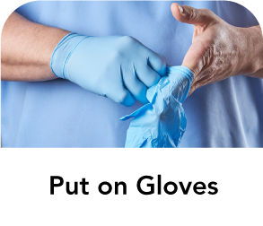
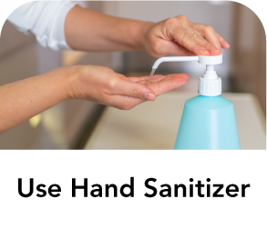


What’s the first thing you should do?
Select the correct option.

Slide 6
INCORRECT
TRY AGAIN

Slide 7
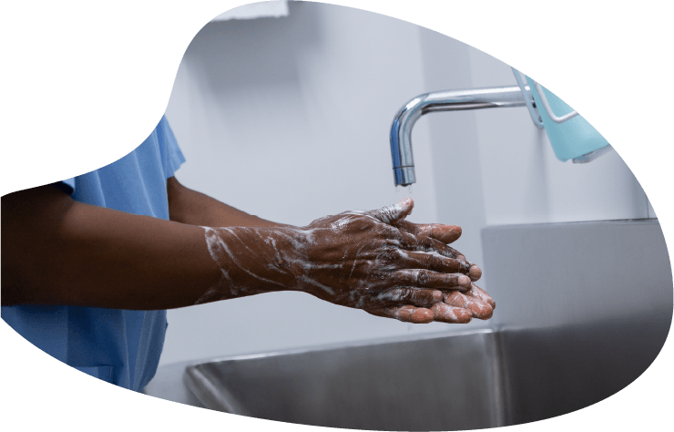
CORRECT!
Wash Hands with Soap and Water
When you pulled the sheets back, you may have touched something that was contaminated with stool. You need to clean your hands before you touch anything else.
When you think you may have gotten stool on your hands, you should use soap and water to clean your hands. Also, this patient's diarrhea may be caused by germs that hand sanitizer doesn't kill.
NEXT

Slide 8
Now that your hands are clean, what’s next?
Select the correct option.

Slide 9
INCORRECT
TRY AGAIN

Slide 10
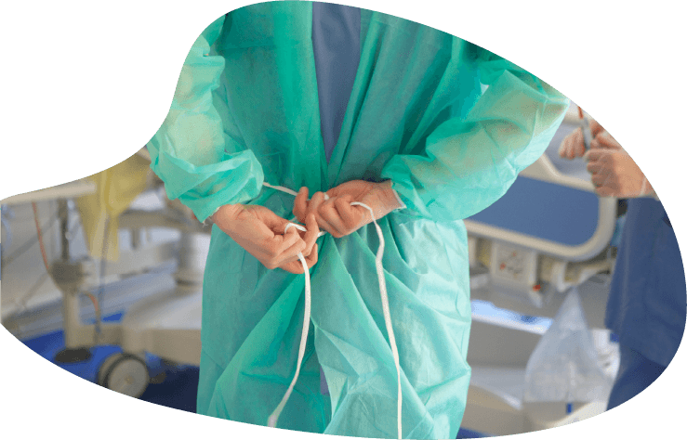
CORRECT!
Put on Gown
You know that if the diarrhea is from an infection, it can be spread by touch. That's why you want to use PPE that helps keep germs off your hands and clothes. Even if they didn't have an infection, you wouldn't want to get stool on your clothes.
NEXT

Slide 11

Great! Now that you have your gown on, what’s next?
Select the correct option.

Slide 12
INCORRECT
TRY AGAIN

Slide 13

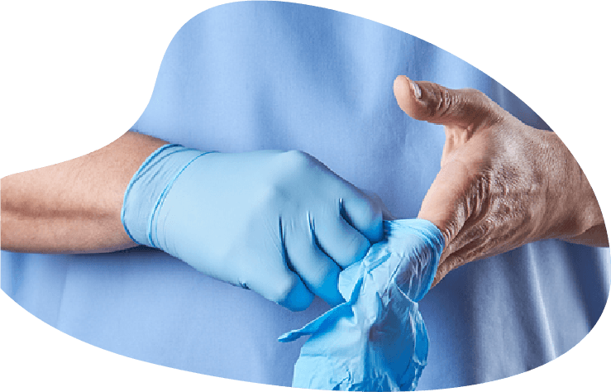
CORRECT!
Put on Gloves
You know that if the diarrhea is from an infection, it can be spread by touch. That's why you want to use PPE that helps keep germs off your hands and clothes. Even if they didn't have an infection, you wouldn't want to get stool on your hands.
NEXT

Slide 14
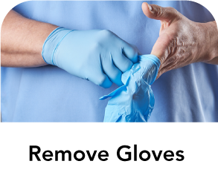
Great! Now that you have a gown and gloves on, what’s next?
Select the correct option.

Slide 15
INCORRECT
TRY AGAIN

Slide 16
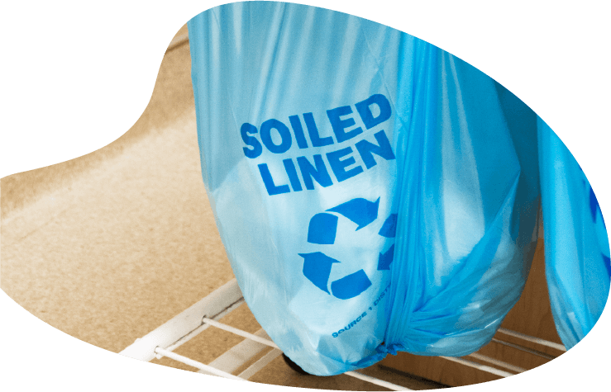
CORRECT!
Remove Dirty Linens and Place in Bag
Now that you are protected with a gown and gloves, you can remove the stool and germs from the bed. You start by taking off the dirty linens. Be sure to put them in a dirty linen bag or container so the germs don't spread.
NEXT

Slide 17
Great! Now that you have removed the dirty linens and placed them in the bag, what’s next?
Select the correct option.

Slide 18
INCORRECT
TRY AGAIN

Slide 19
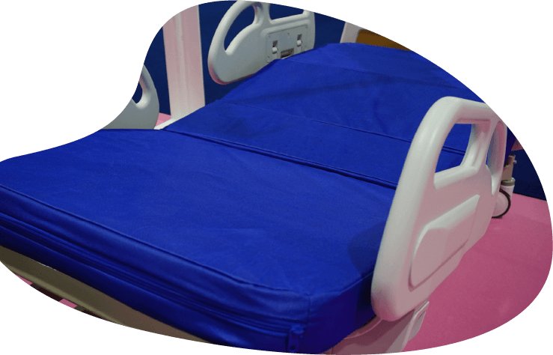
CORRECT!
Clean Mattress
Before you put on clean sheets, you need to make sure the mattress is clean. Because you don't know what is causing the diarrhea, you should use products that work against infections like C. diff and norovirus. Ask a supervisor if you're not sure what to use.
NEXT

Slide 20
Great! Now that you have cleaned the mattress, what’s next?
Select the correct option.

Slide 21
INCORRECT
TRY AGAIN

Slide 22
CORRECT!
Remove Gown
Before you touch the clean linens, you want to take off your dirty PPE. You don't want to spread stool or germs to the fresh linens. You should start by taking off the gown.
NEXT

Slide 23

Great! Now that you have taken off your gown, what’s next?
Select the correct option.

Slide 24
INCORRECT
TRY AGAIN

Slide 25
CORRECT!
Remove Gloves
Before you work with the clean linens, you want to take off your dirty PPE. You don't want to spread stool or germs to the fresh linens. You should remove the gown first, and then remove your gloves.
NEXT

Slide 26
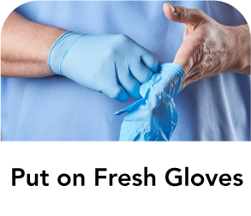
Great! Now that you have removed your gown and gloves, what’s next?
Select the correct option.

Slide 27
INCORRECT
TRY AGAIN

Slide 28
CORRECT!
Wash Hands with Soap and Water
Even when you're wearing gloves, some germs will get on your hands. You should always clean your hands after taking off gloves. Just like before, when you don't know why someone has diarrhea, you should use soap and water to clean your hands. The diarrhea may be caused by germs that hand sanitizer doesn't kill.
NEXT

Slide 29
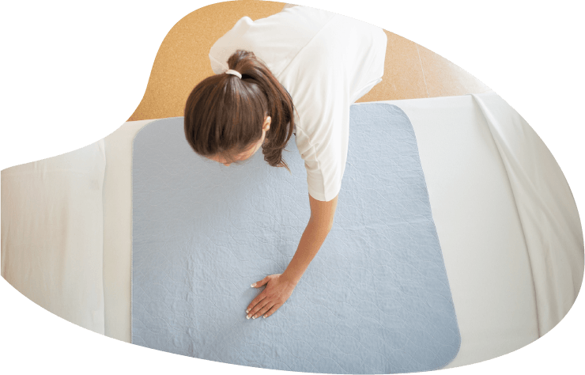
Now that you have cleaned your hands, you are ready to continue with your process of putting clean linens on the bed.
Congratulations for completing this infection control challenge.
You are an Infection Control Pro!

Slide 30
Diarrhea Dilemma
Infection Prevention and Control Review

Slide 31

Questions

Slide 32
Resources
MDH Project Firstline www.health.mn.gov/projectfirstline
CDC PPE Donning and Doffing Sequence (PDF)
CDC Diarrhea Dilemma Interactive Resource (optimized for handheld devices)
CDC How to Read a Disinfectant Label (PDF)
CDC Cómo leer la etiqueta de un desinfectante (PDF)
EPA-Registered Disinfectants | List K C. difficile
CDC Project Firstline | Facebook | Twitter
Subscribe to CDC Project Firstline e-mails
Subscribe to MDH Project Firstline Mailing List
Minnesota Department of Health (@mnhealth)| Facebook
Minnesota Department of Health (@mnhealth)| Twitter
Minnesota Department of Health (@mnhealth) | LinkedIn
Minnesota Department of Health (@mnhealth)| Instagram

