Slide 1

Title V Maternal & Child Health Needs Assessment
Discovery Survey Results
Presented by: Sarah Cox, Molly Meyer, and Blair Harrison
December 14th, 2018

Slide 2


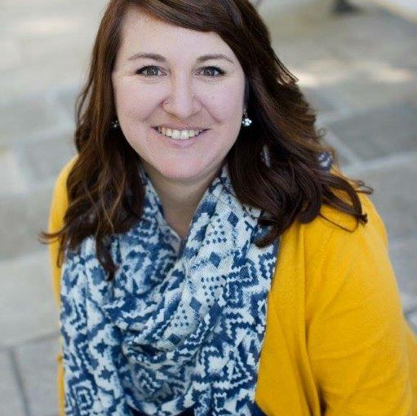
We’re glad you’re here!
Blair Harrison
Title V Needs Assessment Coordinator
Molly Meyer
Title V Data Coordinator
Sarah Cox
Title V CYSHN Coordinator

Slide 3
The Title V MCH Block Grant
Presented by Sarah Cox, CYSHN Title V Coordinator

Slide 4

What is Title V?
Federal-State Partnership
Provides a foundation for promoting and improving the health and well-being of the nation’s mothers, children, including children with special health needs, and their families

Slide 5
Background and History
1935
Title V of Social Security Act
1981
Block Granted
1989
Omnibus Budget Reconciliation Act
Today
“MCH 3.0”
1912
Federal Children’s Bureau
1921 Sheppard-Towner Maternity & Infancy Act

Slide 6
Population Domains
Women/Maternal Health
Perinatal/Infant Health
Child Health
Adolescent Health
Children with Special Health Needs
(CYSHN)
Cross-Cutting/Systems Building
Life Course Theory

Slide 7
Current Title V MCH Block Grant 5-Year Cycle
Year 1
Needs Assessment Summary
2016 Application / 2014 Annual Report
Year 2
2017 Application / 2015 Annual Report
Year 3
2018 Application / 2016 Annual Report
Year 4
2019 Application / 2017 Annual Report
Year 5
2020 Application / 2018 Annual Report
Annual needs assessment updates
Annual updates to objectives and strategies

Slide 8

The Title V Needs Assessment
Presented by Blair Olson, Title V Needs Assessment Coordinator

Slide 9

Title V Needs Assessment
The primary goals of the Title V needs assessment are to improve maternal and child health outcomes and to strengthen partnerships to ensure the effective implementation of strategies that address the needs of the Minnesota’s women, children and families.

Slide 10
Guiding Principles
Stakeholder engagement & planning
Literature review
MCH Target Populations
Translation
Quality Improvement
Ranking criteria
Public comment period
Input from vulnerable populations
Numeracy considerations
Intersectionality
MCH domains
Community Engagement
Health Equity
Theoretical frameworks?
Ongoing evaluation
Transparency
Local public health
Collaboration
Parent engagement
Rural vs. Metro
Communications plan
Accountability
Branding
Adaptability
How to document what we are doing
Tribal engagement
Evidence-Based and Informed Practices
Trauma-Informed
Research questions
Prioritization methods
Notes:
Data-Driven Decisions

Slide 11
Trauma-Informed Needs Assessment Work
Trauma is widespread and its impact significant.

Slide 12
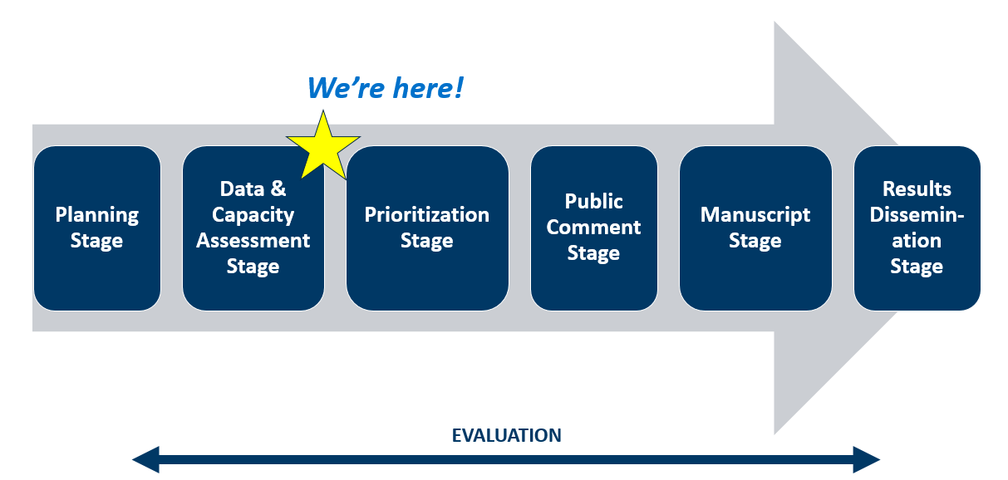
2020 Needs Assessment Process

Slide 13
The Discovery Survey
Presented by Blair Harrison, Title V Needs Assessment Coordinator, and Molly Meyer, Title V Data Coordinator

Slide 14
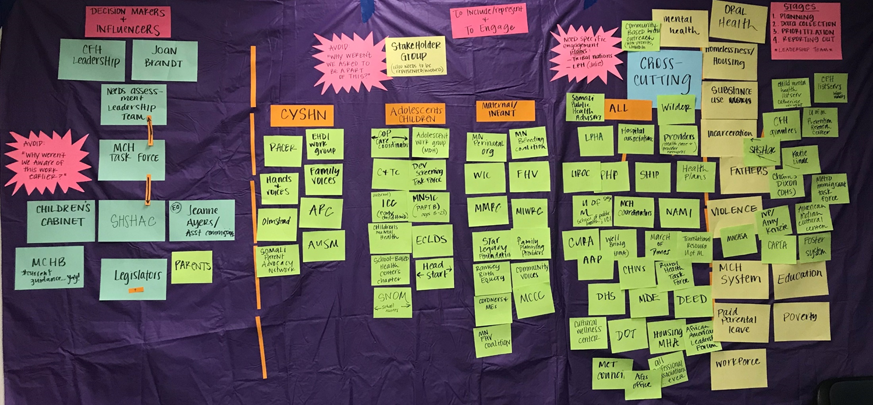
Planning for the Discovery Survey

Slide 15
Statement on Structural Inequality for Data Products that Highlight Health Disparities
The Minnesota Department of Health’s Title V Needs Assessment team acknowledges that generational structural (social, economic, political and environmental) inequities result in poor health outcomes. They have a greater influence on health outcomes than individual choices or one’s ability to access health care, and not all communities are impacted the same way.
All Minnesotans benefit when we reduce health disparities through policies, practices and organizational systems.
*Adapted from a statement created by the Colorado Department of Health

Slide 16
Discovery Survey Results
Presented by Blair Harrison, Title V Needs Assessment Coordinator, and Molly Meyer, Title V Data Coordinator

Slide 17

Discovery Survey | By the numbers
2,659
2,716
784

Slide 18
Interpretive Limitations
* Our Discovery survey was open to anyone and everyone who wanted to provide input *
Voluntary response bias
Due to the nature of a voluntary response sample there are disadvantages:
  No control over the make-up of the sample - to ensure a representative sample
  The sample is likely to be comprised of strongly opinionated people
Discovery survey Results:
  Respondents mirror our population by both region and race/ethnicity but it wasn’t representative by gender
  Large sample size
Response Bias
The wording of the question may be loaded in some way to unduly favor one response over another
“This question seems too simplistic. We would have found the answer and solved it,
had there been one unmet need that would make all the difference.”

Slide 19
Who responded to the Discovery Survey?
37% 35-49
30% 50-64
21% 25-34
5% 65+
3% 18-24
>1% Under 18
39% identified as a community member
11% identified as a community leader
647 Community-based organization/non-profits
608 Healthcare professionals
442 Local public health professionals
Minnesota Department of Health
Department of Health & Human Services
Minnesota Department of Education
Other state workers
Other Maternal & Child Health worker
61 Policymakers

Slide 20
Who responded to the Discovery Survey continued…
Race* | Total Population, Minnesota | Survey Respondents
African American/Black | 6% | 5%
American Indian | 1% | 4%
Asian/Pacific Islander | 5% | 2%
Hispanic/Latinx | 5% | 2%
White (non-Hispanic) | 81% | 78%
85% female
7% male
5% identified as LGBTQ
*Columns for race do not total 100%; do not include those who did
not respond for the survey (10%) and two or more races identified

Slide 21
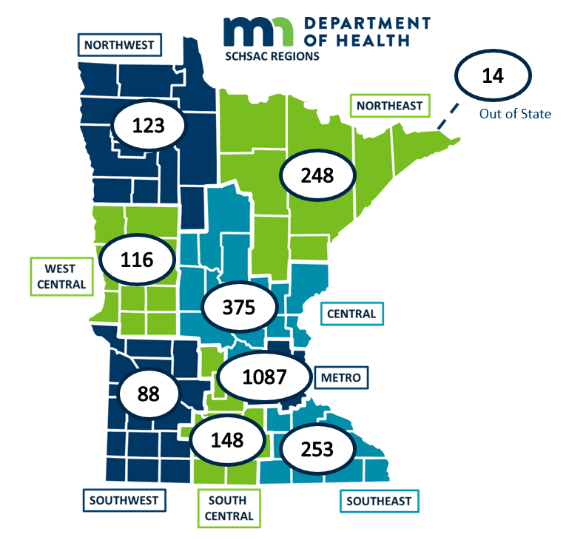
Geographic Distribution of Responses
Minnesota Region | Minnesota Population | Survey Responses
Metro | 55% | 44%
Central | 14% | 15%
Northeast | 6% | 10%
Northwest | 3% | 5%
South Central | 5% | 6%
Southeast | 9% | 10%
Southwest | 4% | 4%
West Central | 4% | 5%
*264 respondents didn’t provide resident county information

Slide 22
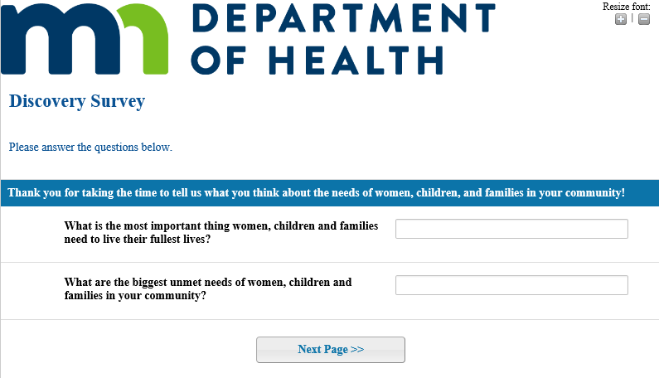
Discovery Survey

Slide 23
Top Themes
Childcare
Housing
Accessible and Affordable Healthcare
Financial Security
Mental Well-Being
Education
Transportation
Food
Access to Behavioral Health Services
Parent Support & Education
11. Paid Parental Leave (tie)
11. Culture of Safety – Abuse of Power (tie)
13. System Navigation
14. Oral Health
15. Reproductive & Maternity Care
16. Family Dynamics
17. Substance Use
18. Policy
19. Early Childhood Systems (3 way tie)
19. Culturally Appropriate Care (3 way tie)
19. Breastfeeding (3 way tie)

Slide 24
Childcare
Childcare should be affordable, convenient, and available when parents and guardians need it. Most importantly, children need a child care program where they are safe, healthy, and able to learn.
“There is not enough child care and not enough affordable child care for women to return to work. Women have to quit working and have a lower family income because of this.”
“Odd-hour childcare. Most centers are only open during traditional business hours, so families that work shift work are left without adequate care.”

Slide 25
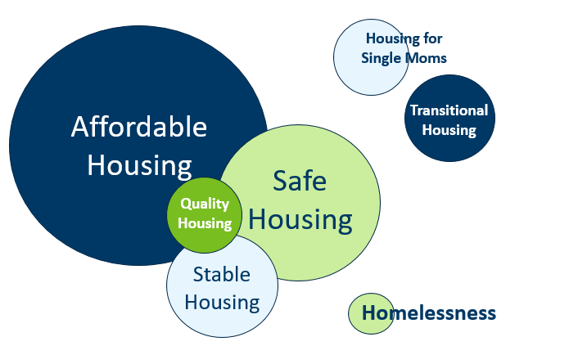
Housing
“There are not enough safe housing options for families.”
Access to safe, adequate, affordable housing builds stronger communities.
“Families with young mothers are struggling with affordable housing options and how to access quality care for their children.”

Slide 26
Accessible and Affordable Healthcare
Access to comprehensive, quality health care services is important for promoting and maintaining health, preventing and managing disease, reducing unnecessary disability and premature death, and achieving health equity for all Americans.
“Access to affordable healthcare and education that is person and family focused and delivered by people who are culturally competent and concerned about their health and education, not just billing and compliance issues.”
“Health care costs are so outrageous that my family can’t afford health care, and because I work 3 jobs to pay the bills I do not qualify for deductions of assistance in costs. Therefore we go without healthcare unless it is an emergency, and then I end up paying for that for years. I’m still paying on the birthing costs of my son who is now 13 years old.”

Slide 27
Financial Security
Financial security is not worrying about your income being enough to cover your expenses. It also means that you have enough money saved to cover emergencies and your future financial goals.
“A living wage is the biggest unmet need. Working parents and singles parents cannot meet the needs of their families, even when they work one or often more jobs, because wages are so low.”
“Resources and information on climbing out of cyclical poverty and/or the effects of cyclical poverty on families.”

Slide 28
Mental Well-Being
State of well-being in which every individual realizes his or her own potential, can cope with the normal stresses of life, can work productively and fruitfully, and is able to make a contribution to her or his community.
  Positive emotions
  Life satisfaction
  Happiness
  Positive relationships
  Empowerment
  Resilience
  Social acceptance
  Sense of community
  Social contribution
  “Mental health and emotional wellbeing for all!”

Slide 29
Education
Education is the process of facilitating learning, or the acquisition of knowledge, skills, values, beliefs, and habits.
“Good schools, especially for kids with special health needs.”
“Education for the lowest income families – daycare support to allow women to further their education and to pursue jobs.”

Slide 30
Transportation
Access to transportation helps people meet their basic needs, such as access to emergency services, medical care and other essential goods (like food), and it helps provide economic opportunity through access to education and employment.
“Dependable rides when single parents need it. Some can’t afford a car, can barely afford rent. So if their one car breaks down who helps out… no one. There is no one to provide help.”

Slide 31
Food
Everyone should have access to healthy, safe, accessible, and affordable food.
“There is a lack of understanding about proper nutrition, and nutrition education
is not delivered in culturally appropriate ways.”

Slide 32
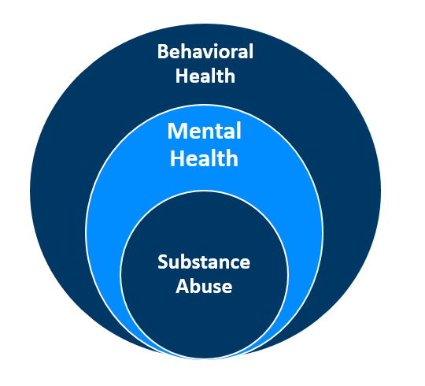
Behavioral Health
“I can’t stress enough… mental health facilities. We should not have to go to the ER in crisis. We need large facilities to deal with this. Emergency crews are diverted out of town to transport because are no psych beds [near here].”
Behavioral health promotes well-being through mental illness and substance abuse prevention and intervention.
“Access to drug treatment centers that take pregnant women and their children.”

Slide 33
Parent Support & Education
“Support. I think the community would benefit immensely from finding ways to support mothers in parenting. By providing relief when needed (childcare, mental health
support).”
Supporting parents can benefit the parent-child relationship, help family’s meet their physical, emotional, and financial needs, and improve outcomes for children and parents.
“There are no resources
for single dads!”

Slide 34
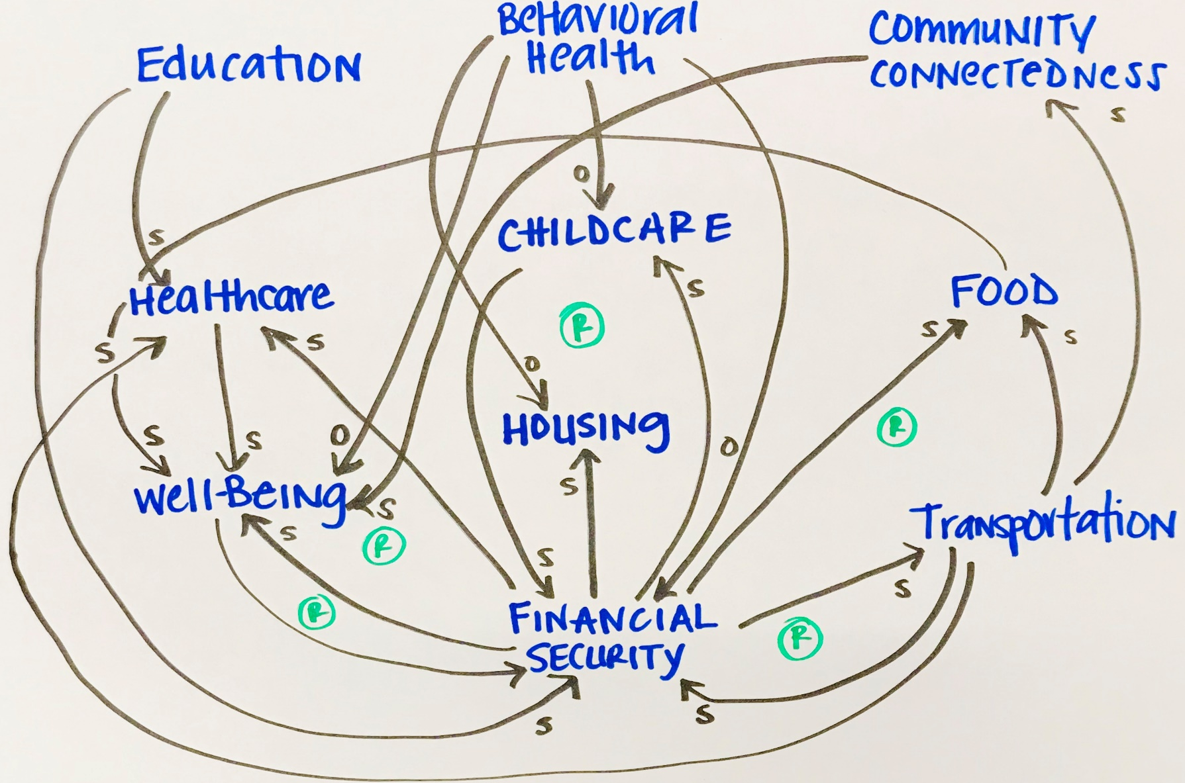
The importance of intersectionality
“There is no such thing as a single-issue struggle because we do not live single-issue lives.”
-Audre Lorde
Unmet needs do not live in isolation.

Slide 35
Sub-Analyses
Presented by Blair Harrison, Title V Needs Assessment Coordinator, and Molly Meyer, Title V Data Coordinator

Slide 36

Top Theme by Region
CHILDCARE
HOUSING

Slide 37
Top Ten Themes of Parents and Guardians of
Children & Youth with Special Health Needs
HEALTHCARE
BEHAVIORAL HEALTH
CHILDCARE
TRANSPORTATION
HOUSING
FOOD
FINANCIAL SECURITY
EDUCATION
MENTAL WELL-BEING
PARENT SUPPORT

Slide 38
Top Ten Themes by Race/Ethnicity
Rank | African American/ Black | American Indian | Asian/Pacific Islander | Hispanic/ Latinx | White
1 | Housing | Housing | Healthcare | Housing | Childcare
2 | Childcare | Childcare | Childcare | Childcare | Housing
3 | Employment | Employment | Housing | Healthcare | Healthcare
4 | Healthcare | Healthcare | Employment | Employment | Employment
5 | Mental Well-being | Food | Mental Well-being | Mental Well-being | Mental Well-being
6 | Education | Transportation | Education | Food | Transportation
7 | Behavioral Health | Education | Behavioral Health | Education | Education
8 | Culture of Safety – Abuse of Power | Culture of Safety – Abuse of Power | Culturally Appropriate Care | Transportation | Food
9 | Transportation | Behavioral Health | System Navigation | Culturally Appropriate Care | Behavioral Health
10 | Food | Mental Well-being | Food | Behavioral Health | Parent Support & Education

Slide 39
What do women, children and families need to live their fullest lives?

Slide 40
The Role of Fathers
“A father in the home to provide financial support and safety for the family, stability in the home, a role model to keep kids in school and teach them right from wrong, to help kids become a productive member of society, self-esteem and self reliance.”

Slide 41
Supporting Women
“For women- the chance and opportunity to meet other women in similar situations and in the same community that can serve as a time to empower and support one another, opportunities for women to have time to themselves…this would allow mothers to have more quality time rather than using the time to meet basic survival needs.”
“Community support so mothers can focus on raising healthy children. Programs for low-income families are crucial to the success of the next generation and keep families safer and more likely to contribute in positive ways to their communities.”
“A secure home, freedom from worry of losing housing or domestic violence. A path to move forward in their lives and hope for a brighter future and the opportunity to improve their standard of living through better jobs, more education, and freedom from any type of discrimination. Last, reasonable access to healthcare without worry of losing coverage and having pre-existing conditions limit medical insurance and healthcare.”

Slide 42
Community Connectedness
“Besides the basics, they need to feel like their lives matter and that they make a difference. We all need that! They need to have hope and success at meeting goals and being able to raise their children in safety and love!”
“The most important thing for women, children and families to live their life to the fullest is a strong community, or feeling like you belong and are supported by a community.”
“Safe, vibrant communities in which all people are respected, can live their lives fully, have opportunities to fully and easily support themselves and feel able to contribute to their neighbors and neighborhood.”

Slide 43
Next Steps
Presented by Blair Harrison, Title V Needs Assessment Coordinator, and Molly Meyer, Title V Data Coordinator

Slide 44
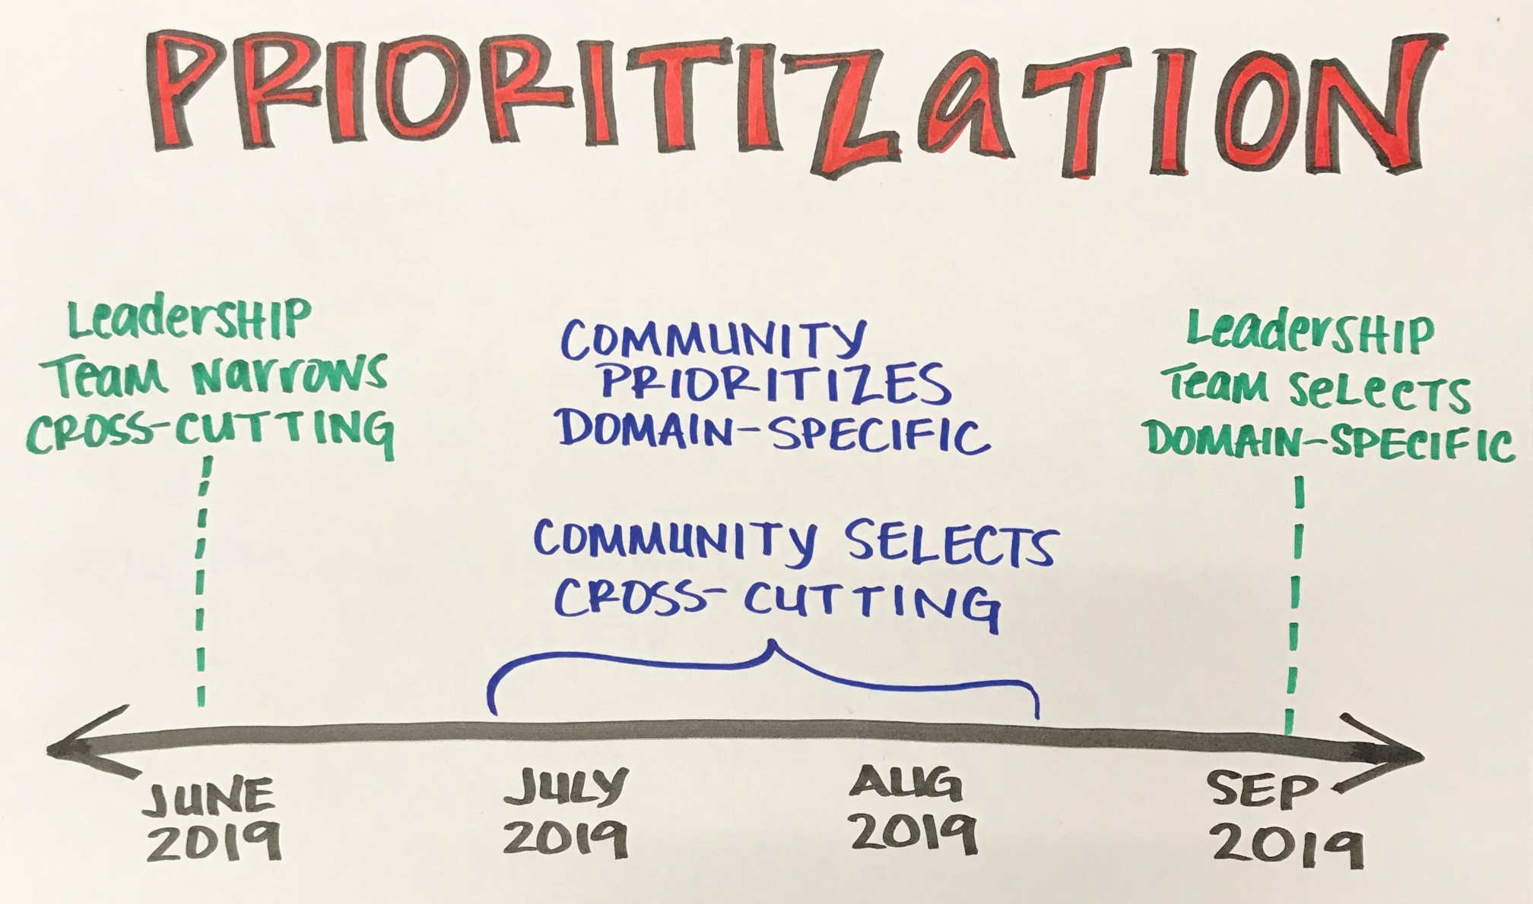
Selecting Minnesota’s Priorities

Slide 45
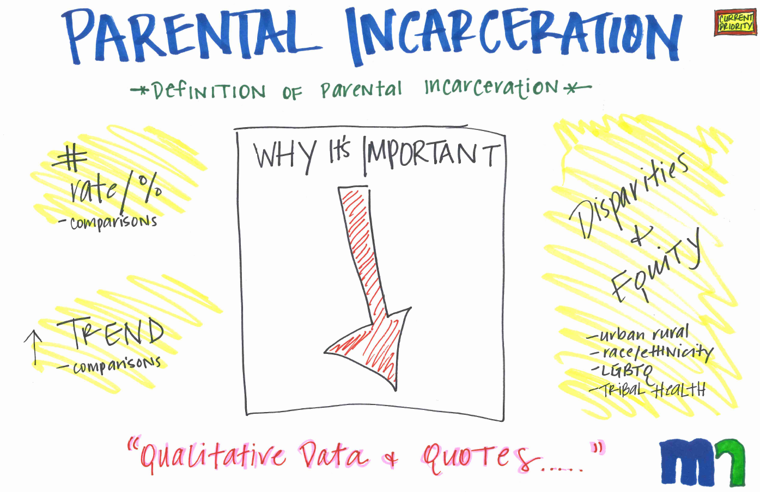
Data Stories

Slide 46

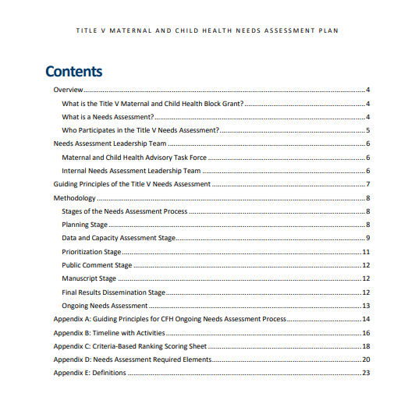
Our Plan

Slide 47
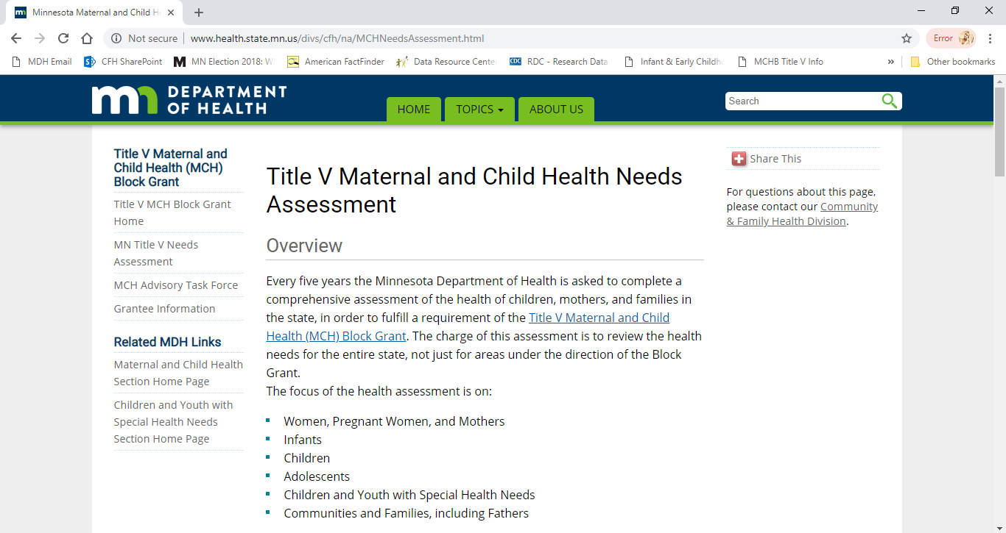
Check out our website for updates

Slide 48

Quote
When a flower doesn’t bloom,
you fix the environment in which it grows,
not the flower.
Alexander Den Heijer

Slide 49
Thank you!
Blair Harrison blair.harrison@state.mn.us
Molly Meyer molly.meyer@state.mn.us
Sarah Cox sarah.cox@state.mn.us

