Slide 1
Sexually Transmitted Disease (STD) Surveillance Report, 2022
Minnesota Department of Health STD Surveillance System

Slide 2
Introduction 1/2
Under Minnesota law, physicians and laboratories are required to report all laboratory-confirmed cases of chlamydia, gonorrhea, syphilis, and chancroid to the Minnesota Department of Health (MDH) within one working day.
The MDH does not maintain statistics for other, non-reportable STDs (ex: herpes, HPV/genital warts).
This slide set describes trends in reportable STDs in Minnesota by person, place, and time.
Analyses exclude cases reported from federal and private prisons.

Slide 3
Introduction 2/2
STD surveillance is the systematic collection of data from cases for the purpose of monitoring the frequency and distribution of STDs in a given population.
STD surveillance data are used to detect problems, prioritize resources, develop and target interventions, and evaluate the effectiveness of interventions.

Slide 4
Interpreting STD Surveillance Data (1/2)
Factors that impact the completeness and accuracy of STD data include:
  Level of STD screening by healthcare providers
  Individual test-seeking behavior
  Sensitivity of diagnostic tests
  Compliance with case reporting
  Completeness of case reporting
  Timeliness of case reporting
Increases and decreases in STD rates can be due to actual changes in disease occurrence and/or changes in one or more of the above factors.
COVID-19 lockdowns likely played a role in the number of cases reported/diagnosed this past year.
Notes:
Factors that impact the completeness and accuracy of STD data include:
Level of STD screening by healthcare providers, individual test-seeking behavior, sensitivity of diagnostic tests, compliance with case reporting, completeness of case reporting, timeliness of case reporting.
Increases and decreases in STD rates can be due to actual changes in disease occurrence and/or changes in one or more of the above factors.
Important to note that COVID-19 lockdowns likely played a role in the number of cases reported or diagnosed this past year.

Slide 5
Interpreting STD Surveillance Data (2/2)
The surveillance system only includes cases with a positive laboratory test. Cases diagnosed solely on symptoms are not counted.
Since 2012 we have included cases that had only a lab report and no corresponding case report form. This has increased the number of unknowns in some variables.
In 2020, the COVID-19 response accelerated the use of laboratory reporting by facilities, again increasing the number of unknown variables.
In 2018, in order to be consistent with CDC, we categorized all White, Hispanic and Black, Hispanic cases as Hispanic. That means the race categories now reflect only White, Non-Hispanic and Black, Non-Hispanic cases.
Surveillance data represent cases of infection, not individuals. A person with multiple infections in a given year will be counted more than once.
Caution is warranted when interpreting changes in STD numbers that can seem disproportionately large when the number of cases is small.

Slide 6
Overview of STDs in Minnesota
Minnesota Department of Health STD Surveillance System

Slide 7
STDs in Minnesota:
Number of Cases Reported in 2022
Total of 32,071 STD cases reported to MDH in 2022:
  22,079 Chlamydia cases
  8,161 Gonorrhea cases
  1831 Syphilis cases (all stages)
  0 Chancroid cases
Notes:
In the year 2022, a total of 32,071 STD cases were reported to the Minnesota Department of Health:
22,079 Chlamydia cases
8,161 Gonorrhea cases
1831 Syphilis cases (all stages)
0 Chancroid cases

Slide 8
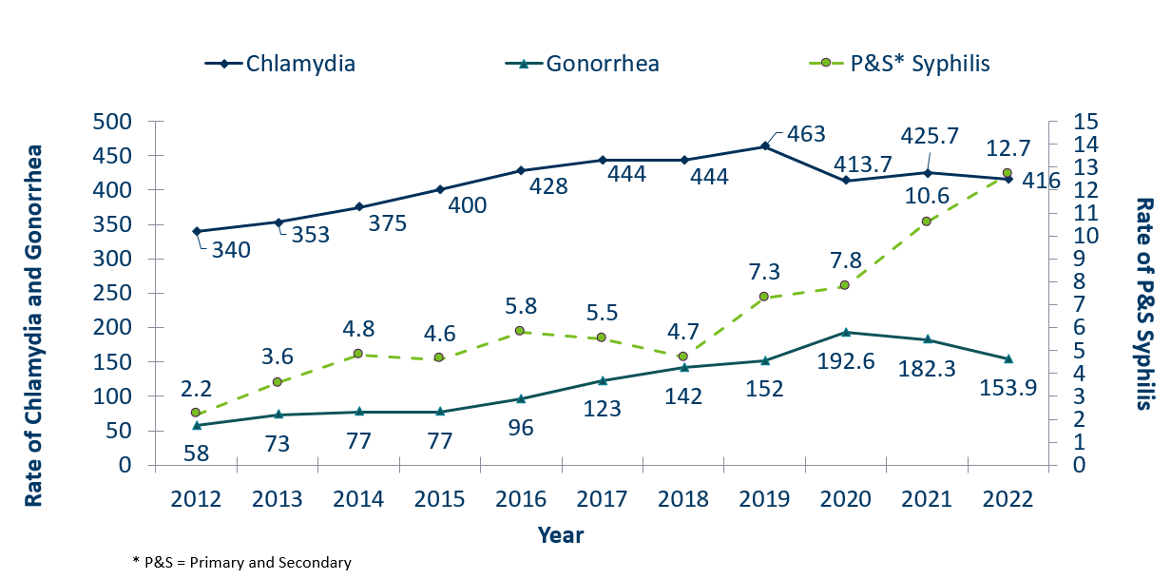
STDs in Minnesota:
Rate per 100,000 by Year of Diagnosis, 2012-2022
 | 2008 | 2009 | 2010 | 2011 | 2012 | 2013 | 2014 | 2015 | 2016 | 2017 | 2018 | 2019 | 2020 | 2021 | 2022
Chlamydia | 275 | 272 | 292 | 319 | 340 | 353 | 375 | 400 | 428 | 444 | 444 | 463 | 413.7 | 425.7 | 416
Gonorrhea | 58 | 44 | 41 | 43 | 58 | 73 | 77 | 77 | 96 | 123 | 142 | 152 | 192.6 | 182.3 | 153.9
P&S* Syphilis | 2.2 | 1.3 | 2.8 | 2.6 | 2.2 | 3.6 | 4.8 | 4.6 | 5.8 | 5.5 | 4.7 | 7.3 | 7.8 | 10.6 | 12.7
Notes:
The rate of chlamydia in MN decreased by 2% to 416 per 100,000 compared to 425.7 per 100,000 in 2021.
The rate of gonorrhea in MN decreased 16% to 153.9 per 100,000 compared to 182.3 per 100,000 in 2021.
The rate of primary and secondary syphilis increased by 20% from 10.6 in 2021 to 12.7 per 100,000 in 2022.

Slide 9
Syphilis
Minnesota Department of Health STD Surveillance System

Slide 10
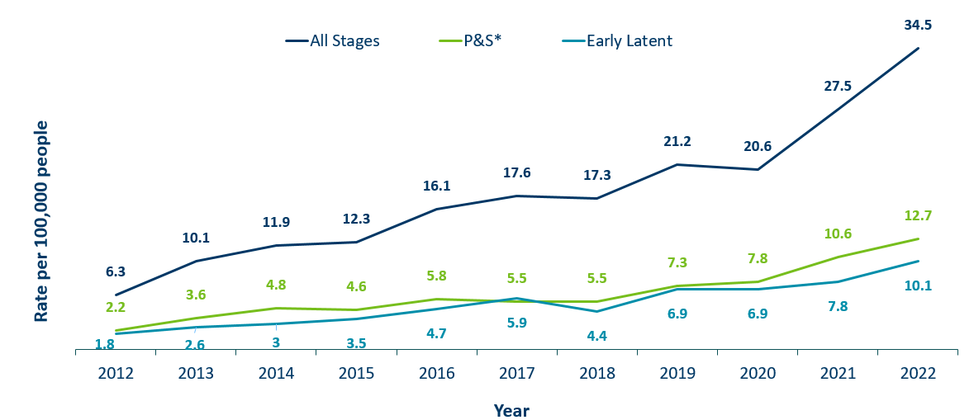
Syphilis Rates by Stage of Diagnosis, Minnesota, 2012-2022
 | 2008 | 2009 | 2010 | 2011 | 2012 | 2013 | 2014 | 2015 | 2016 | 2017 | 2018 | 2019 | 2020 | 2021 | 2022
All Stages | 5 | 4.1 | 6.6 | 6.9 | 6.3 | 10.1 | 11.9 | 12.3 | 16.1 | 17.6 | 17.3 | 21.2 | 20.6 | 27.5 | 34.5
P&S* | 2.2 | 1.3 | 2.8 | 2.6 | 2.2 | 3.6 | 4.8 | 4.6 | 5.8 | 5.5 | 5.5 | 7.3 | 7.8 | 10.6 | 12.7
Early Latent |  |  |  |  |  | 0.9 | 0.9 | 1.4 | 2.3 | 1.8 | 2.6 | 3 | 3.5 | 4.7 | 5.9 | 4.4 | 6.9 | 6.9 | 7.8 | 10.1
* P&S = Primary and Secondary
Notes:
The overall syphilis rate is 34.5 per 100,000. A 25% increase from 2021, and a 440% increase from a decade ago.
Of concern is the rate of primary and secondary syphilis which is 12.7 per 100,000, a 20% increase from 2021.

Slide 11
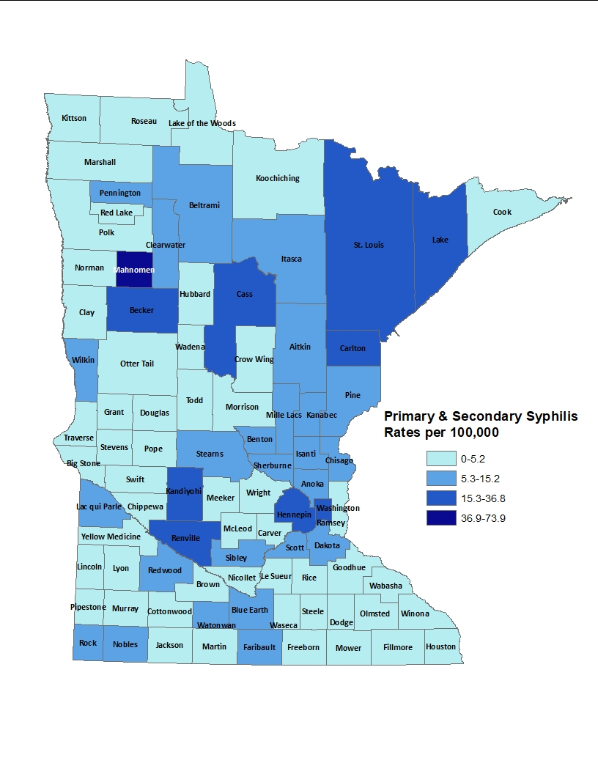
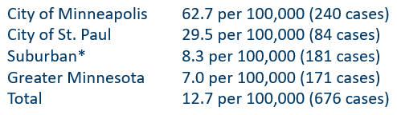
2022 Minnesota Primary and Secondary Syphilis Rates by County
*7-county metro area, excluding the cities of Minneapolis and St. Paul
Notes:
The statewide rate of primary and secondary syphilis increased to 12.7 cases per 100,000 from 10.6.
Within the metro, the highest rate of primary and secondary syphilis remains in the City of Minneapolis at 62.7 cases per 100,000 population.
The City of St. Paul has the second highest rate in the metro at 29.5 per 100,000.
Data:
City of Minneapolis: 62.7 per 100,000 (240 cases)
City of St. Paul: 29.5 per 100,000 (84 cases)
Suburban: 8.3 per 100,000 (181 cases)
Greater Minnesota: 7.0 per 100,000 (171 cases)
Total: 12.7 per 100,000 (676 cases)

Slide 12
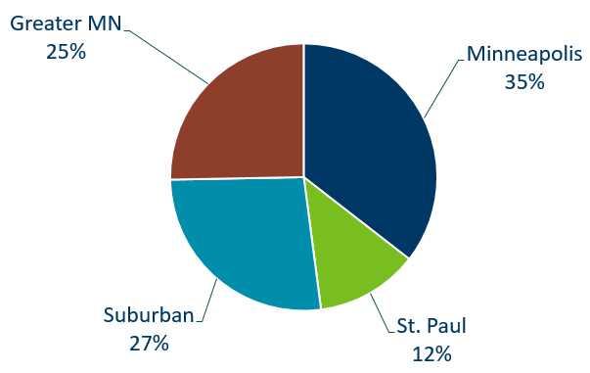
Primary and Secondary Syphilis Infections by Residence at Diagnosis
Minnesota, 2022
Total Number of Cases = 676
Suburban = Seven-county metro area including Anoka, Carver, Dakota, Hennepin (excluding Minneapolis), Ramsey (excluding St. Paul), Scott, and Washington counties. Greater MN = All other Minnesota counties outside the seven-county metro area.
Notes:
The City of Minneapolis had the largest percent of all reported primary and secondary cases with 35%
Second to Suburban MN with 27 % of the cases.
Third largest was Greater MN with 25%
St. Paul Reported 12%.

Slide 13
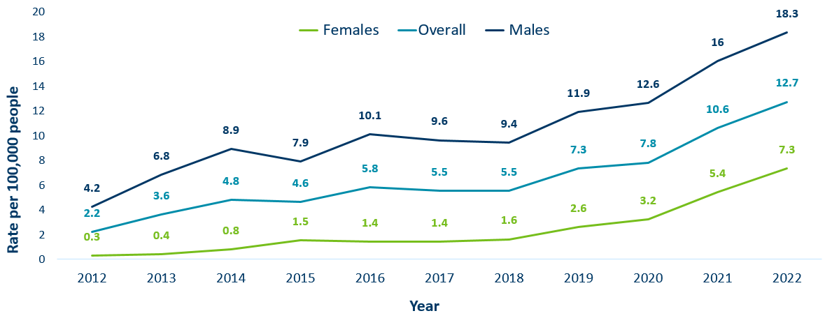
Primary and Secondary Syphilis Rates by Gender, Minnesota, 2012-2022
` | 2008 | 2009 | 2010 | 2011 | 2012 | 2013 | 2014 | 2015 | 2016 | 2017 | 2018 | 2019 | 2020 | 2021 | 2022
Males | 4.3 | 2.7 | 5.4 | 5.1 | 4.2 | 6.8 | 8.9 | 7.9 | 10.1 | 9.6 | 9.4 | 11.9 | 12.6 | 16 | 18.3
Females | 0.2 | 0 | 0.3 | 0.2 | 0.3 | 0.4 | 0.8 | 1.5 | 1.4 | 1.4 | 1.6 | 2.6 | 3.2 | 5.4 | 7.3
Overall | 2.2 | 1.3 | 2.8 | 2.6 | 2.2 | 3.6 | 4.8 | 4.6 | 5.8 | 5.5 | 5.5 | 7.3 | 7.8 | 10.6 | 12.7
Notes:
Males have the highest rates of primary and secondary syphilis at 18.3 cases per 100,0000 population
The rate of primary and secondary syphilis in females is 7.3 per 100,000 per population.

Slide 14
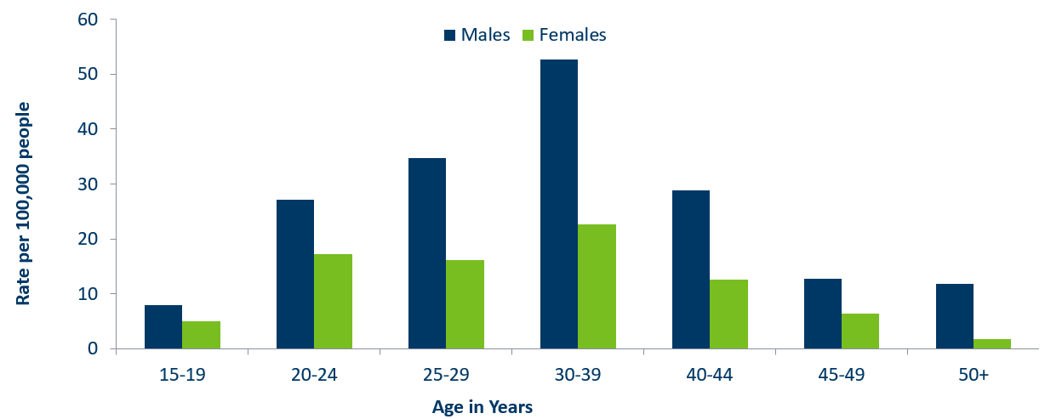
Age-Specific Primary and Secondary Syphilis Rates by Gender, Minnesota, 2022
 | 15-19 | 20-24 | 25-29 | 30-39 | 40-44 | 45-49 | 50+
Males | 8 | 27.1 | 34.7 | 52.6 | 28.8 | 12.8 | 11.8
Females | 5 | 17.2 | 16.2 | 22.7 | 12.5 | 6.4 | 1.8
Notes:
Males have higher rates of primary and secondary syphilis than females in all age groups. The rate in males is 2.5 times higher than females.
30-39 year old males had the highest rate at 52.6 per 100,000
30-39 year old females had the highest rate of the female population at 22.7 per 100,000.

Slide 15
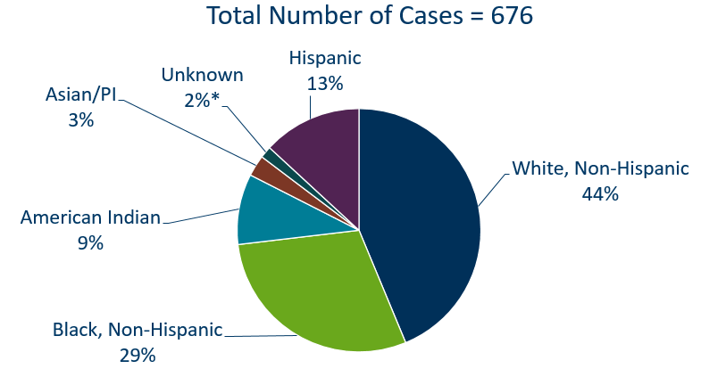
Primary and Secondary Syphilis Cases by Race
Minnesota, 2022
*Includes people reported with more than one race
Notes:
44% percent of all primary and secondary syphilis cases are White, non-Hispanic.
Black, non-Hispanic cases made up 29% of all Primary and Secondary Syphilis cases followed by, American Indian cases at 9%, Hispanic cases at 13%, and Asian/Pacific Islander cases at 3%.

Slide 16
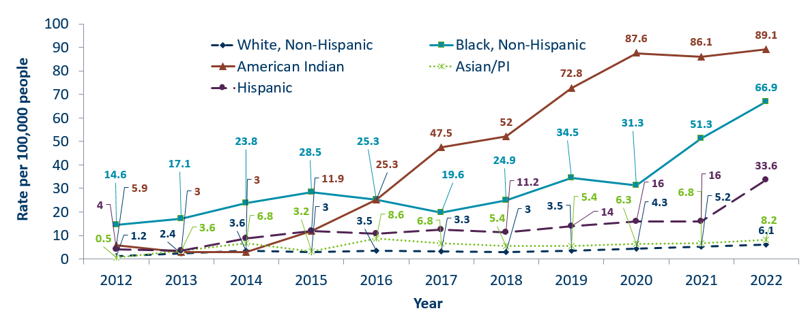
Primary and Secondary Syphilis Rates by Race/Ethnicity
Minnesota, 2012-2022
 | 2008 | 2009 | 2010 | 2011 | 2012 | 2013 | 2014 | 2015 | 2016 | 2017 | 2018 | 2019 | 2020 | 2021 | 2022
White, Non-Hispanic | 1.9 | 1.1 | 2 | 2.1 | 1.2 | 2.4 | 3.6 | 3 | 3.5 | 3.3 | 3 | 3.5 | 4.3 | 5.2 | 6.1
Black, Non-Hispanic | 6.7 | 4 | 13.9 | 8.5 | 14.6 | 17.1 | 23.8 | 28.5 | 25.3 | 19.6 | 24.9 | 34.5 | 31.3 | 51.3 | 66.9
American Indian | 0 | 1.5 | 1.5 | 1.5 | 5.9 | 3 | 3 | 11.9 | 25.3 | 47.5 | 52 | 72.8 | 87.6 | 86.1 | 89.1
Asian/PI | 0.5 | 0 | 0.5 | 2.7 | 0.5 | 3.6 | 6.8 | 3.2 | 8.6 | 6.8 | 5.4 | 5.4 | 6.3 | 6.8 | 8.2
Hispanic | 1.3 | 2.5 | 4.4 | 4 | 4 | 3.6 | 8.8 | 12 | 10.8 | 12.4 | 11.2 | 14 | 16 | 16 | 33.6
* people of Hispanic ethnicity can be of any race.
Notes:
Large disparities continue to exist in the rates of syphilis compared to the White, non-Hispanic population.
The rates of primary and secondary syphilis are 14.7 times higher in the American Indian populations than that of the White, non-Hispanic population.
The rates of primary and secondary syphilis are 11 times higher in the Black/African American, non-Hispanic than that of the White, non-Hispanic population.
The rates of primary and secondary syphilis in the American Indian population are 89.1 per 100,000 compared to 6.1 per 100,000 in the White, non-Hispanic population.
The rates of primary and secondary syphilis in the Black/African American, non-Hispanic population are 66.9 per 100,000 .
The rates in the Hispanic population are 33.6 per 100,000 which is 5.5 times higher than the White, non-Hispanic population.
The rates in the Asian/Pacific Islander population are 8.2 per 100,000 which is 1.3 times higher than the White, non-Hispanic population.

Slide 17
Topic of Interest: Syphilis Among
Females and Congenital Syphilis in Minnesota
Minnesota Department of Health STD Surveillance System
Notes:
Topic of Interest: Syphilis Among
Females and Congenital Syphilis in Minnesota

Slide 18
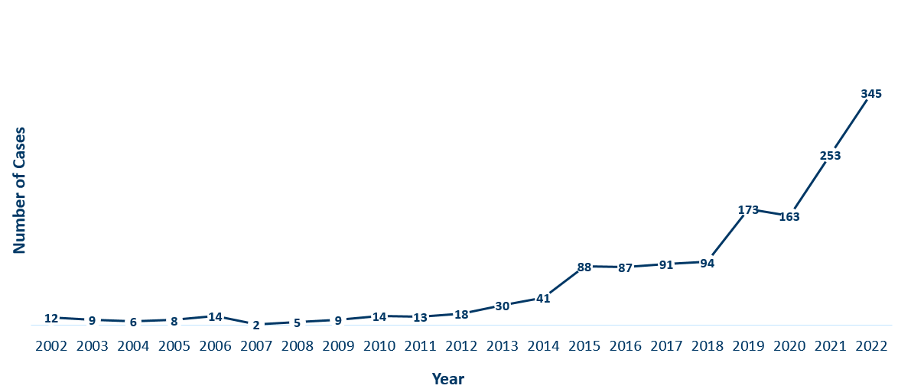
Female Early Syphilis Cases
Minnesota, 2022
Year | Number of Cases
2002 | 12
2003 | 9
2004 | 6
2005 | 8
2006 | 14
2007 | 2
2008 | 5
2009 | 9
2010 | 14
2011 | 13
2012 | 18
2013 | 30
2014 | 41
2015 | 88
2016 | 87
2017 | 91
2018 | 94
2019 | 173
2020 | 163
2021 | 253
2022 | 345
Notes:
The number of female early syphilis cases has increased dramatically over the last 10 years from 18 cases in 2012 to 345 in 2022.

Slide 19
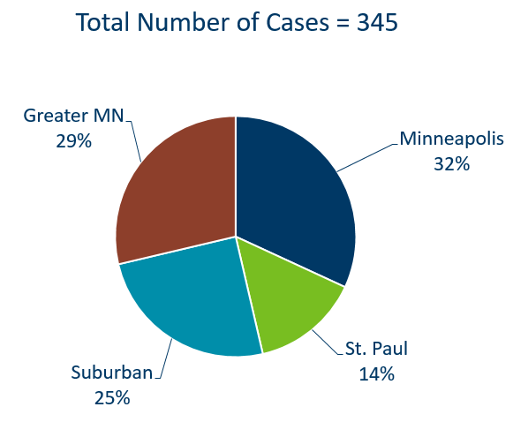
Early Syphilis Infections in Females by Residence at Diagnosis
Minnesota, 2022
Suburban = Seven-county metro area including Anoka, Carver, Dakota, Hennepin (excluding Minneapolis), Ramsey (excluding St. Paul), Scott, and Washington counties. Greater MN = All other Minnesota counties outside the seven-county metro area.
Notes:
29% of female early syphilis cases were residents of Greater Minnesota
25% of female early syphilis cases were residents of the Suburbs of the seven-county metro area
32% were City of Minneapolis residents, and 14% were St. Paul residents.

Slide 20
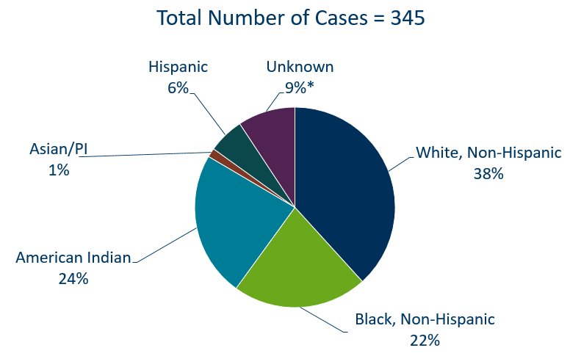
Early Syphilis Cases in Females by Race/Ethnicity
Minnesota, 2022
*Includes people reported with more than one race
Notes:
There are large disparities in women with syphilis. 24% of all early syphilis cases in females are found in the American Indian population and 22% in the Black, African American population.
Data:
Total Number of Cases: 345
Hispanic: 6%
Unknown: 9%
White, Non-Hispanic: 38%
Black, Non-Hispanic: 22%
American Indian: 24%
Asian/PI: 1%

Slide 21
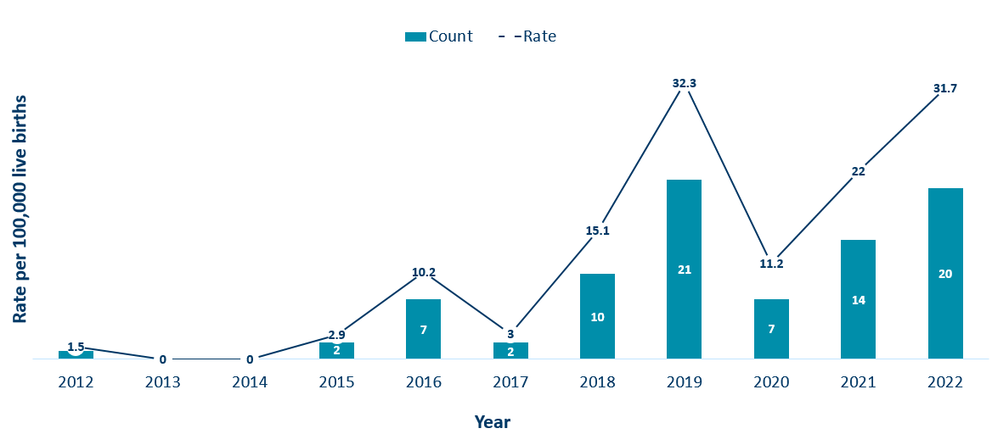
Congenital Syphilis Rates Among Infants
Minnesota, 2012-2022
Year | Rate | Count
2012 | 1.5 | 1
2013 | 0 | 0
2014 | 0 | 0
2015 | 2.9 | 2
2016 | 10.2 | 7
2017 | 3 | 2
2018 | 15.1 | 10
2019 | 32.3 | 21
2020 | 11.2 | 7
2021 | 22 | 14
2022 | 31.7 | 20
Notes:
In Minnesota, the number and rate of congenital syphilis cases among infants has increased in 2022 compared to 2021. Overall, the rate has increased over the past five years from a rate of 15.2 per 100,000 live births in 2018 to 31.7 per 100,000 live births in 2022.
Syphilis may be passed from a pregnant person to the unborn baby through the placenta. The infection can cause miscarriages and stillbirths, and infants born with congenital syphilis can suffer a variety of serious health problems, including deformities, seizures, anemia and jaundice.
The Centers for Disease Control and Prevention reported this fall that the number of infants born with syphilis has more than 200% in the past four years and last year reached a 20-year high.

Slide 22
Topic of Interest: Early Syphilis Among
Men Who Have Sex With Men in Minnesota
Minnesota Department of Health STD Surveillance System
Notes:
Topic of Interest: Early Syphilis Among Men Who Have Sex With Men in Minnesota.
Men who have sex with men (MSM) make up the majority of early syphilis cases.

Slide 23
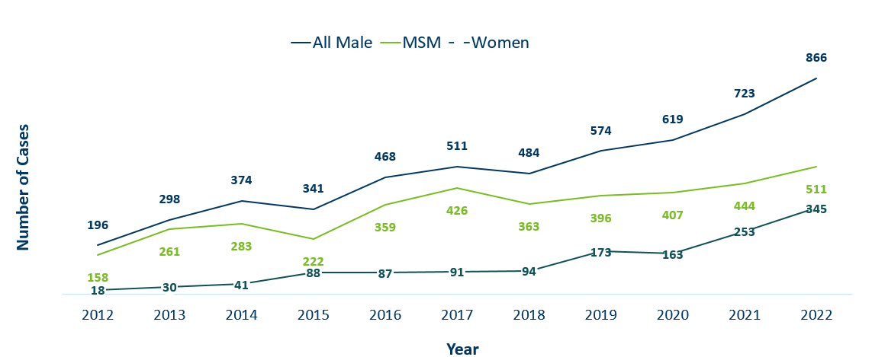
Number of Early Syphilis† Cases by Gender and MSM
Minnesota, 2012-2022
 | 2012 | 2013 | 2014 | 2015 | 2016 | 2017 | 2018 | 2019 | 2020 | 2021 | 2022
All Male | 196 | 298 | 374 | 341 | 468 | 511 | 484 | 574 | 619 | 723 | 866
MSM | 158 | 261 | 283 | 222 | 359 | 426 | 363 | 396 | 407 | 444 | 511
Women | 18 | 30 | 41 | 88 | 87 | 91 | 94 | 173 | 163 | 253 | 345
MSM=Men who have sex with men.
Figure does not include cases diagnosed in transgender people
† Early Syphilis includes primary, secondary, and early latent stages of syphilis.
Notes:
Early syphilis, includes not only primary and secondary syphilis, but all new syphilis acquired in the past year.
Of all early syphilis cases, 72 percent were among people whose current gender was reported as male.
Men who have sex with men (MSM) account for 59% of all early syphilis cases among men.

Slide 24
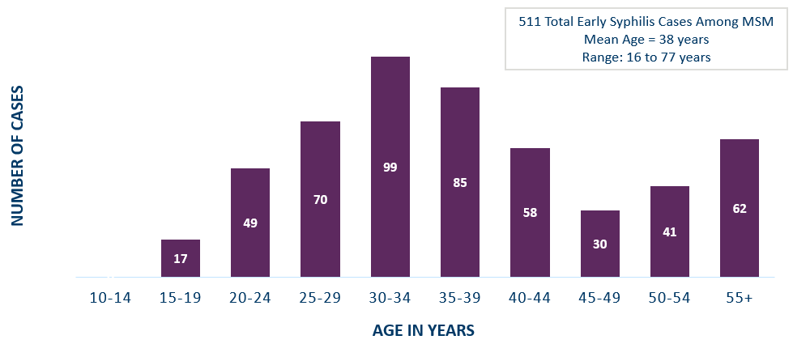
Early Syphilis† Cases Among MSM by Age
Minnesota, 2022
 | 10-14 | 15-19 | 20-24 | 25-29 | 30-34 | 35-39 | 40-44 | 45-49 | 50-54 | 55+
MSM | 0 | 17 | 49 | 70 | 99 | 85 | 58 | 30 | 41 | 62
MSM=Men who have sex with men
† Early Syphilis includes primary, secondary, and early latent stages of syphilis.
Notes:
The average age of MSM with early syphilis is 38 years of age.
Ages ranged from 16–77 years of age
The 30-34 year old age group had the highest number of cases at 99
49% of early syphilis cases are among MSM are in the 25-39 age groups.

Slide 25
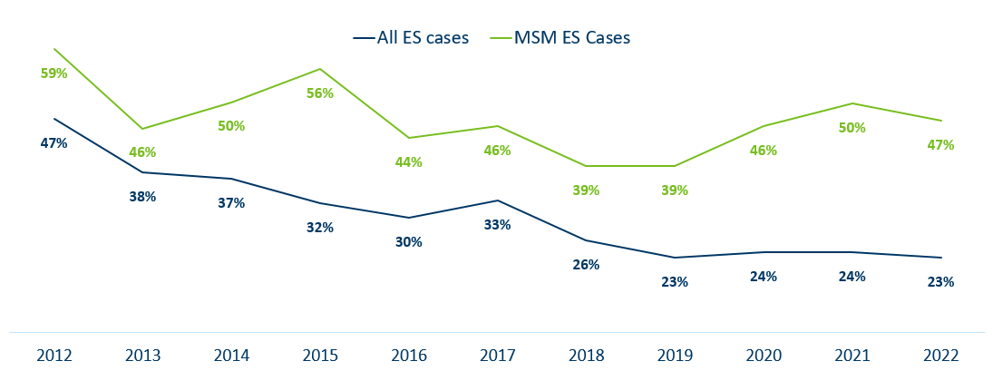
Early Syphilis† (ES) Cases
Co-infected with HIV, 2012-2022
 | 2012 | 2013 | 2014 | 2015 | 2016 | 2017 | 2018 | 2019 | 2020 | 2021 | 2022
All ES cases | 47% | 38% | 37% | 32% | 30% | 33% | 26% | 23% | 24% | 24% | 23%
MSM ES Cases | 59% | 46% | 50% | 56% | 44% | 46% | 39% | 39% | 46% | 50% | 47%
MSM=Men who have sex with men
† Early Syphilis includes primary, secondary, and early latent stages of syphilis.
Notes:
23% percent of all early syphilis cases were co-infected with HIV.
47% percent of all MSM early syphilis cases were co-infected with HIV.

Slide 26
Gonorrhea
Minnesota Department of Health STD Surveillance System
Notes:
Cases of reported gonorrhea saw the greatest decrease of 16 percent. 9,671 in 2021 compared to 8,161 in 2022.

Slide 27
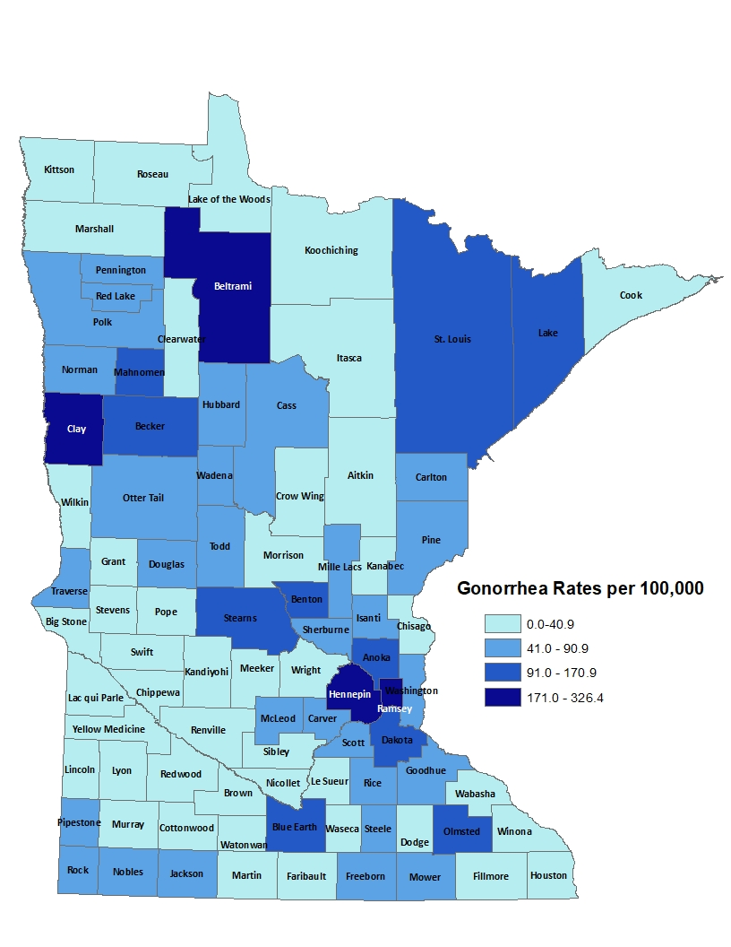
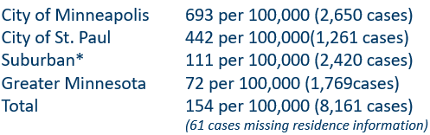
2022 Minnesota Gonorrhea Rates by County
*7-county metro area, excluding the cities of Minneapolis and St. Paul
Data: STD Surveillance Report Data Tables, Minnesota 2022 (PDF)
Notes:
The rate of gonorrhea in MN was 154 per 100,000. This is a rate decrease of 16% from 2021.
The city of Minneapolis continues to have the highest rates of gonorrhea at 693 per 100,000, followed by the city of St. Paul at 442 per 100,000, the suburban area (7-county metro excluding Minneapolis & St. Paul) at 111 per 100,000 and Greater Minnesota at 72 per 100,000.
The rates of gonorrhea decreased in all areas across Minnesota.

Slide 28
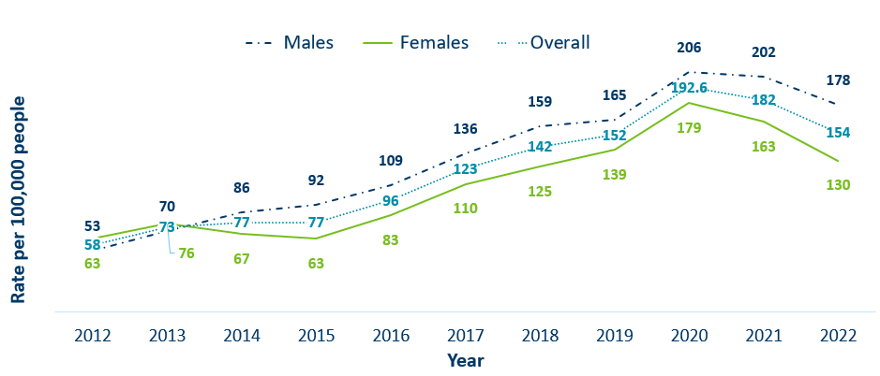
Gonorrhea Rates by Gender
Minnesota, 2012-2022
 | 2012 | 2013 | 2014 | 2015 | 2016 | 2017 | 2018 | 2019 | 2020 | 2021 | 2022
Males | 53 | 70 | 86 | 92 | 109 | 136 | 159 | 165 | 206 | 202 | 178
Females | 63 | 76 | 67 | 63 | 83 | 110 | 125 | 139 | 179 | 163 | 130
Overall | 58 | 73 | 77 | 77 | 96 | 123 | 142 | 152 | 192.6 | 182 | 154
Notes:
The rates of gonorrhea went down in both males and females in 2022. Males continue to have higher rates of gonorrhea than females
Males had a rate of 178 per 100,000 which is a decrease of 12% over the 2021 rate of 202 per 100,000.
Females had a rate of 130 per 100,000 which is a decrease of 20% over the 2021 rate of 163 per 100,000.

Slide 29
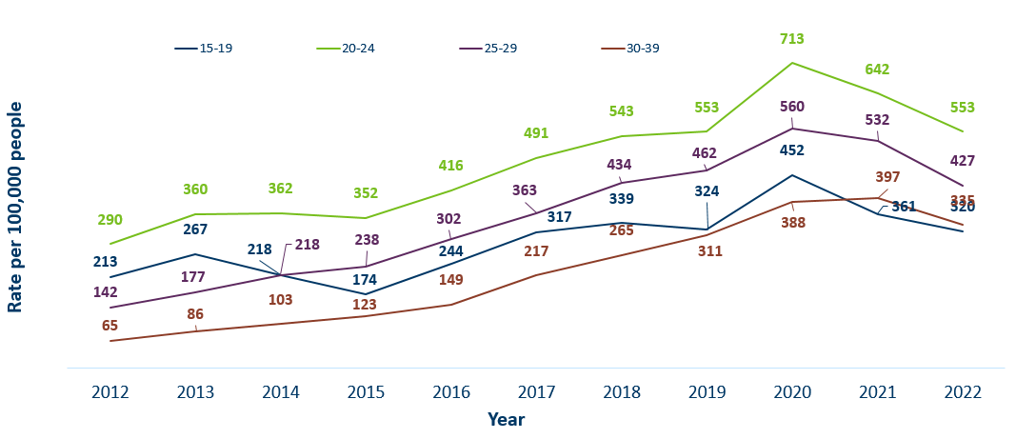
Gonorrhea Rates by Age
Minnesota, 2012-2022
 | 2012 | 2013 | 2014 | 2015 | 2016 | 2017 | 2018 | 2019 | 2020 | 2021 | 2022
15-19 | 213 | 267 | 218 | 174 | 244 | 317 | 339 | 324 | 452 | 361 | 320
20-24 | 290 | 360 | 362 | 352 | 416 | 491 | 543 | 553 | 713 | 642 | 553
25-29 | 142 | 177 | 218 | 238 | 302 | 363 | 434 | 462 | 560 | 532 | 427
30-39 | 65 | 86 | 103 | 123 | 149 | 217 | 265 | 311 | 388 | 397 | 335
Notes:
All age groups saw a decrease in gonorrhea rates.
The highest rate remains in the 20–24-year-old age group at 553 per 100,000.

Slide 30
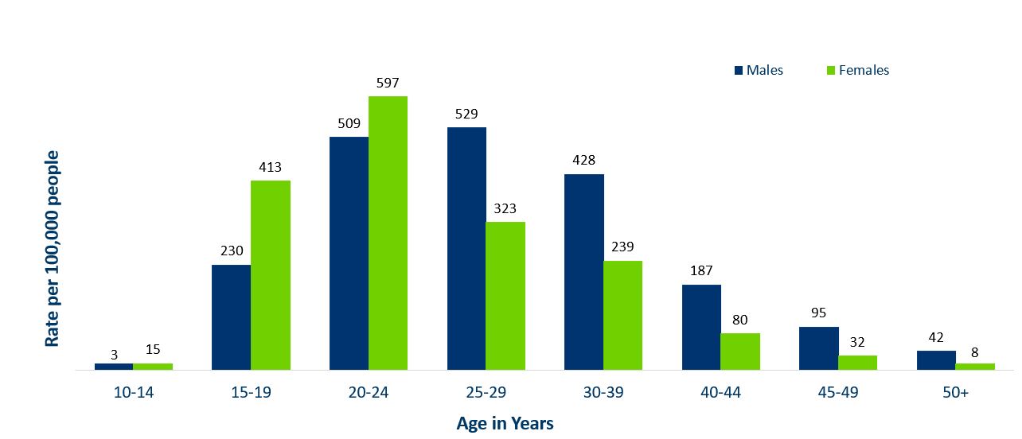
Age-Specific Gonorrhea Rates by Gender
Minnesota, 2022
Data: STD Surveillance Report Data Tables, Minnesota 2022 (PDF)
Notes:
Females under the age of 25 years of age, continue to have higher rates of gonorrhea than males.
Males record the highest rate among age groups older than 25 years.
The highest rates of gonorrhea are in females 20-24 at 597 per 100,000.

Slide 31
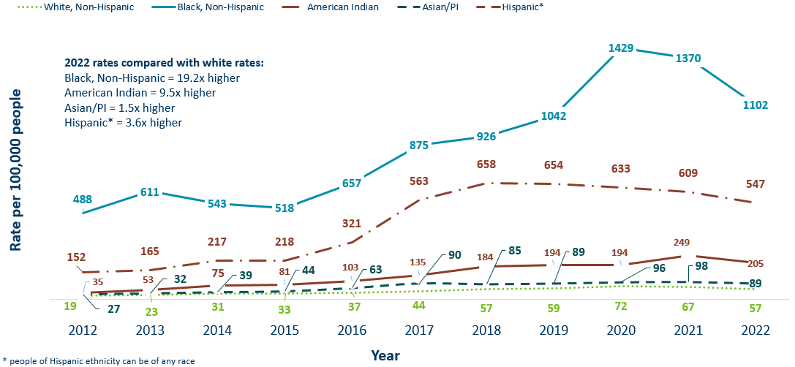
Gonorrhea Rates by Race/Ethnicity
Minnesota, 2012-2022
 | 2012 | 2013 | 2014 | 2015 | 2016 | 2017 | 2018 | 2019 | 2020 | 2021 | 2022
White, Non-Hispanic | 19 | 23 | 31 | 33 | 37 | 44 | 57 | 59 | 72 | 67 | 57
Black, Non-Hispanic | 488 | 611 | 543 | 518 | 657 | 875 | 926 | 1042 | 1429 | 1370 | 1102
American Indian | 152 | 165 | 217 | 218 | 321 | 563 | 658 | 654 | 633 | 609 | 547
Asian/PI | 27 | 32 | 39 | 44 | 63 | 90 | 85 | 89 | 96 | 98 | 89
Hispanic* | 35 | 53 | 75 | 81 | 103 | 135 | 184 | 194 | 194 | 249 | 205
Notes:
There continues to be large disparities in the rates of gonorrhea.
The Black/African American, non-Hispanic population rates are 19.2 times higher than white rates. The rate in the Black/African American population was 1102 per 100,000 compared to the rate in the White, Non-Hispanic population at 57 per 100,000.
The American Indian population had a rate that was 9.5 times higher at 547 per 100,000
The Asian/Pacific Islander population had a rate that was 1.5 times higher at 89 per 100,000
The Hispanic/Latino population, which can be of any race, had a rate that was 3.6 times higher at 205 per 100,000

Slide 32
Chlamydia
Minnesota Department of Health STD Surveillance System
Notes:
Chlamydia decreased 2% in 2022 compared to 2021 which recorded the first decline in over a decade. This could be the result of a true decrease in the number of cases, but it could also reflect the COVID-19 pandemic and reduced preventative visits. Chlamydia is more likely to be asymptomatic than gonorrhea and syphilis, especially in females.

Slide 33
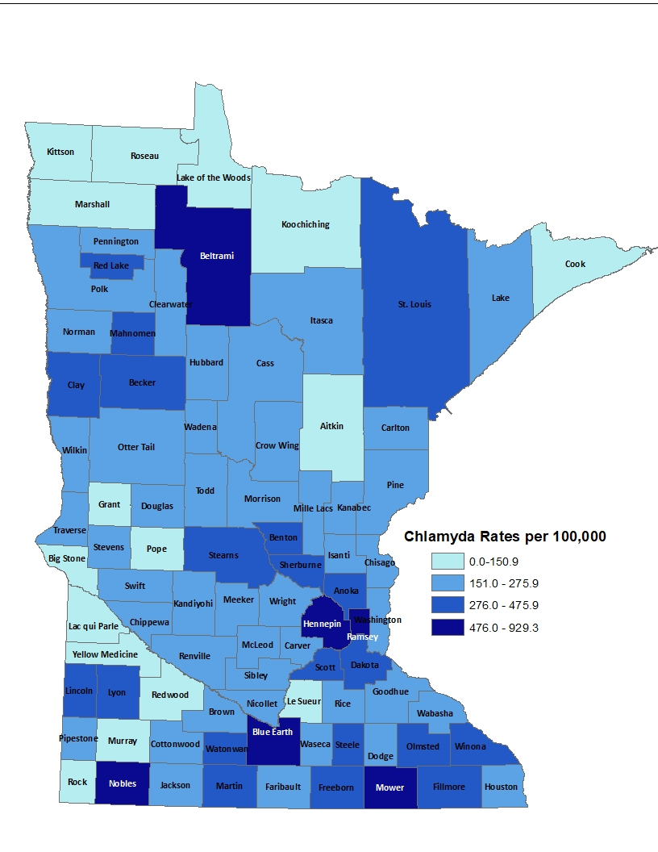
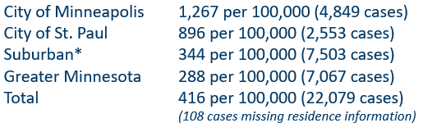
2022 Minnesota Chlamydia Rates by County
*7-county metro area, excluding the cities of Minneapolis and St. Paul
Data: STD Surveillance Report Data Tables, Minnesota 2022 (PDF)
Notes:
Despite the decrease, all counties in Minnesota were affected by chlamydia. There were at least 3 cases in all counties in 2022.
The city of Minneapolis continues to have the highest rates of chlamydia at 1,267 per 100,000, followed by the city of St. Paul at 896 per 100,000, the suburban area (7-county metro excluding Minneapolis & St. Paul) at 344 per 100,000 and Greater Minnesota at 288 per 100,000.

Slide 34
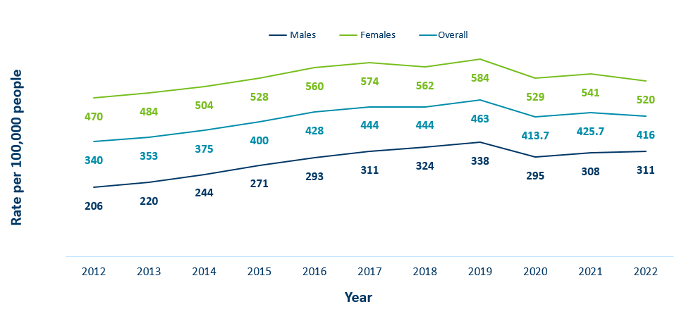
Chlamydia Rates by Gender
Minnesota, 2012-2022
 | 2012 | 2013 | 2014 | 2015 | 2016 | 2017 | 2018 | 2019 | 2020 | 2021 | 2022
Males | 206 | 220 | 244 | 271 | 293 | 311 | 324 | 338 | 295 | 308 | 311
Females | 470 | 484 | 504 | 528 | 560 | 574 | 562 | 584 | 529 | 541 | 520
Overall | 340 | 353 | 375 | 400 | 428 | 444 | 444 | 463 | 413.7 | 425.7 | 416
Notes:
The rates of chlamydia increased for males and decreased for females in 2022.
Females continue to have higher rates of chlamydia than males. Males had a rate of 311 per 100,000 which is a increase of 1% over the 2021 rate of 308 per 100,000.
Females had a rate of 520 per 100,000 which is a decrease of 4% from 2021 rate of 541 per 100,000.

Slide 35
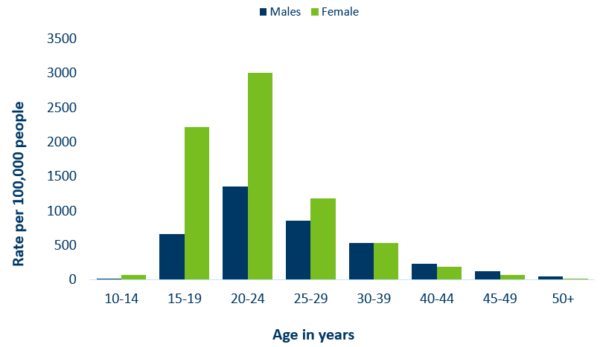
Age-Specific Chlamydia Rates by Gender,
Minnesota, 2022
Data: STD Surveillance Report Data Tables, Minnesota 2022 (PDF)
Notes:
The rates of Chlamydia are highest among females.
Females, 20-24 years of age continue to have the highest rate at 3001 per 100,000.
Males aged 45-49 reported the largest increase of over 13% when compared to 2021.

Slide 36
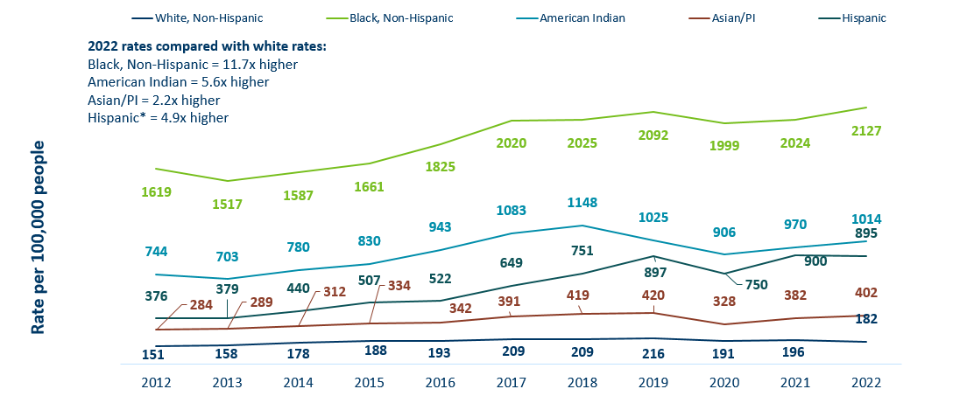
Chlamydia Rates by Race/Ethnicity Minnesota, 2012-2022 (1/2)
 | 2012 | 2013 | 2014 | 2015 | 2016 | 2017 | 2018 | 2019 | 2020 | 2021 | 2022
White, Non-Hispanic | 151 | 158 | 178 | 188 | 193 | 209 | 209 | 216 | 191 | 196 | 182
Black, Non-Hispanic | 1619 | 1517 | 1587 | 1661 | 1825 | 2020 | 2025 | 2092 | 1999 | 2024 | 2127
American Indian | 744 | 703 | 780 | 830 | 943 | 1083 | 1148 | 1025 | 906 | 970 | 1014
Asian/PI | 284 | 289 | 312 | 334 | 342 | 391 | 419 | 420 | 328 | 382 | 402
Hispanic | 376 | 379 | 440 | 507 | 522 | 649 | 751 | 897 | 750 | 900 | 895
Notes:
There continues to be great disparities in rates of chlamydia.
The Black/African American, non-Hispanic population has rates that are 11.7 times higher than that of white rates.
The rate in the Black/African American, non-Hispanic population was 2127 per 100,000 compared to the rate in the White, non-Hispanic population at 182 per 100,000.
The American Indian population had a rate that was 5.6 times higher at 1014 per 100,000
The Asian/Pacific Islander population had a rate that was 2.2 times higher at 402 per 100,000
The Hispanic/Latino population, which can be of any race, had a rate that was 4.9 times higher at 895 per 100,000

Slide 37
Chlamydia and Gonorrhea Among Adolescents and Young Adults
(15-24 years of age)
Minnesota Department of Health STD Surveillance System

Slide 38
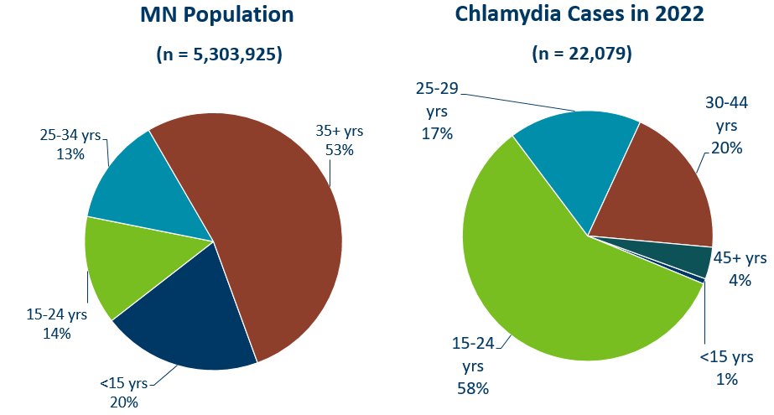
Chlamydia Disproportionately Impacts Youth and Young Adults
Data (right): STD Surveillance Report Data Tables, Minnesota 2022 (PDF)
Notes:
Chlamydia continues to disproportionately impact youth and young adults.
15–24-year-olds make up only 14% of the population, but account for 59% of all chlamydia cases reported.
MN Population Data:
(n=5,303,925)
<15 yrs: 20%
15-24 yrs: 14%
25-34: 13%
35+ yrs: 53%

Slide 39
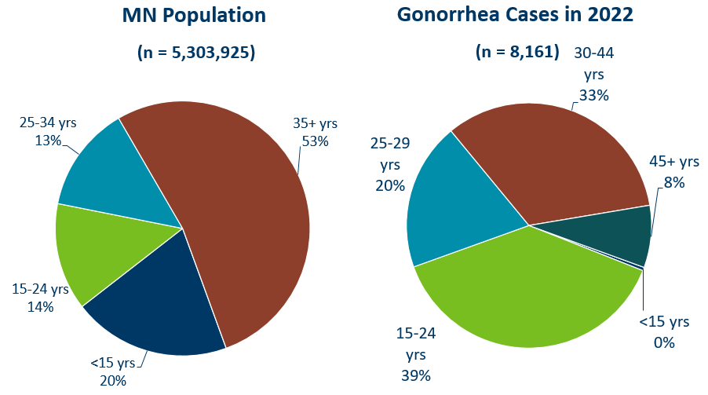
Gonorrhea Disproportionately Impacts Youth and Young Adults
Data (right): STD Surveillance Report Data Tables, Minnesota 2022 (PDF)
Notes:
Gonorrhea also disproportionately impacts youth and young adults.
Again 15–24-year-olds make up only 14% of the population, but account for 38% of all gonorrhea cases reported.
MN Population Data:
(n=5,303,925)
<15 yrs: 20%
15-24 yrs: 14%
25-34: 13%
35+ yrs: 53%

Slide 40
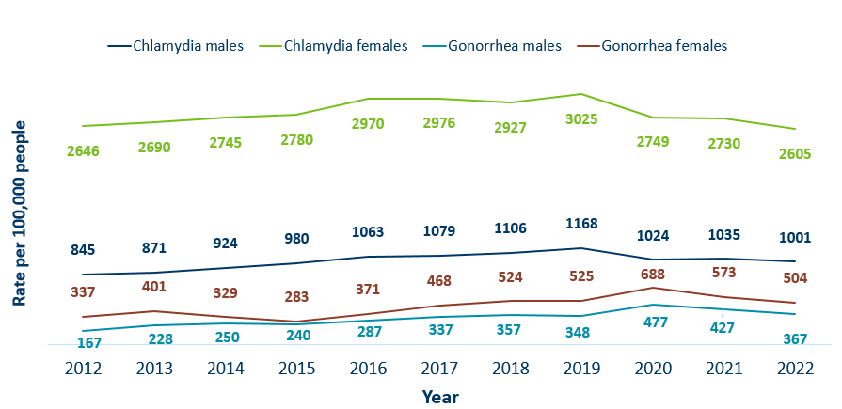
Chlamydia and Gonorrhea Rates Among Adolescents & Young Adults† by Gender in Minnesota, 2012-2022
 | 2012 | 2013 | 2014 | 2015 | 2016 | 2017 | 2018 | 2019 | 2020 | 2021 | 2022
Chlamydia males | 845 | 871 | 924 | 980 | 1063 | 1079 | 1106 | 1168 | 1024 | 1035 | 1001
Chlamydia females | 2646 | 2690 | 2745 | 2780 | 2970 | 2976 | 2927 | 3025 | 2749 | 2730 | 2605
Gonorrhea males | 167 | 228 | 250 | 240 | 287 | 337 | 357 | 348 | 477 | 427 | 367
Gonorrhea females | 337 | 401 | 329 | 283 | 371 | 468 | 524 | 525 | 688 | 573 | 504
Rate = Cases per 100,000 people based on 2010 U.S. Census counts.
† Adolescents defined as 15-19 year-olds; Young Adults defined as 20-24 year-olds.
Notes:
The rates of chlamydia and gonorrhea are higher in females compared to males in the 15–24-year-old age group.
The rates for chlamydia in females are 2605 per 100,000 population compared to males at 1001 per 100,000 population.
The rates of gonorrhea in females is 504 per 100,000 compared to 367 per 100,000 in males

Slide 41
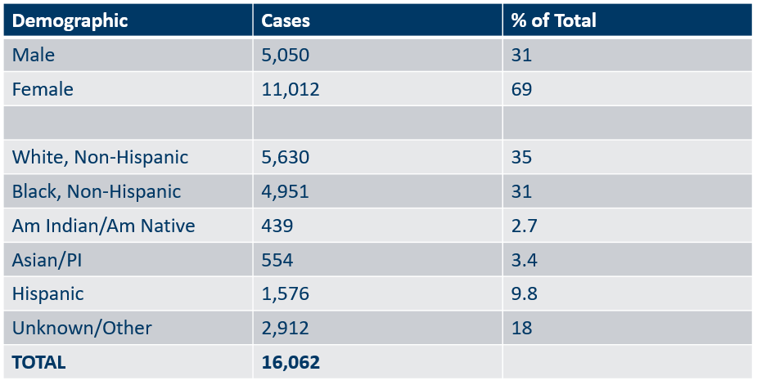
Summary Characteristics of Adolescents and Young Adults†
Diagnosed With Chlamydia or Gonorrhea in 2022
Demographic | Cases | % of Total
Male | 5,050 | 31
Female | 11,012 | 69
White, Non-Hispanic | 5,630 | 35
Black, Non-Hispanic | 4,951 | 31
Am Indian/Am Native | 439 | 2.7
Asian/PI | 554 | 3.4
Hispanic | 1,576 | 9.8
Unknown/Other | 2,912 | 18
TOTAL | 16,062
† Adolescents defined as 15-19 year-olds; young adults defined as 20-24 year-olds, excludes 4 transgender + 22 missing/unknown
Notes:
In adolescents and young adults, the majority of chlamydia and gonorrhea cases are females (68%) .
A little over one-third (36%) are white, non-Hispanic followed by about one-third (30%) that are black, non-Hispanic. 19% were unknown or more than one race.
Adolescents and young adults accounted for 60% of chlamydia and 37% of gonorrhea cases diagnosed in Minnesota.

Slide 42
Summary of STD Trends in Minnesota
From 2012-2022, the chlamydia rate increased by 22%. The rate of gonorrhea increased by 165%, syphilis has increased by 447%.
Adolescent and young females aged 15-24 years old continue to make up the majority of all chlamydia or gonorrhea cases at 53%.
Syphilis has resurged in MN over the past decade, with MSM and those co-infected with HIV being especially impacted. However, the number of females impacted is near the record high for the last decade.
People of color continue to be disproportionately affected by all STDs in Minnesota. Disparities in the rates of STDs are not explained by differences in sexual behavior, but are due to differences in health insurance coverage, employment status and access to healthcare with preventative, screening, and treatment services.
Notes:
From 2012-2022, the chlamydia rate increased by 22%. The rate of gonorrhea increased by 165% syphilis has increased by 447%.
Adolescent and young females aged 15-24 years old continue to make up the majority of all chlamydia or gonorrhea cases at 53%.
Minnesota has seen a resurgence of syphilis over the past decade, with men who have sex with men and those co-infected with HIV being especially impacted. However, the number of females impacted is near the record high for the last decade.
people of color continue to be disproportionately affected by all STDs in Minnesota and nationwide. Disparities in the rates of STDs are not explained by differences in sexual behavior, but are due to differences in health insurance coverage, employment status and access to healthcare with preventative, screening and treatment services.

Slide 43
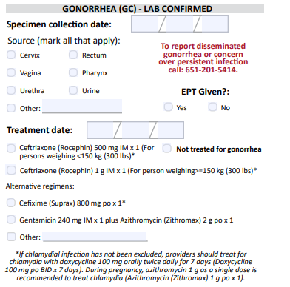
Updates to STD Reporting and Current Follow-Up
A new chlamydia and gonorrhea case report form is available on the MDH website, to accommodate changes in treatment guidelines and highlight DGI reporting.
The case report form can be filled out and mailed or faxed to MDH at 1-800-298-3775.
More information may be requested on gonorrhea cases for Enhanced Gonorrhea Surveillance as part of the CDC PCHD grant.
All cases co-infected with early syphilis will continue to be assigned to MDH Partner Services for follow-up.
All STD cases continue to have the potential for being contacted by MDH for additional follow-up.
Notes:
A new Chlamydia and Gonorrhea case report form is available on the MDH website, to accommodate changes in treatment guidelines and highlight DGI reporting.
The case report form can be filled out and mailed or faxed to MDH at 1-800-298-3775.
More information may be requested on gonorrhea cases for Enhanced Gonorrhea Surveillance as part of the CDC PCHD grant.
All cases co-infected with Early Syphilis will continue to be assigned to MDH Partner Services for follow-up.
All STD cases continue to have the potential for being contacted by MDH for additional follow-up.

