Slide 1
Sexually Transmitted Disease (STD) Surveillance Report, 2022
Minnesota Department of Health STD Surveillance System

Slide 2
Introduction 1/2
Under Minnesota law, physicians and laboratories are required to report all laboratory-confirmed cases of chlamydia, gonorrhea, syphilis, and chancroid to the Minnesota Department of Health (MDH) within one working day.
The MDH does not maintain statistics for other, non-reportable STDs (ex: herpes, HPV/genital warts).
This slide set describes trends in reportable STDs in Minnesota by person, place, and time.
Analyses exclude cases reported from federal and private prisons.

Slide 3
Introduction 2/2
STD surveillance is the systematic collection of data from cases for the purpose of monitoring the frequency and distribution of STDs in a given population.
STD surveillance data are used to detect problems, prioritize resources, develop and target interventions, and evaluate the effectiveness of interventions.

Slide 4
Interpreting STD Surveillance Data (1/2)
Factors that impact the completeness and accuracy of STD data include:
  Level of STD screening by healthcare providers
  Individual test-seeking behavior
  Sensitivity of diagnostic tests
  Compliance with case reporting
  Completeness of case reporting
  Timeliness of case reporting
Increases and decreases in STD rates can be due to actual changes in disease occurrence and/or changes in one or more of the above factors.
COVID-19 lockdowns likely played a role in the number of cases reported/diagnosed this past year.
Notes:
Factors that impact the completeness and accuracy of STD data include:
Level of STD screening by healthcare providers, individual test-seeking behavior, sensitivity of diagnostic tests, compliance with case reporting, completeness of case reporting, timeliness of case reporting.
Increases and decreases in STD rates can be due to actual changes in disease occurrence and/or changes in one or more of the above factors.
Important to note that COVID-19 likely played a role in the number of cases reported/diagnosed over the past few years as people may have delayed care and adopted telehealth options.

Slide 5
Interpreting STD Surveillance Data (2/2)
The surveillance system only includes cases with a positive laboratory test. Cases diagnosed solely on symptoms are not counted.
Since 2012 we have included cases that had only a lab report and no corresponding case report form. This has increased the number of unknowns in some variables.
In 2020, the COVID-19 response accelerated the use of laboratory reporting by facilities, again increasing the number of unknown variables.
In 2018, in order to be consistent with CDC, we categorized all White, Hispanic and Black, Hispanic cases as Hispanic. That means the race categories now reflect only White, Non-Hispanic and Black, Non-Hispanic cases.
Surveillance data represent cases of infection, not individuals. A person with multiple infections in a given year will be counted more than once.
Caution is warranted when interpreting changes in STD numbers that can seem disproportionately large when the number of cases is small.

Slide 6
National Context

Slide 7
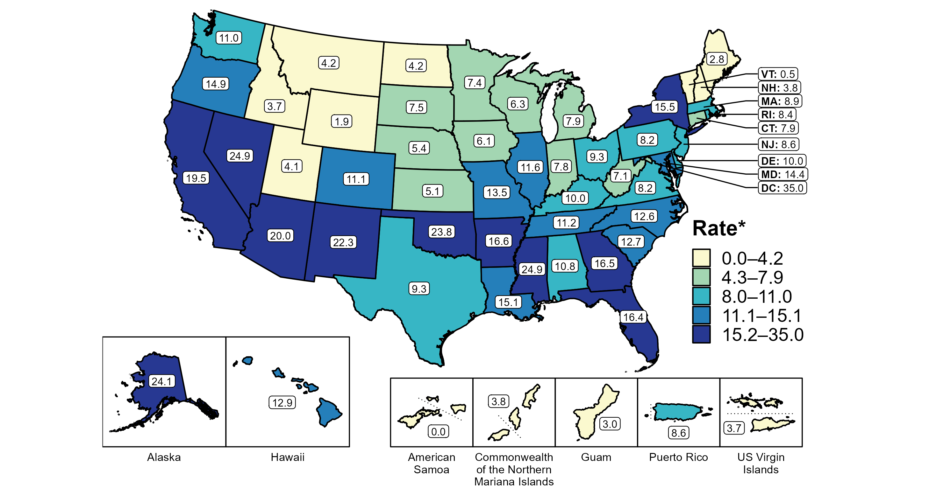
Primary and Secondary Syphilis — Rates of Reported Cases by State, United States and Territories, 2020
* Per 100,000
Notes:
Minnesota’s primary and secondary syphilis rate in 2020 was 7.8 per 100,000
This was lower than the national rate of 12.7 per 100,000
NOTE: Need

Slide 8
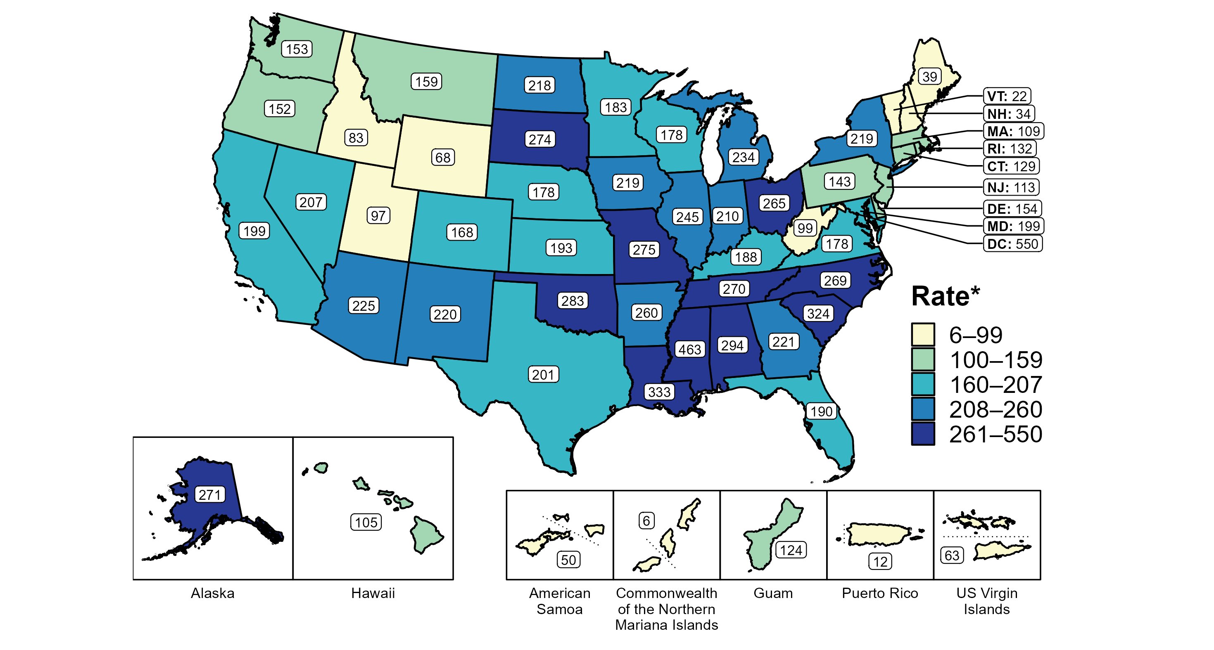
Gonorrhea — Rates of Reported Cases by State, United States and Territories, 2020
* Per 100,000
Notes:
Minnesota’s gonorrhea rate in 2010 was 192.6 per 100,000
This was lower than the national rate of 206.5 per 100,000
NOTE: Need CDC link

Slide 9
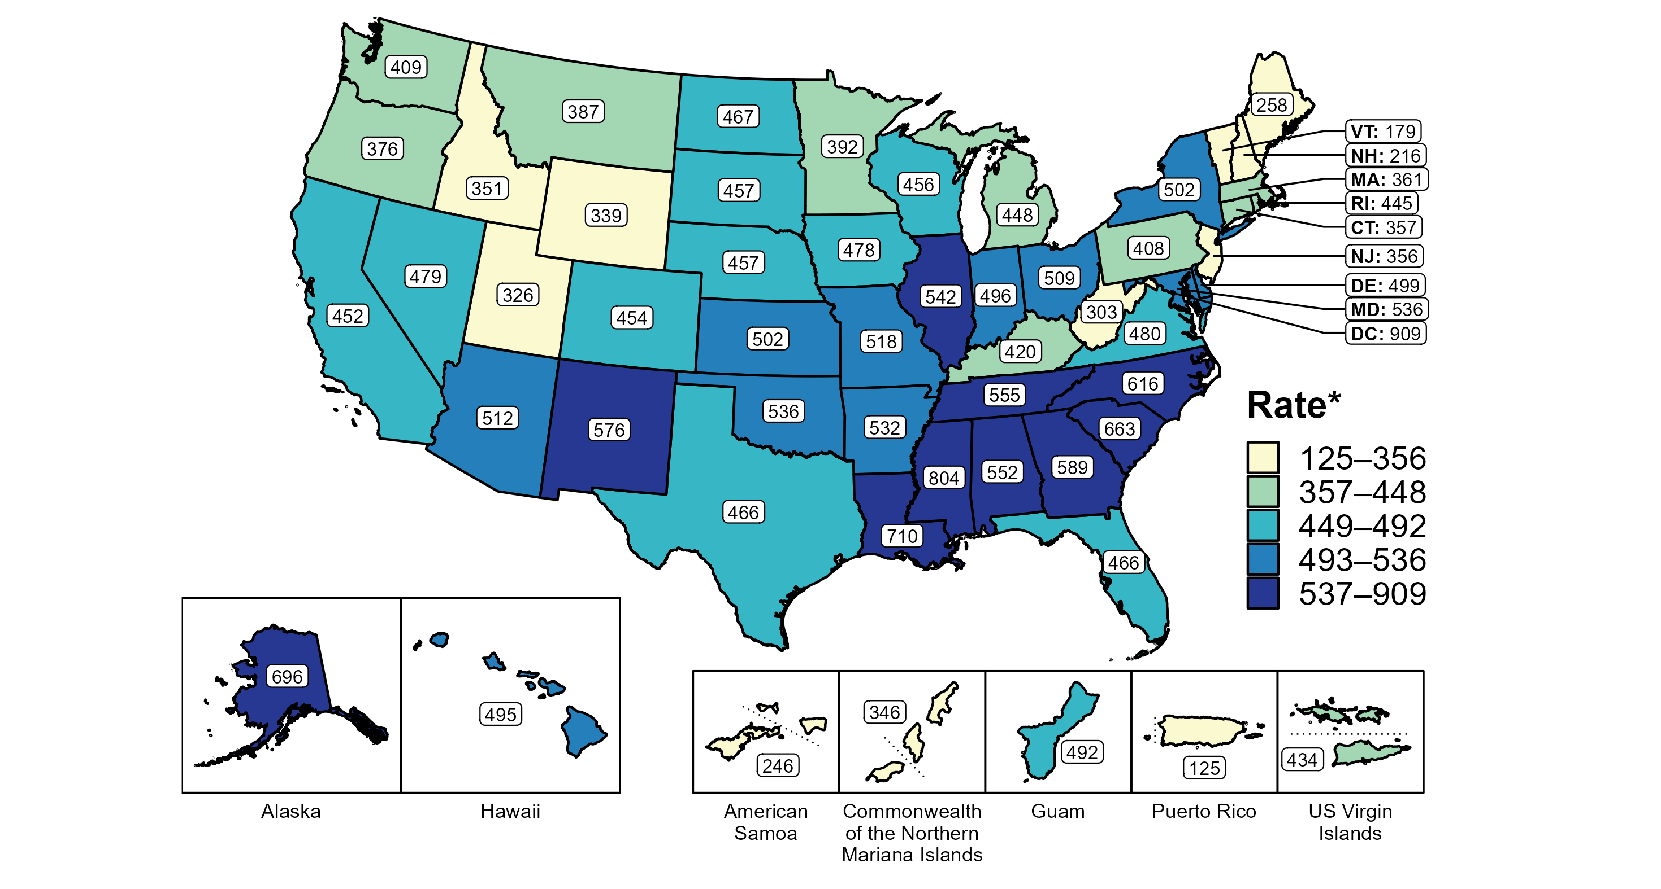
Chlamydia — Rates of Reported Cases by State, United States and Territories, 2020
* Per 100,000
Notes:
Minnesota’s chlamydia rate in 2020 was 413.7 per 100,000
This was lower than the national rate of 481.3 per 100,000
Nationally CT declined 12.6% nationally.
MN declined 11 in 2020.
The COVID-19 pandemic has introduced uncertainty and difficulty in interpreting 2020 case data.
NOTE: need CDC link

Slide 10
Overview of STDs in Minnesota
Minnesota Department of Health STD Surveillance System

Slide 11
STDs in Minnesota:
Number of Cases Reported in 2022
Total of 32,072 STD cases reported to MDH in 2022:
  22,079 Chlamydia cases
  8,161 Gonorrhea cases
  1,832 Syphilis cases (all stages)
  0 Chancroid cases
Notes:
In the year 2022, a total of 32,071 STD cases were reported to the Minnesota Department of Health:
22,079 Chlamydia cases
8,161 Gonorrhea cases
1832 Syphilis cases (all stages)
0 Chancroid cases

Slide 12
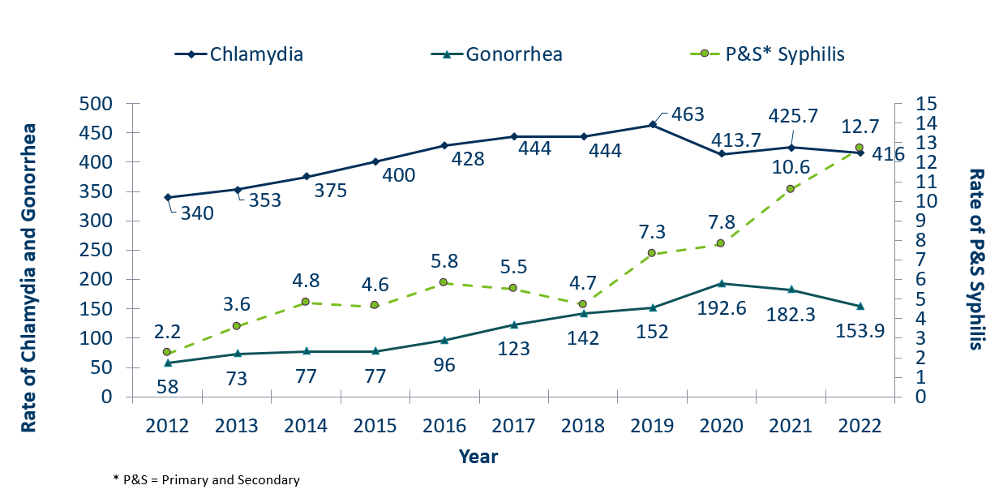
STDs in Minnesota:
Rate per 100,000 by Year of Diagnosis, 2012-2022
 | 2008 | 2009 | 2010 | 2011 | 2012 | 2013 | 2014 | 2015 | 2016 | 2017 | 2018 | 2019 | 2020 | 2021 | 2022
Chlamydia | 275 | 272 | 292 | 319 | 340 | 353 | 375 | 400 | 428 | 444 | 444 | 463 | 413.7 | 425.7 | 416
Gonorrhea | 58 | 44 | 41 | 43 | 58 | 73 | 77 | 77 | 96 | 123 | 142 | 152 | 192.6 | 182.3 | 153.9
P&S* Syphilis | 2.2 | 1.3 | 2.8 | 2.6 | 2.2 | 3.6 | 4.8 | 4.6 | 5.8 | 5.5 | 4.7 | 7.3 | 7.8 | 10.6 | 12.7
Notes:
The rate of chlamydia in MN decreased by 2% to 416 per 100,000 compared to 425.7 per 100,000 in 2021.
The rate of gonorrhea in MN decreased 16% to 153.9 per 100,000 compared to 182.3 per 100,000 in 2021.
The rate of primary and secondary syphilis increased by 20% from 10.6 in 2021 to 12.7 per 100,000 in 2022.

Slide 13
Syphilis
Minnesota Department of Health STD Surveillance System

Slide 14
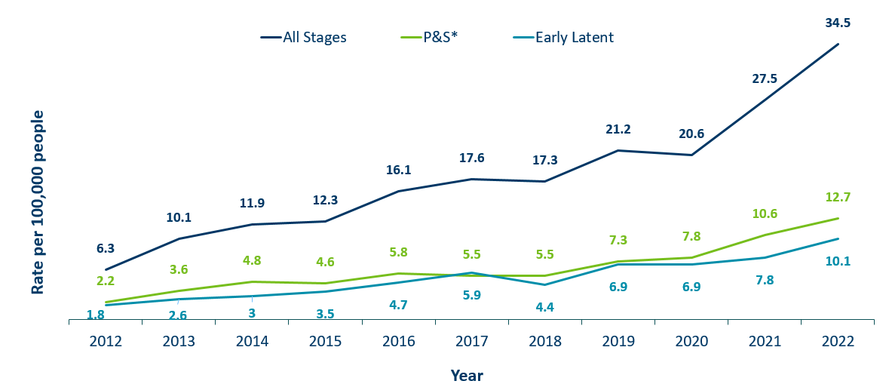
Syphilis Rates by Stage of Diagnosis, Minnesota, 2012-2022
 | 2008 | 2009 | 2010 | 2011 | 2012 | 2013 | 2014 | 2015 | 2016 | 2017 | 2018 | 2019 | 2020 | 2021 | 2022
All Stages | 5 | 4.1 | 6.6 | 6.9 | 6.3 | 10.1 | 11.9 | 12.3 | 16.1 | 17.6 | 17.3 | 21.2 | 20.6 | 27.5 | 34.5
P&S* | 2.2 | 1.3 | 2.8 | 2.6 | 2.2 | 3.6 | 4.8 | 4.6 | 5.8 | 5.5 | 5.5 | 7.3 | 7.8 | 10.6 | 12.7
Early Latent |  |  |  |  |  | 0.9 | 0.9 | 1.4 | 2.3 | 1.8 | 2.6 | 3 | 3.5 | 4.7 | 5.9 | 4.4 | 6.9 | 6.9 | 7.8 | 10.1
* P&S = Primary and Secondary
Notes:
The overall syphilis rate is 34.5 per 100,000. A 25% increase from 2021, and a 440% increase from a decade ago.
Of concern is the rate of primary and secondary syphilis which is 12.7 per 100,000, a 20% increase from 2021.

Slide 15
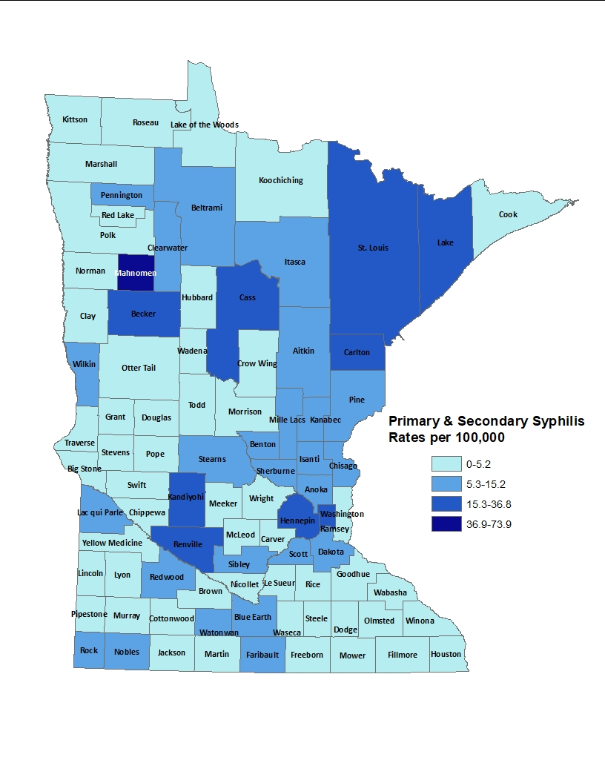
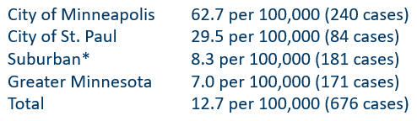
2022 Minnesota Primary and Secondary Syphilis Rates by County
*7-county metro area, excluding the cities of Minneapolis and St. Paul
Notes:
The statewide rate of primary and secondary syphilis increased to 12.7 cases per 100,000 from 10.6.
Within the metro, the highest rate of primary and secondary syphilis remains in the City of Minneapolis at 62.7 cases per 100,000 population.
The City of St. Paul has the second highest rate in the metro at 29.5 per 100,000.
Data:
City of Minneapolis: 62.7 per 100,000 (240 cases)
City of St. Paul: 29.5 per 100,000 (84 cases)
Suburban: 8.3 per 100,000 (181 cases)
Greater Minnesota: 7.0 per 100,000 (171 cases)
Total: 12.7 per 100,000 (676 cases)

Slide 16
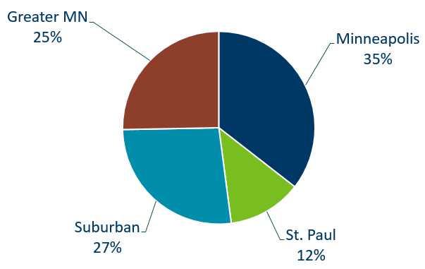
Primary and Secondary Syphilis Infections by Residence at Diagnosis
Minnesota, 2022
Total Number of Cases = 676
Suburban = Seven-county metro area including Anoka, Carver, Dakota, Hennepin (excluding Minneapolis), Ramsey (excluding St. Paul), Scott, and Washington counties. Greater MN = All other Minnesota counties outside the seven-county metro area.
Notes:
The City of Minneapolis had the largest percent of all reported primary and secondary cases with 35%
Second to Suburban MN with 27 % of the cases.
Third largest was Greater MN with 25%
St. Paul Reported 12%.

Slide 17
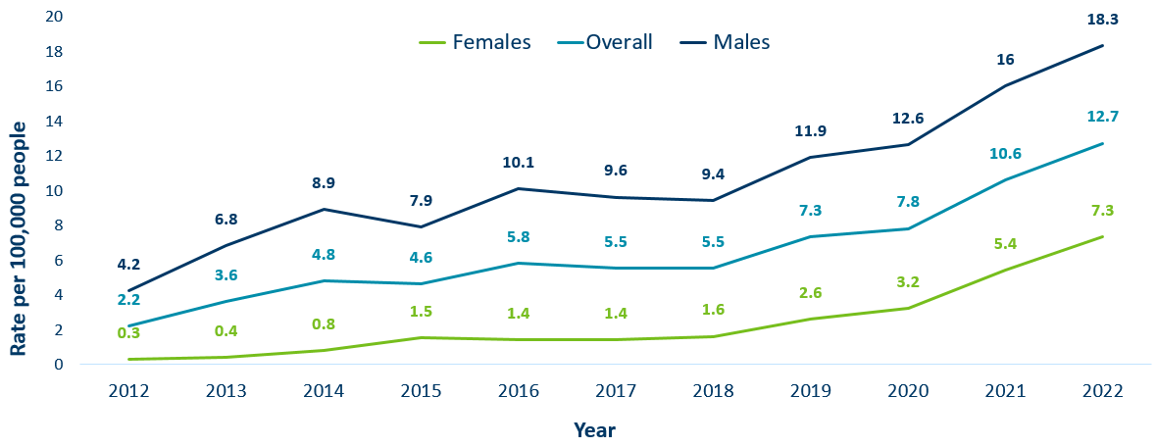
Primary and Secondary Syphilis Rates by Gender, Minnesota, 2012-2022
` | 2008 | 2009 | 2010 | 2011 | 2012 | 2013 | 2014 | 2015 | 2016 | 2017 | 2018 | 2019 | 2020 | 2021 | 2022
Males | 4.3 | 2.7 | 5.4 | 5.1 | 4.2 | 6.8 | 8.9 | 7.9 | 10.1 | 9.6 | 9.4 | 11.9 | 12.6 | 16 | 18.3
Females | 0.2 | 0 | 0.3 | 0.2 | 0.3 | 0.4 | 0.8 | 1.5 | 1.4 | 1.4 | 1.6 | 2.6 | 3.2 | 5.4 | 7.3
Overall | 2.2 | 1.3 | 2.8 | 2.6 | 2.2 | 3.6 | 4.8 | 4.6 | 5.8 | 5.5 | 5.5 | 7.3 | 7.8 | 10.6 | 12.7
Notes:
Males have the highest rates of primary and secondary syphilis at 18.3 cases per 100,0000 population
The rate of primary and secondary syphilis in females is 7.3 per 100,000 per population.

Slide 18
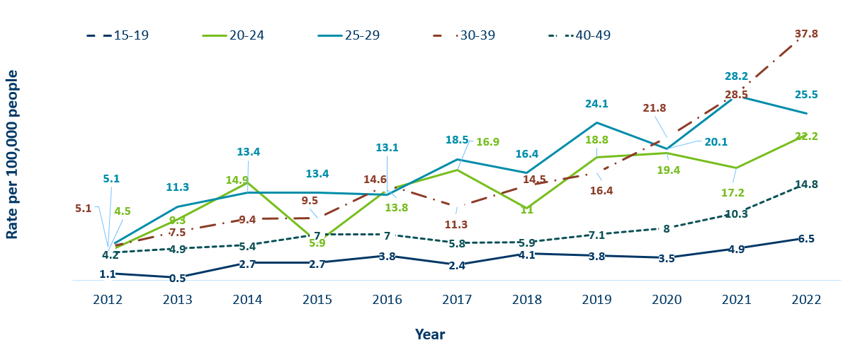
Primary and Secondary Syphilis Rates by Age
Minnesota, 2012-2022
 | 2008 | 2009 | 2010 | 2011 | 2012 | 2013 | 2014 | 2015 | 2016 | 2017 | 2018 | 2019 | 2020 | 2021 | 2022
15-19 | 0.8 | 0.5 | 1.6 | 0.8 | 1.1 | 0.5 | 2.7 | 2.7 | 3.8 | 2.4 | 4.1 | 3.8 | 3.5 | 4.9 | 6.5
20-24 | 6.7 | 3.4 | 9.6 | 7.3 | 4.5 | 9.3 | 14.9 | 5.9 | 13.8 | 16.9 | 11 | 18.8 | 19.4 | 17.2 | 22.2
25-29 | 4.1 | 3 | 4.8 | 7 | 5.1 | 11.3 | 13.4 | 13.4 | 13.1 | 18.5 | 16.4 | 24.1 | 20.1 | 28.2 | 25.5
30-39 | 4.9 | 3 | 6.4 | 5.5 | 5.1 | 7.5 | 9.4 | 9.5 | 14.6 | 11.3 | 14.5 | 16.4 | 21.8 | 28.5 | 37.8
40-49 | 4.1 | 2.3 | 4 | 3.8 | 4.2 | 4.9 | 5.4 | 7 | 7 | 5.8 | 5.9 | 7.1 | 8 | 10.3 | 14.8
Notes:
The highest rates of primary and secondary syphilis were in the 30-39 year old age group at 37.8 cases per 100,000 population, a 33% increase from 2021.
25-29 year olds and 20-24 had the next highest rate at 25.5 and 22.2 per 100,000, respectively.

Slide 19
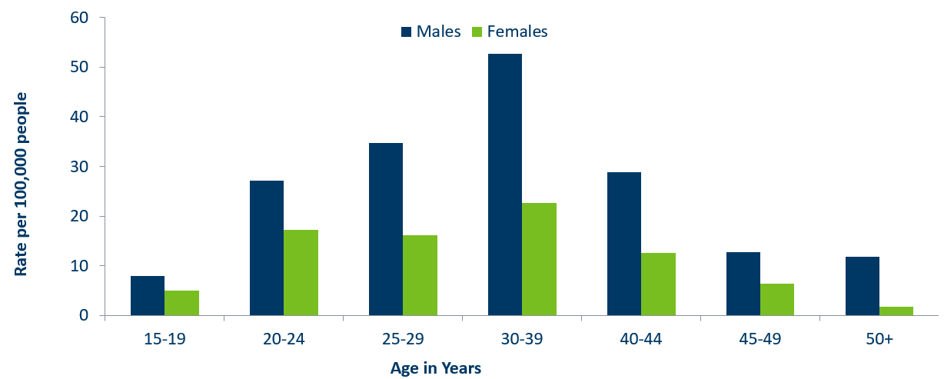
Age-Specific Primary and Secondary Syphilis Rates by Gender, Minnesota, 2022
 | 15-19 | 20-24 | 25-29 | 30-39 | 40-44 | 45-49 | 50+
Males | 8 | 27.1 | 34.7 | 52.6 | 28.8 | 12.8 | 11.8
Females | 5 | 17.2 | 16.2 | 22.7 | 12.5 | 6.4 | 1.8
Notes:
Males have higher rates of primary and secondary syphilis than females in all age groups. The rate in males is 2.5 times higher than females.
30-39 year old males had the highest rate at 52.6 per 100,000
30-39 year old females had the highest rate of the female population at 22.7 per 100,000.

Slide 20
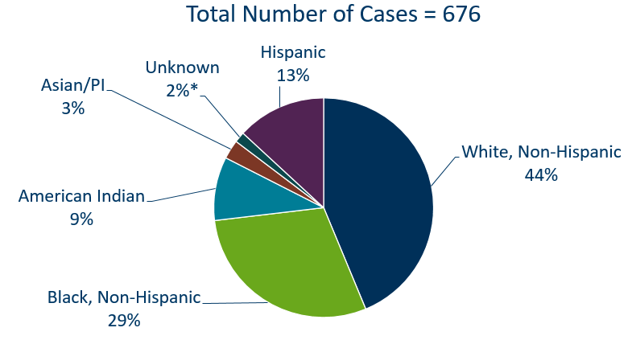
Primary and Secondary Syphilis Cases by Race
Minnesota, 2022
*Includes people reported with more than one race
Notes:
44% percent of all primary and secondary syphilis cases are White, non-Hispanic.
Black, non-Hispanic cases made up 29% of all Primary and Secondary Syphilis cases followed by, American Indian cases at 9%, Hispanic cases at 13%, and Asian/Pacific Islander cases at 3%.

Slide 21
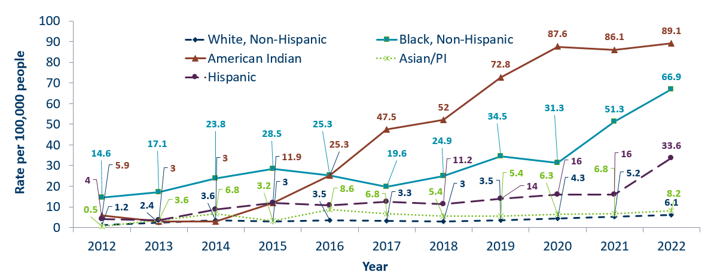
Primary and Secondary Syphilis Rates by Race/Ethnicity
Minnesota, 2012-2022
 | 2008 | 2009 | 2010 | 2011 | 2012 | 2013 | 2014 | 2015 | 2016 | 2017 | 2018 | 2019 | 2020 | 2021 | 2022
White, Non-Hispanic | 1.9 | 1.1 | 2 | 2.1 | 1.2 | 2.4 | 3.6 | 3 | 3.5 | 3.3 | 3 | 3.5 | 4.3 | 5.2 | 6.1
Black, Non-Hispanic | 6.7 | 4 | 13.9 | 8.5 | 14.6 | 17.1 | 23.8 | 28.5 | 25.3 | 19.6 | 24.9 | 34.5 | 31.3 | 51.3 | 66.9
American Indian | 0 | 1.5 | 1.5 | 1.5 | 5.9 | 3 | 3 | 11.9 | 25.3 | 47.5 | 52 | 72.8 | 87.6 | 86.1 | 89.1
Asian/PI | 0.5 | 0 | 0.5 | 2.7 | 0.5 | 3.6 | 6.8 | 3.2 | 8.6 | 6.8 | 5.4 | 5.4 | 6.3 | 6.8 | 8.2
Hispanic | 1.3 | 2.5 | 4.4 | 4 | 4 | 3.6 | 8.8 | 12 | 10.8 | 12.4 | 11.2 | 14 | 16 | 16 | 33.6
* people of Hispanic ethnicity can be of any race.
Notes:
Large disparities continue to exist in the rates of syphilis compared to the White, non-Hispanic population.
The rates of primary and secondary syphilis are 14.7 times higher in the American Indian populations than that of the White, non-Hispanic population.
The rates of primary and secondary syphilis are 11 times higher in the Black/African American, non-Hispanic than that of the White, non-Hispanic population.
The rates of primary and secondary syphilis in the American Indian population are 89.1 per 100,000 compared to 6.1 per 100,000 in the White, non-Hispanic population.
The rates of primary and secondary syphilis in the Black/African American, non-Hispanic population are 66.9 per 100,000 .
The rates in the Hispanic population are 33.6 per 100,000 which is 5.5 times higher than the White, non-Hispanic population.
The rates in the Asian/Pacific Islander population are 8.2 per 100,000 which is 1.3 times higher than the White, non-Hispanic population.

Slide 22
Topic of Interest: Syphilis Among
Females and Congenital Syphilis in Minnesota
Minnesota Department of Health STD Surveillance System
Notes:
Topic of Interest: Syphilis Among
Females and Congenital Syphilis in Minnesota

Slide 23
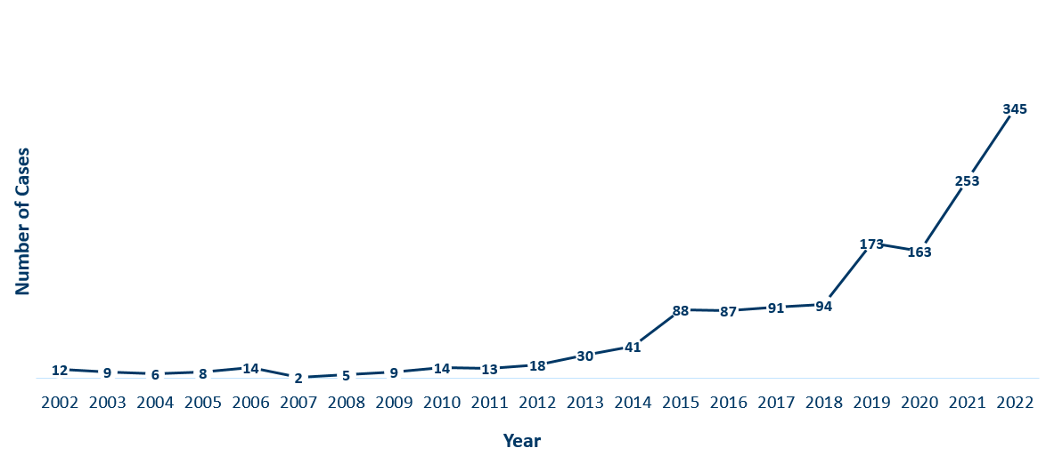
Female Early Syphilis Cases
Minnesota, 2022
Year | Number of Cases
2002 | 12
2003 | 9
2004 | 6
2005 | 8
2006 | 14
2007 | 2
2008 | 5
2009 | 9
2010 | 14
2011 | 13
2012 | 18
2013 | 30
2014 | 41
2015 | 88
2016 | 87
2017 | 91
2018 | 94
2019 | 173
2020 | 163
2021 | 253
2022 | 345
Notes:
The number of female early syphilis cases has increased dramatically over the last 10 years from 18 cases in 2012 to 345 in 2022.

Slide 24
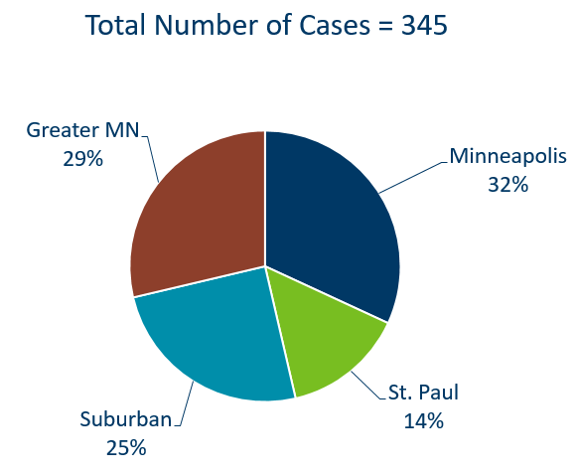
Early Syphilis Infections in Females by Residence at Diagnosis
Minnesota, 2022
Suburban = Seven-county metro area including Anoka, Carver, Dakota, Hennepin (excluding Minneapolis), Ramsey (excluding St. Paul), Scott, and Washington counties. Greater MN = All other Minnesota counties outside the seven-county metro area.
Notes:
29% of female early syphilis cases were residents of Greater Minnesota
25% of female early syphilis cases were residents of the Suburbs of the seven-county metro area
32% were City of Minneapolis residents, and 14% were St. Paul residents.
NOTE: Not included

Slide 25
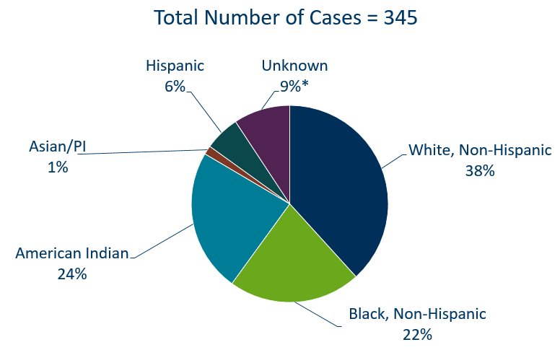
Early Syphilis Cases in Females by Race/Ethnicity
Minnesota, 2022
*Includes people reported with more than one race
Notes:
There are large disparities in women with syphilis. 24% of all early syphilis cases in females are found in the American Indian population and 22% in the Black, African American population.
Data:
Total Number of Cases: 345
Hispanic: 6%
Unknown: 9%
White, Non-Hispanic: 38%
Black, Non-Hispanic: 22%
American Indian: 24%
Asian/PI: 1%

Slide 26
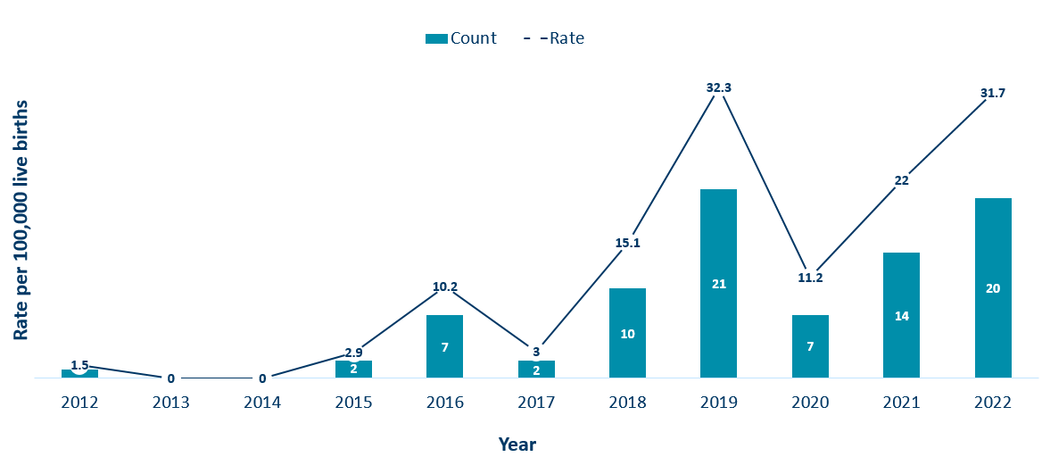
Congenital Syphilis Rates Among Infants
Minnesota, 2012-2022
Year | Rate | Count
2012 | 1.5 | 1
2013 | 0 | 0
2014 | 0 | 0
2015 | 2.9 | 2
2016 | 10.2 | 7
2017 | 3 | 2
2018 | 15.1 | 10
2019 | 32.3 | 21
2020 | 11.2 | 7
2021 | 22 | 14
2022 | 31.7 | 20
Notes:
In Minnesota, the number and rate of congenital syphilis cases among infants has increased in 2022 compared to 2021. Overall, the rate has increased over the past five years from a rate of 15.2 per 100,000 live births in 2018 to 31.7 per 100,000 live births in 2022.
Syphilis may be passed from a pregnant person to the unborn baby through the placenta. The infection can cause miscarriages and stillbirths, and infants born with congenital syphilis can suffer a variety of serious health problems, including deformities, seizures, anemia and jaundice.
The Centers for Disease Control and Prevention reported this fall that the number of infants born with syphilis has more than 200% in the past four years and last year reached a 20-year high.

Slide 27
Topic of Interest: Early Syphilis Among
Men Who Have Sex With Men in Minnesota
Minnesota Department of Health STD Surveillance System
Notes:
Topic of Interest: Early Syphilis Among Men Who Have Sex With Men in Minnesota.
Men who have sex with men (MSM) make up the majority of early syphilis cases.

Slide 28
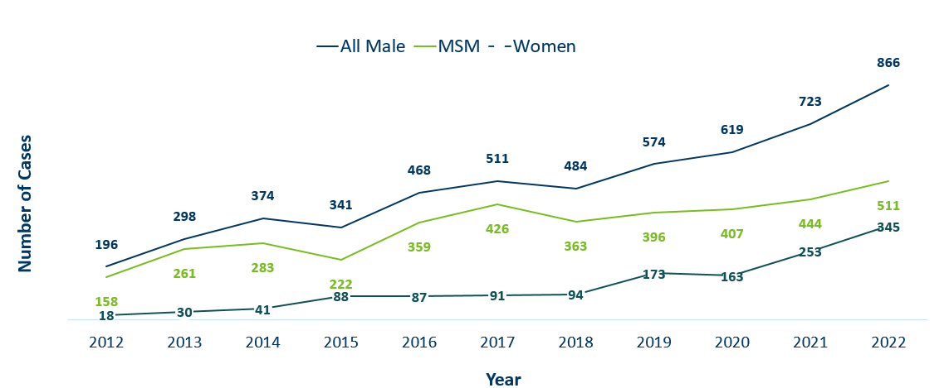
Number of Early Syphilis† Cases by Gender and MSM
Minnesota, 2012-2022
 | 2012 | 2013 | 2014 | 2015 | 2016 | 2017 | 2018 | 2019 | 2020 | 2021 | 2022
All Male | 196 | 298 | 374 | 341 | 468 | 511 | 484 | 574 | 619 | 723 | 866
MSM | 158 | 261 | 283 | 222 | 359 | 426 | 363 | 396 | 407 | 444 | 511
Women | 18 | 30 | 41 | 88 | 87 | 91 | 94 | 173 | 163 | 253 | 345
MSM=Men who have sex with men.
Figure does not include cases diagnosed in transgender people
† Early Syphilis includes primary, secondary, and early latent stages of syphilis.
Notes:
Early syphilis, includes not only primary and secondary syphilis, but all new syphilis acquired in the past year.
Of all early syphilis cases, 72 percent were among people whose current gender was reported as male.
Men who have sex with men (MSM) account for 59% of all early syphilis cases among men.

Slide 29
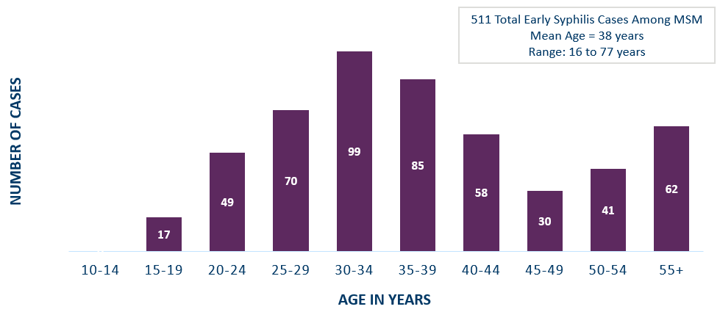
Early Syphilis† Cases Among MSM by Age
Minnesota, 2022
 | 10-14 | 15-19 | 20-24 | 25-29 | 30-34 | 35-39 | 40-44 | 45-49 | 50-54 | 55+
MSM | 0 | 17 | 49 | 70 | 99 | 85 | 58 | 30 | 41 | 62
MSM=Men who have sex with men
† Early Syphilis includes primary, secondary, and early latent stages of syphilis.
Notes:
The average age of MSM with early syphilis is 38 years of age.
Ages ranged from 16–77 years of age
The 30-34 year old age group had the highest number of cases at 99
49% of early syphilis cases are among MSM are in the 25-39 age groups.

Slide 30
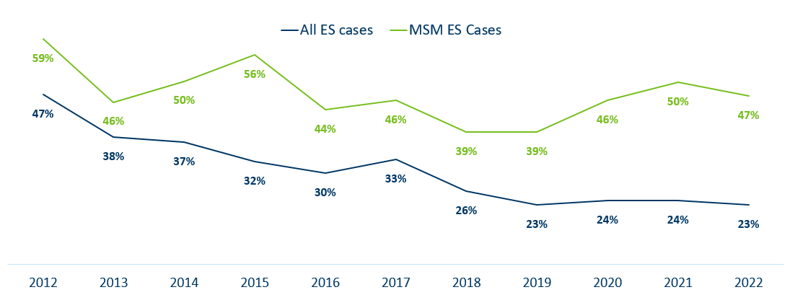
Early Syphilis† (ES) Cases
Co-infected with HIV, 2012-2022
 | 2012 | 2013 | 2014 | 2015 | 2016 | 2017 | 2018 | 2019 | 2020 | 2021 | 2022
All ES cases | 47% | 38% | 37% | 32% | 30% | 33% | 26% | 23% | 24% | 24% | 23%
MSM ES Cases | 59% | 46% | 50% | 56% | 44% | 46% | 39% | 39% | 46% | 50% | 47%
MSM=Men who have sex with men
† Early Syphilis includes primary, secondary, and early latent stages of syphilis.
Notes:
23% percent of all early syphilis cases were co-infected with HIV.
47% percent of all MSM early syphilis cases were co-infected with HIV.

Slide 31
Gonorrhea
Minnesota Department of Health STD Surveillance System
Notes:
Cases of reported gonorrhea saw the greatest decrease of 16 percent. 9,671 in 2021 compared to 8,161 in 2022.

Slide 32
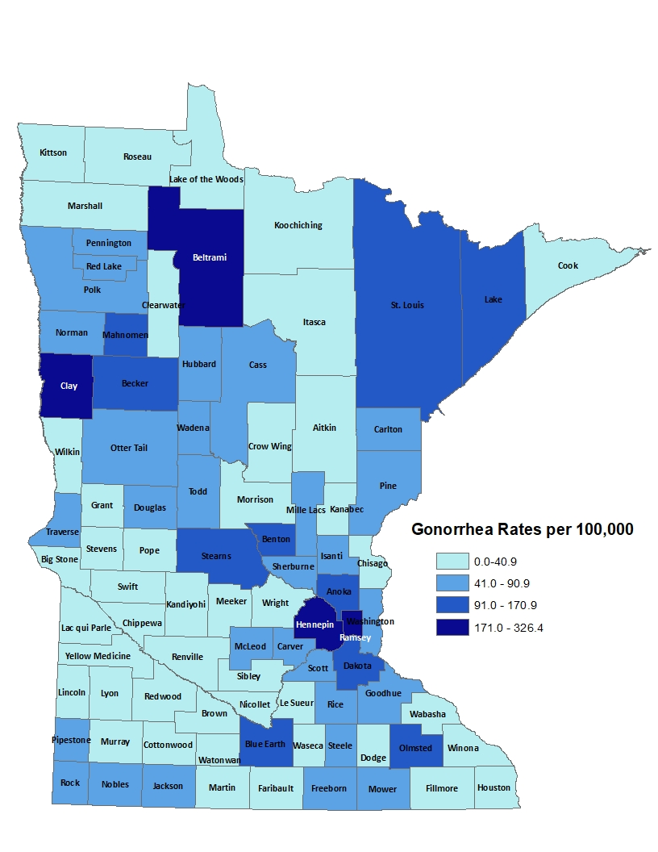
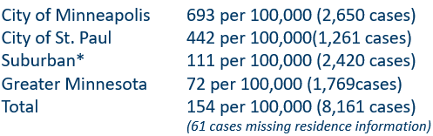
2022 Minnesota Gonorrhea Rates by County
*7-county metro area, excluding the cities of Minneapolis and St. Paul
Data: STD Surveillance Report Data Tables, Minnesota 2022 (PDF)
Notes:
The rate of gonorrhea in MN was 154 per 100,000. This is a rate decrease of 16% from 2021.
The city of Minneapolis continues to have the highest rates of gonorrhea at 693 per 100,000, followed by the city of St. Paul at 442 per 100,000, the suburban area (7-county metro excluding Minneapolis & St. Paul) at 111 per 100,000 and Greater Minnesota at 72 per 100,000.
The rates of gonorrhea decreased in all areas across Minnesota.

Slide 33
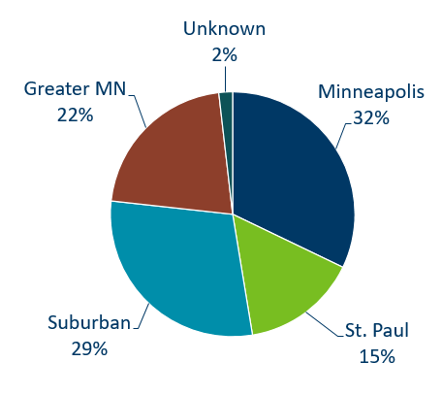
Gonorrhea Infections in Minnesota by Residence at Diagnosis, 2022
Suburban = Seven-county metro area including Anoka, Carver, Dakota, Hennepin (excluding Minneapolis), Ramsey (excluding St. Paul), Scott, and Washington counties. Greater MN = All other Minnesota counties outside the seven-county metro area.
Notes:
All parts of Minnesota are affected by gonorrhea. The cities of Minneapolis and St. Paul reported 47% of the cases; followed by 29% in the Suburban area surrounding the cities, and 22% in Greater Minnesota.

Slide 34
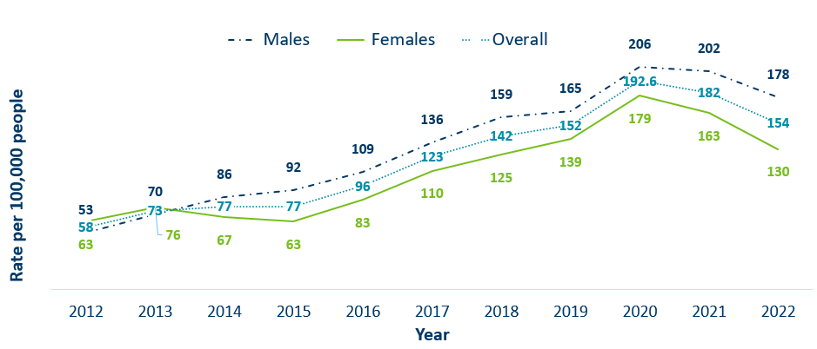
Gonorrhea Rates by Gender
Minnesota, 2012-2022
 | 2012 | 2013 | 2014 | 2015 | 2016 | 2017 | 2018 | 2019 | 2020 | 2021 | 2022
Males | 53 | 70 | 86 | 92 | 109 | 136 | 159 | 165 | 206 | 202 | 178
Females | 63 | 76 | 67 | 63 | 83 | 110 | 125 | 139 | 179 | 163 | 130
Overall | 58 | 73 | 77 | 77 | 96 | 123 | 142 | 152 | 192.6 | 182 | 154
Notes:
The rates of gonorrhea went down in both males and females in 2022. Males continue to have higher rates of gonorrhea than females
Males had a rate of 178 per 100,000 which is a decrease of 12% over the 2021 rate of 202 per 100,000.
Females had a rate of 130 per 100,000 which is a decrease of 20% over the 2021 rate of 163 per 100,000.

Slide 35
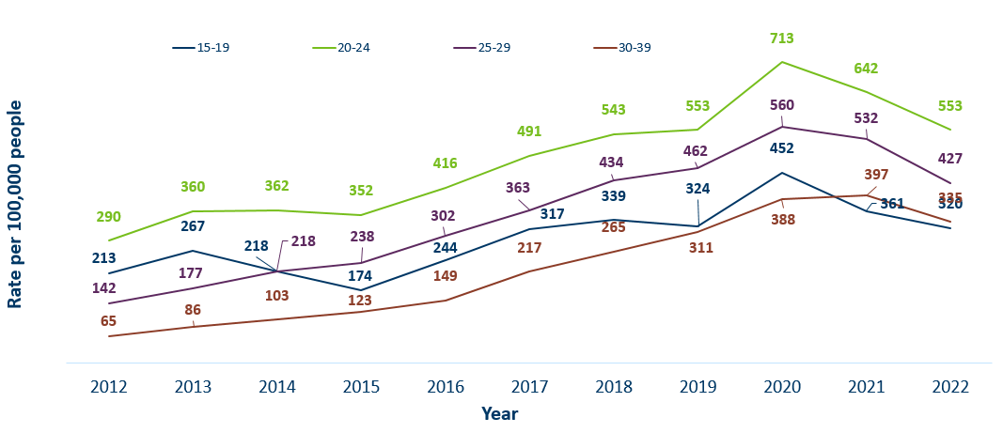
Gonorrhea Rates by Age
Minnesota, 2012-2022
 | 2012 | 2013 | 2014 | 2015 | 2016 | 2017 | 2018 | 2019 | 2020 | 2021 | 2022
15-19 | 213 | 267 | 218 | 174 | 244 | 317 | 339 | 324 | 452 | 361 | 320
20-24 | 290 | 360 | 362 | 352 | 416 | 491 | 543 | 553 | 713 | 642 | 553
25-29 | 142 | 177 | 218 | 238 | 302 | 363 | 434 | 462 | 560 | 532 | 427
30-39 | 65 | 86 | 103 | 123 | 149 | 217 | 265 | 311 | 388 | 397 | 335
Notes:
All age groups saw a decrease in gonorrhea rates.
The highest rate remains in the 20–24-year-old age group at 553 per 100,000.

Slide 36
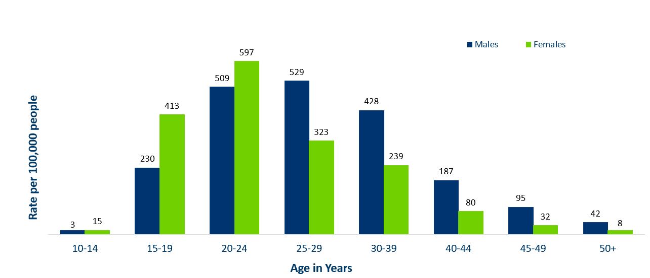
Age-Specific Gonorrhea Rates by Gender
Minnesota, 2022
Data: STD Surveillance Report Data Tables, Minnesota 2022 (PDF)
Notes:
Females under the age of 25 years of age, continue to have higher rates of gonorrhea than males.
Males record the highest rate among age groups older than 25 years.
The highest rates of gonorrhea are in females 20-24 at 597 per 100,000.

Slide 37
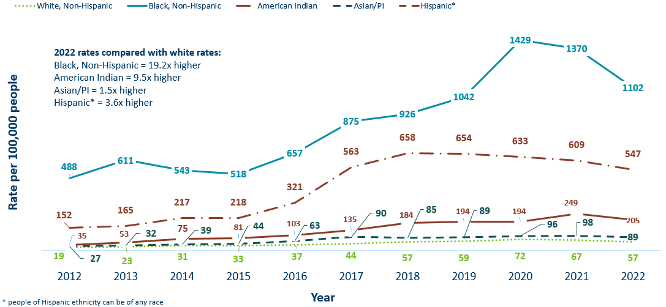
Gonorrhea Rates by Race/Ethnicity
Minnesota, 2012-2022
 | 2012 | 2013 | 2014 | 2015 | 2016 | 2017 | 2018 | 2019 | 2020 | 2021 | 2022
White, Non-Hispanic | 19 | 23 | 31 | 33 | 37 | 44 | 57 | 59 | 72 | 67 | 57
Black, Non-Hispanic | 488 | 611 | 543 | 518 | 657 | 875 | 926 | 1042 | 1429 | 1370 | 1102
American Indian | 152 | 165 | 217 | 218 | 321 | 563 | 658 | 654 | 633 | 609 | 547
Asian/PI | 27 | 32 | 39 | 44 | 63 | 90 | 85 | 89 | 96 | 98 | 89
Hispanic* | 35 | 53 | 75 | 81 | 103 | 135 | 184 | 194 | 194 | 249 | 205
Notes:
There continues to be large disparities in the rates of gonorrhea.
The Black/African American, non-Hispanic population rates are 19.2 times higher than white rates. The rate in the Black/African American population was 1102 per 100,000 compared to the rate in the White, Non-Hispanic population at 57 per 100,000.
The American Indian population had a rate that was 9.5 times higher at 547 per 100,000
The Asian/Pacific Islander population had a rate that was 1.5 times higher at 89 per 100,000
The Hispanic/Latino population, which can be of any race, had a rate that was 3.6 times higher at 205 per 100,000

Slide 38
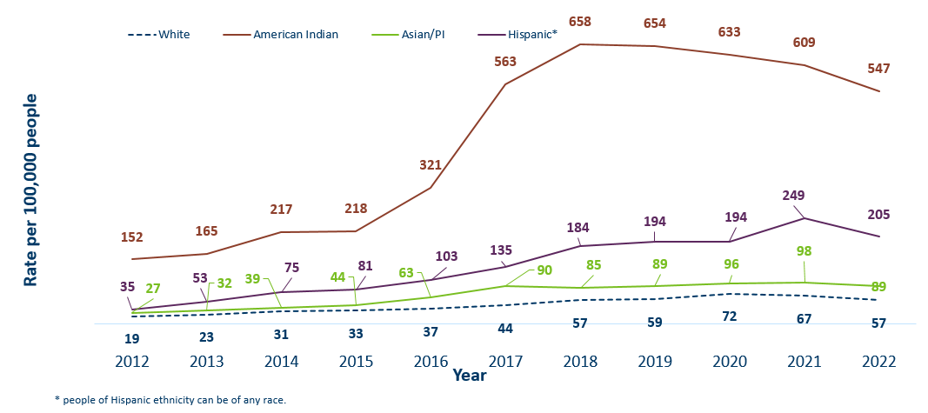
Gonorrhea Rates by Race/Ethnicity
Minnesota, 2012-2022
 | 2012 | 2013 | 2014 | 2015 | 2016 | 2017 | 2018 | 2019 | 2020 | 2021 | 2022
White | 19 | 23 | 31 | 33 | 37 | 44 | 57 | 59 | 72 | 67 | 57
American Indian | 152 | 165 | 217 | 218 | 321 | 563 | 658 | 654 | 633 | 609 | 547
Asian/PI | 27 | 32 | 39 | 44 | 63 | 90 | 85 | 89 | 96 | 98 | 89
Hispanic* | 35 | 53 | 75 | 81 | 103 | 135 | 184 | 194 | 194 | 249 | 205
Notes:
This is a clearer view of the rates of Gonorrhea by Race/Ethnicity from the previous slide, after removing the Black/African American, Non-Hispanic data.

Slide 39
Chlamydia
Minnesota Department of Health STD Surveillance System
Notes:
Chlamydia decreased 2% in 2022 compared to 2021 which recorded the second decline in over a decade. This could be the result of a true decrease in the number of cases, but it could also reflect the COVID-19 pandemic and reduced preventative visits. Chlamydia is more likely to be asymptomatic than gonorrhea and syphilis, especially in females.

Slide 40
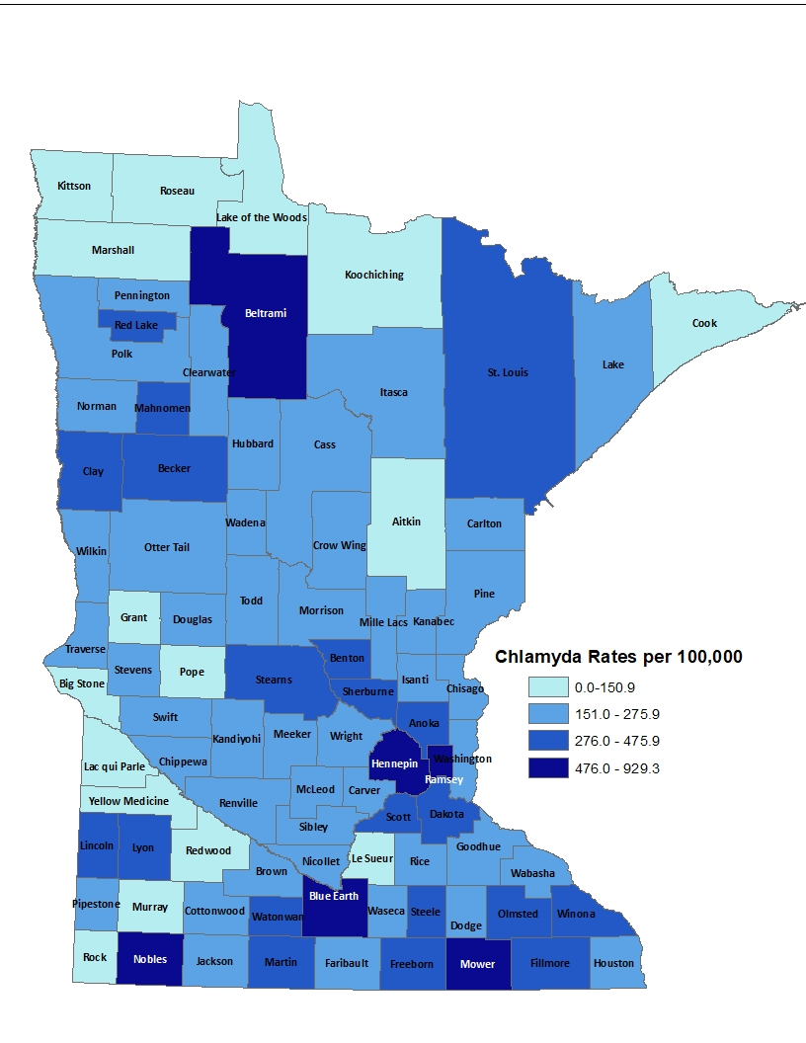
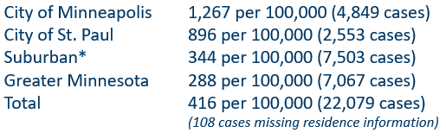
2022 Minnesota Chlamydia Rates by County
*7-county metro area, excluding the cities of Minneapolis and St. Paul
Data: STD Surveillance Report Data Tables, Minnesota 2022 (PDF)
Notes:
Despite the decrease, all counties in Minnesota were affected by chlamydia. There were at least 3 cases in all counties in 2022.
The city of Minneapolis continues to have the highest rates of chlamydia at 1,267 per 100,000, followed by the city of St. Paul at 896 per 100,000, the suburban area (7-county metro excluding Minneapolis & St. Paul) at 344 per 100,000 and Greater Minnesota at 288 per 100,000.

Slide 41
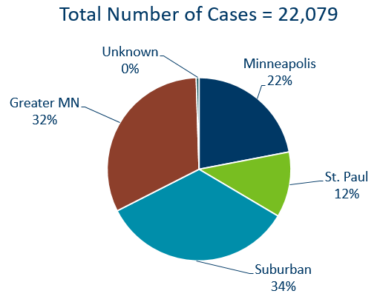
Chlamydia Infections by Residence at Diagnosis
Minnesota, 2022
Suburban = Seven-county metro area including Anoka, Carver, Dakota, Hennepin (excluding Minneapolis), Ramsey (excluding St. Paul), Scott, and Washington counties. Greater MN = All other Minnesota counties outside the seven-county metro area.
Notes:
All areas of Minnesota are affected by chlamydia. About a third of the cases occurred in the cities of Minneapolis and St. Paul, a third in the Suburban area surround the cities, and a third in Greater Minnesota.

Slide 42
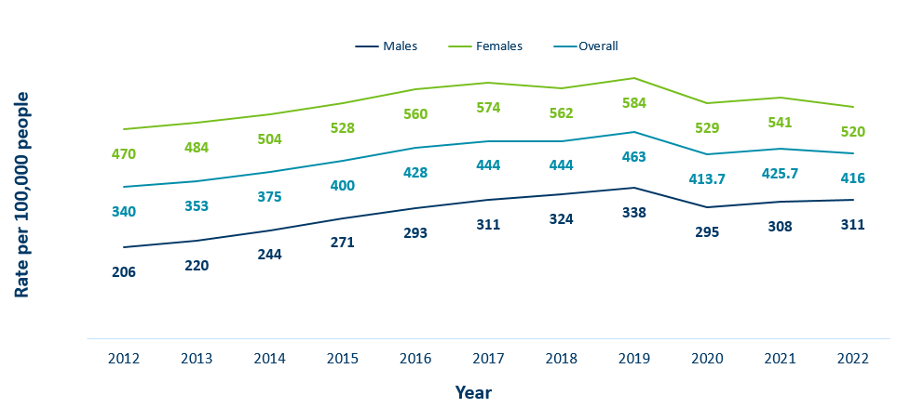
Chlamydia Rates by Gender
Minnesota, 2012-2022
 | 2012 | 2013 | 2014 | 2015 | 2016 | 2017 | 2018 | 2019 | 2020 | 2021 | 2022
Males | 206 | 220 | 244 | 271 | 293 | 311 | 324 | 338 | 295 | 308 | 311
Females | 470 | 484 | 504 | 528 | 560 | 574 | 562 | 584 | 529 | 541 | 520
Overall | 340 | 353 | 375 | 400 | 428 | 444 | 444 | 463 | 413.7 | 425.7 | 416
Notes:
The rates of chlamydia increased for males and decreased for females in 2022.
Females continue to have higher rates of chlamydia than males. Males had a rate of 311 per 100,000 which is a increase of 1% over the 2021 rate of 308 per 100,000.
Females had a rate of 520 per 100,000 which is a decrease of 4% from 2021 rate of 541 per 100,000.

Slide 43
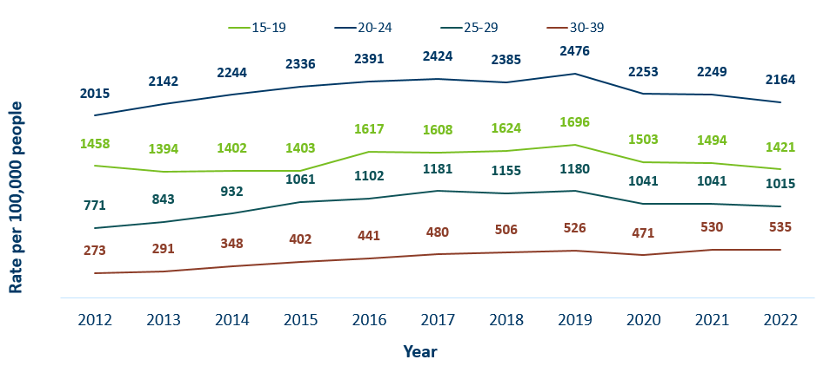
Chlamydia Rates by Age
Minnesota, 2012-2022
 | 2012 | 2013 | 2014 | 2015 | 2016 | 2017 | 2018 | 2019 | 2020 | 2021 | 2022
15-19 | 1458 | 1394 | 1402 | 1403 | 1617 | 1608 | 1624 | 1696 | 1503 | 1494 | 1421
20-24 | 2015 | 2142 | 2244 | 2336 | 2391 | 2424 | 2385 | 2476 | 2253 | 2249 | 2164
25-29 | 771 | 843 | 932 | 1061 | 1102 | 1181 | 1155 | 1180 | 1041 | 1041 | 1015
30-39 | 273 | 291 | 348 | 402 | 441 | 480 | 506 | 526 | 471 | 530 | 535
Notes:
The highest rate remains in the 20-24 year old age group at 2,164 per 100,000.
The next highest rate remains in the 15-19 year old age group at 1,421 per 100,000.

Slide 44
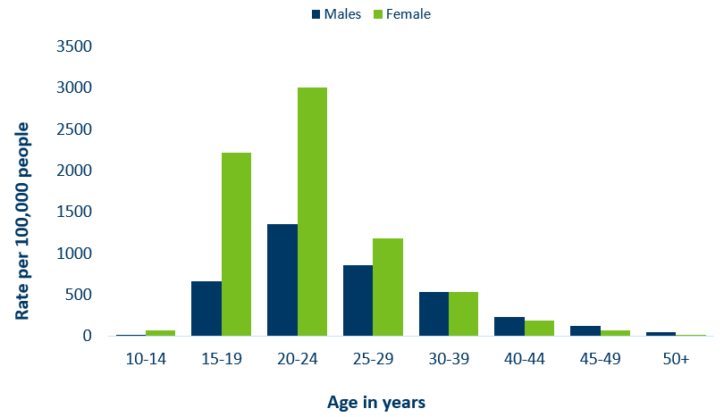
Age-Specific Chlamydia Rates by Gender,
Minnesota, 2022
Data: STD Surveillance Report Data Tables, Minnesota 2022 (PDF)
Notes:
The rates of Chlamydia are highest among females.
Females, 20-24 years of age continue to have the highest rate at 3001 per 100,000.
Males aged 45-49 reported the largest increase of over 13% when compared to 2021.

Slide 45
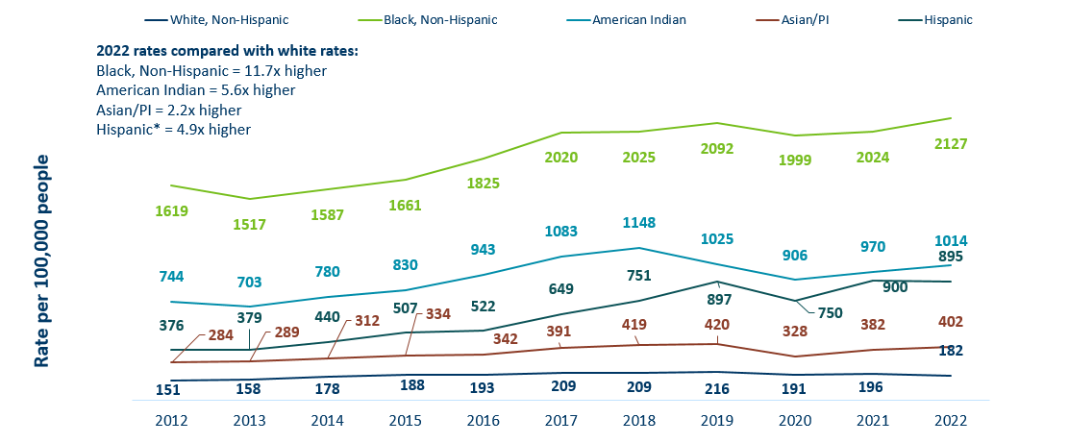
Chlamydia Rates by Race/Ethnicity Minnesota, 2012-2022 (1/2)
 | 2012 | 2013 | 2014 | 2015 | 2016 | 2017 | 2018 | 2019 | 2020 | 2021 | 2022
White, Non-Hispanic | 151 | 158 | 178 | 188 | 193 | 209 | 209 | 216 | 191 | 196 | 182
Black, Non-Hispanic | 1619 | 1517 | 1587 | 1661 | 1825 | 2020 | 2025 | 2092 | 1999 | 2024 | 2127
American Indian | 744 | 703 | 780 | 830 | 943 | 1083 | 1148 | 1025 | 906 | 970 | 1014
Asian/PI | 284 | 289 | 312 | 334 | 342 | 391 | 419 | 420 | 328 | 382 | 402
Hispanic | 376 | 379 | 440 | 507 | 522 | 649 | 751 | 897 | 750 | 900 | 895
Notes:
There continues to be great disparities in rates of chlamydia.
The Black/African American, non-Hispanic population has rates that are 11.7 times higher than that of white rates.
The rate in the Black/African American, non-Hispanic population was 2127 per 100,000 compared to the rate in the White, non-Hispanic population at 182 per 100,000.
The American Indian population had a rate that was 5.6 times higher at 1014 per 100,000
The Asian/Pacific Islander population had a rate that was 2.2 times higher at 402 per 100,000
The Hispanic/Latino population, which can be of any race, had a rate that was 4.9 times higher at 895 per 100,000

Slide 46
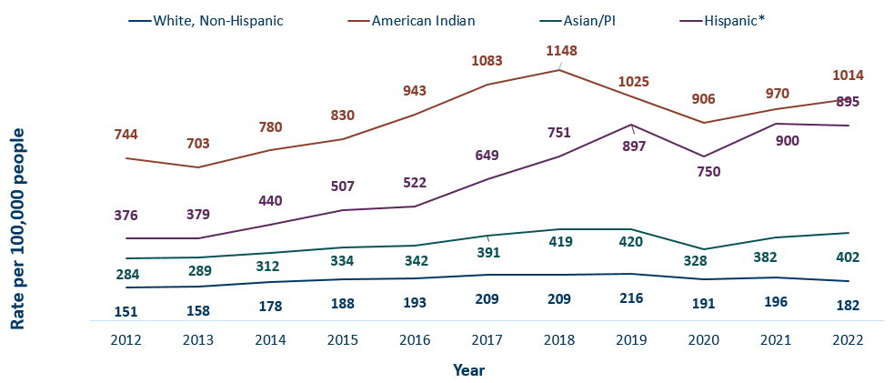
Chlamydia Rates by Race/Ethnicity, Minnesota, 2012-2022 (2/2)
 | 2012 | 2013 | 2014 | 2015 | 2016 | 2017 | 2018 | 2019 | 2020 | 2021 | 2022
White, Non-Hispanic | 151 | 158 | 178 | 188 | 193 | 209 | 209 | 216 | 191 | 196 | 182
American Indian | 744 | 703 | 780 | 830 | 943 | 1083 | 1148 | 1025 | 906 | 970 | 1014
Asian/PI | 284 | 289 | 312 | 334 | 342 | 391 | 419 | 420 | 328 | 382 | 402
Hispanic* | 376 | 379 | 440 | 507 | 522 | 649 | 751 | 897 | 750 | 900 | 895
Notes:
This is a clearer view of the rates from the previous slide, removing the Black/African American, non-Hispanic data.

Slide 47
Chlamydia and Gonorrhea Among Adolescents and Young Adults
(15-24 years of age)
Minnesota Department of Health STD Surveillance System

Slide 48
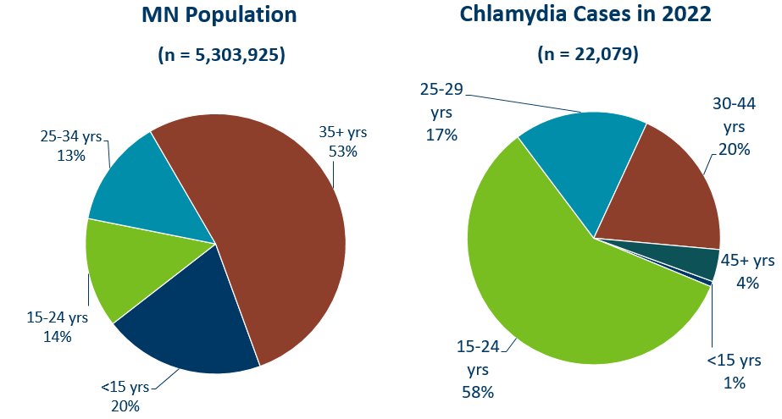
Chlamydia Disproportionately Impacts Youth and Young Adults
Data (right): STD Surveillance Report Data Tables, Minnesota 2022 (PDF)
Notes:
Chlamydia continues to disproportionately impact youth and young adults.
15–24-year-olds make up only 14% of the population, but account for 59% of all chlamydia cases reported.
MN Population Data:
(n=5,303,925)
<15 yrs: 20%
15-24 yrs: 14%
25-34: 13%
35+ yrs: 53%

Slide 49
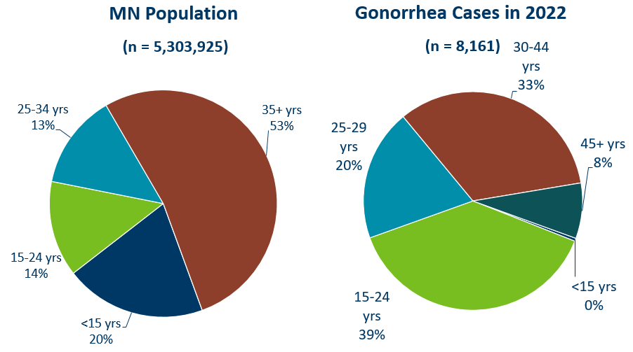
Gonorrhea Disproportionately Impacts Youth and Young Adults
Data (right): STD Surveillance Report Data Tables, Minnesota 2022 (PDF)
Notes:
Gonorrhea also disproportionately impacts youth and young adults.
Again 15–24-year-olds make up only 14% of the population, but account for 38% of all gonorrhea cases reported.
MN Population Data:
(n=5,303,925)
<15 yrs: 20%
15-24 yrs: 14%
25-34: 13%
35+ yrs: 53%

Slide 50
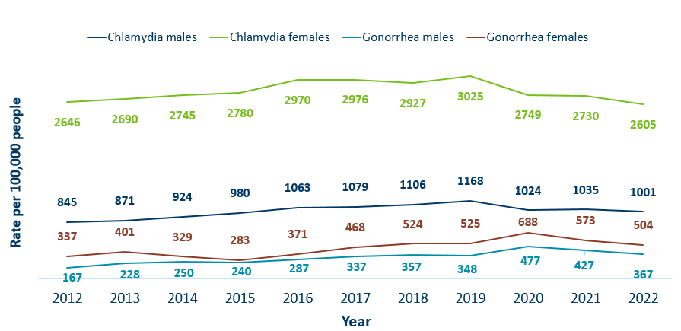
Chlamydia and Gonorrhea Rates Among Adolescents & Young Adults† by Gender in Minnesota, 2012-2022
 | 2012 | 2013 | 2014 | 2015 | 2016 | 2017 | 2018 | 2019 | 2020 | 2021 | 2022
Chlamydia males | 845 | 871 | 924 | 980 | 1063 | 1079 | 1106 | 1168 | 1024 | 1035 | 1001
Chlamydia females | 2646 | 2690 | 2745 | 2780 | 2970 | 2976 | 2927 | 3025 | 2749 | 2730 | 2605
Gonorrhea males | 167 | 228 | 250 | 240 | 287 | 337 | 357 | 348 | 477 | 427 | 367
Gonorrhea females | 337 | 401 | 329 | 283 | 371 | 468 | 524 | 525 | 688 | 573 | 504
Rate = Cases per 100,000 people based on 2010 U.S. Census counts.
† Adolescents defined as 15-19 year-olds; Young Adults defined as 20-24 year-olds.
Notes:
The rates of chlamydia and gonorrhea are higher in females compared to males in the 15–24-year-old age group.
The rates for chlamydia in females are 2605 per 100,000 population compared to males at 1001 per 100,000 population.
The rates of gonorrhea in females is 504 per 100,000 compared to 367 per 100,000 in males

Slide 51
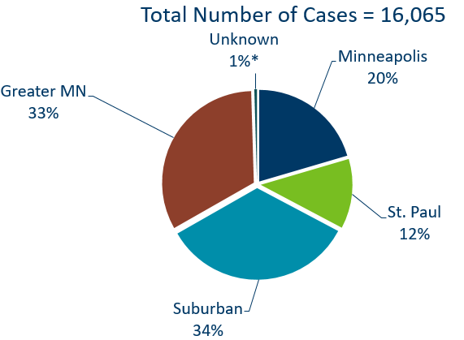
Geographic Characteristics of Adolescents and Young Adults † Diagnosed with Chlamydia or Gonorrhea, Minnesota 2022
Suburban = Seven-county metro area including Anoka, Carver, Dakota, Hennepin (excluding Minneapolis), Ramsey (excluding St. Paul), Scott, and Washington counties. Greater MN = All other Minnesota counties outside the seven-county metro area.
† Adolescents defined as 15-19 year-olds; Young Adults defined as 20-24 year-olds.
Notes:
In adolescents and young adults diagnosed with chlamydia or gonorrhea in 2022, about one-third (32%) reside in Minneapolis or St. Paul, one-third (33%) in Greater MN and one-third (34%) in the seven-county metro region.

Slide 52
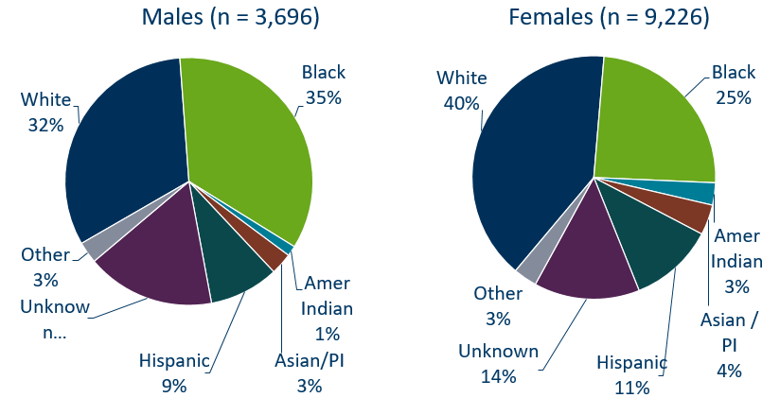
Chlamydia Cases Among Adolescents and Young Adults† by Gender and Race, Minnesota, 2022
† Adolescents defined as 15-19 year-olds; Young Adults defined as 20-24 year-olds
* Other is more than one race. Excludes 1 transgender person
Data: STD Surveillance Report Data Tables, Minnesota 2022 (PDF)
Notes:
There is a large number of chlamydia cases among adolescents and young adults that are missing race/ethnicity when reported.
The use of electronic lab reporting has increased missing variables.

Slide 53
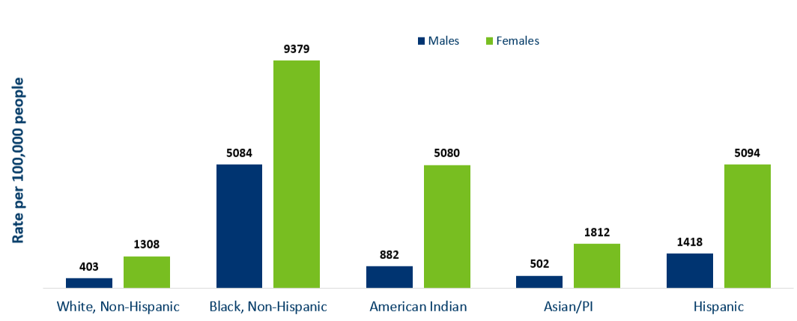
Chlamydia Rates Among Adolescents and
Young Adults† by Race, Minnesota, 2022
Rate=Cases per 100,000 people based on 2010 U.S. Census counts.
† Adolescents defined as 15-19 year-olds; Young Adults defined as 20-24 year-olds.
Data: STD Surveillance Report Data Tables, Minnesota 2022 (PDF)
Notes:
The highest rates among adolescents and young adults are among females in the Black, non-Hispanic community. Their rate is 9,739 per 100,000 compared to 1308 in white, non-Hispanic youth and young adults.
Black, non-Hispanic males also have the highest rates among adolescent and young adult males at 5,084 per 100,000 population, compared to 403 in the white, non-Hispanic population.
Young females have the highest rates of chlamydia in all races.

Slide 54
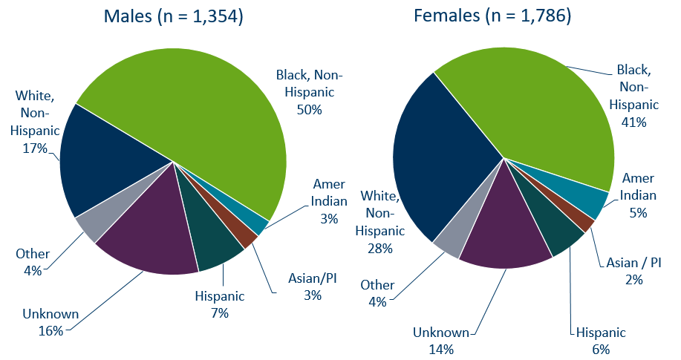
Gonorrhea Cases Among Adolescents and Young Adults† by Gender and Race, 2022
† Adolescents defined as 15-19 year-olds; Young adults defined as 20-24 year-olds. Excludes unknown/transgender/missing.
Data: STD Surveillance Report Data Tables, Minnesota 2022 (PDF)
Notes:
Black, Non-Hispanic males make up 50% of gonorrhea cases in male adolescent and young adults and 41% of gonorrhea cases in Black, Non-Hispanic females.

Slide 55
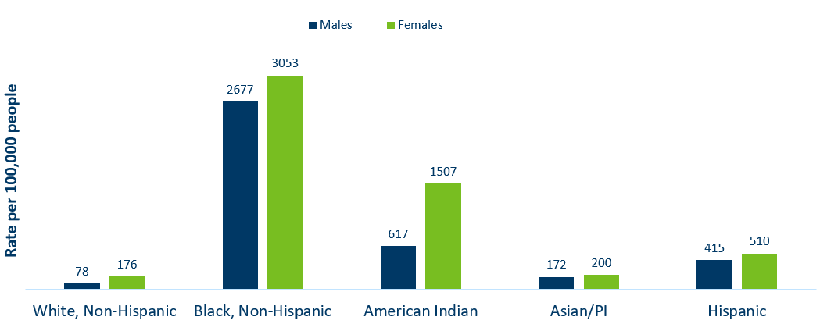
Gonorrhea Rate Among Adolescents and Young Adults† by Race, Minnesota, 2022
 | White, Non-Hispanic | Black, Non-Hispanic | American Indian | Asian/PI | Hispanic
Males | 78 | 2677 | 617 | 172 | 415
Females | 176 | 3053 | 1507 | 200 | 510
†Adolescents defined as 15-19 year-olds; Young Adults defined as 20-24 year-olds.
Rate = Cases per 100,000 people based on 2010 U.S. Census counts.
Notes:
Black, non-Hispanic and American Indian males and female adolescents and young adults are disproportionately affected by gonorrhea.

Slide 56
Burden of STDs on Young Females and Communities of Color
Females and particularly females of color disproportionately bear the long-term consequences of STDs.
  68% of chlamydia or gonorrhea cases diagnosed among adolescents and young adults were females.
  30% of all chlamydia or gonorrhea cases diagnosed among adolescents and young adults were in the Black, non-Hispanic population.
People with vulvas are biologically more prone to contracting an STD, but less likely to have symptoms. Untreated STDs can have serious consequences on their health and future reproductive ability.
  Untreated STDs in people with vulvas can lead to pelvic inflammatory disease, infertility and ectopic pregnancy.
  Pregnant people are at risk of passing a STDs to their newborn, causing premature delivery, infant pneumonia and blindness.
  Importance of annual preventive and prenatal screening
Notes:
Women and particularly women of color disproportionately bear the long-term consequences of STDs.
68% of chlamydia or gonorrhea cases diagnosed among adolescents and young adults were females.
30% of all chlamydia or gonorrhea cases diagnosed among adolescents and young adults were in the Black, non-Hispanic population.
Women are biologically more prone to contracting a STD, but less likely to have symptoms. Untreated STDs can have serious consequences on their health and future reproductive ability.
Untreated STDs in women can lead to pelvic inflammatory disease, infertility and ectopic pregnancy.
Women are at risk of passing a STDs to their newborn, causing premature delivery, infant pneumonia and blindness.
This highlights the importance of annual preventive and prenatal screening.

Slide 57
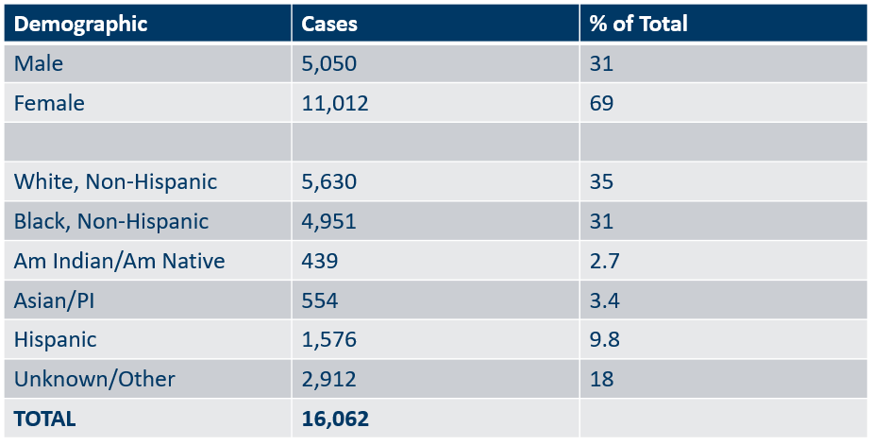
Summary Characteristics of Adolescents and Young Adults†
Diagnosed With Chlamydia or Gonorrhea in 2022
Demographic | Cases | % of Total
Male | 5,050 | 31
Female | 11,012 | 69
White, Non-Hispanic | 5,630 | 35
Black, Non-Hispanic | 4,951 | 31
Am Indian/Am Native | 439 | 2.7
Asian/PI | 554 | 3.4
Hispanic | 1,576 | 9.8
Unknown/Other | 2,912 | 18
TOTAL | 16,062
† Adolescents defined as 15-19 year-olds; young adults defined as 20-24 year-olds, excludes 4 transgender + 22 missing/unknown
Notes:
In adolescents and young adults, the majority of chlamydia and gonorrhea cases are females (68%) .
A little over one-third (36%) are white, non-Hispanic followed by about one-third (30%) that are black, non-Hispanic. 19% were unknown or more than one race.
Adolescents and young adults accounted for 60% of chlamydia and 37% of gonorrhea cases diagnosed in Minnesota.

Slide 58
What’s Being Done in Minnesota?
The MDH Partner Services Program continues to follow up on early syphilis cases and their sex partners and all pregnant syphilis cases.
All HIV/syphilis co-infected cases are assigned to Partner Services for follow-up.
Physicians are encouraged to screen men who have sex with men at least annually and to ask about sex partners.
All pregnant females should be screened for syphilis at first prenatal visit, 28 weeks’ gestation (at minimum 28-36 weeks), and at delivery.

Slide 59
Summary of STD Trends in Minnesota
From 2012-2022, the chlamydia rate increased by 22%. The rate of gonorrhea increased by 165%, syphilis has increased by 447%.
Adolescent and young females aged 15-24 years old continue to make up the majority of all chlamydia or gonorrhea cases at 53%.
Syphilis has resurged in MN over the past decade, with MSM and those co-infected with HIV being especially impacted. However, the number of females impacted is near the record high for the last decade.
People of color continue to be disproportionately affected by all STDs in Minnesota. Disparities in the rates of STDs are not explained by differences in sexual behavior, but are due to differences in health insurance coverage, employment status and access to healthcare with preventative, screening, and treatment services.
Notes:
From 2012-2022, the chlamydia rate increased by 22%. The rate of gonorrhea increased by 165% syphilis has increased by 447%.
Adolescent and young females aged 15-24 years old continue to make up the majority of all chlamydia or gonorrhea cases at 53%.
Minnesota has seen a resurgence of syphilis over the past decade, with men who have sex with men and those co-infected with HIV being especially impacted. However, the number of females impacted is near the record high for the last decade.
people of color continue to be disproportionately affected by all STDs in Minnesota and nationwide. Disparities in the rates of STDs are not explained by differences in sexual behavior, but are due to differences in health insurance coverage, employment status and access to healthcare with preventative, screening and treatment services.

Slide 60
Health Watch: Disseminated Gonococcal Infection (DGI) (1/2)
9 cases of disseminated gonococcal infections (DGI) diagnosed in MN in 2022.
DGI occurs when a gonorrhea infection moves into the bloodstream and spreads to distant sites in the body, which can lead to clinical findings: septic arthritis, polyarthralgia, tenosynovitis, petechial/pustular lesions, bacteremia, or rarely: endocarditis or meningitis.
DGI is uncommon and occurs in 0.5-3% of untreated cases.
If there is clinical suspicion for DGI, nucleic acid amplification test (NAAT) & culture specimens from urogenital and extra-genital (e.g., pharyngeal and rectal) mucosal site(s), as applicable, should be collected and processed, in addition to culture specimens from disseminated sites of infection (e.g., skin, synovial, blood, CSF).
Source: Health Alert Template for Disseminated Gonococcal Infection (DGI) (https://www.cdc.gov/std/program/outbreakresources/HANtemplate-dgi.htm)
Notes:
9 cases of disseminated gonococcal infections (DGI) were diagnosed in Minnesota in 2021.
DGI occurs when a gonorrhea infection moves into the bloodstream and spreads to distant sites in the body, which can lead to clinical findings, such as septic arthritis, polyarthralgia, tenosynovitis, petechial/pustular lesions, bacteremia, or on rare occasions endocarditis or meningitis.
DGI is uncommon and occurs in 0.5-3% of untreated cases.
Report all laboratory confirmed cases of DGI or concern over persistent infection to MDH within 24 hours of identification. Also please call MDH when these cases are identified at 651-201-5414.
Management of DGI cases should be guided by the CDC STD Treatment Guidelines.

Slide 61
Health Watch: Disseminated Gonococcal Infection (DGI) (2/2)
Report all laboratory confirmed cases of DGI or concern over persistent infection to MDH within 24 hours of identification at 651-201-5414.
All DGI cases should be cultured and tested for antimicrobial susceptibility. Please contact MDH for guidance on sending samples to the MDH Lab for additional testing.
Management of DGI cases should be guided by the STI Treatment Guidelines (https://www.cdc.gov/std/treatment-guidelines/default.htm)
Source: Health Alert Template for Disseminated Gonococcal Infection (DGI) (https://www.cdc.gov/std/program/outbreakresources/HANtemplate-dgi.htm)
Notes:
8 cases of disseminated gonococcal infections (DGI) were diagnosed in Minnesota in 2021.
DGI occurs when a gonorrhea infection moves into the bloodstream and spreads to distant sites in the body, which can lead to clinical findings, such as septic arthritis, polyarthralgia, tenosynovitis, petechial/pustular lesions, bacteremia, or on rare occasions endocarditis or meningitis.
DGI is uncommon and occurs in 0.5-3% of untreated cases.
Report all laboratory confirmed cases of DGI or concern over persistent infection to MDH within 24 hours of identification. Also please call MDH when these cases are identified at 651-201-5414.
Management of DGI cases should be guided by the CDC STD Treatment Guidelines.

Slide 62
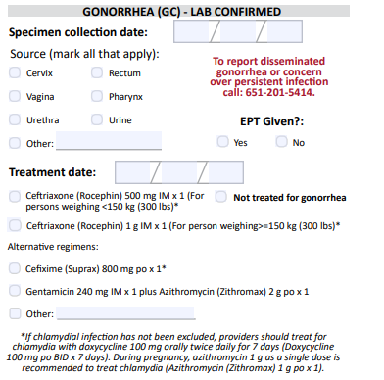
Updates to STD Reporting and Current Follow-Up
A new chlamydia and gonorrhea case report form is available on the MDH website, to accommodate changes in treatment guidelines and highlight DGI reporting.
The case report form can be filled out and mailed or faxed to MDH at 1-800-298-3775.
More information may be requested on gonorrhea cases for Enhanced Gonorrhea Surveillance as part of the CDC PCHD grant.
All cases co-infected with early syphilis will continue to be assigned to MDH Partner Services for follow-up.
All STD cases continue to have the potential for being contacted by MDH for additional follow-up.
Notes:
A new Chlamydia and Gonorrhea case report form is available on the MDH website, to accommodate changes in treatment guidelines and highlight DGI reporting.
The case report form can be filled out and mailed or faxed to MDH at 1-800-298-3775.
More information may be requested on gonorrhea cases for Enhanced Gonorrhea Surveillance as part of the CDC PCHD grant.
All cases co-infected with Early Syphilis will continue to be assigned to MDH Partner Services for follow-up.
All STD cases continue to have the potential for being contacted by MDH for additional follow-up.

