Slide 1
Sexually Transmitted Disease (STD) Surveillance Report, 2020
Minnesota Department of Health STD Surveillance System

Slide 2
Introduction 1/2
Under Minnesota law, physicians and laboratories are required to report all laboratory-confirmed cases of chlamydia, gonorrhea, syphilis, and chancroid to the Minnesota Department of Health (MDH) within one working day.
The MDH does not maintain statistics for other, non-reportable STDs (ex: herpes, HPV/genital warts).
This slide set describes trends in reportable STDs in Minnesota by person, place, and time.
Analyses exclude cases reported from federal and private prisons.

Slide 3
Introduction 2/2
STD surveillance is the systematic collection of data from cases for the purpose of monitoring the frequency and distribution of STDs in a given population.
STD surveillance data are used to detect problems, prioritize resources, develop and target interventions, and evaluate the effectiveness of interventions.

Slide 4
Interpreting STD Surveillance Data 1/2
Factors that impact the completeness and accuracy of STD data include:
  Level of STD screening by healthcare providers
  Individual test-seeking behavior
  Sensitivity of diagnostic tests
  Compliance with case reporting
  Completeness of case reporting
  Timeliness of case reporting
Increases and decreases in STD rates can be due to actual changes in disease occurrence and/or changes in one or more of the above factors.
COVID-19 stay-at-home orders likely played a role in the number of cases reported/diagnosed this past year.
Notes:
Factors that impact the completeness and accuracy of STD data include:
Level of STD screening by healthcare providers, individual test-seeking behavior, sensitivity of diagnostic tests, compliance with case reporting, completeness of case reporting, timeliness of case reporting.
Increases and decreases in STD rates can be due to actual changes in disease occurrence and/or changes in one or more of the above factors.
Important to note that COVID-19 lockdowns likely played a role in the number of cases reported or diagnosed this past year.

Slide 5
Interpreting STD Surveillance Data 2/2
The surveillance system only includes cases with a positive laboratory test. Cases diagnosed solely on symptoms are not counted.
Since 2012, we have included cases that had only a lab report and no corresponding case report form. This has increased the number of unknowns in some variables.
In 2020, the COVID-19 response accelerated the use of laboratory reporting by facilities, again increasing the number of unknown variables.
In 2018, in order to be consistent with CDC, we categorized all White, Hispanic and Black, Hispanic cases as Hispanic. That means the race categories now reflect only White, Non-Hispanic and Black, Non-Hispanic cases.
Surveillance data represent cases of infection, not individuals. A person with multiple infections in a given year will be counted more than once.
Caution is warranted when interpreting changes in STD numbers that can seem disproportionately large when the number of cases is small.

Slide 6
National Context

Slide 7
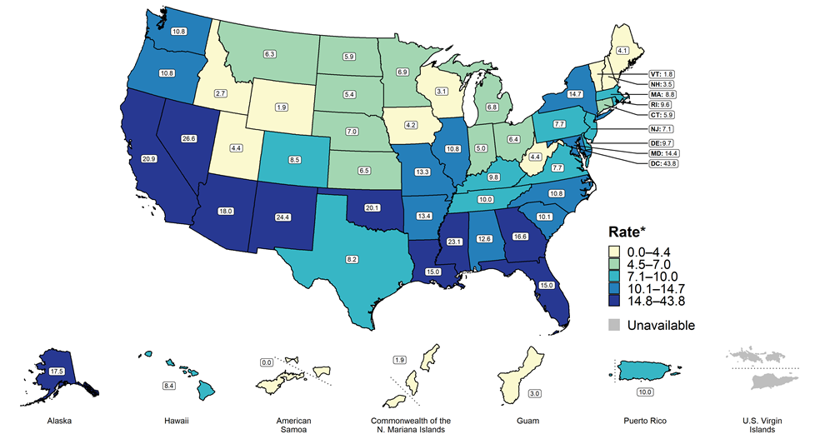
Primary and Secondary Syphilis — Rates of Reported Cases by State, United States and Territories, 2019
Notes:
Minnesota’s primary and secondary syphilis rate in 2019 was 6.9 per 100,000
This was lower than the national rate of 11.9 per 100,000

Slide 8
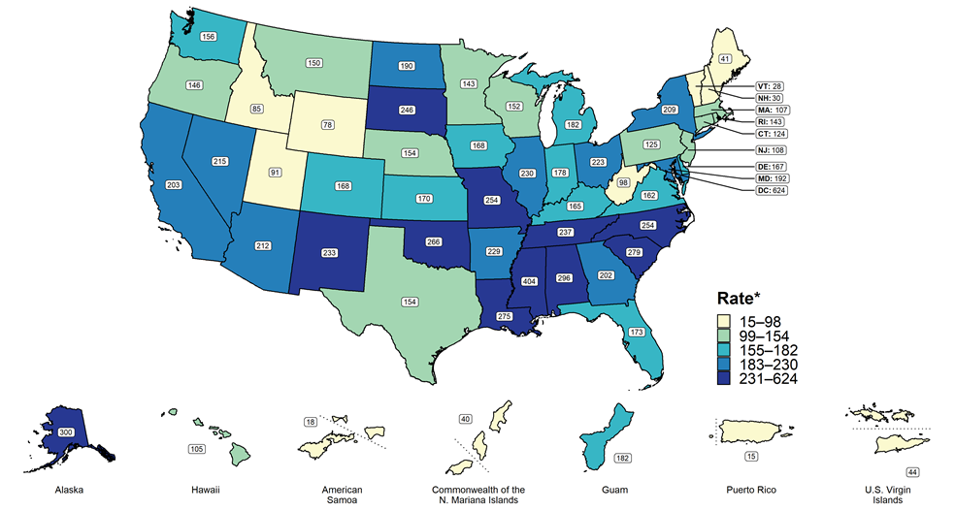
Gonorrhea — Rates of Reported Cases by State, United States and Territories, 2019
Notes:
Minnesota’s gonorrhea rate in 2019 was 143 per 100,000
This was lower than the national rate of 188.4 per 100,000

Slide 9
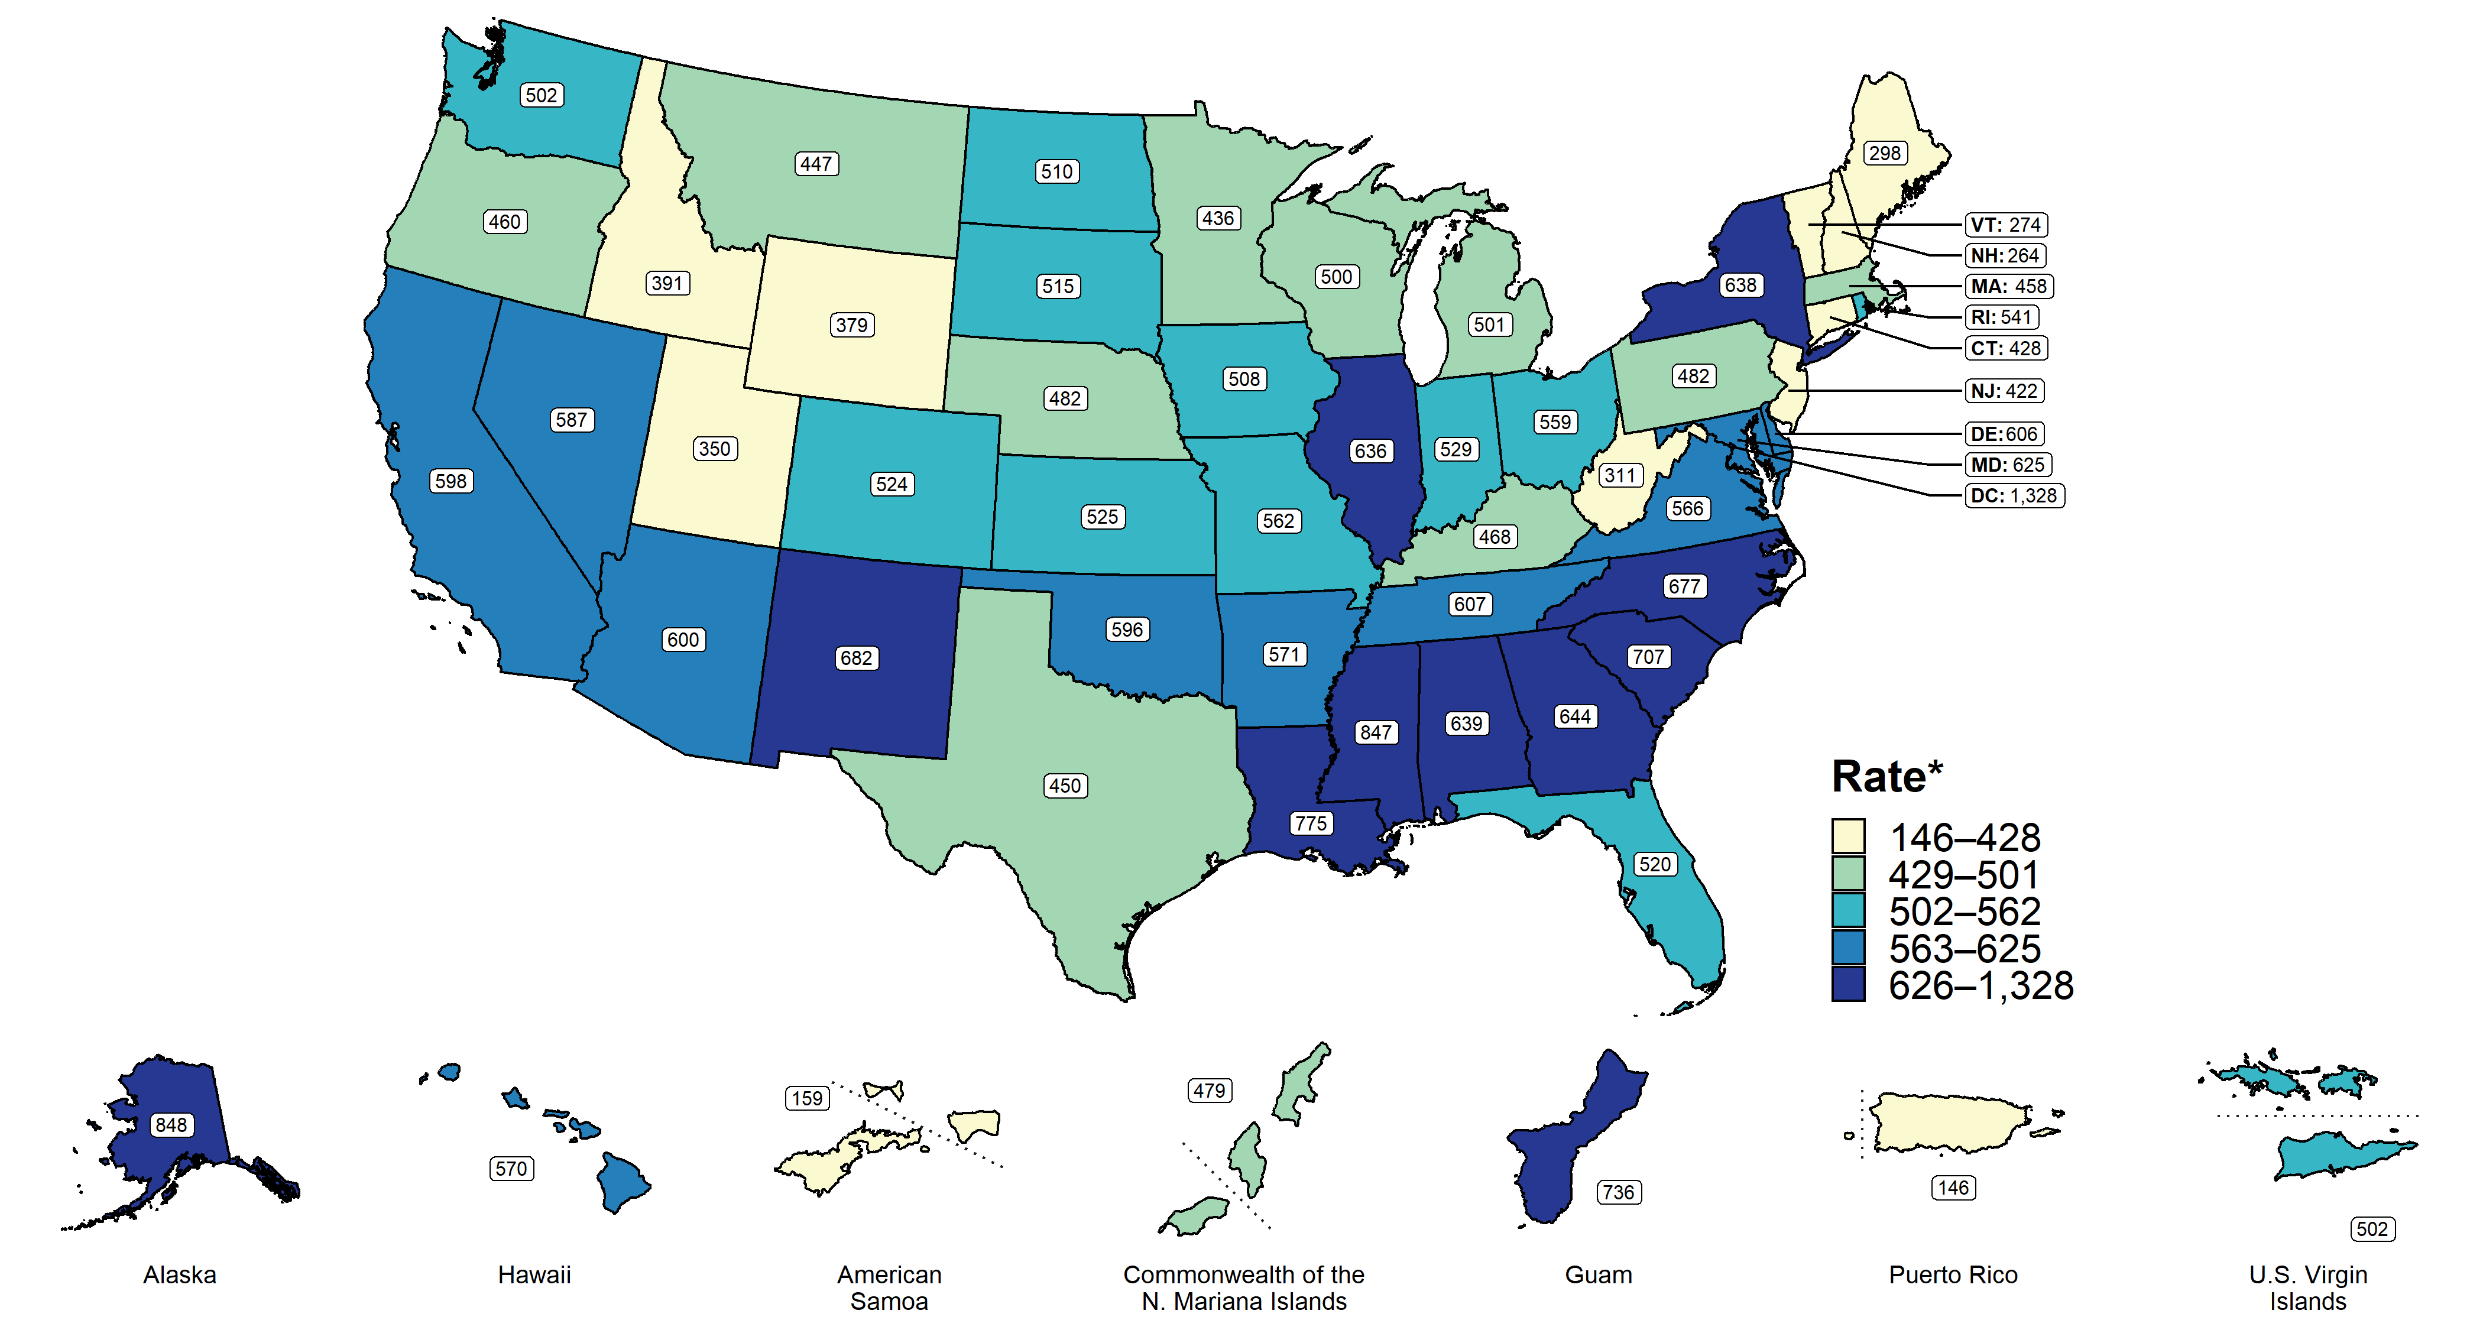
Chlamydia — Rates of Reported Cases by State, United States and Territories, 2019
Notes:
Minnesota’s chlamydia rate in 2019 was 436 per 100,000
This was lower than the national rate of 552.8 per 100,000

Slide 10
Overview of STDs in Minnesota

Slide 11
STDs in Minnesota:
Number of Cases Reported in 2020
Total of 33,252 STD cases reported to MDH in 2020:
  21,942 Chlamydia cases
  10,217 Gonorrhea cases
  1,093 Syphilis cases (all stages)
  0 Chancroid cases
Notes:
In the year 2020, a total of 33,252 STD cases were reported to the Minnesota Department of Health:
21,942 Chlamydia cases
10,217 Gonorrhea cases
1093 Syphilis cases (all stages)
0 Chancroid cases

Slide 12
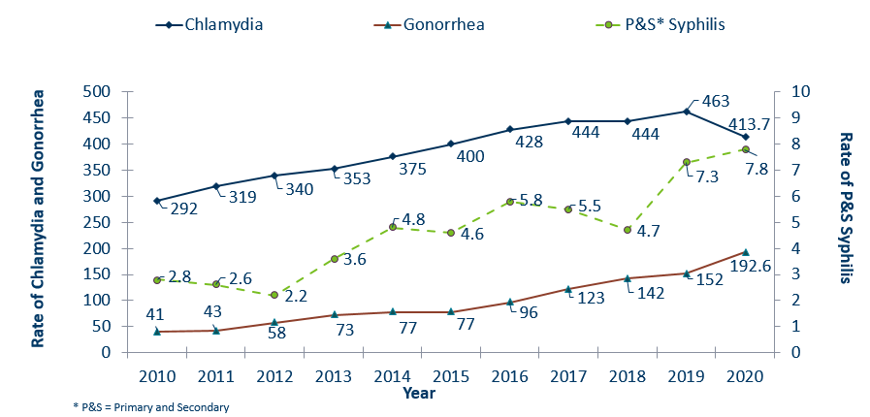
STDs in Minnesota:
Rate per 100,000 by Year of Diagnosis, 2010-2020
Notes:
The rate of chlamydia in MN decreased by 11% to 413.7 per 100,000 compared to 463 per 100,000 in 2019.
The rate of gonorrhea in MN increased 27% to 192.6 per 100,000 compared to 152 per 100,000 in 2019.
The rate of primary and secondary syphilis increased by 7% from 7.3 in 2019 to 7.8 per 100,000 in 2020.

Slide 13
Syphilis

Slide 14
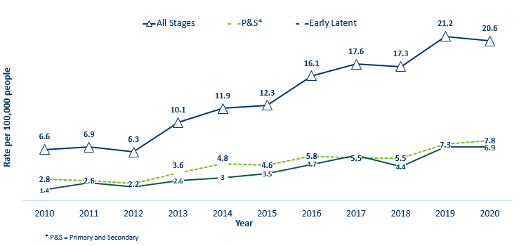
Syphilis Rates by Stage of Diagnosis
Minnesota, 2010-2020
Notes:
The overall syphilis rate is 20.6 per 100,000. A slight decrease from 2019, but a 211% increase from a decade ago.
Of concern is the rate of primary and secondary syphilis which is 7.8 per 100,000, a slight increase from 2019.

Slide 15
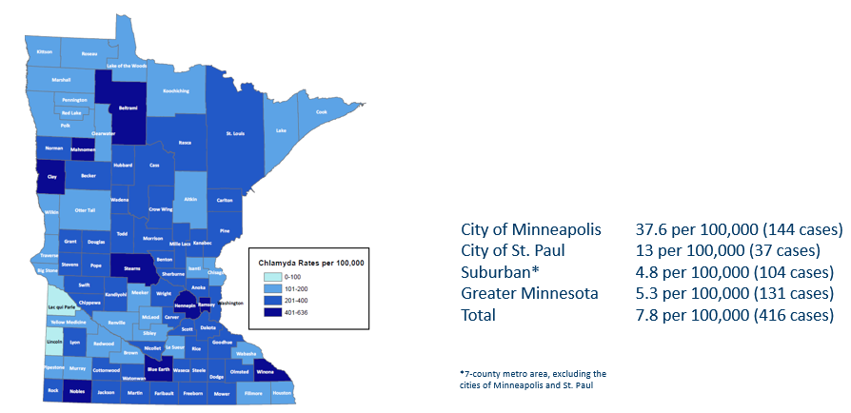
2020 Minnesota Primary & Secondary Syphilis Rates by County
Notes:
The statewide rate of primary and secondary syphilis increased slightly to 7.8 cases per 100,000 from 7.3.
Within the metro, the highest rate of primary and secondary syphilis remains in the City of Minneapolis at 37.6 cases per 100,000 population.
The City of St. Paul has the second highest rate in the metro at 13 per 100,000.

Slide 16
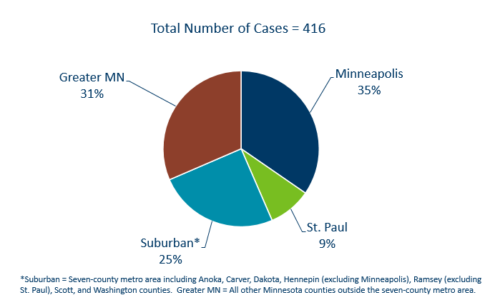
Primary & Secondary Syphilis Infections by Residence at Diagnosis
Minnesota, 2020
Notes:
The City of Minneapolis had the largest percent of all reported primary and secondary cases with 35%, second to Greater Minnesota with 31% of the cases.
The suburban area had 25% and St. Paul had 9%.

Slide 17
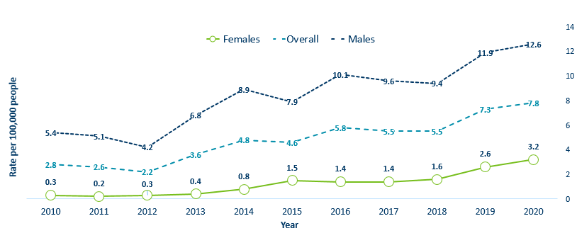
Primary & Secondary Syphilis Rates by Gender
Minnesota, 2010-2020
Notes:
Males have the highest rates of primary and secondary syphilis at 12.6 cases per 100,0000 population
The rate of primary and secondary syphilis in females is 3.2 per 100,000 per population.

Slide 18
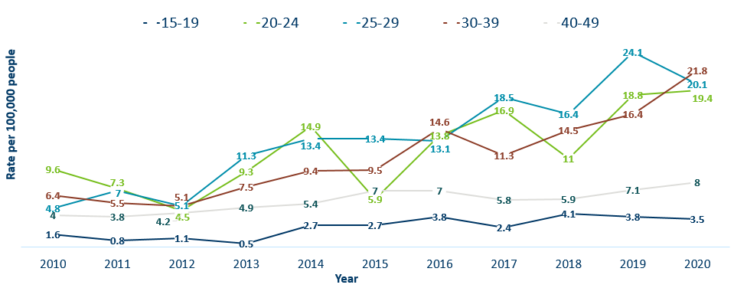
Primary & Secondary Syphilis Rates by Age
Minnesota, 2010-2020
Notes:
The highest rates of primary and secondary syphilis were in the 30-39 year old age group at 21.8 cases per 100,000 population, a 33% increase from 2019.
20-29 year olds and 20-24 had the next highest rate at 20.1 and 19.4 per 100,000, respectively.

Slide 19
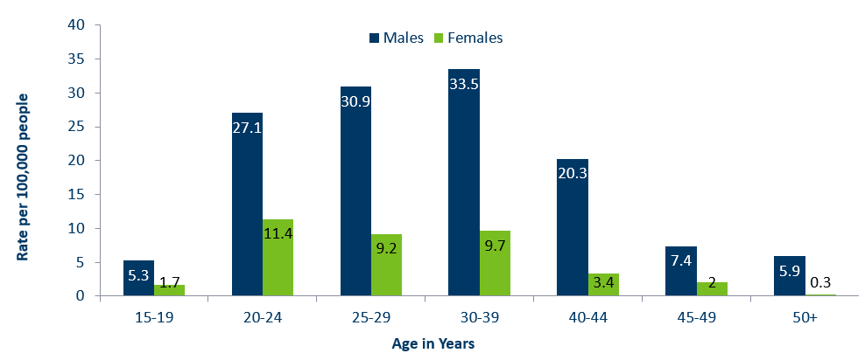
Age-Specific Primary & Secondary Syphilis Rates by Gender, Minnesota, 2020
Notes:
People assigned male at birth have higher rates of primary and secondary syphilis than females in all age groups. The rate in males is 4 times higher than females.
30-39 year old males had the highest rate at 33.5 per 100,000
20-24 year old females had the highest rate of the female population at 11.4 per 100,000.

Slide 20
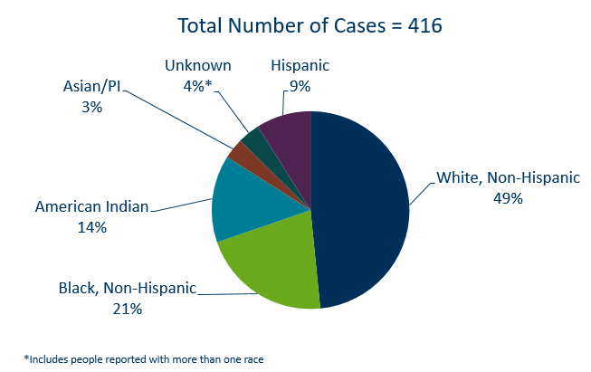
Primary & Secondary Syphilis Cases by Race
Minnesota, 2020

Slide 21
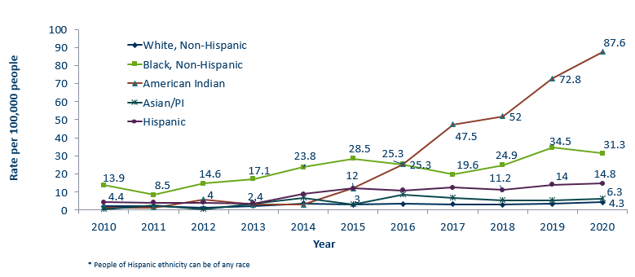
Primary & Secondary Syphilis Rates by Race/Ethnicity
Minnesota, 2010-2020

Slide 22
Gonorrhea

Slide 23
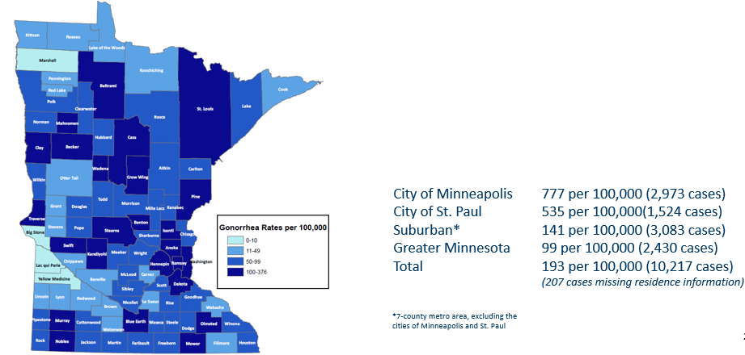
2020 Minnesota Gonorrhea Rates by County
Notes:
The rate of gonorrhea in MN reached an all time high at 193 per 100,000. This is a rate increase of 27% from 2019.
The city of Minneapolis continues to have the highest rates of gonorrhea at 777 per 100,000, followed by the city of St. Paul at 535 per 100,000, the suburban area (7-county metro excluding Minneapolis & St. Paul) at 141 per 100,000 and Greater Minnesota at 99 per 100,000.
The rates of gonorrhea increased in all areas across Minnesota.
The seven-county metro Suburban area had the highest increase at 37%, followed by the City of St Paul with 29%.
Greater Minnesota increased by 26% and the City of Minneapolis had the smallest increase of 13%.

Slide 24
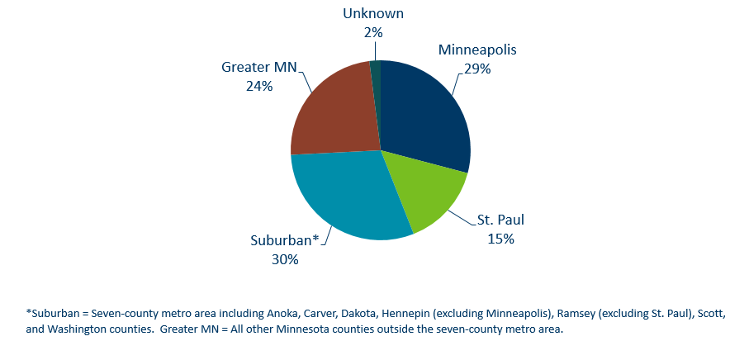
Gonorrhea Infections in Minnesota by Residence at Diagnosis, 2020
Notes:
All parts of Minnesota are affected by gonorrhea. The cities of Minneapolis and St. Paul reported 44% of the cases; followed by 30% in the Suburban area surrounding the cities, and 24% in Greater Minnesota.

Slide 25
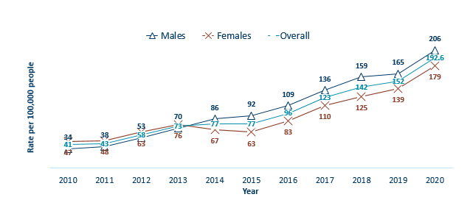
Gonorrhea Rates by Gender
Minnesota, 2010-2020
Notes:
The rates of gonorrhea went up in both people assigned male and female at birth in 2020. Males continue to have higher rates of gonorrhea than females, but the rate in females is increasing.
The males had a rate of 206 per 100,000 which is an increase of 25% over the 2019 rate of 165 per 100,000.
The females had a rate of 179 per 100,000 which is an increase of 29% over the 2019 rate of 139 per 100,000.

Slide 26
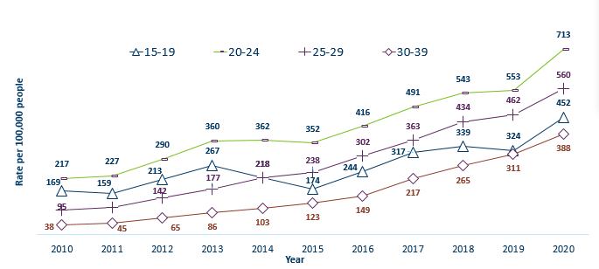
Gonorrhea Rates by Age
Minnesota, 2010-2020
Notes:
All age groups saw an increase in gonorrhea rates.
The highest rate remains in the 20–24-year-old age group at 713 per 100,000.
The 15–19-year-old age group had the largest rate increase from 324 in 2019 to 452 in 2020 a 40% increase.

Slide 27
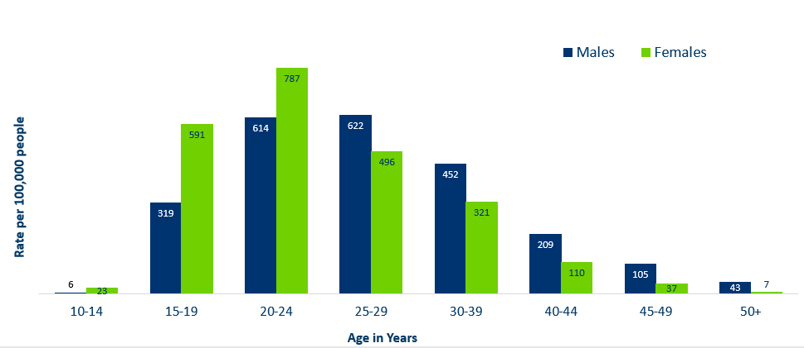
Age-Specific Gonorrhea Rates by Gender
Minnesota, 2020
Notes:
The rates of gonorrhea went up in both males and females for all age groups in 2020 compared to 2019.
Females under the age of 25 years of age, continue to have higher rates of gonorrhea than males.
Males record the highest rate among age groups older than 25 years.
The highest rates of gonorrhea are in females 20-24 at 787 per 100,000.

Slide 28
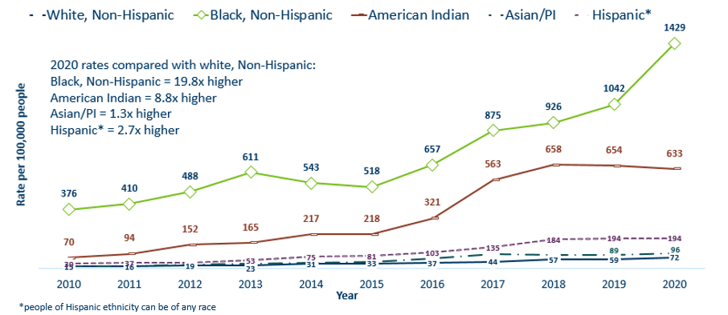
Gonorrhea Rates by Race/Ethnicity
Minnesota, 2010-2020 1/2

Slide 29
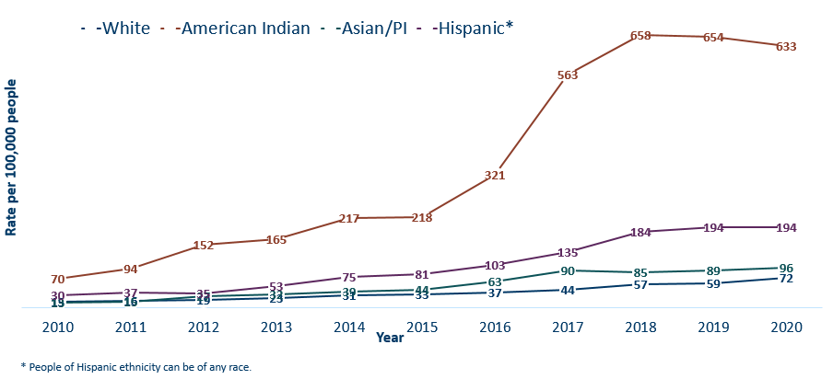
Gonorrhea Rates by Race/Ethnicity
Minnesota, 2010-2020 2/2
Notes:
This is a clearer view of the rates of Gonorrhea by Race/Ethnicity from the previous slide, after removing the Black/African American, Non-Hispanic data.

Slide 30
Chlamydia
Notes:
Chlamydia decreased for the first time since 2009. This could be the result of a true decrease in the number of cases, but it could also reflect the COVID-19 pandemic and reduced preventative visits. Chlamydia is more likely to be asymptomatic than gonorrhea and syphilis, especially in females.

Slide 31
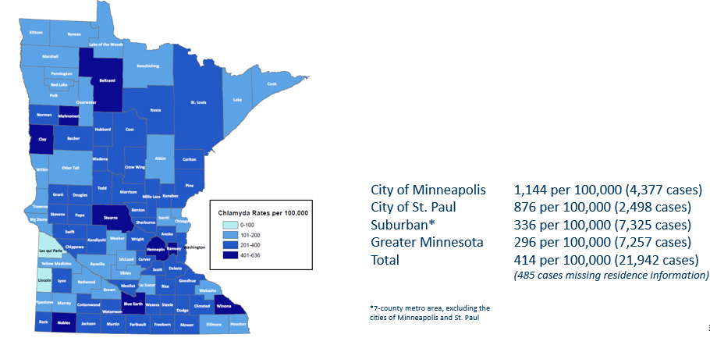
2020 Minnesota Chlamydia Rates by County
Notes:
Despite the decrease, all counties in Minnesota were affected by chlamydia. There were at least 4 cases in all counties in 2020.
The city of Minneapolis continues to have the highest rates of chlamydia at 1,144 per 100,000, followed by the city of St. Paul at 876 per 100,000, the suburban area (7-county metro excluding Minneapolis & St. Paul) at 336 per 100,000 and Greater Minnesota at 296 per 100,000.
All geographic areas saw a decrease in the rate of chlamydia reported in 2020 from 2019.

Slide 32
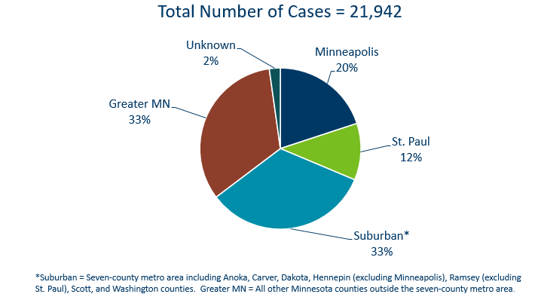
Chlamydia Infections by Residence at Diagnosis
Minnesota, 2020

Slide 33
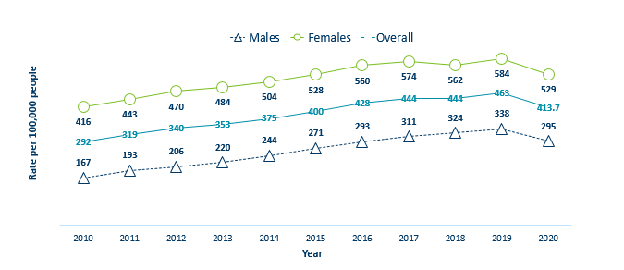
Chlamydia Rates by Gender
Minnesota, 2010-2020
Notes:
The rates of chlamydia decreased for both males and females in 2020.
Females continue to have higher rates of chlamydia than males. Males had a rate of 295 per 100,000 which is a decrease of 13% over the 2019 rate of 338 per 100,000.
Females had a rate of 529 per 100,000 which is a decrease of 9% from 2019 rate of 584 per 100,000.

Slide 34
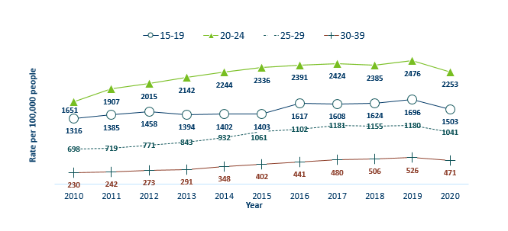
Chlamydia Rates by Age
Minnesota, 2010-2020
Notes:
The highest rate remains in the 20-24 year old age group at 2,253 per 100,000.
The next highest rate remains in the 15-19 year old age group at 1,503 per 100,000.
All age groups, except for 10-14 year olds with a rate of 43 per 100,000 decreased in 2020.

Slide 35
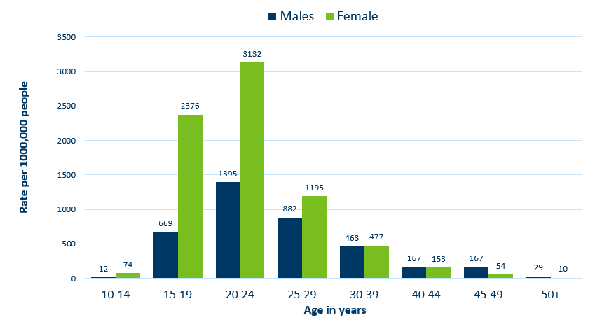
Age-Specific Chlamydia Rates by Gender
Minnesota, 2020
Notes:
The rates of Chlamydia are highest among females and females, 20-24 years of age continue to have the highest rate at 3132 per 100,000.
Females aged 40-44 were the only group that increased from 2019, by 4%.

Slide 36
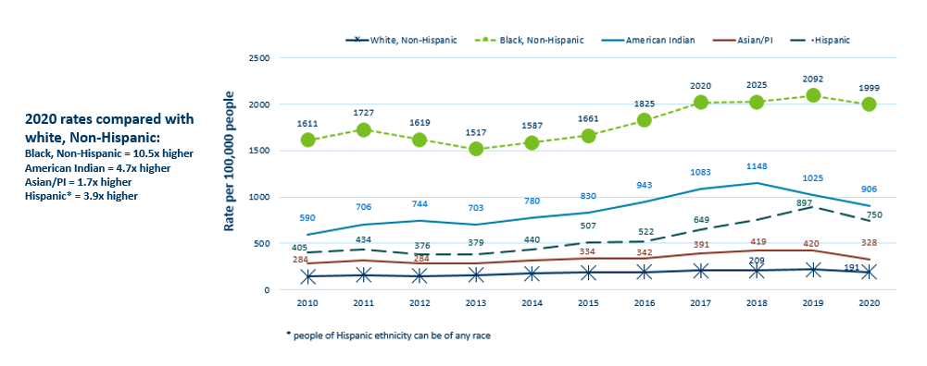
Chlamydia Rates by Race/Ethnicity
Minnesota, 2010-2020 1/2
Notes:
There continues to be great disparities in rates of chlamydia.
The Black/African American, non-Hispanic population has rates that are 10.5 times higher than that of whites.
The rate in the Black/African American, non-Hispanic population was 1,999 per 100,000 compared to the rate in the White, non-Hispanic population at 191 per 100,000.
The American Indian population had a rate that was 4.7 times higher at 906 per 100,000
The Asian/Pacific Islander population had a rate that was 1.7 times higher at 328 per 100,000
The Hispanic/Latino population, which can be of any race, had a rate that was 3.9 times higher at 750 per 100,000

Slide 37
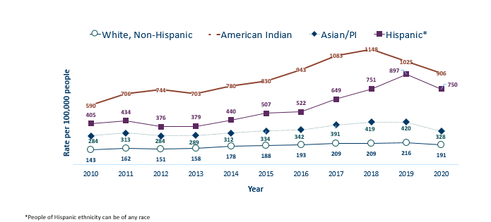
Chlamydia Rates by Race/Ethnicity
Minnesota, 2010-2020 2/2
Notes:
This is a clearer view of the rates from the previous slide, removing the Black/African American, non-Hispanic data.

Slide 38
Chlamydia and Gonorrhea Among Adolescents and Young Adults
(15-24 years of age)

Slide 39
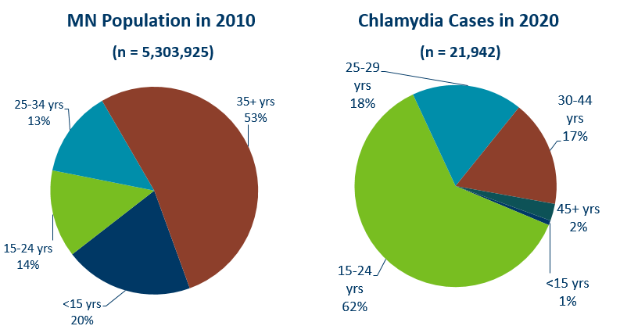
Chlamydia Disproportionately Impacts Youth and Young Adults
Notes:
Chlamydia continues to disproportionately impact youth and young adults.
15–24-year-olds make up only 14% of the population, but account for 62% of all chlamydia cases reported.

Slide 40
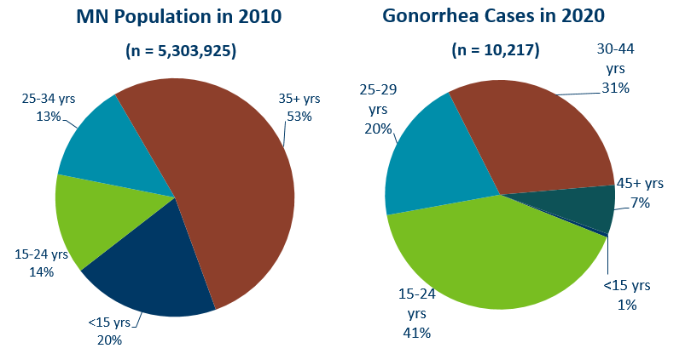
Gonorrhea Disproportionately Impacts Youth and Young Adults
Notes:
Gonorrhea also disproportionately impacts youth and young adults.
Again 15–24-year-olds make up only 14% of the population, but account for 41% of all gonorrhea cases reported.

Slide 41
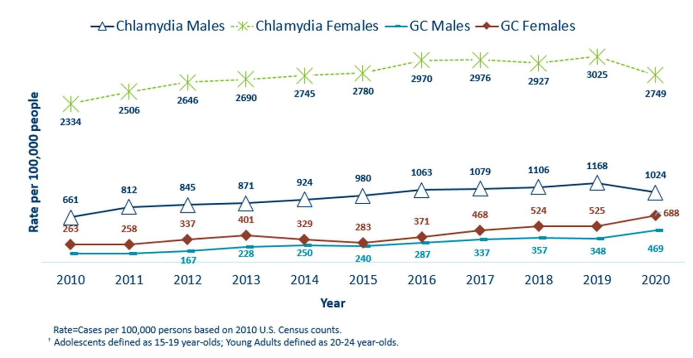
Chlamydia and Gonorrhea Rates Among Adolescents & Young Adults† by Gender in Minnesota, 2010-2020
Notes:
The rates of chlamydia and gonorrhea are higher in people assigned female at birth compared to people assigned male at birth in the 15–24-year-old age group.
The rates for chlamydia in females are 2749 per 100,000 population compared to males at 1024 per 100,000 population.
The rates of gonorrhea in females is 688 per 100,000 compared to 469 per 100,000 in males.

Slide 42
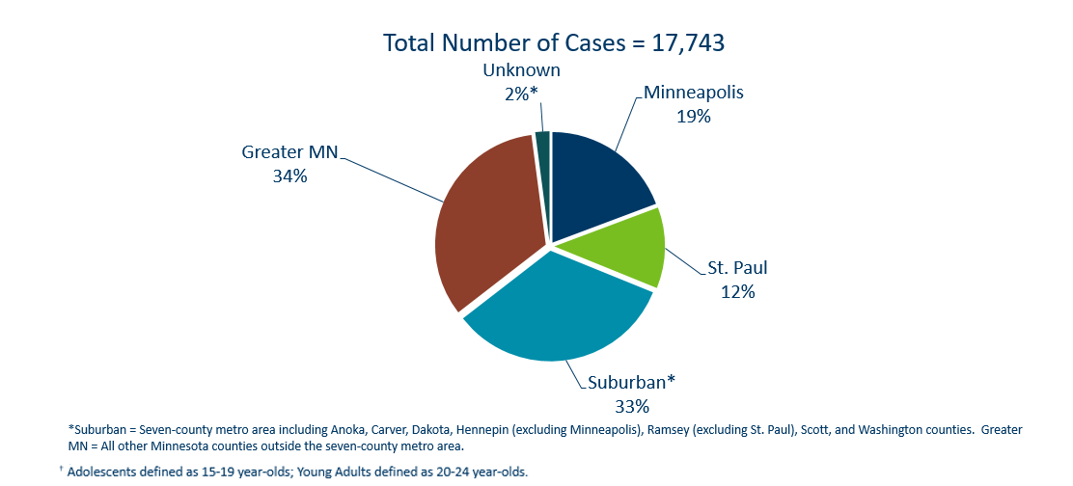
Geographic Characteristics of Adolescents and Young Adults † Diagnosed with Chlamydia or Gonorrhea, Minnesota 2020
Notes:
In adolescents and young adults diagnosed with chlamydia or gonorrhea in 2020, about one-third (31%) reside in Minneapolis or St. Paul, one-third (33%) in Greater MN and one-third (33%) in the seven-county metro region.

Slide 43
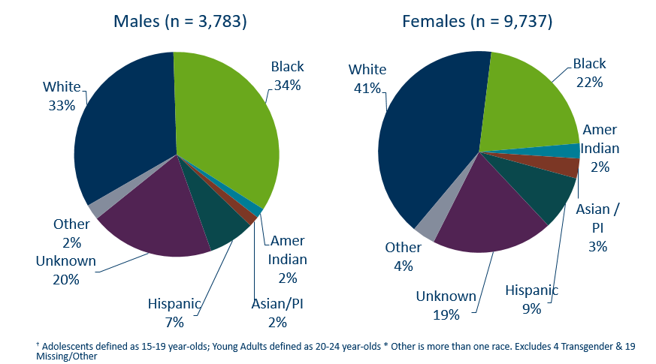
Chlamydia Cases Among Adolescents and Young Adults† by Gender and Race, Minnesota, 2020
Notes:
There is a large number of chlamydia cases among adolescents and young adults that are missing race/ethnicity when reported.
The use of electronic lab reporting has increased missing variables.

Slide 44
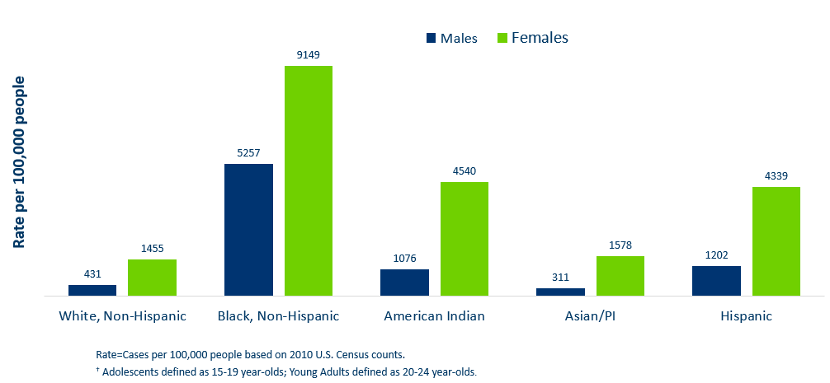
Chlamydia Rate Among Adolescents and
Young Adults† by Race, Minnesota, 2020
Notes:
The highest rates among adolescents and young adults are among females in the Black, non-Hispanic community. Their rate is 9,149 per 100,000 compared to 1455 in white, non-Hispanic youth and young adults.
Black, non-Hispanic males also have the highest rates among adolescent and young adult males at 5,257 per 100,000 population, compared to 431 in the white, non-Hispanic population.
Young females have the highest rates of chlamydia in all races.

Slide 45
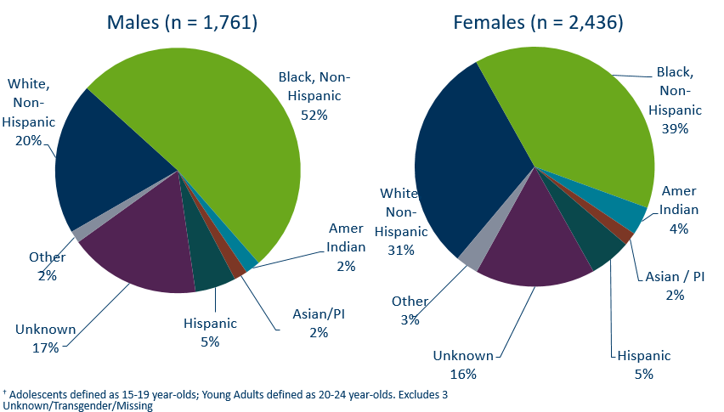
Gonorrhea Cases Among Adolescents and Young Adults† by Gender and Race, 2020
Notes:
Black, Non-Hispanic males make up 52% of gonorrhea cases in male adolescent and young adults and 41% of gonorrhea cases in Black, Non-Hispanic females.

Slide 46
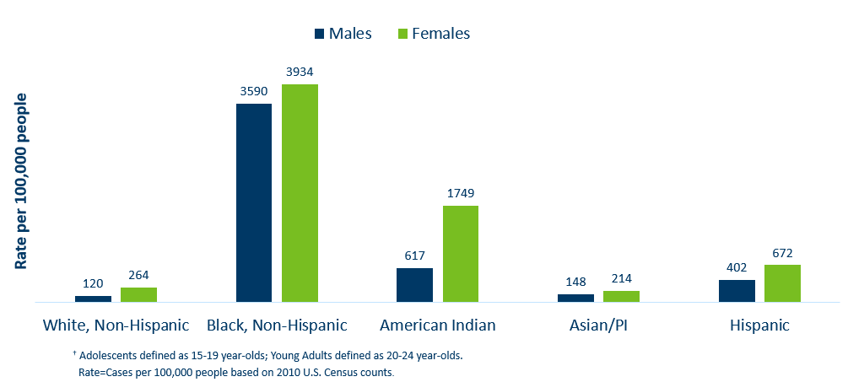
Gonorrhea Rate Among Adolescents and Young Adults† by Race, Minnesota, 2020
Notes:
Black, non-Hispanic and American Indian males and female adolescents and young adults are disproportionately affected by gonorrhea.

Slide 47
Burden of STDs on Young Women and people of Color
Women, and particularly women of color, disproportionately bear the long-term consequences of STDs.
  69% of chlamydia or gonorrhea cases diagnosed among adolescents and young adults were females.
  26% of all chlamydia or gonorrhea cases diagnosed among adolescents and young adults were in the Black, non-Hispanic females.
Women are biologically more prone to contracting an STD, but less likely to have symptoms. Untreated STDs can have serious consequences on their health and future reproductive ability.
  Untreated STDs in women can lead to pelvic inflammatory disease, infertility and ectopic pregnancy.
  Women are at risk of passing a STDs to their newborn, causing premature delivery, infant pneumonia and blindness.
  Importance of annual preventive and prenatal screening
Notes:
Women and particularly women of color disproportionately bear the long-term consequences of STDs.
69% of chlamydia or gonorrhea cases diagnosed among adolescents and young adults were females.
26% of all chlamydia or gonorrhea cases diagnosed among adolescents and young adults were in the Black, non-Hispanic females.
Women are biologically more prone to contracting a STD, but less likely to have symptoms. Untreated STDs can have serious consequences on their health and future reproductive ability.
Untreated STDs in women can lead to pelvic inflammatory disease, infertility and ectopic pregnancy.
Women are at risk of passing a STDs to their newborn, causing premature delivery, infant pneumonia and blindness.
This highlights the importance of annual preventive and prenatal screening.

Slide 48
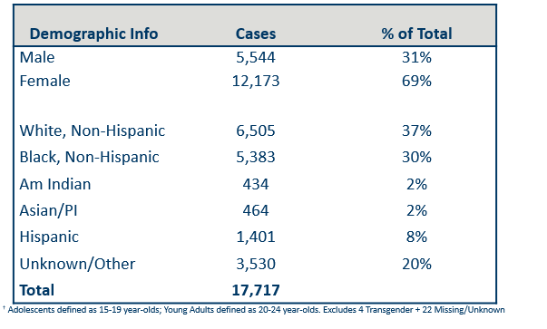
Summary Characteristics of Adolescents & Young Adults†
Diagnosed With Chlamydia or Gonorrhea in 2020
Notes:
In adolescents and young adults, the majority of chlamydia and gonorrhea cases are females (69%) .
A little over one-third (37%) are white, non-Hispanic followed by about one-third (30%) that are black, non-Hispanic. 20% were unknown or more than one race.
Adolescents and young adults accounted for 62% of chlamydia and 41% of gonorrhea cases diagnosed in Minnesota.

Slide 49
Topic of Interest: Syphilis Among
Females and Congenital Syphilis in Minnesota
Notes:
Topic of Interest: Syphilis Among
Females and Congenital Syphilis in Minnesota

Slide 50
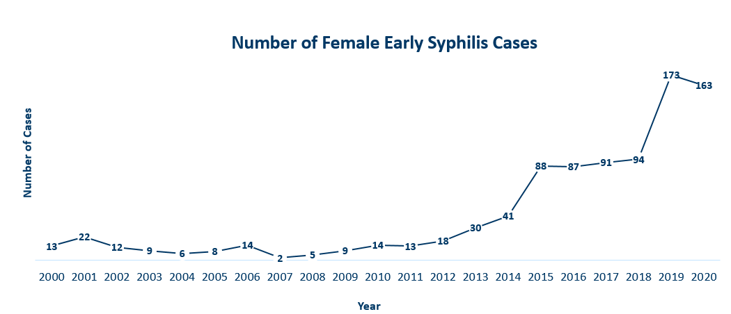
Female Early Syphilis Cases
Minnesota, 2020
Notes:
The number of female early syphilis cases has increased dramatically over the last 10 years from 14 cases in 2010 to 163 in 2020.

Slide 51
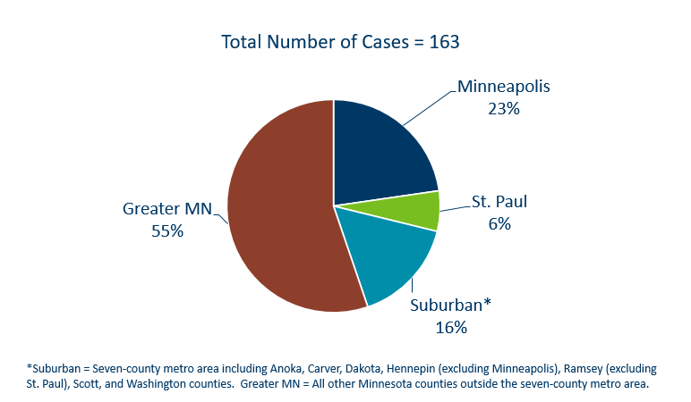
Early Syphilis Infections in Females by Residence at Diagnosis
Minnesota, 2020
Notes:
55 percent of female early syphilis cases were residents of Greater Minnesota
16 percent of female early syphilis cases were residents of the Suburbs of the seven-county metro area
23 percent were City of Minneapolis residents, and 6 percent were St. Paul residents.

Slide 52
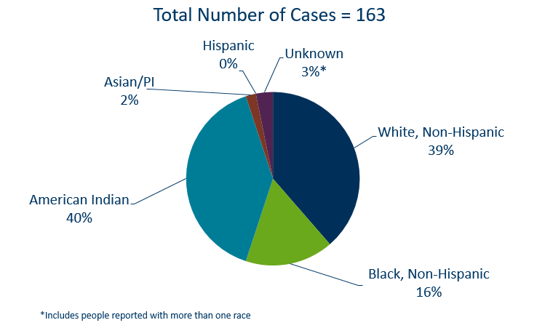
Early Syphilis Cases in Females by Race/Ethnicity
Minnesota, 2020
Notes:
There are large disparities in women with syphilis. 40 percent of all early syphilis cases in females are found in the American Indian population and 16% in the Black, African American population.

Slide 53
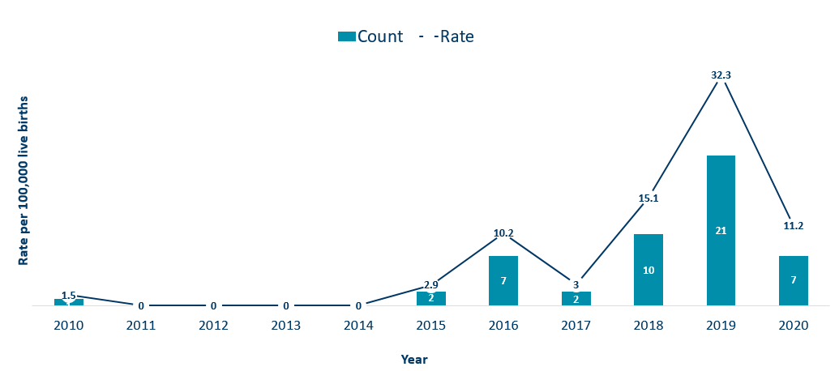
Congenital Syphilis (CS) Rates among infants
Minnesota, 2010-2020
Notes:
In Minnesota, the number and rate of congenital syphilis cases among infants has decreased in 2020 from a high of 21 in 2019 to 7 in 2020. Overall, the rate has increased over the past five years from a rate of 0 per 100,000 live births in 2014 to 11.2 per 100,000 live births in 2020.
Syphilis may be passed from a pregnant person to the unborn baby through the placenta. The infection can cause miscarriages and stillbirths, and infants born with congenital syphilis can suffer a variety of serious health problems, including deformities, seizures, anemia and jaundice.
The Centers for Disease Control and Prevention reported this fall that the number of infants born with syphilis has more than doubled in the past four years and last year reached a 20-year high.

Slide 54
Topic of Interest: Early Syphilis Among
Men Who Have Sex With Men in Minnesota
Notes:
Topic of Interest: Early Syphilis Among Men Who Have Sex With Men in Minnesota.
Men who have sex with men (MSM) make up the majority of early syphilis cases.

Slide 55
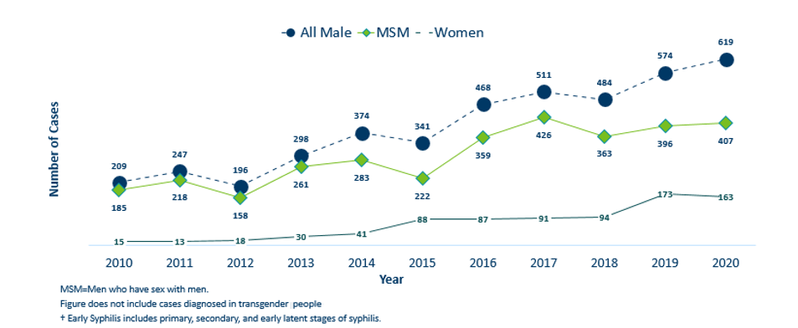
Number of Early Syphilis† Cases by Gender and MSM
Minnesota, 2010-2020
Notes:
Early syphilis, includes not only primary and secondary syphilis, but all new syphilis acquired in the past year.
Of all early syphilis cases, 79 percent were among people whose current gender was reported as male.
Men who have sex with men (MSM) account for 66% of all early syphilis cases among men.

Slide 56
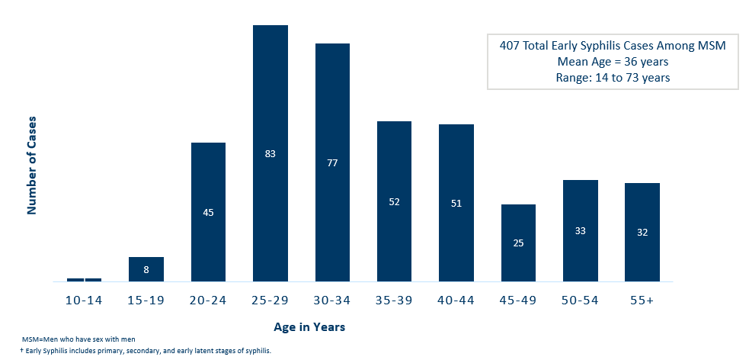
Early Syphilis† Cases Among MSM by Age
Minnesota, 2020
Notes:
The average age of MSM with early syphilis is 36 years of age.
Ages ranged from 14–73 years of age
The 25-29 year old age group had the highest number of cases at 83.
39% of early syphilis cases are among MSM are in the 25-34 age groups.

Slide 57
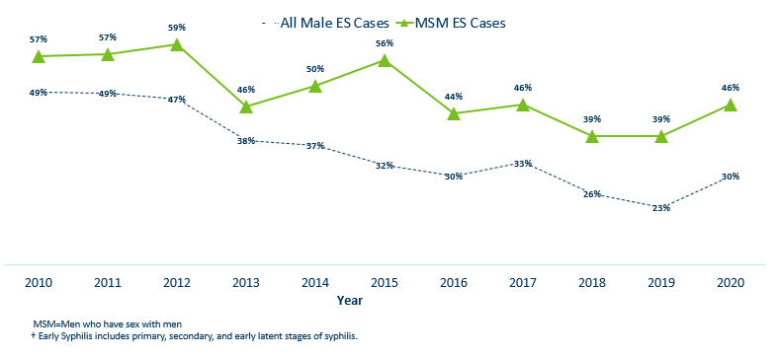
Early Syphilis† (ES) Cases
Co-infected with HIV, 2010-2020
Notes:
30% percent of all early syphilis cases were co-infected with HIV.
46% percent of all MSM early syphilis cases were co-infected with HIV.

Slide 58
What’s Being Done in Minnesota?
The MDH Partner Services Program continues to follow up on early syphilis cases and their sex partners and all pregnant syphilis cases.
All HIV/Syphilis co-infected cases are assigned to Partner Services for follow-up.
Physicians are encouraged to screen men who have sex with men at least annually and to ask about sex partners.
All pregnant people should be screened for syphilis at first prenatal visit, 28 weeks’ gestation (at minimum 28-36 weeks), and at delivery.

Slide 59
Summary of STD Trends in Minnesota
From 2010-2020, the chlamydia rate increased by 42%. The rate of gonorrhea increased by 370%. Syphilis has increased by 212%.
Adolescent and young females aged 15-24 years old continue to make up the majority of all chlamydia or gonorrhea cases at 69%.
Minnesota has seen a resurgence of syphilis over the past decade, with men who have sex with men and those co-infected with HIV being especially impacted. However, the number of females impacted is near the record high for the last decade.
People of color continue to be disproportionately affected by all STDs in Minnesota and nationwide. Disparities in the rates of STDs are not explained by differences in sexual behavior, but are due to differences in health insurance coverage, employment status and access to healthcare, preventative screening, and treatment services.
Notes:
From 2010-2020, the chlamydia rate increased by 42%. The rate of gonorrhea increased by 370% syphilis has increased by 212%.
Adolescent and young females aged 15-24 years old continue to make up the majority of all chlamydia or gonorrhea cases at 69%.
Minnesota has seen a resurgence of syphilis over the past decade, with men who have sex with men and those co-infected with HIV being especially impacted. However, the number of females impacted is near the record high for the last decade.
people of color continue to be disproportionately affected by all STDs in Minnesota and nationwide. Disparities in the rates of STDs are not explained by differences in sexual behavior, but are due to differences in health insurance coverage, employment status and access to healthcare with preventative, screening and treatment services.

Slide 60
Health Watch: Disseminated Gonococcal Infection (DGI)
8 cases of disseminated gonococcal infections (DGI) were diagnosed in Minnesota in 2020.
DGI occurs when a gonorrhea infection moves into the bloodstream and spreads to distant sites in the body, which can lead to clinical findings, such as septic arthritis, polyarthralgia, tenosynovitis, petechial/pustular lesions, bacteremia, or on rare occasions endocarditis or meningitis.
DGI is uncommon and occurs in 0.5-3% of untreated cases.
If there is clinical suspicion for DGI, nucleic acid amplification test (NAAT) and culture specimens from urogenital and extra-genital (e.g., pharyngeal and rectal) mucosal site(s), as applicable, should be collected and processed, in addition to culture specimens from disseminated sites of infection (e.g., skin, synovial, blood, CSF).
Report all laboratory confirmed cases of DGI or concern over persistent infection to MDH within 24 hours of identification at 651-201-5414.
All DGI cases should be cultured and tested for antimicrobial susceptibility. Please contact MDH for guidance on sending samples to the MDH Lab for additional testing.
Management of DGI cases should be guided by the CDC STD Treatment Guidelines (https://www.cdc.gov/std/tg2015/gonorrhea.htm).
Source: https://www.cdc.gov/std/program/outbreakresources/HANtemplate-dgi.htm
Notes:
8 cases of disseminated gonococcal infections (DGI) were diagnosed in Minnesota in 2020.
DGI occurs when a gonorrhea infection moves into the bloodstream and spreads to distant sites in the body, which can lead to clinical findings, such as septic arthritis, polyarthralgia, tenosynovitis, petechial/pustular lesions, bacteremia, or on rare occasions endocarditis or meningitis.
DGI is uncommon and occurs in 0.5-3% of untreated cases.
Report all laboratory confirmed cases of DGI or concern over persistent infection to MDH within 24 hours of identification. Also please call MDH when these cases are identified at 651-201-5414.
Management of DGI cases should be guided by the CDC STD Treatment Guidelines.

Slide 61
New Treatment Guidelines for Uncomplicated Gonorrhea Infection
New CDC Treatment Guidelines for Uncomplicated Gonorrhea Infection were published in the MMWR in December 2020 “Update to CDC’s Treatment Guidelines for Gonococcal Infection, 2020” (https://www.cdc.gov/mmwr/volumes/69/wr/mm6950a6.htm?s_cid=mm6950a6_w)
New treatment guidelines were prompted by an increased finding of gonorrhea's resistant to Azithromycin through the CDC’s Gonococcal Isolate Surveillance Project (GISP).
Regimen for uncomplicated gonococcal infections of the cervix, urethra, or rectum:
  Ceftriaxone 500 mg IM as a single dose for people weighing <150 kg (300 lb)
  OR
  Ceftriaxone 1g of IM for people weighing ≥150 kg (300 lb)
  If chlamydial infection has not been excluded, providers should treat for chlamydia with doxycycline 100 mg orally twice daily for 7 days. During pregnancy, azithromycin 1 g as a single dose is recommended to treat chlamydia.
  For alternative treatment options and a full guidelines refer to CDC STD Treatment Guidelines (https://www.cdc.gov/std/tg2015/gonorrhea.htm).
Notes:
New CDC Treatment Guidelines for Uncomplicated Gonorrhea Infection were published in the MMWR in December 2020.
New treatment guidelines were prompted by an increased finding of gonorrhea's resistant to Azithromycin through the CDC’s Gonococcal Isolate Surveillance Project (GISP).
The biggest change for uncomplicated gonococcal infections of the cervix, urethra, or rectum is only Ceftriaxone 500 mg IM as a single dose for people weighing <150 kg (300 lb) OR ceftriaxone 1g for people weighing ≥150 kg (300 lb),
If chlamydial infection has not been excluded, providers should treat for chlamydia with doxycycline 100 mg orally twice daily for 7 days. During pregnancy, azithromycin 1 g as a single dose is recommended to treat chlamydia.
For alternative treatment options and a full guidelines refer to CDC STD Treatment Guidelines.

Slide 62
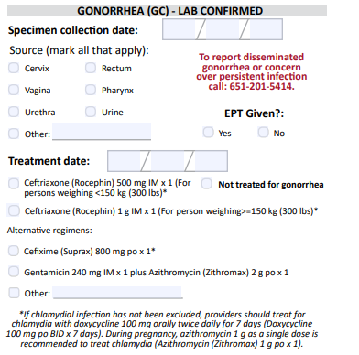
Updates to STD Reporting and Current Follow-Up
A new chlamydia and gonorrhea case report form is available on the MDH website, to accommodate changes in treatment guidelines and highlight DGI reporting.
The case report form can be filled out and mailed or faxed to MDH at 651-201-4040.
More information may be requested on gonorrhea cases for Enhanced Gonorrhea Surveillance as part of the CDC PCHD grant.
All cases co-infected with Early Syphilis will continue to be assigned to MDH Partner Services for follow-up.
All STD cases continue to have the potential for being contacted by MDH for additional follow-up.
Notes:
A new Chlamydia and Gonorrhea case report form is available on the MDH website, to accommodate changes in treatment guidelines and highlight DGI reporting.
The case report form can be filled out and mailed or faxed to MDH at 651-201-4040.
More information may be requested on gonorrhea cases for Enhanced Gonorrhea Surveillance as part of the CDC PCHD grant.
All cases co-infected with Early Syphilis will continue to be assigned to MDH Partner Services for follow-up.
All STD cases continue to have the potential for being contacted by MDH for additional follow-up.

