Slide 1
Sexually Transmitted Disease (STD) Surveillance Report, 2019
Minnesota Department of Health STD Surveillance System
Notes:
First we will discuss information concerning the reportable sexually transmitted diseases in Minnesota for 2019, followed by HIV statistics, and then hepatitis.

Slide 2
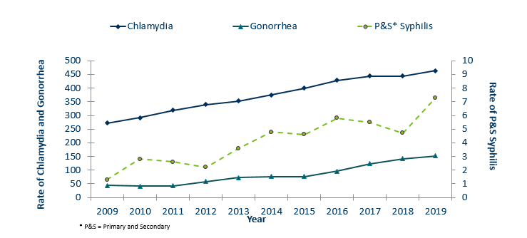
STDs in Minnesota
Rate per 100,000 by Year of Diagnosis, 2009-2019
Notes:
The rate of chlamydia in MN reached an all time high at 463 per 100,000.
The rate of gonorrhea in MN increased 7% to 152 per 100,000 compared to 142 per 100,000 in 2018.
The rate of primary and secondary syphilis is at 7.3 per 100,000. The rate of primary and secondary syphilis reached an all time high, which is an increase of 55% from 2018.

Slide 3
STDs in Minnesota:
Number of Cases Reported in 2019
Total of 32,983 STD cases reported to MDH in 2019:
  24,535 Chlamydia cases
  8,063 Gonorrhea cases
  1,127 Syphilis cases (all stages)
  0 Chancroid cases

Slide 4
Syphilis
Minnesota Department of Health STD Surveillance System
Notes:
Now we will talk about syphilis.
We will focus mostly on primary and secondary syphilis, which are the most infectious stages of syphilis.

Slide 5
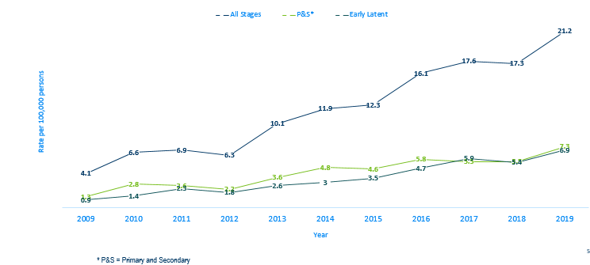
Syphilis Rates by Stage of Diagnosis Minnesota, 2009-2019
Notes:
The overall syphilis rate is now up to 21.2 per 100,000. Compared to the low of 4.1 back in 2009, which is five times higher.
Of concern is the rate of primary and secondary syphilis which is 7.3 per 100,000, which is a 33% percent increase from 2018 at 5.5 per 100,000.

Slide 6
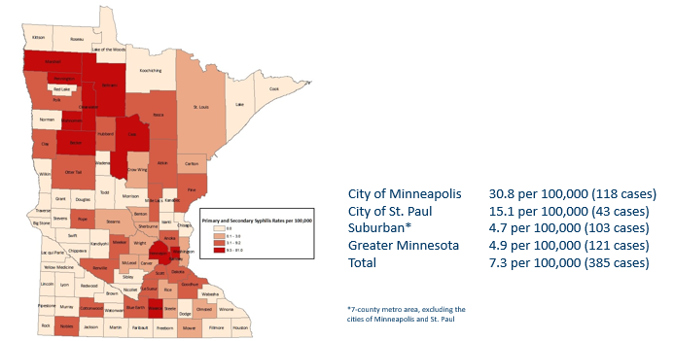
2019 Minnesota Primary & Secondary Syphilis Rates by County
Notes:
The statewide rate of primary and secondary syphilis increased by 32.7% from 5.5 in 2018 to 7.3 in 2019 cases per 100,000 population.
Within the metro, the highest rate of primary and secondary syphilis remains in the City of Minneapolis at 30.8 cases per 100,000 population.
The City of St. Paul has the second highest rate in the metro at 15.1 per 100,000.
The highest increase in rates occurred in Greater Minnesota at 104.2% from 2.4 in 2018 to 4.9 2019 cases per 100,000 population.

Slide 7
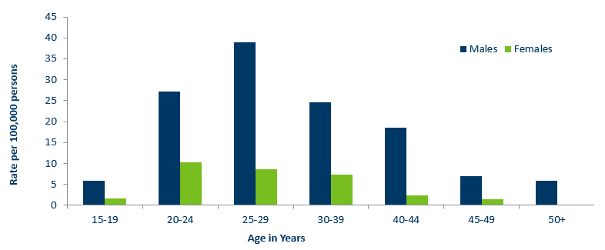
Age-Specific Primary & Secondary Syphilis Rates by Gender, Minnesota, 2019
Notes:
Males have higher rates of primary and secondary syphilis than females in all age groups. The rate in males is 5 times higher than females.
The 25-29 year old males have the highest rate at 38.9 per 100,000
The 20-24 year old females have the highest rate of the female population at 10.3 per 100,000

Slide 8
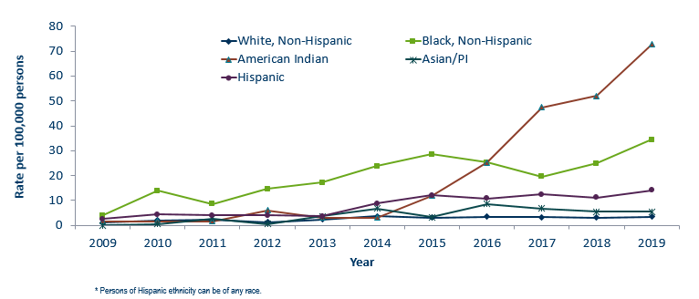
Primary & Secondary Syphilis Rates by Race/Ethnicity
Minnesota, 2009-2019
Notes:
The rates of primary and secondary syphilis are 21 times higher in the American Indian populations than that of the White, non-Hispanic population.
The rates of primary and secondary syphilis are 10 times higher in the Black/African American, non-Hispanic than that of the White, non-Hispanic population.
The rates of primary and secondary syphilis in the America Indian population are 72.8 per 100,000 compared to 3.5 per 100,000 in the White, non-Hispanic population.
The rates of primary and secondary syphilis in the Black/African American, non-Hispanic population are 34.5 per 100,000 compared to 3.5 per 100,000 in the White, Non-Hispanic population.
The rates in the Hispanic/Latino population are 14.0 per 100,000 which is 4 times higher than the White, non-Hispanic population.
The rates in the Asian/Pacific Islander population are 5.4 per 100,000 which is 2 times higher than the White, non-Hispanic population.

Slide 9
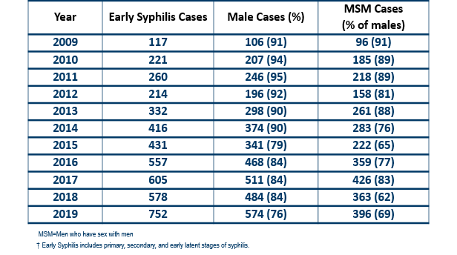
Early Syphilis† by Gender and Sexual Behavior Minnesota, 2009-2019
Notes:
Early syphilis, includes not only primary and secondary syphilis, but all new syphilis acquired in the past year.
Of all early syphilis cases, seventy-six percent were among persons whose current gender was reported as male.
Among males with early syphilis in 2019, 69 percent reported having one or more male partners.

Slide 10
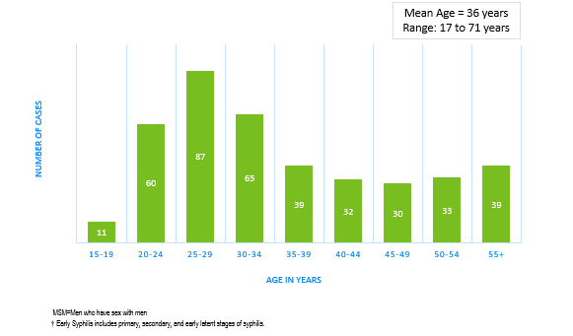
Early Syphilis† Cases Among MSM by Age Minnesota, 2019 (n=396)
Notes:
The average age of MSM with early syphilis is 36 years of age.
Ages ranged from 17 – 71 years of age
The 25-29 year old age group had the highest number of cases at 87 which is 22 percent of MSM early syphilis cases in 2019.

Slide 11
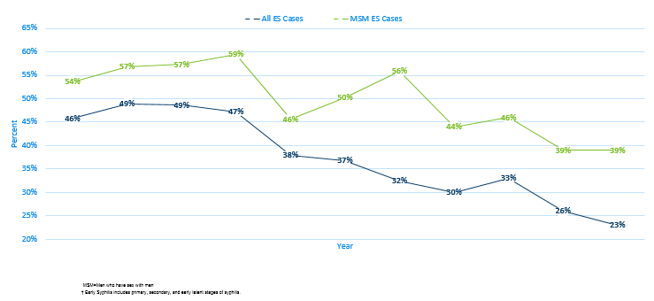
Early Syphilis† (ES) Cases
Co-infected with HIV, 2009-2019
Notes:
Twenty-three percent of all early syphilis cases were co-infected with HIV.
Thirty-nine percent of all MSM early syphilis cases were co-infected with HIV.

Slide 12
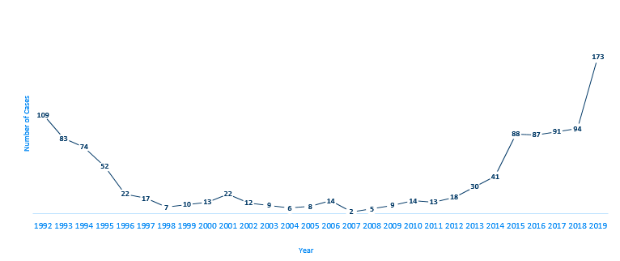
Female Early Syphilis cases
Notes:
The number of female early syphilis cases has increased dramatically from 9 cases in 2009 to the highest number of cases in the last decade to 173 in 2019, which is a 84 percent increase compared to 2018 at 94 cases in females.

Slide 13
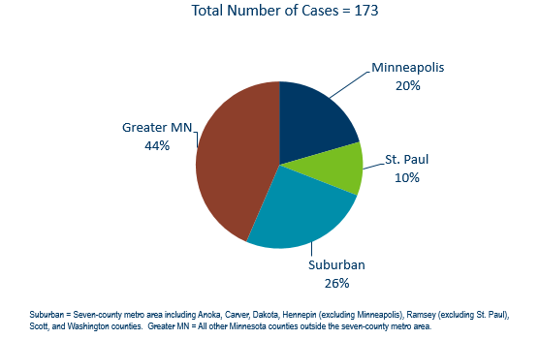
Early Syphilis Infections in Women in Minnesota by Residence at Diagnosis, 2019
Notes:
Forty-four percent of female early syphilis cases were residents of Greater Minnesota
Twenty-six percent of female early syphilis cases were residents of the Suburbs of the seven-county metro area
Twenty percent were City of Minneapolis residents, and 10% were St. Paul residents.

Slide 14
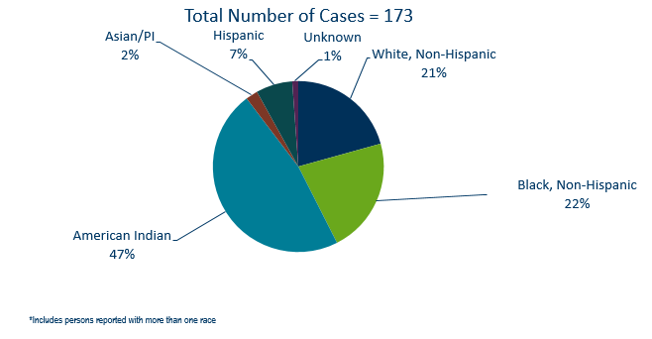
Early Syphilis Cases in Females by Race
Minnesota, 2019
Notes:
There are large disparities in women with syphilis. Almost half (47%) percent of all early syphilis cases in females are found in the American Indian population and 22% in the Black, African American population.

Slide 15
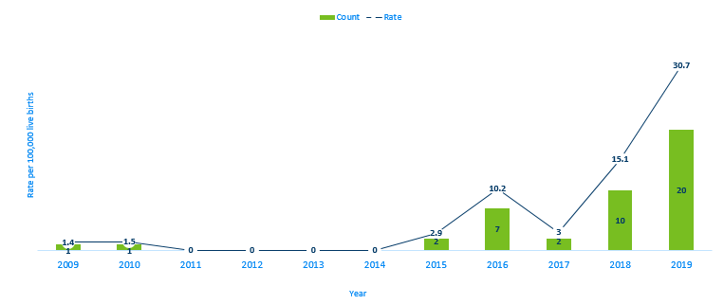
Congenital Syphilis Rates among infants
Minnesota, 2009-2019
Notes:
Syphilis may be passed from a pregnant person to the unborn baby through the placenta. The infection can cause miscarriages and stillbirths, and infants born with congenital syphilis can suffer a variety of serious health problems, including deformities, seizures, anemia and jaundice.
The Centers for Disease Control and Prevention reported this fall that the number of infants born with syphilis has more than doubled in the past four years and last year reached a 20-year high.
In Minnesota, the number and rate of congenital syphilis cases among infants has increased over the past five years from a rate of 2.9 per 100,000 live births in 2015 to 30.7 per 100,000 live births in 2019, which is a 959 percent increase since 2015.

Slide 16
Chlamydia
Minnesota Department of Health STD Surveillance System
Notes:
Now we will talk about Chlamydia

Slide 17
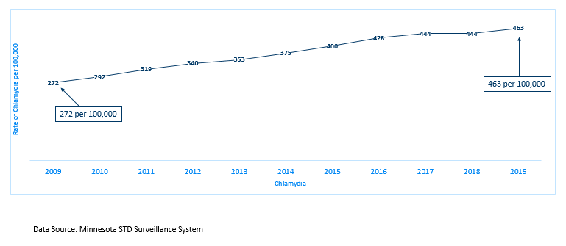
Chlamydia in Minnesota
Rate per 100,000 by Year of Diagnosis, 2009-2019
Notes:
As mentioned previously, the rate of chlamydia in MN reached an all time high at 463 per 100,000.

Slide 18
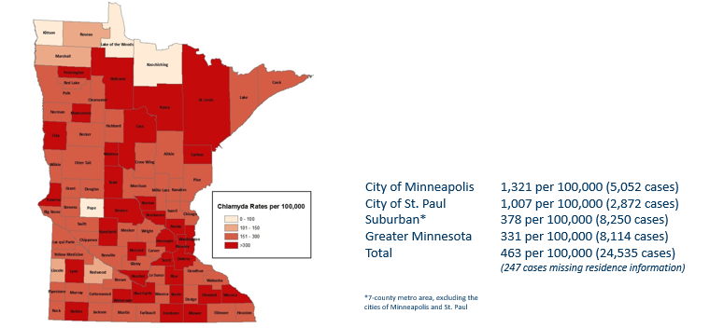
2019 Minnesota Chlamydia Rates by County
Notes:
All counties in Minnesota are affected by chlamydia. There were at least 5 cases in all counties except 1 in 2019.
The city of Minneapolis continues to have the highest rates of chlamydia at 1,255 per 100,000, followed by the city of St. Paul at 982 per 100,000, the suburban area (7-county metro excluding Minneapolis & St. Paul) at 358 per 100,000 and Greater Minnesota at 316 per 100,000.
The suburban area had the greatest increase in rates between 2018 and 2019 at 5.6%.

Slide 19
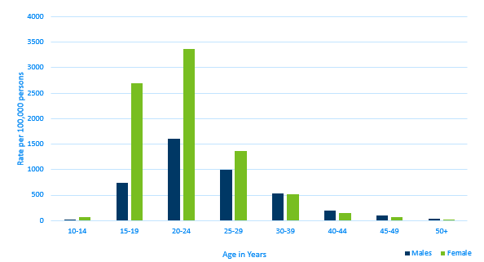
Age-Specific Chlamydia Rates by Gender
Minnesota, 2019
Notes:
Females, 20-24 years of age continue to have the highest rate at 3368 per 100,000.
The next highest rate continue to be females, 15-19 years of age at 2691 per 100,000.

Slide 20
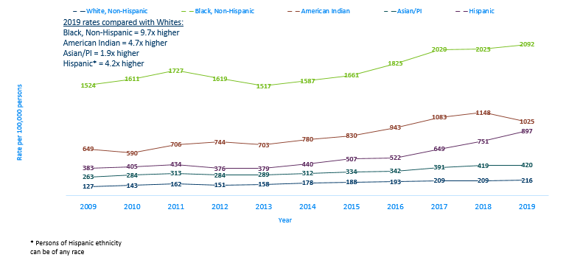
Chlamydia Rates by Race/Ethnicity
Minnesota, 2009-2019
Notes:
There continues to be disparities in rates of chlamydia.
The Black/African American, non-Hispanic population has rates that are 9.7 times higher than that of whites.
The rate in the Black/African American, non-Hispanic population was 2,092 per 100,000 compared to the rate in the White, non-Hispanic population at 216 per 100,000.
The American Indian population had a rate that was 4.7 times higher at 1,148 per 100,000
The Asian/Pacific Islander population had a rate that was 1.9 times higher at 420 per 100,000
The Hispanic/Latino population, which can be of any race, had a rate that was 4.2 times higher at 897 per 100,000

Slide 21
Gonorrhea
Minnesota Department of Health STD Surveillance System
Notes:
Lastly, we will cover Gonorrhea

Slide 22
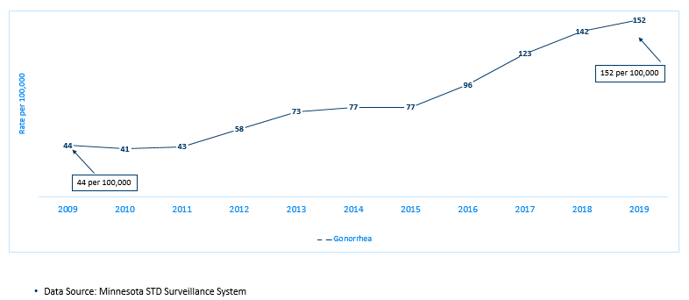
Gonorrhea in Minnesota
Rate per 100,000 by Year of Diagnosis, 2009-2019
Notes:
As mentioned previously, the rate of gonorrhea in MN reached an all time high at 152 per 100,000. This is a rate increase of 7% from 2018.

Slide 23
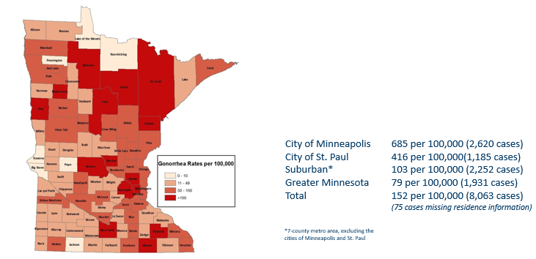
2019 Minnesota Gonorrhea Rates by County
Notes:
The city of Minneapolis continues to have the highest rates of gonorrhea at 685 per 100,000, followed by the city of St. Paul at 416 per 100,000, the suburban area (7-county metro excluding Minneapolis & St. Paul) at 103 per 100,000 and Greater Minnesota at 79 per 100,000.
The City of Minneapolis had the highest increase at 11%.

Slide 24
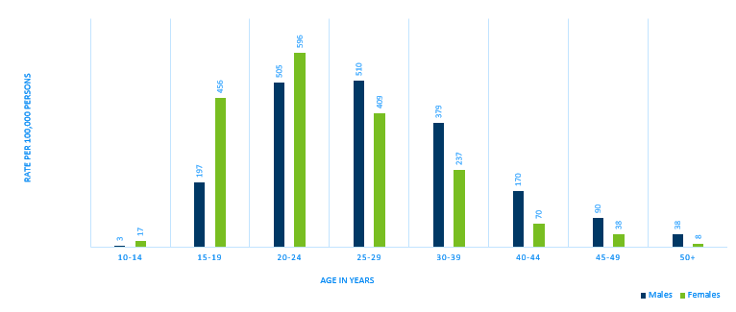
Age-Specific Gonorrhea Rates by Gender Minnesota, 2019
Notes:
Females continue to have higher rates of gonorrhea than males that are younger than 25 years of age. In 2019 the males have higher rates in the 25 and over age groups.
The highest rates of gonorrhea are in females 20-24 at 596 per 100,000.

Slide 25
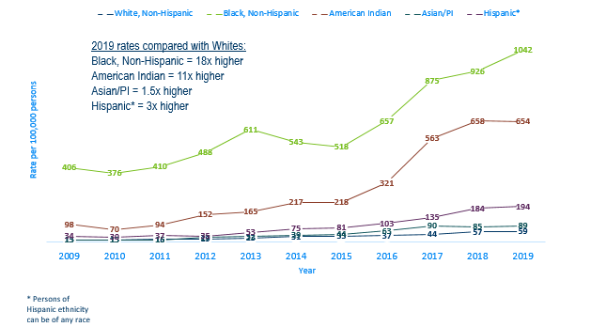
Gonorrhea Rates by Race/Ethnicity
Minnesota, 2009-2019
Notes:
There continues to be disparities in rates of gonorrhea.
The Black/African American, non-Hispanic population rates are 18 times higher than that of whites. The rate in the Black/African American population was 1042 per 100,000 compared to the rate in the White, Non-Hispanic population at 59 per 100,000.
The American Indian population had a rate that was 11 times higher at 654 per 100,000
The Asian/Pacific Islander population had a rate that was 1.5 times higher at 89 per 100,000
The Hispanic/Latino population, which can be of any race, had a rate that was 3 times higher at 194 per 100,000

Slide 26
Gonorrhea is a notifiable condition in MN
Please remember to notify all patients after any STD diagnosis that their name and information is required by law to be reported to the Minnesota Department of Health.
Please ensure all STD case and lab reports are submitted to the MDH with proper contact information, including telephone number.
Please inform your patients, after a STD diagnosis, that they have a chance of being contacted by the MDH for additional follow up.
Notes:
Many SSuN cases are surprised when they received a call from the MDH regarding their gonorrhea infection. They did not know their name was required by law to be reported to the Minnesota Department of Health.

Slide 27
Summary of STD Trends in Minnesota
From 2009-2019, the chlamydia rate increased by 70%. The rate of gonorrhea increased by 245%. The rates of primary and secondary syphilis have increased 32% compared to 2018.
Minnesota has seen a resurgence of syphilis over the past decade, with men who have sex with men and those co-infected with HIV being especially impacted. However, the number of females is at the record high for the last decade.
Persons of color continue to be disproportionately affected by STDs.
STD rates are generally highest in the metro. However, chlamydia continues to be reported from every county in 2019.
Between 2018 and 2019, early syphilis cases increased by 30%. Men who have sex with men comprised 76% of all male cases in 2019; cases among women are continuing to rise.

Slide 28
Future Updates to STD Reporting and Current Follow-Up
The case report form (available online) can be filled out and mailed or faxed into MDH
All cases co-infected with Early Syphilis will continue to be assigned to MDH Partner Services for follow-up
All STD cases continue to have the potential for being contacted by MDH for additional follow-up
Statewide STD outbreak surveillance continues to be conducted on a monthly basis.
Starting in 2020, the STD outbreak detection methodology is being updated. The new response plan improves our abilities to identify and respond to impacted communities in more real time. Look for supportive documentation to be posted on our website in Fall of 2020.
Notes:
[NEED TO UPDATE SLIDE]

Slide 29
Thank you
To speak to someone regarding STD surveillance, please call 651-201-5414
For data requests, please visit the STD/HIV/TB Data and Presentation Request Form (https://survey.vovici.com/se/56206EE3662437AB)
Notes:
To speak with someone regarding STD statistics, or to make a data request, please reference the contact information on this slide

