Slide 1
STD, HIV, and Hepatitis 2018 Data Release
April 30, 2019
Notes:
Good Afternoon and welcome to the STD, HIV and Hepatitis 2018 data release webinar. My name is Chryssie Jones and I am the STD/HIV/TB section manager for the Minnesota Department of Health.

Slide 2
Announcements
Ask all questions in the chat box
If possible, note the slide number when asking questions
All questions will be answered at the conclusion of the webinar
Contact information will be provided at the end
This presentation is available online at:
  HIV Statistics (www.health.state.mn.us/diseases/hiv/stats/index.html)
  STD Statistics (www.health.state.mn.us/diseases/stds/stats/index.html)
Notes:
First, a few housekeeping items. We will have a series of presentations and a question and answer session at the end. You may type your questions into the chat box at any time during the presentation, and note the slide number if possible. All lines will be muted until the conclusion of all presenters. Contact information will be provided at the end so people can follow up with the speakers more directly if additional information is needed. This presentation is available on our website as a narrated PowerPoint or a PDF with speakers notes.

Slide 3
Agenda
STD Surveillance Data
HIV Surveillance Data
Hepatitis C Surveillance Data
Q & A
  Adrianna Sonnek- HIV/AIDS Surveillance Coordinator
  Cheryl Barber, M.S., M.P.H. -Senior Epidemiologist Specialist, STD/HIV/TB Section
  Jared Shenk – HIV Care and Prevention Epidemiologist
  Kristin Sweet, Ph.D, M.P.H. - Section Manager, Cross-Cutting Epidemiology, Programs, and Partnerships
3
Notes:
Today’s webinar will cover highlights from the 2018 STD, HIV, and Hepatitis C surveillance reports. Jared Shenk, HIV Care and Prevention Epidemiologist, will be your webinar host. He will be joined by
Adrianna Sonnek, HIV/AIDS Surveillance Coordinator
Cheryl Barber, Senior Epidemiologist Specialist, STD/HIV/TB Section
Kristin Sweet, Section Manager, Cross-Cutting Epidemiology, Programs, and Partnerships
During the Q & A session.

Slide 4
Acronyms & Definitions
MDH = Minnesota Department of Health
STD = Sexually transmitted disease
MSM = Men who have sex with men
HCV = Hepatitis C virus
HBV =Hepatitis B virus
IDU =Injection drug use
SSuN = STD Surveillance Network
Cisgender Women = people who are assigned female sex at birth and their current gender is blank or is female
Cisgender Men = people who are assigned male sex at birth and their current gender is blank or is male
Transgender people = people whose assigned birth sex is different from their current gender identity
Notes:
Finally, I would like to cover some common acronyms and definitions that will be used in todays presentation.
MDH = Minnesota Department of Health
STD = Sexually transmitted disease, also know as STI or sexually transmitted infection
MSM = Men who have sex with men
HCV = Hepatitis C virus
HBV = Hepatitis B virus
IDU = Injection drug use
SSuN = STD Surveillance Network
Cisgender Women = people who are assigned female sex at birth and their current gender is blank or is female
Cisgender Man = people who are assigned male sex at birth and their current gender is blank or is male
Transgender people = people whose assigned birth sex is different from the current gender identity
Thank you for attending the Minnesota Department of Health’s annual STD, HIV, and Hepatitis C data release. I will now pass it off to Jared.

Slide 5
Sexually Transmitted Disease (STD) Surveillance Report, 2018
STD Surveillance System
Notes:
Thank you for participating in the webinar today. I’m Jared Shenk, an epidemiologist at the Minnesota Department of Health. First we will discuss information concerning the reportable sexually transmitted diseases in Minnesota for 2018, followed by HIV statistics, and then hepatitis.

Slide 6
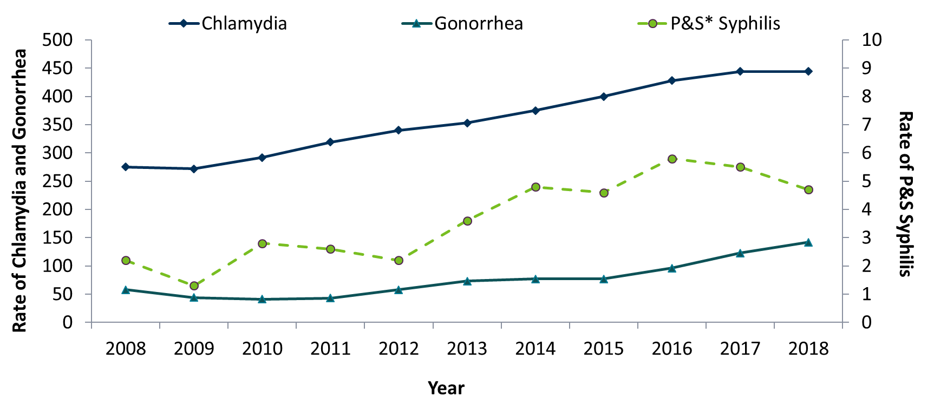
STDs in Minnesota: Rate per 100,000 by Year of Diagnosis, 2008-2018
* P&S = Primary and Secondary
Notes:
The rate of chlamydia in MN reached an all time high at 444 per 100,000. This is the same rate as 2017.
The rate of gonorrhea in MN increased 15% to 142 per 100,000 compared to 123 per 100,000 in 2017.
The rate of primary and secondary syphilis is at 4.7 per 100,000. This is an decrease of 14% from 2017.

Slide 7
STDs in Minnesota: Number of Cases Reported in 2018
Total of 32,024 STD cases reported to MDH in 2018:
  23,564 Chlamydia cases
  7,542 Gonorrhea cases
  918 Syphilis cases (all stages)
  0 Chancroid cases
Notes:
Total of 32,024 STD cases reported to MDH in 2018:
23,564 Chlamydia cases
7,542 Gonorrhea cases
918 Syphilis cases (all stages)
0 Chancroid cases

Slide 8
Syphilis
Minnesota Department of Health STD Surveillance System
Notes:
Now we will talk about syphilis.
We will focus mostly on primary and secondary syphilis, which are the most infectious stages of syphilis.

Slide 9
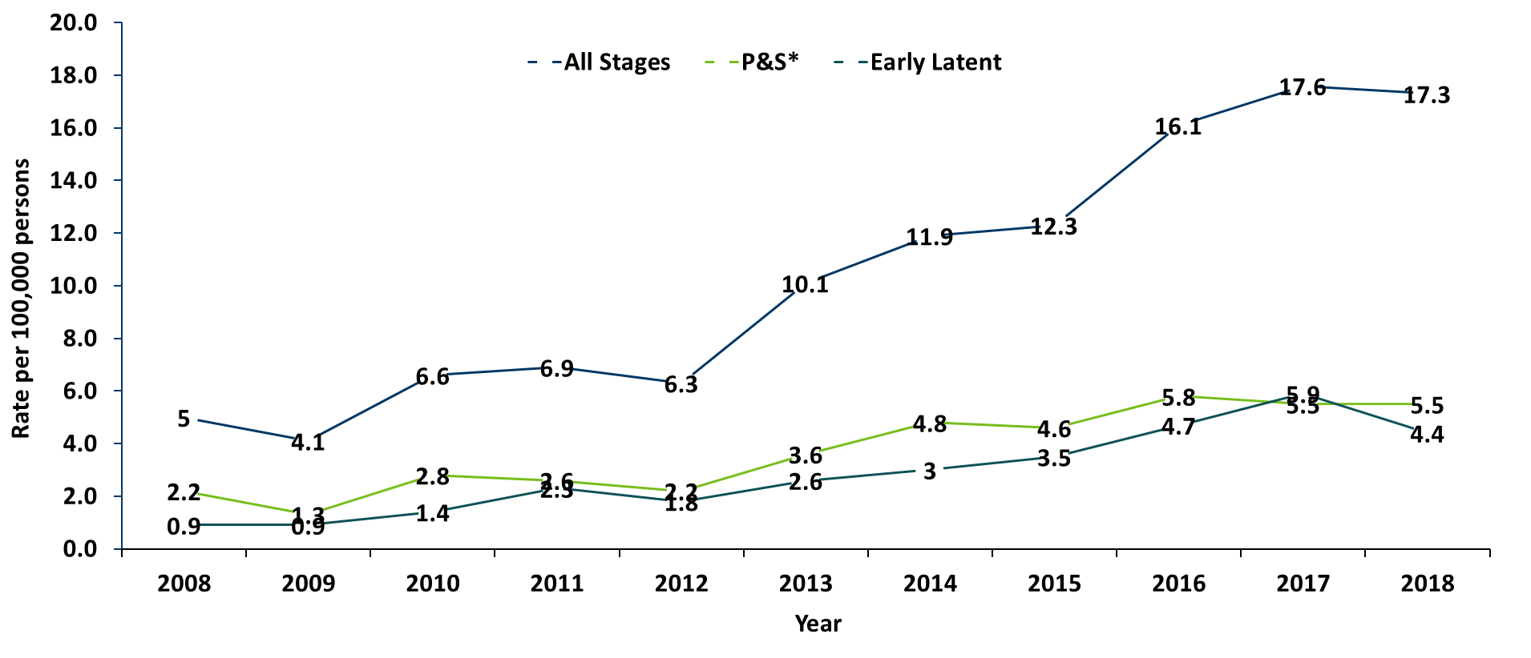
Syphilis Rates by Stage of Diagnosis Minnesota, 2008-2018
* P&S = Primary and Secondary
Notes:
The overall syphilis rate is now up to 17.3 per 100,000. Compared to the low of 4.1 back in 2009, which is four times higher.
Of concern is the rate of primary and secondary syphilis which is 5.5 per 100,000, which remained the same as the previous year.

Slide 10
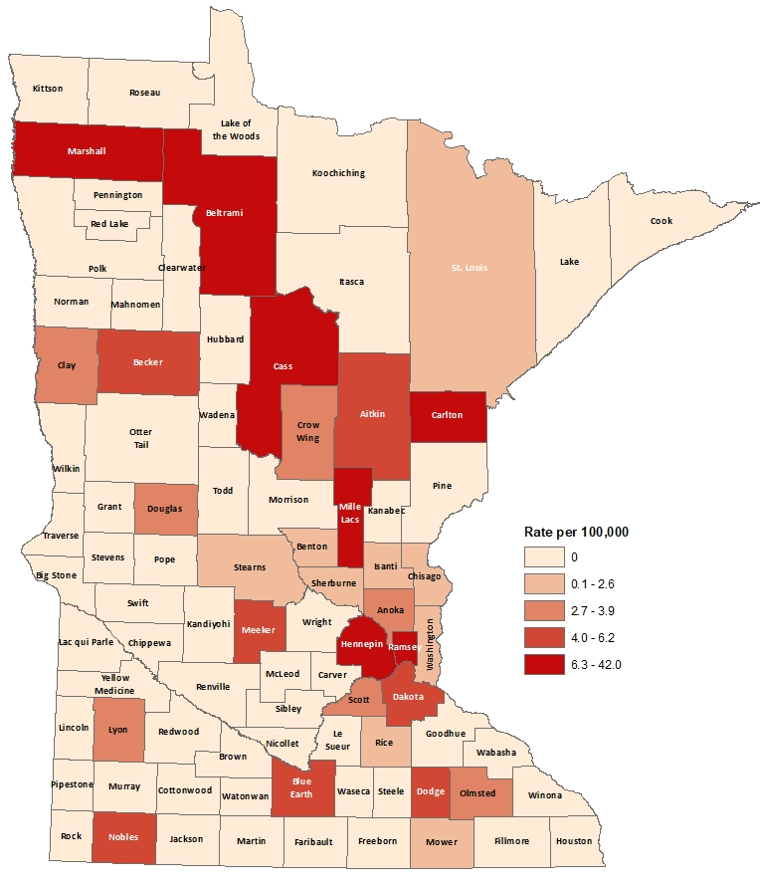
2018 Minnesota Primary & Secondary Syphilis Rates by County
City of Minneapolis
City of St. Paul
Suburban*
Greater Minnesota
Total
29.0 per 100,000 (111 cases)
10.5 per 100,000 (30 cases)
4.2 per 100,000 (91 cases)
2.4 per 100,000 (60 cases)
5.5 per 100,000 (292 cases)
*7-county metro area, excluding the cities of Minneapolis and St. Paul
Notes:
The statewide rate of primary and secondary syphilis remains at 5.5 cases per 100,000
Within the metro, the highest rate of primary and secondary syphilis remains in the City of Minneapolis at 29 cases per 100,000 population.
The City of St. Paul has the second highest rate in the metro at 10.5 per 100,000.

Slide 11
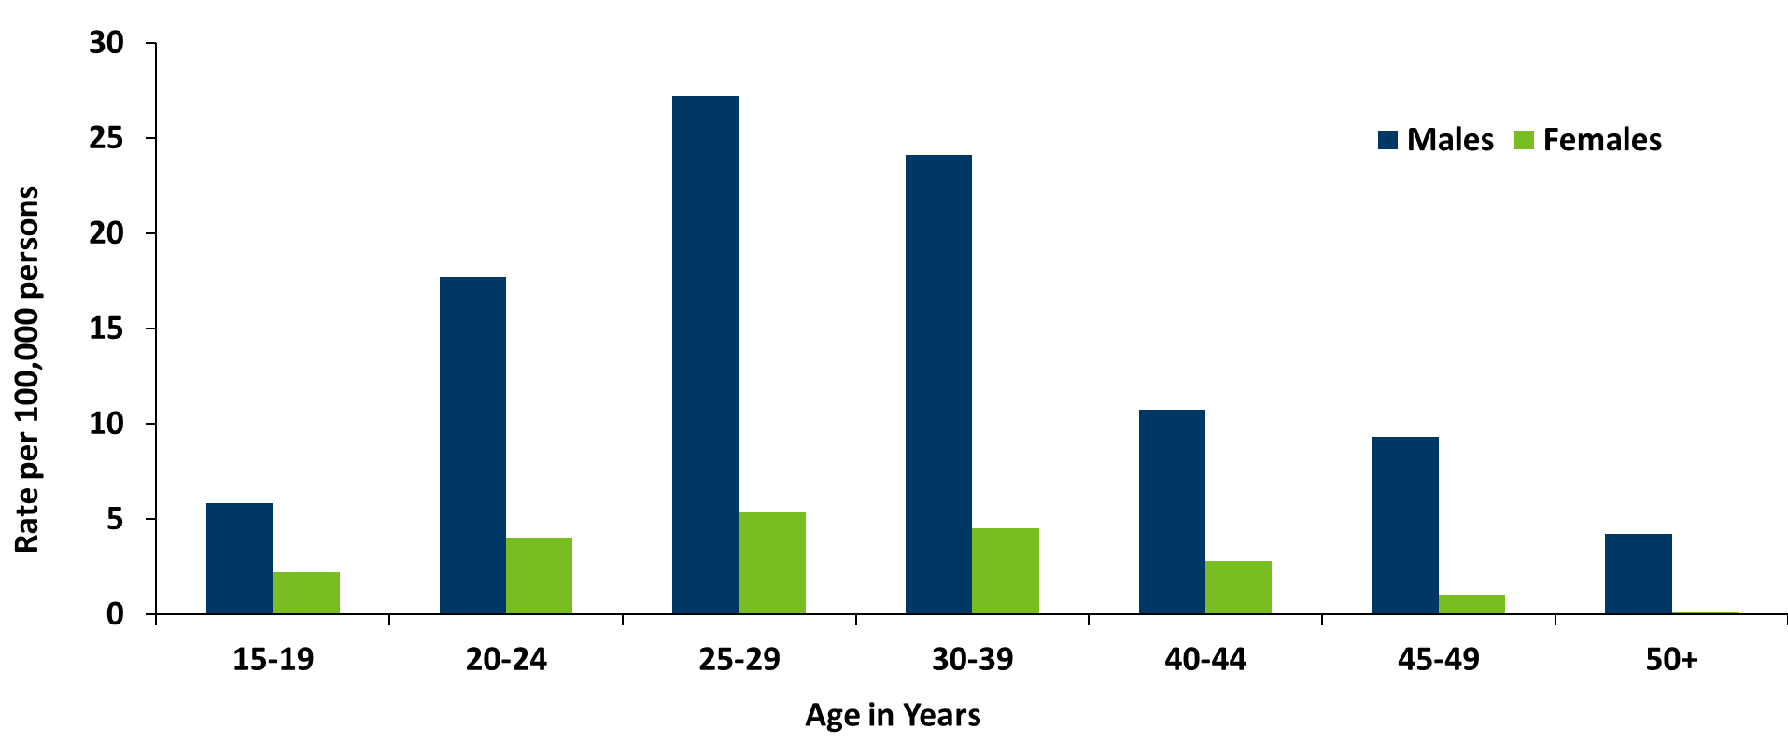
Age-Specific Primary & Secondary Syphilis Rates by Gender, Minnesota, 2018
Notes:
Males have higher rates of primary and secondary syphilis than females in all age groups. The rate in males is 7 times higher than females.
The 25-29 year old males have the highest rate at 27.2 per 100,000
The 25-29 year old females have the highest rate of the female population at 5.4 per 100,000

Slide 12
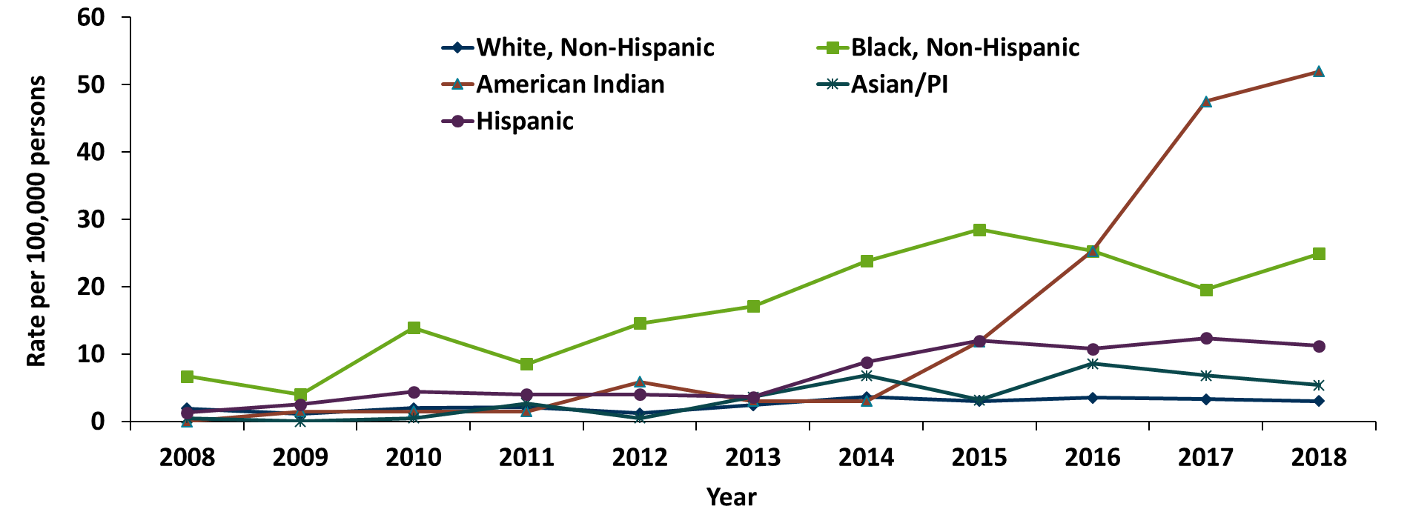
Primary & Secondary Syphilis Rates by Race/Ethnicity
Minnesota, 2008-2018
* Persons of Hispanic ethnicity can be of any race.
Notes:
The rates of primary and secondary syphilis are 17 times higher in the American Indian populations than that of the White, non-Hispanic population.
The rates of primary and secondary syphilis are 8 times higher in the Black/African American, non-Hispanic than that of the White, non-Hispanic population.
The rates of primary and secondary syphilis in the America Indian population are 52.0 per 100,000 compared to 3.0 per 100,000 in the White, non-Hispanic population.
The rates of primary and secondary syphilis in the Black/African American, non-Hispanic population are 24.9 per 100,000 compared to 3.0 per 100,000 in the White, Non-Hispanic population.
The rates in the Hispanic/Latino population are 11.2 per 100,000 which is 4 times higher than the White, non-Hispanic population.
The rates in the Asian/Pacific Islander population are 5.4 per 100,000 which is 2 times higher than the White, non-Hispanic population.

Slide 13
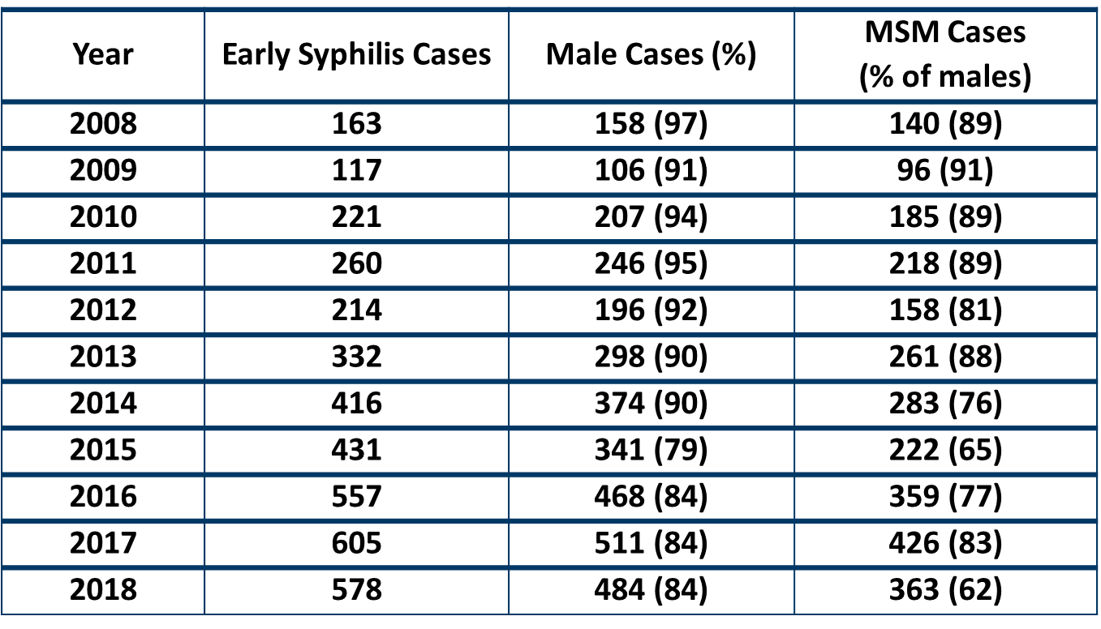
Early Syphilis† by Gender and Sexual Behavior
Minnesota, 2008-2018
MSM=Men who have sex with men
† Early Syphilis includes primary, secondary, and early latent stages of syphilis.
Notes:
Early syphilis, includes not only primary and secondary syphilis, but all new syphilis acquired in the past year.
Of all early syphilis cases, eighty-four percent were among persons whose current gender was reported as male.
Among males with early syphilis in 2018, 62 percent reported having one or more male partners.

Slide 14
Early Syphilis† Cases Among MSM by Age Minnesota, 2018 (n=363)
Mean Age = 35 years
Range: 17 to 70 years
MSM=Men who have sex with men
† Early Syphilis includes primary, secondary, and early latent stages of syphilis.
Notes:
The average age of MSM with early syphilis is 35 years of age.
Ages ranged from 17 – 70 years of age
The 30-34 year old age group had the highest number of cases at 85.

Slide 15
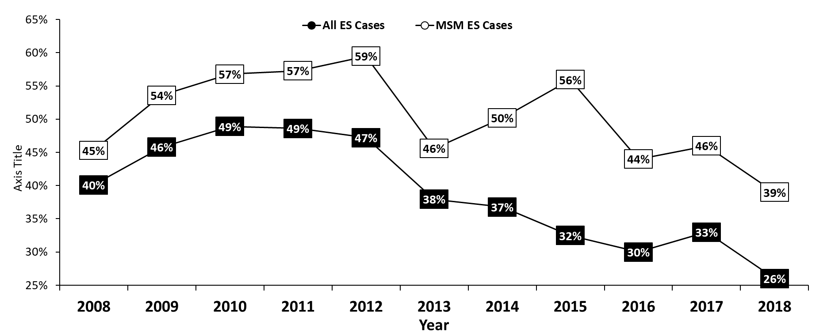
Early Syphilis† (ES) Cases Co-infected with HIV, 2008-2018
MSM=Men who have sex with men
† Early Syphilis includes primary, secondary, and early latent stages of syphilis.
Notes:
Twenty-six percent of all early syphilis cases were co-infected with HIV.
Thirty-nine percent of all MSM early syphilis cases were co-infected with HIV.
Due to increased report of heterosexual behavior among early syphilis cases, who historically have lower rates of HIV infection, the overall percent of HIV co-infection among early syphilis cases has dropped.
The co-infection rate among MSM has also decreased during this time.

Slide 16
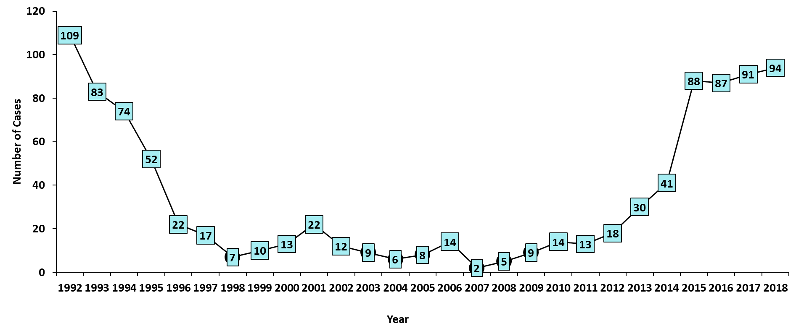
Female Early Syphilis Cases
Notes:
In 2018 we continued to see more reports or early syphilis among persons whose current gender was reported as female.
This continues a trend which started in 2015.
In 2018 females made up 16% of all early syphilis cases reported.

Slide 17
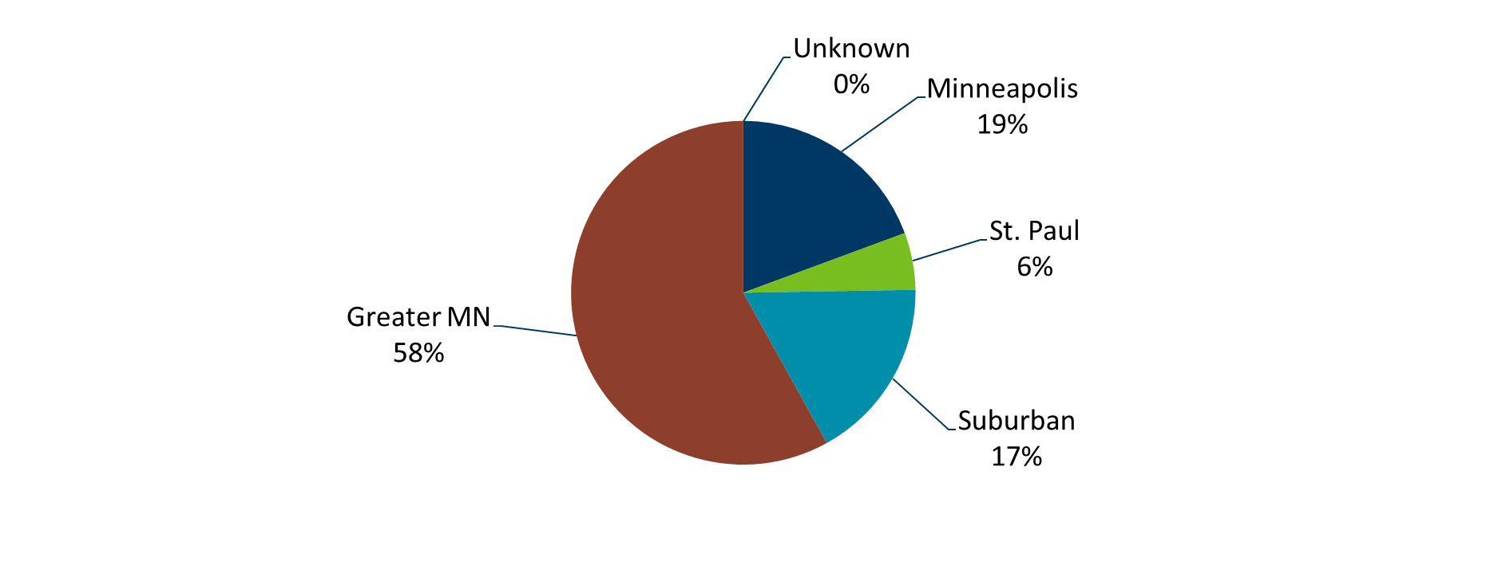
Early Syphilis Infections in Women in Minnesota by Residence at Diagnosis, 2018
Total Number of Cases = 94
Suburban = Seven-county metro area including Anoka, Carver, Dakota, Hennepin (excluding Minneapolis), Ramsey (excluding St. Paul), Scott, and Washington counties. Greater MN = All other Minnesota counties outside the seven-county metro area.
Notes:
Fifty-eight percent of female early syphilis cases were residents of Greater Minnesota
Seventeen percent of female early syphilis cases were residents of the Suburbs of the seven-county metro area
Nineteen percent were City of Minneapolis residents, and 6% were St. Paul residents.

Slide 18
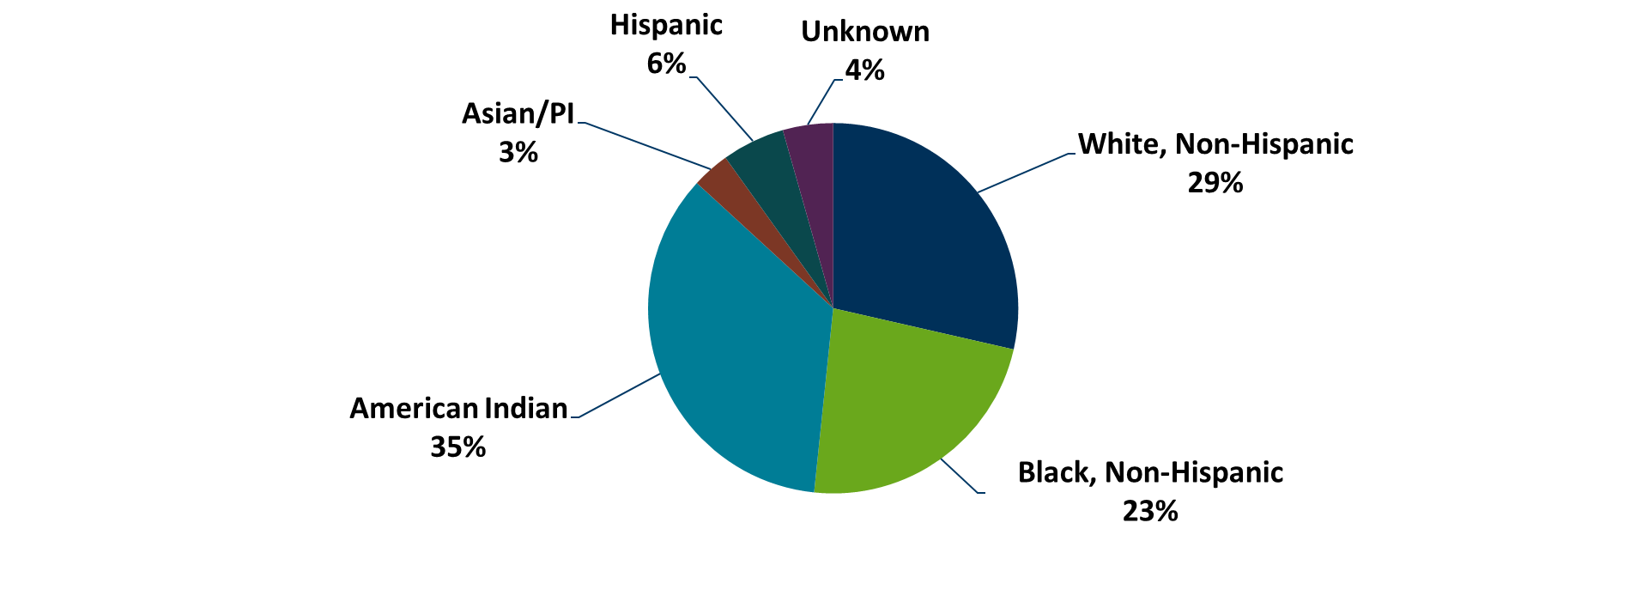
Early Syphilis Cases in Females by Race Minnesota, 2018
Total Number of Cases = 91
*Includes persons reported with more than one race
Notes:
There are large disparities in women with syphilis. Thirty-five percent of all early syphilis cases in females are found in the American Indian population and 23% in the Black, African American population.

Slide 19
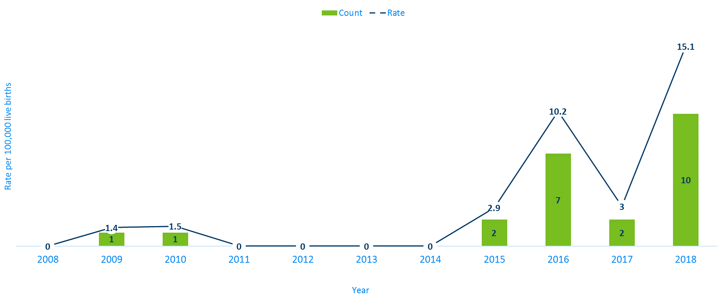
Congenital Syphilis Rates among Infants
Minnesota, 2008-2018
Notes:
Syphilis may be passed from a pregnant person to the unborn baby through the placenta. The infection can cause miscarriages and stillbirths, and infants born with congenital syphilis can suffer a variety of serious health problems, including deformities, seizures, anemia and jaundice.
The Centers for Disease Control and Prevention reported this fall that the number of infants born with syphilis has more than doubled in the past four years and last year reached a 20-year high.
In Minnesota, the number and rate of congenital syphilis cases among infants has increased over the past five years from a rate of 0 per 100,000 live births in 2014 to 15.1 per 100,000 live births in 2018.

Slide 20
Chlamydia
Minnesota Department of Health STD Surveillance System
Notes:
Now we will talk about Chlamydia

Slide 21
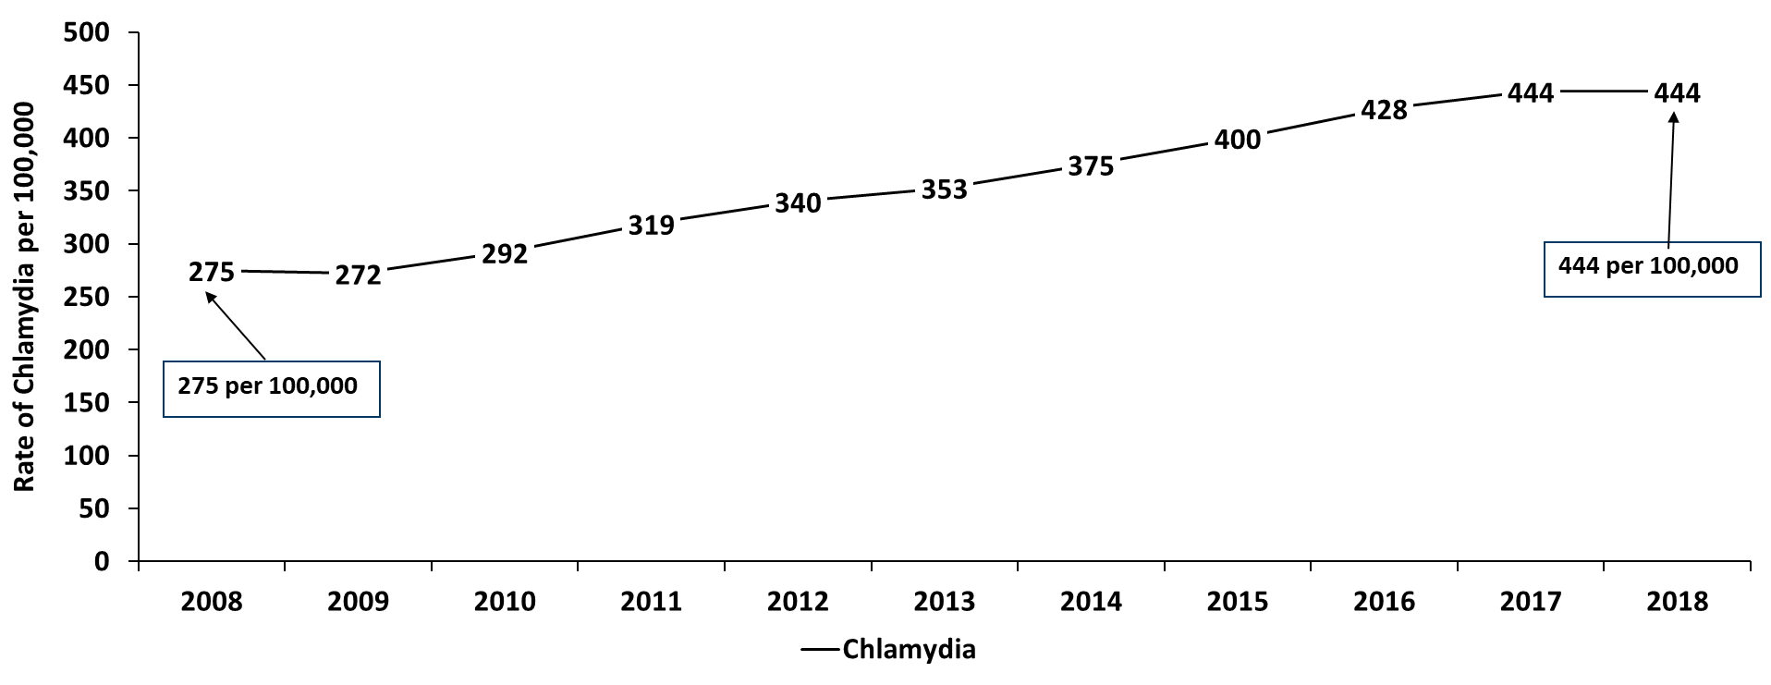
Chlamydia in Minnesota
Rate per 100,000 by Year of Diagnosis, 2008-2018
Notes:
As mentioned previously, the rate of chlamydia in MN reached an all time high at 444 per 100,000. This is the same rate as 2017.

Slide 22
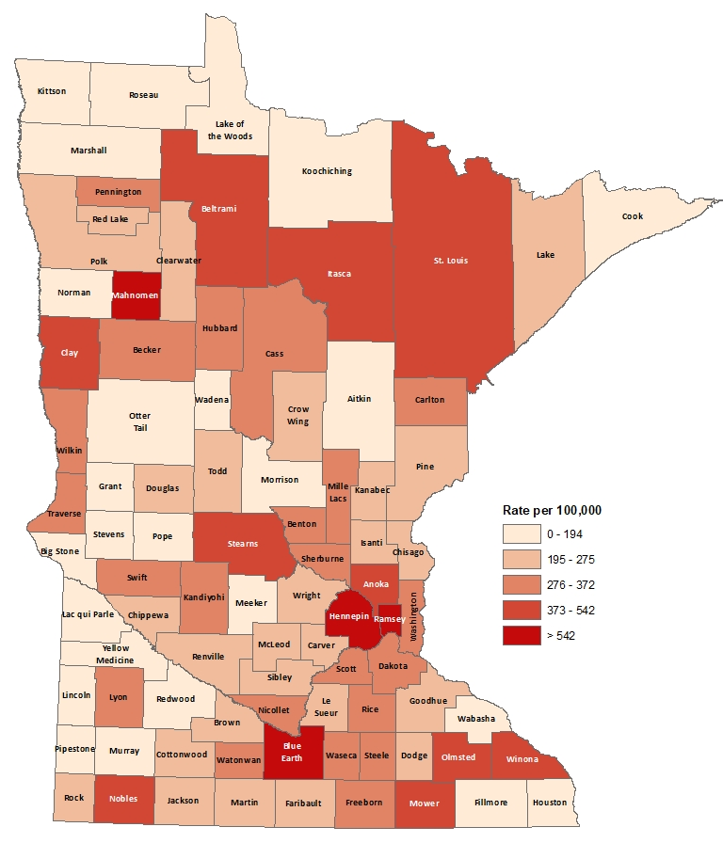
2018 Minnesota Chlamydia Rates by County
City of Minneapolis
City of St. Paul
Suburban*
Greater Minnesota
Total
1,255 per 100,000 (4,801 cases)
982 per 100,000 (2,798 cases)
358 per 100,000 (7,812 cases)
316 per 100,000 (7,750 cases)
444 per 100,000 (23,564 cases)
(403 cases missing residence information)
*7-county metro area, excluding the cities of Minneapolis and St. Paul
Notes:
All counties in Minnesota are affected by chlamydia. There were at least 5 cases in all counties in 2018.
The city of Minneapolis continues to have the highest rates of chlamydia at 1,255 per 100,000, followed by the city of St. Paul at 982 per 100,000, the suburban area (7-county metro excluding Minneapolis & St. Paul) at 358 per 100,000 and Greater Minnesota at 316 per 100,000.
Greater Minnesota had the greatest increase in rates between 2017 and 2018 at 5%.
The City of Minneapolis had a 2.9% decrease in rates for 2018 compared to 2017.

Slide 23
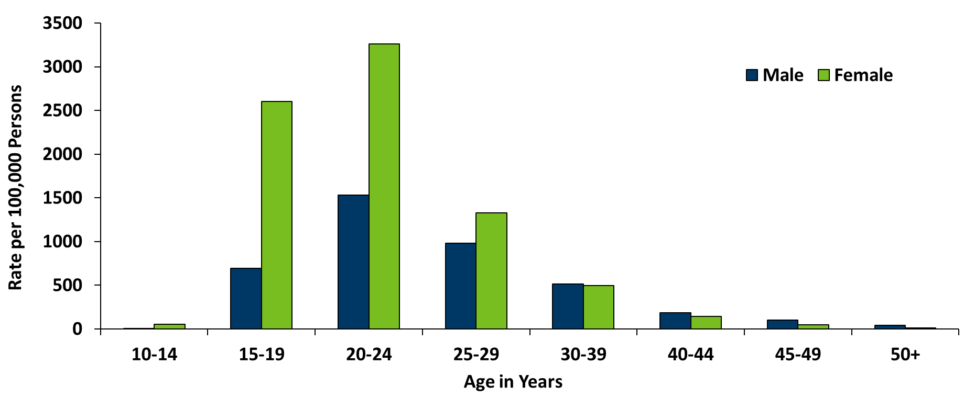
Age-Specific Chlamydia Rates by Gender, Minnesota, 2018
Notes:
Females, 20-24 years of age continue to have the highest rate at 3261 per 100,000.
The age group with the largest increase in rate were females, 40-44 years of age with a 18% increase from 2017.

Slide 24
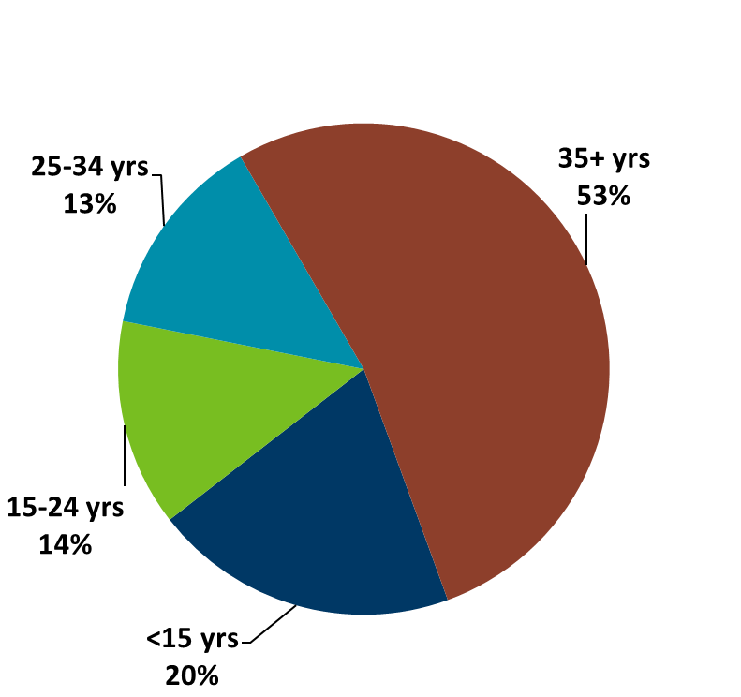
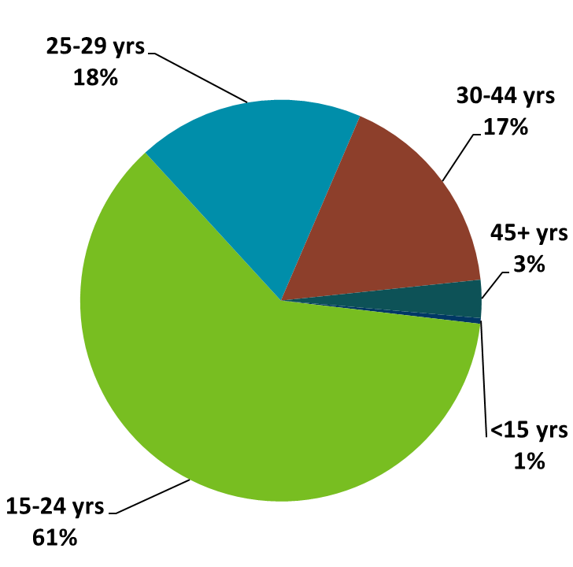
Chlamydia Disproportionately Impacts Youth
MN Population in 2010
(n = 5,303,925)
Chlamydia Cases in 2018
(n = 23,564)
Notes:
Chlamydia continues to disproportionately impact youth. The 15-24 year olds make up only 14% of the population, but account for 61% of all chlamydia cases reported.

Slide 25
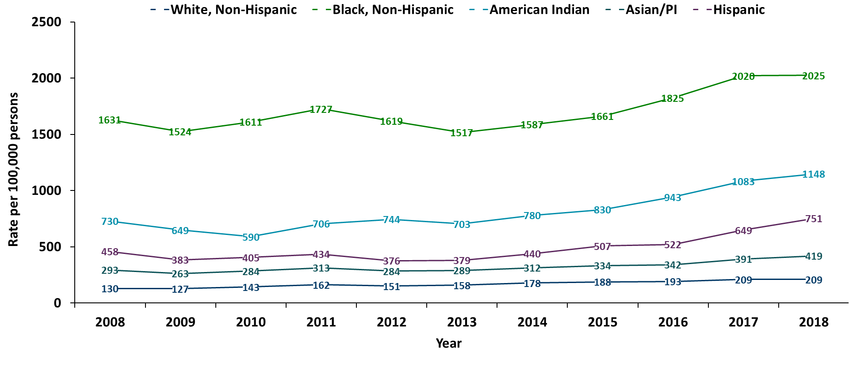
Chlamydia Rates by Race/Ethnicity, Minnesota, 2008-2018
2018 rates compared with Whites:
Black, Non-Hispanic = 9.7x higher
American Indian = 5.5x higher
Asian/PI = 2x higher
Hispanic* = 3.6x higher
Notes:
There continues to be disparities in rates of chlamydia.
The Black/African American, non-Hispanic population has rates that are 9.7 times higher than that of whites.
The rate in the Black/African American, non-Hispanic population was 2,025 per 100,000 compared to the rate in the White, non-Hispanic population at 209 per 100,000.
The American Indian population had a rate that was 5.5 times higher at 1,148 per 100,000
The Asian/Pacific Islander population had a rate that was 2 times higher at 419 per 100,000
The Hispanic/Latino population, which can be of any race, had a rate that was 3.6 times higher at 751 per 100,000

Slide 26
Gonorrhea
Minnesota Department of Health STD Surveillance System
Notes:
Lastly, we will cover Gonorrhea

Slide 27
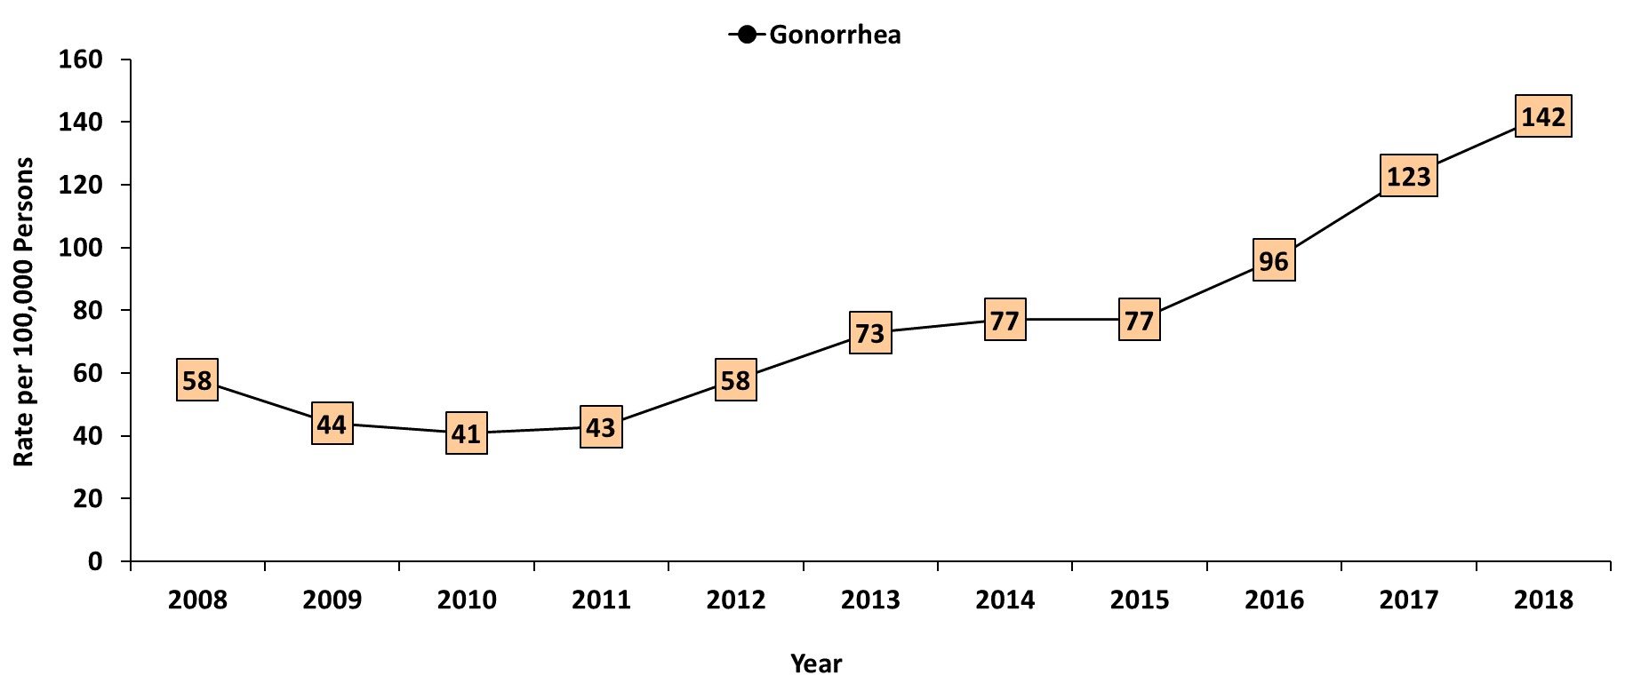
Gonorrhea in Minnesota
Rate per 100,000 by Year of Diagnosis, 2008-2018
Notes:
As mentioned previously, the rate of gonorrhea in MN reached an all time high at 142 per 100,000. This is a rate increase of 15% from 2017.

Slide 28
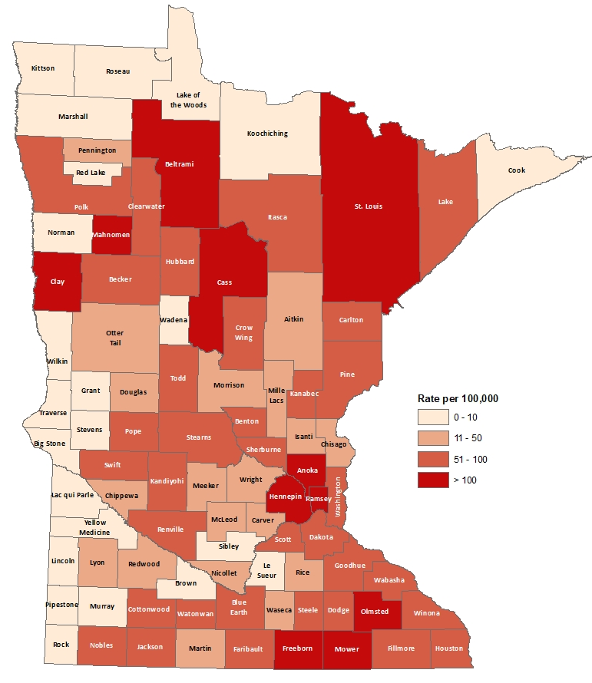
2018 Minnesota Gonorrhea Rates by County
City of Minneapolis
City of St. Paul
Suburban*
Greater Minnesota
Total
617 per 100,000 (2,361 cases)
393 per 100,000(1,121 cases)
99 per 100,000 (2,166 cases)
73 per 100,000 (1,787 cases)
142 per 100,000 (7,542 cases)
(107 cases missing residence information)
*7-county metro area, excluding the cities of Minneapolis and St. Paul
Notes:
The city of Minneapolis continues to have the highest rates of gonorrhea at 617 per 100,000, followed by the city of St. Paul at 393 per 100,000, the suburban area (7-county metro excluding Minneapolis & St. Paul) at 99 per 100,000 and Greater Minnesota at 73 per 100,000.
Greater Minnesota area had the highest increase at 35%, followed by the seven county metro Suburban area with a 14% increase. The City of Minneapolis had a 10% increase and the City of St Paul had the smallest increase at 8%.

Slide 29
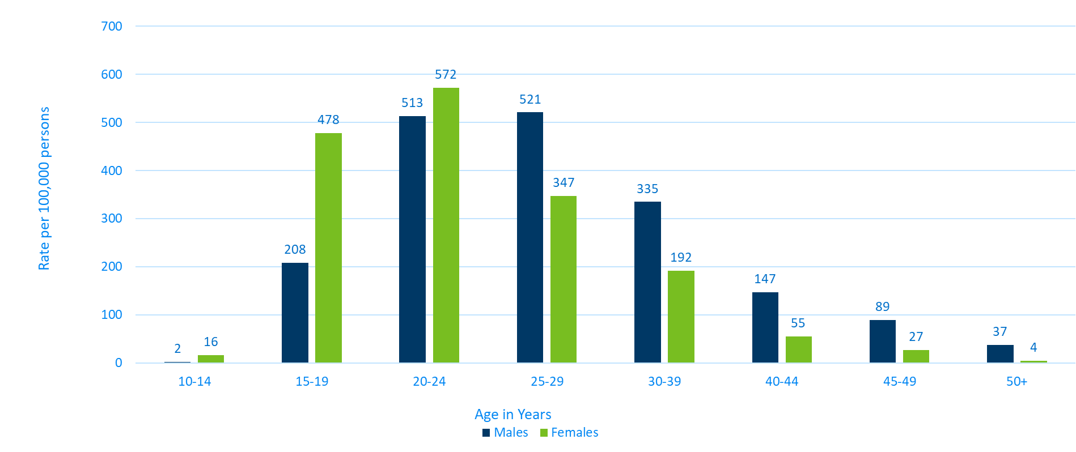
Age-Specific Gonorrhea Rates by Gender Minnesota, 2018
Notes:
The rates of gonorrhea went up in both males and females for each age group 15 years of age and older in 2018 compared to 2017. Females continue to have higher rates of gonorrhea than males that are younger than 25 years of age. In 2018 the males have higher rates in the 25 and over age groups.
The highest rates of gonorrhea are in females 20-24 at 572 per 100,000.

Slide 30
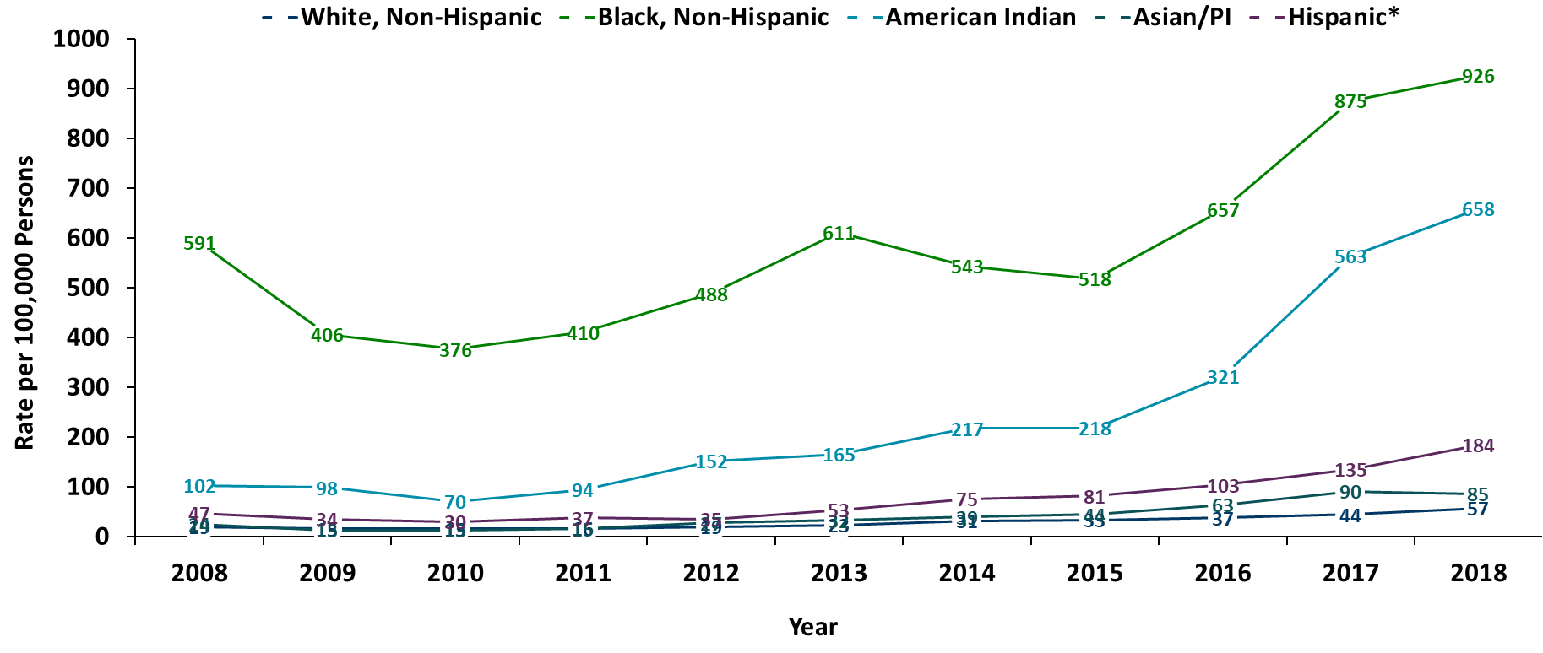
Gonorrhea Rates by Race/Ethnicity, Minnesota, 2008-2018
2018 rates compared with Whites:
Black, Non-Hispanic = 16x higher
American Indian = 12x higher
Asian/PI = 2x higher
Hispanic* = 3x higher
Notes:
There continues to be disparities in rates of gonorrhea.
The Black/African American, non-Hispanic population rates are 16 times higher than that of whites. The rate in the Black/African American population was 926 per 100,000 compared to the rate in the White, Non-Hispanic population at 57 per 100,000.
The American Indian population had a rate that was 12 times higher at 658 per 100,000
The Asian/Pacific Islander population had a rate that was 2 times higher at 85 per 100,000
The Hispanic/Latino population, which can be of any race, had a rate that was 3 times higher at 184 per 100,000

Slide 31
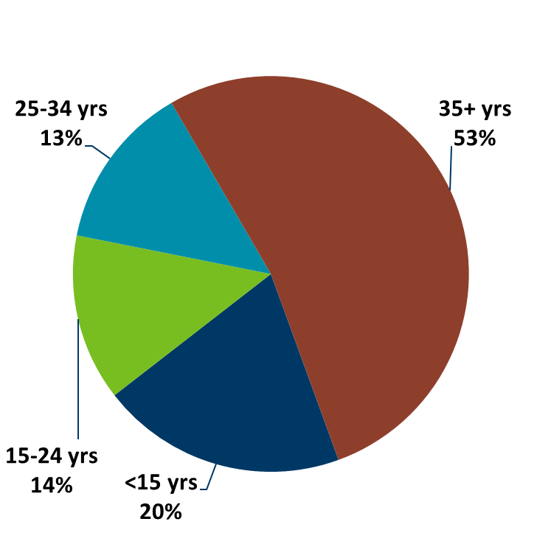
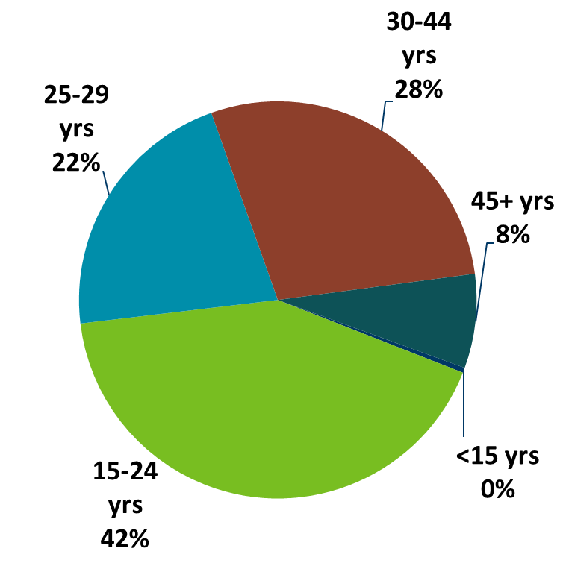
Gonorrhea Disproportionately Impacts Youth
MN Population in 2010
(n = 5,303,925)
Gonorrhea Cases in 2018
(n = 7542)
Notes:
Gonorrhea also disproportionately impacts youth. The 15-24 year olds make up only 14% of the population, but account for 42% of all gonorrhea cases reported.

Slide 32
SSuN
Minnesota Department of Health STD Surveillance System
Notes:
The Minnesota Department of Health continues to participate in the CDC-funded STD Surveillance Network (SSuN). We are one of 10 sites across the United States participating in the SSuN enhanced surveillance project.
SSuN is an enhanced STD surveillance project that focuses on collecting additional gonorrhea surveillance information from both patients and providers. Gonorrhea cases reported to the MDH are randomly selected for enhanced surveillance. The randomized sample is created to be a representative pictures of gonorrhea morbidity throughout the state of Minnesota.

Slide 33
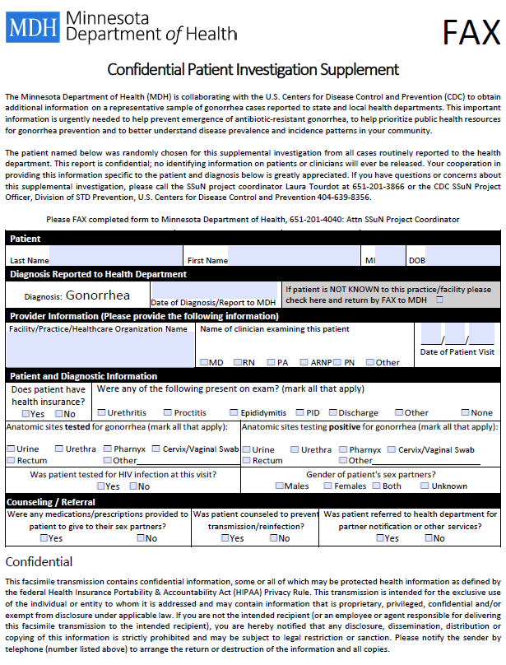
Provider Investigation
Notes:
For the gonorrhea cases who are randomly selected for SSuN, providers will receive a standard fax form shown here, requesting additional surveillance information including: classification of treating provider, does the patient have health insurance, symptoms present during exam, all anatomic sites tested for GC, was the patient test for HIV and gender of sex partner.

Slide 34
Gonorrhea is a notifiable condition in MN
Please remember to notify all patients after any STD diagnosis that their name and information is required by law to be reported to the Minnesota Department of Health.
Please ensure all STD case and lab reports are submitted to the MDH with proper contact information, including telephone number.
Please inform your patients, after a STD diagnosis, that they have a chance of being contacted by the MDH for additional follow up.
Notes:
Many SSuN cases are surprised when they received a call from the MDH regarding their gonorrhea infection. They did not know their name was required by law to be reported to the Minnesota Department of Health. Please remember to notify all patients after any STD diagnosis that their name and information is required by law to be reported to the Minnesota Department of Health. Please ensure all STD case and lab reports are submitted to the MDH with proper contact information, including telephone number. Please inform your patients, after a STD diagnosis, that they have a chance of being contacted by MDH for additional follow up.

Slide 35
Summary of STD Trends in Minnesota
From 2008-2018, the chlamydia rate increased by 61%. The rate of gonorrhea increased by 145%. While rates of reported syphilis have increased over the past decade, they have remained the same in 2018 as compared to 2017.
Minnesota has seen a resurgence of syphilis over the past decade, with men who have sex with men and those co-infected with HIV being especially impacted. However, the number of females is at the record high for the last decade.
Persons of color continue to be disproportionately affected by STDs.
STD rates are generally highest in the metro. However, chlamydia continues to be reported from every county in 2018.
Between 2017 and 2018, early syphilis cases decreased by 5%. Men who have sex with men comprised 84% of all male cases in 2018; cases among women are continuing to rise.
Notes:
To summarize the STD trends,
From 2008-2018, the chlamydia rate increased by 61%. The rate of gonorrhea increased by 145%. While rates of reported syphilis have increased over the past decade, they have remained the same in 2018 as compared to 2017.
Minnesota has seen a resurgence of syphilis over the past decade, with men who have sex with men and those co-infected with HIV being especially impacted. However, the number of females is at the record high for the last decade.
Persons of color continue to be disproportionately affected by STDs.
STD rates are generally highest in the metro. However, chlamydia continues to be reported from every county in 2018.
Between 2017 and 2018, early syphilis cases decreased by 5%. Men who have sex with men comprised 84% of all male cases in 2018; cases among women are continuing to rise.

Slide 36
Future Updates to STD Reporting and Current Follow-Up
There will soon be a new case report form to accommodate changes in treatment guidelines, requesting HIV testing status, and PrEP (Pre-Exposure Prophylaxis) usage
The case report form (available online) can be filled out and mailed or faxed into MDH
All cases co-infected with Early Syphilis will continue to be assigned to MDH Partner Services for follow-up
All STD cases continue to have the potential for being contacted by MDH for additional follow-up
Notes:
There will soon be a new case report form to accommodate changes in treatment guidelines, requesting HIV testing status, and PrEP (Pre-Exposure Prophylaxis) usage
The case report form (available online) can be filled out and mailed or faxed into MDH
All cases co-infected with Early Syphilis will continue to be assigned to MDH Partner Services for follow-up
All STD cases continue to have the potential for being contacted by MDH for additional follow-up

Slide 37
Thank you
To speak to someone regarding STD surveillance, please call 651-201-5414
For data requests, please visit: https://survey.vovici.com/se/56206EE3662437AB
Notes:
To speak with someone regarding STD statistics, or to make a data request, please reference the contact information on this slide

Slide 38
Highlights from the Minnesota HIV Surveillance Report, 2018
HIV/AIDS Surveillance System
Notes:
Today we are releasing our annual HIV surveillance report for 2018. During the webinar, I will be primarily discussing highlights from data about new HIV diagnoses reported to the health department during 2018, as well as updates to HIV prevalence in the state and ongoing Data2Care activities. The information that we will present is just a snapshot of the data we are releasing today and the full slide set, as well as accompanying tables, are all are available on our website at the link on this slide.

Slide 39
New HIV diagnoses in Minnesota, 2018
Notes:
We will first discuss highlights from data about new HIV diagnoses reported during 2018.

Slide 40
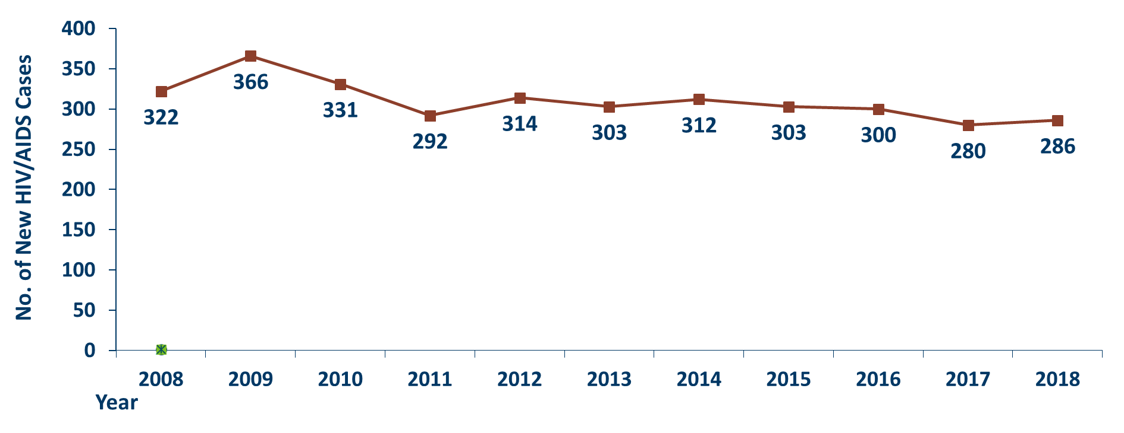
New HIV Disease Diagnoses*, HIV/AIDS Cases by Year, 2008-2018
Notes:
In this report, the term “new HIV diagnoses” refers to HIV-infected Minnesota residents who were diagnosed in a particular calendar year and reported to MDH. This includes persons whose first diagnosis of HIV infection is AIDS (AIDS at first diagnosis). HIV diagnoses data are displayed by earliest known date of HIV diagnosis.
In 2018, there was a slight increase of new HIV diagnoses from 2017. In 2018 there were 286 newly diagnosed cases, as compared to 280 cases in 2017. This represents an increase of about 2% compared to 2017. In reviewing newly diagnosed cases since 2014, 286 cases for 2018 is below the 5 year average of 296 cases per year.

Slide 41
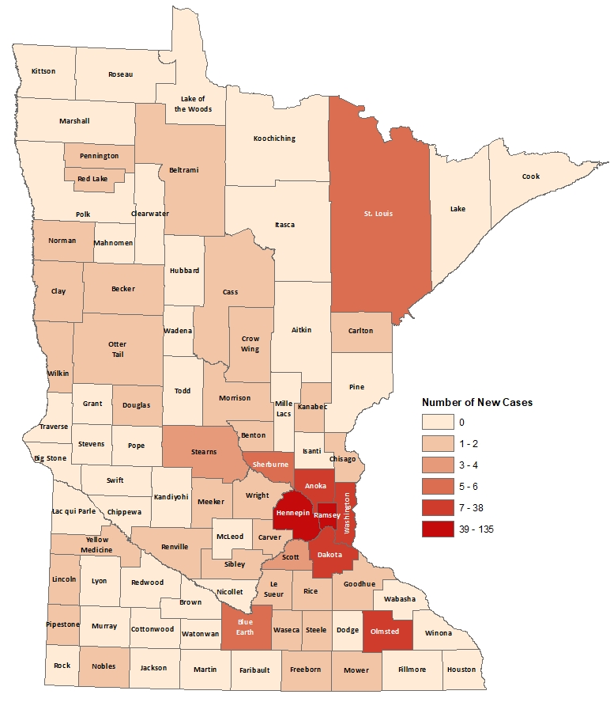
HIV Diagnoses# by County of Residence at Diagnosis, 2018
City of Minneapolis
City of St. Paul
Suburban*
Greater Minnesota
Total
75 cases (26%)
33 cases (11%)
113 cases (40%)
65 cases (23%)
286 cases
#HIV or AIDS at first diagnosis
*7-county metro area, excluding the cities of Minneapolis and St. Paul
Notes:
Historically, about 80% of new HIV infections diagnosed in Minnesota have occurred in Minneapolis, St. Paul and the surrounding seven-county metropolitan area.
In 2018, geographically, the new cases were concentrated in the Twin Cities metropolitan area, with 77% of the cases located in the seven county Twin Cities metro region with 26% in Minneapolis, 11% in St. Paul, and 40% in the remaining suburban area (excluding Minneapolis/St. Paul). In greater Minnesota, there were 65 newly diagnosed HIV cases in 35 counties.

Slide 42
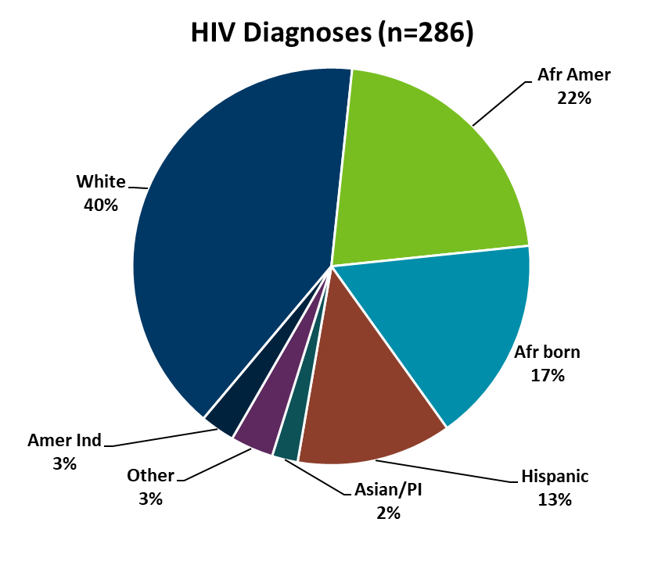
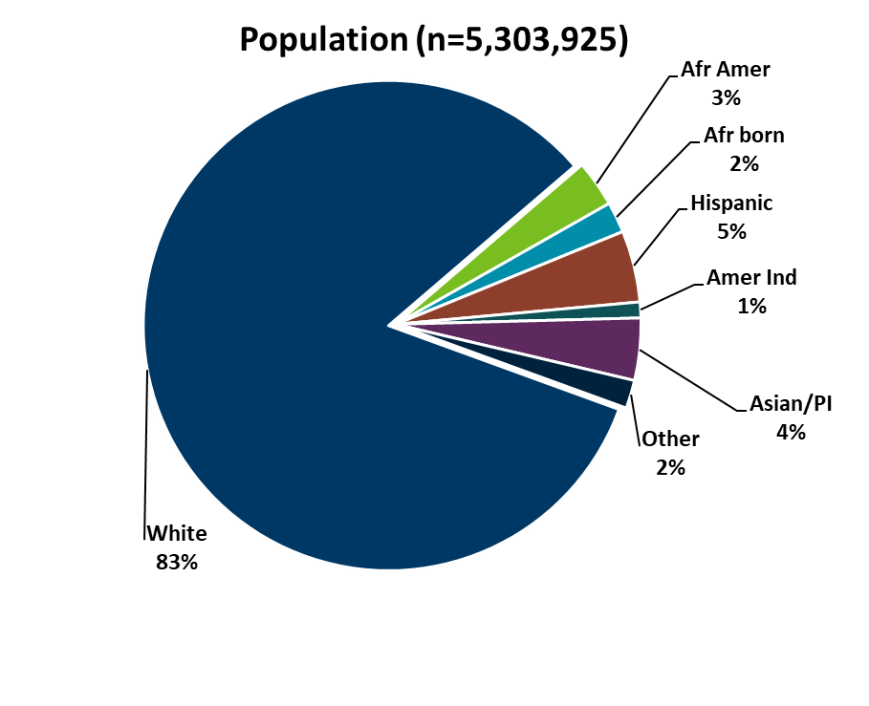
HIV Diagnoses* in Year 2018 and General Population in Minnesota by Race/Ethnicity
Notes:
When you look at the racial/ethnic distribution of new HIV diagnoses compared to the racial/ethnic distribution of the general population of Minnesota, it is apparent that disparities continue to exist among persons of color. Non-Hispanic African-American and Black African-born Minnesotans jointly make up about 5% of the population in Minnesota, yet, account for 38% of the newly diagnosed cases of HIV in 2018. Similarly, Hispanics of any race also account for approximately 5% of the population, but account for 13% of the newly diagnosed cases.

Slide 43
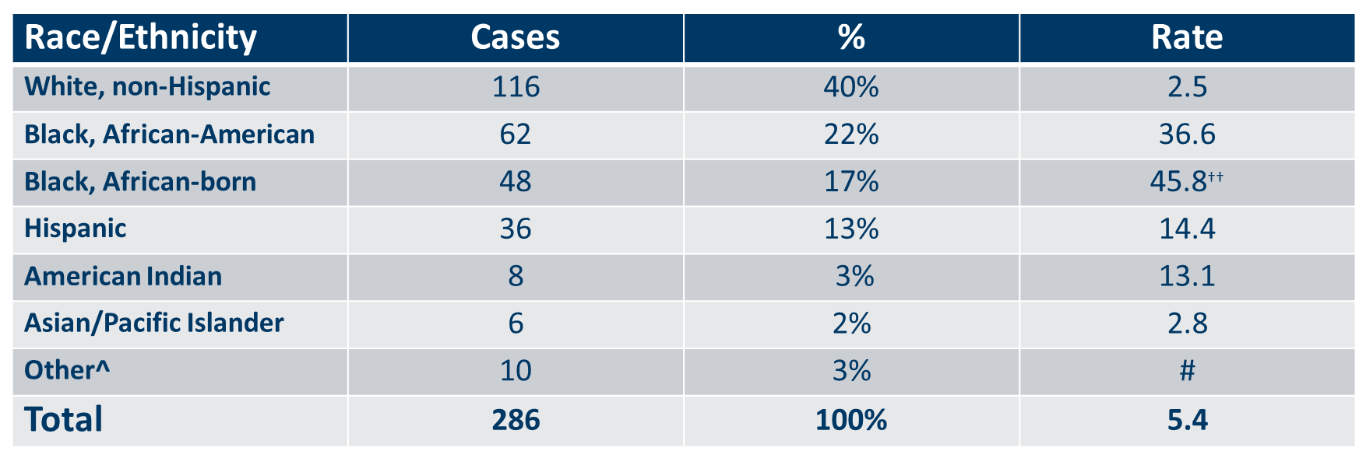
Number of Cases and Rates (per 100,000 persons) of HIV Diagnoses* by Race/Ethnicity† Minnesota, 2018
Notes:
Each year we calculate the rate of diagnosis for each racial/ethnic group represented in the surveillance system to assess the impact of HIV within each community. The rate takes into account the size of the population of each group.
Non-Hispanic black, African-born and African-Americans had the highest rate of diagnoses in 2018 with 45.8 HIV diagnoses per 100,000 population and 36.6 HIV diagnoses per 100,000 population respectively. This represents a rate of HIV diagnosis among the black, African-born community that is 18 times higher than the white non-Hispanic population in Minnesota. The rate among African-American non-Hispanic population is nearly 15 times higher than white non-Hispanic population. (Note: Rates for black, African-American and black, African-born are not comparable to previous years due to a decrease in the estimate for black, African-born population.)
Hispanic persons of any race have the next highest rate of newly diagnosed HIV cases in Minnesota at 14.4 per 100,000 persons; this is a rate of nearly 6 times higher than white, non-Hispanic persons.
American Indians have a rate of persons newly diagnosed with HIV of 13.1 per 100,000 persons, over five times the rate of white, non-Hispanic persons.

Slide 44
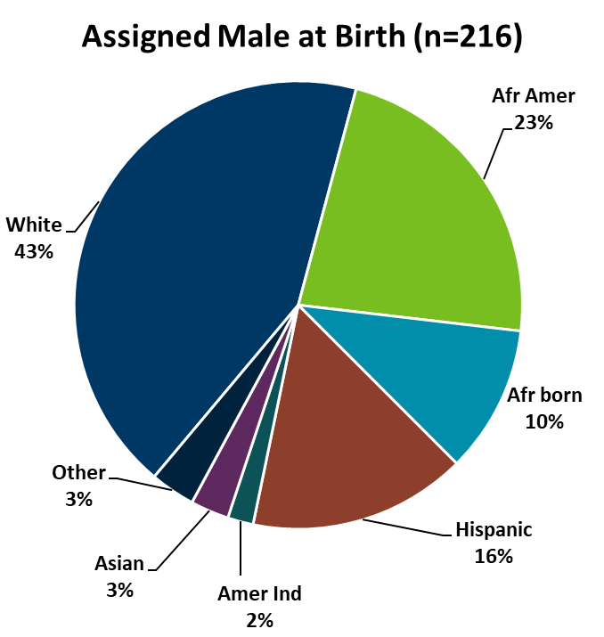
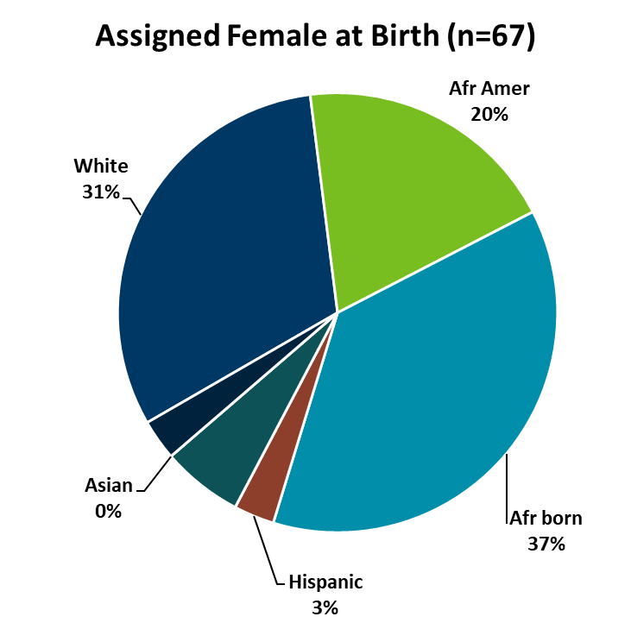
HIV Diagnoses* Diagnosed in Year 2018 by Sex Assigned at Birth and Race/Ethnicity
Notes:
There are differences in the racial/ethnic distribution by sex assigned at birth. Among those assigned the sex of male at birth, 43% of the 2018 cases diagnosed in Minnesota are Non-Hispanic white. Non-Hispanic African-American and black, African-born males made up 33% of cases and Hispanic males of any race accounted for 16% of cases.
Among those assigned the sex of female at birth, the disparities are even more apparent with women of color representing 70% of all the newly diagnosed females in 2018, with black, African-born women accounting for over a third (37%) of cases and Non-Hispanic African-American women accounting for 20% of cases.

Slide 45
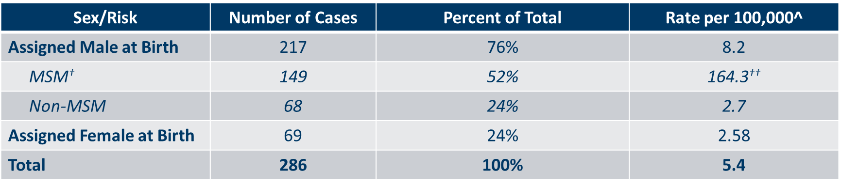
Number of Cases and Rates of Adults and Adolescents* Diagnosed with HIV/AIDS by Sex Assigned at Birth and Risk† in Minnesota, 2018
Notes:
Men who have Sex with Men have the highest rate of HIV diagnosis than any other sub-category. In 2018, the estimated rate of HIV diagnosis among MSM was 164.3 per 100,000 population. This is more than 60 times higher than the rate among non-MSM men.
It’s important to note that MSM contains cases from all racial/ethnic categories and therefore, cannot be directly compared to the rates on the previous slide. For more information on how this rate was estimated, see the HIV Surveillance Technical Notes which are available on our website.

Slide 46
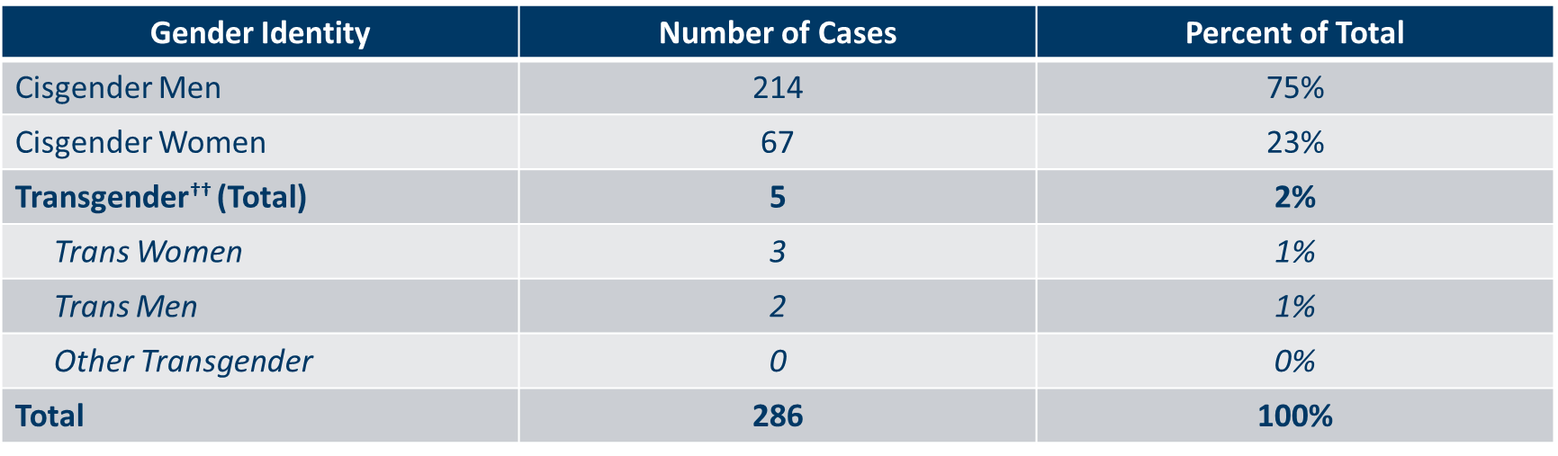
Number of Cases of Adults and Adolescents* Diagnosed with HIV/AIDS by Gender Identity in Minnesota, 2018
Notes:
This slide shows the number of people living with HIV/AIDS by gender identity.
In 2018, there were 5 transgender newly reported HIV cases in Minnesota (3 Trans Women and 2 Trans Men). This represents 2% of new cases reported in the state.

Slide 47
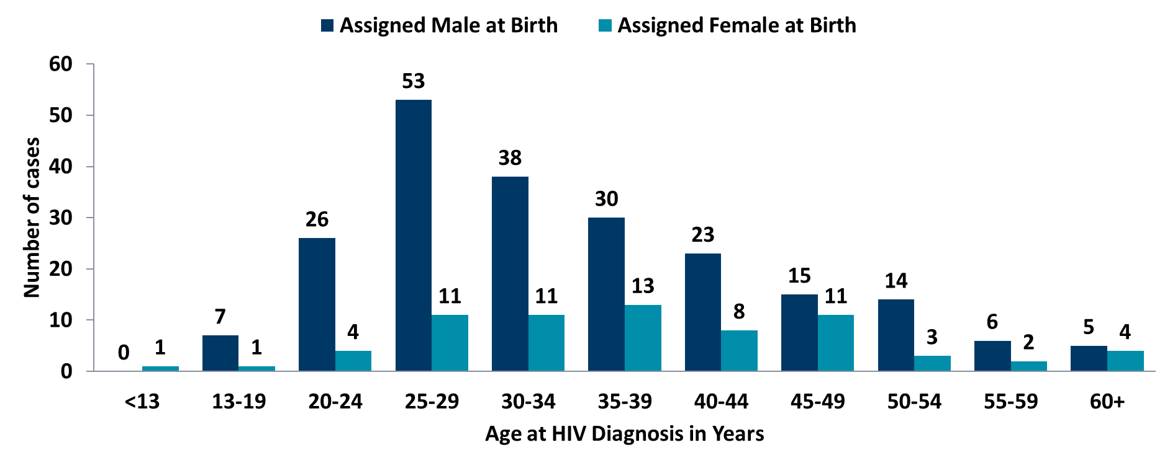
Age at HIV Diagnosis* by Sex at Birth, Minnesota, 2018
Notes:
In 2018, there were 103 cases diagnosed under the age of 30. This accounts for 36% of all cases. Most of these cases were among young people assigned the sex of male at birth, where 83% of cases under the age of 30 were male. The age groups from 25-34 had the largest number of cases in 2018, a change from 2017 when the most cases were seen in 20-29 age group.

Slide 48
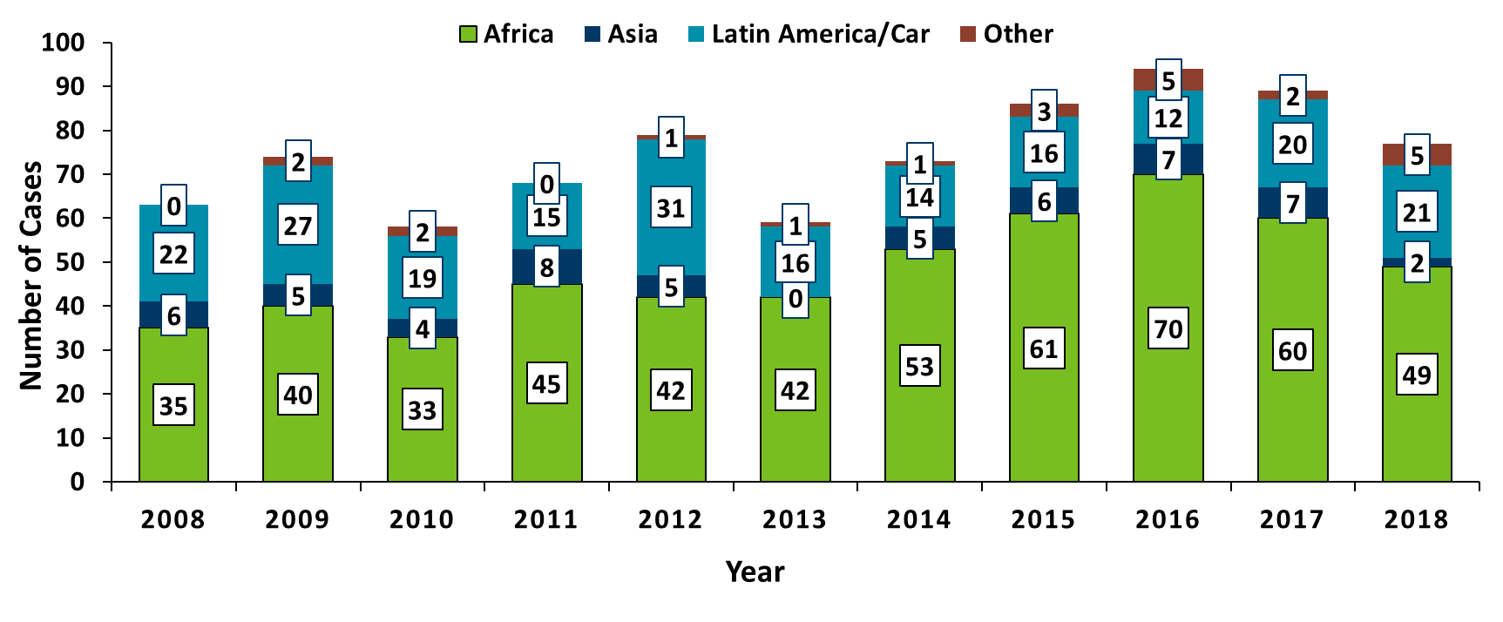
HIV Diagnoses* among Foreign-Born Persons† in Minnesota by Year and Region of Birth, 2008 - 2018
Notes:
The number of new HIV infections diagnosed among foreign-born persons in Minnesota has steadily increased from 20 cases in 1990 to 77 cases in 2018. This increase has been largely driven by the increase of cases among African-born persons from 8 cases in 1990 to 49 cases in 2018, as well as, persons from Mexico, Central and South America and the Caribbean from 6 cases in 1990 to 21 cases in 2018. Among new HIV infections diagnosed in 2018, 27% were among foreign-born persons. Based on 2010-2012 American Community Survey data, foreign-born persons make up 7% of the total Minnesota population and are, therefore, disproportionately affected by HIV. Among African-born this disparity is even more evident, while African-born persons make up just over 1% of the Minnesota population they accounted for 17% of new HIV infections in 2018.
In 2018, there were 77 cases of newly reported HIV among foreign-born persons, over one out of four of all new cases. The majority of foreign born cases in 2018 were from Africa, followed by Latin America and the Caribbean.

Slide 49
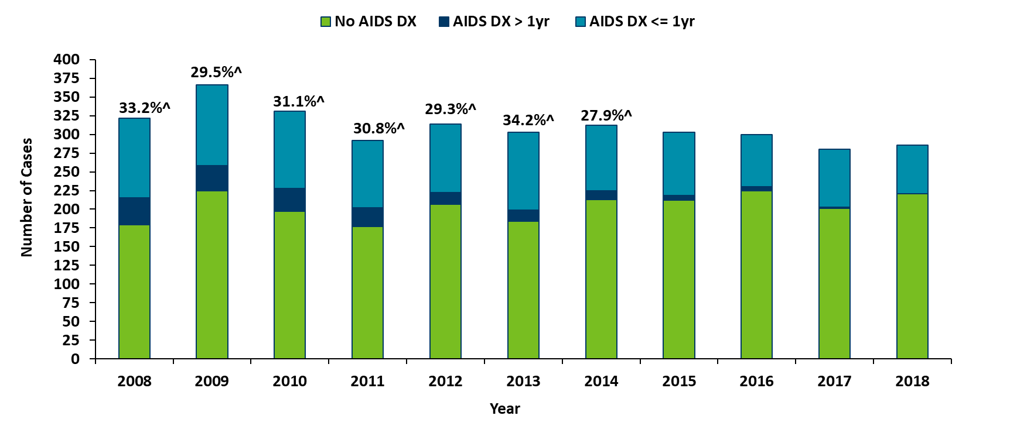
Time of Progression to AIDS for HIV Diagnoses in Minnesota*
2008 - 2018†
28.1%^
23.3%^
22.7%^
27.5%^
Notes:
In 2017, 28% of new cases were late testers. This proportion of cases has remained relatively the same over the past 10 years, ranging between 23-34%. Most late testers, about 85%, are diagnosed with AIDS at the same time they are initially diagnosed with HIV infection.
For 2018, 23% of new cases were late testers so far, which represents only a partial follow-up year to only April 1st, 2018.
As with other characteristics of the HIV epidemic in Minnesota, the proportion of late testers varies by demographic characteristics. Historically, foreign-born persons have had a higher proportion of late-testers.

Slide 50
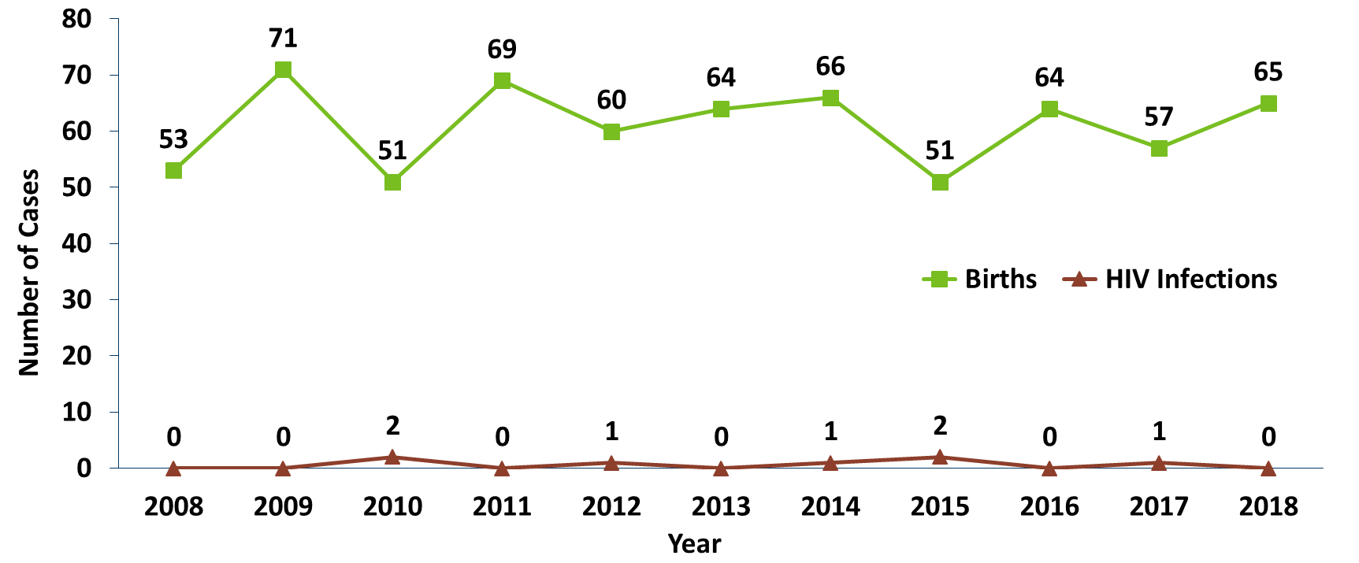
Births to HIV-Infected Pregnant Persons and Number of Perinatal Acquired HIV Infections* by Year of Birth, 2008- 2018
Notes:
The ability to interrupt the transmission of HIV from mother to child via antiretroviral therapy and appropriate perinatal care is an important accomplishment in the history of the HIV/AIDS epidemic. Newborn HIV infection rates range from 25-30% without antiretroviral therapy, but decrease to 1-2% with appropriate medical intervention.
For the past decade the number of births to HIV-infected pregnant parents has ranged between 51-71 births (2008-2018). For 2018, there were 65 births to pregnant parents living with HIV pregnant parents. The rate of transmission has decreased from 15% between 1994 and 1996 to 0.6% in the past three years (2016-2018), with 1 baby born with HIV in 2017.

Slide 51
Persons Living with HIV/AIDS in Minnesota
Notes:
Now we will talk about prevalence, or the cumulative number of people diagnosed with HIV and reported to the Minnesota Department of Health, and still believed to be living in the state. The HIV surveillance system is dynamic, with information being entered on a daily basis. These numbers are a snapshot as of the end of 2018, based on what was reported to the health department.

Slide 52
Estimated Number of Persons Living with HIV/AIDS in Minnesota
As of December 31, 2018 8,981* persons are assumed alive and living in Minnesota with HIV/AIDS. This includes:
  4,937 (55%) living with HIV infection (non-AIDS)
  4,044 (45%) living with AIDS
This number includes 2,331 persons who were first reported with HIV or AIDS elsewhere and subsequently moved to Minnesota
This number excludes 1,560 persons who were first reported with HIV or AIDS in Minnesota and subsequently moved out of the state
Notes:
As of the end of 2018, 8,981 people were believed to be alive and still living in the state of Minnesota. This number includes 4,937 (55%) living with HIV infection that had not progressed to an AIDS diagnosis, and 4,044 (45%) that had progressed to a clinical AIDS diagnosis. This total number also includes 2,331 people who were first reported with HIV or AIDS elsewhere and subsequently moved to Minnesota, and excludes 1,560 people who were first reported with HIV or AIDS in Minnesota and subsequently moved out of the state.

Slide 53
Foreign Born Persons Living with HIV/AIDS in Minnesota by Region of Birth, 2008-2018
*This number includes persons who reported Minnesota as their current state of residence, regardless of residence at time of diagnosis. It also includes state prisoners and refugees arriving through the HIV+ Refugee Resettlement Program, as well as HIV+ refugees/immigrants arriving through other programs.
Notes:
One particular population of interest in Minnesota that sets us apart from other states is our larger foreign-born HIV-positive population. Between 1990 and 2018, the number of foreign-born people living with HIV/AIDS in Minnesota increased substantially, especially among the African-born population. In 1990, 50 foreign-born people were reported to be living with HIV/AIDS in Minnesota, and by 2007 this number had increased to 1,126 people. In 2018, the total number of foreign-born people living with HIV/AIDS in Minnesota was 2,244, a nearly 7% increase from 2017. The majority of these people immigrated to the United States from Africa and Latin America. This trend illustrates the growing diversity of the HIV-positive population in Minnesota and the need for culturally appropriate HIV care and prevention efforts.

Slide 54
Data2Care Activities
Notes:
As mentioned earlier, the HIV surveillance system is dynamic and includes many different pieces of information from a variety of sources who report to the health department. One major project during the last year has been Data2Care, or the use of HIV surveillance data to support linkage to care for newly identified HIV diagnoses and re-engagement services for people who have fallen out of care.

Slide 55
What causes a Care Link Investigation?
Regular HIV care
CD4 and viral load results reported to MDH
Neither CD4 nor viral load received within 15 months
Patient contact from Care Link Services staff
Re-engagement in HIV care
Notes:
This chart shows the flow of HIV surveillance information as it specifically relates to re-engagement in HIV care services. The Minnesota Disease Reporting Rule requires submission of all CD4 and viral load results to the health department. These labs are used as a proxy for medical care for all people in the state HIV surveillance system. Whenever a patient has not had either a CD4 or viral load reported within 15 months, Care Link Services staff reach out to the patient to help them re-engage in care and provide additional referrals and counseling to overcome barriers to care.

Slide 56
MDH Care Link Services Program
The Care Link Services (CLS) program conducts activities to facilitate linkage or re-engagement to medical care and other services for HIV positive persons who may be in need of these services and who reside in Minnesota outside of Hennepin County.
The CLS team consists of:
  Supervisors: Marcie Babcock and Brian Kendrick
  Lead CLS Disease Intervention Specialist (DIS): George Kraus
  CLS DIS: Anna Bosch, Mady Ekue-Hettah
For information contact George Kraus, George.Krause@state.mn.us or 651-201-4010
Hennepin County residents are serviced by the Red Door Data2Care program. For information contact Scott Bilodeau scott.bilodeau@hennepin.us or 612-596-7905
Notes:
The MDH care link services program or CLS conducts activities to link or re-engage people living with HIV to medical and other supportive services. The program serves residents of Minnesota living outside of Hennepin County.
CLS has two supervisors for operational support, Marcie and Brian; one lead worker who coordinates outreach and field activities, George; and two CLS disease intervention specialists, Anna and Mady who, along with the lead worker, provide direct client services.
For more information about the CLS program, contact George at the email or phone number listed on this slide.
Hennepin county residents are serviced by the data-to care program of the Hennepin County Public Health Red Door clinic. Scott is a data to care program specialist, and he can be reached at the email or number on the slide for program information.

Slide 57
Conclusions
Total HIV diagnoses for 2018 slightly higher than 2017
Men who have sex with Men continue to have high rates of new HIV infections
More than half of newly reported HIV infections were among communities of color
More than one-third of newly reported HIV infections were under 30 years of age
HIV prevalence only increased by 192 during 2018, as a result of Data2Care activities and interstate deduplication efforts
Notes:
To conclude, the number of new HIV infections in 2018 are up 2% from 2017. Most of the new infections were concentrated in the seven county Twin Cities metro region.
Men who have sex with men and persons of color continue to have higher rates of new infections. More than half, four of every six (59%) of newly reported HIV cases were among persons of color.
More than one-third (36%) of newly reported HIV infections were under 30 years of age.
HIV prevalence increased by 192 during 2018, which is considerably lower than our 10-year average of 285 per year. Some of this is a result of Data2Care activities in the state, which have helped us identify patients who moved from Minnesota and we had not been previously notified at the health department.

Slide 58
Thank you!
Cheryl Barber, Jared Shenk, and Adrianna Sonnek, MDH Epidemiologists
Cheryl.Barber@state.mn.us
Jared.Shenk@state.mn.us
Adrianna.Sonnek@state.mn.us
Notes:
Thank you for your time. If you have questions regarding the slides and annual report you can contact us at the e-mail addresses here on the slide. And again, the full set of slides, text and tables are now available on our website for you to use.

Slide 59
Hepatitis A, B & C in Minnesota, 2018
Hepatitis Surveillance System
Notes:
Here are some highlights from the 2018 hepatitis surveillance data.

Slide 60
Introduction
Data in this presentation are current through 2018
Definitions:
  Acute case:
    Infected within the last six months
    Symptomatic OR negative test in six months before diagnosis
  Chronic case:
    Infected for over six months
    Asymptomatic or symptomatic
  Resolved cases:
    No evidence of current infection
    Evidence of past infection
Notes:
Before I get started, I’d like to give some background and information that will help you understand this presentation. Data in this presentation are current through the end of 2018. Then on to some definitions of hepatitis cases, because clinically people use different language around hepatitis C, so I want to share how we think about things from a public health perspective. So when I’m talking about acute cases in this presentation, I’m talking about cases that were infected within the last 6 months. They may be symptomatic or may have a negative test in the six months before their diagnosis and be asymptomatic. When we talk about chronic cases, we are talking about cases that have been infected for over 6 months, symptomatic or asymptomatic. And resolved cases are those with no evidence of current infection, but they do have evidence of past infection.

Slide 61
Data limitations
The slides rely on data from HCV and HBV cases diagnosed through 2018 and reported to the Minnesota Department of Health (MDH) Hepatitis Surveillance System.
Some limitations of surveillance data:
  Data do not include hepatitis-infected persons who have not been tested
  Data do not include persons whose positive test results have not been reported to the MDH
Persons are assumed to be alive unless the MDH has knowledge of their death. Most recent match with Minnesota death records was in 2016.
Persons whose most recently reported state of residence was Minnesota are assumed to be currently residing in Minnesota unless the MDH has knowledge of their relocation.
Notes:
I also want to be sure to mention the limitations of hepatitis surveillance data. The data in this presentation are based on cases in our surveillance system, which only include cases that have been tested for hepatitis and have been reported to the Minnesota Department of Health. We assume that people are alive unless we have knowledge of their death. This information is most readily available for individual who pass away in Minnesota. We are able to utilize death record matches to remove these cases from our surveillance data. This match was most recently completed in 2016 and has not yet been completed for the last two years of data. We also assume people are living in Minnesota if this was their most recently reported state of residence. Unlike HIV, we don’t have a system to notify other states as cases move from state to state, so we are unaware of many of our cases that move in and out of the state.

Slide 62
Acute Viral Hepatitis
Acute case:
  Infected within the last six months
  Symptomatic OR negative test within 6 months before diagnosis
Notes:
I’ll start with acute cases and provide some information on what has been happening with acute viral hepatitis over the last few years.

Slide 63
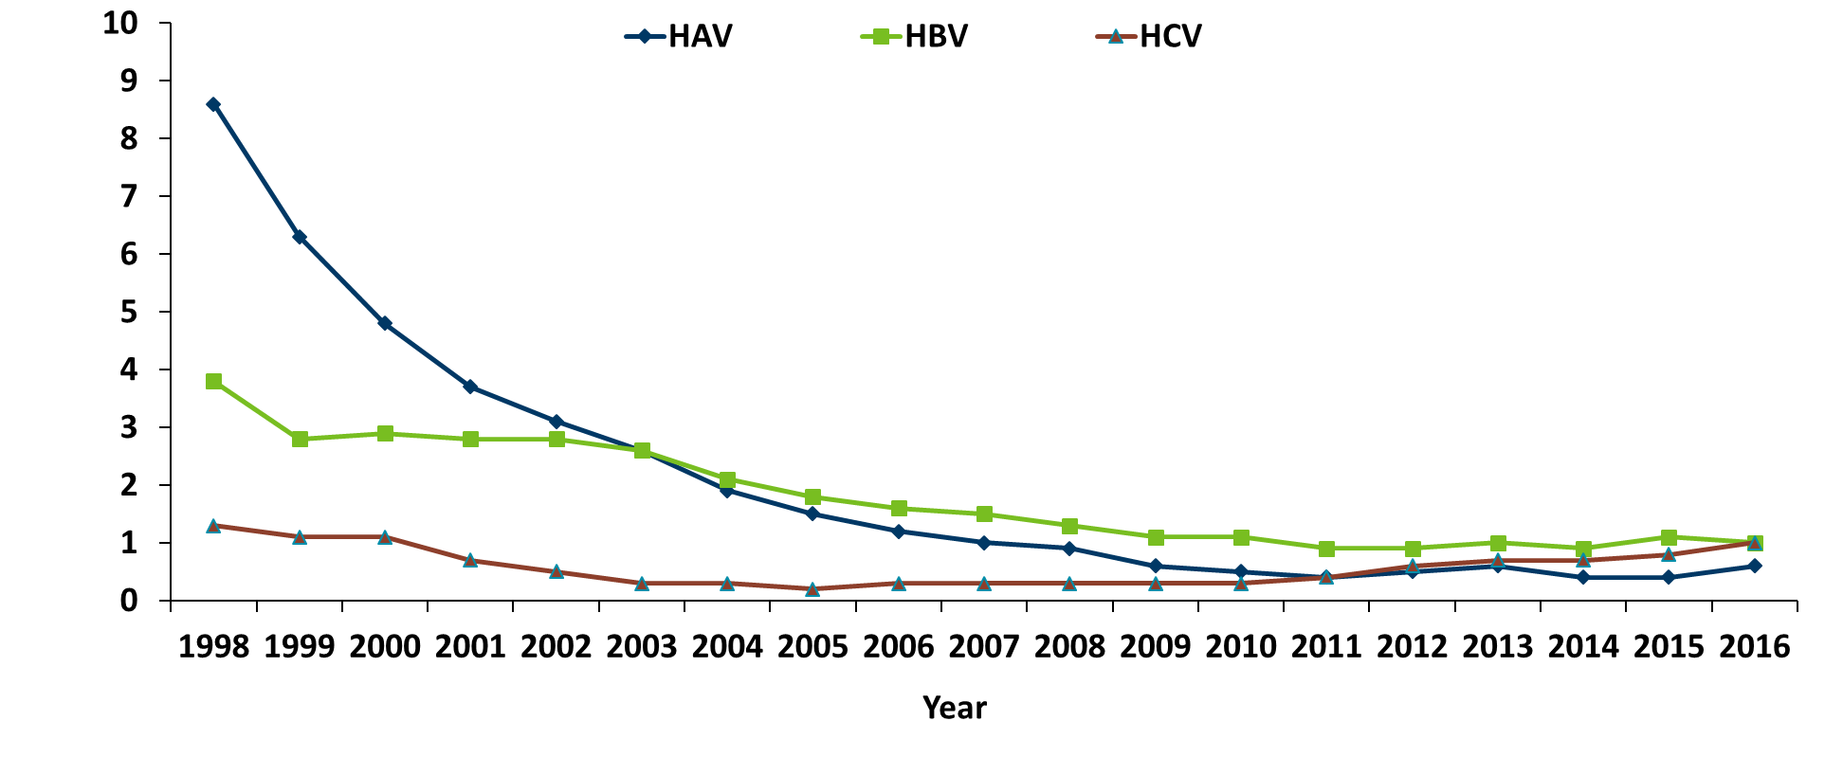
Reported rate per 100,000 population of acute viral hepatitis United States, 1998-2016
Notes:
In the United States, we’ve seen over the past 15+ years, a decrease in the incidence of acute hepatitis A and hepatitis B. You can see those in the dark blue and green lines here. These are both vaccine preventable diseases and we have seen decreases as vaccine rates have increased over that time period. If you look at hepatitis C though, you can see that from 1998 until 2005, we saw a decrease in the incidence of acute hepatitis C. But starting in 2010, you can see that nationally we are seeing increases in the incidence of hepatitis C.

Slide 64
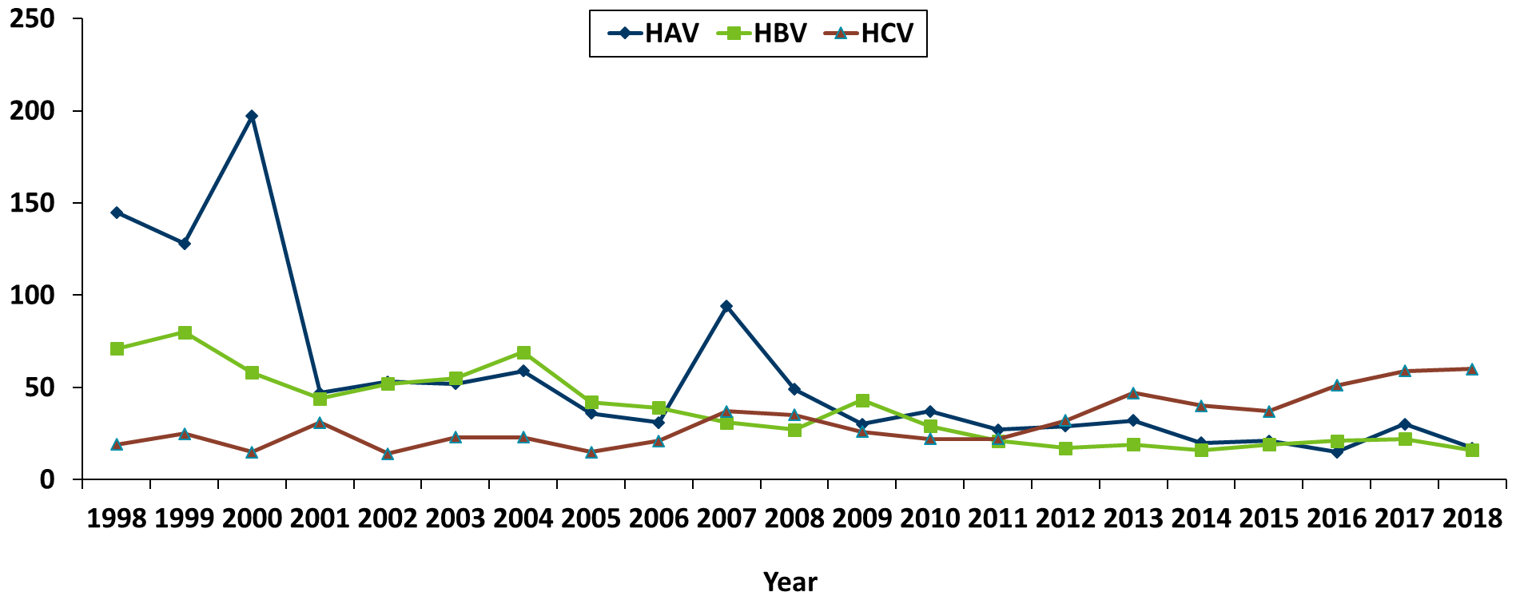
Number of Acute* Cases per year Minnesota, 1998-2018
Notes:
You can see the same pattern when we look at Minnesota cases. There is a little more obvious fluctuation in the data due to smaller case counts. But you can see in dark blue, hepatitis A has a general decreasing trend over the time period. Hepatitis B, in green, has a decrease as well, although slightly smaller. But hepatitis C, while having some ups and downs over time, has been showing an upward trend. In 2018, there were 60 cases of acute hepatitis C reported.

Slide 65
Chronic Viral Hepatitis C
Notes:
Now I’m going to move on to chronic viral hepatitis.

Slide 66
Overview of HCV in Minnesota
A hepatitis C case is defined as current infection with hepatitis C and includes:
Chronic cases:
  Probable – anti-HCV + alone
  Confirmed – HCV RNA +
Notes:
Looking at hepatitis C in Minnesota, our chronic cases are those with current infection with hepatitis C. These are people with either just a positive antibody test or those with confirmatory RNA testing that is positive.

Slide 67
Changes in Case Counting, 2016
Removed resolved infections from case counts
Completed match with death registry for 1997 through 2016
Notes:
In 2016, we did change our case counting to use this criteria. We removed resolved infections from our case counts, and as mentioned earlier, we did complete a match with our death records through 2016.

Slide 68
Reported Number of Persons Living with HCV in MN
As of December 31, 2018, 33,856* persons are assumed alive and living in MN with HCV.
Note: Includes all acute, chronic, probable chronic, and resolved cases.
*Includes persons with unknown city of residence
Notes:
At the end of 2018, we had 33,856 persons assumed alive and living with hepatitis C in Minnesota. This is the second year in a row that we’ve seen a decrease in the overall number of cases of hepatitis C. This means that there were more people that were reported as having their hepatitis C infection cured than reports of newly identified cases. So for comparison, in 2016, we had 35,623 cases, compared with 2017 at 34,720 cases and here, 2018 with 33,856 persons assumed alive and living in Minnesota with hepatitis C. So these are decreases of just shy of 1,000 people per year. This is certainly the direction we want to see things going!

Slide 69
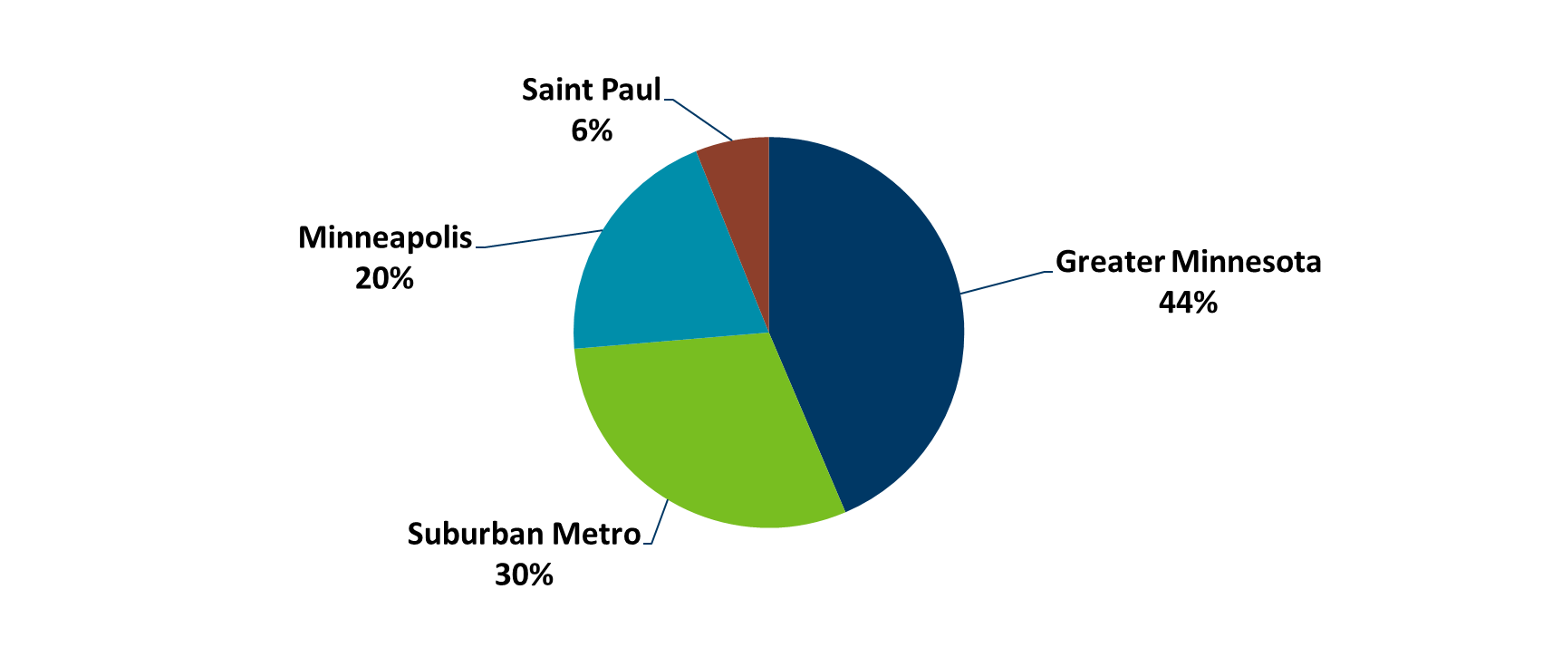
Persons Living with HCV in MN by Current Residence, 2018
Total number with residence information = 33,081
(775 missing residence information)
Suburban = Seven-county metro area including Anoka, Carver, Dakota, Hennepin (except Minneapolis), Ramsey (except St. Paul), Scott, and Washington counties including those in Hennepin County or Ramsey County with unknown city. Greater MN = All other Minnesota counties, outside the seven-county metro area.
Data Source: MN Viral Hepatitis Surveillance System
Notes:
There is some misperception that the majority of hepatitis C cases live in the metro area of the state. But we actually have a significant number of our cases that live in Greater Minnesota – 44%, with 30% living in the suburban metro, 20% living in Minneapolis, and 6% in St. Paul. So under half of the cases are in Greater Minnesota, but still a large number of our cases.

Slide 70
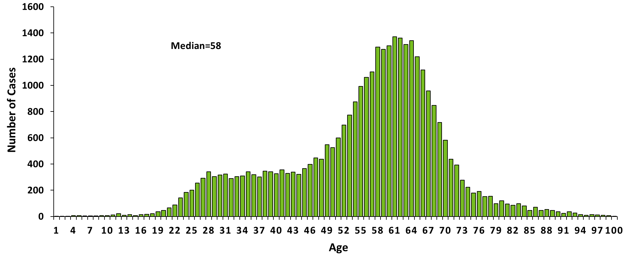
Persons Living with HCV in MN by Age, 2018
Notes:
If we look at hepatitis C by age, you can see that the median age is 58 and the main peak is in the baby boomer cohort. This is consistent with what we know about hepatitis C infection and prevalent cases. Most of these cases were infected long ago and are living with hepatitis C, but do not represent recently infected individuals.

Slide 71
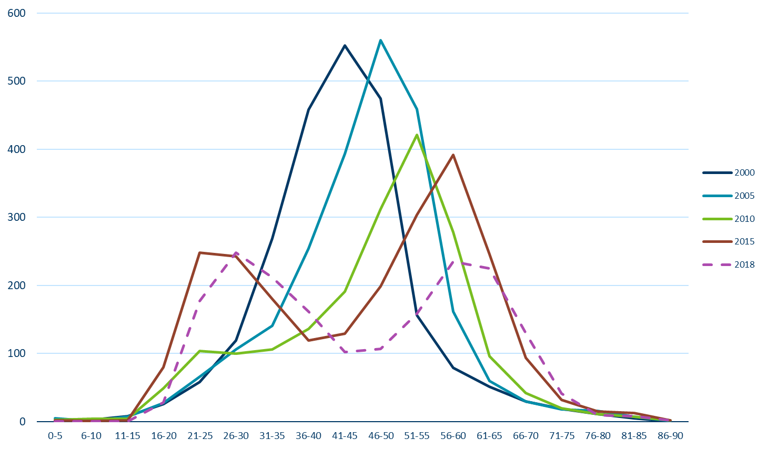
New Reports of HCV in Minnesota by Age Group, 2018
Notes:
When we look at new reports of hepatitis C by age group, you can see that there are a few different years here – 2000, 2005, 2010, 2015, and 2018. If you look at the early years, 2000 and 2005, those are the years with high peaks in the middle in the 40-50 age range. This peak is inclusive of our baby boomer cohort. Over time, you can see that the peak moves to the right as this population ages, and begins to drop as more and more of this age group is diagnosed over time. What we start to see in 2010 and 2015 is that a second peak has emerged. This peak is in our 21-30 year old age range. You can see in 2010 this peak starts to show up, and by 2015 it becomes a strong double peak pattern. 2018 is included on this graph, even though it’s not a 5-year interval, to show what happened last year. In 2018, the peak in our young populations surpassed our baby boomer cohort for the first time. This is concerning because these young people who have hepatitis C are likely to be more recently infected. Along with the previously mentioned increase in acute hepatitis C infections, this data shows we have more ongoing transmission of hepatitis C in Minnesota.

Slide 72
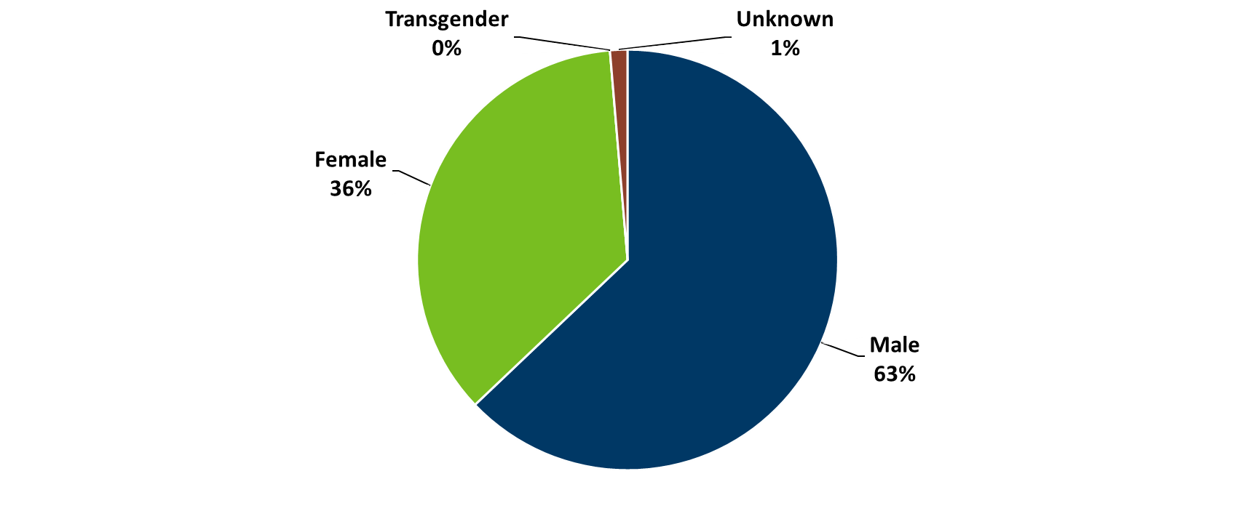
Persons Living with HCV in MN by Gender*, 2018
Notes:
When we look at hepatitis C by gender, we have more male cases than female. This is starting to shift a little in our new infections, where we are starting to see more female cases. But overall, since the majority of our cases are still in the baby boomer population, this distribution still holds with more male than female cases since that is what we see in that baby boomer cohort.

Slide 73
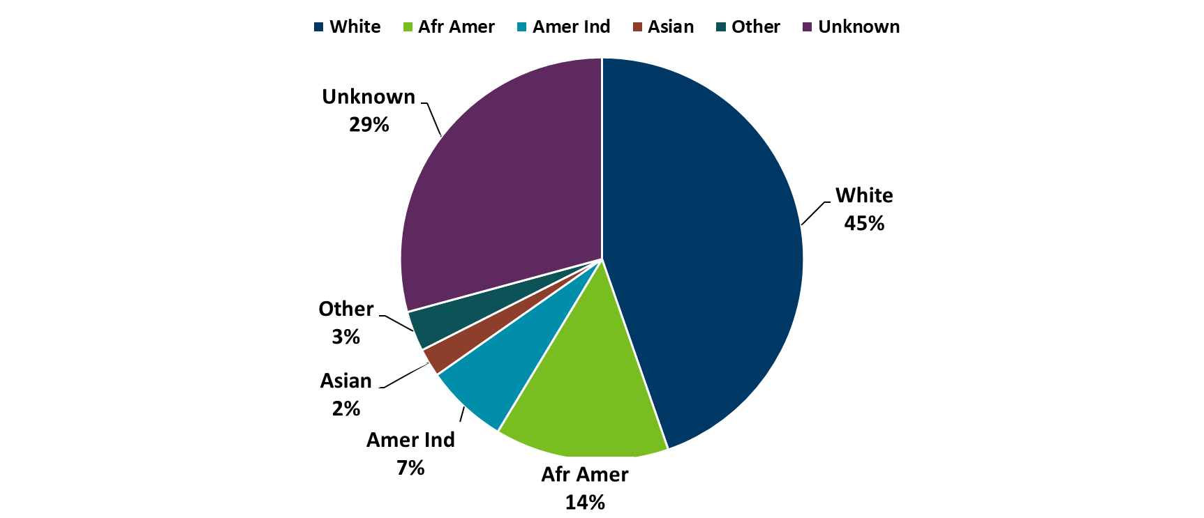
Persons Living with Chronic HCV in Minnesota by Race, 2018
Afr Amer = African American /Black Asian=Asian or Pacific Islander Amer Ind = American Indian
Other = Multi-racial persons or persons with other race
Notes:
When we look at cases by race, the largest percentage of cases is in white, non-Hispanic Minnesotans. But when we look at the next slide, which looks at this racial data using rates, it tells a different story.

Slide 74
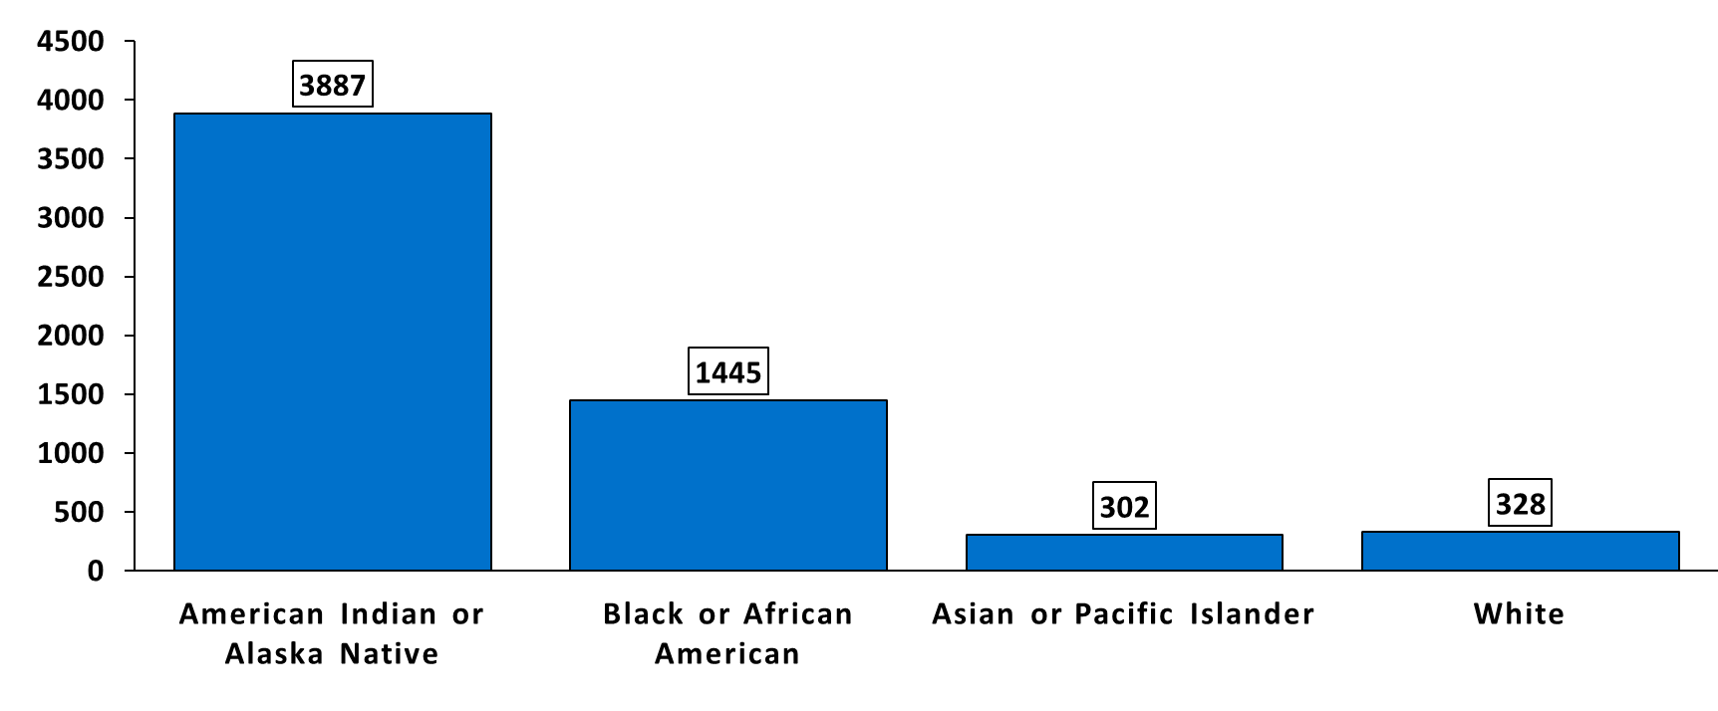
Persons Living with HCV in Minnesota by Race rates (per 100,000 persons*), 2018
Notes:
When we look at rates of hepatitis C, you can see that hepatitis C disproportionately impacts our American Indian and Alaskan Native and Black or African American Minnesotans.

Slide 75
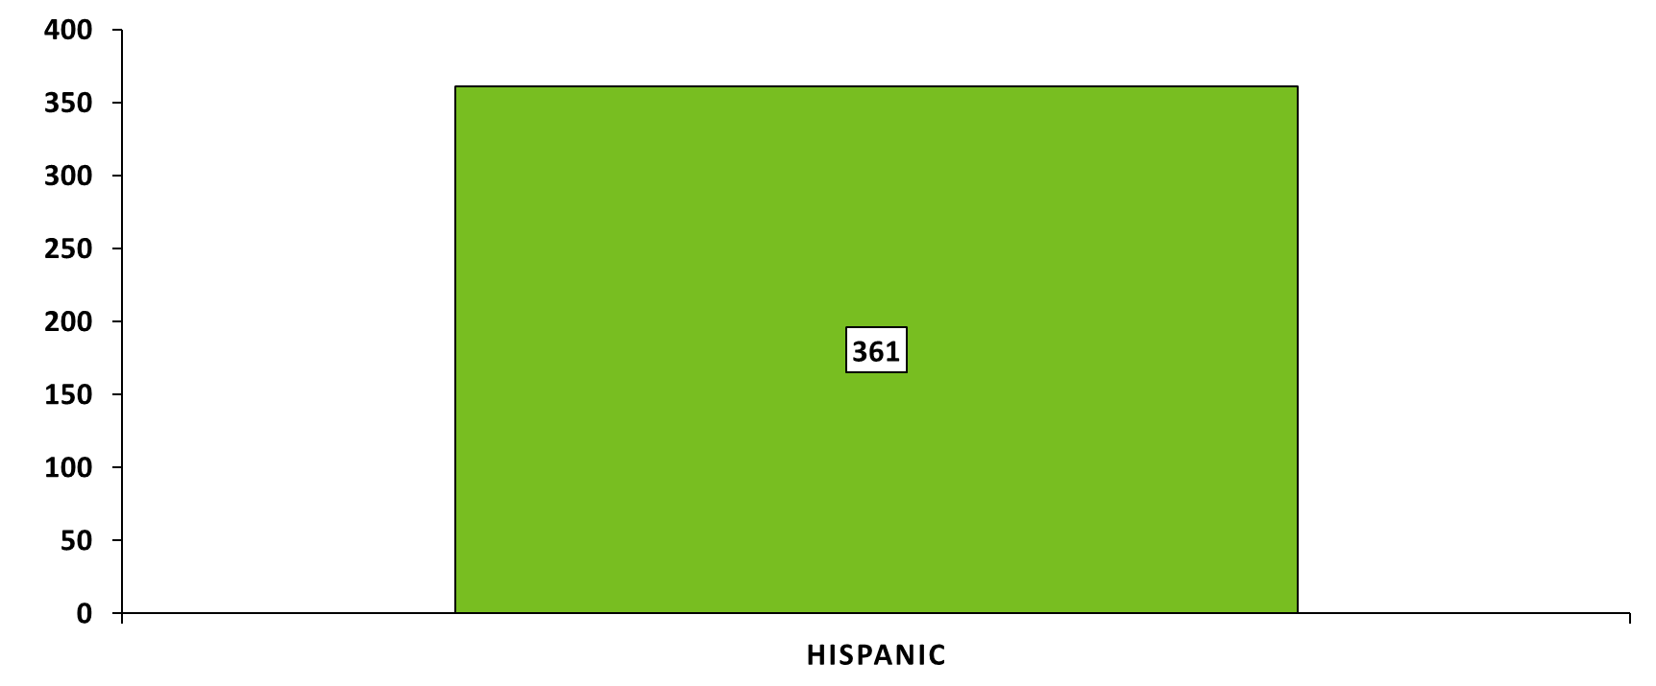
Persons Living with HCV in Minnesota by Ethnicity rates (per 100,000 persons*), 2018
*Rates calculated using 2017 U.S. Census ACS data
Excludes persons with unknown ethnicity, n=18,343
Notes:
This slide shows the rates in Hispanic Minnesotans, which is 361 per 100,000, which is similar to Asian or White Minnesotans.

Slide 76
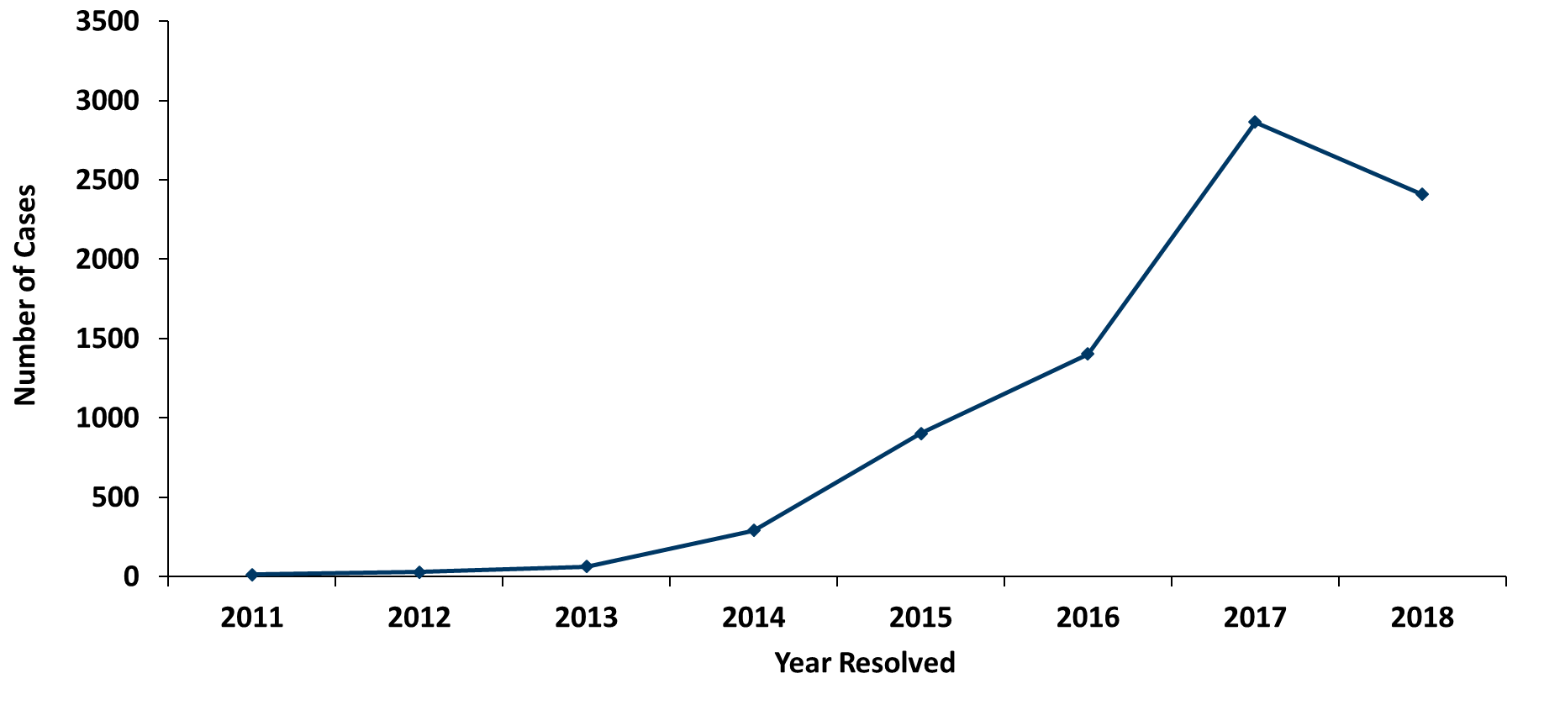
Resolved hepatitis C, 2018
Notes:
We are continuing to see a large number of our cases resolve their hepatitis C infection each year, as you can see in the trend from 2011 to 2018. We had over 2,400 people reported as having resolved infections this year. So we have the good news that we are still seeing a lot of cases resolve, but there is still the unfortunate trend of increasing infections in younger people. We did also see fewer cases resolve their infection in 2018 compared with 2017. This is likely somewhat driven by individuals who were very interested in receiving treatment seeking it out at the earliest point. But with over 33,000 people still infected, providing treatment to individuals with hepatitis C needs to continue to be a priority in the state.

Slide 77
Hepatitis A
Notes:
So I’d like to switch gears quickly to talk about one other form of viral hepatitis – hepatitis A.

Slide 78
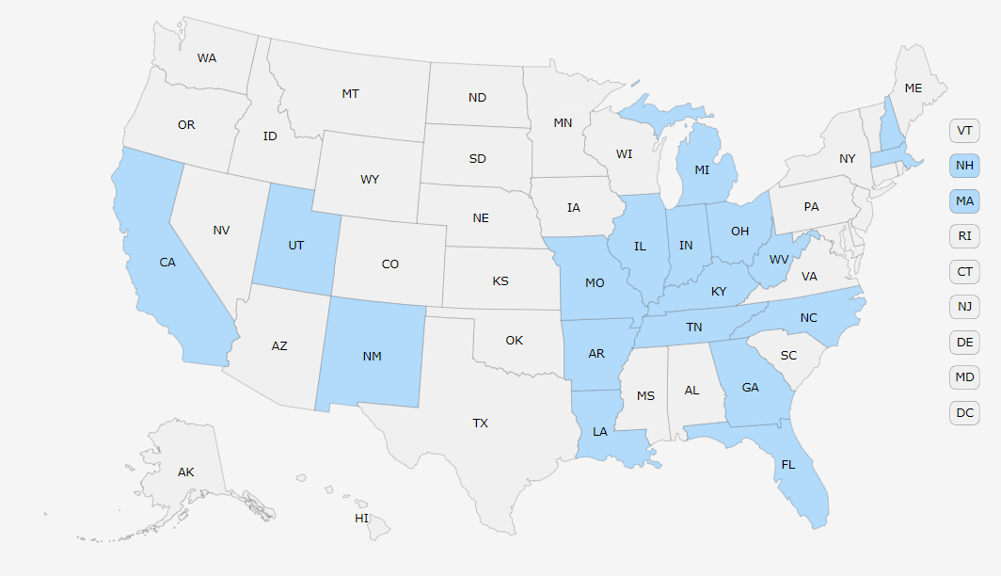

Hepatitis A – National Outbreaks
Notes:
Beginning in late 2016, states across the US have seen state-level outbreaks of hepatitis A. To date, 18 states have declared outbreaks. Of these, 16 are ongoing and only two have ended. The outbreaks are occurring across the US and new outbreaks continue to occur

Slide 79
Hepatitis A – National Outbreaks I
Large national outbreaks ongoing – began in late 2016
  18 states with declared outbreaks
  Over 16,000 cases
  Approximately 9,000 hospitalizations
  158 reported deaths
No increase in cases in MN
  5 imported outbreak-associated cases
Notes:
There have been over 16,000 cases, nearly 9,000 hospitalizations, and 158 reported deaths linked to these outbreaks. We have not seen an increase in cases in Minnesota during this time period. In 2018, we had 16 cases of hepatitis A, which is a low-average year. However, October of 2018 we have identified five cases of hepatitis A that were tested in Minnesota, but were found to be individuals who were infected in outbreak states.

Slide 80
Hepatitis A – National Outbreaks II
The following groups are at highest risk and should be offered the hepatitis A vaccine:
  People who use drugs (injection or non-injection)
  People experiencing unstable housing or homelessness
  Men who have sex with men (MSM)
  People who are, or were recently, incarcerated
  People with chronic liver disease, including cirrhosis, hepatitis B, or hepatitis C
Hep A vaccine – two dose series
One dose of single-antigen hepatitis A vaccine provides up to 95% seroprotection in healthy individuals for up to 11 years.
Notes:
Hepatitis A is generally thought of as a foodborne or travel-associated illness. However, the individuals at-risk in the ongoing outbreaks are not the usual populations we see impacted by hepatitis A. The populations that are most at risk in the current outbreaks include persons who use injection and non-injection drugs, people experiencing homelessness or unstable housing, men who have sex with men, and people who are, or were recently, incarcerated. If infected with hepatitis A persons with chronic liver disease are more likely to experience severe illness. These groups should all be offered hepatitis A vaccine and education about reducing the risk of hepatitis A disease. The hepatitis A vaccine is given in a two dose series. However, getting even one vaccine dose in can have a huge impact on preventing a hepatitis A outbreak in Minnesota, as one dose of hepatitis A vaccine is highly protective in most individuals.

Slide 81
Thank you!
Kristin Sweet, Ph.D, M.P.H. - Section Manager, Cross-Cutting Epidemiology, Programs, and Partnerships
Kristin.Sweet@state.mn.us

