Slide 1
Sexually Transmitted Disease (STD) Surveillance Report, 2018
Minnesota Department of Health STD Surveillance System

Slide 2
Introduction 1/2
Under Minnesota law, physicians and laboratories must report all laboratory-confirmed cases of chlamydia, gonorrhea, syphilis, and chancroid to the Minnesota Department of Health (MDH) within one working day.
The MDH does not maintain statistics for other, non-reportable STDs (ex: herpes, HPV/genital warts).
This slide set describes trends in reportable STDs in Minnesota by person, place, and time.
Analyses exclude cases reported from federal and private prisons.

Slide 3
Introduction 2/2
STD surveillance is the systematic collection of data from cases for the purpose of monitoring the frequency and distribution of STDs in a given population.
STD surveillance data are used to detect problems, prioritize resources, develop and target interventions, and evaluate the effectiveness of interventions.

Slide 4
Interpreting STD Surveillance Data I
Factors that impact the completeness and accuracy of STD data include:
  Level of STD screening by healthcare providers
  Individual test-seeking behavior
  Sensitivity of diagnostic tests
  Compliance with case reporting
  Completeness of case reporting
  Timeliness of case reporting
Increases and decreases in STD rates can be due to actual changes in disease occurrence and/or changes in one or more of the above factors

Slide 5
Interpreting STD Surveillance Data II
The surveillance system only includes cases with a positive laboratory test. Cases diagnosed solely on symptoms are not counted.
Since 2012 we have included cases that had only a lab report and no corresponding case report form. This has increased the number of unknowns in some variables.
In 2018, in order to be consistent with CDC, we categorized all White, Hispanic and Black, Hispanic cases as Hispanic. That means the race categories now reflect only White, Non-Hispanic and Black, Non-Hispanic cases
Surveillance data represent cases of infection, not individuals. A person with multiple infections in a given year will be counted more than once.
Caution is warranted when interpreting changes in STD numbers that can seem disproportionately large when the number of cases is small.

Slide 6
National Context

Slide 7
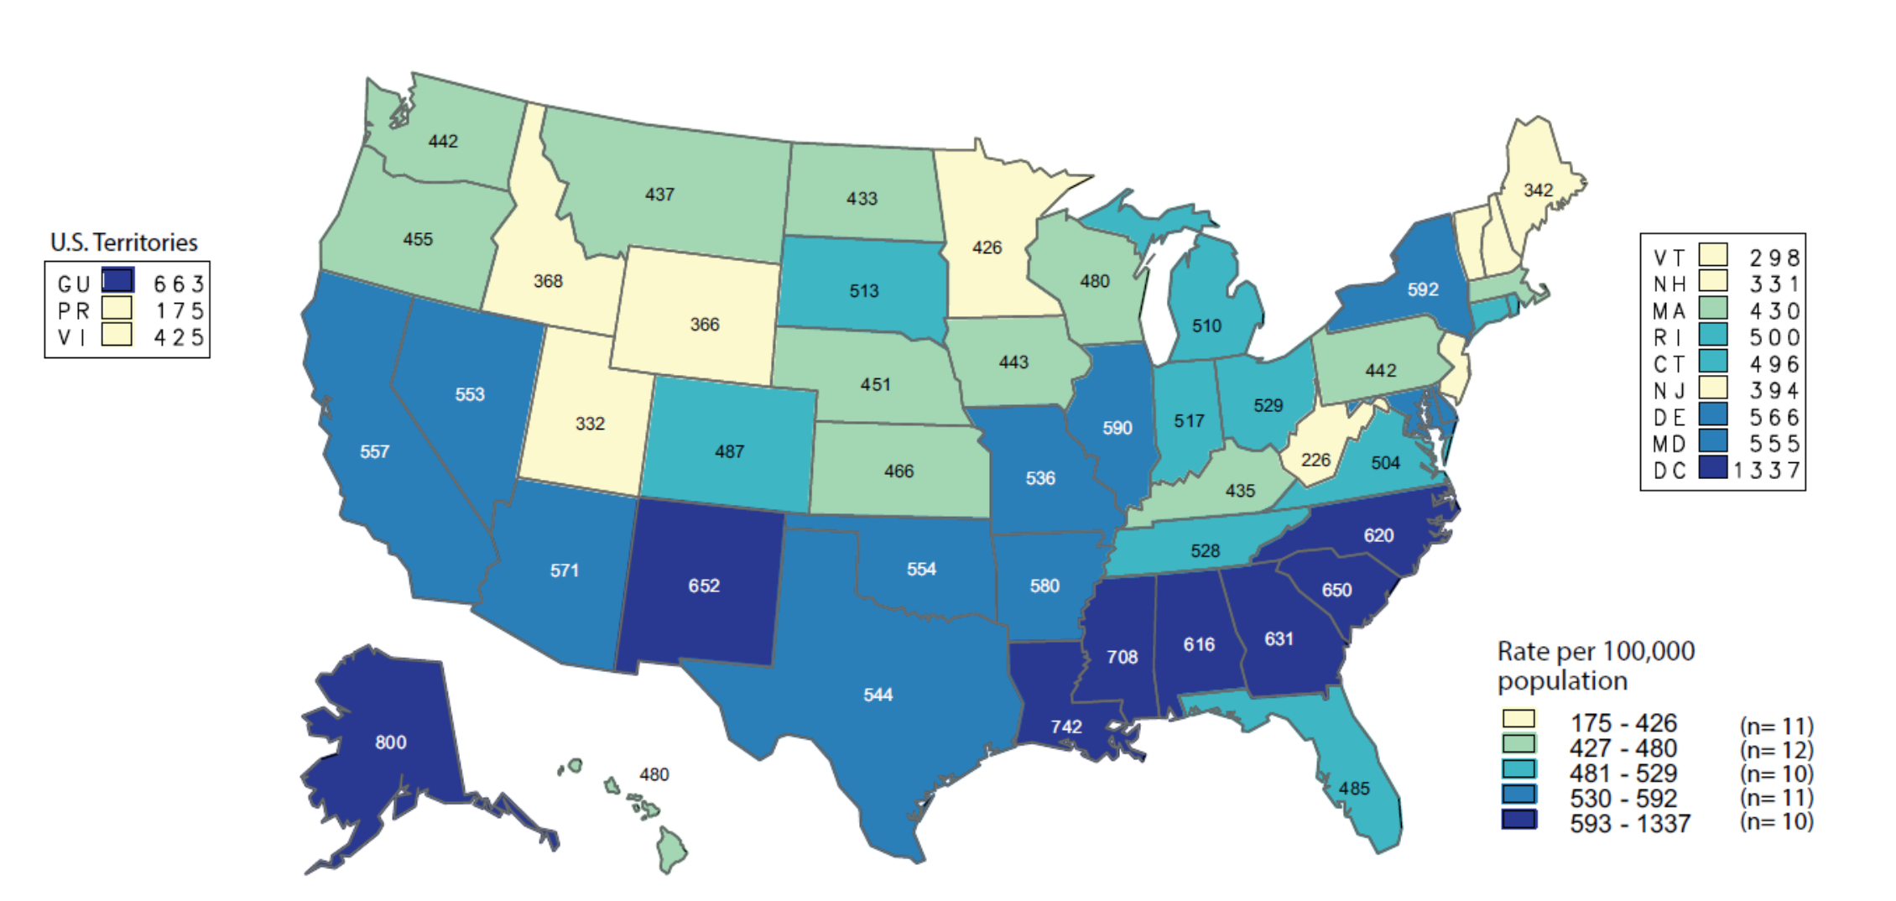
Chlamydia — Rates of Reported Cases by State
United States and Outlying Areas, 2017
NOTE: The total rate of reported cases of chlamydia for the United States and outlying areas (Guam, Puerto Rico, and Virgin Islands) was 525.1 cases per 100,000 population.
Notes:
Minnesota’s chlamydia rate in 2017 was 426 per 100,000
This was lower than the national rate of 525.1 per 100,000

Slide 8
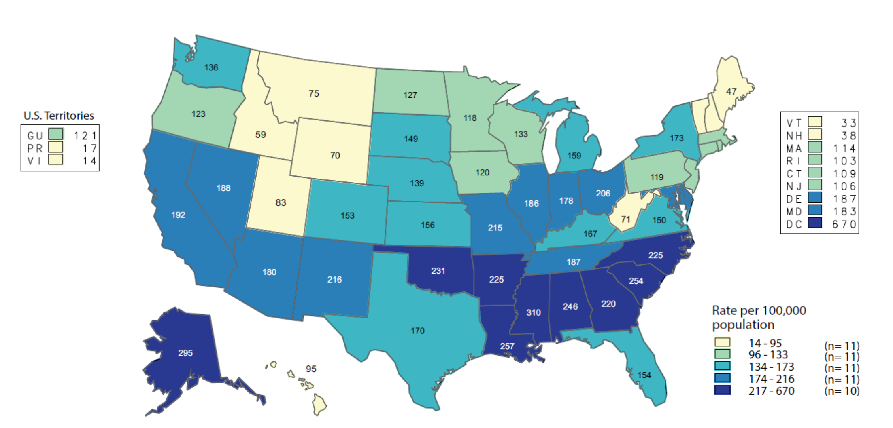
Gonorrhea — Rates of Reported Cases by State
United States and Outlying Areas, 2017
NOTE: The total rate of reported cases of gonorrhea for the United States and outlying areas (Guam, Puerto Rico, and Virgin Islands) was 170.3 cases per 100,000 population.
Notes:
Minnesota’s gonorrhea rate in 2017 was 118 per 100,000
This was lower than the national rate of 170.3 per 100,000

Slide 9
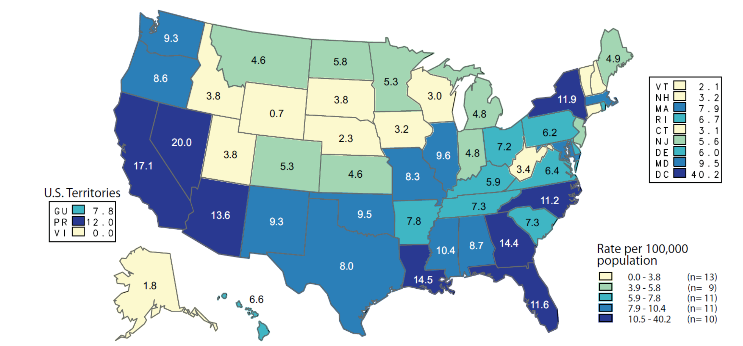
Primary and Secondary Syphilis — Rates of Reported Cases by State, United States and Outlying Areas, 2017
NOTE: The total rate of primary and secondary syphilis for the United States and outlying areas (Guam, Puerto Rico, and Virgin Islands) was 9.5 cases per 100,000 population.
Notes:
Minnesota’s primary and secondary syphilis rate in 2017 was 5.3 per 100,000
This was lower than the national rate of 9.5 per 100,000

Slide 10
Overview of STDs in Minnesota
Minnesota Department of Health STD Surveillance System

Slide 11
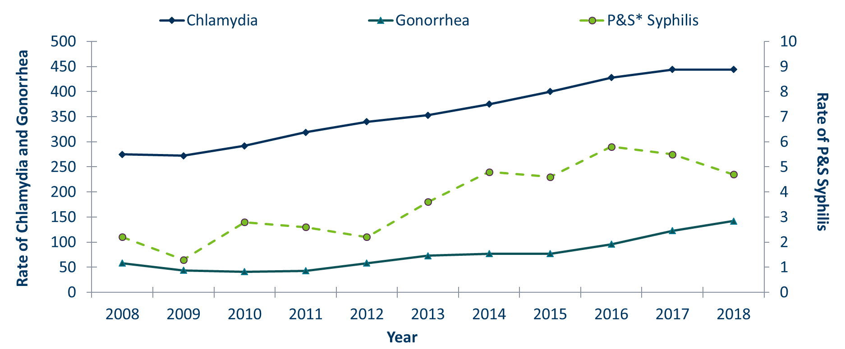
STDs in Minnesota
Rate per 100,000 by Year of Diagnosis, 2008-2018
* P&S = Primary and Secondary
Notes:
The rate of chlamydia in MN reached an all time high at 444 per 100,000. This is the same rate as 2017.
The rate of gonorrhea in MN increased 15% to 142 per 100,000 compared to 123 per 100,000 in 2017.
The rate of primary and secondary syphilis is at 4.7 per 100,000. This is an decrease of 14% from 2017.

Slide 12
STDs in Minnesota:
Number of Cases Reported in 2018
Total of 32,024 STD cases reported to MDH in 2018:
  23,564 Chlamydia cases
  7,542 Gonorrhea cases
  918 Syphilis cases (all stages)
  0 Chancroid cases

Slide 13
Chlamydia
Minnesota Department of Health STD Surveillance System

Slide 14
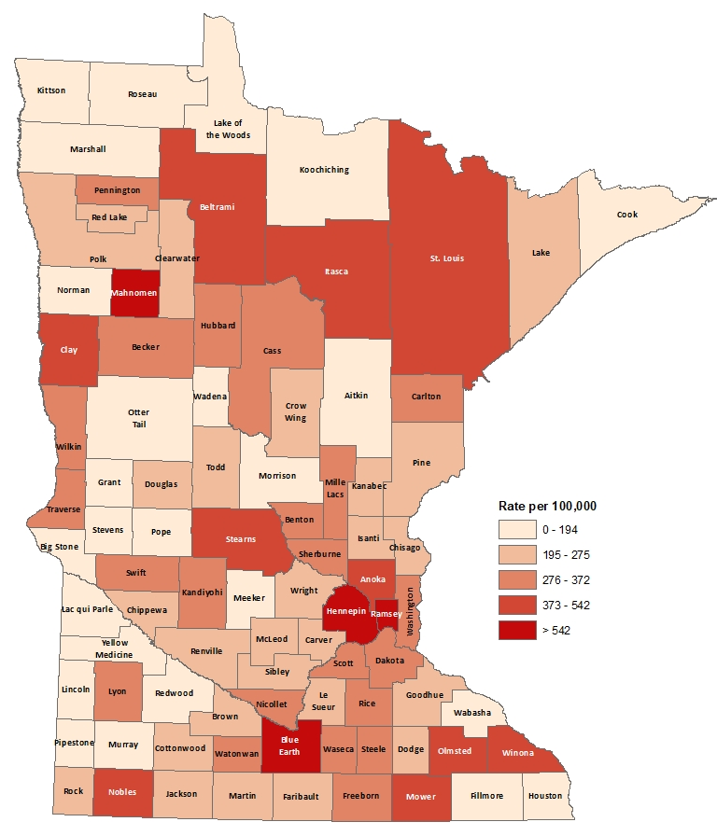
2018 Minnesota Chlamydia Rates by County
City of Minneapolis
City of St. Paul
Suburban*
Greater Minnesota
Total
1,255 per 100,000 (4,801 cases)
982 per 100,000 (2,798 cases)
358 per 100,000 (7,812 cases)
316 per 100,000 (7,750 cases)
444 per 100,000 (23,564 cases)
(403 cases missing residence information)
*7-county metro area, excluding the cities of Minneapolis and St. Paul
Notes:
All counties in Minnesota are affected by chlamydia. There were at least 5 cases in all counties in 2018.
The city of Minneapolis continues to have the highest rates of chlamydia at 1,255 per 100,000, followed by the city of St. Paul at 982 per 100,000, the suburban area (7-county metro excluding Minneapolis & St. Paul) at 358 per 100,000 and Greater Minnesota at 316 per 100,000.
Greater Minnesota had the greatest increase in rates between 2017 and 2018 at 5%.
The City of Minneapolis had a 2.9% decrease in rates for 2018 compared to 2017.

Slide 15
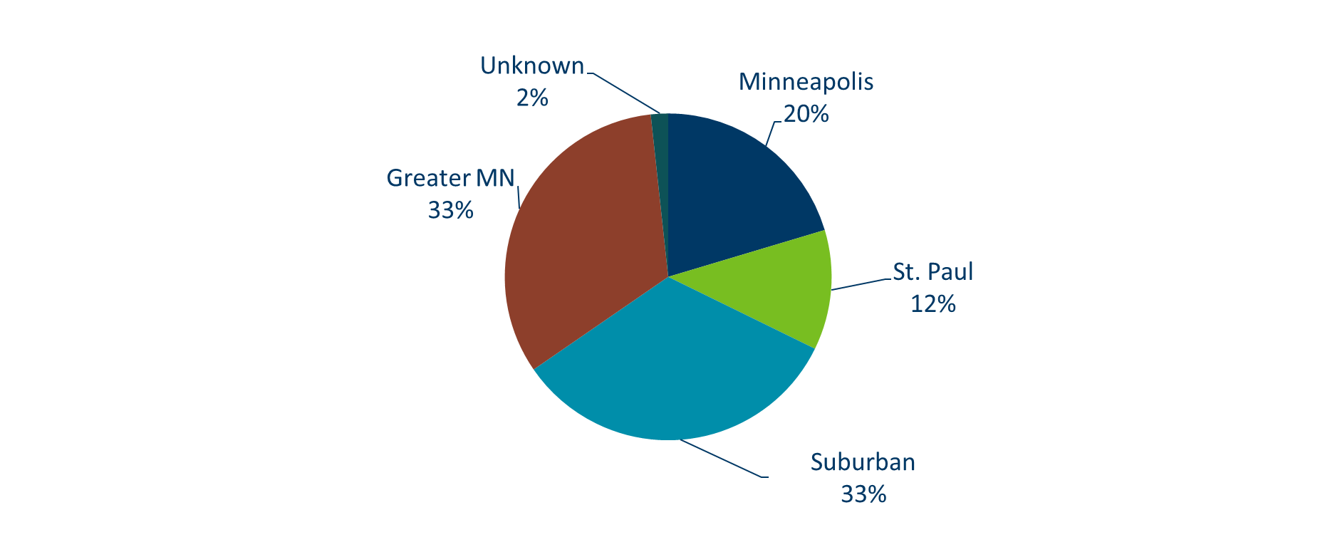
Chlamydia Infections by Residence at Diagnosis Minnesota, 2018
Total Number of Cases = 23,564
Suburban = Seven-county metro area including Anoka, Carver, Dakota, Hennepin (excluding Minneapolis), Ramsey (excluding St. Paul), Scott, and Washington counties. Greater MN = All other Minnesota counties outside the seven-county metro area.
Notes:
All parts of Minnesota are affected by chlamydia. Roughly a third of the cases are in the cities of Minneapolis and St. Paul, a third in the Suburban area surround the cities, and a third in Greater Minnesota.

Slide 16
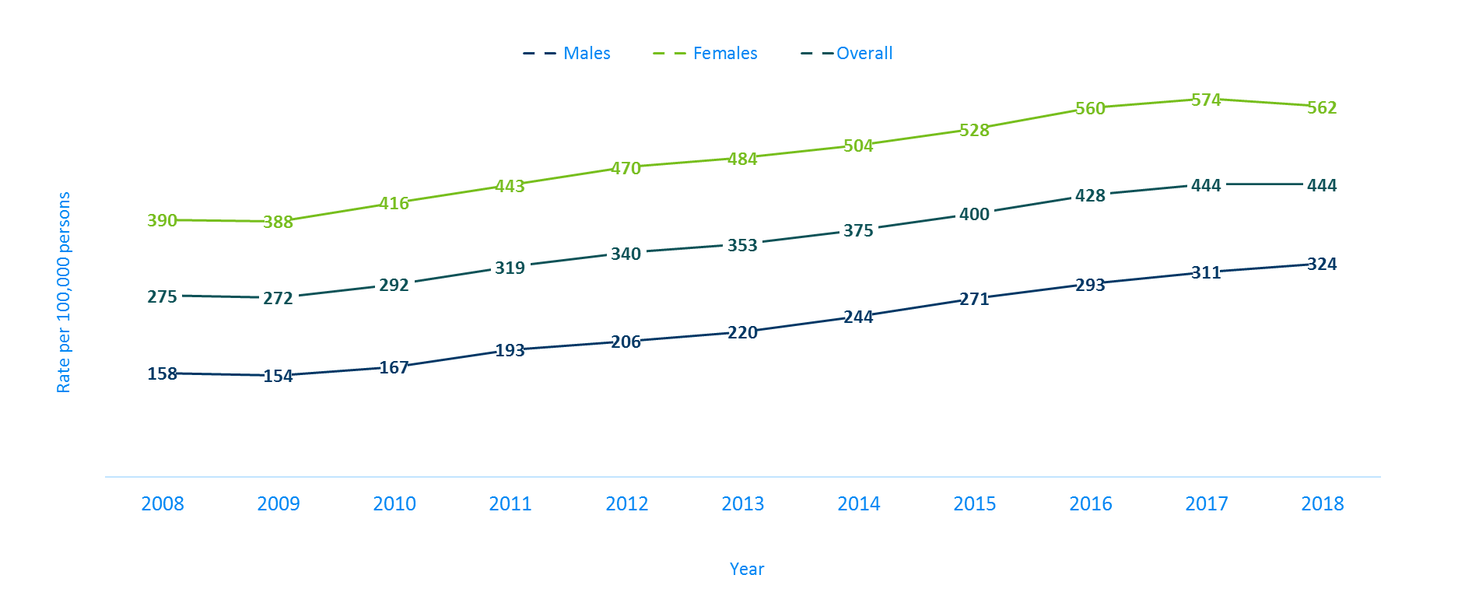
Chlamydia Rates by Gender, Minnesota, 2008-2018
Notes:
The rates of chlamydia increased for males and decreased for females in 2018. Females continue to have higher rates of chlamydia than males. The males had a rate of 324 per 100,000 which is an increase of 4% over the 2017 rate of 311 per 100,000.
The females had a rate of 562 per 100,000 which is an decrease of 2% over the 2017 rate of 574 per 100,000.

Slide 17
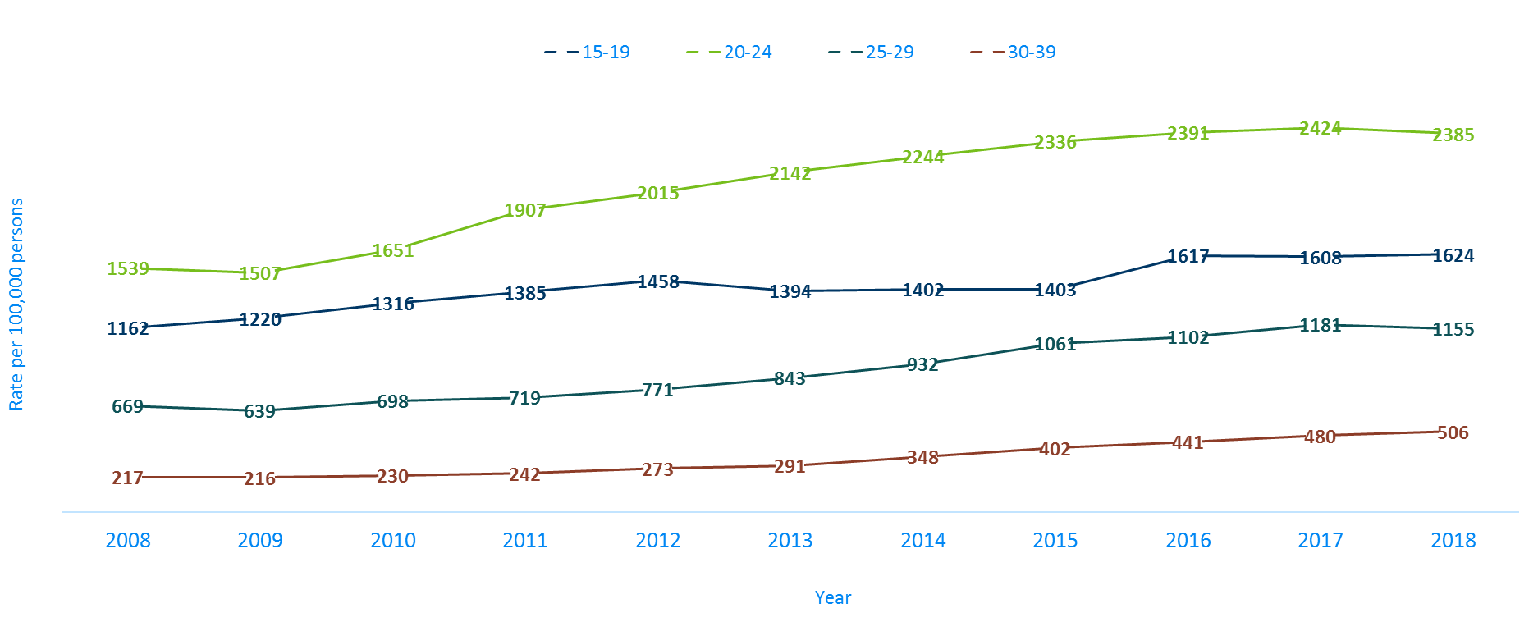
Chlamydia Rates by Age, Minnesota, 2008-2018
Notes:
The highest rate remains in the 20-24 year old age group at 2,385 per 100,000.
The next highest rate remains in the 15-19 year old age group at 1,624 per 100,000.
The 30-39 year old age group had the largest rate increase from 2017 at 5%. Their rate is 506 per 100,000. This age group still has the fourth highest rates of chlamydia.

Slide 18
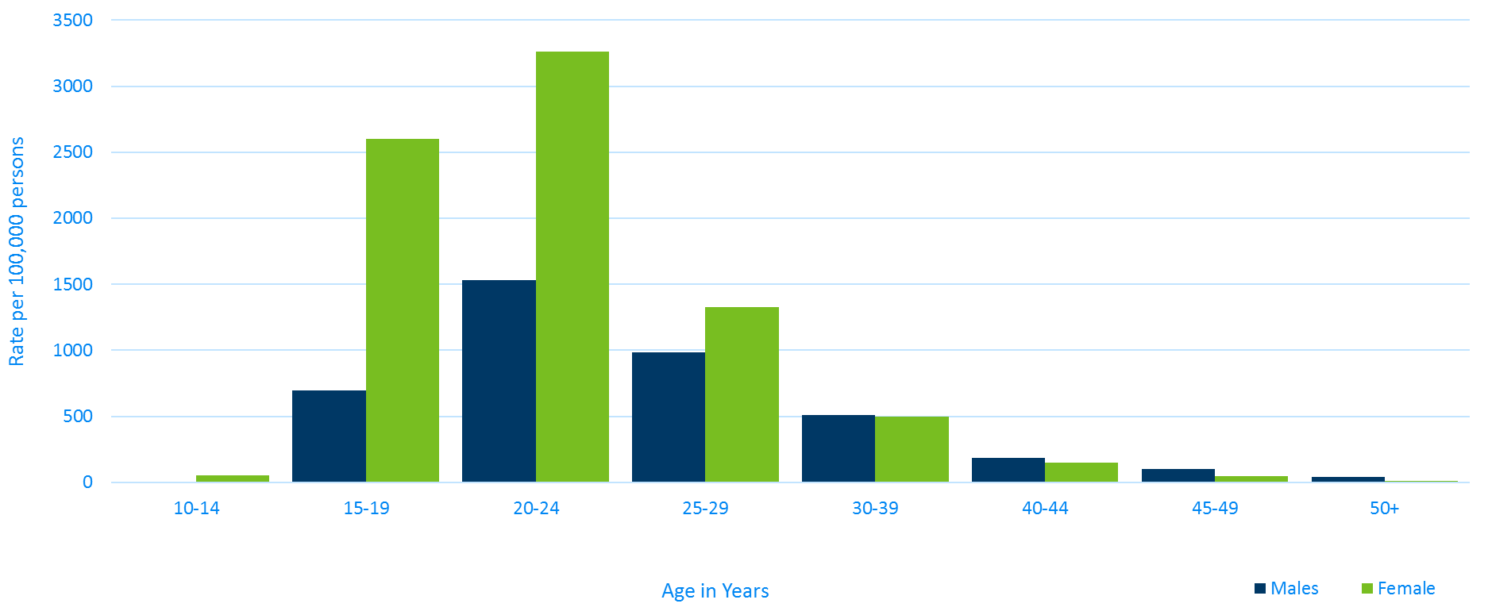
Age-Specific Chlamydia Rates by Gender
Minnesota, 2018
Notes:
Females, 20-24 years of age continue to have the highest rate at 3261 per 100,000.
The age group with the largest increase in rate were females, 40-44 years of age with a 18% increase from 2017.

Slide 19
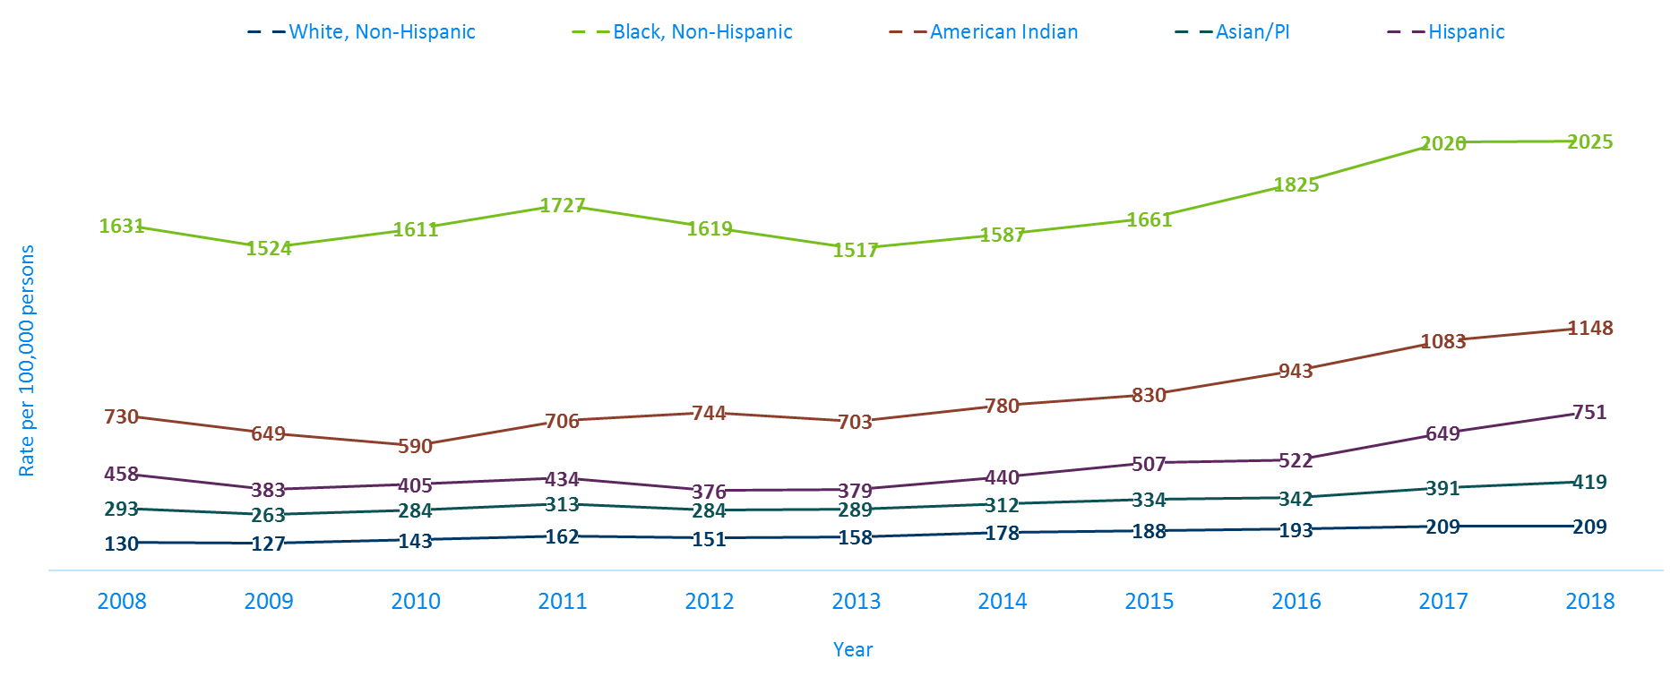
Chlamydia Rates by Race/Ethnicity
Minnesota, 2008-2018 (I)
2018 rates compared with Whites:
Black, Non-Hispanic = 9.7x higher
American Indian = 5.5x higher
Asian/PI = 2x higher
Hispanic* = 3.6x higher
Notes:
There continues to be disparities in rates of chlamydia.
The Black/African American, non-Hispanic population has rates that are 9.7 times higher than that of whites.
The rate in the Black/African American, non-Hispanic population was 2,025 per 100,000 compared to the rate in the White, non-Hispanic population at 209 per 100,000.
The American Indian population had a rate that was 5.5 times higher at 1,148 per 100,000
The Asian/Pacific Islander population had a rate that was 2 times higher at 419 per 100,000
The Hispanic/Latino population, which can be of any race, had a rate that was 3.6 times higher at 751 per 100,000

Slide 20
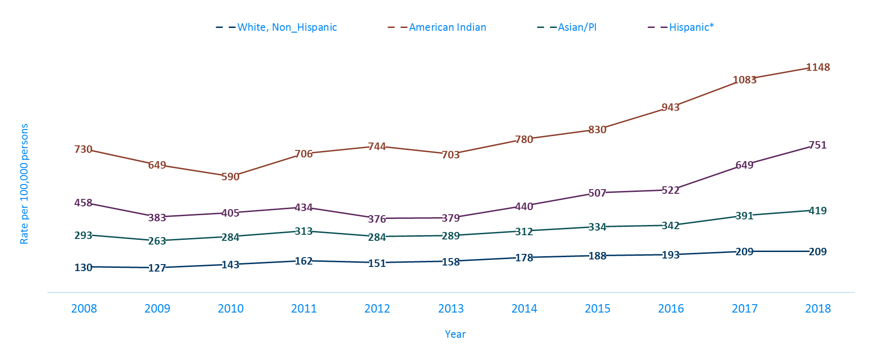
Chlamydia Rates by Race/Ethnicity
Minnesota, 2008-2018 (II)
Notes:
This is a clearer view of the rates from the previous slide, removing the Black/African American, non-Hispanic data.

Slide 21
Gonorrhea
Minnesota Department of Health STD Surveillance System

Slide 22
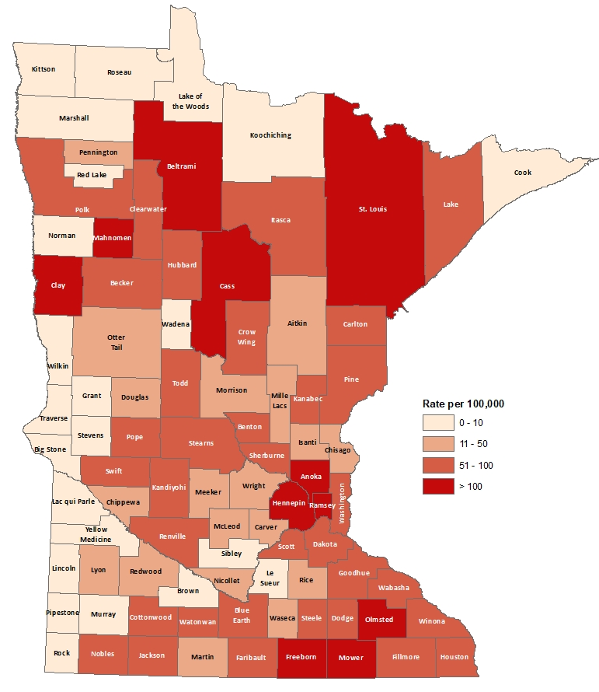
2018 Minnesota Gonorrhea Rates by County
City of Minneapolis
City of St. Paul
Suburban*
Greater Minnesota
Total
617 per 100,000 (2,361 cases)
393 per 100,000(1,121 cases)
99 per 100,000 (2,166 cases)
73 per 100,000 (1,787 cases)
142 per 100,000 (7,542 cases)
(107 cases missing residence information)
*7-county metro area, excluding the cities of Minneapolis and St. Paul
Notes:
The city of Minneapolis continues to have the highest rates of gonorrhea at 617 per 100,000, followed by the city of St. Paul at 393 per 100,000, the suburban area (7-county metro excluding Minneapolis & St. Paul) at 99 per 100,000 and Greater Minnesota at 73 per 100,000.
Greater Minnesota area had the highest increase at 35%, followed by the seven county metro Suburban area with a 14% increase. The City of Minneapolis had a 10% increase and the City of St Paul had the smallest increase at 8%.

Slide 23
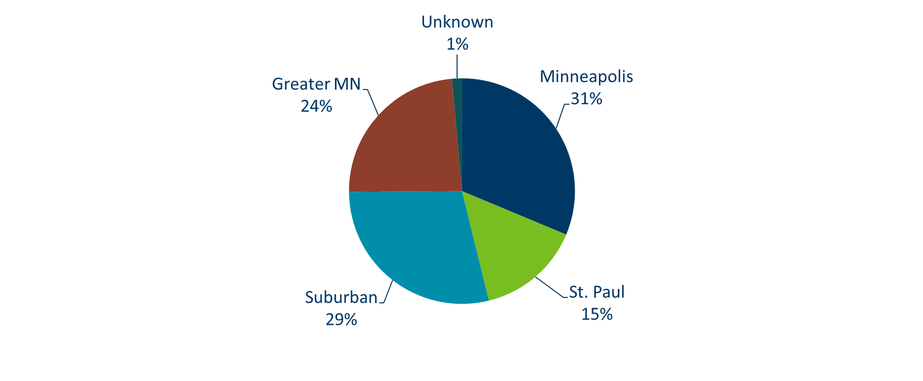
Gonorrhea Infections in Minnesota by Residence at Diagnosis, 2018
Suburban = Seven-county metro area including Anoka, Carver, Dakota, Hennepin (excluding Minneapolis), Ramsey (excluding St. Paul), Scott, and Washington counties. Greater MN = All other Minnesota counties outside the seven-county metro area.
Notes:
All parts of Minnesota are affected by gonorrhea. The cities of Minneapolis and St. Paul reported 46% of the cases; followed by 29% in the Suburban area surrounding the cities, and about one in four cases (24%) in Greater Minnesota.

Slide 24
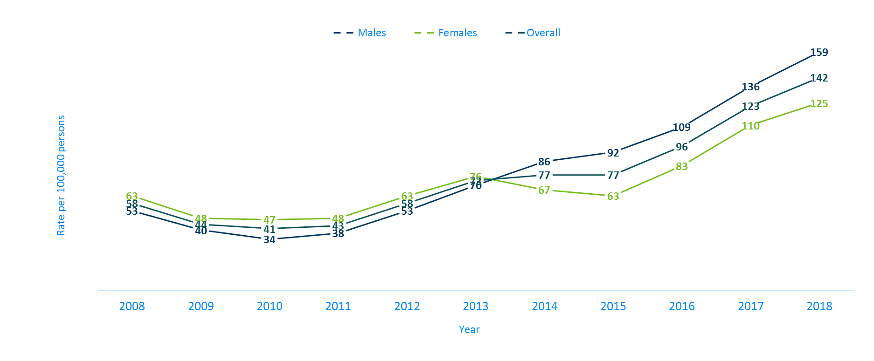
Gonorrhea Rates by Gender
Minnesota, 2008-2018
Notes:
The rates of gonorrhea went up in both males and females in 2018. Males continue to have higher rates of gonorrhea than females.
The males had a rate of 159 per 100,000 which is an increase of 17% over the 2017 rate of 136 per 100,000.
The females had a rate of 125 per 100,000 which is an increase of 14% over the 2017 rate of 110 per 100,000.

Slide 25
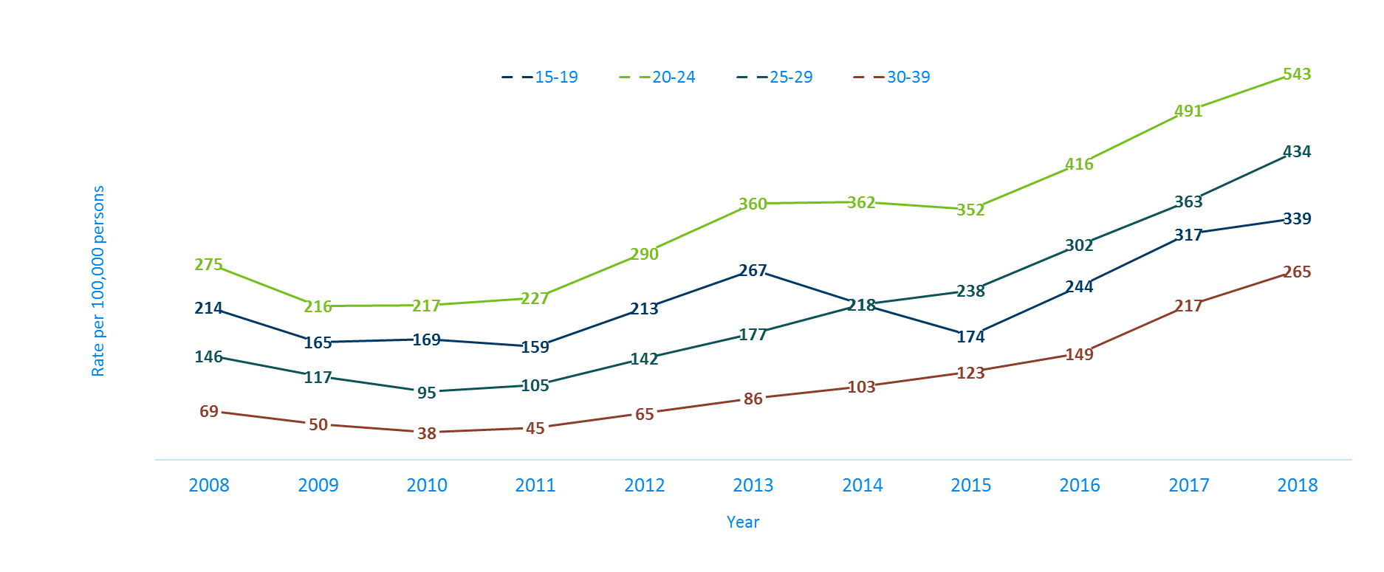
Gonorrhea Rates by Age
Minnesota, 2008-2018
Notes:
All age groups saw an increase in gonorrhea rates.
The highest rate remains in the 20-24 year old age group at 543 per 100,000.
The 30-39 year old age group had the largest rate increase from 2017 to 2018 at 22%.

Slide 26
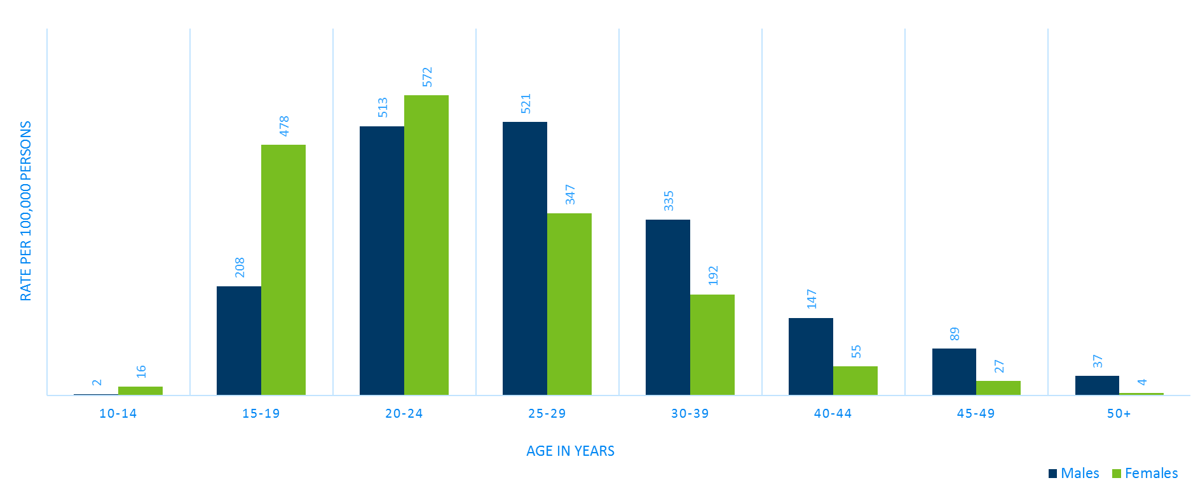
Age-Specific Gonorrhea Rates by Gender Minnesota, 2018
Notes:
The rates of gonorrhea went up in both males and females for each age group 15 years of age and older in 2018 compared to 2017. Females continue to have higher rates of gonorrhea than males that are younger than 25 years of age. In 2018 the males have higher rates in the 25 and over age groups.
The highest rates of gonorrhea are in females 20-24 at 572 per 100,000.

Slide 27
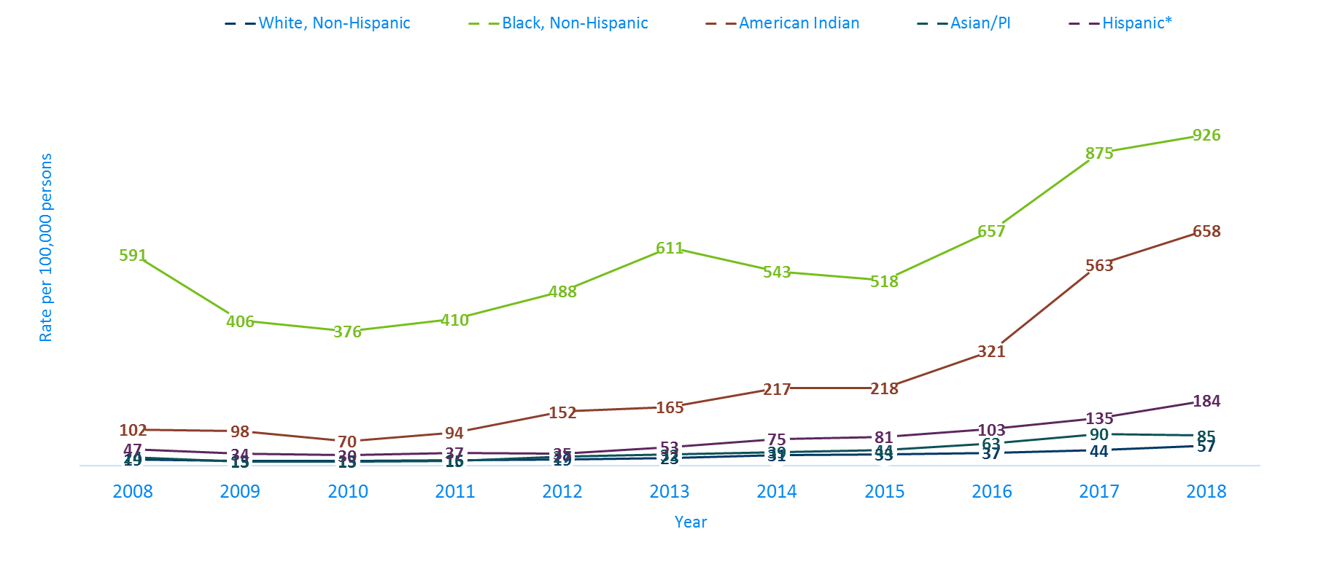
Gonorrhea Rates by Race/Ethnicity
Minnesota, 2008-2018 (I)
2018 rates compared with Whites:
Black, Non-Hispanic = 16x higher
American Indian = 12x higher
Asian/PI = 2x higher
Hispanic* = 3x higher
Notes:
There continues to be disparities in rates of gonorrhea.
The Black/African American, non-Hispanic population rates are 16 times higher than that of whites. The rate in the Black/African American population was 926 per 100,000 compared to the rate in the White, Non-Hispanic population at 57 per 100,000.
The American Indian population had a rate that was 12 times higher at 658 per 100,000
The Asian/Pacific Islander population had a rate that was 2 times higher at 85 per 100,000
The Hispanic/Latino population, which can be of any race, had a rate that was 3 times higher at 184 per 100,000

Slide 28
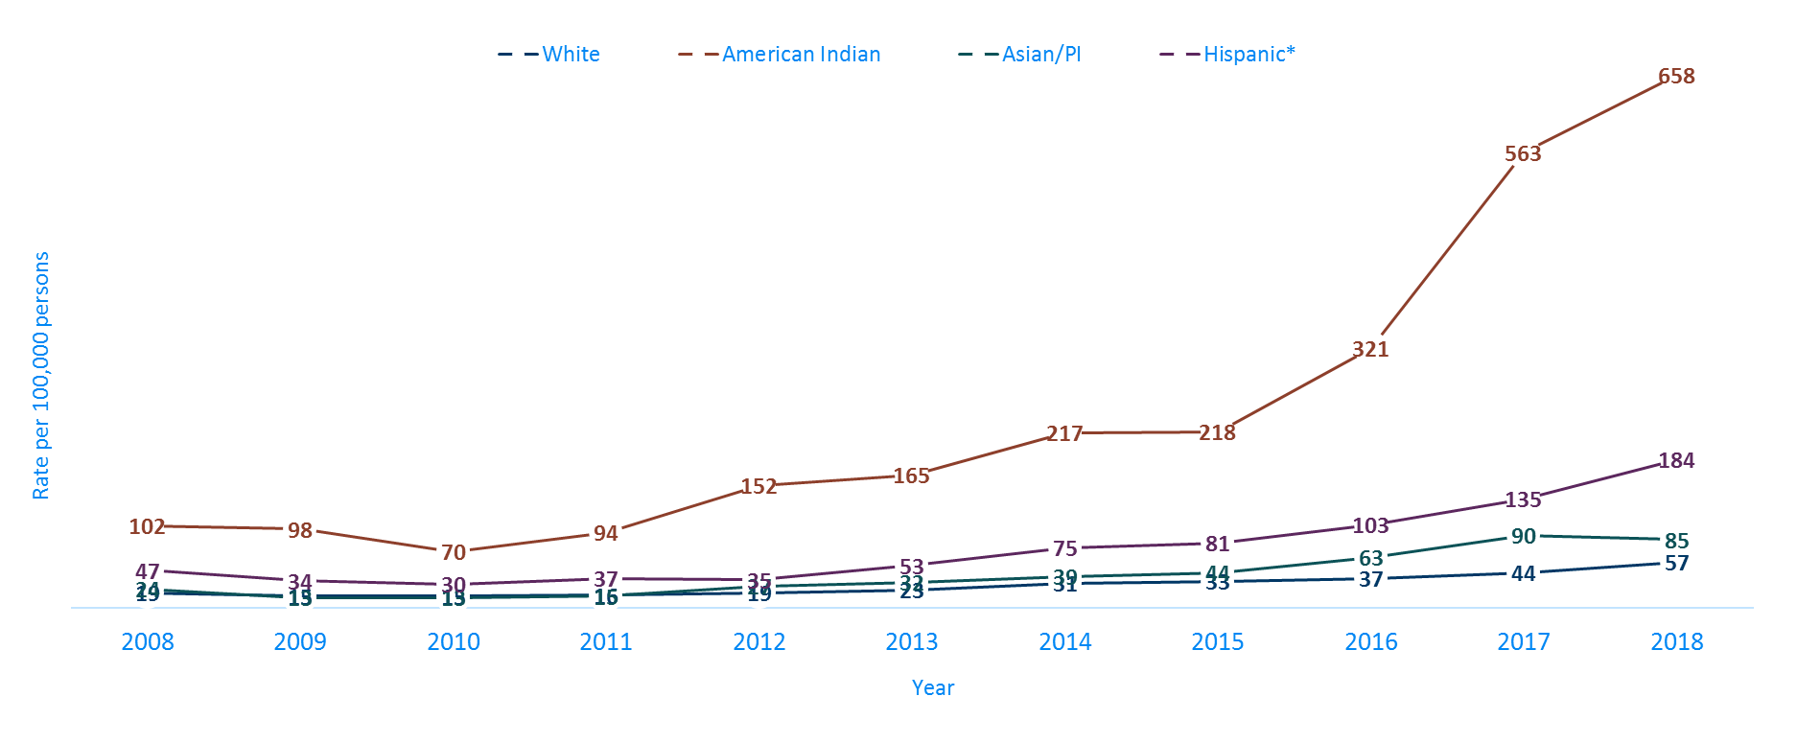
Gonorrhea Rates by Race/Ethnicity
Minnesota, 2008-2018 (II)
* Persons of Hispanic ethnicity can be of any race
Notes:
This is a clearer view of the rates from the previous slide, removing the Black/African American, Non-Hispanic data.

Slide 29
Syphilis
Minnesota Department of Health STD Surveillance System

Slide 30
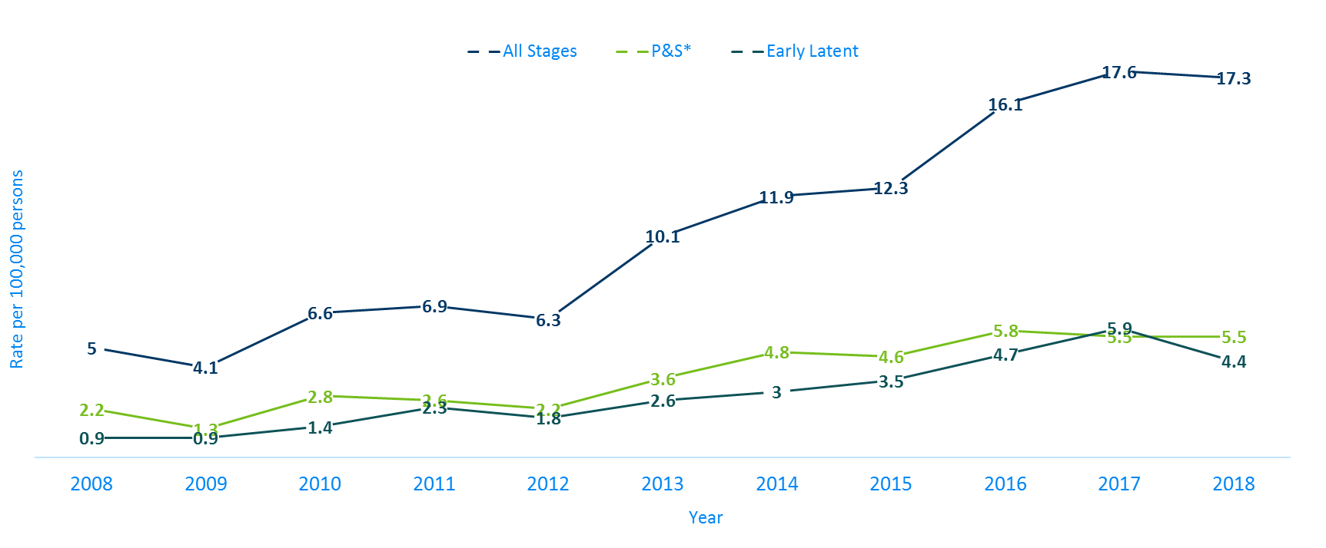
Syphilis Rates by Stage of Diagnosis Minnesota, 2008-2018
* P&S = Primary and Secondary
Notes:
The overall syphilis rate is now up to 17.3 per 100,000. Compared to the low of 4.1 back in 2009, which is four times higher.
Of concern is the rate of primary and secondary syphilis which is 5.5 per 100,000, which remained the same as the previous year.

Slide 31
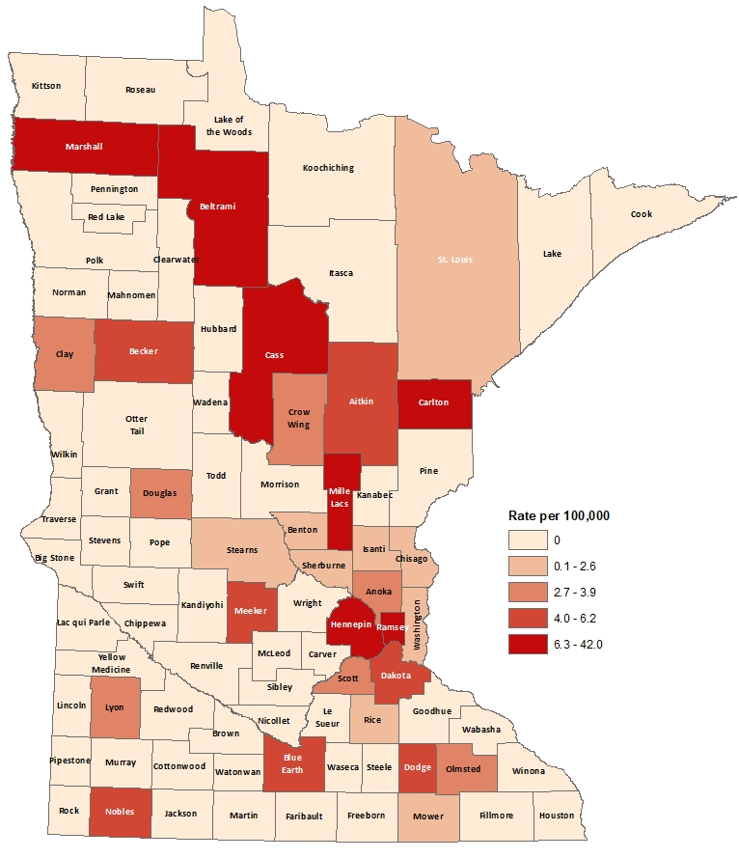
2018 Minnesota Primary & Secondary Syphilis Rates by County
City of Minneapolis
City of St. Paul
Suburban*
Greater Minnesota
Total
29.0 per 100,000 (111 cases)
10.5 per 100,000 (30 cases)
4.2 per 100,000 (91 cases)
2.4 per 100,000 (60 cases)
5.5 per 100,000 (292 cases)
*7-county metro area, excluding the cities of Minneapolis and St. Paul
Notes:
The statewide rate of primary and secondary syphilis remains at 5.5 cases per 100,000
Within the metro, the highest rate of primary and secondary syphilis remains in the City of Minneapolis at 29 cases per 100,000 population.
The City of St. Paul has the second highest rate in the metro at 10.5 per 100,000.

Slide 32
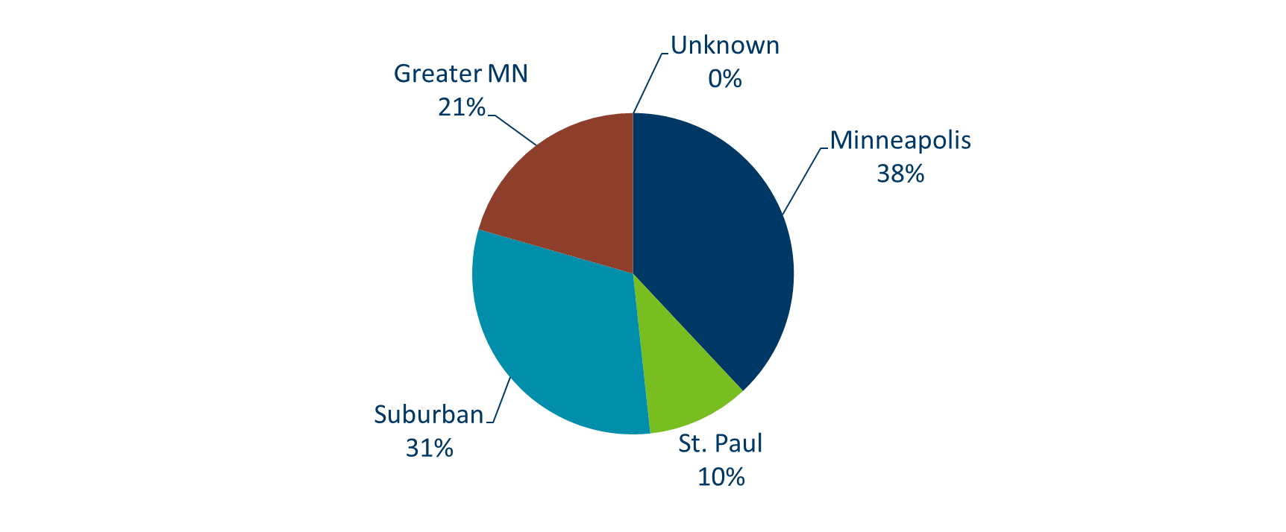
Primary & Secondary Syphilis Infections in Minnesota by Residence at Diagnosis, 2018
Total Number of Cases = 292
Suburban = Seven-county metro area including Anoka, Carver, Dakota, Hennepin (excluding Minneapolis), Ramsey (excluding St. Paul), Scott, and Washington counties. Greater MN = All other Minnesota counties outside the seven-county metro area.
Notes:
The City of Minneapolis has 38% of all reported primary and secondary cases.
The suburban area has 31% of the cases, St. Paul has 10% of the cases, and Greater Minnesota has 21% of the cases.

Slide 33
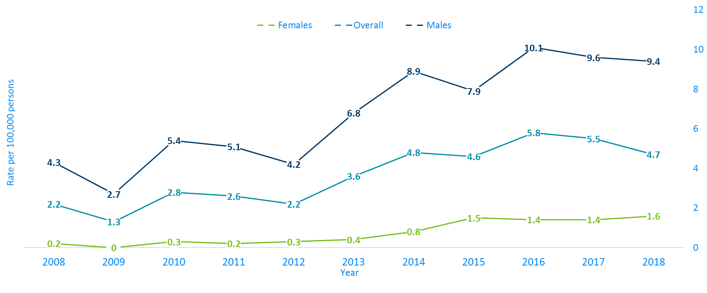
Primary & Secondary Syphilis Rates by Gender
Minnesota, 2008-2018
Notes:
Males have the highest rates of primary and secondary syphilis at 9.4 cases per 100,0000 population
The rate of primary and secondary syphilis in females is 1.6 per 100,000 per population.

Slide 34
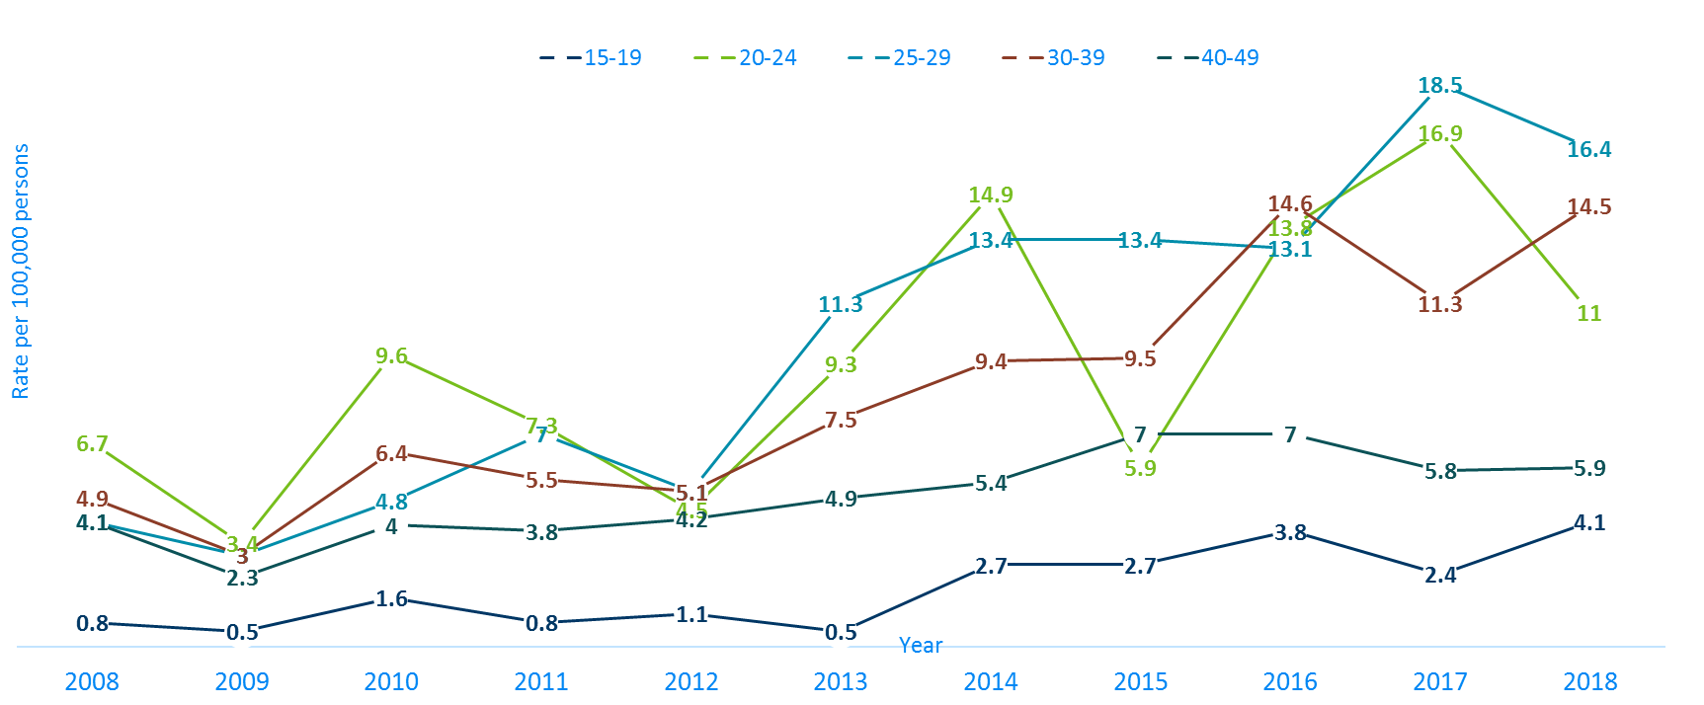
Primary & Secondary Syphilis Rates by Age
Minnesota, 2008-2018
Notes:
The highest rates of primary and secondary syphilis are in the 25-29 year old age group at 16.4 cases per 100,000 population, followed by the 30-39 year old age group at 14.5 cases per 100,000 population.

Slide 35
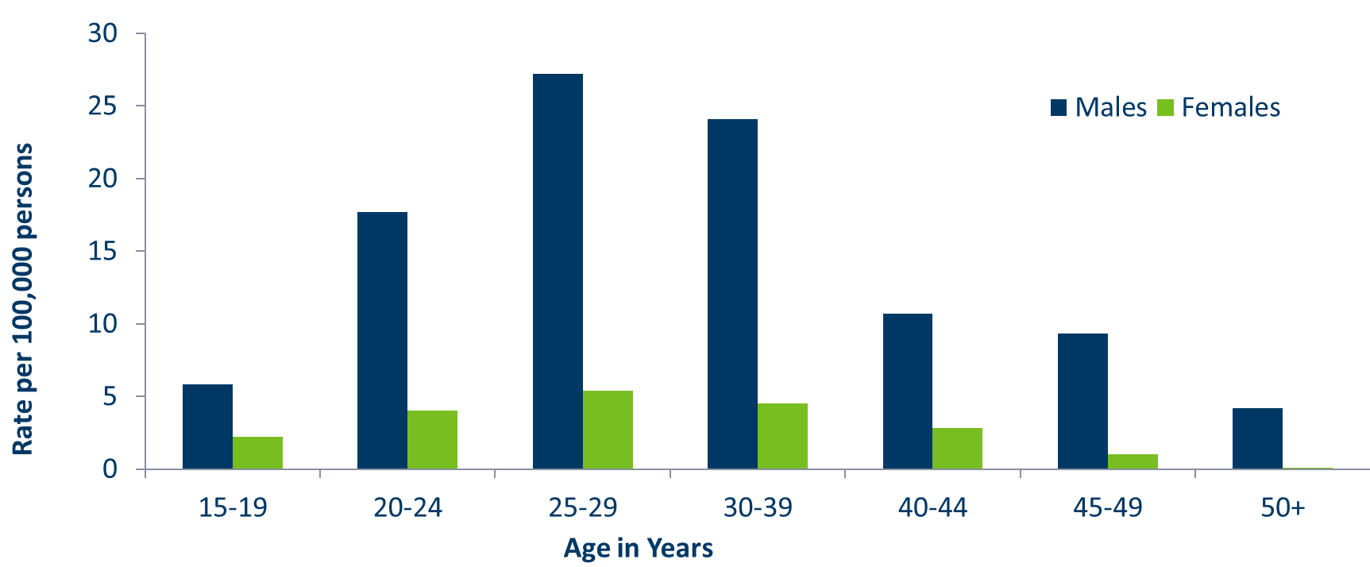
Age-Specific Primary & Secondary Syphilis Rates by Gender, Minnesota, 2018
Notes:
Males have higher rates of primary and secondary syphilis than females in all age groups. The rate in males is 7 times higher than females.
The 25-29 year old males have the highest rate at 27.2 per 100,000
The 25-29 year old females have the highest rate of the female population at 5.4 per 100,000

Slide 36
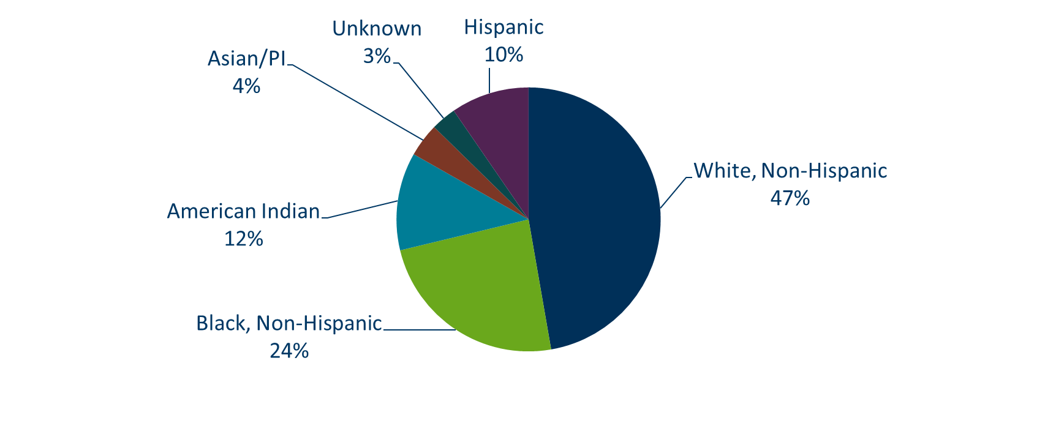
Primary & Secondary Syphilis Cases by Race
Minnesota, 2018
Total Number of Cases = 292
*Includes persons reported with more than one race
Notes:
Forty seven percent of all primary and secondary syphilis cases are White, non-Hispanic.
Black, non-Hispanic cases are at 24%, American Indian cases are 12%, Hispanic cases are at 10%, and Asian/Pacific Islander cases are 4%.

Slide 37
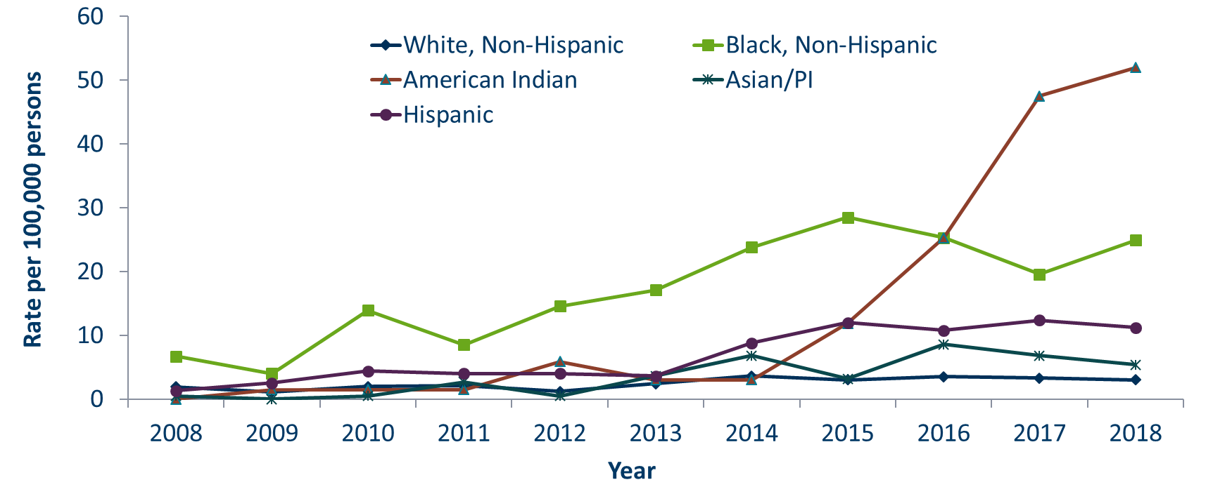
Primary & Secondary Syphilis Rates by Race/Ethnicity
Minnesota, 2008-2018
* Persons of Hispanic ethnicity can be of any race.
Notes:
The rates of primary and secondary syphilis are 17 times higher in the American Indian populations than that of the White, non-Hispanic population.
The rates of primary and secondary syphilis are 8 times higher in the Black/African American, non-Hispanic than that of the White, non-Hispanic population.
The rates of primary and secondary syphilis in the America Indian population are 52.0 per 100,000 compared to 3.0 per 100,000 in the White, non-Hispanic population.
The rates of primary and secondary syphilis in the Black/African American, non-Hispanic population are 24.9 per 100,000 compared to 3.0 per 100,000 in the White, Non-Hispanic population.
The rates in the Hispanic/Latino population are 11.2 per 100,000 which is 4 times higher than the White, non-Hispanic population.
The rates in the Asian/Pacific Islander population are 5.4 per 100,000 which is 2 times higher than the White, non-Hispanic population.

Slide 38
Chlamydia and Gonorrhea Among
Adolescents & Young Adults
Minnesota Department of Health STD Surveillance System

Slide 39
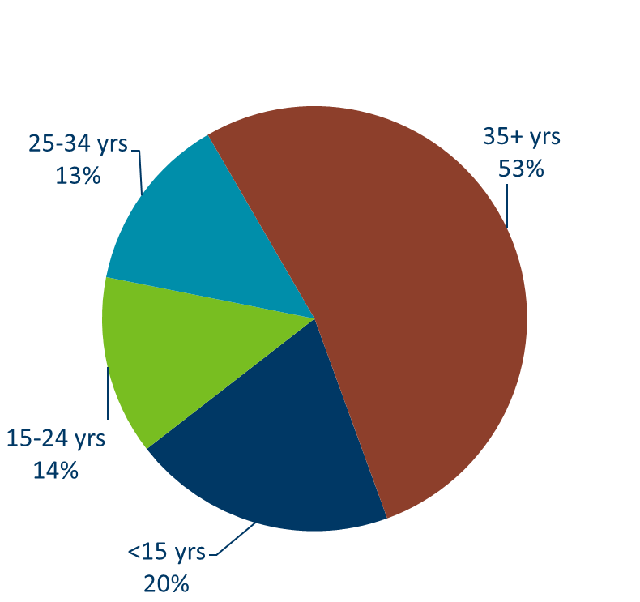
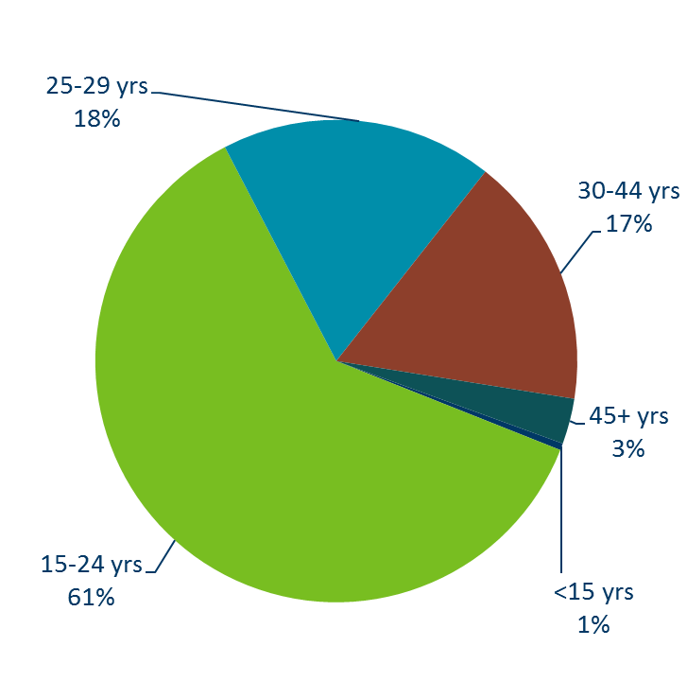
Chlamydia Disproportionately Impacts Youth
MN Population in 2010
(n = 5,303,925)
Chlamydia Cases in 2018
(n = 23,564)
Notes:
Chlamydia continues to disproportionately impact youth. The 15-24 year olds make up only 14% of the population, but account for 61% of all chlamydia cases reported.

Slide 40
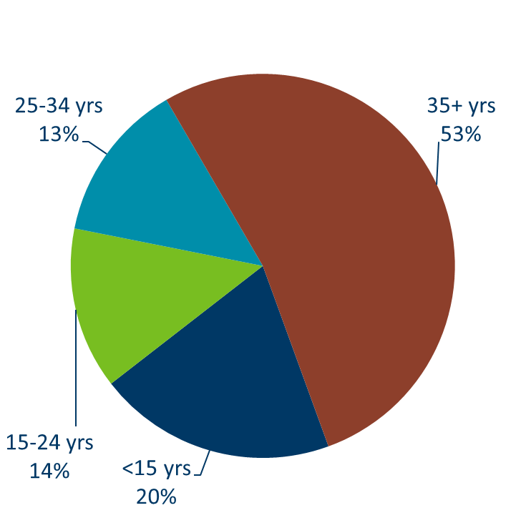
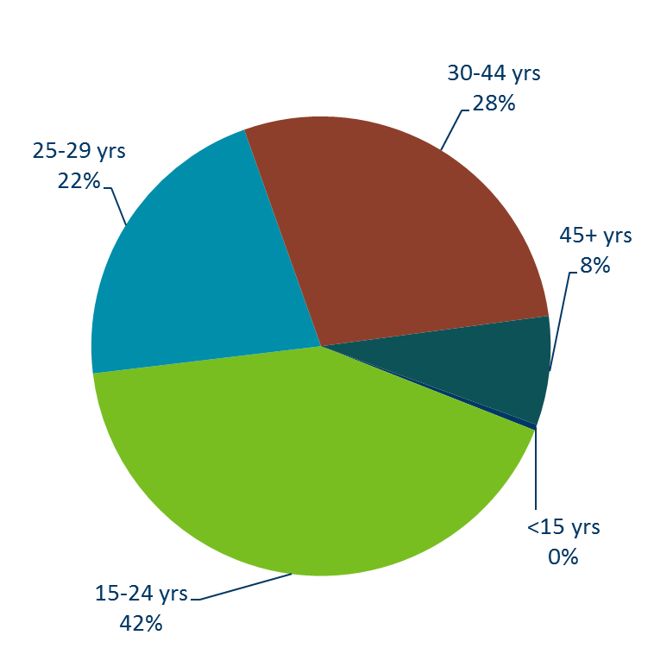
Gonorrhea Disproportionately Impacts Youth
MN Population in 2010
(n = 5,303,925)
Gonorrhea Cases in 2018
(n = 7542)
Notes:
Gonorrhea also disproportionately impacts youth. The 15-24 year olds make up only 14% of the population, but account for 42% of all gonorrhea cases reported.

Slide 41
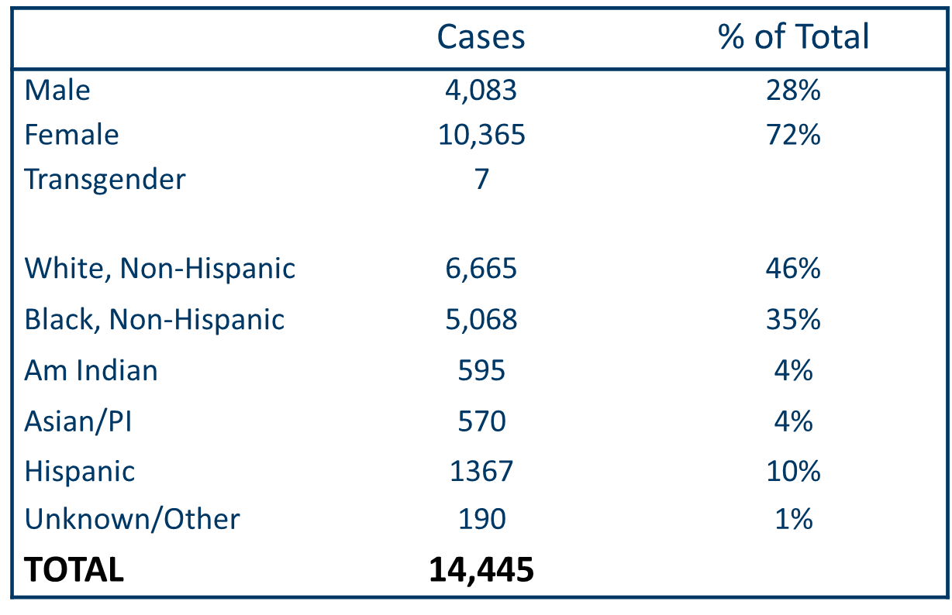
Characteristics of Adolescents & Young Adults†
Diagnosed With Chlamydia or Gonorrhea in 2018
† Adolescents defined as 15-19 year-olds; Young Adults defined as 20-24 year-olds.
Notes:
In adolescents and young adults, the majority of chlamydia and gonorrhea cases are females (72%) .
Almost half (46%) are white, non-Hispanic followed by more than one-third (35%) that are black, non-Hispanic.

Slide 42
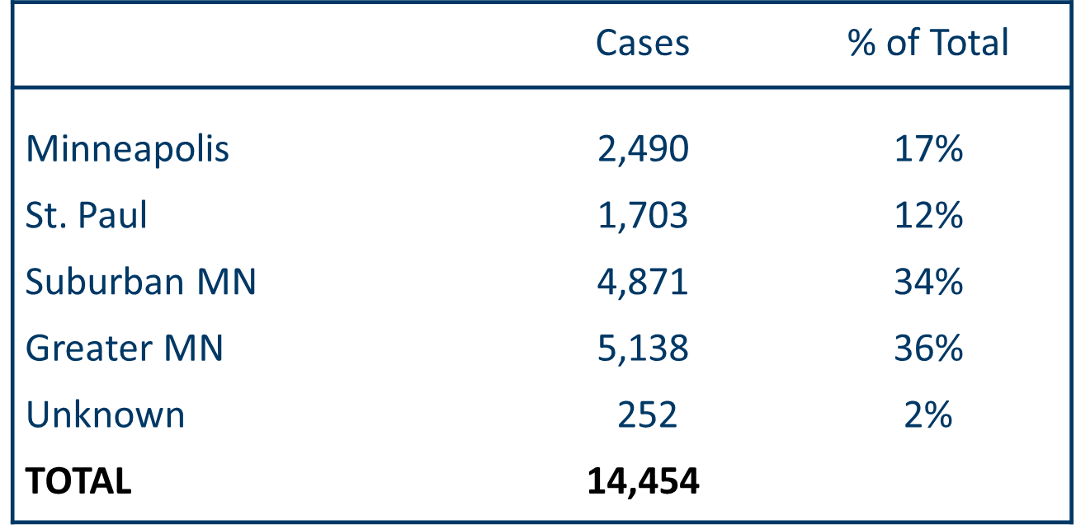
Characteristics of Adolescents & Young Adults† Diagnosed With Chlamydia or Gonorrhea in 2018
Suburban = Seven-county metro area including Anoka, Carver, Dakota, Hennepin (excluding Minneapolis), Ramsey (excluding St. Paul), Scott, and Washington counties. Greater MN = All other Minnesota counties outside the seven-county metro area.
† Adolescents defined as 15-19 year-olds; Young Adults defined as 20-24 year-olds
Notes:
In adolescents and young adults diagnosed with chlamydia or gonorrhea in 2018, about one-third reside in Greater MN (36%) and the seven county metro region (excluding Minneapolis and St. Paul).

Slide 43
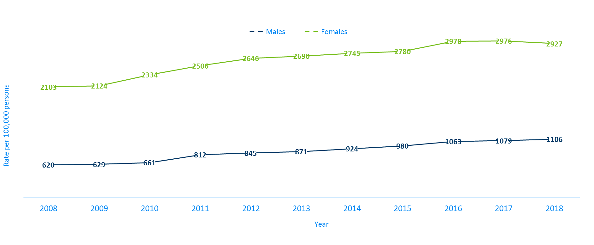
Chlamydia Rates Among Adolescents & Young Adults† by Gender in Minnesota, 2008-2018
Rate=Cases per 100,000 persons based on 2010 U.S. Census counts.
† Adolescents defined as 15-19 year-olds; Young Adults defined as 20-24 year-olds
Notes:
The rates of chlamydia are higher in females compared to males in the 15-24 year old age group. The rates for females are 2927 per 100,000 population compared to males at 1106 per 100,000 population.

Slide 44
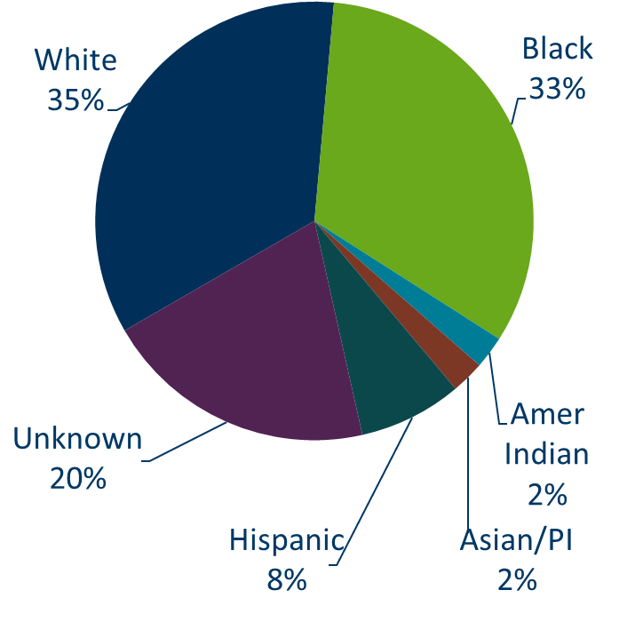
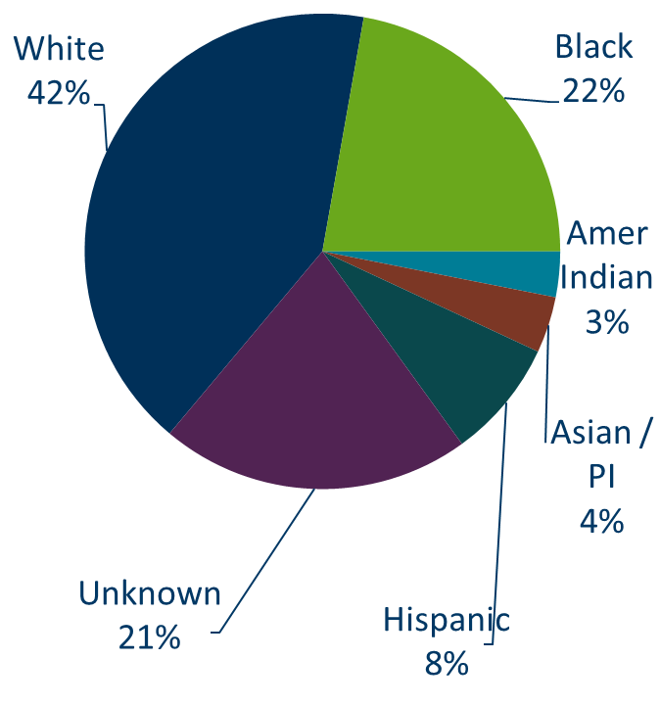
Chlamydia Cases Among Adolescents and Young Adults† by Gender and Race, Minnesota, 2018
Males (n = 4,083)
Females (n = 10,365)
† Adolescents defined as 15-19 year-olds; Young Adults defined as 20-24 year-olds.
Notes:
There are a large number of chlamydia cases among adolescents and young adults that are missing race/ethnicity when reported.

Slide 45
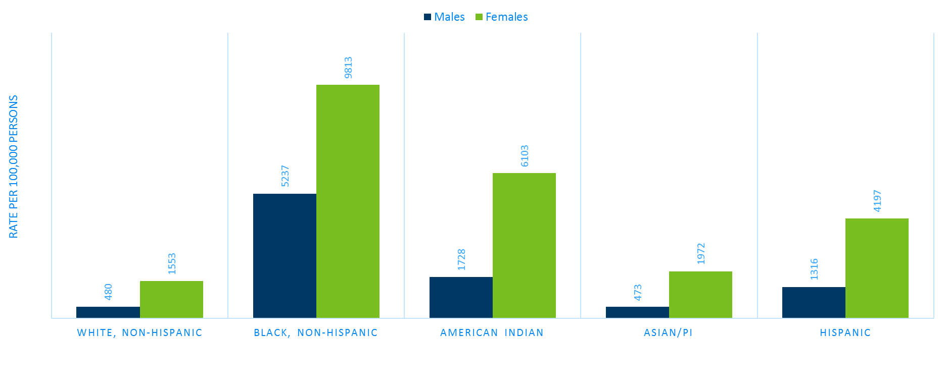
Chlamydia Rate Among Adolescents and
Young Adults† by Race, Minnesota, 2018
Rate=Cases per 100,000 persons based on 2010 U.S. Census counts.
† Adolescents defined as 15-19 year-olds; Young Adults defined as 20-24 year-olds
Notes:
The highest rates among adolescents and young adults are among females in the Black, non-Hispanic community. Their rate is 9,813 per 100,000 population.
Black, non-Hispanic males also have the highest rates among adolescent and young adult males at 5,237 per 100,000 population.

Slide 46
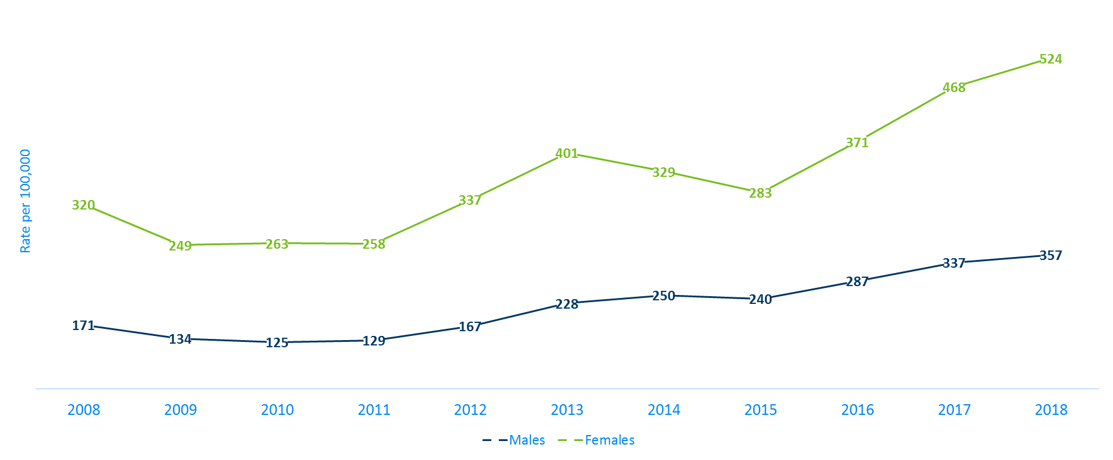
Gonorrhea Rates Among Adolescents & Young Adults† by Gender in Minnesota, 2008-2018
Rate=Cases per 100,000 persons based on 2010 U.S. Census counts. † Adolescents defined as 15-19 year-olds; Young Adults defined as 20-24 year-olds.
Notes:
The rates of gonorrhea in adolescent and young adults increased in both males and females.
The rate in adolescent and young adult females increase more than males and is now at 524 per 100,000 population.

Slide 47
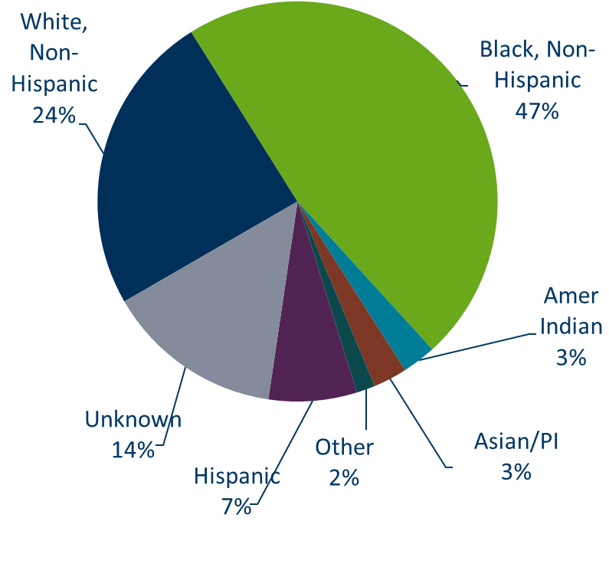
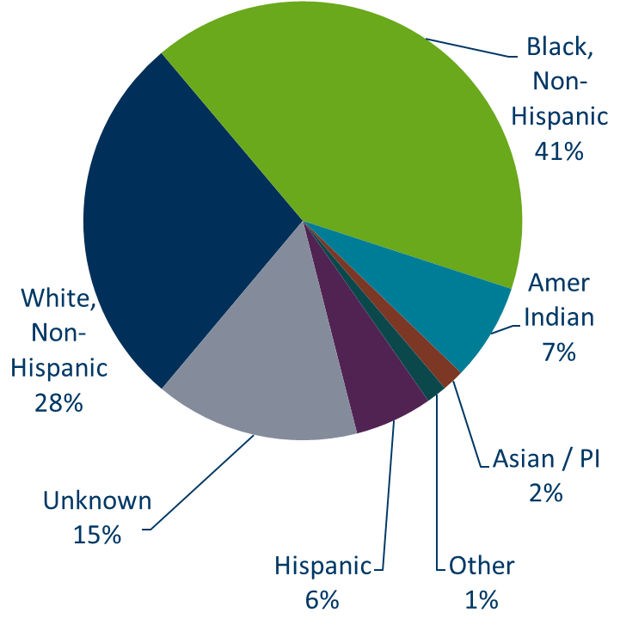
Gonorrhea Cases Among Adolescents and Young Adults† by Gender and Race, 2018
Males (n = 1,319)
Females (n = 1,856)
† Adolescents defined as 15-19 year-olds; Young Adults defined as 20-24 year-olds.
Notes:
Black, Non-Hispanic males make up 47% of gonorrhea cases in male adolescent and young adults.
Black, Non-Hispanic females also make up 41% of gonorrhea cases in female adolescent and young adults

Slide 48
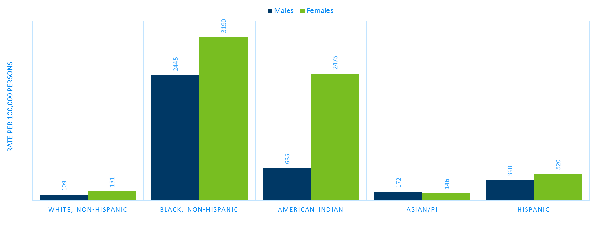
Gonorrhea Rate Among Adolescents and Young Adults† by Race, Minnesota, 2018
Rate=Cases per 100,000 persons based on 2010 U.S. Census counts.
† Adolescents defined as 15-19 year-olds; Young Adults defined as 20-24 year-olds.
Notes:
Black, non-Hispanic and American Indian males and females adolescents and young adults are disproportionately affected by gonorrhea.

Slide 49
Summary of Chlamydia and Gonorrhea Among Adolescents and Young Adults†, Minnesota, 2018
Adolescents and young adults accounted for 61% of chlamydia and 43% of gonorrhea cases diagnosed in Minnesota.
72% of chlamydia or gonorrhea cases diagnosed among adolescents and young adults were females.
About one of every six cases of chlamydia and gonorrhea diagnosed among adolescents and young adults are missing race/ethnicity
29% of gonorrhea or chlamydia cases were in the Cities of Minneapolis and Saint Paul.
† Adolescents defined as 15-19 year-olds; Young Adults defined as 20-24 year-olds.

Slide 50
Topic of Interest: Early Syphilis Among
Men Who Have Sex With Men in Minnesota
Minnesota Department of Health STD Surveillance System

Slide 51
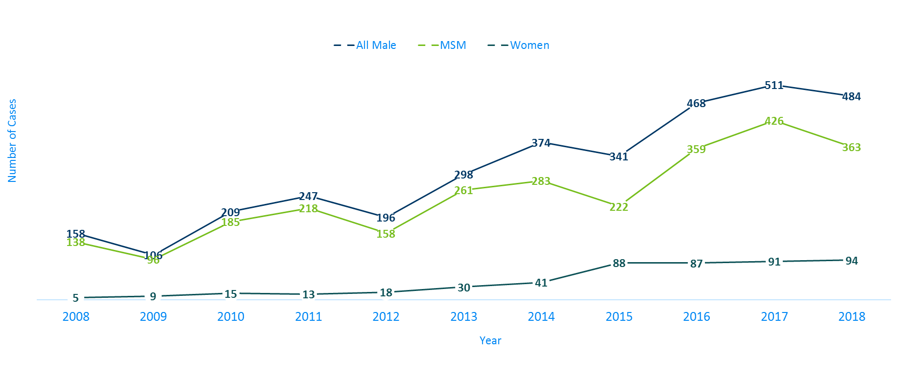
Number of Early Syphilis† Cases by Gender
Minnesota, 2008-2018
MSM=Men who have sex with men.
Figure does not include cases diagnosed in transgender persons (1 each in 2005, 2007, 2009, 4 in 2013, 1 in 2014, 2 in 2015, 3 in 2017).
† Early Syphilis includes primary, secondary, and early latent stages of syphilis.
Notes:
Men who have sex with men (MSM) make up the majority of early syphilis cases.

Slide 52
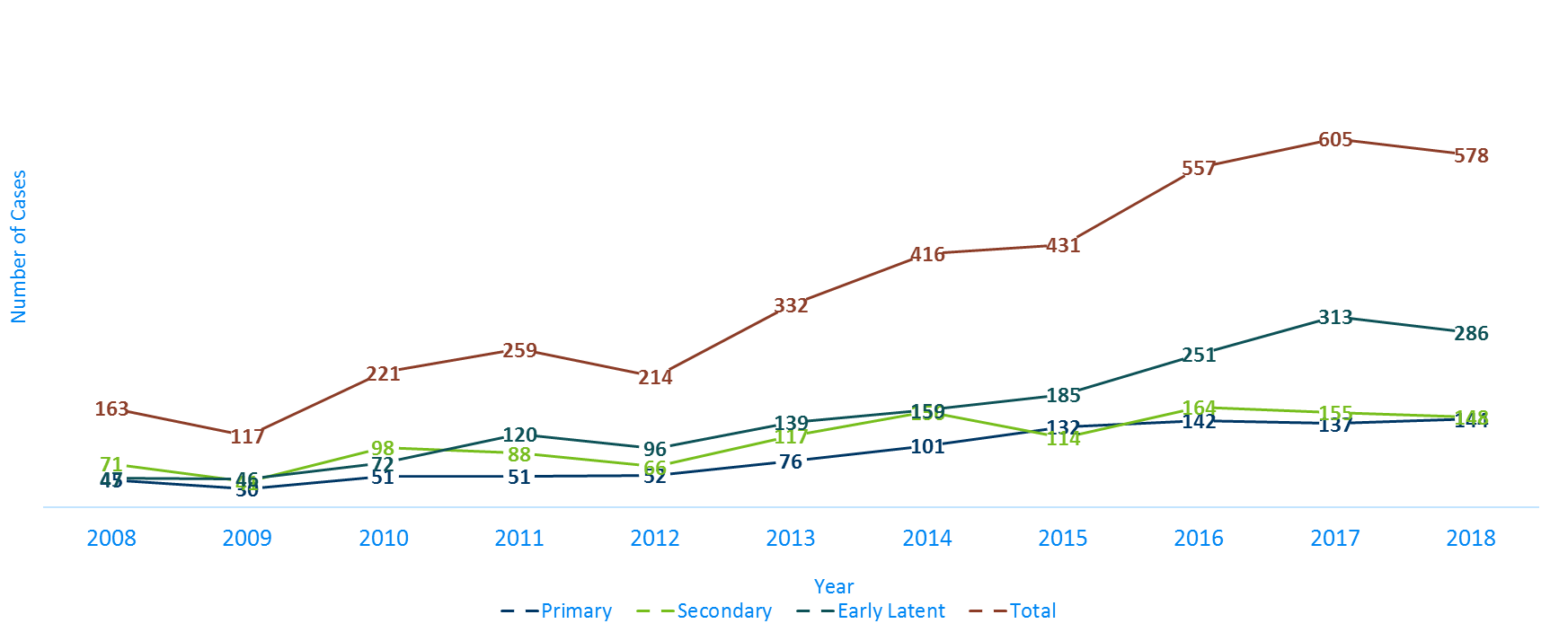
Early Syphilis† Cases by Stage at Diagnosis
Minnesota, 2008-2018
† Early Syphilis includes primary, secondary, and early latent stages of syphilis.
Notes:
There were 578 early syphilis cases reported in 2018.
286 of the cases were staged as early latent, followed by 148 secondary, and 144 primary.

Slide 53
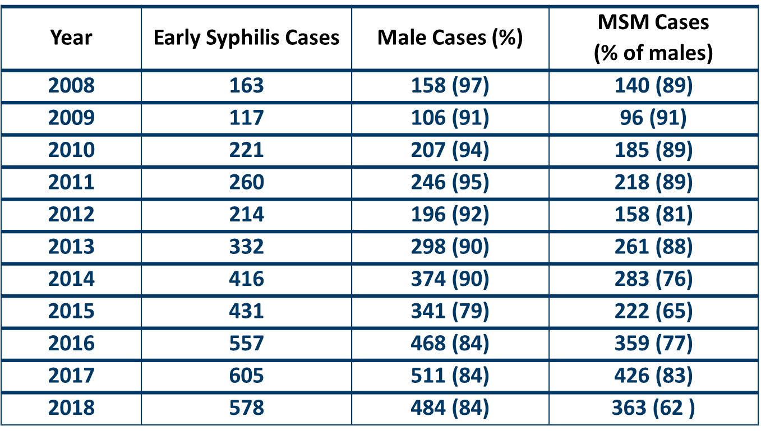
Early Syphilis† by Gender and Sexual Behavior Minnesota, 2008-2018
MSM=Men who have sex with men
† Early Syphilis includes primary, secondary, and early latent stages of syphilis.

Slide 54
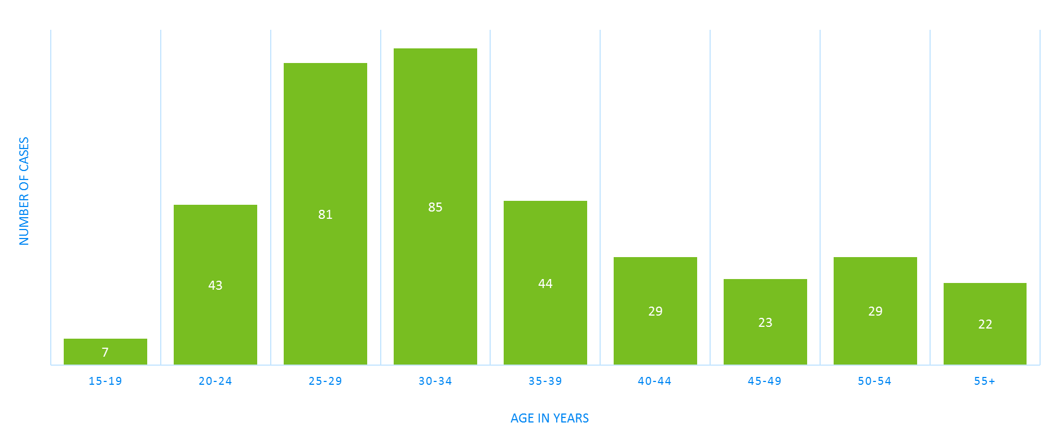
Early Syphilis† Cases Among MSM by Age Minnesota, 2018 (n=363)
Mean Age = 35 years
Range: 17 to 70 years
MSM=Men who have sex with men
† Early Syphilis includes primary, secondary, and early latent stages of syphilis.
Notes:
The average age of MSM with early syphilis is 35 years of age.
Ages ranged from 17 – 70 years of age
The 30-34 year old age group had the highest number of cases at 85.

Slide 55
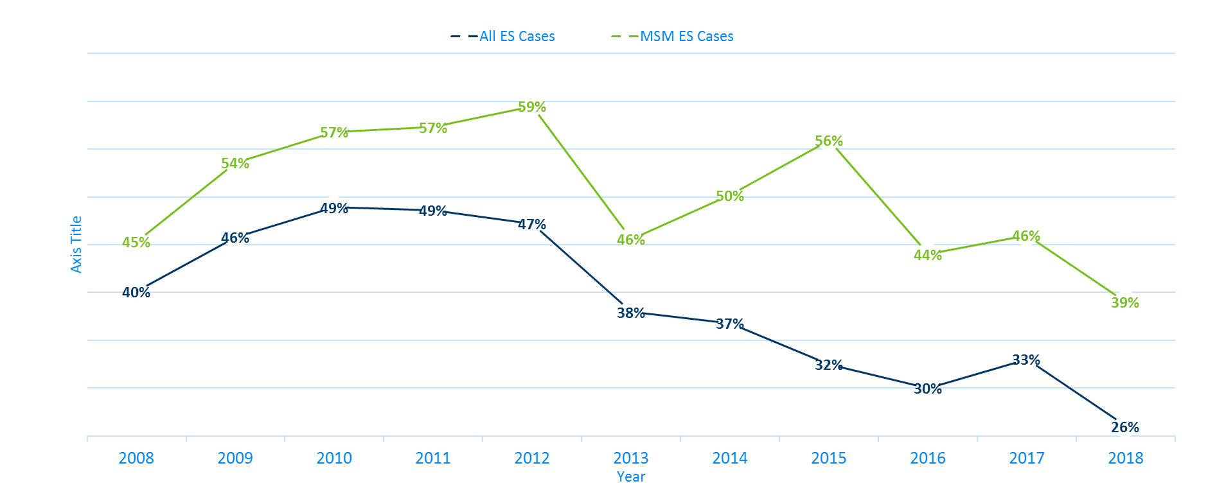
Early Syphilis† (ES) Cases Co-infected with HIV, 2008-2018
MSM=Men who have sex with men
† Early Syphilis includes primary, secondary, and early latent stages of syphilis.
Notes:
Twenty-six percent of all early syphilis cases were co-infected with HIV.
Thirty-nine percent of all MSM early syphilis cases were co-infected with HIV.

Slide 56
Characteristics of Early Syphilis† Cases Among MSM, Minnesota, 2018
Gay and bisexual men account for 75% of cases among men.
Almost half (46%) of cases among MSM are in the 25-34 age groups.
39% of cases are also infected with HIV.
MSM=Men who have sex with men
† Early Syphilis includes primary, secondary, and early latent stages of syphilis.

Slide 57
Topic of Interest: Syphilis Among
Females and Congenital Syphilis in Minnesota
Minnesota Department of Health STD Surveillance System

Slide 58
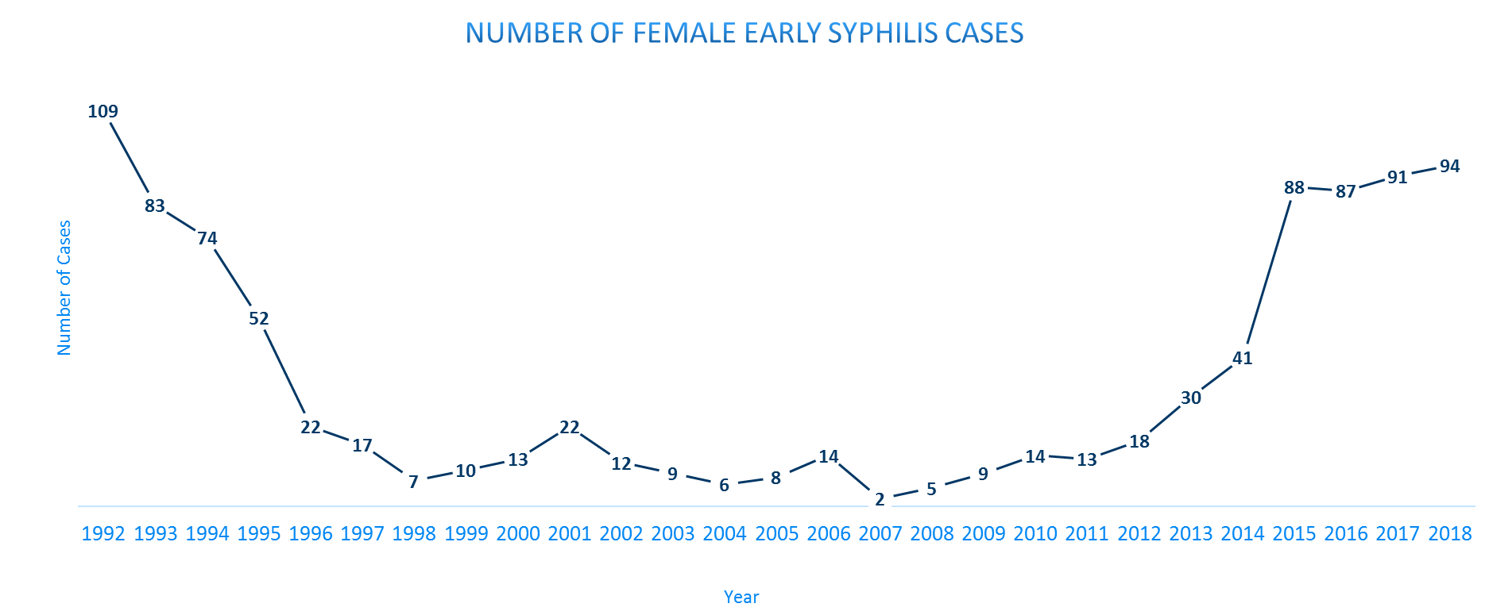
Female Early Syphilis cases
Notes:
The number of female early syphilis cases has increased dramatically from 5 cases in 2008 to the highest number of cases in the last decade of 94 in 2018.

Slide 59
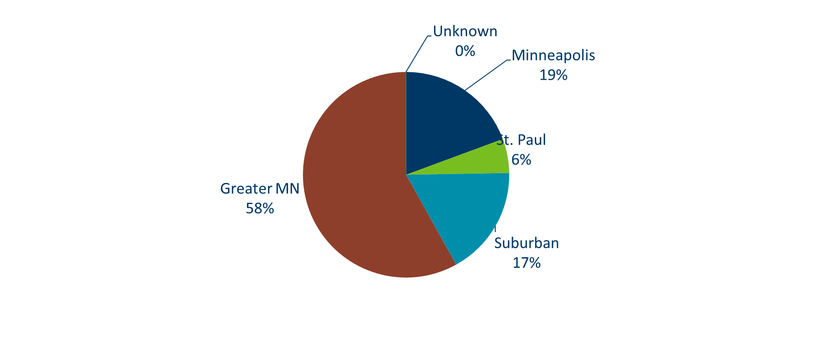
Early Syphilis Infections in Women in Minnesota by Residence at Diagnosis, 2018
Total Number of Cases = 94
Suburban = Seven-county metro area including Anoka, Carver, Dakota, Hennepin (excluding Minneapolis), Ramsey (excluding St. Paul), Scott, and Washington counties. Greater MN = All other Minnesota counties outside the seven-county metro area.
Notes:
Fifty-eight percent of female early syphilis cases were residents of Greater Minnesota
Seventeen percent of female early syphilis cases were residents of the Suburbs of the seven-county metro area
Nineteen percent were City of Minneapolis residents, and 6% were St. Paul residents.

Slide 60
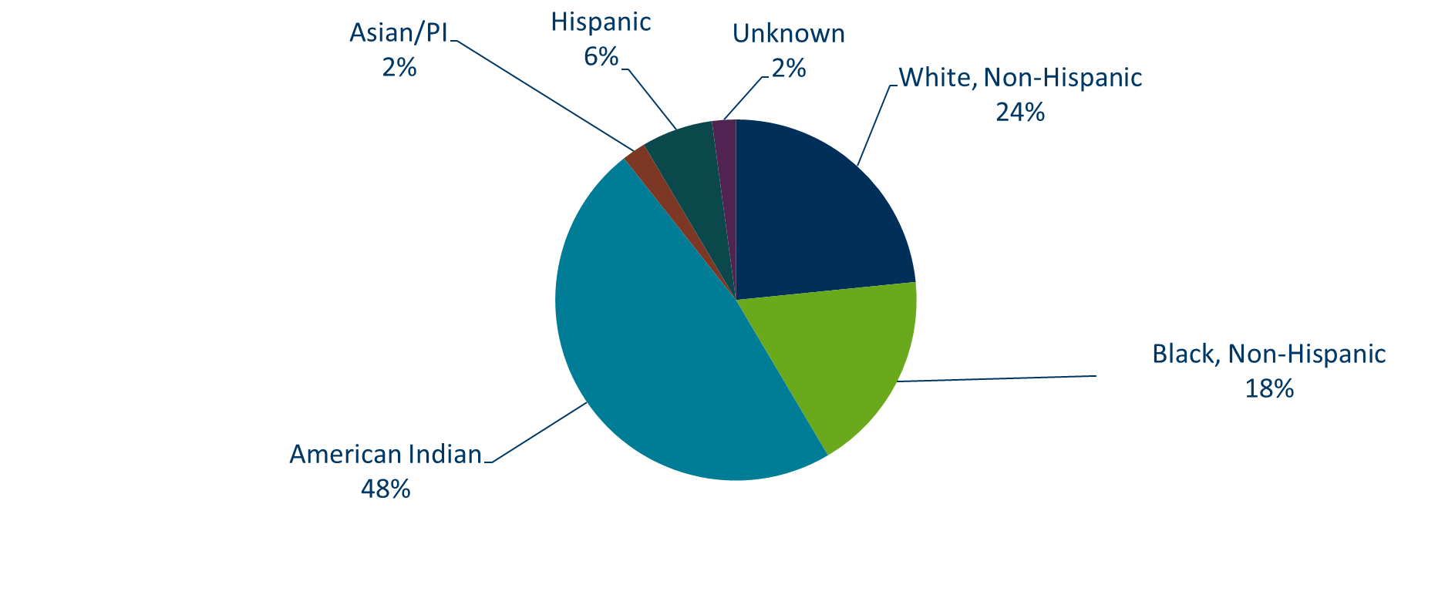
Early Syphilis Cases in Females by Race
Minnesota, 2018
Total Number of Cases = 94
*Includes persons reported with more than one race
Notes:
There are large disparities in women with syphilis. Almost half (48%) percent of all early syphilis cases in females are found in the American Indian population and 18% in the Black, African American population.

Slide 61
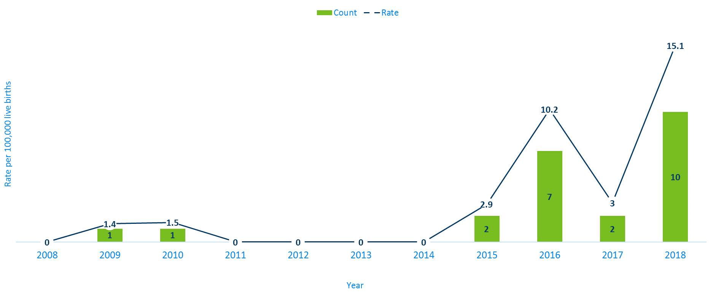
Congenital Syphilis Rates among infants
Minnesota, 2008-2018
Notes:
Syphilis may be passed from a pregnant person to the unborn baby through the placenta. The infection can cause miscarriages and stillbirths, and infants born with congenital syphilis can suffer a variety of serious health problems, including deformities, seizures, anemia and jaundice.
The Centers for Disease Control and Prevention reported this fall that the number of infants born with syphilis has more than doubled in the past four years and last year reached a 20-year high.
In Minnesota, the number and rate of congenital syphilis cases among infants has increased over the past five years from a rate of 0 per 100,000 live births in 2014 to 15.1 per 100,000 live births in 2018.

Slide 62
What’s Being Done in Minnesota?
The MDH Partner Services Program continues to follow up on early syphilis cases and their sex partners and all pregnant syphilis cases.
All HIV/Syphilis co-infected cases are assigned to Partner Services for follow-up.
Physicians are encouraged to screen men who have sex with men at least annually and to ask about sex partners.
All pregnant people should be screened for syphilis at first prenatal visit, 28 weeks’ gestation (at minimum 28-36 weeks), and many need a third test at delivery

Slide 63
Summary of STD Trends in Minnesota
From 2008-2018, the chlamydia rate increased by 61%. The rate of gonorrhea increased by 145%. While rates of reported syphilis have increased over the past decade, they have remained the same in 2018 as compared to 2017.
Minnesota has seen a resurgence of syphilis over the past decade, with men who have sex with men and those co-infected with HIV being especially impacted. However, the number of females is at the record high for the last decade.
Persons of color continue to be disproportionately affected by STDs.
STD rates are generally highest in the metro. However, chlamydia continues to be reported from every county in 2018.
Between 2017 and 2018, early syphilis cases decreased by 5%. Men who have sex with men comprised 84% of all male cases in 2018; cases among women are continuing to rise.

Slide 64
Future Updates to STD Reporting and Current Follow-Up
There will soon be a new case report form to accommodate changes in treatment guidelines, requesting HIV testing status, and PrEP (Pre-Exposure Prophylaxis) usage
The case report form (available online) can be filled out and mailed or faxed into MDH
All cases co-infected with Early Syphilis will continue to be assigned to MDH Partner Services for follow-up
All STD cases continue to have the potential for being contacted by MDH for additional follow-up

