Slide 1
Sexually Transmitted Disease (STD) Surveillance Report, 2017
STD Surveillance System
http://www.health.state.mn.us/divs/idepc/dtopics/stds/stats/index.html

Slide 2
Introduction 1/2
Under Minnesota law, physicians and laboratories must report all laboratory-confirmed cases of chlamydia, gonorrhea, syphilis, and chancroid to the Minnesota Department of Health (MDH) within one working day.
MDH does not maintain statistics for other, non-reportable STDs (ex: herpes, HPV/genital warts).
This slide set describes trends in reportable STDs in Minnesota by person, place, and time.
Analyses exclude cases reported from federal and private prisons.

Slide 3
Introduction 2/2
STD surveillance is the systematic collection of data from cases for the purpose of monitoring the frequency and distribution of STDs in a given population.
STD surveillance data are used to detect problems, prioritize resources, develop and target interventions, and evaluate the effectiveness of interventions.

Slide 4
Interpreting STD Surveillance Data 1/2
Factors that impact the completeness and accuracy of STD data include:
  Level of STD screening by healthcare providers
  Individual test-seeking behavior
  Sensitivity of diagnostic tests
  Compliance with case reporting
  Completeness of case reporting
  Timeliness of case reporting
Increases and decreases in STD rates can be due to actual changes in disease occurrence and/or changes in one or more of the above factors

Slide 5
Interpreting STD Surveillance Data 2/2
The surveillance system only includes cases with a positive laboratory test. Cases diagnosed solely on symptoms are not counted.
Since 2012 we have included cases that had only a lab report and no corresponding case report form. This has increased the number of unknowns in some variables.
In 2016, in order to be consistent with CDC, we categorized all White, Hispanic and Black, Hispanic cases as Hispanic. That means the race categories now reflect only White, Non-Hispanic and Black, Non-Hispanic cases
Surveillance data represent cases of infection, not individuals. A person with multiple infections in a given year will be counted more than once.
Caution is warranted when interpreting changes in STD numbers that can seem disproportionately large when the number of cases is small.

Slide 6
National Context

Slide 7
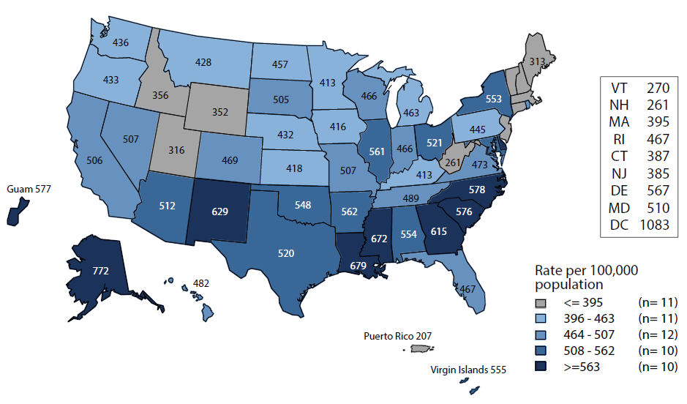
Chlamydia — Rates of Reported Cases by State
United States and Outlying Areas, 2016
NOTE: The total rate of reported cases of chlamydia for the United States and outlying areas (Guam, Puerto Rico, and Virgin Islands) was 494.2 cases per 100,000 population.
Notes:
Minnesota’s chlamydia rate in 2016 was 413 per 100,000
This was lower than the national rate of 494.2 per 100,000

Slide 8
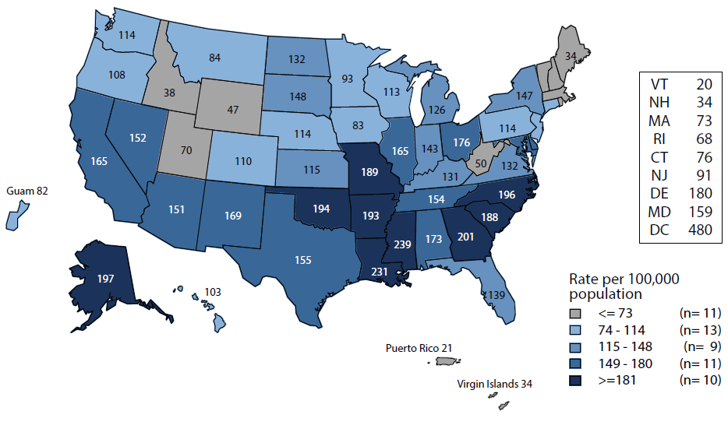
Gonorrhea — Rates of Reported Cases by State
United States and Outlying Areas, 2016
NOTE: The total rate of reported cases of gonorrhea for the United States and outlying areas (Guam, Puerto Rico, and Virgin Islands) was 144.4 cases per 100,000 population.
Notes:
Minnesota’s gonorrhea rate in 2016 was 93 per 100,000
This was lower than the national rate of 144.4 per 100,000

Slide 9
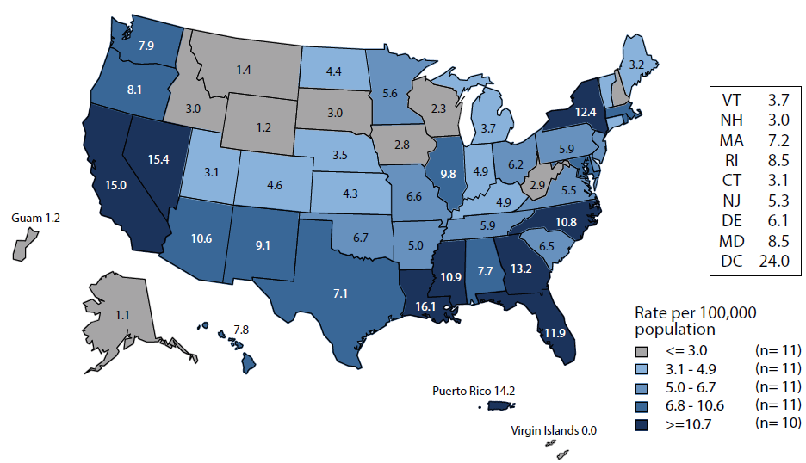
Primary & Secondary Syphilis — Rates of Reported Cases by State
United States and Outlying Areas, 2016
NOTE: The total rate of primary and secondary syphilis for the United States and outlying areas (Guam, Puerto Rico, and Virgin Islands) was 8.7 cases per 100,000 population.
Notes:
Minnesota’s primary and secondary syphilis rate in 2016 was 5.6 per 100,000
This was lower than the national rate of 8.7 per 100,000

Slide 10
Overview of STDs in Minnesota

Slide 11
STDs in Minnesota
Rate per 100,000 by Year of Diagnosis, 2007-2017
* P&S = Primary and Secondary
Notes:
The rate of chlamydia in MN reached an all time high at 444 per 100,000. This is a rate increase of 4% from 2016.
The rate of gonorrhea in MN increased 28% to 123 per 100,000 compared to 96 per 100,000 in 2016.
The rate of primary and secondary syphilis is at 5.5 per 100,000. This is an decrease of 5% from 2016.

Slide 12
STDs in Minnesota
Number of Cases Reported in 2017
Total of 30,981 STD cases reported to MDH in 2017:
  23,528 Chlamydia cases
  6,519 Gonorrhea cases
  934 Syphilis cases (all stages)
  0 Chancroid cases

Slide 13
Chlamydia

Slide 14
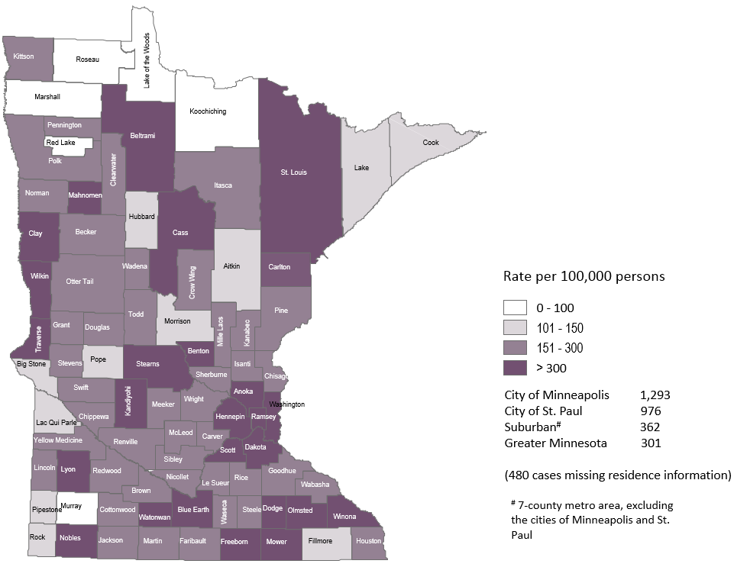
2017 Minnesota Chlamydia Rates by County
Notes:
All counties in Minnesota are affected by chlamydia. There were at least 2 cases in all counties in 2017.
The city of Minneapolis continues to have the highest rates of chlamydia at 1,293 per 100,000, followed by the city of St. Paul at 976 per 100,000, the suburban area (7-county metro excluding Minneapolis & St. Paul) at 362 per 100,000 and Greater Minnesota at 301 per 100,000.
The seven county metro Suburban area and Minneapolis had the greatest increase in rates between 2016 and 2017 at 8%. The City of St. Paul an increase of 7%, and Greater Minnesota had an 1% increase.

Slide 15
Chlamydia Infections by Residence at Diagnosis
Minnesota, 2017
Total Number of Cases = 23,528
Suburban = Seven-county metro area including Anoka, Carver, Dakota, Hennepin (excluding Minneapolis), Ramsey (excluding St. Paul), Scott, and Washington counties. Greater MN = All other Minnesota counties outside the seven-county metro area.
Notes:
All parts of Minnesota are affected by chlamydia. Roughly a third of the cases are in the cities of Minneapolis and St. Paul, a third in the Suburban area surround the cities, and a third in Greater Minnesota.

Slide 16
Chlamydia Rates by Gender
Minnesota, 2007-2017
Notes:
The rates of chlamydia went up in both males and females in 2017. Females continue to have higher rates of chlamydia than males. The rate in males increased more than the rate in females in 2017.
The males had a rate of 311 per 100,000 which is an increase of 6% over the 2016 rate of 293 per 100,000.
The females had a rate of 574 per 100,000 which is an increase of 2% over the 2016 rate of 560 per 100,000.

Slide 17
Chlamydia Rates by Age, Minnesota, 2007-2017
Notes:
All age groups, except the 15-19 yr. old age group, saw an increase in chlamydia rates.
The 15-19 yr. old age group had a rate of 1,608 per 100,000 which is a 1 percent decrease over the 2016 rate of 1,617 per 100,000.
The highest rate remains in the 20-24 yr. old age group at 2,424 per 100,000.
The 30-39 yr. olds had the largest rate increase from 2016 at 9%. Their rate is 480 per 100,000. This age group still has the fourth highest rates of chlamydia.

Slide 18
Age-Specific Chlamydia Rates by Gender
Minnesota, 2017
Notes:
The age group with the largest increase in rate was males 50+ at a 47% increase over 2016.
The rates of chlamydia went up in both males and females in 2017.
Females continue to have higher rates of chlamydia than males in age groups 39 and under.
In 2017 males have higher rates in the 40 and over age groups.
The rate in males increased more than the rate in females in 2017.
The highest rates of chlamydia continue to be in females 20-24 year of age at 3,353 per 100,000.

Slide 19
Chlamydia Rates by Race/Ethnicity
Minnesota, 2007-2017 (1/2)
2017 rates compared with Whites:
Black, Non-Hispanic = 9.7x higher
American Indian = 5x higher
Asian/PI = 2x higher
Hispanic* = 3x higher
* Persons of Hispanic ethnicity can be of any race
Notes:
There continues to be disparities in rates of chlamydia.
The Black/African American, Non-Hispanic population has rates that are 9.7 times higher than that of whites. The rate in the Black/African American population was 2,020 per 100,000 compared to the rate in the White, Non-Hispanic population at 209 per 100,000.
The American Indian population had a rate that was 5 times higher at 1,083 per 100,000
The Asian/Pacific Islander population had a rate that was 2 times higher at 391 per 100,000
The Hispanic/Latino population, which can be of any race, had a rate that was 3 times higher at 649 per 100,000

Slide 20
Chlamydia Rates by Race/Ethnicity
Minnesota, 2007-2017 (2/2)
Notes:
This is a clearer view of the rates from the previous slide, removing the Black/African American, Non-Hispanic data.

Slide 21
Gonorrhea

Slide 22
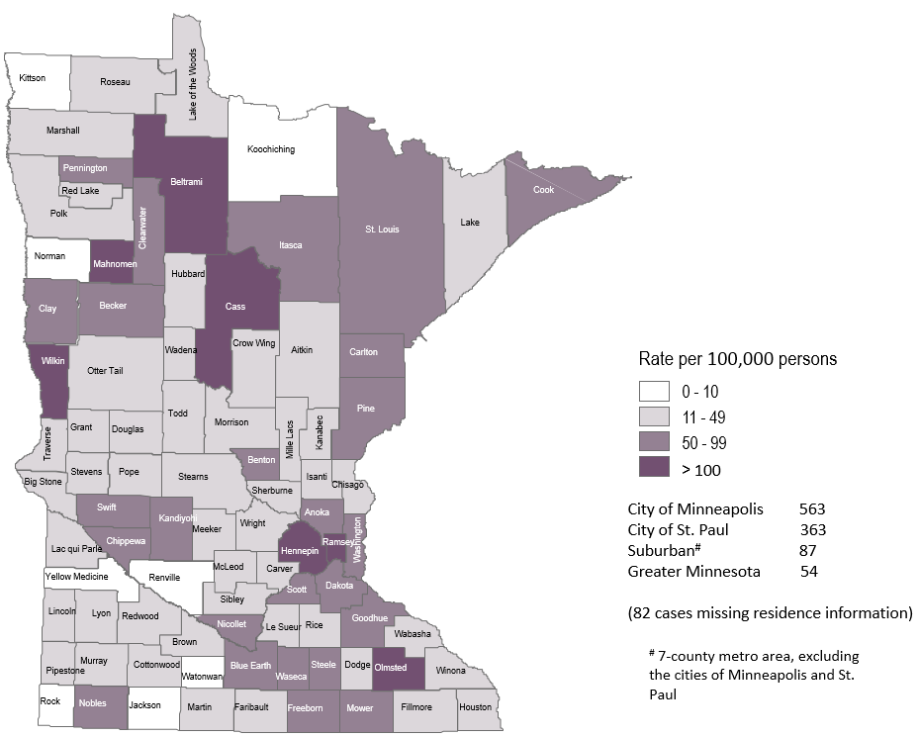
2017 Minnesota Gonorrhea Rates by County
Notes:
The city of Minneapolis continues to have the highest rates of gonorrhea at 563 per 100,000, followed by the city of St. Paul at 363 per 100,000, the suburban area (7-county metro excluding Minneapolis & St. Paul) at 87 per 100,000 and Greater Minnesota at 54 per 100,000.
Greater Minnesota area had the highest increase at 39%, followed by the City of St. Paul with a 35% increase. The seven county metro Suburban area and the City of Minneapolis had the smallest increase both at 26%.

Slide 23
Gonorrhea Infections in Minnesota by Residence at Diagnosis, 2017
Suburban = Seven-county metro area including Anoka, Carver, Dakota, Hennepin (excluding Minneapolis), Ramsey (excluding St. Paul), Scott, and Washington counties. Greater MN = All other Minnesota counties outside the seven-county metro area.

Slide 24
Gonorrhea Rates by Gender
Minnesota, 2007-2017
Notes:
The rates of gonorrhea went up in both males and females in 2017. Males continue to have higher rates of gonorrhea than females. The rate in females increased more than the rate in males in 2017.
The males had a rate of 136 per 100,000 which is an increase of 24% over the 2016 rate of 109 per 100,000.
The females had a rate of 110 per 100,000 which is an increase of 33% over the 2016 rate of 83 per 100,000.

Slide 25
Gonorrhea Rates by Age
Minnesota, 2007-2017
Notes:
All age groups saw an increase in gonorrhea rates.
The highest rate remains in the 20-24 yr. old age group at 491 per 100,000.
The 30-39 yr. olds had the largest rate increase from 2016 to 2017 at 46%.

Slide 26
Age-Specific Gonorrhea Rates by Gender Minnesota, 2017
Notes:
The rates of gonorrhea went up in both males and females in 2017. Females continue to have higher rates of gonorrhea than males in age groups 19 and under. In 2017 males have higher rates in the 20 and over age groups. The rate in females increased more than the rate in males in 2017.
The highest rates of gonorrhea are in males 20-24 at 500 per 100,000.

Slide 27
Gonorrhea Rates by Race/Ethnicity
Minnesota, 2007-2017 (1/2)
2017 rates compared with Whites:
Black, Non-Hispanic = 20x higher
American Indian = 13x higher
Asian/PI = 2x higher
Hispanic* = 3x higher
Notes:
There continues to be disparities in rates of gonorrhea.
The Black/African American, Non-Hispanic population has rates that are 20 times higher than that of whites. The rate in the Black/African American population was 875 per 100,000 compared to the rate in the White, Non-Hispanic population at 44 per 100,000.
The American Indian population had a rate that was 13 times higher at 563 per 100,000
The Asian/Pacific Islander population had a rate that was 2 times higher at 90 per 100,000
The Hispanic/Latino population, which can be of any race, had a rate that was 3 times higher at 135 per 100,000

Slide 28
Gonorrhea Rates by Race/Ethnicity
Minnesota, 2007-2017 (2/2)
* Persons of Hispanic ethnicity can be of any race.
Notes:
This is a clearer view of the rates from the previous slide, removing the Black/African American, Non-Hispanic data.

Slide 29
Syphilis

Slide 30
Syphilis Rates by Stage of Diagnosis Minnesota, 2007-2017
* P&S = Primary and Secondary
Notes:
The overall syphilis rate is now up to 17.6 per 100,000. Compared to the low of 3.6 back in 2007.
Of concern is the rate of primary and secondary syphilis which is 5.5 per 100,000.

Slide 31
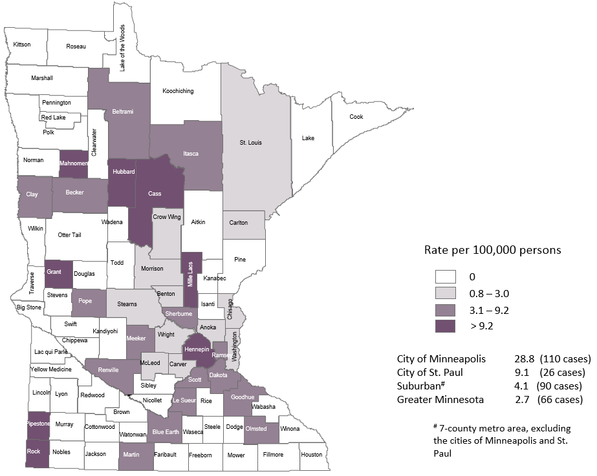
2017 Minnesota Primary & Secondary Syphilis Rates by County
Notes:
The highest rate of primary and secondary syphilis remains in the City of Minneapolis at 28.8 cases per 100,000 population.
The City of St. Paul has the second rate at 9.1 per 100,000.

Slide 32
Primary & Secondary Syphilis Infections in Minnesota by Residence at Diagnosis, 2017
Total Number of Cases = 292
Suburban = Seven-county metro area including Anoka, Carver, Dakota, Hennepin (excluding Minneapolis), Ramsey (excluding St. Paul), Scott, and Washington counties. Greater MN = All other Minnesota counties outside the seven-county metro area.
Notes:
The City of Minneapolis has 38% of all reported primary and secondary cases.
The suburban area has 31% of the cases, St. Paul has 9% of the cases, and Greater Minnesota has 22% of the cases.
The only increase was in Greater Minnesota at 18%. This is the second year in a row that Greater Minnesota has an increase in primary and secondary syphilis cases.

Slide 33
Primary & Secondary Syphilis Rates by Gender
Minnesota, 2007-2017
Notes:
Males have the highest rates of primary and secondary syphilis at 9.6 cases per 100,0000 population
The rate of primary and secondary syphilis in females is 1.4 per 100,000 per population.

Slide 34
Primary & Secondary Syphilis Rates by Age
Minnesota, 2007-2017
Notes:
The highest rates of primary and secondary syphilis are in the 25-29 year old age group at 18.5 cases per 100,000 population, followed by the 20-24 year old age group at 16.9 cases per 100,000 population.

Slide 35
Age-Specific Primary & Secondary Syphilis Rates by Gender Minnesota, 2017
Notes:
Males have higher rates of primary and secondary syphilis than females in all age groups. The rate in males is 7 times higher than females.
The 25-29 yr. old males have the highest rate at 31.5 per 100,000
The 20-24 yr. old females have the highest rate of the female population at 5.7 per 100,000

Slide 36
Primary & Secondary Syphilis Cases by Race
Minnesota, 2017
Total Number of Cases = 292
*Includes persons reported with more than one race
Notes:
Fifty-three percent of all primary and secondary syphilis cases are White, Non-Hispanic.
Black, Non-Hispanic cases are at 19%, American Indian cases are 11%, Hispanic cases are at 10%, and Asian/Pacific Islander cases are 5%.

Slide 37
Primary & Secondary Syphilis Rates by Race/Ethnicity
Minnesota, 2007-2017
* Persons of Hispanic ethnicity can be of any race.
Notes:
The rates of primary and secondary syphilis are 14 times higher in the American Indian populations than that of the White, Non-Hispanic population.
The rates of primary and secondary syphilis are 6 times higher in the Black/African American, Non-Hispanic than that of the White, Non-Hispanic population.
The rates of primary and secondary syphilis in the America Indian population are 47.5 per 100,000 compared to 3.3 per 100,000 in the White, Non-Hispanic population.
The rates of primary and secondary syphilis in the Black/African American, Non-Hispanic population are 19.6 per 100,000 compared to 3.3 per 100,000 in the White, Non-Hispanic population.
The rates in the Hispanic/Latino population are 12.4 per 100,000 which is 4 times higher than the White, Non-Hispanic population.
The rates in the Asian/Pacific Islander population are 6.8 per 100,000 which is 2 times higher than the White, Non-Hispanic population.

Slide 38
Chlamydia and Gonorrhea among
Adolescents & Young Adults

Slide 39
Chlamydia Disproportionately Impacts Youth
MN Population in 2010
(n = 5,303,925)
Chlamydia Cases in 2017
(n = 23,528)
Notes:
Chlamydia continues to disproportionately impact youth. The 15-24 year olds make up only 14% of the population, but account for 62% of all chlamydia cases reported.
The <15 yrs old population account for 0.63% of Chlamydia cases in 2017

Slide 40
Gonorrhea Disproportionately Impacts Youth
MN Population in 2010
(n = 5,303,925)
Gonorrhea Cases in 2017
(n = 6,519)
Notes:
Gonorrhea also disproportionately impacts youth. The 15-24 year olds make up only 14% of the population, but account for 45% of all gonorrhea cases reported.

Slide 41
Characteristics of Adolescents & Young Adults†
Diagnosed With Chlamydia or Gonorrhea in 2017
 | Cases | % of Total
Male | 5,231 | 29%
Female | 12,199 | 70%
Transgender | 12
White, Non-Hispanic | 6,600 | 38%
Black, Non-Hispanic | 5,029 | 29%
Am Indian | 555 | 3%
Asian/PI | 545 | 3%
Hispanic Other/Unknown | 1,152 3,564 | 6% 20%
TOTAL | 17,445
† Adolescents defined as 15-19 year-olds; Young Adults defined as 20-24 year-olds.

Slide 42
Characteristics of Adolescents & Young Adults† Diagnosed With Chlamydia or Gonorrhea in 2017
 | Cases | % of Total
Minneapolis | 3,509 | 20%
St. Paul | 2,161 | 12%
Suburban MN | 5,807 | 33%
Greater MN | 5,619 | 32%
Unknown | 349 | 2%
TOTAL | 17,445
Suburban = Seven-county metro area including Anoka, Carver, Dakota, Hennepin (excluding Minneapolis), Ramsey (excluding St. Paul), Scott, and Washington counties. Greater MN = All other Minnesota counties outside the seven-county metro area.
† Adolescents defined as 15-19 year-olds; Young Adults defined as 20-24 year-olds

Slide 43
Chlamydia Rates Among Adolescents & Young Adults† by Gender in Minnesota, 2007-2017
Rate= Cases per 100,000 persons based on 2010 U.S. Census counts.
† Adolescents defined as 15-19 year-olds; Young Adults defined as 20-24 year-olds.
Notes:
The rates of chlamydia are higher in females compared to males in the 15-24 year old age group. The rates for females are 2976 per 100,000 population compared to males at 1079 per 100,000 population.

Slide 44
Chlamydia Cases Among Adolescents and Young Adults† by Gender and Race, Minnesota, 2017
Males (n = 3,986)
Females (n = 10,540)
† Adolescents defined as 15-19 year-olds; Young Adults defined as 20-24 year-olds.
Notes:
There are a large number of chlamydia cases among adolescents and young adults that are missing race/ethnicity when reported.

Slide 45
Chlamydia Rate Among Adolescents and
Young Adults† by Race, Minnesota, 2017
Rate= Cases per 100,000 persons based on 2010 U.S. Census counts.
† Adolescents defined as 15-19 year-olds; Young Adults defined as 20-24 year-olds.
Notes:
The highest rates among adolescents and young adults are among females in the Black, Non-Hispanic community. Their rate is 9,926 per 100,000 population.
Black, Non-Hispanic males also have the highest rates among adolescent and young adult males at 5,036 per 100,000 population.

Slide 46
Gonorrhea Rates Among Adolescents & Young Adults† by Gender in Minnesota, 2007-2017
Rate=Cases per 100,000 persons based on 2010 U.S. Census counts.
† Adolescents defined as 15-19 year-olds; Young Adults defined as 20-24 year-olds.
Notes:
The rates of gonorrhea in adolescent and young adults increased in both males and females.
The rate in adolescent and young adult females increase more than males and is now at 468 per 100,000 population.

Slide 47
Gonorrhea Cases Among Adolescents and Young Adults† by Gender and Race, 2017
Males (n = 1,245)
Females (n = 1,659)
† Adolescents defined as 15-19 year-olds; Young Adults defined as 20-24 year-olds.
Notes:
Black, Non-Hispanic males make up 50% of gonorrhea cases in male adolescent and young adults.
Black, Non-Hispanic females also make up 45% of gonorrhea cases in female adolescent and young adults

Slide 48
Gonorrhea Rate Among Adolescents and Young Adults† by Race, Minnesota, 2017
Rate= Cases per 100,000 persons based on 2010 U.S. Census counts.
† Adolescents defined as 15-19 year-olds; Young Adults defined as 20-24 year-olds.
Notes:
Black, Non-Hispanic and American Indian males and females adolescents and young adults are disproportionately affected by gonorrhea.

Slide 49
Summary of Chlamydia and Gonorrhea Among Adolescents and Young Adults†, Minnesota, 2017
Adolescents and young adults accounted for 62% of chlamydia and 45% of gonorrhea cases diagnosed in Minnesota.
70% of chlamydia or gonorrhea cases diagnosed among adolescents and young adults were females.
19% of chlamydia and gonorrhea cases diagnosed among adolescents and young adults are missing race/ethnicity
33% of gonorrhea or chlamydia cases were in the Cities of Minneapolis and Saint Paul.
† Adolescents defined as 15-19 year-olds; Young Adults defined as 20-24 year-olds.

Slide 50
Topic of Interest: Early Syphilis Among
Men Who Have Sex With Men in Minnesota

Slide 51
Number of Early Syphilis† Cases by Gender
Minnesota, 2007-2017
MSM=Men who have sex with men.
Figure does not include cases diagnosed in transgender persons (1 each in 2005, 2007, 2009, 4 in 2013, 1 in 2014, 2 in 2015, 3 in 2017).
† Early Syphilis includes primary, secondary, and early latent stages of syphilis.
Notes:
Men who have sex with men (MSM) make up the majority of early syphilis cases.

Slide 52
Early Syphilis† Cases by Stage at Diagnosis
Minnesota, 2007-2017
† Early Syphilis includes primary, secondary, and early latent stages of syphilis.
Notes:
There were 605 early syphilis cases reported in 2017.
313 of the cases were staged as early latent, followed by 155 secondary, and 137 primary.

Slide 53
Early Syphilis† by Gender and Sexual Behavior Minnesota 2007-2017
Year | Early Syphilis Cases | Male Cases (%) | MSM Cases (% of males)
2007 | 114 | 111 (97) | 103 (93)
2008 | 163 | 158 (97) | 140 (89)
2009 | 117 | 106 (91) | 96 (91)
2010 | 221 | 207 (94) | 185 (89)
2011 | 260 | 246 (95) | 218 (89)
2012 | 214 | 196 (92) | 158 (81)
2013 | 332 | 298 (90) | 261 (88)
2014 | 416 | 374 (90) | 283 (76)
2015 | 431 | 341 (79) | 222 (65)
2016 | 557 | 468 (84) | 359 (77)
2017 | 605 | 511 (84) | 426 (83)
MSM=Men who have sex with men
† Early Syphilis includes primary, secondary, and early latent stages of syphilis.

Slide 54
Early Syphilis† Cases Among MSM by Age
Minnesota, 2017 (n=426)
Mean Age = 35 years
Range: 15 to 65 years
MSM=Men who have sex with men
† Early Syphilis includes primary, secondary, and early latent stages of syphilis.
Notes:
The average age of MSM with early syphilis 35 years of age.
Ages ranged from 15 – 65 years of age
The 25-29 year old age group had the highest number of cases at 89.

Slide 55
Early Syphilis† (ES) Cases Co-infected with HIV
2007-2017
MSM=Men who have sex with men
† Early Syphilis includes primary, secondary, and early latent stages of syphilis.
Notes:
Thirty-three percent of all early syphilis cases were co-infected with HIV.
Forty-six percent of all MSM early syphilis cases were co-infected with HIV.

Slide 56
Characteristics of Early Syphilis† Cases
Among MSM, Minnesota, 2016
Gay and bisexual men account for 77% of cases among men.
62% of cases among MSM are White, but a disproportionate number of cases (17%) are African American.
44% of cases are also infected with HIV.
MSM=Men who have sex with men
† Early Syphilis includes primary, secondary, and early latent stages of syphilis.

Slide 57
Topic of Interest: Syphilis Among
Females and Congenital Syphilis in Minnesota

Slide 58
Female Early Syphilis Cases

Slide 59
Early Syphilis Infections in Women in Minnesota by Residence at Diagnosis, 2017
Total Number of Cases = 91
Suburban = Seven-county metro area including Anoka, Carver, Dakota, Hennepin (excluding Minneapolis), Ramsey (excluding St. Paul), Scott, and Washington counties. Greater MN = All other Minnesota counties outside the seven-county metro area.
Notes:
Fourty-seven percent of female early syphilis cases were residents of Greater Minnesota
Twenty-six percent of female early syphilis cases were residents of the Suburbs of the seven-county metro area
Nineteen percent were City of Minneapolis residents, and 8% were St. Paul residents.

Slide 60
Early Syphilis Cases in Females by Race
Minnesota, 2017
Total Number of Cases = 91
*Includes persons reported with more than one race
Notes:
There are large disparities in women with syphilis. Thirty-five percent of all early syphilis cases in females are found in the American Indian population and 23% in the Black, African American population.

Slide 61
What’s Being Done in Minnesota?
The MDH Partner Services Program continues to follow up on early syphilis cases and their sex partners and all pregnant syphilis cases.
All HIV/Syphilis co-infected cases are assigned to Partner Services for follow-up.
Physicians are encouraged to screen men who have sex with men at least annually and to ask about sex partners.
All pregnant females should be screened for syphilis at first prenatal visit, 28 weeks’ gestation (at minimum 28-36 weeks), and at delivery.

Slide 62
Summary of STD Trends in Minnesota
From 2007-2017, the chlamydia rate increased by 71%. The rate of gonorrhea increased by 84%. Rates of reported syphilis increased in 2017 compared to 2016 by 10%.
Minnesota has seen a resurgence of syphilis over the past decade, with men who have sex with men and those co-infected with HIV being especially impacted. However, the number of females is near the record high for the last decade.
Persons of color continue to be disproportionately affected by STDs.
STD rates are highest in the cities of Minneapolis and Saint Paul. However, chlamydia and gonorrhea cases in the Twin Cities suburbs and Greater Minnesota account for 62% of the reported cases in 2017.
Between 2016 and 2017, early syphilis cases increased by 9%. Men who have sex with men comprised 83% of all male cases in 2017; cases among women are continuing to rise.

Slide 63
Future Updates to STD Reporting and Current Follow-Up
New case report form to accommodate changes in treatment guidelines, requesting HIV testing status, and PrEP (Pre-Exposure Prophylaxis) usage.
Case report form is be able to be filled out on a computer and printed to be mailed or faxed in
All cases co-infected with HIV (diagnosed in the last year)/Gonorrhea, HIV/Syphilis, and Early Syphilis will be continue to be assigned to MDH Partner Services for follow-up
All Gonorrhea cases continue to have the potential for being contacted by MDH for additional follow-up

