Slide 1
Highlights from Minnesota HIV Surveillance Report, 2022
HIV/AIDS Surveillance System
April 2023
Notes:
.

Slide 2
Land Acknowledgement
Every community owes its existence and vitality to generations from around the world who contributed their hopes, dreams, and energy to making the history that led to this moment. Some were brought here against their will, some were drawn to leave their distant homes in hope of a better life, and some have lived on this land for more generations than can be counted. Truth and acknowledgment are critical to building mutual respect and connection across all barriers of heritage and difference.
We begin this effort to acknowledge what has been buried by honoring the truth. We are standing on the ancestral lands of the Dakota people. We want to acknowledge the Dakota, the Ojibwe, the Ho Chunk, and the other nations of people who also called this place home. We pay respects to their elders past and present. Please take a moment to consider the treaties made by the Tribal nations that entitle non-Native people to live and work on traditional Native lands. Consider the many legacies of violence, displacement, migration, and settlement that bring us together here today. Please join us in uncovering such truths at any and all public events.*
*This is the acknowledgment given in the USDAC Honor Native Land Guide – edited to reflect this space by Shannon Geshick, MTAG, Executive Director Minnesota Indian Affairs Council
Notes:
Before we begin our webinar, we take a moment to acknowledge that Minnesota stands on ancestral land of tribal nations… including the Dakota, Ojibwe, Ho Chunk, and other nations. Please take a moment to consider the treaties made by the Tribal nations that entitle non-native people to live and work on traditional Native lands.

Slide 3
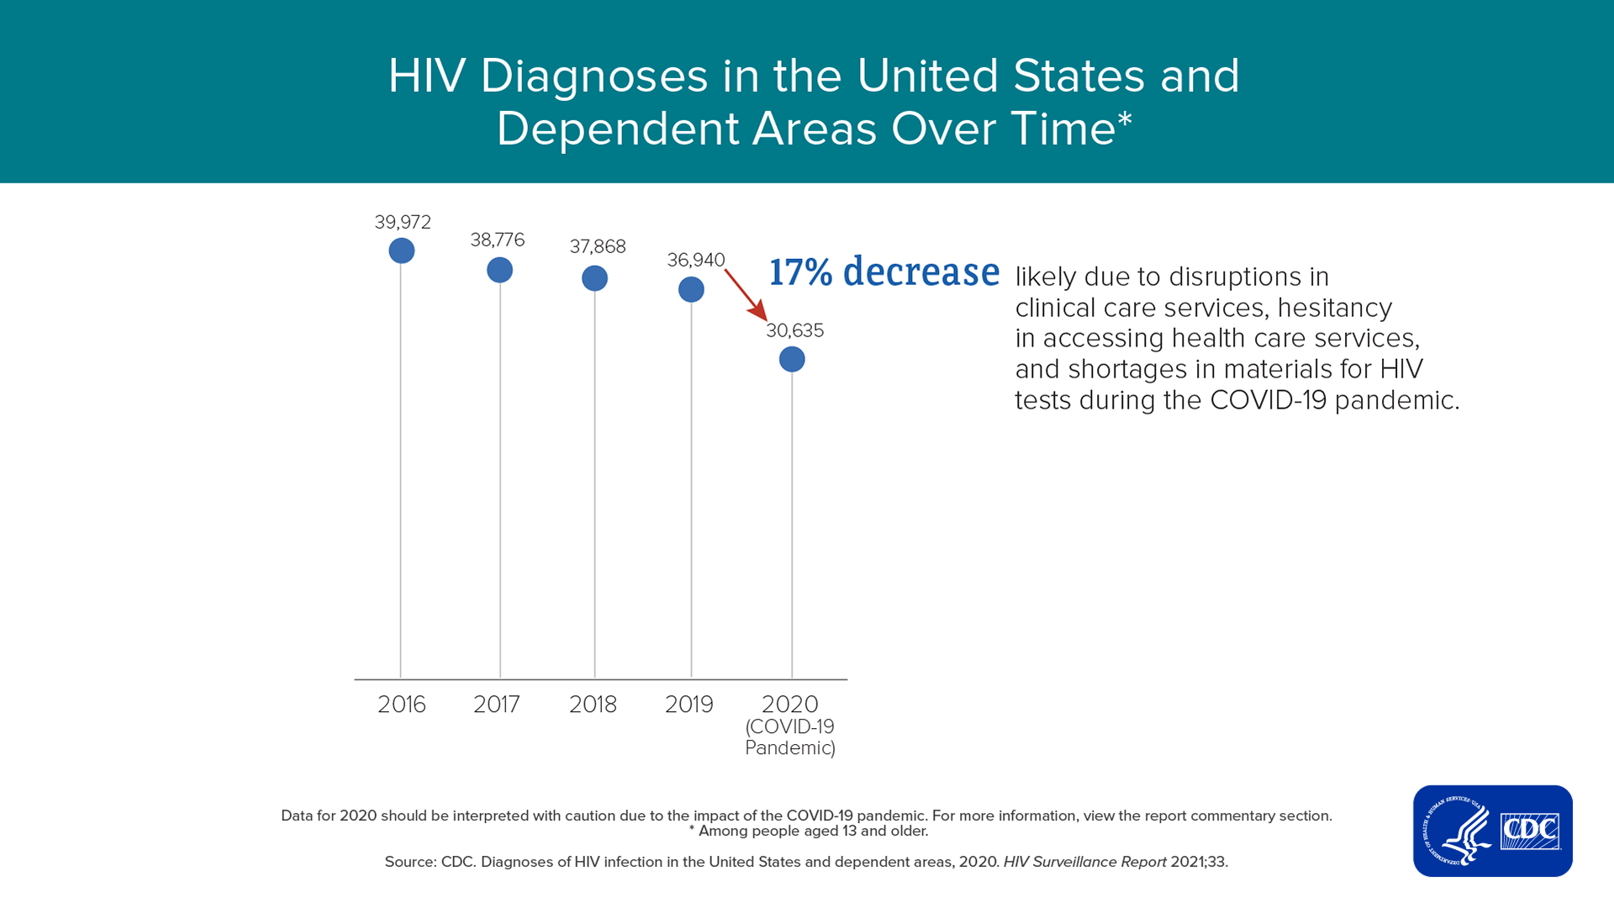
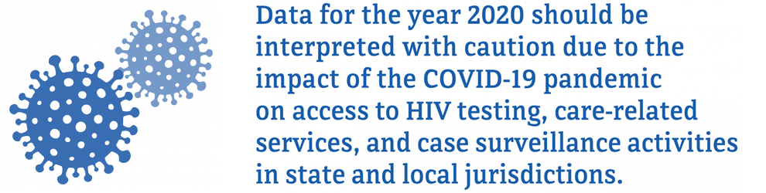
COVID-19 Pandemic Impact on HIV Diagnoses in United States, 2020
Notes:
The COVID-19 pandemic in the United States led to disruptions in HIV testing services and access to clinical services throughout 2020. This disruption resulted in a steep, single-year decline in HIV diagnoses that is mostly attributed to declines in testing caused by less frequent visits to health centers, reduced outreach services, and shifting of public health staff to COVID-19 response activities. Given these disruptions, data for 2020 should be interpreted with caution.
The overall number of HIV diagnoses in the United States in 2020 (30,403) was 17% lower than in 2019. Disruptions in clinical care services, patient hesitancy in accessing clinical services, shortages in HIV testing reagents and materials, shifting of partner services staff to COVID-19 activities, and disruptions in services provided by community-based organizations in 2020 likely led to underdiagnosis of HIV in the U.S. Although state and local health departments quickly developed and implemented innovative strategies for HIV-related testing and care services, such as self-testing and telehealth, during the first year of the COVID-19 pandemic, these strategies did not make up for declines in laboratory-based HIV testing. In addition, telehealth visits might not have included orders for laboratory testing due to social distancing recommendations, or patients may have been reluctant to access testing during this time. Underreporting of laboratory test results to state and local HIV surveillance programs was not a major contributor to declines in diagnoses, as all jurisdictions reported entry and reported to CDC all laboratory results received.
Since the COVID-19 pandemic is still ongoing, more time and data are needed to accurately assess COVID-19’s impact on HIV in the United States. Assessments of trends in HIV diagnoses that include the year 2020 are discouraged.

Slide 4
Transmission Categories
CDC defines transmission category as “the term for classification of cases that summarizes an adult’s or adolescent’s possible HIV risk factors; the summary classification results from selecting, from the presumed hierarchical order of probability, the single risk factor most likely to have been responsible for transmission.”
  Male-to-male sexual contact (MMSC): includes individuals assigned male sex at birth, regardless of current gender identity, who have had sexual contact with other males, and individuals assigned male sex at birth who have had sexual contact with both males and females (bisexual contact)
  Injection drug use (IDU): includes persons who injected nonprescription drugs or who injected prescription drugs for nonmedical purposes
  Male-to-male sexual contact and injection drug use (MMSC/IDU): includes individuals assigned male sex at birth, regardless of current gender identity, who have had sexual contact with other males and injected nonprescription drugs or injected prescription drugs for nonmedical purposes
  Heterosexual contact: includes persons who have ever had sexual contact with a person known to have, or with a risk factor for, HIV infection
  Perinatal: includes persons who acquired HIV through mother-to-child transmission
  Other: includes persons with other risk factors (ie. blood transfusion, hemophilia) or whose risk factor was not reported or identified
Technical Notes | Volume 33 | HIV Surveillance | Reports | Resource Library | HIV/AIDS | CDC

Slide 5
Gender Identity
  Gender identity refers to a “person’s internal understanding of their own gender, or gender with which a person identifies. HIV surveillance personnel collect data on gender identity, when available, from sources such as case report forms submitted by health care or HIV testing providers and medical records, or by matching with other health department databases”
  Cisgender “is a term used to indicate that a person’s sex assigned at birth and current gender identity are the same (ie. a person assigned male at birth and who currently identifies as a man is a cisgender male)
  Transgender woman: “a person assigned “male” sex at birth who identifies as female”
  Transgender man: “a person assigned “female” sex at birth who identifies as male”
Technical Notes | Volume 33 | HIV Surveillance | Reports | Resource Library | HIV/AIDS | CDC
Notes:
How do we use these definitions: We follow CDC’s transmission category hierarchy
We use person-first language (ie. gender identity) to better represent HIV data in our state, specifically where transmission categories fall short in representing the HIV burden in each community
How can you help us gather more complete, accurate, and inclusive data:
Continue/start to collect and include gender identity on case report forms and lab documents. Without this we don’t have much data to understand the true, granular HIV burden on every community

Slide 6
New HIV Diagnoses in Minnesota, 2022

Slide 7
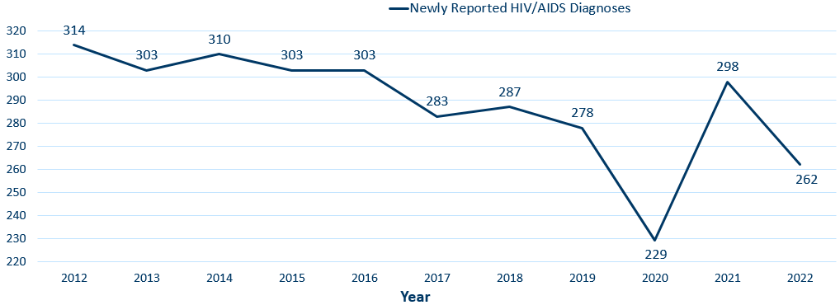
New HIV Disease Diagnoses*
HIV/AIDS Cases by Year, 2012–2022
*Includes all new cases of HIV infection (both HIV (non-AIDS) and AIDS at first diagnosis) diagnosed within a given calendar year.
Data: HIV Incidence Report 2022 Tables (PDF)
Notes:
In this report, the term “new HIV diagnoses” refers to Minnesota residents living with HIV who were diagnosed in a particular calendar year and reported to MDH. This includes people whose first diagnosis of HIV infection is AIDS (AIDS at first diagnosis). HIV diagnoses data are displayed by earliest known date of HIV diagnosis. In the decade prior to 2020, there were an average of 300 new diagnoses per year, trending down on average 5.5 diagnoses per year. 2020 saw a 16% decrease in HIV diagnoses from 2019, and a rebound effect was seen in 2021. The 262 new diagnoses in 2022 is a possible return to trend.
As discussed earlier, it may take more time and data analysis to accurately assess COVID-19’s impact on HIV over the last 3 years.

Slide 8
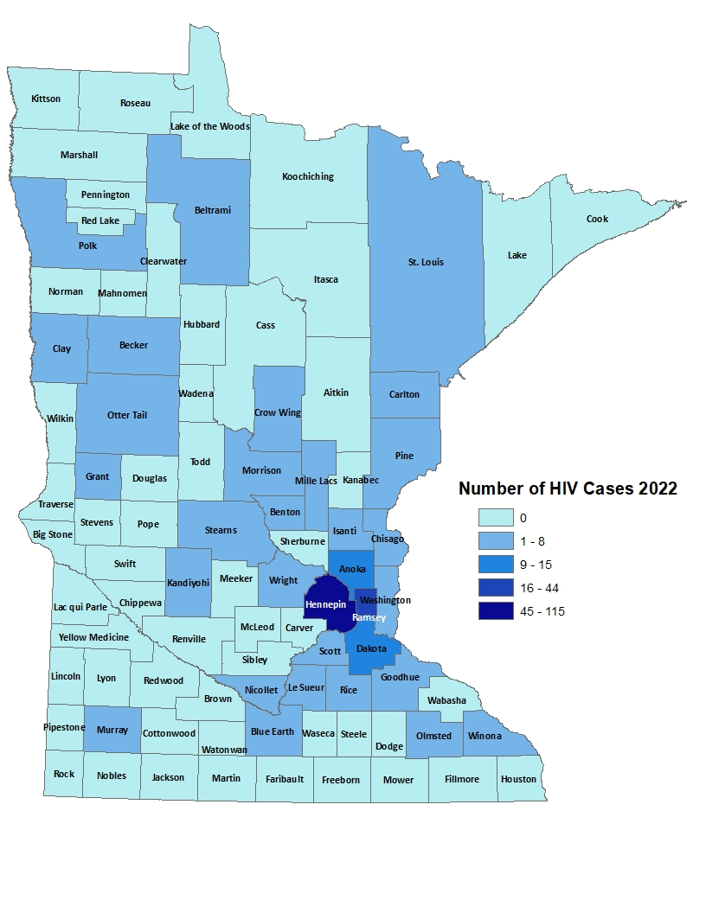
HIV Diagnoses# by County of Residence at Diagnosis, 2022
City of Minneapolis
City of St. Paul
Suburban*
Greater Minnesota
Total
70 cases (27%)
37 cases (14%)
86 cases (33%)
69 cases (26%)
262 cases
#HIV or AIDS at first diagnosis
*7-county metro area, excluding the cities of Minneapolis and St. Paul
Data: HIV Incidence Report 2022 Tables (PDF)
Notes:
Historically, about 80% of new HIV infections diagnosed in Minnesota have occurred in Minneapolis, St. Paul and the surrounding seven-county metropolitan area.
In 2022, of 262 total HIV diagnoses, 74% of the cases were in the seven-county Twin Cities metro region with 27% in Minneapolis, 14% in St. Paul, and 33% in the remaining suburban area (excluding Minneapolis/St. Paul). In greater Minnesota, there were 69 newly diagnosed HIV cases across 26 counties.

Slide 9
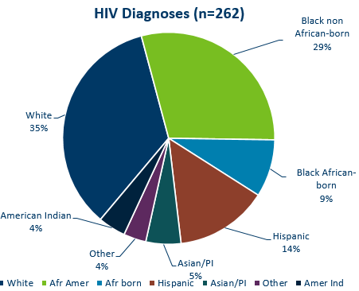
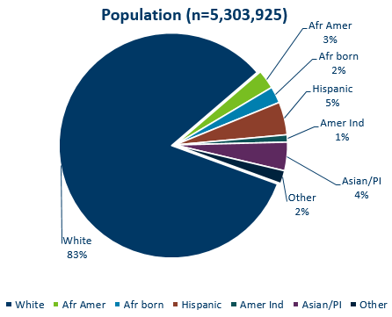
HIV Diagnoses* in Year 2022 and General Population in Minnesota by Race/Ethnicity
HIV or AIDS at first diagnosis † Population estimates based on 2010 U.S. Census data. (n = Number of people)
Data (left): HIV Incidence Report 2022 Tables (PDF)
Notes:
Comparing the racial/ethnic distribution of new HIV diagnoses [LEFT] to the general population of Minnesota [RIGHT], it is apparent that disparities continue to exist. Non-Hispanic African-American and Black African-born Minnesotans jointly make up about 5% of the population in Minnesota, yet accounted for 38% of the newly diagnosed cases of HIV in 2022. Similarly, Hispanics of any race account for approximately 5% of the population, but account for 14% of the newly diagnosed cases.
Population: 5,303,925
White: 83%
African American: 3%
African born: 2%
Hispanic: 5%
American Indian: 1%
Asian / Pacific Islander: 4%
Other: 2%

Slide 10
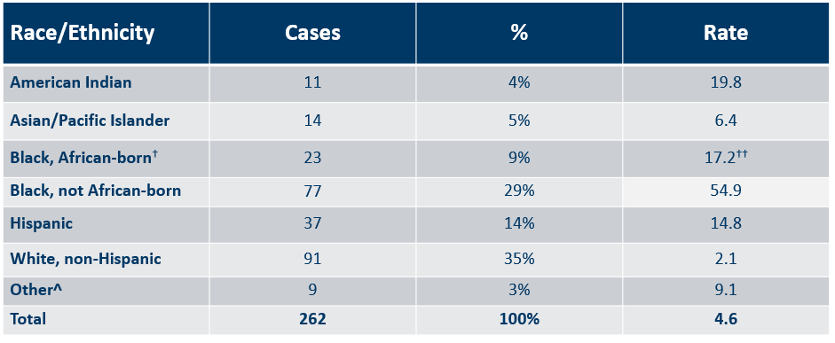
Number of Cases and Rates (per 100,000 people) of HIV Diagnoses* by Race/Ethnicity† Minnesota, 2022
* HIV or AIDS at first diagnosis; 2010 U.S. Census Data used for rate calculations.
† “Black African-born” refers to Black people who reported an African country of birth; “Black not African-born” refers to all other Black people.
†† Estimate of 125,939 Source: 2019 American Community Survey.
^ Other = Multi-racial people or people with unknown or missing race
# Unable to calculate rate, unknown denominator
Data: HIV Incidence Report 2022 Tables (PDF)
Notes:
Each year we calculate the rate of diagnosis for each racial/ethnic group represented in the surveillance system to assess the impact of HIV within each community. The rate takes into account the size of the population of each group.
Non-Hispanic Black Minnesotans had the highest rate of diagnoses in 2022 with 54.9 HIV diagnoses per 100,000 population among Black, not African-born people. For African-Americans who are not African-born, this represents a rate that is 26 times the rate in the white non-Hispanic population in Minnesota. The next highest rate was among American Indians with a rate of people newly diagnosed with HIV of 19.8 per 100,000 people, 9.4 times the rate of white, non-Hispanic people.
Black African-born people had a rate of 17.2 HIV diagnoses per 100,000 population which is 8 times that of the white non-Hispanic population.
Hispanic people of any race have the next highest rate of newly diagnosed HIV cases in Minnesota at 14.8 per 100,000 people; this is a rate 7 times that of white, non-Hispanic people.

Slide 11
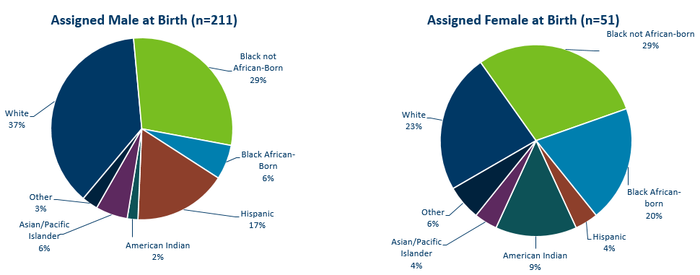
HIV Diagnoses* in 2022 by Sex Assigned at Birth and Race/Ethnicity†
*HIV or AIDS at first diagnosis (n = Number of people)
†“Black African-born” refers to Black people who reported an African country of birth; “Black not African-born” refers to all other Black people. Cases with unknown race are excluded.
Data: HIV Incidence Report 2022 Tables (PDF)
Notes:
There are differences in the racial/ethnic distribution by sex assigned at birth. Left to right are data for people assigned Male and Female at birth.
On the LEFT, among 211 people assigned the sex of male at birth, 37% of the 2022 cases diagnosed in Minnesota are Non-Hispanic white [seen in dark BLUE]. Non-Hispanic Black non-African born [In light GREEN] and black, African-born males [light BLUE] made up 35% of cases and Hispanic males of any race accounted for 17% of cases.
ON the RIGHT, Among the 51 people assigned the sex of female at birth, the disparities of new HIV diagnoses are even more apparent among people of color. They represent 77% of new HIV cases assigned female at birth vs 63% of new HIV cases assigned male at birth. Nearly half of female infections, or 49% combined, are Black, African-born and non-African born.

Slide 12
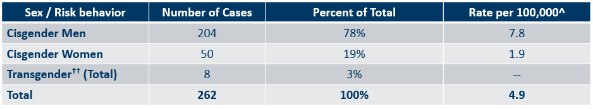
Number of Cases and Rates (per 100,000 people) of Adults and Adolescents* Diagnosed with HIV/AIDS by Gender Identity† in Minnesota, 2022
*HIV or AIDS at first diagnosis ages 13 and older.
^2010 United States Census Data used for rate calculations, except where otherwise specified.
Data: HIV Incidence Report 2022 Tables (PDF)
Notes:
Here we look at cases and rates of the 262 new HIV infections by sex assigned at birth and reported sexual behavior.
By sex assigned at birth….
The proportion of cases among cisgender men has increased over the last few years. Cisgender men represent 81% of all new HIV diagnoses.
The number of diagnoses among cisgender women has decreased to 50 in 2022 from more than 60 in 2021.
Looking further at data by risk behavior….
Men who have Sex with Men (MSM), have the highest rate of HIV diagnosis than any other sub-category. In 2022, the estimated rate of HIV diagnosis among MSM was 121.3 per 100,000 population. This is nearly 33 times higher than the rate among non-MSM cisgender men.
It’s important to note that MSM contains cases from all racial/ethnic categories and therefore, cannot be directly compared to the rates on the previous slide. For more information on how this rate was estimated, see the HIV Surveillance Technical Notes which are available on our website.

Slide 13
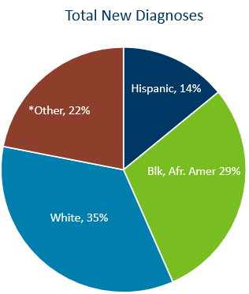
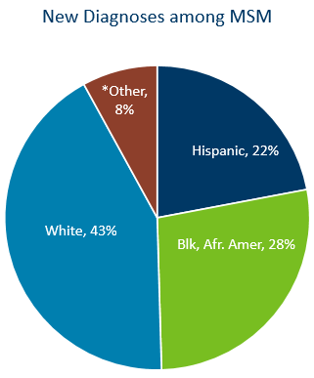
HIV Diagnoses among MSM in Minnesota by Race and Ethnicity, 2022
*Other includes Black African-born, American Indian, Asian/Pacific-Islander, multi-race, and unknown
Data (left): HIV Incidence Report 2022 Tables (PDF)
Notes:
In 2022, new diagnoses among MSM were largely made up of white (43%), Black African-American (28%), and Hispanic (22%) MSM. This is compared to total new diagnoses in Minnesota, where White people made up only 35% and other races made up 22% of all new diagnoses.
Data: New Diagnoses Among MSM
White: 43%
Black / African American: 28%
Hispanic: 22%
Other: 8%

Slide 14
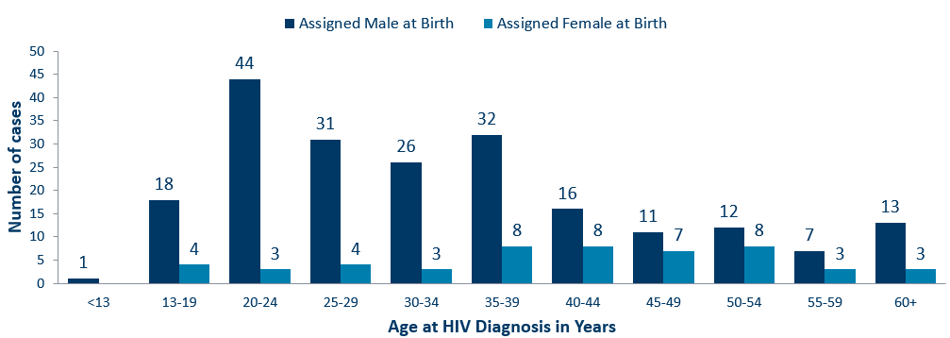
Age at HIV Diagnosis* by Sex Assigned at Birth, Minnesota, 2022
*HIV or AIDS at first diagnosis
Data: HIV Incidence Report 2022 Tables (PDF)
Notes:
In 2022, there were 105 cases diagnosed under the age of 30, accounting for 40% of all cases. 94 (90%) of these were in people assigned male sex at birth. Age groups 20-24 and 35-39 had the largest number of new cases in 2022.

Slide 15
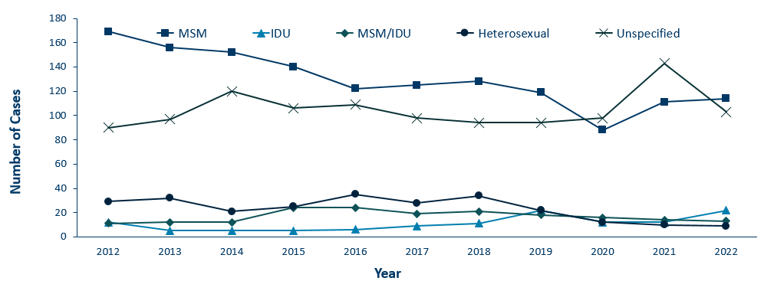
HIV Diagnoses* by Mode of Exposure and Year, 2012–2022
Category | 2009 | 2010 | 2011 | 2012 | 2013 | 2014 | 2015 | 2016 | 2017 | 2018 | 2019 | 2020 | 2021 | 2022
MSM | 211 | 177 | 154 | 169 | 156 | 152 | 140 | 122 | 125 | 128 | 119 | 88 | 111 | 114
IDU | 9 | 11 | 5 | 12 | 5 | 5 | 5 | 6 | 9 | 11 | 22 | 12 | 12 | 22
MSM/IDU | 16 | 15 | 10 | 11 | 12 | 12 | 24 | 24 | 19 | 21 | 18 | 16 | 14 | 13
Heterosexual | 43 | 43 | 32 | 29 | 32 | 21 | 25 | 35 | 28 | 34 | 22 | 12 | 10 | 9
Unspecified | 87 | 83 | 89 | 90 | 97 | 120 | 106 | 109 | 98 | 94 | 94 | 98 | 143 | 103
*HIV or AIDS at first diagnosis
MSM = Men who have sex with men IDU = Injection drug use Heterosexual = Heterosexual contact Unspecified = No mode of exposure ascertained
Notes:
This slide depicts risk for all people diagnosed with HIV in Minnesota during the past decade and since the beginning of the epidemic. In 2022, of cases where mode of transmission was reported, men having sex with men was the most common, accounting for 47% of all diagnoses and 77% of diagnoses with known modes of transmission. Mode of exposure was unknown or undisclosed in 39% of cases in 2022.
The number of cases among people who inject drugs (IDU only) was 22 cases in 2022, an increase from 2020 and 2021, which continues the trend seen since 2019 when an outbreak began among persons who inject drugs in Hennepin-Ramsey counties. Another outbreak in the Duluth region includes about half of cases that are among persons who inject drugs. More details on these outbreaks later in this slide presentation.

Slide 16
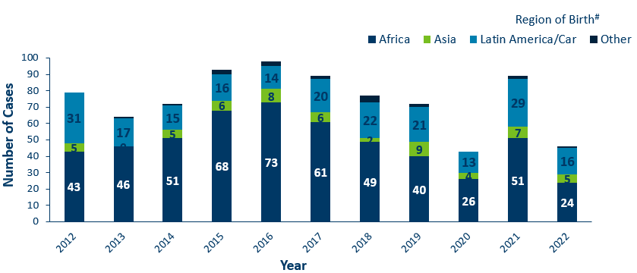
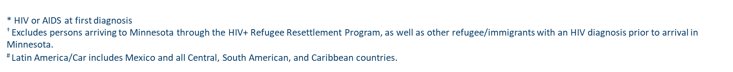
HIV Diagnoses* among Foreign-Born People† in Minnesota by Year and Region of Birth
2012–2022
Region of Birth | 2012 | 2013 | 2014 | 2015 | 2016 | 2017 | 2018 | 2019 | 2020 | 2021 | 2022
Africa | 43 | 46 | 51 | 68 | 73 | 61 | 49 | 40 | 26 | 51 | 24
Asia | 5 | 0 | 5 | 6 | 8 | 6 | 2 | 9 | 4 | 7 | 5
Latin America/Car | 31 | 17 | 15 | 16 | 14 | 20 | 22 | 21 | 13 | 29 | 16
Other | 0 | 1 | 1 | 3 | 3 | 2 | 4 | 2 | 0 | 2 | 1
Notes:
This slides describes HIV diagnoses by global region of birth among foreign-born people. In general, the number of new HIV infections diagnosed among foreign-born people in Minnesota has steadily increased from 20 cases in 1990 to an average of 82 cases over the last decade. This increase has been largely driven by the increase of cases among African-born people, as well as people from Mexico, Central and South America and the Caribbean.
In 2022, there were 46 cases of newly reported HIV among foreign-born people. This is about one in five of all new cases (18%) The majority of foreign-born cases in 2022 were from Africa, followed by Latin America and the Caribbean.

Slide 17
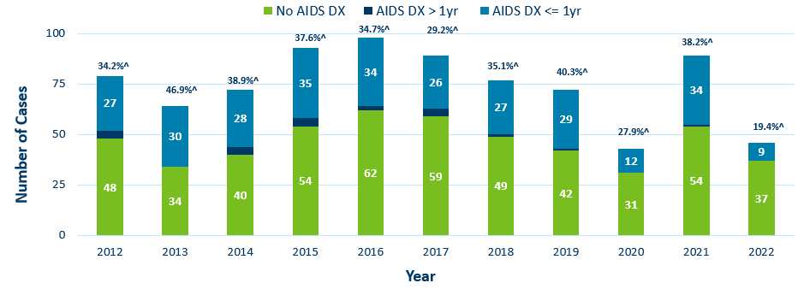
Time of Progression to AIDS for HIV Diagnoses* Among Foreign-born people
Minnesota 2012–2022 †
Diagnoses | 2012 | 2013 | 2014 | 2015 | 2016 | 2017 | 2018 | 2019 | 2020 | 2021 | 2022
No AIDS DX | 48 | 34 | 40 | 54 | 62 | 59 | 49 | 42 | 31 | 54 | 37
AIDS DX > 1yr | 4 | 0 | 4 | 4 | 2 | 4 | 1 | 1 | 0 | 1 | 0
AIDS DX <= 1yr | 27 | 30 | 28 | 35 | 34 | 26 | 27 | 29 | 12 | 34 | 9
*Numbers include AIDS at 1st report but exclude people arriving to Minnesota through the HIV+ Refugee Resettlement Program, as well as other refugee/immigrants with an HIV diagnosis prior to arrival in Minnesota.
^ Percent of cases progressing to AIDS within one year of initial diagnosis with HIV
† Numbers/Percent for cases diagnosed in 2022 only represents cases progressing to AIDS through February 2023.
Notes:
During the past decade, foreign-born cases have a higher rate of late testers compared to US-born cases. In 2021, Among 89 foreign-born cases, 34 (38%) of foreign-born cases were late testers compared to 18% of US-born cases. Over the decade, the range of foreign-born cases that were late testers ranged from 27% - 46%.
Percentage of late testers for 2022 includes only those progressing to AIDS through February 2023. Please note that cases diagnosed in 2022 may not encompass all cases diagnosed – since a full year of observation is required to capture progress to AIDS within a year (which would end later this year in December 2023).

Slide 18
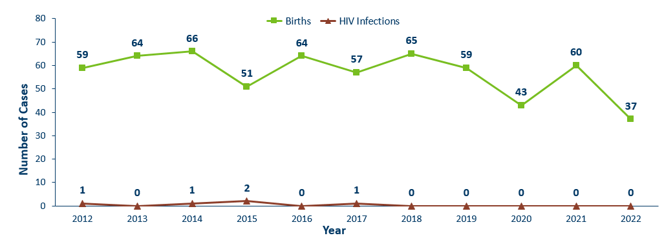
Births to Pregnant People Living with HIV and Number of Perinatal Acquired HIV Infections* by Year of Birth, 2012–2022
HIV or AIDS at first diagnosis for a child exposed to HIV during pregnant person’s pregnancy, at birth, and/or during breastfeeding.
Data: HIV Incidence Report 2022 Tables (PDF)
Notes:
The ability to interrupt the transmission of HIV from mother to child via antiretroviral therapy and appropriate perinatal care is an important accomplishment in the history of the HIV/AIDS epidemic. Without antiretroviral therapy, newborn HIV infection rates range from 25-30%, but decrease to 1-2% with appropriate medical intervention. The rate of transmission has decreased from 15% between 1994 and 1996 to 0.0% in the past three years (2020-2022). The last HIV perinatal transmission was in 2017.
For the past decade, the number of births to pregnant parents living with HIV has ranged between 37-66 births (2012-2022).
For 2022, there was a decrease to 37 births to pregnant people living with HIV with no perinatal HIV baby born to a HIV-positive pregnant person in Minnesota during the year.

Slide 19
Adolescents & Young Adults (Ages 13-24)*

Slide 20
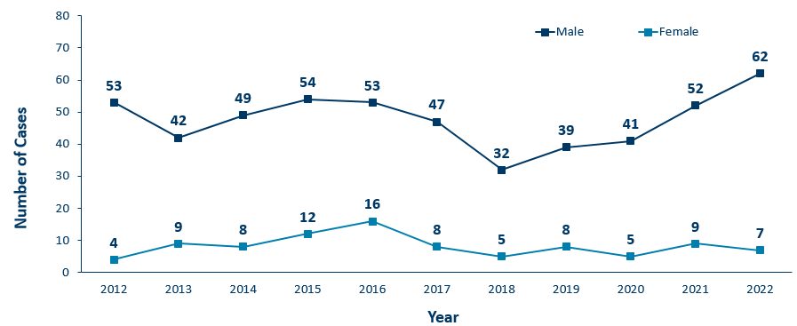
HIV Diagnoses* Among Adolescents and Young Adults† by Sex Assigned at Birth and Year 2012–2022
Sex Assigned at Birth | 2012 | 2013 | 2014 | 2015 | 2016 | 2017 | 2018 | 2019 | 2020 | 2021 | 2022
Male | 53 | 42 | 49 | 54 | 53 | 47 | 32 | 39 | 41 | 52 | 62
Female | 4 | 9 | 8 | 12 | 16 | 8 | 5 | 8 | 5 | 9 | 7
* HIV or AIDS at first diagnosis
† Adolescents defined as 13-19 year-olds; Young Adults defined as 20-24 year-olds.
Notes:
The number of new HIV diagnoses among people assigned male sex at birth aged 13-24 has ranged from 32-62 cases over the past decade. Since the low in 2018, we’ve seen an increase of new diagnoses among males in this age group where there are 62 cases reported in 2022.
In 2022, among adolescent and young adults assigned female sex at birth, there were 7 cases.
In 2022, the total number of cases among adolescents and young adults were higher from the previous year with 69 cases in 2022 compared to 61 cases in 2021.

Slide 21
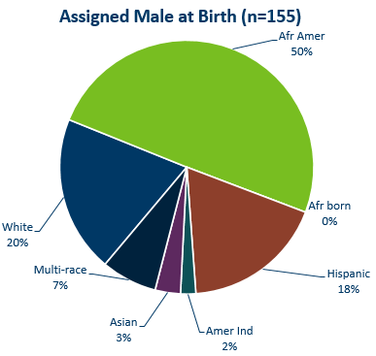
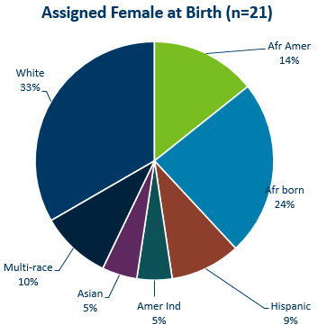
HIV Diagnoses* Among Adolescents and Young Adults† by Sex Assigned at Birth and Race/Ethnicity, 2020–2022 Combined
* HIV or AIDS at first diagnosis (n = Number of people)
Amer Ind = American Indian , Afr Amer = African American (Black, not African-born people) , and Afr born = African-born (Black, African-born people)
Notes:
Looking at racial distribution among adolescents/young adults by sex assigned at birth combining the most recent three years of data.
Between the years 2020 and 2022 we had 155 cases assigned male sex at birth [LEFT Graph] reported among adolescents and young adults, and 21 females reported in the 13-24 age group. For people assigned male sex at birth, Non-Hispanic African-American [GREEN] accounted for half of the cases, Non-Hispanic White [DARK BLUE] and Hispanic of any race [BROWN] young adults accounted for about 1 in 5 cases each in the 13-24 age group.
Among people with female sex assigned at birth [RIGHT], Non-Hispanic White [DARK BLUE] accounted for about one-third and black African-born [LIGHT BLUE] accounted for about one quarter of the cases in the 13-24 age group. Non-Hispanic African-Americans [GREEN] accounted for about 1 in 7 cases and Non-Hispanic Multi-race accounted for 1 in 10 of the cases.
Data:
Assigned Male at Birth (N=155)
African American: 50%
White: 20%
Multi-race: 7%
Asian: 3%
American Indian: 25%
Hispanic: 18%
African born: 0%
Assigned Female at Birth (N=21)
African American: 14%
White: 33%
Multi-race: 10%
Asian: 5%
American Indian: 5%
Hispanic: 9%
African Born: 24%

Slide 22
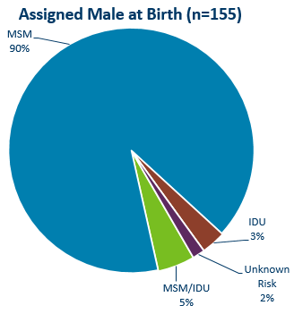
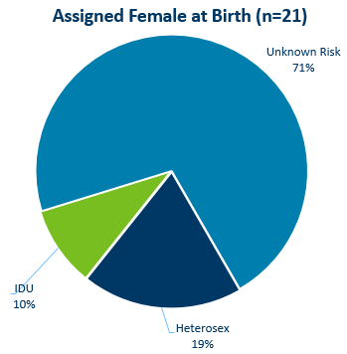
HIV Diagnoses* Among Adolescents and Young Adults† by Sex at Birth and Exposure Group 2020–2022 Combined
† Adolescents defined as 13-19 year-olds; Young Adults defined as 20-24 year-olds.
MSM = Men who have sex with men IDU = Injection drug use Heterosex = Heterosexual contact
n = Number of people
HIV or AIDS at first diagnosis
Notes:
For mode of exposure among people assigned male sex at birth in the 13-24 age group [LEFT] , Male to Male sex was found to account for 90% of the cases, while the combined risk of MSM and IDU was estimated to account for 5% of the cases and 3% was attributed to injection drug use mode of transmission.
Among adolescent people assigned female sex at birth [RIGHT], Most women HIV risk is unknown (71%) [LIGHT BLUE], while 19% of cases were found to have heterosexual contact as their mode of exposure [DARK BLUE], and 10% attributed to injection drug use [LIGHT GREEN].
Data:
Assigned Male at Birth (n=155)
MSM: 90%
IDU: 3%
MSM/IDU: 5%
Unknown Risk: 2%
Assigned Female at Birth (n=21)
Unknown Risk: 71%
Heterosex: 19%
IDU: 10%

Slide 23
Persons Living with HIV/AIDS in Minnesota

Slide 24
Estimated Number of Persons Living with HIV/AIDS in Minnesota
As of December 31, 2022 9,805* persons are assumed alive and living in Minnesota with HIV/AIDS. This includes:
  5,615 (57%) living with HIV infection (non-AIDS)
  4,190 (43%) living with AIDS
This number includes 2,702 persons who were first reported with HIV or AIDS elsewhere and subsequently moved to Minnesota
This number excludes 1,734 persons who were first reported with HIV or AIDS in Minnesota and subsequently moved out of state
*This number includes persons with Minnesota reported as their current state of residence, regardless of residence at time of diagnosis. It also includes state prisoners and refugees arriving through the HIV+ Refugee Resettlement Program, as well as HIV+ refugees/immigrants arriving through other programs.
Notes:
As of December 31, 2022, there were estimated to be 9,805 persons alive and living with HIV/AIDS in Minnesota. This number included 5,615 (57%) living with an HIV infection that had not progressed to an AIDS diagnosis and 4,190 (43%) living with AIDS. This number also included 2,702 persons who were first reported with HIV or AIDS elsewhere and now live in Minnesota and excluded 1,734 persons first reported with HIV or AIDS in Minnesota who now live out of state.

Slide 25
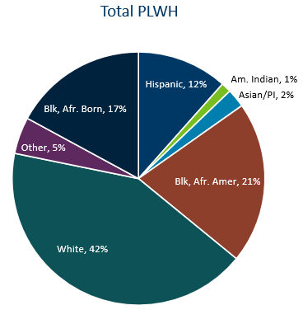
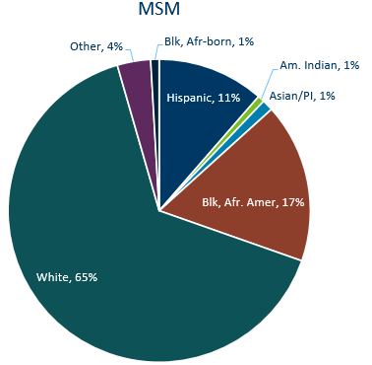
Distribution by Race and Ethnicity of People Living with HIV/AIDS in Minnesota, 2022
Notes:
In 2022, MSM (including MSM&IDU) made up 53% of all people living with HIV in Minnesota. 42% of all people living with HIV are white, while 65% of MSM living with HIV are white. 21% of all people living with HIV in Minnesota are Black, African-American, while only 17% of MSM living with HIV are Black, African-American.
Data:
Total PLWH
White: 42%
Black, African American: 21%
Asian/Pacific Islander: 2%
American Indian: 1%
Hispanic: 12%
Black, African Born: 17%
Other: 5%
MSM
White: 65%
Black, African American: 17%
Asian/Pacific Islander: 1%
American Indian: 1%
Hispanic: 11%
Black, African Born: 1%
Other: 4%

Slide 26
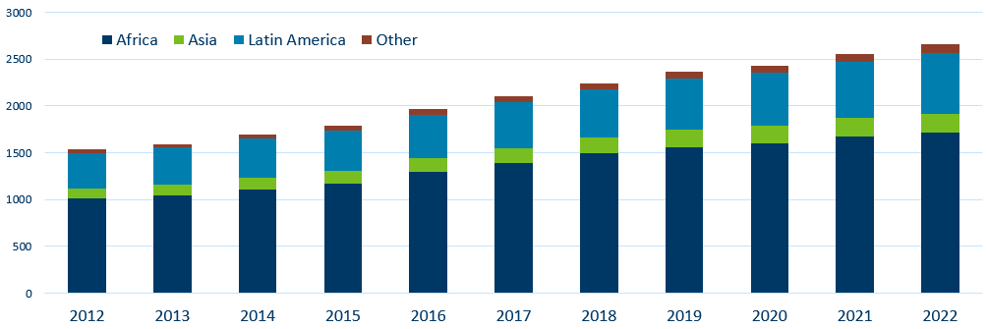
Foreign Born Persons Living with HIV/AIDS in Minnesota* by Region of Birth, 2012–2022
Year | Africa | Asia | Latin America | Other
2012 | 1008 | 108 | 378 | 40
2013 | 1047 | 111 | 396 | 41
2014 | 1109 | 122 | 417 | 43
2015 | 1174 | 134 | 429 | 48
2016 | 1299 | 147 | 463 | 55
2017 | 1391 | 160 | 491 | 59
2018 | 1494 | 170 | 516 | 64
2019 | 1560 | 185 | 549 | 73
2020 | 1599 | 190 | 566 | 75
2021 | 1677 | 194 | 604 | 78
2022 | 1713 | 200 | 650 | 101
*This number includes persons who reported Minnesota as their current state of residence, regardless of residence at time of diagnosis. It also includes state prisoners and refugees arriving through the HIV+ Refugee Resettlement Program, as well as HIV+ refugees/immigrants arriving through other programs.
Notes:
One particular population of interest in Minnesota that sets us apart from other states is our larger foreign-born HIV-positive population. Between 1990 and 2022, the number of foreign-born people living with HIV/AIDS in Minnesota increased substantially, especially among the African-born population. In 1990, 50 foreign-born people were reported to be living with HIV/AIDS in Minnesota, and by 2007 this number had increased to 1,126 people. In 2022, the total number of foreign-born people living with HIV/AIDS in Minnesota was 2655, a 4% increase from 2021. The majority of these people immigrated to the United States from Africa and Latin America. This trend illustrates the growing diversity of the HIV-positive population in Minnesota and the need for culturally appropriate HIV care and prevention efforts.
Non-U.S. born persons make up 37% of all people living with HIV in Minnesota

Slide 27
HIV Outbreaks

Slide 28
HIV Outbreak in Hennepin/Ramsey Counties
Hennepin/Ramsey Counties HIV Outbreak
In February 2020, MDH Health Alert Network declared an outbreak among persons who inject drugs (PWID)
Current Case Count: 168 cases
Inclusion Criteria:
73 encampment-related
95 MSM/IDU & IDU non-encampment
People at high-risk in the current outbreak:
People who use injection drugs (PWID) or share needles/works
People experiencing homelessness or unstable housing
People who exchange sex for income or other items they need
Notes:
Minnesota has seen an increase of HIV among certain populations in Hennepin and Ramsey Counties. An outbreak was declared in Hennepin and Ramsey counties among people who inject drugs (PWID) in 2020 with cases dating back to December 2018.
Minnesota's outbreak-associated cases have risk factors consistent with the national outbreaks.
People at high risk in the current outbreaks include:
People who use injection drugs or share needles/works.
People experiencing homelessness or unstable housing.
People who exchange sex for income and other items they need.
For more information, please see our updated HIV statistics website, described at the end of the presentation.

Slide 29
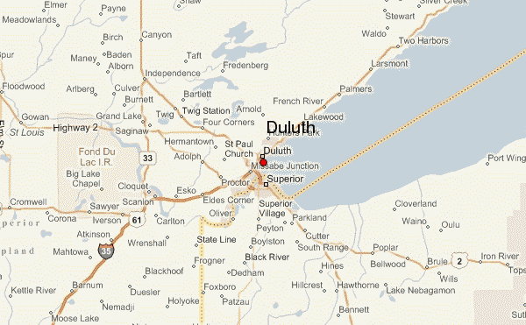
HIV Outbreak in Duluth Region
People at high-risk in the current outbreak:
  People who use injection drugs (PWID) or share needles/works
  People experiencing homelessness or unstable housing
  People who exchange sex for income or other items they need
  Men who have sex with men
Duluth Region HIV Outbreak
In March 2021, MDH Health Alert Network declared an outbreak in the Duluth Region (30-mile area) among newly diagnosed HIV cases
Current Case Count: 35 cases
Notes:
Minnesota has seen an increase of HIV in the Duluth area (30-mile radius). Minnesota declared an outbreak in 2021 in the Duluth area with cases dating back to 2019. The Duluth area outbreak includes all newly diagnosed HIV cases and linked cases within the region. Typically, there are 1-5 cases of HIV per year in St. Louis County, beginning in the fall of 2019 there was a significant increase of newly diagnosed HIV cases in the area.
People at high risk in the current outbreaks include:
People who use injection drugs or share needles/works.
People experiencing homelessness or unstable housing.
People who exchange sex for income and other items they need.
Men who have sex with men.
For more information, please see our updated HIV statistics website, described at the end of the presentation.

Slide 30
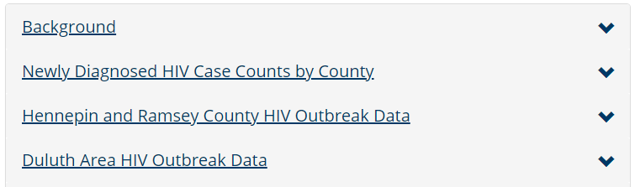
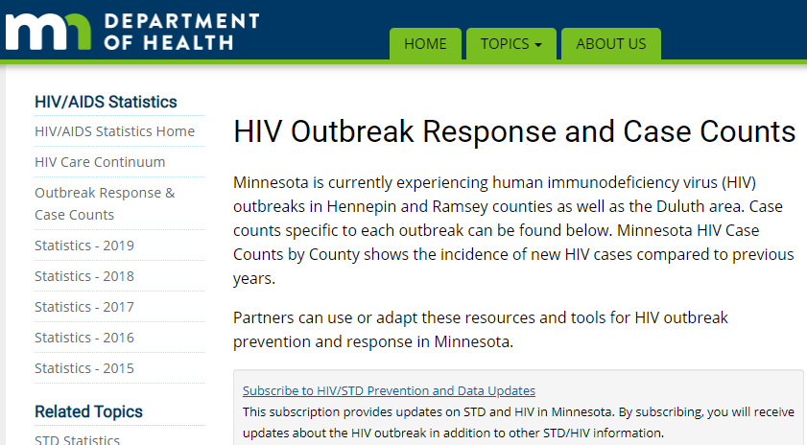
Updated webpage: Outbreak Data e-Resources
HIV Outbreak Response and Case Counts
https://www.health.state.mn.us/diseases /hiv/stats/hiv.html
Subscribe to receive our HIV/STD prevention and data e-mail updates.
Notes:
In addition to newly diagnosed HIV case counts by county, we recently updated our statistics web page to include information on outbreak data.
Please visit the Minnesota Department of Health HIV pages at www.health.state.mn for additional details.
While you’re here, you can subscribe to our listserv to receive HIV/STD prevention updates to your email.

Slide 31
Thank you.
HIV Surveillance Team
Health.HIV.Surveillance@state.mn.us
1-800-318-8137

