Slide 1
HIV/AIDS Prevalence and Mortality Report, 2022
HIV/AIDS Surveillance System
http://www.health.state.mn.us/diseases/hiv/stats/index.html

Slide 2
Introduction (I)
These three introduction slides provide a general context for the data used to create this slide set. If you have questions about any of the slides, please refer to the Surveillance Technical Notes.
This slide set displays estimates of the number of persons living with HIV/AIDS (prevalence) and mortality in Minnesota by person, place, and time.
The slides rely on data from HIV/AIDS cases diagnosed through 2022 and reported to the Minnesota Department of Health (MDH) HIV/AIDS Surveillance System, which is part of the National HIV/AIDS Surveillance System (NHSS).

Slide 3
Introduction (II)
Data analyses exclude persons diagnosed in federal or private correctional facilities, but include state prisoners (number of state prisoners believed to be living with HIV/AIDS as of 2022 = 17)
Data analyses for new infections exclude persons arriving in Minnesota through the HIV+ Refugee Resettlement Program (number of primary HIV+ refugees in this program living in Minnesota as of December 31, 2022 = 163), as well as other refugees/immigrants reporting a positive test prior to their arrival in Minnesota (n = 160).
Some limitations of surveillance data:
Do not include HIV-infected persons who have not been tested for HIV
Do not include persons whose positive test results have not been reported to MDH
Do not include HIV-infected persons who have only tested anonymously
Case numbers for the most recent years may be undercounted due to delays in reporting
Reporting of living cases that were not initially diagnosed in Minnesota is known to be incomplete, as well as transfer of living cases that have moved to other states from Minnesota. However, since 2018, every jurisdiction funded for HIV surveillance by CDC has been part of a deduplication project in the National HIV Surveillance System.

Slide 4
Introduction (III)
Persons are assumed to be alive unless MDH has knowledge of their death.
Persons whose most recently reported state of residence was Minnesota are assumed to be currently residing in Minnesota unless MDH has knowledge of their relocation. Our ability to track changes of residence, including within the state, is limited and subject to reporting delays and incomplete case and lab reporting.
Vital status and current residence are updated through one or more of the following methods:
Standard case and lab reporting
Correspondence with other health departments
Active surveillance
Death certificate reviews (at least annually)
Birth certificate reviews (at least annually, pregnant persons only)

Slide 5
National Context

Slide 6
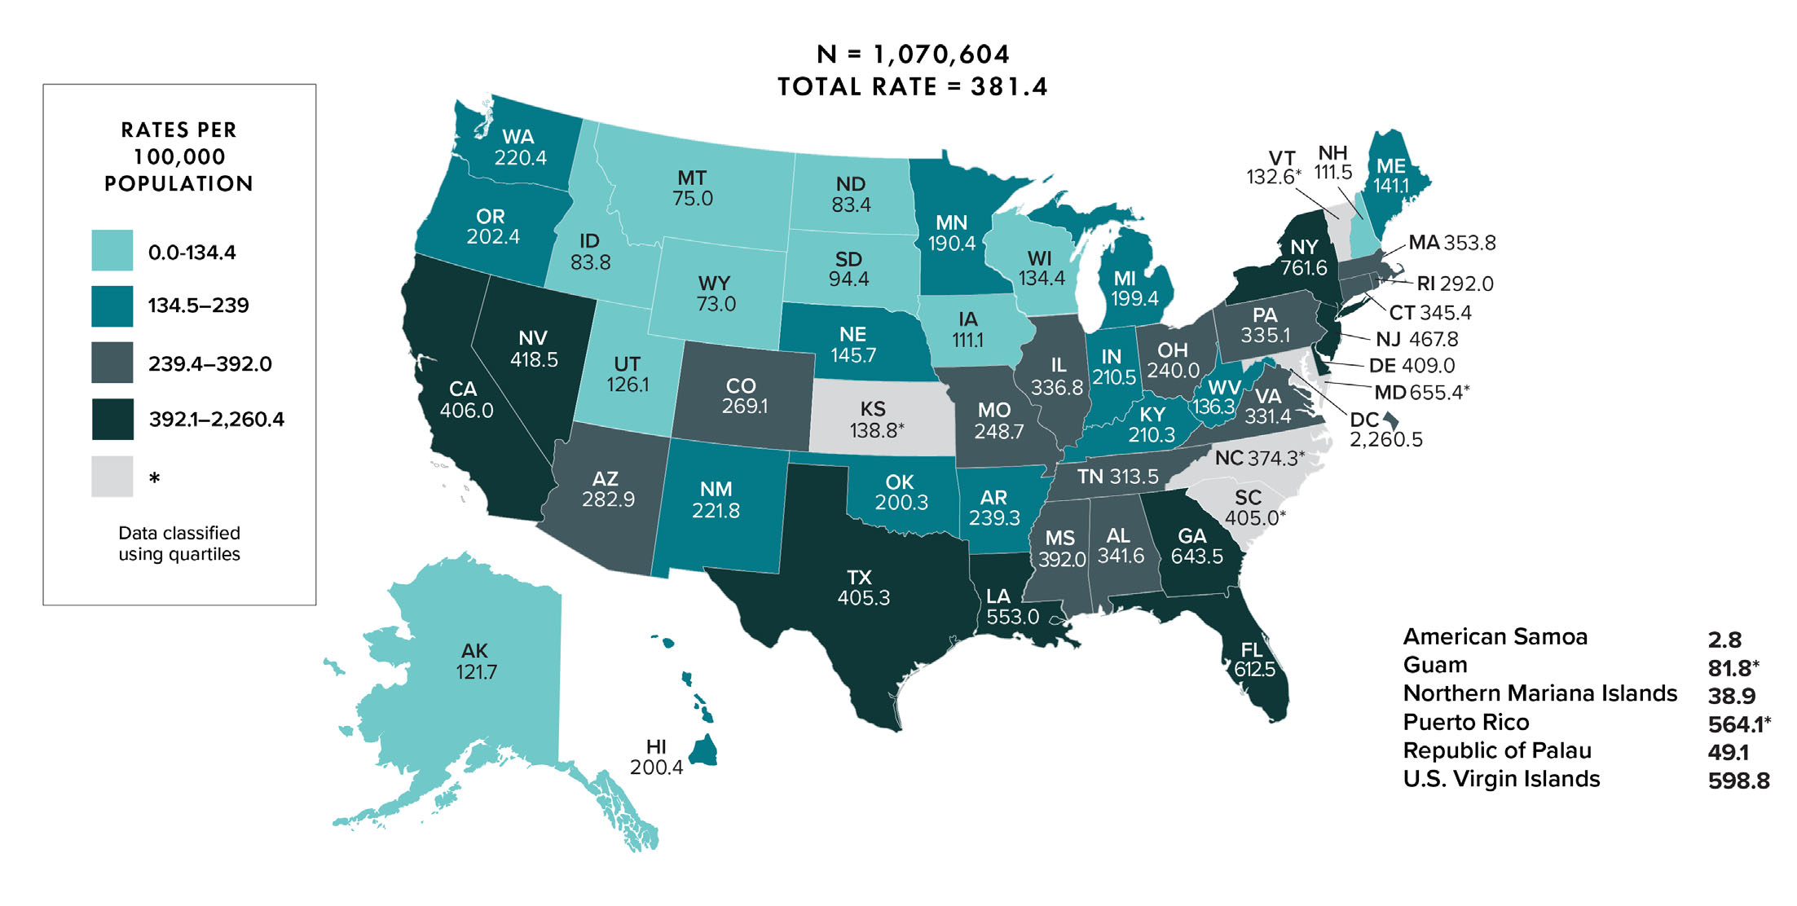
Rates of Adults and Adolescents Living with Diagnosed HIV Infection, by Area of Residence, Year-end 2020—United States and 6 Dependent Areas
Note. Data are based on address of residence as of December 31, 2019 (i.e., most recent known address).
Notes:
At the end of 2018, the rate of adults and adolescents living with diagnosed HIV infection in the United States and 6 dependent areas was 374.6 per 100,000 population. The rates of adults and adolescents living with diagnosed HIV infection ranged from 7.9 per 100,000 in American Samoa to 2,360.8 per 100,000 in the District of Columbia.
The District of Columbia (i.e., Washington, DC) is a city; use caution when comparing the rate of persons living with diagnosed HIV infection in DC with the rates in states.
Data are based on address of residence as of December 31, 2018 (i.e., most recent known address).

Slide 7
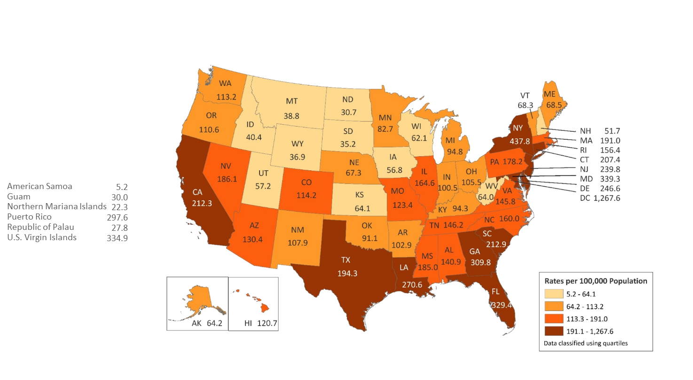
Rates of Adults and Adolescents Living with Diagnosed HIV Infection Ever Classified as Stage 3 (AIDS), by Area of Residence, Year-end 2017—United States and 6 Dependent Areas N = 533,556 Total Rate: 193.6
Note. Data are based on address of residence as of December 31, 2017 (i.e., most recent known address).
Notes:
This is the most recent data available from the CDC, but we thought it still important to show.
At the end of 2017, the rate of adults and adolescents in the United States living with diagnosed HIV infection ever classified as stage 3 (AIDS) was 193.6 per 100,000. The rates of adults and adolescents living with diagnosed HIV infection ever classified as stage 3 (AIDS) ranged from 5.2 per 100,000 in American Samoa to 1,267.6 per 100,000 in the District of Columbia.
The District of Columbia (i.e., Washington, DC) is a city; use caution when comparing the rate of persons living with diagnosed HIV infection in DC with the rates in states.
Data are based on address of residence as of December 31, 2017 (i.e., most recent known address).

Slide 8
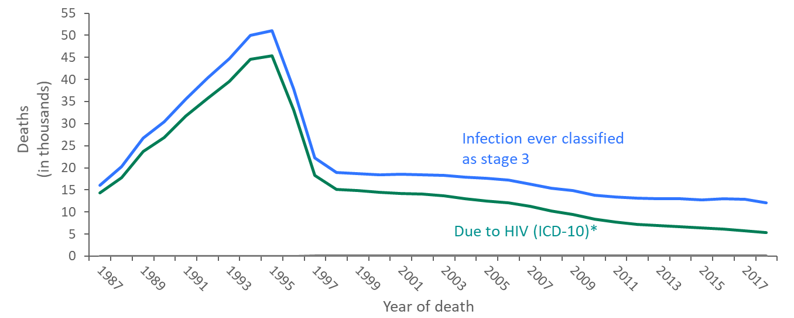
Comparison of Deaths among persons with HIV Ever Classified as Stage 3 (AIDS) in National HIV Surveillance System and Deaths Reported in Death Certificates in which HIV was the Underlying Cause of Death, 1987−2018—United States
*For comparison with data for 1999 and later years, data for 1987−1998 were modified to account for ICD-10 rules instead of ICD-9 rules.
Notes:
The annual number of deaths of persons with HIV Infection ever classified as stage 3 (AIDS) (some of which were not caused by HIV stage 3), as reported to the National HIV Surveillance System through December 31, 2019, was 10% to 46% (depending on the year) greater than the number of deaths attributed to HIV infection in death certificate data (by ICD-10 rules for selecting the underlying cause of death). The greater number of deaths of persons with stage 3 is partly because some persons with HIV infection classified as stage 3 die of causes not attributable to HIV infection, such as motor vehicle accidents, and partly because some deaths due to HIV infection are not reported as such on death certificates.
The blue line represents data from the National HIV Surveillance System.
The green line represents death certificate data compiled by the National Center for Health Statistics.

Slide 9
Overview of HIV/AIDS in Minnesota

Slide 10
New HIV Diagnoses, HIV (non-AIDS) and AIDS Cases by Year of HIV Diagnosis, 2012–2022
Category | 2012 | 2013 | 2014 | 2015 | 2016 | 2017 | 2018 | 2019 | 2020 | 2021 | 2022
HIV Disease Diagnoses* | 314 | 302 | 311 | 302 | 303 | 282 | 285 | 275 | 230 | 298 | 262
HIV (non-AIDS) | 237 | 218 | 234 | 234 | 242 | 217 | 227 | 221 | 186 | 238 | 223
AIDS Total^ | 275 | 263 | 244 | 216 | 196 | 213 | 193 | 182 | 152 | 175 | 141
AIDS at first diagnosis^^ | 77 | 85 | 76 | 69 | 61 | 66 | 60 | 57 | 43 | 60 | 39
AIDS (progressed)^^^ | 198 | 178 | 168 | 147 | 135 | 147 | 133 | 125 | 109 | 115 | 102
*Includes all new cases of HIV infection (both HIV (non-AIDS) and AIDS at first diagnosis diagnosed within a given calendar year.
^Includes all cases diagnosed with HIV in that year who subsequently progressed to AIDS diagnosis status, including those diagnosed with AIDS when they were first diagnosed with HIV^^ and those who were diagnosed with AIDS in subsequent years^^^
This includes refugees in the HIV+ Resettlement Program, as well as, other refugee/immigrants diagnosed with AIDS subsequent to their arrival in the United States.
Notes:
Of the 262 diagnoses in 2022, 223 were new HIV diagnoses, while 39 were simultaneous HIV and AIDS diagnoses.

Slide 11
Persons Living with HIV/AIDS in Minnesota

Slide 12
Estimated Number of Persons Living with HIV/AIDS in Minnesota
As of December 31, 2022 9,805* persons are assumed alive and living in Minnesota with HIV/AIDS. This includes:
5,615 (57%) living with HIV infection (non-AIDS)
4,190 (43%) living with AIDS
This number includes 2,702 persons who were first reported with HIV or AIDS elsewhere and subsequently moved to Minnesota
This number excludes 1,734 persons who were first reported with HIV or AIDS in Minnesota and subsequently moved out of state
*This number includes persons with Minnesota reported as their current state of residence, regardless of residence at time of diagnosis. It also includes state prisoners and refugees arriving through the HIV+ Refugee Resettlement Program, as well as HIV+ refugees/immigrants arriving through other programs.
Notes:
As of December 31, 2022, there were estimated to be 9,805 persons alive and living with HIV/AIDS in Minnesota. This number included 5,615 (57%) living with an HIV infection that had not progressed to an AIDS diagnosis and 4,190 (43%) living with AIDS. This number also included 2,702 persons who were first reported with HIV or AIDS elsewhere and now live in Minnesota and excluded 1,734 persons first reported with HIV or AIDS in Minnesota who now live out of state.

Slide 13
Place

Slide 14
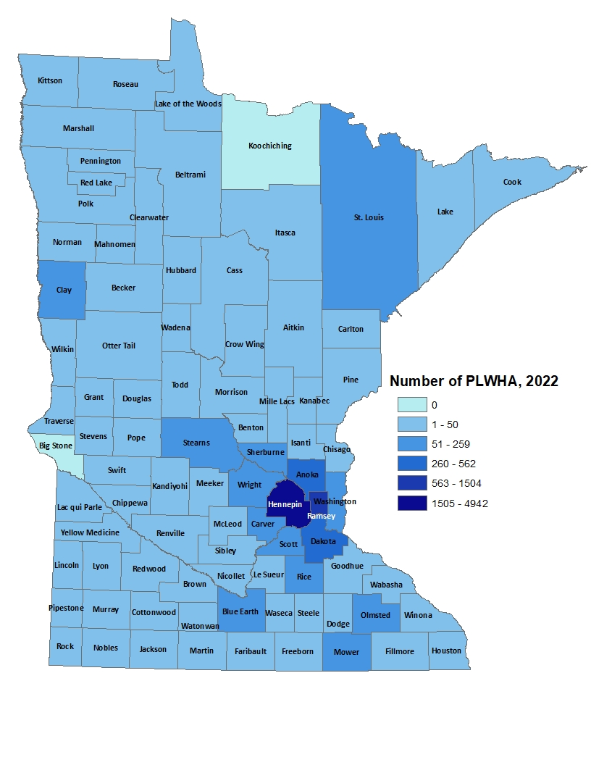
Minnesotans Living with HIV# by County of Current Residence, 2022
City of Minneapolis 3,199 (836.2 per 100,000)
City of St. Paul 1,195 (419.2 per 100,000)
Suburban* 3,557 (163.0 per 100,000)
Greater Minnesota 1,839 (74.9 per 100,000)
Total 9,790 (184.6 per 100,000)
#HIV or AIDS at last medical appointment
*7-county metro area, excluding the cities of Minneapolis and St. Paul Data: HIV/AIDS Prevalence and Mortality Report 2022 Tables
Notes:
In 2022, among prevalent HIV cases in Minnesota, the majority clustered in the twin cities metro area with the highest rates of infection in the cities of Minneapolis and Saint Paul, followed by the suburban areas and then Greater Minnesota.

Slide 15
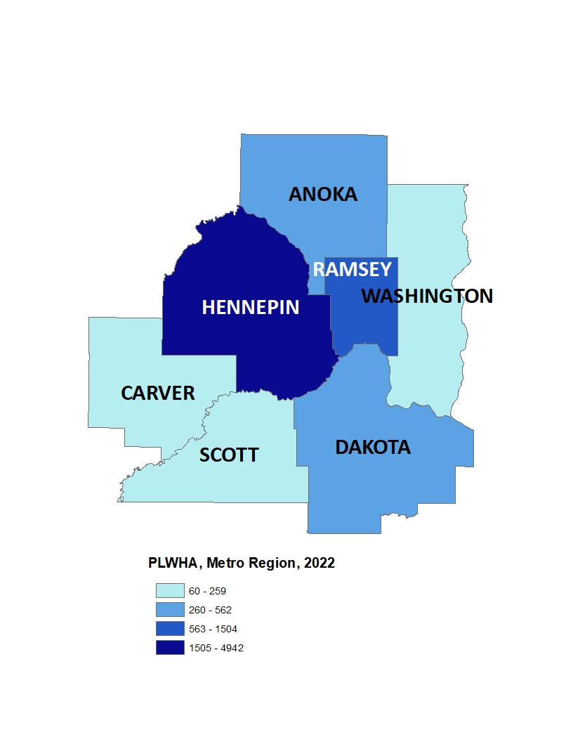
Minnesotans Living with HIV by Metro* County, 2022
City of Minneapolis 3,199 (836.2 per 100,000)
City of St. Paul 1,195 (419.2 per 100,000)
Suburban* 3,557 (163.0 per 100,000)
Greater Minnesota 1,839 (74.9 per 100,000)
Total 9,790 (184.6 per 100,000)
*7-county metro area, excluding the cities of Minneapolis and St. Paul
Data: HIV/AIDS Prevalence and Mortality Report 2022 Tables
Notes:
In 2022, within the twin cities metro area, the highest rates of prevalent HIV infection were in the cities of Minneapolis and Saint Paul.

Slide 16
Persons Living with HIV/AIDS in Minnesota by Current Residence, 2022
*15 persons missing county-level residence information
Suburban includes the 7-county metro area of Anoka, Carver, Dakota, Hennepin (except Minneapolis), Ramsey (except St. Paul), Scott, and Washington counties. Greater Minnesota includes all other counties outside of the 7-county metro area.
Data: HIV/AIDS Prevalence and Mortality Report 2022 Tables
Notes:
Overall, of the 9,805 people living with HIV/AIDS for whom complete residence information is available, 33% of all people living with HIV/AIDS in Minnesota live in the city of Minneapolis, along with 36% living in the surrounding suburban area. People living with HIV/AIDS in Greater Minnesota account for 19% of all people living with HIV/AIDS. Finally, people living with HIV/AIDS in Saint Paul account for 12% of all people living with HIV/AIDS.

Slide 17
Sex Assigned at Birth, Gender Identity, and Race/Ethnicity

Slide 18
Transmission Categories
CDC defines Transmission categories as “the term for classification of cases that summarizes an adult’s or adolescent’s possible HIV risk factors; the summary classification results from selecting, from the presumed hierarchical order of probability, the single risk factor most likely to have been responsible for transmission.”
Male-to-male sexual contact (MMSC): includes individuals assigned male sex at birth, regardless of current gender identity, who have had sexual contact with other males, and individuals assigned male sex at birth who have had sexual contact with both males and females (bisexual contact)
Injection drug use (IDU): includes persons who injected nonprescription drugs or who injected prescription drugs for nonmedical purposes
Male-to-male sexual contact and injection drug use (MMSC/IDU): includes individuals assigned male sex at birth, regardless of current gender identity, who have had sexual contact with other males and injected nonprescription drugs or injected prescription drugs for nonmedical purposes
Heterosexual contact: includes persons who have ever had sexual contact with a person known to have, or with a risk factor for, HIV infection
Perinatal: includes persons who acquired HIV through mother-to-child transmission
Other: includes persons with other risk factors (ie. blood transfusion, hemophilia) or whose risk factor was not reported or identified
Technical Notes | Volume 33 | HIV Surveillance | Reports | Resource Library | HIV/AIDS | CDC

Slide 19
Gender Identity
Gender identity refers to a “person’s internal understanding of their own gender, or gender with which a person identifies. HIV surveillance personnel collect data on gender identity, when available, from sources such as case report forms submitted by health care or HIV testing providers and medical records, or by matching with other health department databases”
Cisgender “is a term used to indicate that a person’s sex assigned at birth and current gender identity are the same (ie. a person assigned male at birth and who currently identifies as a man is a cisgender male)
Transgender woman: “a person assigned “male” sex at birth who identifies as female”
Transgender man: “a person assigned “female” sex at birth who identifies as male”
Technical Notes | Volume 33 | HIV Surveillance | Reports | Resource Library | HIV/AIDS | CDC
Notes:
How do we use these definitions: We follow CDC’s transmission category hierarchy
We use person-first language (ie. gender identity) to better represent HIV data in our state, specifically where transmission categories fall short in representing the HIV burden in each community
How can you help us gather more complete, accurate, and inclusive data:
Continue/start to collect and include gender identity on case report forms and lab documents. Without this we don’t have much data to understand the true, granular HIV burden on every community

Slide 20
Persons Living with HIV/AIDS in Minnesota by Sex Assigned at Birth, 2022
Notes:
Seventy-five percent (75%) of prevalent HIV/AIDS cases were assigned the sex of male at birth, while twenty-five percent (25%) were assigned the sex of female at birth.
Data:
Assigned Male at Birth: 7,329
Assigned Female at Birth: 2,476

Slide 21
Persons Living with HIV/AIDS in Minnesota by Sex Assigned at Birth and Race/Ethnicity^, 2022
*Other includes multi-racial persons and persons with unknown race
^Race/ethnicity information missing for 2 PWH. Race is a social construct. While there are health disparities between racial and ethnic groups, these are driven by underlying factors relating to historical traumas and current systematic impacts of those traumas.
Data: HIV/AIDS Prevalence and Mortality Report 2022 Tables
Notes:
Seventy-five percent (75%) of prevalent HIV/AIDS cases are were assigned the sex of male at birth. Broken down by race/ethnicity, 50% of male cases are white, 20% Black not African-born, 13% are Hispanic, 9% are African-born, 1% are American Indian, 2% are Asian/Pacific Islander, and 5% are persons of multiple or unknown race. In total, 50% of males living with HIV/AIDS are among men of color; whereas only 17% of the general male population are people of color. Among cases who were assigned the sex of female at birth, the distribution is even more skewed toward women of color: 40% are African-born, 23% are Black not African-born, 21% are white, 6% are Hispanic, 2% are American Indian, 3% are Asian/Pacific Islander, and 5% are persons of multiple or unknown race. Thus, 79% of prevalent female HIV/AIDS cases are among women or color whereas only 17% of the general female population in Minnesota is comprised of women of color.
Please note that race is not considered a biological reason for disparities related to HIV/AIDS experienced by persons of color. Race is a social construct, and while there are health disparities between racial and ethnic groups, these are driven by underlying factors relating to historical traumas and current systematic impacts of those traumas.

Slide 22
Persons Living with HIV/AIDS in Minnesota by Gender Identity** and Race/Ethnicity^, 2022
*Other includes multi-racial persons and persons with unknown race
^Race/ethnicity information missing for 2 PWH. Race is a social construct. While there are health disparities between racial and ethnic groups, these are driven by underlying factors relating to historical traumas and current systematic impacts of those traumas.
**Current gender was not reportable until 2009, so may be incomplete for HIV infections reported before that time. Because current gender is incomplete for a large number of cases, there may be misclassification of transgender Minnesotans in the cisgender group.
Data (left): HIV/AIDS Prevalence and Mortality Report 2022 Tables
Notes:
Ninety-nine (98%) of prevalent HIV/AIDS cases are cisgender. Broken down by race/ethnicity, 43% of cisgender cases are white, 21% Black non African-born, 17% are African-born, 11% are Hispanic,1% are American Indian, 2% are Asian/Pacific Islander, and 5% are persons of multiple or unknown race. In total, 57% of cisgender Minnesotans living with HIV/AIDS are among people of color; whereas only 17% of the general population are people of color. Among transgender Minnesotans living with HIV, the distribution is even more skewed toward people of color: 36% are Black not African-born, 26% are white, 24% are Hispanic, 3% are African-born, 1% are American Indian, 3% are Asian/Pacific Islander, and 7% are persons of multiple or unknown race. Thus, 74% of prevalent transgender HIV/AIDS cases are among people of color whereas only 17% of the general population in Minnesota is comprised of people of color.
Please note that race is not considered a biological reason for disparities related to HIV/AIDS experienced by persons of color. Race is a social construct, and while there are health disparities between racial and ethnic groups, these are driven by underlying factors relating to historical traumas and current systematic impacts of those traumas.
Data: Transgender Minnesotans (n=163)
Black, non-African born: 38%
White: 26%
Hispanic: 21%
Other: 7%
Black, African born: 4%
Asian/Pacific Islander: 3%
American Indian: 1%

Slide 23
Number of Cases and Rates (per 100,000 persons) of Persons Living with HIV/AIDS by Race/Ethnicity** in Minnesota, 2022
^2010 United States Census Data used for rate calculations, except where otherwise specified.
**Race/ethnicity information missing for 2 PWH. Race is a social construct. While there are health disparities between racial and ethnic groups, these are driven by underlying factors relating to historical traumas and current systematic impacts of those traumas.
*African-born refers to Blacks who reported an African country of birth. Non African-born refers to all other Blacks. Rates for black, non African-born and black, African-born are not comparable to previous years due to an increase in the estimate for black, African-born population.
† Other includes multi-racial persons and persons with unknown race
††Estimate of 145,078 Source: 2019 American Community Survey. Data: HIV/AIDS Prevalence and Mortality Report 2022 Tables
Notes:
While white persons account for the greatest number of persons living with HIV/AIDS in Minnesota (4,165 cases), they have one of the lowest rates of people living with HIV/AIDS (94.4 per 100,000 persons). Black, African-born persons account for 1,636 cases living with HIV/AIDS in Minnesota, however since this population makes up a small proportion of the overall population in Minnesota, the rate of people living with HIV/AIDS in this community is higher than other races and ethnicities. The rate of African-born persons living with HIV/AIDS is 1,301.7 per 100.000 persons; this is a rate nearly 14 times greater than white, non-Hispanic persons. Black, non African-born persons also have higher rates of people living with HIV/AIDS at 1386.8 per 100,000 persons; this is more than 14 times higher than the rate among white people. Hispanic persons have the next highest rate of people living with HIV/AIDS in Minnesota at 437.9 per 100,000; this is a rate of more than 4 times higher than white, non-Hispanic persons. American Indians have a rate of people living with HIV/AIDS of 212.2 per 100,000 persons; this is a rate more than two times higher than white non-Hispanic persons. Finally, Asian/Pacific Islanders have a rate of people living with HIV/AIDS of 101.8 per 100,000; this accounts for an HIV/AIDS rate similar to the rate among white non-Hispanic persons. The overall rate of HIV/AIDS in Minnesota is 182.8 per 100,000.

Slide 24
Number of Cases Living with HIV/AIDS by Gender Identity in Minnesota, 2022
††Current gender was not reportable until 2009, so may be incomplete for HIV infections reported before that time. Because current gender is incomplete for many cases, there may be misclassification of transgender Minnesotans in either of the cisgender groups.
*Percentages are based on the total number of cases reported at that stratum.
** includes nonbinary and other gender identity
Data: HIV/AIDS Prevalence and Mortality Report 2022 Tables
Notes:
This slide shows the number of people living with HIV/AIDS by gender identity (male, female, transgender, or other gender identity).
As of 2022, there are 153 transgender people living with HIV/AIDS in Minnesota, of which the majority are trans women (93%). This represents about 2% of people living with HIV/AIDS in the state.

Slide 25
Age

Slide 26
Persons Living with HIV/AIDS in Minnesota by Age Group*, 2022
*Age missing for 8 persons living with HIV/AIDS
Data: HIV/AIDS Prevalence and Mortality Report 2022 Tables
Notes:
Over 72% of persons living with HIV/AIDS as of 2021 are currently 40 years of age or older. As with new cases, there are differences by sex assigned at birth in the age of living cases.

Slide 27
Persons Living with HIV/AIDS in Minnesota by Age Group* and Sex Assigned at Birth, 2022
*Age missing for 8 persons living with HIV/AIDS
Notes:
This slide depicts the age breakouts by sex at birth for those living with HIV. Because people live a lifetime with HIV on medication, we see more people living with HIV the older the age group. But you can notice some minor differences between those assigned male at birth and those assigned female at birth. For example 36% of those assigned male at birth living with HIV are 60+. Where only 19% of females living with HIV are 60+.
Data:
Assigned Male at Birth (n=7321)
<13: 0%
12-19: 1%
20-24: 2%
25-29: 5%
30-34: 10%
35-39: 10%
40-44: 10%
45-49: 10%
50-55: 13%
55-59: 15%
60+: 26%
Assigned Female at Birth (n=2476)
<13: 0%
12-19: 1%
20-24: 2%
25-29: 5%
30-34: 10%
35-39: 10%
40-44: 10%
45-49: 10%
50-55: 13%
55-59: 15%
60+: 26%

Slide 28
MSM Analysis

Slide 29
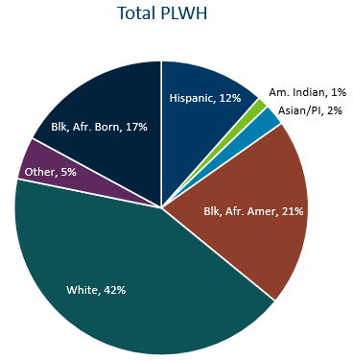
Distribution by Race and Ethnicity of People Living with HIV/AIDS in Minnesota, 2022
Notes:
In 2022, MSM (including MSM&IDU) made up 53% of all people living with HIV in Minnesota. 42% of all people living with HIV are white, while 65% of MSM living with HIV are white. 21% of all people living with HIV in Minnesota are Black, African-American, while only 17% of MSM living with HIV are Black, African-American.
Data:
Total PLWH
White: 42%
Black, African American: 21%
Asian/Pacific Islander: 2%
American Indian: 1%
Hispanic: 12%
Black, African Born: 17%
Other: 5%
MSM
White: 65%
Black, African American: 17%
Asian/Pacific Islander: 1%
American Indian: 1%
Hispanic: 11%
Black, African Born: 1%
Other: 4%

Slide 30
MSM Living with HIV in MN by Age, 2022
Notes:
Here we are looking at the number of MSM living with HIV by age group in Minnesota. Similar to what we would expect, there are more MSM living with HIV over 50 years old than compared to those 24 and under. But it’s important to note that this doesn’t necessarily depict new cases and what populations are disproportionately impacted by new infections.
Data:
<24: 129
25-29: 214
30-34: 481
35-39: 484
40-44: 424
45-49: 409
50-54: 563
55-59: 778
60+: 1400

Slide 31
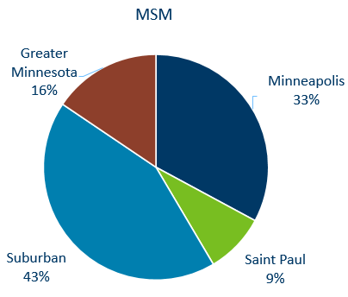
MSM Living with HIV/AIDS in Minnesota by Current Residence, 2022
Suburban includes the 7-county metro area of Anoka, Carver, Dakota, Hennepin (except Minneapolis), Ramsey (except St. Paul), Scott, and Washington counties. Greater Minnesota includes all other counties outside of the 7-county metro area.
Notes:
Overall, of the 9,805 people living with HIV/AIDS for whom complete residence information is available, 33% of all people living with HIV/AIDS in Minnesota live in the city of Minneapolis. This is similar to the percent of MSM living with HIV – 33% also reside in Minneapolis. Only 9% reside in St. Paul, compared to 12% of all people living with HIV.
Data:
MSM
Suburban: 43%
Saint Paul: 9%
Minneapolis: 33%
Greater Minnesota: 16%
Total PLWH
Suburban: 36%
Saint Paul: 12%
Minneapolis: 33%
Greater Minnesota: 19%

Slide 32
MSM Living with HIV & AIDS compared to the Population of Minnesota, 2022
Notes:
Of all people living with HIV in Minnesota, 43% are living with AIDS. This is compared to only 40% of MSM living with AIDS in Minnesota.
Data:
MSM
HIV (non-AIDS): 60%
AIDS: 40%
All PLWH
HIV (non-AIDS): 58%
AIDS: 43%

Slide 33
Foreign Born Populations

Slide 34
Foreign Born Persons Living with HIV/AIDS in Minnesota* by Region of Birth, 2012–2022
Year | Africa | Asia | Latin America | Other
2012 | 1008 | 108 | 378 | 40
2013 | 1047 | 111 | 396 | 41
2014 | 1109 | 122 | 417 | 43
2015 | 1174 | 134 | 429 | 48
2016 | 1299 | 147 | 463 | 55
2017 | 1391 | 160 | 491 | 59
2018 | 1494 | 170 | 516 | 64
2019 | 1560 | 185 | 549 | 73
2020 | 1599 | 190 | 566 | 75
2021 | 1677 | 194 | 604 | 78
2022 | 1713 | 200 | 650 | 101
*This number includes persons who reported Minnesota as their current state of residence, regardless of residence at time of diagnosis. It also includes state prisoners and refugees arriving through the HIV+ Refugee Resettlement Program, as well as HIV+ refugees/immigrants arriving through other programs.
Notes:
One particular population of interest in Minnesota that sets us apart from other states is our larger foreign-born HIV-positive population. Between 1990 and 2022, the number of foreign-born people living with HIV/AIDS in Minnesota increased substantially, especially among the African-born population. In 1990, 50 foreign-born people were reported to be living with HIV/AIDS in Minnesota, and by 2007 this number had increased to 1,126 people. In 2022, the total number of foreign-born people living with HIV/AIDS in Minnesota was 2655, a 4% increase from 2021. The majority of these people immigrated to the United States from Africa and Latin America. This trend illustrates the growing diversity of the HIV-positive population in Minnesota and the need for culturally appropriate HIV care and prevention efforts.
Non-U.S. born persons make up 37% of all people living with HIV in Minnesota

Slide 35
African-Born* Persons Living with HIV/AIDS Compared to Other Minnesota Cases by Sex Assigned at Birth, 2022
*Includes persons arriving to Minnesota through the HIV+ Refugee Resettlement Program and other refugee/immigrant programs. Also includes 10 Hispanic, 5 White, 25 Multi-Race, and 1 unknown identifying African-born persons.
Notes:
The characteristics of foreign-born persons living with HIV/AIDS in Minnesota differ from U.S.-born, especially in sex assigned at birth. While females account for 18% of cases among U.S.-born persons, they account for 46% of foreign-born cases. This is especially noticeable among African-born cases, where women account for 59% of those living with HIV/AIDS in Minnesota.
Data:
African-born Cases (n=1718)
Assigned Male at Birth: 41%
Assigned Female at Birth: 59%
US-born Cases (n=7158)
Assigned Male at Birth: 82%
Assigned Female at Birth: 18%

Slide 36
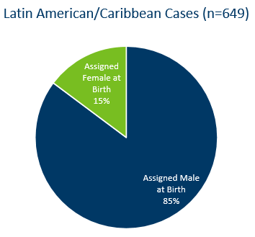
Latin American/Caribbean* Persons Living with HIV/AIDS Compared to Other Minnesota Cases by Sex Assigned at Birth, 2022
*Includes Mexico and all Central/South American and Caribbean countries.
Notes:
The sex assigned at birth distribution among cases born in Latin America/the Caribbean is similar to that of U.S.-born cases, where 18% of prevalent cases are among women.
Data:
Latin American/Caribbean Cases (n=649)
Assigned Male at Birth: 85%
Assigned Female at Birth: 15%
US-born Cases (n=7158)
Assigned Male at Birth: 82%
Assigned Female at Birth: 18%

Slide 37
Countries of Birth Among Foreign Born Persons* Living with HIV/AIDS in Minnesota, 2022
*Includes over 100 additional countries
Notes:
Data:
Country of Birth: Number of Prevalent Cases (Percent of Total)
Ethiopia: 364 cases (14%)
Mexico: 334 cases (12%)
Liberia: 312 cases (12%)
Kenya: 214 cases (8%)
Somalia: 171 cases (6%)
Cameroon: 149 cases (6%)
Nigeria: 73 cases (3%)
Sudan: 71 cases (3%)
Guatemala: 46 cases (2%)
Uganda: 40 cases (1%)
Other* Countries: 923 cases (34%)

Slide 38
Mortality

Slide 39
Reported Deaths Among Persons living with HIV/AIDS in Minnesota, 1984–2022
*Number of deaths known to have occurred among all people living with HIV infection in Minnesota, regardless of location of diagnosis or cause of death
^Number of deaths known to have occurred among people living with AIDS in Minnesota in a given calendar year, regardless of location of diagnosis or cause of death
**Number of deaths known to have occurred among people living with HIV (non-AIDS) in Minnesota in a given calendar year, regardless of location of diagnosis or cause of death
***Number of deaths known to have occurred among people living with HIV (non-AIDS) and AIDS in Minnesota in a given calendar year, attributable to underlying HIV infection. Because of delays in reporting and incomplete information from some death record matches, numbers may be artificially low. Data: HIV/AIDS Prevalence and Mortality Report 2022 Tables
Notes:
The number of deaths among all people living with HIV infection in Minnesota decreased dramatically between 1995 and 1997 and has remained relatively constant over the past decade. In 2022, a total of 122 deaths were reported among people living with HIV infection in Minnesota. The total number of deaths reported in Minnesota for those living with AIDS was 85 (70% of all deaths) in 2022. Overall deaths among people living with HIV/AIDS in Minnesota increased almost 13% from 2020 to 2021 and more than 17% from 2021 to 2022. 24% of all deaths were from underlying HIV disease (29 out of 122 deaths).

