Slide 1
HIV/AIDS Incidence Report, 2021
HIV/AIDS Surveillance System
June 2022
Notes:
.

Slide 2
Land Acknowledgement
Every community owes its existence and vitality to generations from around the world who contributed their hopes, dreams, and energy to making the history that led to this moment. Some were brought here against their will, some were drawn to leave their distant homes in hope of a better life, and some have lived on this land for more generations than can be counted. Truth and acknowledgment are critical to building mutual respect and connection across all barriers of heritage and difference.
We begin this effort to acknowledge what has been buried by honoring the truth. We are standing on the ancestral lands of the Dakota people. We want to acknowledge the Dakota, the Ojibwe, the Ho Chunk, and the other nations of people who also called this place home. We pay respects to their elders past and present. Please take a moment to consider the treaties made by the Tribal nations that entitle non-Native people to live and work on traditional Native lands. Consider the many legacies of violence, displacement, migration, and settlement that bring us together here today. Please join us in uncovering such truths at any and all public events.*
*This is the acknowledgment given in the USDAC Honor Native Land Guide – edited to reflect this space by Shannon Geshick, MTAG, Executive Director Minnesota Indian Affairs Council
Notes:
Before we begin our webinar, we take a moment to acknowledge that Minnesota stands on ancestral land of tribal nations… including the Dakota, Ojibwe, Ho Chunk, and other nations. Please take a moment to consider the treaties made by the Tribal nations that entitle non-native people to live and work on traditional Native lands.

Slide 3
New HIV Diagnoses in Minnesota, 2021

Slide 4
Introduction (I)
These two introduction slides provide a general context for the data used to create this slide deck. If you have questions about any of the slides, please refer to HIV Surveillance Technical Notes.
This slide deck describes new HIV diagnoses (including AIDS at first diagnosis) in Minnesota by person, place, and time.
The slides rely on data from HIV/AIDS cases diagnosed through 2021 and reported to the Minnesota Department of Health (MDH) HIV/AIDS Surveillance System.
The data are displayed by year of HIV diagnosis.

Slide 5
Introduction (II)
Data analyses exclude people diagnosed in federal or private correctional facilities but include people incarcerated by the state (number of people incarcerated by the state believed to be living with HIV/AIDS [n=20]).
Data analyses for new HIV diagnoses exclude people arriving to Minnesota through the HIV+ Refugee Resettlement Program (number of primary HIV+ refuges in this program living in MN as of December 31, 2021 = 163), as well as other refugees and immigrants reporting a positive test prior to their arrival in Minnesota (n=166).
Some limitations of surveillance data:
Data do not include people living with HIV who have not been tested for HIV
Data do not include people whose positive test results have not been reported to MDH
Data do not include people living with HIV who have only tested anonymously
Case numbers for the most recent years may be undercounted due to delays in reporting
Reporting of living cases that were not initially diagnosed in Minnesota is known to be incomplete

Slide 6
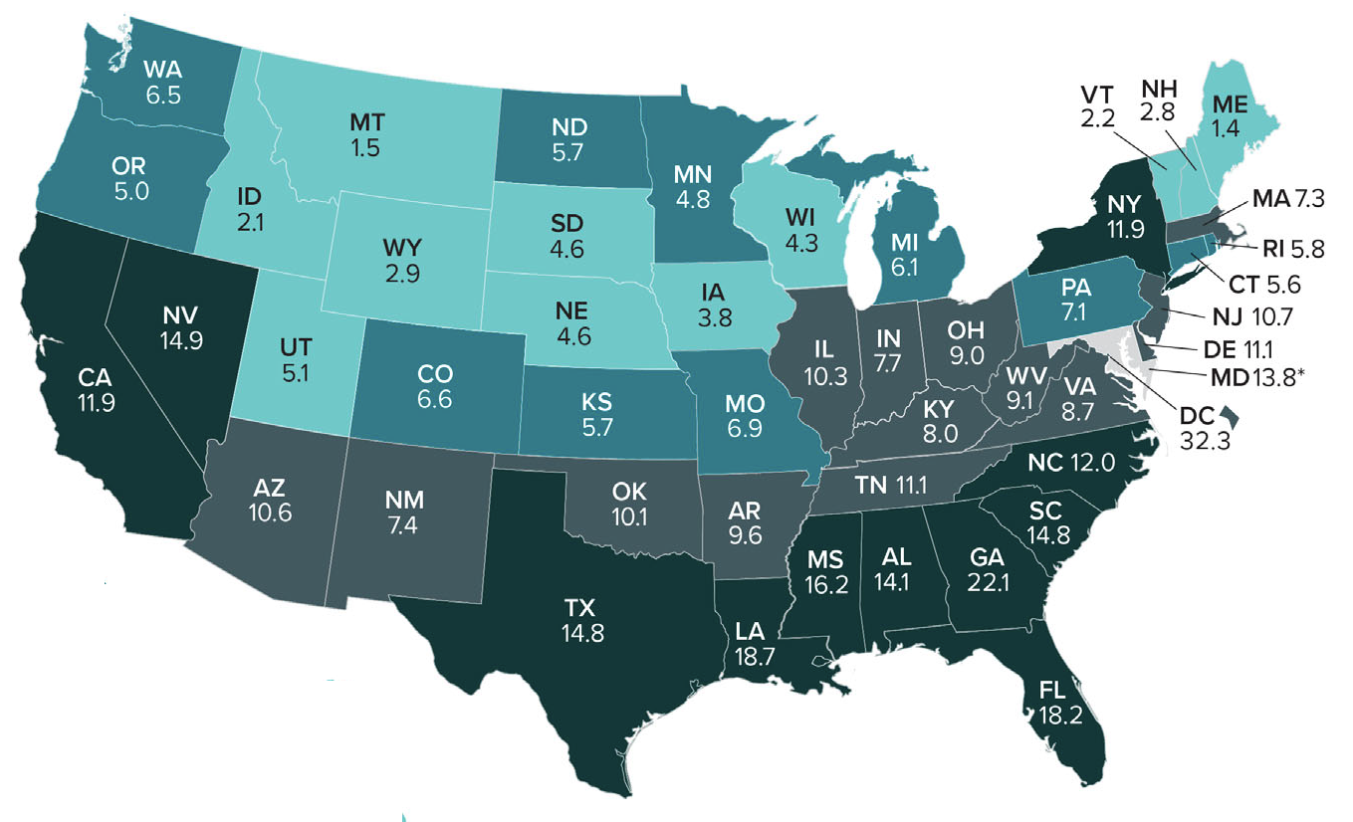
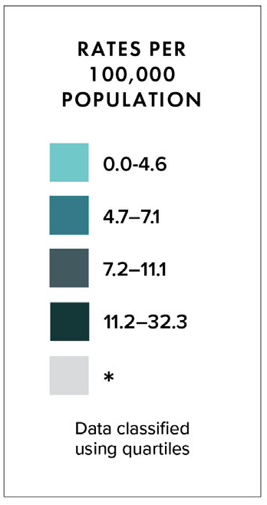
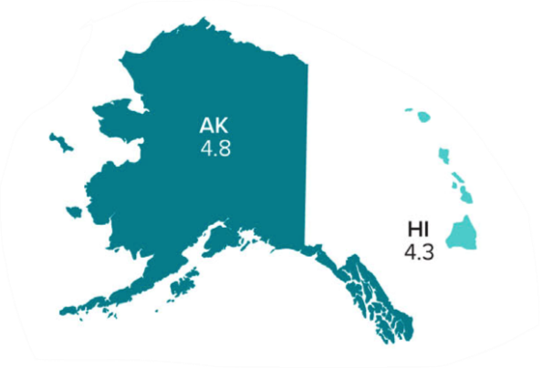
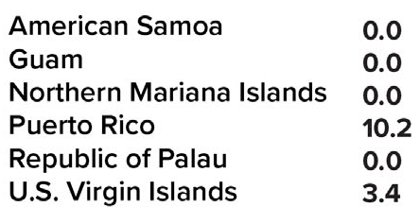
Rates of Diagnoses of HIV Infection among Adults >13 2020—United States and 6 Dependent Areas N = 30,635 Total Rate = 10.9
Note. Data for the year 2018 are considered preliminary and based on 6 months reporting delay.
Notes:
Please note that the most recent data available for national context was last prepared for 2020.
In the United States and 6 dependent areas, the rate of diagnoses of HIV infection among adults was 10.9 per 100,000 population in 2020. The rate of diagnoses of HIV infection for adults and adolescents ranged from zero in American Samoa, Guam, the Northern Mariana Islands and the Republic of Palau to 42.4 per 100,000 in the District of Columbia. This represents a 17% decline in new diagnoses from 2019, a reduction likely due to COVID-associated disruptions in clinical services, changes in patient care-seeking behaviors, and shortages in HIV testing materials. More time will be required to fully assess the COVID pandemic’s affect on HIV nationally.
The District of Columbia (i.e., Washington, DC) is a city; use caution when comparing the HIV diagnosis rate in DC with the rates in states.
Updated for 2020?

Slide 7
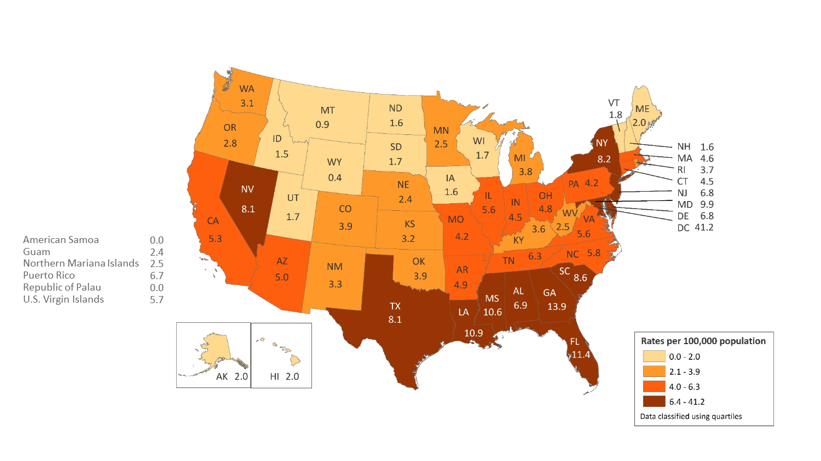
Rates of Diagnosed HIV Infection Classified as Stage 3 (AIDS) among Adults and Adolescents, by Area of Residence, 2018—United States and 6 Dependent Areas N = 17,186 Total Rate: 6.2
Note. Data for the year 2018 are considered preliminary and based on 6 months reporting delay.
Notes:
In 2018, in the United States and 6 dependent areas, the rate of stage 3 (AIDS) classifications among adults and adolescents with HIV Infection was 6.2 per 100,000 population. The rates of stage 3 (AIDS) classifications ranged from 0.0 per 100,000 in American Samoa and the Republic of Palau to 41.2 per 100,000 in the District of Columbia.
The District of Columbia (i.e., Washington, DC) is a city; use caution when comparing the rate of people living with diagnosed HIV infection in DC with the rates in states.
Data for the year 2018 are considered preliminary and based on 6 months reporting delay.

Slide 8
Overview of HIV/AIDS in Minnesota

Slide 9
New HIV Disease Diagnoses* HIV/AIDS Cases by Year, 1991-2021
*Includes all new cases of HIV infection (both HIV (non-AIDS) and AIDS at first diagnosis) diagnosed within a given calendar year.
Notes:
Nationally, Minnesota is considered a low- to moderate-risk state for HIV and AIDS infections as defined by the Centers for Disease Control and Prevention (CDC). The annual number of new HIV and AIDS cases increased steadily from the beginning of the epidemic to the early 1990s. Beginning in 1996, the number of newly diagnosed AIDS cases declined sharply, primarily due to the success of new antiretroviral therapies including protease inhibitors. These treatments have been shown to be effective at preventing transmission of HIV.

Slide 10
New HIV Disease Diagnoses* HIV/AIDS Cases by Year, 2011-2021
*Includes all new cases of HIV infection (both HIV (non-AIDS) and AIDS at first diagnosis) diagnosed within a given calendar year.
Notes:
In this report, the term “new HIV diagnoses” refers to Minnesota residents living with HIV who were diagnosed in a particular calendar year and reported to MDH. This includes people whose first diagnosis of HIV infection is AIDS (AIDS at first diagnosis). HIV diagnoses data are displayed by earliest known date of HIV diagnosis.
In 2021 there were 298 newly diagnosed cases compared to 230 cases in 2020. 2020 was an outlier year, however, with a 16% decrease in HIV diagnoses from the previous year, likely attributable to the same factors driving the national decrease in diagnoses in 2020. 298 diagnoses in 2021, while a 30% increase over 2020, is an 8% increase from 2019, and is average compared to the number of diagnoses per year in the prior decade, excluding 2020. More time and data will be required to determine whether this is a true increase in HIV infection rates or if part of the increase is due to a rebound in diagnoses after disruptions in 2020.

Slide 11
New HIV Diagnoses, HIV (non-AIDS) and AIDS Cases by Year of HIV Diagnosis, 2011-2021
*Includes all new cases of HIV infection (both HIV (non-AIDS) and AIDS at first diagnosis diagnosed within a given calendar year.
^Includes all cases diagnosed with HIV in that year who subsequently progressed to AIDS diagnosis status, including those diagnosed with AIDS when they were first diagnosed with HIV^^ and those who were diagnosed with AIDS in subsequent years^^^
This includes refugees in the HIV+ Resettlement Program, as well as, other refugee/immigrants diagnosed with AIDS subsequent to their arrival in the United States.
Notes:
Over the past decade, the number of HIV/AIDS cases diagnosed has remained stable with an average of 290 cases diagnosed each year. In 2020, however, there was a decrease in new HIV diagnoses. 2021 saw an increase to slightly above average, possibly attributable to a rebound effect in diagnostics. Of the 298 diagnoses in 2021, 245 were new HIV diagnoses, while 53 were simultaneous HIV and AIDS diagnoses.
By the end of 2021, an estimated 9,697 people with HIV/AIDS were assumed to be living in Minnesota.
This number includes people whose most recently reported state of residence was Minnesota, regardless of residence at time of diagnosis. This estimate does not include people with undiagnosed HIV infection.

Slide 12
New HIV Diagnoses, Deaths and Prevalent Cases by Year, 2011-2021
Includes all new cases of HIV infection (both HIV (non-AIDS) and AIDS at first diagnosis) diagnosed within a given calendar year.
^Deaths in Minnesota among people with HIV/AIDS, regardless of location of diagnosis and cause.
Notes:
Beginning in 1996, both the number of newly diagnosed AIDS cases and the number of deaths among AIDS cases declined sharply, primarily due to the success of new antiretroviral therapies including protease inhibitors. These treatments do not cure but can delay progression to AIDS among people with HIV (non-AIDS) infection and improve survival among those with AIDS. These treatments have been shown to be effective at preventing transmission of HIV.
Since 1996, the number of new diagnoses has remained relatively stable in Minnesota at around 300 cases per year. During this same time, deaths among HIV positive people in Minnesota has decreased dramatically. As people with HIV are living longer and healthier lives, the number of people living with HIV in Minnesota continues to grow as seen in the green line here.
At the end of 2021, there were 9,697 people estimated to be living with HIV or AIDS in Minnesota.
This number does not include 1,662 people who were first reported with HIV or AIDs in Minnesota and subsequently moved out of the state, but it does include 2,644 people who were first reported with HIV or AIDS elsewhere and subsequently moved to Minnesota.

Slide 13
HIV (non-AIDS) and AIDS^ at Diagnosis by Year, 2011-2021
^Includes all new cases of HIV that were diagnosed with HIV and AIDS simultaneously
This includes refugees in the HIV+ Resettlement Program, as well as, other refugee/immigrants diagnosed with AIDS subsequent to their arrival in the United States.
Notes:
Over the last 10 years, the proportion of cases diagnosed with AIDS at initial HIV diagnosis has tended to be between 20 and 25%.
In 2021, the proportion of cases diagnosed with AIDS at initial HIV diagnosis was below average at 18%.

Slide 14
HIV Diagnoses in Minnesota by Person, Place, and Time

Slide 15
Place

Slide 16
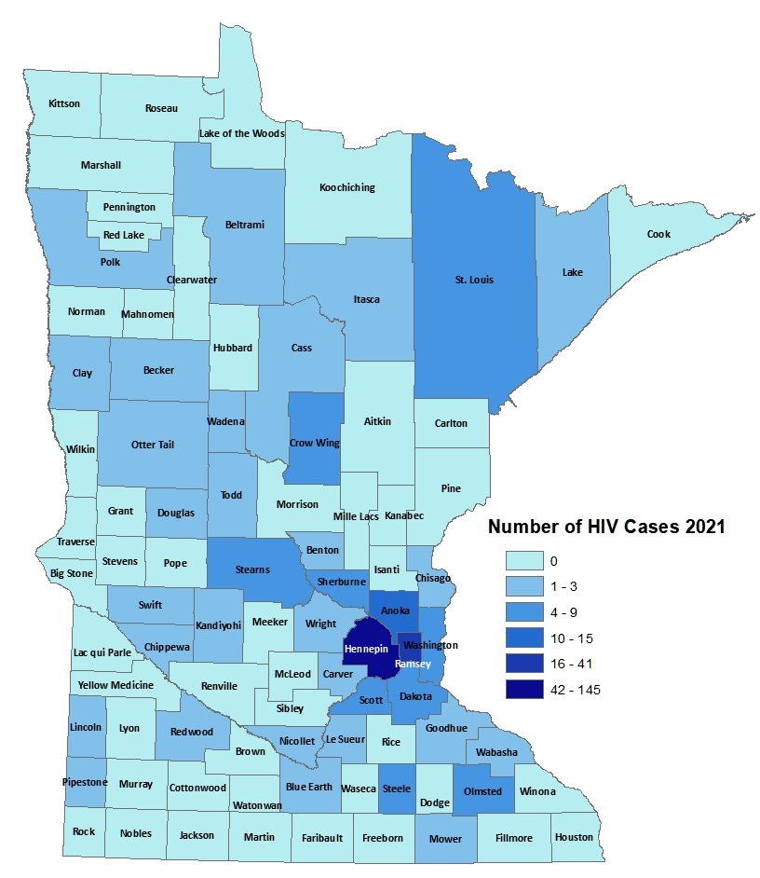
HIV Diagnoses# by County of Residence at Diagnosis, 2021
City of Minneapolis
City of St. Paul
Suburban*
Greater Minnesota
Total
93 cases (31%)
34 cases (11%)
95 cases (32%)
76 cases (26%)
298 cases
#HIV or AIDS at first diagnosis
*7-county metro area, excluding the cities of Minneapolis and St. Paul
Notes:
Historically, about 80% of new HIV infections diagnosed in Minnesota have occurred in Minneapolis, St. Paul and the surrounding seven-county metropolitan area.
In 2021, of 298 total HIV diagnoses, 74% of the cases were in the seven-county Twin Cities metro region with 31% in Minneapolis, 11% in St. Paul, and 32% in the remaining suburban area (excluding Minneapolis/St. Paul). In greater Minnesota, there were 76 newly diagnosed HIV cases across 39 counties.

Slide 17
2021 Minnesota HIV New Diagnoses by Metro County
City of Minneapolis
City of St. Paul
Suburban*
Greater Minnesota
Total
93 cases (31%)
34 cases (11%)
95 cases (32%)
76 cases (26%)
298 cases
HIV or AIDS at first diagnosis
*7-county metro area, excluding the cities of Minneapolis and St. Paul
Notes:
While 74% of all new HIV diagnoses in Minnesota occur in the Twin Cities seven-county metropolitan area, the cases in the metro area are concentrated in Hennepin and Ramsey counties.

Slide 18
HIV Diagnoses* in Minnesota by Residence at Diagnosis, 2021
*Suburban includes the 7-county metro area of Anoka, Carver, Dakota, Hennepin (except Minneapolis), Ramsey (except St. Paul), Scott, and Washington counties. Greater Minnesota includes all other counties outside of the 7-county metro area.
Notes:
Overall, of the 298 HIV diagnoses in Minnesota in 2021, 74% were among residents of suburban seven-county metro area. Of these, 31% were residents of Minneapolis and 11% were residents of St. Paul. The remaining 26% were residents of Greater Minnesota at the time of diagnosis.

Slide 19
Sex at Birth, Gender, and Race/Ethnicity

Slide 20
HIV Diagnoses* by Sex Assigned at Birth and Year of Diagnosis 2011 - 2021
*HIV or AIDS at first diagnosis
Notes:
By sex assigned at birth….
The number of cases among people assigned male at birth tends to be between 74 and 79%. After a decline in diagnoses among people assigned female at birth in 2020, this proportion rebounded in 2021, with people assigned male at birth representing 79% of all new HIV diagnoses,

Slide 21
Number of Cases and Rates (per 100,000 people) of HIV Diagnoses* by Race/Ethnicity† Minnesota, 2021
* HIV or AIDS at first diagnosis; 2010 U.S. Census Data used for rate calculations.
† “Black African-born” refers to Black people who reported an African country of birth; “Black not African-born” refers to all other Black people.
†† Estimate of 125,939 Source: 2019 American Community Survey.
^ Other = Multi-racial people or people with unknown or missing race
# Unable to calculate rate, unknown denominator
Notes:
Each year we calculate the rate of diagnosis for each racial/ethnic group represented in the surveillance system to assess the impact of HIV within each community. The rate takes into account the size of the population of each group.
Non-Hispanic Black communities had the highest rate of diagnoses in 2021 with 36.5 HIV diagnoses per 100,000 population among Black African-born people and 53.8 HIV diagnoses per 100,000 population among Black, not African-born people. For African-Americans who are not African-born, this represents a rate that is 22 times the rate in the white non-Hispanic population in Minnesota. The rate among the African-born population is 15 times that of the white non-Hispanic population.
Hispanic people of any race have the next highest rate of newly diagnosed HIV cases in Minnesota at 17.2 per 100,000 people; this is a rate 7 times that of white, non-Hispanic people.
American Indians have a rate of people newly diagnosed with HIV of 18 per 100,000 people, 7.5 times the rate of white, non-Hispanic people.

Slide 22
HIV Diagnoses* in Year 2021 and General Population in Minnesota by Race/Ethnicity
Notes:
Comparing the racial/ethnic distribution of new HIV diagnoses [LEFT] to the general population of Minnesota [RIGHT], it is apparent that disparities continue to exist. Non-Hispanic African-American and Black African-born Minnesotans jointly make up about 5% of the population in Minnesota, yet accounted for 42% of the newly diagnosed cases of HIV in 2021. Similarly, Hispanics of any race account for approximately 5% of the population, but account for 14% of the newly diagnosed cases.

Slide 23
HIV Diagnoses* Diagnosed in Year 2021 by Sex Assigned at Birth and Race/Ethnicity†
Notes:
There are differences in the racial/ethnic distribution by sex assigned at birth. Left to right are data for people assigned Male and Female at birth.
On the LEFT, among 234 people assigned the sex of male at birth, 37% of the 2021 cases diagnosed in Minnesota are Non-Hispanic white [seen in dark BLUE]. Non-Hispanic Black non-African born [In light GREEN] and black, African-born males [light BLUE] made up 38% of cases and Hispanic males of any race accounted for 18% of cases.
ON the RIGHT, Among the 64 people assigned the sex of female at birth, the disparities of new HIV diagnoses are even more apparent among people of color. They represent 74% of new HIV cases assigned female at birth vs 63% of new HIV cases assigned male at birth. Greater than half of female infections, or 55% combined, are Black, African-born and non-African born.

Slide 24
HIV Diagnoses* Among People Assigned Male Sex at Birth by Race/Ethnicity† and Year of Diagnosis 2011 - 2021
* HIV or AIDS at first diagnosis
† “African-born” refers to Black people who reported an African country of birth; “African American” refers to all other Black people. Cases with unknown or multiple races are excluded.
Notes:
Trends in the annual number of new HIV infections diagnosed among people assigned male sex at birth differ by racial/ethnic group.
White and black non-African born people accounted for the largest number of new infections.
In 2021, white people [in DARK BLUE] assigned male sex at birth accounted for (87 of 234) 37% (up from 34% in 2020) of the new HIV diagnoses among people assigned male sex at birth. [In GREEN] Cases among African-American people assigned male sex at birth has fluctuated over the past 10 years, and increased in 2021 to 68 (29%) new HIV diagnoses in 2021 (from 61 cases in 2019).
IN other words… if in 2021 you drew 3 newly diagnosed HIV infections among people assigned male at birth , 1 person would likely be white and 1 person would likely be Black non-African born.
The annual number of HIV infections diagnosed among Hispanic people assigned male sex at birth has remained relatively stable, with small fluctuation from year to year. HIV infections in Hispanic people assigned male sex at birth was similar to the previous year with 30 cases in 2020. African-born people assigned male sex at birth diagnosed with HIV declined in 2020 to 14 cases, like 2019 (n=13), relatively low compared to the previous years.

Slide 25
HIV Diagnoses* Among People Assigned Female Sex at Birth by Race/Ethnicity† and Year of Diagnosis 2011 - 2021
*HIV or AIDS at first diagnosis
† “Black African-born” refers to Black people who reported an African country of birth; “Black not African-born” refers to all other Black people. Cases with unknown race are excluded.
Notes:
Next, let’s look at newly diagnosed HIV among people assigned female sex at birth. We again note that these Female cases increased nearly 75% from 2020, from 37 cases in 2020 to 64 cases in 2021.
While the exact reasons for the 2020 50% decrease in cases among people assigned female at birth is not yet understood at this time, it does appear that the reductions in 2 key racial populations attribute to this decrease.*
With regards to racial distribution in 2020 among people assigned female sex at birth, Both African-born black cases [In RED] and White cases [in Dark BLUE] decreased most notably. Black African born cases, which typically experience the highest counts, decreased more than half… from 25 in 2019 to 11 cases in 2020. It is now the same count as Black, not-African born cases [in GREEN]. White cases also dropped dramatically by 75% from 24 cases in 2019 to 6 cases in 2020.
* In 2020, we note that there was approximately 6,000 population decrease in the estimate for the general black, African-born population in Minnesota since 2019 (From 131,832 in 2019 to 125,939 in 2020).

Slide 26
Number of Cases and Rates (per 100,000 people) of Adults and Adolescents* Diagnosed with HIV/AIDS by Sex Assigned at Birth and Risk† in Minnesota, 2021
*HIV or AIDS at first diagnosis ages 13 and older.
^2010 United States Census Data used for rate calculations, except where otherwise specified.
†MSM refers to both MSM and MSM/IDU risk identified at time of reported HIV diagnosis. It includes all PLWH assigned the sex of male at birth who report a male sexual partner. Therefore, some Trans Women are included in both the total number of cases and the population estimate.
††Estimate of 90,663 Source: http://www.emorycamp.org/item.php?i=92
Notes:
Here we look at cases and rates of the 298 new HIV infections by sex assigned at birth and reported sexual behavior.
By sex assigned at birth….
The number of cases among people assigned male at birth have remained stable, with 234 of 298 new HIV cases. However, In 2021, the number of infections among people assigned female at birth increased from 37 in 2020 to 64 in 2021. However, this is still a decrease from 76 cases in 2019. The reason for this decrease is currently unknown.
As a result, people assigned male at birth represent 84% of all new HIV diagnoses- which is an increase from previous years.
Looking further at data by risk behavior….
Men who have Sex with Men, or MSM, have the highest rate of HIV diagnosis than any other sub-category. In 2020, the estimated rate of HIV diagnosis among MSM was 137.9 per 100,000 population. This is nearly 38 times higher than the rate among non-MSM men.
It’s important to note that MSM contains cases from all racial/ethnic categories and therefore, cannot be directly compared to the rates on the previous slide. For more information on how this rate was estimated, see the HIV Surveillance Technical Notes which are available on our website.

Slide 27
Number of Cases of Adults and Adolescents* Diagnosed with HIV/AIDS by Gender Identity in Minnesota, 2021
*HIV or AIDS at first diagnosis ages 13 and older.
††Current gender was not reportable until 2009, so may be incomplete for HIV infections reported before that time. Because current gender is incomplete for a large number of cases, there may be misclassification of transgender Minnesotans in either of the cisgender groups.
Notes:
This slide shows the number of people living with HIV/AIDS by gender identity. In 2021, there were 12 transgender newly reported HIV cases in Minnesota (11 Trans Women, and 1 other Transgender identity). This represents 4% of new cases reported in the state.

Slide 28
Age

Slide 29
Age at HIV Diagnosis* by Sex Assigned at Birth, Minnesota, 2021
*HIV or AIDS at first diagnosis
Notes:
In 2021, there were 100 cases diagnosed under the age of 30, accounting for 34% of all cases. 87 (85%) of these were in people assigned to the male sex at birth. Age groups 20-24 and 30-34 had the largest number of new cases in 2021.

Slide 30
Average Age at HIV Diagnosis* by Sex Assigned at Birth, 2011-2021
*HIV or AIDS at first diagnosis
Notes:
The average age at diagnosis in 2021 was 36.13 years. People assigned female sex at birth [In GREEN] were 3.5 years older at age of diagnosis than people assigned male at birth.

Slide 31
Mode of Exposure

Slide 32
HIV Diagnoses* by Mode of Exposure and Year, 2011 – 2021
*HIV or AIDS at first diagnosis
MSM = Men who have sex with men IDU = Injection drug use Heterosexual = Heterosexual contact Unspecified = No mode of exposure ascertained
Notes:
This slide depicts risk for all people diagnosed with HIV in Minnesota during the past decade and since the beginning of the epidemic. In 2021, mode of exposure was unknown or undisclosed in a plurality (48%) of cases. Of cases where mode of transmission was reported, men having sex with men was the most common, accounting for 42% of all diagnoses but over 80% of diagnoses with known modes of transmission.
The number of cases among people who inject drugs (IDU only) was 20 cases in 2021, down from 2019 (n=22) yet an increase from 2018 (n=11) and 2020 (n=12). However, Minnesota has declared an ongoing outbreak among people who inject drugs in St. Louis County, with cases dating back to 2019. Hennepin-Ramsey counties are also experiencing an ongoing outbreak among people who inject drugs, with some cases dating back to 2018. More details on these outbreaks later in this slide presentation.

Slide 33
HIV Diagnoses* Among People Assigned Male Sex at Birth by Mode of Exposure and Year 2011 - 2021
* HIV or AIDS at first diagnosis
MSM = Men who have sex with men IDU = Injection drug use Heterosexual = Heterosexual contact Unspecified = No mode of exposure ascertained
Notes:
By gender,
Among people assigned male sex at birth, same-sex sexual relations in male-sex with males (MSM) continues to be a leading risk, with 125 of 234 cases in 2021 (47%).
IDU are 3 of 234 cases (1%)
MSM-IDU are 12 of 234 cases (6%).
Heterosexual contact is 13 of 234 cases (6%).

Slide 34
HIV Diagnoses* Among People Assigned Female Sex at Birth by Mode of Exposure and Year of Diagnosis 2010 - 2020
* HIV or AIDS at first diagnosis
IDU = Injection drug use Heterosexual = Heterosexual contact Unspecified = No mode of exposure ascertained
Notes:
For people assigned female sex at birth, the most known common mode of exposure for the past decade has been Heterosexual contact (with a person of known HIV infection), as seen in RED. In 2021, however, this changed, with IDU overtaking heterosexual contact as the most common reported mode of exposure.

Slide 35
Births to Pregnant People Living with HIV and Number of Perinatal Acquired HIV Infections* by Year of Birth, 2011- 2021
* HIV or AIDS at first diagnosis for a child exposed to HIV during pregnant person’s pregnancy, at birth, and/or during breastfeeding.
Notes:
The ability to interrupt the transmission of HIV from mother to child via antiretroviral therapy and appropriate perinatal care is an important accomplishment in the history of the HIV/AIDS epidemic. Without antiretroviral therapy, newborn HIV infection rates range from 25-30%, but decrease to 1-2% with appropriate medical intervention. The rate of transmission has decreased from 15% between 1994 and 1996 to 0.0% in the past three years (2019-2021). The last transmission was in 2017.
For the past decade, the number of births to pregnant parents living with HIV has ranged between 42-69 births (2011-2021).
For 2021, there was an increase to 60 births to pregnant parents living with HIV with no perinatal HIV cases baby born to a HIV-positive pregnant person in Minnesota in 2021.

Slide 36
Outcome for Perinatal HIV-Exposed Infants born in 2020
Notes:
Starting in 2018, CDC HIV Surveillance required that all HIV surveillance jurisdictions conduct follow-up of perinatal HIV-exposed infants every 6 months until 18 months of age or until HIV infection status is determined.
Infants exposed to HIV at birth may or may not be infected with HIV. Because of placental transfer of HIV maternal antibodies, HIV tests at birth will be positive, regardless of the infant’s true HIV status. Therefore, perinatal exposures need to be followed up over the next 18 months until the child’s diagnostic status is known (usually with lab results after two months of age and then every six months).
The pie chart above shows the HIV infection status for infants born in 2020. Data on infants born in 2021 are not available until those infants are 18 months of age.
IN 2021, Of the 42 perinatal HIV-exposed infants born in 2020, 100% have a HIV infection status determination of HIV negative (n=42) and none were HIV positive. Minnesota is above the CDC outcome standard of greater than or equal to 85% of HIV-exposed infants that have HIV infection status determined by 18 months of age. None of the infants had a HIV indeterminate status.

Slide 37
Adolescents & Young Adults (Ages 13-24)*

Slide 38
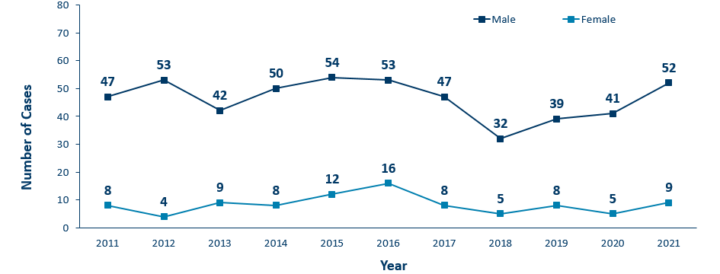
HIV Diagnoses* Among Adolescents and Young Adults† by Sex Assigned at Birth and Year 2011 - 2021
* HIV or AIDS at first diagnosis
† Adolescents defined as 13-19 year-olds; Young Adults defined as 20-24 year-olds.
Notes:
The number of new HIV diagnoses among people assigned male sex at birth aged 13-24 has ranged from 32-54 cases over the past decade. Since the low in 2018, we’ve seen an increase of new diagnoses among males in this age group where there are 52 cases reported in 2021.
In 2021, among adolescent and young adults assigned female sex at birth, there were 9 cases compared to 5 cases in 2021.
In 2021, the total number of cases among adolescents and young adults were higher from the previous year with 61 cases in 2021 compared to 46 cases in 2020.

Slide 39
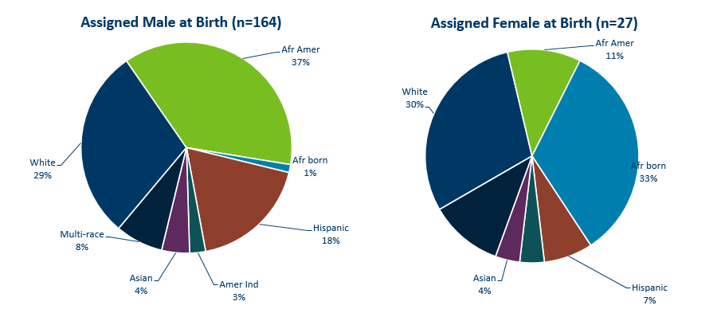
HIV Diagnoses* Among Adolescents and Young Adults† by Sex Assigned at Birth and Race/Ethnicity, 2018 - 2021 Combined
* HIV or AIDS at first diagnosis (n = Number of people)
Amer Ind = American Indian , Afr Amer = African American (Black, not African-born people) , and Afr born = African-born (Black, African-born people)
Notes:
Looking at racial distribution among adolescents by sex assigned at birth.
Between the years 2018 and 2020 we had 112 cases assigned male sex at birth [LEFT Graph] reported among adolescents and young adults, and 18 females reported in the 13-24 age group. For people assigned male sex at birth, Non-Hispanic white [DARK BLUE] and African-American people [GREEN] each accounted for one-third, and Hispanic people of any race [RED] accounted for 16% in the 13-24 age group. Among people with female sex assigned at birth [RIGHT], Non-Hispanic black African-born [LIGHT BLUE] and African-Americans [GREEN] together accounted for 44% of the cases; while non-Hispanic white people [DARK BLUE] accounted for 33%, and Hispanic people of any race [RED] accounted for 11% of cases.

Slide 40
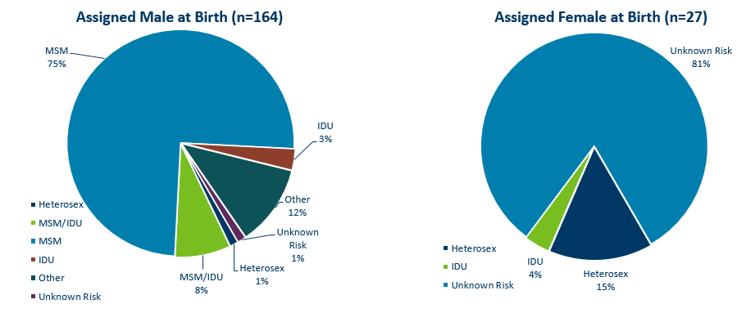
HIV Diagnoses* Among Adolescents and Young Adults† by Sex at Birth and Exposure Group 2018 – 2021 Combined
† Adolescents defined as 13-19 year-olds; Young Adults defined as 20-24 year-olds.
MSM = Men who have sex with men IDU = Injection drug use Heterosex = Heterosexual contact
n = Number of people
HIV or AIDS at first diagnosis
Notes:
For mode of exposure among people assigned male sex at birth in the 13-24 age group [LEFT] , Male to Male sex was found to account for 81% of the cases, while the combined risk of MSM and IDU was estimated to account for 11% of the cases and 2% was attributed to heterosexual contact.
Among adolescent people assigned female sex at birth [RIGHT], Most women HIV risk is unknown (78%) [LIGHT BLUE]. 14% of cases were found to have heterosexual contact as their mode of exposure [DARK BLUE], while 5% were attributed to injection drug use [LIGHT GREEN].

Slide 41
Foreign-born Cases

Slide 42
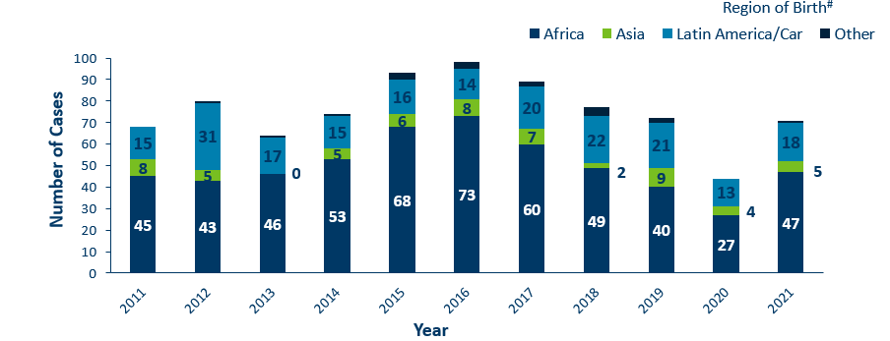
HIV Diagnoses* among Foreign-Born People† in Minnesota by Year and Region of Birth 2011 - 2021
Notes:
This slides describes HIV diagnoses by global region of birth among foreign-born people. In general, the number of new HIV infections diagnosed among foreign-born people in Minnesota has steadily increased from 20 cases in 1990 to an average of 83 cases over the last decade. This increase has been largely driven by the increase of cases among African-born people, as well as people from Mexico, Central and South America and the Caribbean.
In 2021, there were 71 cases of newly reported HIV among foreign-born people. This is about one out of four of all new cases (24%) The majority of foreign-born cases in 2021 were from Africa, followed by Latin America and the Caribbean.

Slide 43
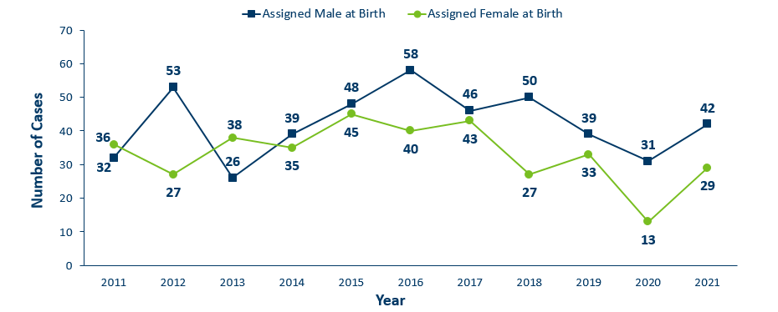
HIV Diagnoses* Among Foreign-Born people† by Sex Assigned at Birth and Year 2011 – 2021
*HIV or AIDS at first diagnosis
† Excludes people arriving in Minnesota through the HIV+ Refugee Resettlement Program, as well as other refugee/immigrants with an HIV diagnosis prior to arrival in Minnesota.
Notes:
In 2021, the number of foreign-born people assigned male sex [in DARK BLUE] at birth increased from 31 cases in 2020 to 42 in 2021.
There was an increase for foreign-born people assigned female sex [in GREEN] at birth from 13 in 2020 to 29 in 2021.

Slide 44
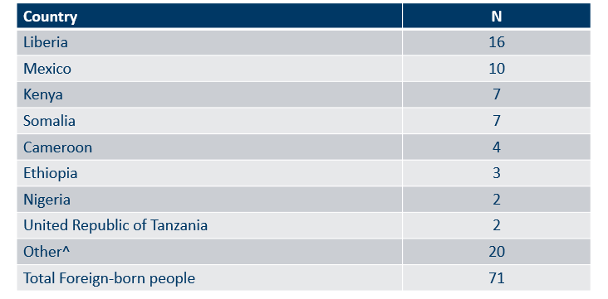
Countries of Birth Among Foreign-Born people† Diagnosed with HIV* Minnesota, 2021
* HIV or AIDS at first diagnosis
† Excludes people arriving to Minnesota through the HIV+ Refugee Resettlement Program, as well as other refugee/immigrants with an HIV diagnosis prior to arrival in Minnesota.
^ Includes 20 additional countries.
Notes:
Four countries (Liberian, Mexico, Kenya, Somalia) accounted for 56 percent of new infections among foreign-born people, however there are 28 countries represented among the 71 new foreign-born cases in 2021.

Slide 45
Late-Testers (AIDS Diagnosis within one year of initial HIV Diagnosis)
Notes:
Late testers are defined as anyone with an AIDS diagnosis within one year of their initial HIV diagnosis. This is an important trend to watch as people who progress to AIDS within one year of their HIV diagnosis represent persons who are likely diagnosed well after their initial infection and represent missed testing opportunities earlier in the course of their infection.
[This statistic helps MDH monitor whether new HIV infections are detected early, before AIDS diagnosis. People diagnosed early with HIV can start treatment that can reduce their viral load to undetectable levels… and ultimately… reduce community transmission risk. Known as U=U or undetectable equals un-transmittable, the science is clear: when people have undetectable viral loads, they can't pass HIV through sex to their partners.] To include this language for Webinar?

Slide 46
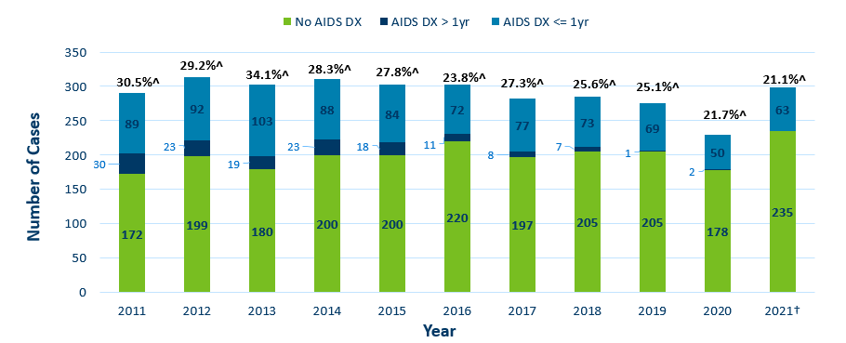
Time of Progression to AIDS for HIV Diagnoses in Minnesota* 2011 - 2021†
*Numbers include AIDS at 1st report but exclude people arriving to Minnesota through the HIV+ Refugee Resettlement Program, as well as other refugee/immigrants with an HIV diagnosis prior to arrival in Minnesota.
^ Percent of cases progressing to AIDS within one year of initial diagnosis with HIV
† Numbers/Percent for cases diagnosed in 2021 only represents cases progressing to AIDS through April 2022
Notes:
Late testers are defined as anyone with an AIDS diagnosis within one year of their initial HIV diagnosis. They represent missed opportunities for early intervention.
In 2020, 21.7% of new cases were late testers. This proportion of cases has remained relatively the same over the past 10 years, ranging between 22-34%. Most late testers, about 85%, are diagnosed with AIDS at the same time they are initially diagnosed with HIV infection. As with other characteristics of the HIV epidemic in Minnesota, the proportion of late testers varies by demographic characteristics.
For 2021, 21.1% (63) of new HIV cases were “late testers” to date, which represents only a partial follow-up year through April 2022. Please note that cases diagnosed in 2021 may not encompass all cases diagnosed – since a full year of observation is required to capture progress to AIDS within a year (which would end later this year in December 2022).

Slide 47
Progression to AIDS within 1 year of initial HIV Diagnosis* by Sex Assigned at Birth 2011 - 2021†
*Numbers include AIDS at 1st report but exclude people arriving to Minnesota through the HIV+ Refugee Resettlement Program, as well as other refugee/immigrants with an HIV diagnosis prior to arrival in Minnesota.
† Numbers/Percent for cases diagnosed in 2021 only represents cases progressing to AIDS through April 2022
Notes:
The proportion of late testers can vary by sex assigned at birth from year to year. Over the past decade among people assigned male sex at birth the proportion of late testers ranged from 24%- 35%. Among people assigned female sex at birth the proportion of late testers ranged from 20%-37%.
Percentage of late testers for 2021 includes only those progressing to AIDS through April 2022. Please note that cases diagnosed in 2021 may not encompass all cases diagnosed – since a full year of observation is required to capture progress to AIDS within a year (which would end later this year in December 2022).

Slide 48
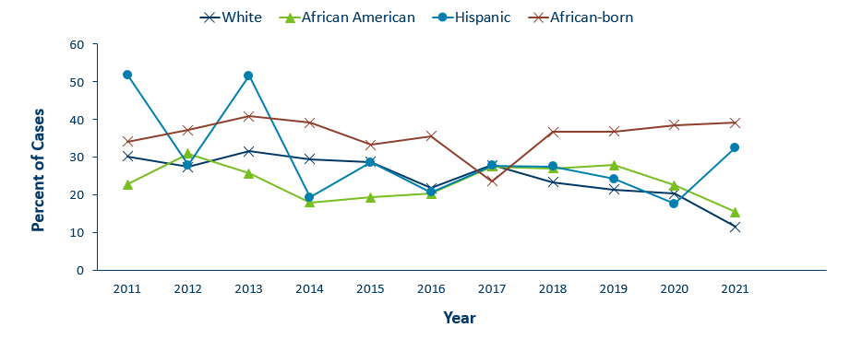
Progression to AIDS within 1 year of initial HIV Diagnoses* by Race/Ethnicity^ 2011 - 2021†
*Numbers include AIDS at 1st report but exclude people arriving to Minnesota through the HIV+ Refugee Resettlement Program, as well as other refugee/immigrants with an HIV diagnosis prior to arrival in Minnesota.
† Numbers/Percent for cases diagnosed in 2021 only represents cases progressing to AIDS through April 2022.
^Percentage not calculated if less than 10 cases diagnosed per year
Notes:
As with other characteristics of the HIV epidemic in Minnesota, the proportion of late testers varies by demographic characteristics. Differences occur by race/ethnicity. Over the past three years of full data on late testers (2018-2020), African-born black persons have had the highest proportion of late testers ranging between 37-39%. For 2020, The proportions of late testers by race and Hispanic ethnicity include white, non-Hispanic (20%), black, African American, non-Hispanic (23%), African-born, black (38%), and Hispanic, any race (18%). Similar data for non-Hispanic American Indian and Asian/Pacific Islander persons in a single year had fewer than 10 cases and are considered not stable and are therefore not represented here.
Percentage of late testers for 2021 includes only those progressing to AIDS through April 2022. Please note that cases diagnosed in 2021 may not encompass all cases diagnosed – since a full year of observation is required to capture progress to AIDS within a year (which would end later this year in December 2022).

Slide 49
Progression to AIDS within 1 year of initial HIV Diagnosis* by Age 2011 - 2021†
*Numbers include AIDS at 1st report but exclude people arriving to Minnesota through the HIV+ Refugee Resettlement Program, as well as other refugee/immigrants with an HIV diagnosis prior to arrival in Minnesota.
† Numbers/Percent for cases diagnosed in 2021 only represents cases progressing to AIDS through April 2022.
^Percentage not calculated if less than 10 cases diagnosed per year
Notes:
Differences by age are as expected with the percentage of late testers increasing with age at time of diagnosis. In 2020, all age groups experienced notable decreases in proportion of late testers. In 2020, younger age groups had lower percentage of late testers, 13-24 and 25-29 age groups both at 11%. Older age groups had higher percentage of late testers, 40-44 (44%) and 45-plus (32%).
Percentage of late testers for 2021 includes only those progressing to AIDS through April 2022. Please note that cases diagnosed in 2021 may not encompass all cases diagnosed – since a full year of observation is required to capture progress to AIDS within a year (which would end later this year in December 2022). Caution should be used due to smaller numbers by age group when interrupting the data.

Slide 50
Progression to AIDS within 1 year of initial HIV Diagnosis* by Mode of Transmission 2011 - 2021†
*Numbers include AIDS at 1st report but exclude people arriving to Minnesota through the HIV+ Refugee Resettlement Program, as well as other refugee/immigrants with an HIV diagnosis prior to arrival in Minnesota.
† Numbers/Percent for cases diagnosed in 2021 only represents cases progressing to AIDS through April 2022.
^Includes MSM/IDU
Notes:
In 2020, people with a risk category of unspecified risk had the highest proportion of late testers at 39%, followed by heterosexual contact at 25%, MSM at 16%, and finally IDU at 11%.
Percentage of late testers for 2020 includes only those progressing to AIDS through April 2021. Please note that cases diagnosed in 2021 may not encompass all cases diagnosed – since a full year of observation is required to capture progress to AIDS within a year (which would end later this year in December 2022).

Slide 51
Time of Progression to AIDS for HIV Diagnoses* Among Foreign-Born People, Minnesota 2011 - 2021
*Numbers include AIDS at 1st report but exclude people arriving to Minnesota through the HIV+ Refugee Resettlement Program, as well as other refugee/immigrants with an HIV diagnosis prior to arrival in Minnesota.
^ Percent of cases progressing to AIDS within one year of initial diagnosis with HIV
† Numbers/Percent for cases diagnosed in 2021 only represents cases progressing to AIDS through April 2022.
Notes:
During the past decade, foreign-born cases have a higher rate of late testers compared to US-born cases. In 2020, Among 44 foreign-born cases, 13 (30%) of foreign-born cases were late testers compared to 20% of US-born cases. Over the decade, the range of foreign-born cases that were late testers ranged from 29% - 47%.
Percentage of late testers for 2021 includes only those progressing to AIDS through April 2022. Please note that cases diagnosed in 2021 may not encompass all cases diagnosed – since a full year of observation is required to capture progress to AIDS within a year (which would end later this year in December 2022).

Slide 52
Additional Topics

Slide 53
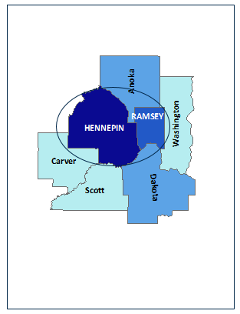
HIV Outbreak in Hennepin/Ramsey Counties
Hennepin/Ramsey Counties HIV Outbreak
In February 2020, MDH Health Alert Network declared an outbreak among persons who inject drugs (PWID)
Current Case Count: 101 cases
Inclusion Criteria:
51 encampment-related
40 MSM/IDU
10 IDU
People at high-risk in the current outbreak:
People who use injection drugs (PWID) or share needles/works
People experiencing homelessness or unstable housing
People who exchange sex for income or other items they need
Notes:
Minnesota has seen an increase of HIV among certain populations in Hennepin and Ramsey Counties. An outbreak was declared in Hennepin and Ramsey counties among people who inject drugs (PWID) in 2020 with cases dating back to December 2018.
Minnesota's outbreak-associated cases have risk factors consistent with the national outbreaks.
People at high risk in the current outbreaks include:
People who use injection drugs or share needles/works.
People experiencing homelessness or unstable housing.
People who exchange sex for income and other items they need.
For more information, please see our updated HIV statistics website, described at the end of the presentation.

Slide 54
HIV Outbreak in Duluth Region
People at high-risk in the current outbreak:
People who use injection drugs (PWID) or share needles/works
People experiencing homelessness or unstable housing
People who exchange sex for income or other items they need
Men who have sex with men
Duluth Region HIV Outbreak
In March 2021, MDH Health Alert Network declared an outbreak in the Duluth Region (30-mile area) among newly diagnosed HIV cases
Current Case Count: 23 cases
Notes:
Minnesota has seen an increase of HIV in the Duluth area (30-mile radius) . Duluth area declared an outbreak in 2021 with cases dating back to 2019. The Duluth area outbreak includes all newly diagnosed HIV cases and linked cases within the region. Typically, there are 1-5 cases of HIV per year in St. Louis County, beginning in the fall of 2019 there was a significant increase of newly diagnosed HIV cases in the area.
People at high risk in the current outbreaks include:
People who use injection drugs or share needles/works.
People experiencing homelessness or unstable housing.
People who exchange sex for income and other items they need.
Men who have sex with men.
For more information, please see our updated HIV statistics website, described at the end of the presentation.

Slide 55
Updated webpage: Outbreak Data e-Resources
HIV Outbreak Response and Case Counts
https://www.health.state.mn.us/diseases /hiv/stats/hiv.html
Subscribe to receive our HIV/STD prevention and data e-mail updates.
Notes:
In addition to newly diagnosed HIV case counts by county, we recently updated our statistics web page to include information on outbreak data.
Please visit the Minnesota Department of Health HIV pages at www.health.state.mn for additional details.
While you’re here, you can subscribe to our listserv to receive HIV/STD prevention updates to your email.

Slide 56
Thank you.
HIV Surveillance Team
Health.HIV.Surveillance@state.mn.us
651-201-4040

