Slide 1

Highlights from the Minnesota
HIV Surveillance Report, 2020
Jared Shenk. MPH | Epidemiologist Intermediate
June 2021
Notes:
Thank you for listening to our 2020 annual HIV data release. I’m Jared Shenk, an epidemiologist at the Minnesota Department of Health. I will be primarily discussing highlights from data about new HIV diagnoses reported to the health department during 2020, as well as updates to HIV prevalence in the state, our recent HIV outbreak, and molecular HIV data.

Slide 2
Land Acknowledgement
Every community owes its existence and vitality to generations from around the world who contributed their hopes, dreams, and energy to making the history that led to this moment. Some were brought here against their will, some were drawn to leave their distant homes in hope of a better life, and some have lived on this land for more generations than can be counted. Truth and acknowledgment are critical to building mutual respect and connection across all barriers of heritage and difference.
We begin this effort to acknowledge what has been buried by honoring the truth. We are standing on the ancestral lands of the Dakota people. We want to acknowledge the Dakota, the Ojibwe, the Ho Chunk, and the other nations of people who also called this place home. We pay respects to their elders past and present. Please take a moment to consider the treaties made by the Tribal nations that entitle non-Native people to live and work on traditional Native lands. Consider the many legacies of violence, displacement, migration, and settlement that bring us together here today. Please join us in uncovering such truths at any and all public events.*
*This is the acknowledgment given in the USDAC Honor Native Land Guide – edited to reflect this space by Shannon Geshick, MTAG, Executive Director Minnesota Indian Affairs Council
Notes:
Before we begin our webinar, we take a moment to acknowledge that Minnesota stands on ancestral land of tribal nations… including the Dakota, Ojibwe, Ho Chunk, and other nations. Please take a moment to consider the treaties made by the Tribal nations that entitle non-native people to live and work on traditional Native lands.

Slide 3
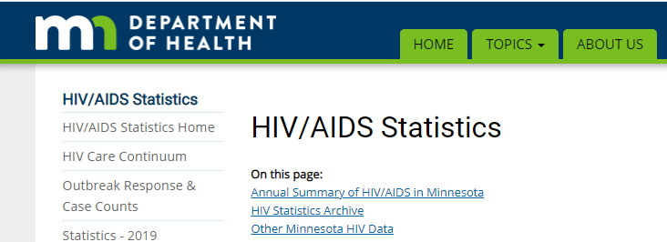
Where to access 2020 HIV annual data
www.health.state.mn.us/diseases/hiv/stats/index.html
Notes:
Please note that The information that we will present is just a snapshot of the data available on our website at www.health.state.mn.us

Slide 4
New HIV diagnoses in Minnesota, 2020
Notes:
We will first discuss highlights from data about new HIV diagnoses reported during 2020.

Slide 5
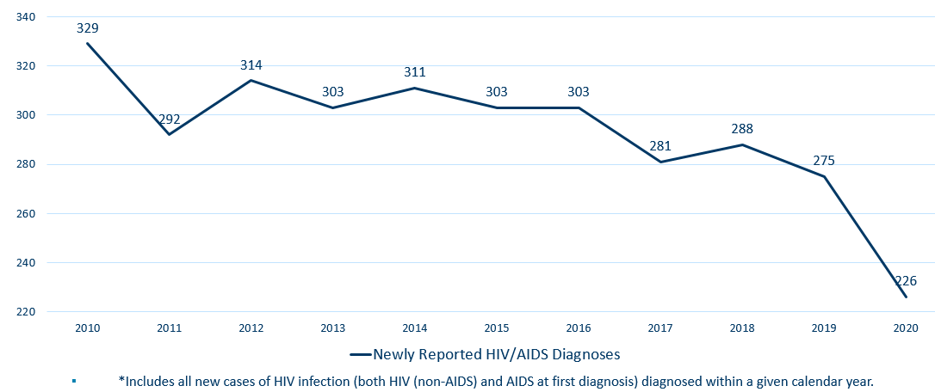
New HIV Disease Diagnoses*
HIV/AIDS Cases by Year, 2010-2020
Notes:
In this report, the term “new HIV diagnoses” refers to people living with HIV, are Minnesota residents who were diagnosed in a particular calendar year, and have had their status reported to MDH. This includes people whose first diagnosis of HIV is AIDS (AIDS at first diagnosis). HIV diagnoses data are displayed by earliest known date of HIV diagnosis.
In 2020, there was a notable decrease of 17% of new HIV diagnoses from 2019. In 2020 there were 226 newly diagnosed cases compared to 275 cases in 2019.
In reviewing newly diagnosed cases since 2016, 226 cases for 2020 is below the 5-year average of 274 cases per year. In reviewing newly diagnosed cases since 2010, 226 cases for 2020 represents a 31% decrease in new cases since 2010.
We acknowledge that 2020 was an exceptional year, due to the COVID-19 pandemic. It is currently unclear whether this is a true decrease in new HIV infections. We continue to monitor and provide updates as more information is collected.

Slide 6
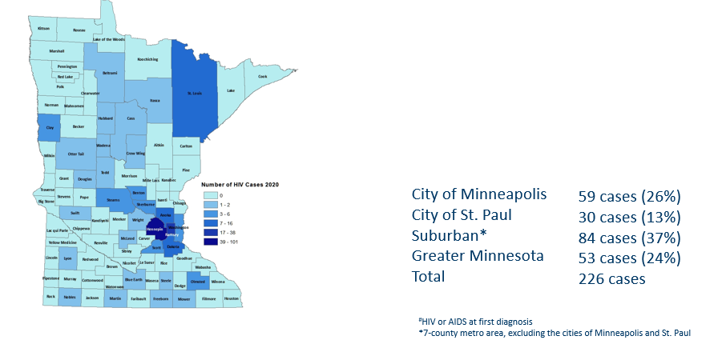
HIV Diagnoses# by County of Residence at Diagnosis, 2020
Notes:
Historically, about 80% of new HIV infections diagnosed in Minnesota have occurred in Minneapolis, St. Paul and the surrounding seven-county metropolitan area.
In 2020, of 226 total HIV diagnoses, 76% of the cases located in the seven county Twin Cities metro region with 26% in Minneapolis, 13% in St. Paul, and 37% in the remaining suburban area (excluding Minneapolis/St. Paul). In greater Minnesota, there were 53 newly diagnosed HIV cases in 33 counties.

Slide 7
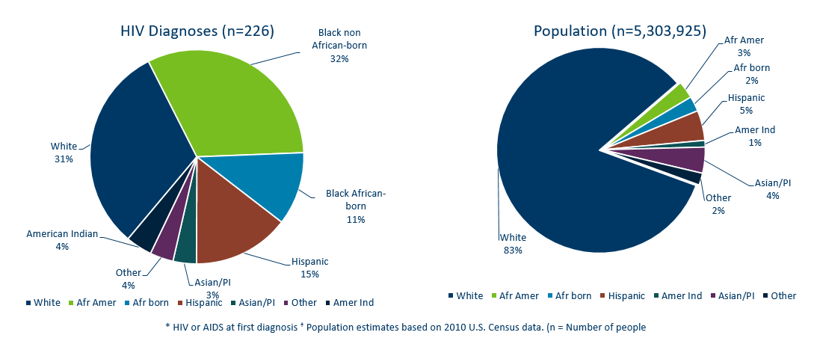
HIV Diagnoses* in Year 2020 and General Population in Minnesota by Race/Ethnicity
Notes:
When you look at the racial/ethnic distribution of new HIV diagnoses [at LEFT] compared to the corresponding racial/ethnic distribution of the general population of Minnesota [at RIGHT], it is apparent that disparities continue to exist among people of color. Non-Hispanic African-American and Black African-born Minnesotans jointly make up about 5% of the population in Minnesota, yet account for 43% of the newly diagnosed cases of HIV in 2020. Similarly, Hispanic people of any race also account for approximately 5% of the population, but account for 15% of the newly diagnosed cases.

Slide 8
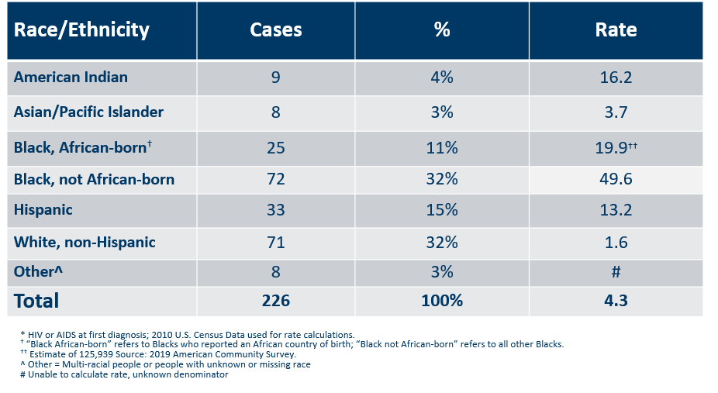
Number of Cases and Rates (per 100,000 people) of HIV Diagnoses* by Race/Ethnicity† Minnesota, 2020
Notes:
Each year we calculate the rate of diagnosis for each racial/ethnic group represented in the surveillance system to assess the impact of HIV within each community. The rate takes into account the size of the population of each group.
Non-Hispanic black, African-born and African-Americans had the highest rate of diagnoses in 2020 with 19.9 HIV diagnoses per 100,000 population and 49.6 HIV diagnoses per 100,000 population respectively. For African-Americans who are not African born, this represents a rate that is 31 times higher than the white non-Hispanic population in Minnesota. The rate among African-born, non-Hispanic population is nearly 12 times higher than white non-Hispanic population. (Note: Rates for black, African-American and black, African-born are not comparable to previous years due to a 6,000 decrease in the estimate for black, African-born population since 2019.)
Hispanic people of any race have the next highest rate of newly diagnosed HIV cases in Minnesota at 13.2 per 100,000 people; this is a rate 8 times higher than white, non-Hispanic people.
American Indians have a rate of people newly diagnosed with HIV of 16.2 per 100,000 people, over ten times the rate of white, non-Hispanic people.

Slide 9
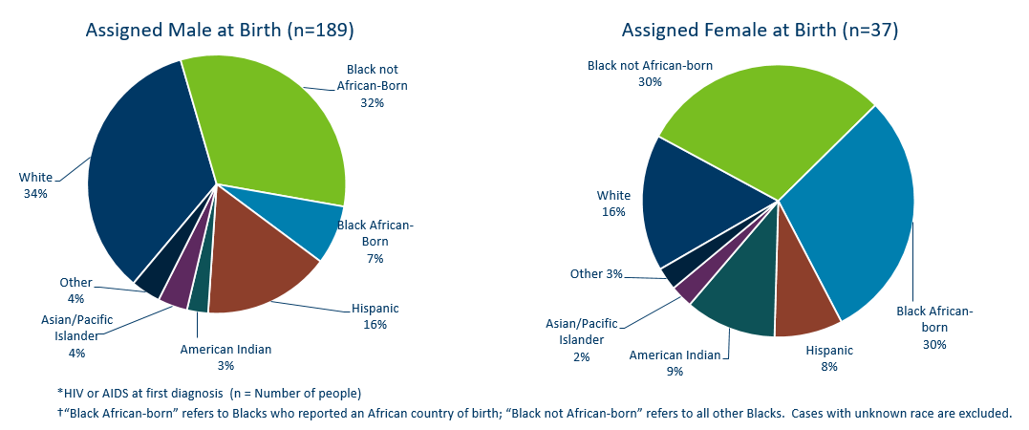
HIV Diagnoses* Diagnosed in Year 2020 by Sex Assigned at Birth and Race/Ethnicity†
Notes:
There are differences in the racial/ethnic distribution by sex assigned at birth. Left to right are data for people assigned Male and Female at birth.
On the LEFT, among 189 people assigned the sex of male at birth, 34% of the 2020 cases diagnosed in Minnesota are Non-Hispanic white [seen in dark BLUE]. Non-Hispanic Black, non-African born [In light GREEN] and black, African-born males [light BLUE] made up 39% of cases and Hispanic males of any race accounted for 16% of cases.
ON the RIGHT, among the 37 people assigned the sex of female at birth, the disparities of new HIV diagnoses are even more apparent among people of color. They represent 81% of new HIV cases assigned female at birth vs 62% of new HIV cases assigned male at birth. Greater than half of diagnoses among people assigned female sex at birth, or 60% combined, are Black, African-born and non-African born.

Slide 10
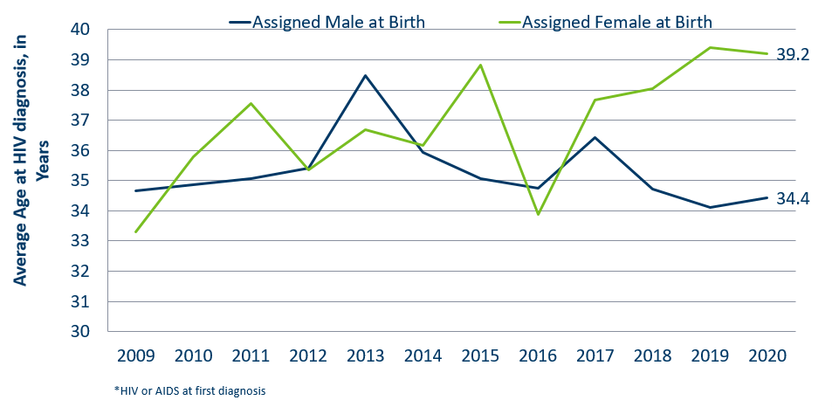
Average Age at HIV Diagnosis* by Sex Assigned at Birth, 2009-2020
Notes:
Looking at the average age at diagnosis in 2020, people assigned female sex at birth [In GREEN] were 5 years older on average (at 39 years of age) compared to people assigned male at birth.

Slide 11
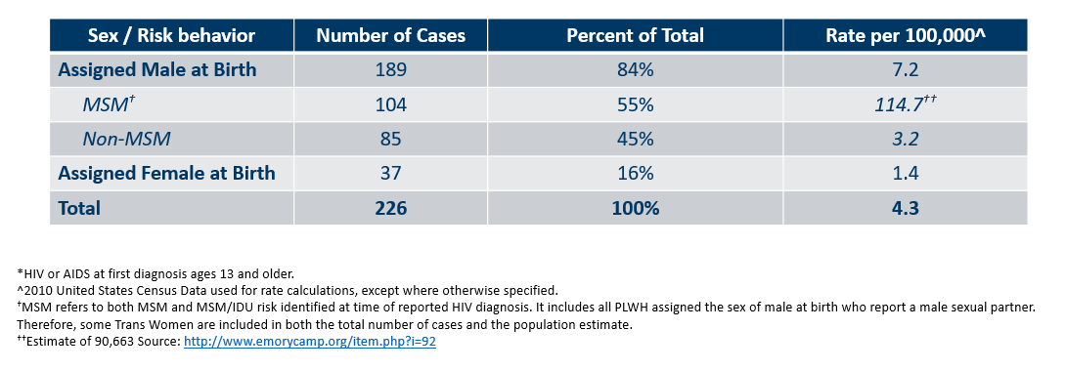
Number of Cases and Rates (per 100,000 people) of Adults and Adolescents* Diagnosed with HIV/AIDS by Sex Assigned at Birth and Risk† in Minnesota, 2020
Notes:
Here we look at cases and rates of the 226 new HIV infections by sex assigned at birth and reported sexual behavior.
By sex assigned at birth….
The number of cases among people assigned male at birth have remained stable, with 189 of 226 new HIV cases. However, In 2020, the number of infections among people assigned female at birth decreased from 76 cases in 2019 to 37 cases in 2020. The reason for this decrease is currently unknown.
As a result, people assigned male at birth represent 84% of all new HIV diagnoses- which is an increase from previous years.
Looking further at data by risk behavior….
Men who have Sex with Men, or MSM, have the highest rate of HIV diagnosis than any other sub-category. In 2020, the estimated rate of HIV diagnosis among MSM was 114.7 per 100,000 population. This is nearly 38 times higher than the rate among non-MSM men.
It’s important to note that MSM contains cases from all racial/ethnic categories and therefore, cannot be directly compared to the rates on the previous slide. For more information on how this rate was estimated, see the HIV Surveillance Technical Notes which are available on our website.

Slide 12
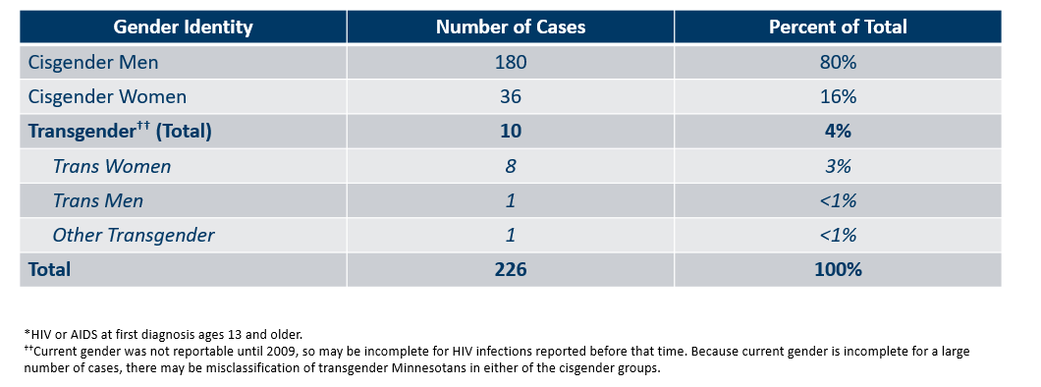
Number of Cases of Adults and Adolescents* Diagnosed with HIV/AIDS by Gender Identity in Minnesota, 2020
Notes:
This slide shows the number of people living with HIV/AIDS by gender identity. In 2020, there were 10 transgender newly reported HIV cases in Minnesota (8 Trans Women, 1 Trans Man, and 1 additional Transgender identities). This represents 4% of new cases reported in the state.

Slide 13
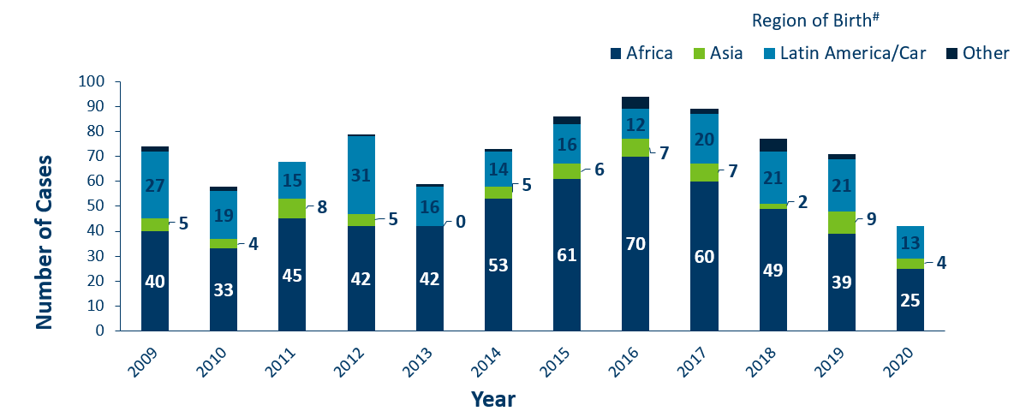
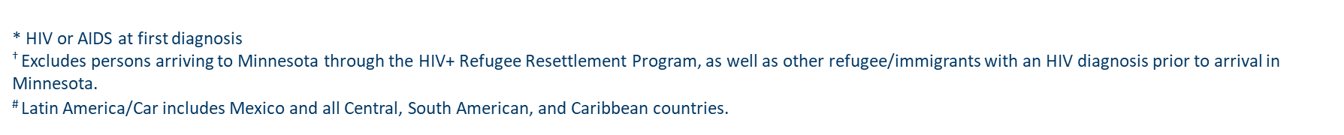
HIV Diagnoses* Among Foreign-Born People† in Minnesota by Year and Region of Birth
2009 - 2020
Notes:
This slides describes HIV diagnoses by global region of birth among people who are foreign-born. In general, the number of new HIV infection diagnoses among foreign-born people in Minnesota has steadily increased from 20 cases in 1990 to an average of 83 cases in the previous 5 years (since 2015). This increase has been largely driven by the increase of cases among African-born people, as well as, people from Mexico, Central and South America and the Caribbean.
In 2020, there were 44 cases of newly reported HIV among foreign-born people. Although in general foreign-born cases are a relatively small number, this is a decrease of 38% since 2019 (n=71). This is about one out of five of all new cases. The majority of foreign-born cases in 2020 were from Africa [25 of 44 cases, at bottom in DARK BLUE], followed by Latin America and the Caribbean [13 of 44 cases at top in LIGHT BLUE]. Among new HIV infections diagnosed in 2020, 44 (18%) were among foreign-born people.

Slide 14
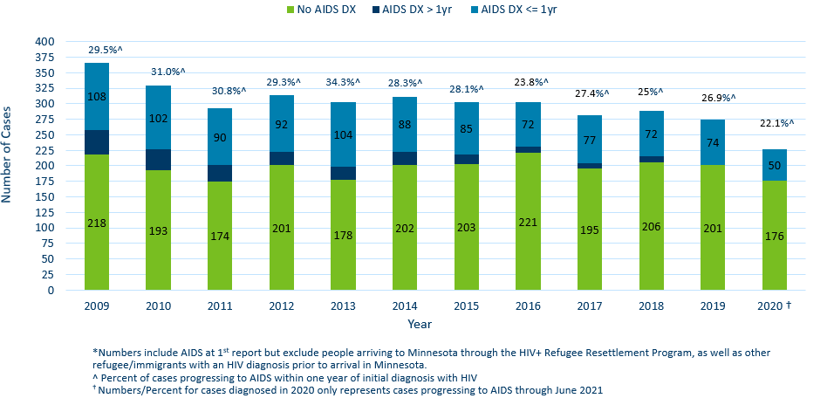
Time of Progression to AIDS for HIV Diagnoses in Minnesota*
2009 - 2020†
Notes:
Now, let’s look at Time of Progression to AIDS and “late testers”. Historically, foreign-born people have had a higher proportion of late-testers.
This statistic helps MDH monitor whether new HIV infections are detected early, before AIDS diagnosis. When people get diagnosed early they have the ability to get on treatment that can reduce their viral load to undetectable levels… and ultimately… reduce community transmission risk. Known as U=U or undetectable equals untransmittable, the science is clear: when people have undetectable viral loads, they can't pass HIV through sex to their partners.
[In BLUE] Late testers are defined as anyone with an AIDS diagnosis within one year of their initial HIV diagnosis. They represent missed opportunities for early intervention.
In 2019, 26.9% of new cases were late testers (2019 data followed-up to June 2020. Currently being updated with 2020 follow-up data). This proportion of cases has remained relatively the same over the past 10 years, ranging between 23-34%. Most late testers, about 85%, are diagnosed with AIDS at the same time they are initially diagnosed with HIV infection.
For 2020. 22% (or 50 of 226) of new HIV cases were “late testers” to date, which represents only a partial follow-up year through April 2021. Please note that cases diagnosed in 2020 may not encompass all cases diagnosed – since a full year of observation is required to capture progress to AIDS within a year (which would end later this year in December 2021).

Slide 15
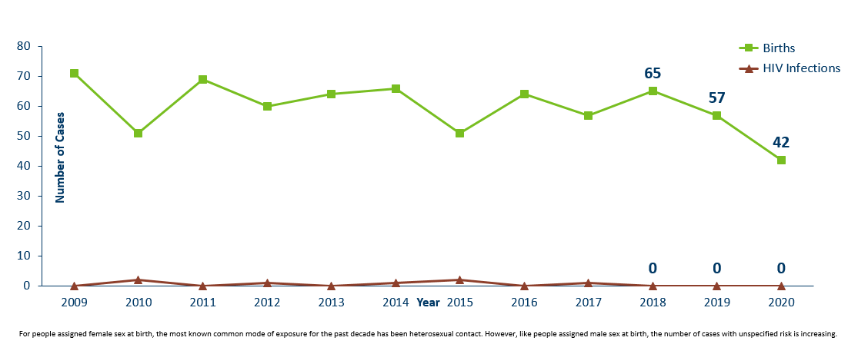
Births to Pregnant People Living with HIV and Number of Perinatal Acquired HIV Infections* by Year of Birth, 2009- 2020
Notes:
The ability to interrupt the transmission of HIV from pregnant person to child via antiretroviral therapy and appropriate perinatal care is an important accomplishment in the history of the HIV/AIDS epidemic. Without antiretroviral therapy, newborn HIV infection rates range from 25-30%, but decrease to 1-2% with appropriate medical intervention. The rate of transmission has decreased from 15% between 1994 and 1996 to 0.0% in the past three years (2018-2020).
For the past decade, the number of births to pregnant parents with HIV has ranged between 51-69 births (2010-2019).
For 2020, there was a decrease to 42 births to pregnant parents with HIV. There were no perinatal HIV cases to a pregnant person with HIV in Minnesota in 2020.

Slide 16
People Living with HIV/AIDS in Minnesota
Notes:
Now we will talk about prevalence, or the cumulative number of people diagnosed with HIV and reported to the Minnesota Department of Health, and still believed to be living in the state. The HIV surveillance system is dynamic, with information being entered daily. These numbers are a snapshot as of the end of 2020, based on what was reported to the health department.

Slide 17
Estimated Number of people Living with HIV/AIDS in Minnesota
As of December 31, 2020 9,422* people are assumed alive and living in Minnesota with HIV/AIDS. This includes:
  5,247 (56%) living with HIV infection (non-AIDS)
  4,175 (44%) living with AIDS
This number includes 2,540 people who were first reported with HIV or AIDS elsewhere and subsequently moved to Minnesota
This number excludes 1,629 people who were first reported with HIV or AIDS in Minnesota and subsequently moved out of state
*This number includes people with Minnesota reported as their current state of residence, regardless of residence at time of diagnosis. It also includes state prisoners and refugees arriving through the HIV+ Refugee Resettlement Program, as well as HIV+ refugees/immigrants arriving through other programs.
Notes:
As of December 31, 2020, there were estimated to be 9,422 people alive and living with HIV/AIDS in Minnesota. This number included 5,247 (56%) living with HIV that had not progressed to an AIDS diagnosis and 4,175 (44%) living with AIDS. This number also included 2,540 people who were first reported with HIV or AIDS elsewhere and now live in Minnesota and excluded 1,629 people first reported with HIV or AIDS in Minnesota who now live out of state.

Slide 18
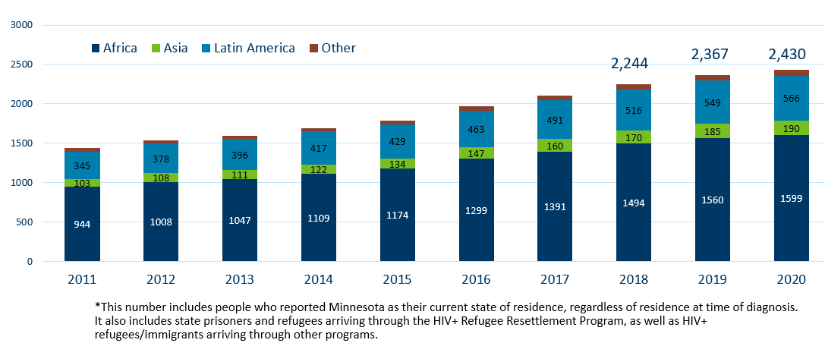
Foreign Born People Living with HIV/AIDS in Minnesota* by Region of Birth, 2011-2020
Notes:
One particular population of interest in Minnesota that sets us apart from other states is our larger foreign-born population of people living with HIV. Between 1990 and 2020, the number of foreign-born people living with HIV/AIDS in Minnesota increased substantially, especially among the African-born population. In 1990, 50 foreign-born people were reported to be living with HIV/AIDS in Minnesota, and by 2007 this number had increased to 1,126 people. In 2020, the total number of foreign-born people living with HIV/AIDS in Minnesota was 2,430, a 3% increase from 2019. The majority of these people immigrated to the United States from Africa and Latin America. This trend illustrates the growing diversity of the population of people living with HIV in Minnesota and the need for culturally appropriate HIV care and prevention efforts.

Slide 19
Additional Topics
Notes:
Now we’ll discuss a couple additional topics of particular relevance this year.

Slide 20
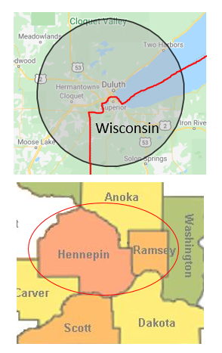
HIV Outbreaks in Hennepin/Ramsey Counties
& Duluth Region
Duluth area Outbreak
Declared 3/2021
Cases (N=15)*
Hennepin/Ramsey Counties Outbreak
Declared 2/2020
People who inject drugs
Cases (N=71)*
* Data counts as of 6/2/21
People at high-risk in the current outbreaks:
  People who use injection drugs (PWID) or share needles/works
  People experiencing homelessness or unstable housing
  People who exchange sex for income or other items they need
Notes:
Minnesota has seen an increase of HIV in the Duluth area (30 mile radius) and *among certain populations in Hennepin and Ramsey Counties. The Duluth area declared an outbreak in 2021 with cases dating back to 2019; MDH is coordinating investigations with Wisconsin. An outbreak was declared in Hennepin and Ramsey counties among people who inject drugs (PWID) in 2020 with cases dating back to 2018.
Minnesota's outbreak-associated cases have risk factors consistent with the national outbreaks.
People at high risk in the current outbreaks include:
People who use injection drugs or share needles/works.
People experiencing homelessness or unstable housing.
People who exchange sex for income and other items they need.
For more information, please see our updated HIV statistics website, described at the end of the presentation.

Slide 21
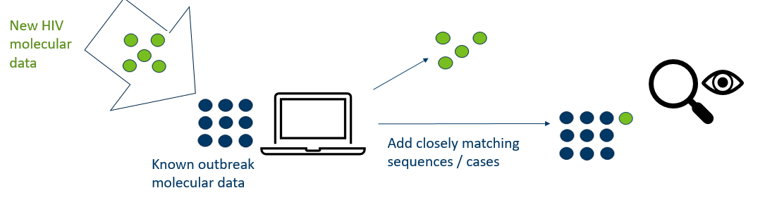
Molecular Tools for Outbreak Monitoring
To address data privacy concerns:
Molecular data is from the HIV virus, and is not a person’s genetic material
Cannot infer causal directionality of infection
HIV virus sequences securely housed at the health department
Notes:
In addition to monitoring the number of cases reported in certain populations, molecular data can also be used to supplement existing outbreak investigation methods. We have been doing this with our current outbreaks. This approach compares HIV virus data collected from routine, patient-care laboratory tests.
As illustrated in the slide, imagine that each dot represents a person with diagnosed HIV infection, and their HIV virus molecular data. [in GREEN], as new people with HIV are reported in Minnesota, we compare virus molecular data to existing outbreak cases [in BLUE] using scientifically-established methods and computer software. When new HIV sequences closely match within our threshold, we prioritize those people for interview and linkage to care and treatment.
We can then examine the shared characteristics of matching data, which represent a social network, to more effectively target our outreach efforts moving forward.
At MDH, we understand that this method may be concerning for some community members. We want to address potential concerns about data privacy. First, this small portion of molecular data are from the HIV virus only, and are not a person’s molecular information. Further, one cannot infer causal directionality. However, we continue to take the utmost care in data collection, and HIV virus molecular data are securely-housed at the health department.
For more information, please see the link on our website for a more in-depth presentation about this topic.

Slide 22
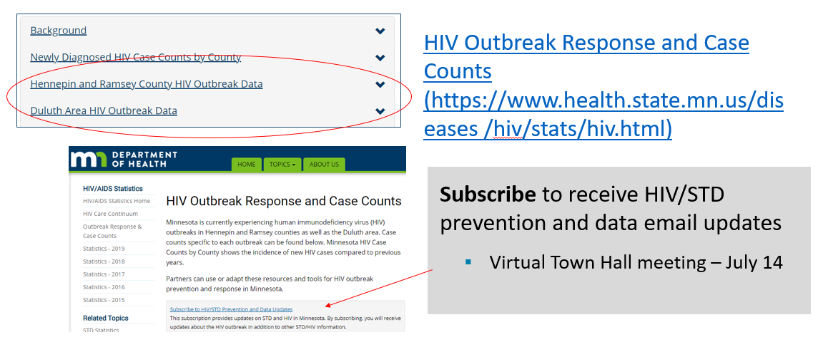
Updated webpage: HIV Outbreak Data
Notes:
In addition to newly diagnosed HIV case counts by county, we recently updated our statistics web page to include information on outbreak data.
Please visit the Minnesota Department of Health HIV pages at www.health.state.mn for additional details.
While you’re here, you can subscribe to our GovDelivery email listserv to receive HIV/STD prevention updates to your email. Please stay tuned via our listserv for the upcoming Town Hall, proposed for July 14.

Slide 23
Thank you.
MDH HIV Epidemiologists
Cheryl.Barber@state.mn.us
Jared.Shenk@state.mn.us
Trent.Daugherty@state.mn.us
Jennifer.Mark@state.mn.us
Notes:
Thank you for your time. If you have questions regarding the slides and annual report you can contact us at the e-mail addresses here on the slide. And again, the full set of slides, text and tables are also available on our website for you to use.

