Slide 1
HIV/AIDS Prevalence and Mortality Report, 2020
HIV/AIDS Surveillance System
http://www.health.state.mn.us/diseases/hiv/stats/index.html

Slide 2
Introduction (I)
These three introduction slides provide a general context for the data used to create this slide set. If you have questions about any of the slides, please refer to the Surveillance Technical Notes.
This slide set displays estimates of the number of people living with HIV/AIDS (prevalence) and mortality in Minnesota by person, place, and time.
The slides rely on data from HIV/AIDS cases diagnosed through 2020 and reported to the Minnesota Department of Health (MDH) HIV/AIDS Surveillance System, which is part of the National HIV/AIDS Surveillance System (NHSS).

Slide 3
Introduction (II)
Data analyses exclude people diagnosed in federal or private correctional facilities, but include people incarcerated by the state (number of people incarcerated by the state believed to be living with HIV/AIDS as of 2020 = 20)
Data analyses for new infections exclude people arriving in Minnesota through the HIV+ Refugee Resettlement Program (number of primary HIV+ refugees in this program living in Minnesota as of December 31, 2020 = 163), as well as other refugees/immigrants reporting a positive test prior to their arrival in Minnesota (n = 167).
Some limitations of surveillance data:
Do not include people living with HIV who have not been tested for HIV
Do not include people whose positive test results have not been reported to MDH
Do not include people living with HIV who have only tested anonymously
Case numbers for the most recent years may be undercounted due to delays in reporting
Reporting of living cases that were not initially diagnosed in Minnesota is known to be incomplete, as well as transfer of living cases that have moved to other states from Minnesota. However, since 2018, every jurisdiction funded for HIV surveillance by CDC has been part of a deduplication project in the National HIV Surveillance System.

Slide 4
Introduction (III)
People are assumed to be alive unless MDH has knowledge of their death.
People whose most recently reported state of residence was Minnesota are assumed to be currently residing in Minnesota unless MDH has knowledge of their relocation. Our ability to track changes of residence, including within the state, is limited and subject to reporting delays and incomplete case and lab reporting.
Vital status and current residence are updated through one or more of the following methods:
Standard case and lab reporting
Correspondence with other health departments
Active surveillance
Death certificate reviews (at least annually)
Birth certificate reviews (at least annually, pregnant people only)

Slide 5
National Context

Slide 6
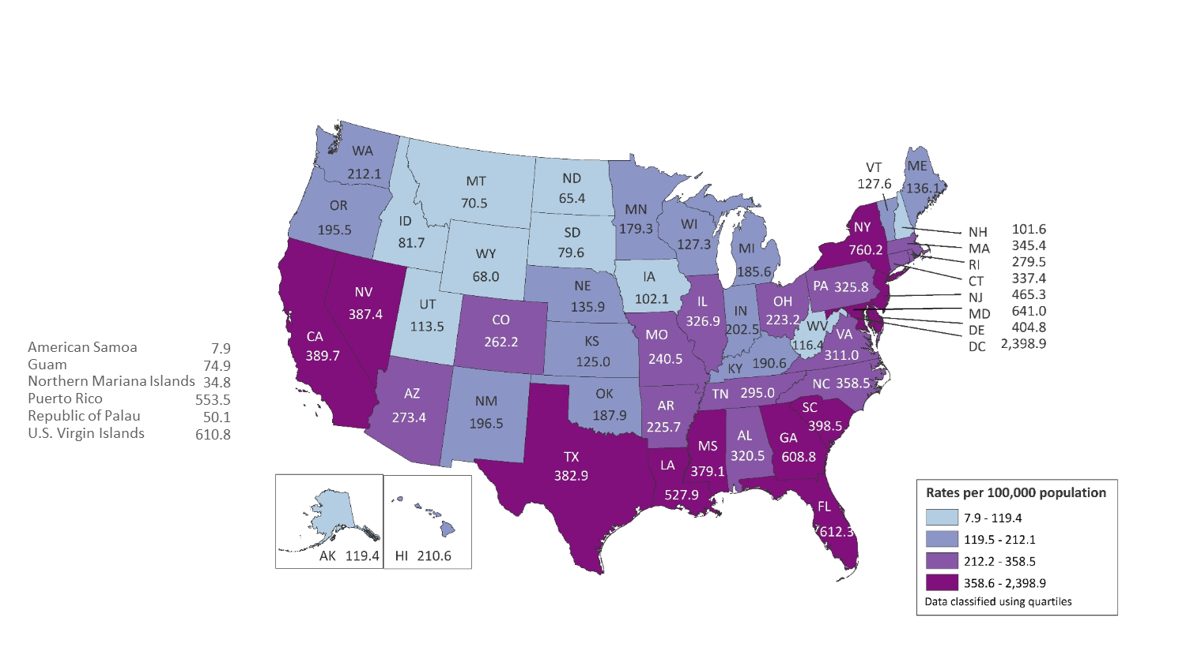
Rates of Adults and Adolescents Living with Diagnosed HIV Infection, by Area of Residence, Year-end 2017—United States and 6 Dependent Areas N = 1,018,346 Total Rate: 369.4
Note. Data are based on address of residence as of December 31, 2017 (i.e., most recent known address).
Notes:
At the end of 2017, the rate of adults and adolescents living with diagnosed HIV infection in the United States and 6 dependent areas was 369.4 per 100,000 population. The rates of adults and adolescents living with diagnosed HIV infection ranged from 7.9 per 100,000 in American Samoa to 2,398.9 per 100,000 in the District of Columbia.
The District of Columbia (i.e., Washington, DC) is a city; use caution when comparing the rate of persons living with diagnosed HIV infection in DC with the rates in states.
Data are based on address of residence as of December 31, 2017 (i.e., most recent known address).

Slide 7
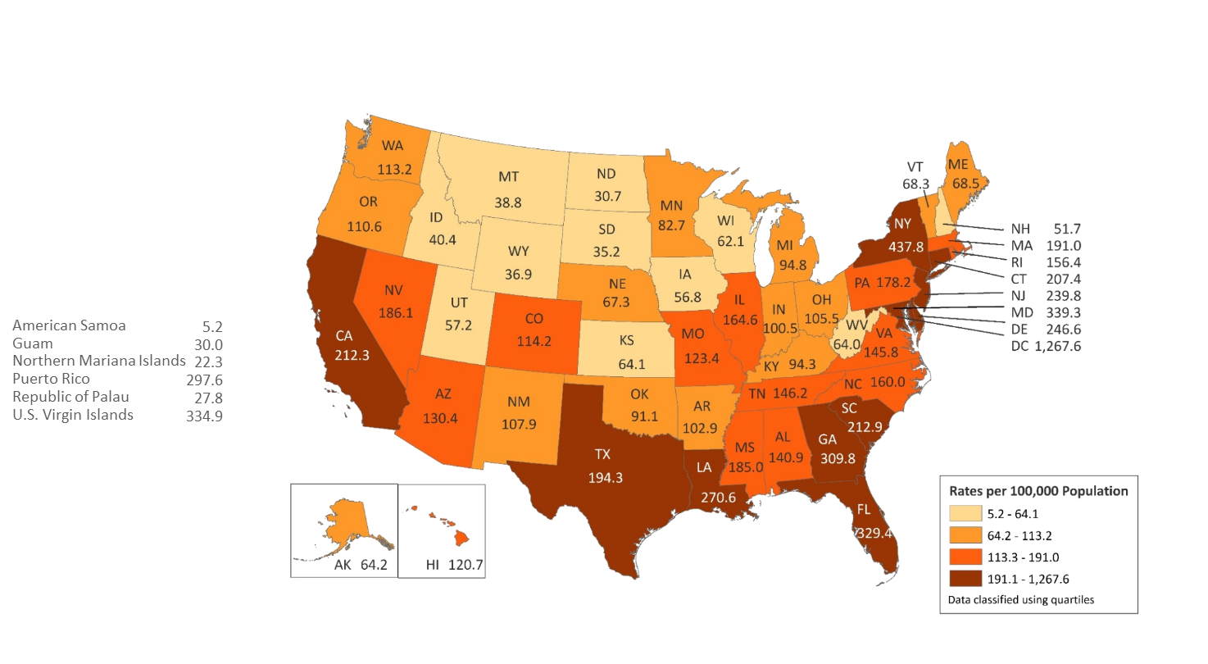
Rates of Adults and Adolescents Living with Diagnosed HIV Infection Ever Classified as Stage 3 (AIDS), by Area of Residence, Year-end 2017—United States and 6 Dependent Areas N = 533,556 Total Rate: 193.6
Note. Data are based on address of residence as of December 31, 2017 (i.e., most recent known address).
Notes:
At the end of 2017, the rate of adults and adolescents in the United States living with diagnosed HIV infection ever classified as stage 3 (AIDS) was 193.6 per 100,000. The rates of adults and adolescents living with diagnosed HIV infection ever classified as stage 3 (AIDS) ranged from 5.2 per 100,000 in American Samoa to 1,267.6 per 100,000 in the District of Columbia.
The District of Columbia (i.e., Washington, DC) is a city; use caution when comparing the rate of persons living with diagnosed HIV infection in DC with the rates in states.
Data are based on address of residence as of December 31, 2017 (i.e., most recent known address).

Slide 8
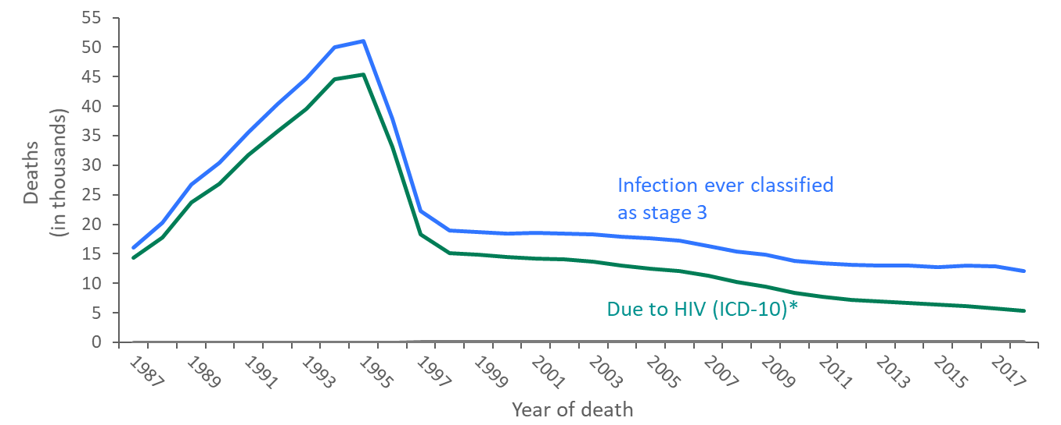
Comparison of Deaths among Persons with HIV Ever Classified as Stage 3 (AIDS) in National HIV Surveillance System and Deaths Reported in Death Certificates in which HIV was the Underlying Cause of Death, 1987−2018—United States
*For comparison with data for 1999 and later years, data for 1987−1998 were modified to account for ICD-10 rules instead of ICD-9 rules.
Notes:
The annual number of deaths of people with HIV Infection ever classified as stage 3 (AIDS) (some of which were not caused by HIV stage 3), as reported to the National HIV Surveillance System through December 31, 2019, was 10% to 46% (depending on the year) greater than the number of deaths attributed to HIV infection in death certificate data (by ICD-10 rules for selecting the underlying cause of death). The greater number of deaths of persons with stage 3 is partly because some persons with HIV infection classified as stage 3 die of causes not attributable to HIV infection, such as motor vehicle accidents, and partly because some deaths due to HIV infection are not reported as such on death certificates.
The blue line represents data from the National HIV Surveillance System.
The green line represents death certificate data compiled by the National Center for Health Statistics.

Slide 9
Overview of HIV/AIDS in Minnesota

Slide 10
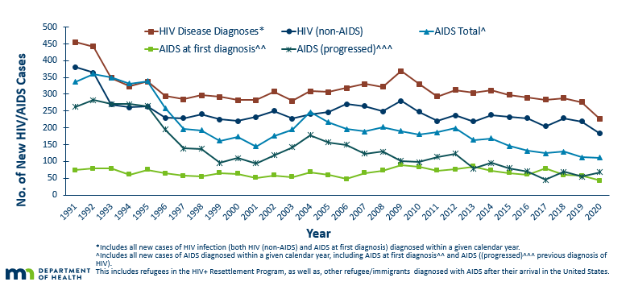
New HIV Disease Diagnoses, HIV (non-AIDS) and AIDS Cases by Year, 1991-2020
Notes:
Nationally, Minnesota is considered within the low to moderate risk of HIV and AIDS infections as defined by the Centers for Disease Control and Prevention (CDC). The annual number of new HIV and AIDS cases increased steadily from the beginning of the epidemic to the early 1990s. Beginning in 1996, both the number of newly diagnosed AIDS cases and the number of deaths among AIDS cases declined sharply, primarily due to the success of new antiretroviral therapies including protease inhibitors. These treatments do not cure but can delay progression to AIDS among persons with HIV (non-AIDS) infection and improve survival among those with AIDS. These treatments have been shown to be effective at preventing transmission of HIV. Over the past five years, the number of HIV/AIDS cases diagnosed has remained relatively stable with a 5-year average of 275 cases diagnosed each year. By the end of 2020, an estimated 9,422 persons with HIV/AIDS were assumed to be living in Minnesota.
This number includes persons whose most recently reported state of residence was Minnesota, regardless of residence at time of diagnosis. This estimate does not include persons with undiagnosed HIV infection.
In 2020, there was a decrease of new HIV diagnoses from 2019. In 2019, there were 226 newly diagnosed cases compared to 276 cases in 2019. This represents a decrease of about 18% compared to 2019. This change may have been impacted by the covid-19 pandemic.

Slide 11
People Living with HIV/AIDS in Minnesota

Slide 12
Estimated Number of People Living with HIV/AIDS in Minnesota
As of December 31, 2020 9,422* people are assumed alive and living in Minnesota with HIV/AIDS. This includes:
5,247 (56%) living with HIV (non-AIDS)
4,175 (44%) living with AIDS
This number includes 2,540 people who were first reported with HIV or AIDS elsewhere and subsequently moved to Minnesota
This number excludes 1,629 people who were first reported with HIV or AIDS in Minnesota and subsequently moved out of state
*This number includes people with Minnesota reported as their current state of residence, regardless of residence at time of diagnosis. It also includes people incarcerated by the state and refugees arriving through the HIV+ Refugee Resettlement Program, as well as HIV+ refugees/immigrants arriving through other programs.

Slide 13
Place

Slide 14
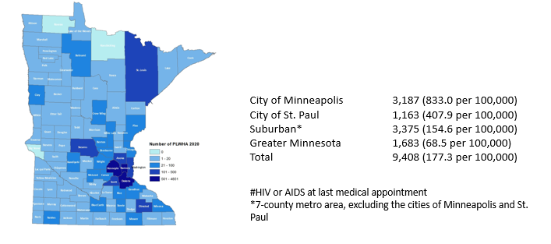
Minnesotans Living with HIV# by County of Current Residence, 2020
Notes:
In 2020, among prevalent HIV cases in Minnesota, the majority clustered in the twin cities metro area with the highest rates of infection in the cities of Minneapolis and Saint Paul, followed by the suburban areas and then Greater Minnesota.

Slide 15
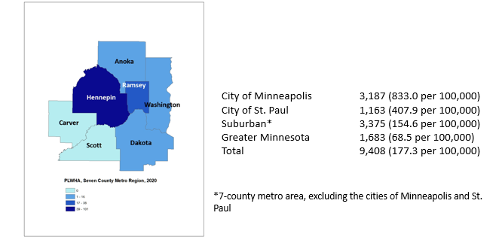
Minnesotans Living with HIV by Metro* County, 2020
Notes:
In 2020, within the twin cities metro area, the highest rates of prevalent HIV infection were in the cities of Minneapolis and Saint Paul.

Slide 16
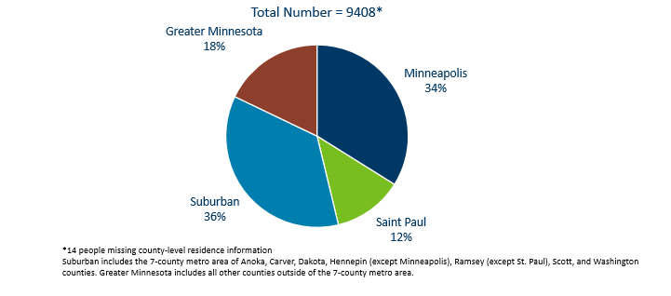
People Living with HIV/AIDS in Minnesota by Current Residence, 2020
Notes:
Overall, of the 9,422 people living with HIV/AIDS for whom complete residence information is available, 34% of all people living with HIV/AIDS in Minnesota live in the city of Minneapolis, along with 36% living in the surrounding suburban area. People living with HIV/AIDS in Greater Minnesota account for 18% of all people living with HIV/AIDS. Finally, people living with HIV/AIDS in Saint Paul account for 12% of all people living with HIV/AIDS.

Slide 17
Sex Assigned at Birth, Gender Identity, and Race/Ethnicity

Slide 18
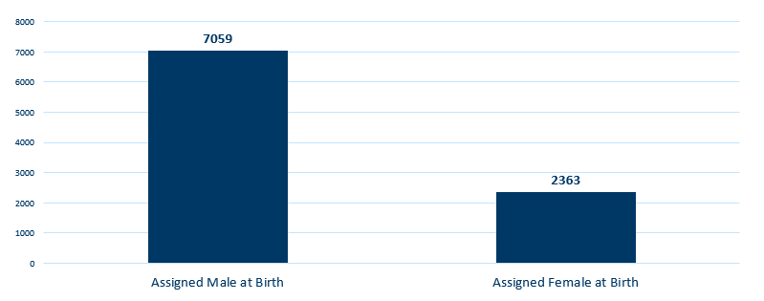
People Living with HIV/AIDS in Minnesota by Sex Assigned at Birth, 2020
Notes:
Seventy-five percent (75%) of prevalent HIV/AIDS cases were assigned the sex of male at birth, while twenty-five percent (25%) were assigned the sex of female at birth.

Slide 19
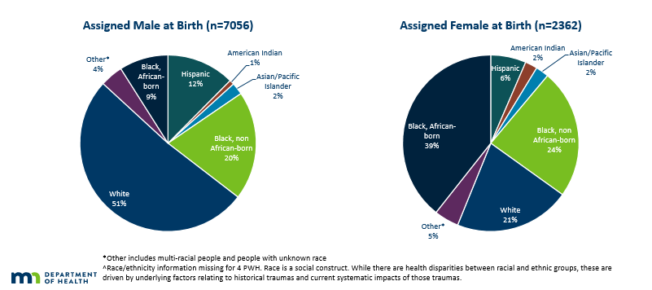
People Living with HIV/AIDS in Minnesota by Sex Assigned at Birth and Race/Ethnicity^, 2020
Notes:
Seventy-five percent (75%) of prevalent HIV/AIDS cases are were assigned the sex of male at birth. Broken down by race/ethnicity, 51% of male cases are white, 20% Black not African-born, 12% are Hispanic, 9% are African-born, 1% are American Indian, 2% are Asian/Pacific Islander, and 4% are people of multiple or unknown race. In total, 49% of males living with HIV/AIDS are among men of color; whereas only 17% of the general male population are people of color. Among cases who were assigned the sex of female at birth, the distribution is even more skewed toward women of color: 39% are African-born, 24% are Black not African-born, 21% are white, 6% are Hispanic, 2% are American Indian, 2% are Asian/Pacific Islander, and 5% are perople of multiple or unknown race. Thus, 79% of prevalent female HIV/AIDS cases are among women or color whereas only 17% of the general female population in Minnesota is comprised of women of color.
Please note that race is not considered a biological reason for disparities related to HIV/AIDS experienced by people of color. Race is a social construct, and while there are health disparities between racial and ethnic groups, these are driven by underlying factors relating to historical traumas and current systematic impacts of those traumas.

Slide 20
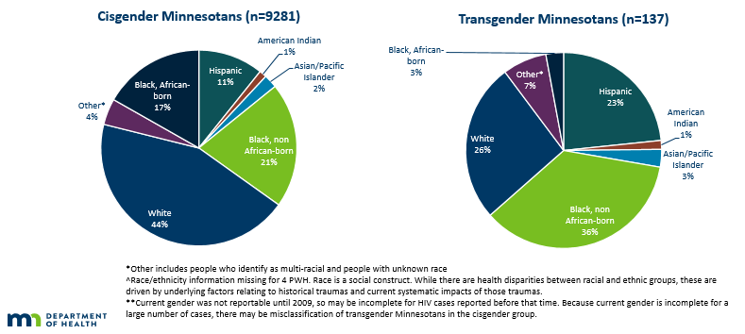
People Living with HIV/AIDS in Minnesota by Gender Identity** and Race/Ethnicity^, 2020
Notes:
Ninety-nine (99%) of prevalent HIV/AIDS cases are cisgender. Broken down by race/ethnicity, 44% of cisgender cases are white, 21% Black non African-born, 17% are African-born, 11% are Hispanic,1% are American Indian, 2% are Asian/Pacific Islander, and 4% are people of multiple or unknown race. In total, 56% of cisgender Minnesotans living with HIV/AIDS are among people of color; whereas only 17% of the general population are people of color. Among transgender Minnesotans living with HIV, the distribution is even more skewed toward people of color: 36% are Black not African-born, 26% are white, 23% are Hispanic, 3% are African-born, 1% are American Indian, 3% are Asian/Pacific Islander, and 7% are people of multiple or unknown race. Thus, 74% of prevalent transgender HIV/AIDS cases are among people of color whereas only 17% of the general population in Minnesota is comprised of people of color.
Please note that race is not considered a biological reason for disparities related to HIV/AIDS experienced by people
of color. Race is a social construct, and while there are health disparities between racial and ethnic groups, these are driven by underlying factors relating to historical traumas and current systematic impacts of those traumas.

Slide 21
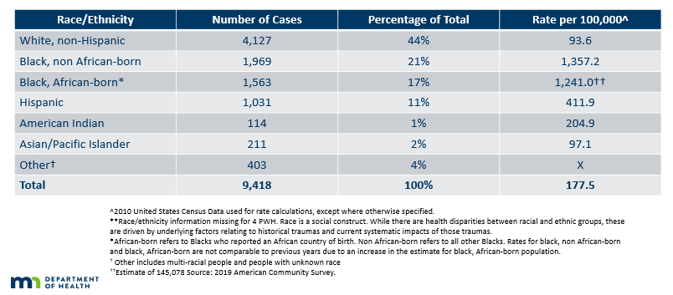
Number of Cases and Rates (per 100,000 people) of People Living with HIV/AIDS by Race/Ethnicity** in Minnesota, 2020
Notes:
While white people account for the greatest number of people living with HIV/AIDS in Minnesota (4,127 cases), they have one of the lowest rates of people living with HIV/AIDS (93.6 per 100,000 people). Black, African-born people account for 1,563 cases living with HIV/AIDS in Minnesota, however since this population makes up a small proportion of the overall population in Minnesota, the rate of people living with HIV/AIDS in this community is higher than other races and ethnicities. The rate of African-born people living with HIV/AIDS is 1,241.0 per 100.000 people; this is a rate of more than 13 times greater than white, non-Hispanic people. Black, non African-born people also have higher rates of people living with HIV/AIDS at 1,357.2 per 100,000 people; this is more than 14 times higher than the rate among white people. Hispanic people have the next highest rate of people living with HIV/AIDS in Minnesota at 411.9 per 100,000; this is a rate of more than 4 times higher than white, non-Hispanic people. American Indians have a rate of people living with HIV/AIDS of 204.9 per 100,000 people; this is a rate more than two times higher than white non-Hispanic people. Finally, Asian/Pacific Islanders have a rate of people living with HIV/AIDS of 97.1 per 100,000; this accounts for an HIV/AIDS rate similar to the rate among white non-Hispanic people. The overall rate of HIV/AIDS in Minnesota is 177.5 per 100,000.

Slide 22
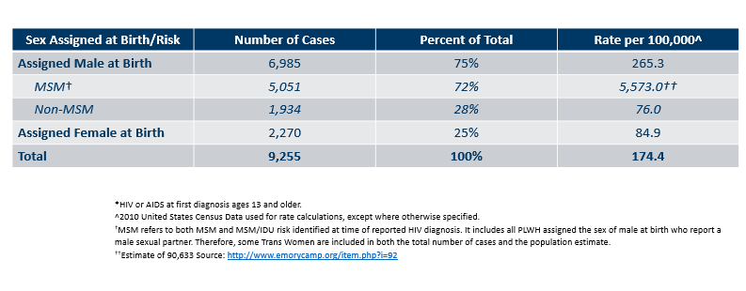
Number of Cases and Rates (per 100,000 people) of Adults and Adolescents* Living with HIV/AIDS by Sex Assigned at Birth and Risk† in Minnesota, 2020
Notes:
Beginning in 2012, MDH began estimating the number of MSM living in Minnesota. This number was updated in 2017 with more recent data from Emory University. Men who have sex with Men have the highest rate of people living with HIV/AIDS than any other sub-group. In 2020, the estimated rate of people living with HIV/AIDS among MSM was 5,573.0 per 100,000 population. This is 73 times higher than the rate among non-MSM men (76.0 per 100,000 population). It’s important to note that MSM contains cases from all racial/ethnic categories and therefore cannot be directly compared to the rates by race/ethnicity. For more information on how this was estimated, see the HIV Surveillance Technical Notes.

Slide 23
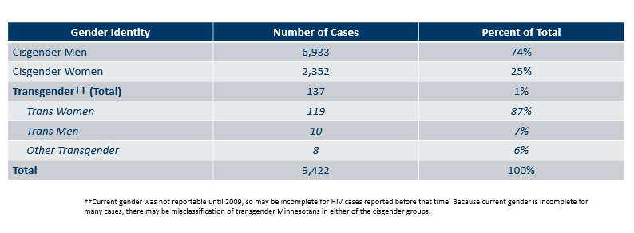
Number of Cases Living with HIV/AIDS by Gender Identity in Minnesota, 2020
Notes:
This slide shows the number of people living with HIV/AIDS by gender identity (male, female, or transgender).
As of 2020, there are 137 transgender people living with HIV/AIDS in Minnesota, of which the majority are trans women (87%). This represents about 1% of people living with HIV/AIDS in the state.

Slide 24
Age

Slide 25
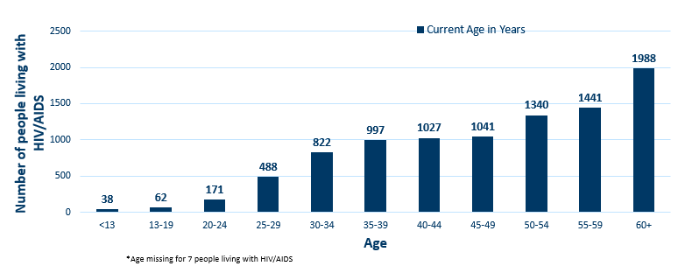
People Living with HIV/AIDS in Minnesota by Age Group*, 2020
Notes:
Over 72% of people living with HIV/AIDS as of 2020 are currently 40 years of age or older. As with new cases, there are differences by sex assigned at birth in the age of living cases.

Slide 26
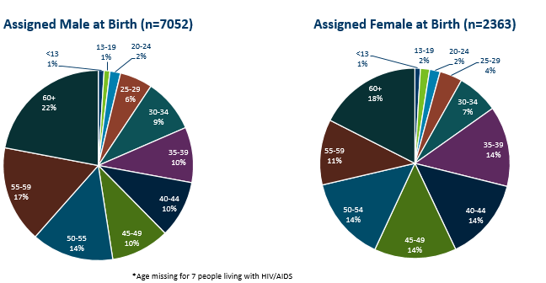
People Living with HIV/AIDS in Minnesota by Age Group* and Sex Assigned at Birth, 2020

Slide 27
Foreign Born Populations

Slide 28
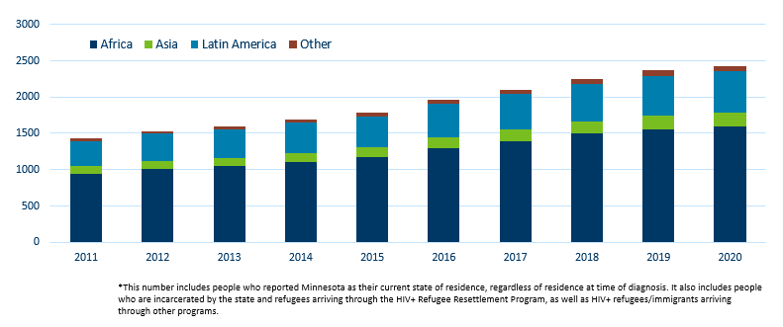
Foreign Born People Living with HIV/AIDS in Minnesota* by Region of Birth, 2011-2020
Notes:
One particular population of interest in Minnesota that sets us apart from other states is our larger foreign-born HIV-positive population. Between 1990 and 2020, the number of foreign-born people living with HIV/AIDS in Minnesota increased substantially, especially among the African-born population. In 1990, 50 foreign-born people were reported to be living with HIV/AIDS in Minnesota, and by 2007 this number had increased to 1,126 people. In 2020, the total number of foreign-born people living with HIV/AIDS in Minnesota was 2,430, a 3% increase from 2019. The majority of these people immigrated to the United States from Africa and Latin America. This trend illustrates the growing diversity of the HIV-positive population in Minnesota and the need for culturally appropriate HIV care and prevention efforts.

Slide 29
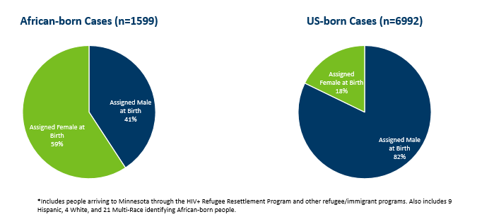
African-Born* People Living with HIV/AIDS Compared to Other Minnesota Cases by Sex Assigned at Birth, 2020
Notes:
The characteristics of foreign-born people living with HIV/AIDS in Minnesota differ from U.S.-born, especially in sex assigned at birth. While females account for 18% of cases among U.S.-born people, they account for 46% of foreign-born cases. This is especially noticeable among African-born cases, where women account for 59% of those living with HIV/AIDS in Minnesota.

Slide 30
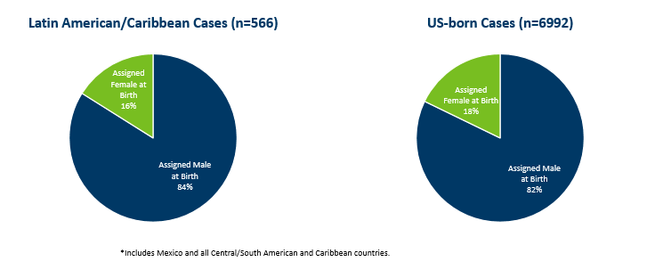
Latin American/Caribbean* People Living with HIV/AIDS Compared to Other Minnesota Cases by Sex Assigned at Birth, 2020
Notes:
The sex assigned at birth distribution among cases born in Latin America/the Caribbean is similar to that of U.S.-born cases, where 16% of prevalent cases are among women.

Slide 31
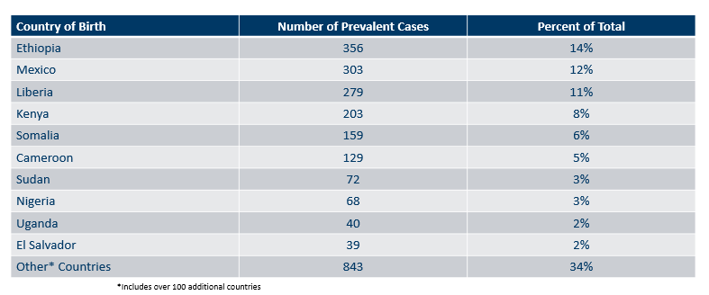
Countries of Birth Among Foreign Born People* Living with HIV/AIDS in Minnesota, 2020

Slide 32
Mortality

Slide 33
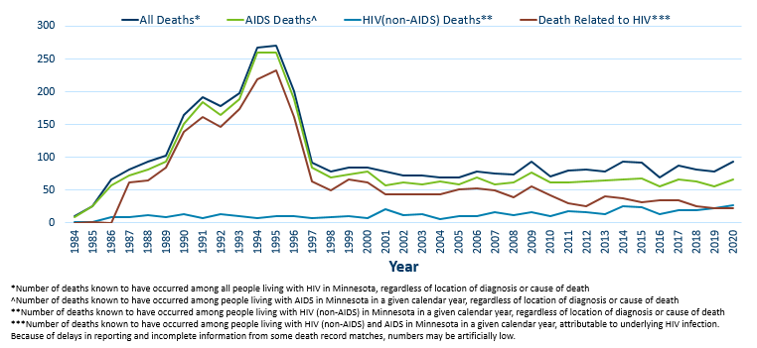
Reported Deaths Among People living with HIV/AIDS in Minnesota, 1984-2020
Notes:
The number of deaths among all people living with HIV in Minnesota decreased dramatically between 1995 and 1997 and has remained relatively constant over the past decade. In 2020, a total of 93 deaths were reported among people living with HIV in Minnesota. The total number of deaths reported in Minnesota for those living with AIDS was 66 (71% of all deaths) in 2020. While overall deaths among people living with HIV/AIDS in Minnesota increased almost 20% from 2019 to 2020, the percentage of those deaths from underlying HIV disease decreased to 25% (23 out of 93 deaths). This was likely due to excess death worldwide related to the covid-19 pandemic.

