Slide 1
HIV/AIDS Incidence Report, 2020
HIV/AIDS Surveillance System
June 2021
Notes:
.

Slide 2
Land Acknowledgement
Every community owes its existence and vitality to generations from around the world who contributed their hopes, dreams, and energy to making the history that led to this moment. Some were brought here against their will, some were drawn to leave their distant homes in hope of a better life, and some have lived on this land for more generations than can be counted. Truth and acknowledgment are critical to building mutual respect and connection across all barriers of heritage and difference.
We begin this effort to acknowledge what has been buried by honoring the truth. We are standing on the ancestral lands of the Dakota people. We want to acknowledge the Dakota, the Ojibwe, the Ho Chunk, and the other nations of people who also called this place home. We pay respects to their elders past and present. Please take a moment to consider the treaties made by the Tribal nations that entitle non-Native people to live and work on traditional Native lands. Consider the many legacies of violence, displacement, migration, and settlement that bring us together here today. Please join us in uncovering such truths at any and all public events.*
*This is the acknowledgment given in the USDAC Honor Native Land Guide – edited to reflect this space by Shannon Geshick, MTAG, Executive Director Minnesota Indian Affairs Council
Notes:
Before we begin our webinar, we take a moment to acknowledge that Minnesota stands on ancestral land of tribal nations… including the Dakota, Ojibwe, Ho Chunk, and other nations. Please take a moment to consider the treaties made by the Tribal nations that entitle non-native people to live and work on traditional Native lands.

Slide 3
New HIV diagnoses in Minnesota, 2020

Slide 4
Introduction (I)
These two introduction slides provide a general context for the data used to create this slide set. If you have questions about any of the slides, please refer to HIV Surveillance Technical Notes.
This slide set describes new HIV diagnoses (including AIDS at first diagnosis) in Minnesota by person, place, and time.
The slides rely on data from HIV/AIDS cases diagnosed through 2020 and reported to the Minnesota Department of Health (MDH) HIV/AIDS Surveillance System.
The data are displayed by year of HIV diagnosis.

Slide 5
Introduction (II)
Data analyses exclude people diagnosed in federal or private correctional facilities but include people incarcerated by the state (number of people incarcerated by the state believed to be living with HIV/AIDS [n=22]).
Data analyses for new HIV diagnoses exclude people arriving to Minnesota through the HIV+ Refugee Resettlement Program (number of primary HIV+ refuges in this program living in MN as of December 31, 2020 = 167), as well as, other refuges/immigrants reporting a positive test prior to their arrival in Minnesota (n=166).
Some limitations of surveillance data:
  Data do not include people living with HIV who have not been tested for HIV
  Data do not include people whose positive test results have not been reported to MDH
  Data do not include people living with HIV who have only tested anonymously
  Case numbers for the most recent years may be undercounted due to delays in reporting
  Reporting of living cases that were not initially diagnosed in Minnesota is known to be incomplete

Slide 6
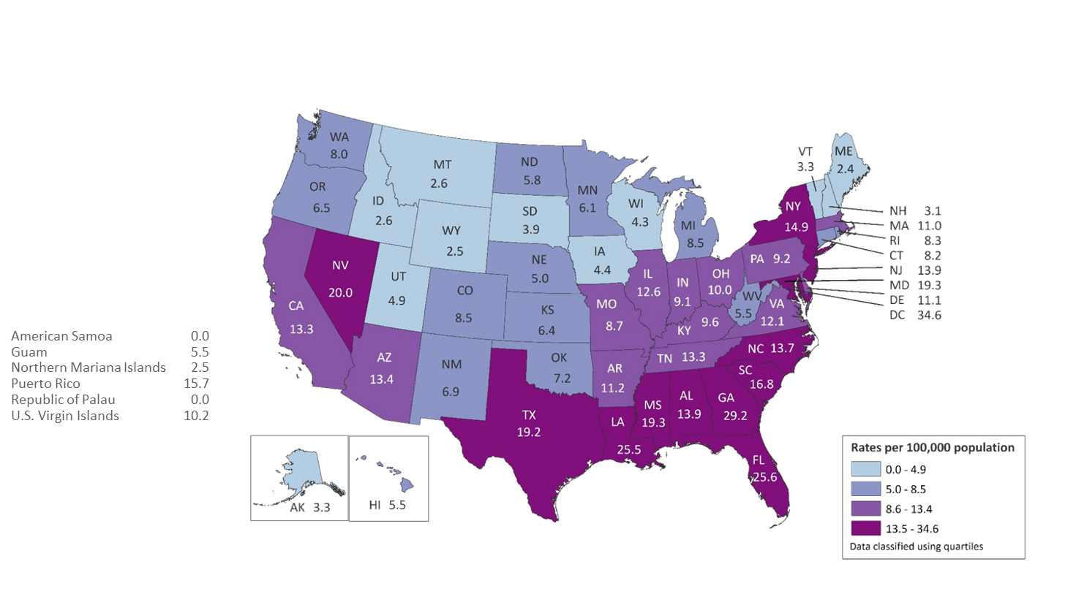
Rates of Diagnoses of HIV Infection among Adults and Adolescents
2018—United States and 6 Dependent Areas
N = 37,741 Total Rate = 13.6
Note. Data for the year 2018 are considered preliminary and based on 6 months reporting delay.
Notes:
Please note that the most recent data available for national context was last prepared for 2017, and published in 2018.
In the United States and 6 dependent areas, the rate of diagnoses of HIV infection among adults and adolescents was 13.6 per 100,000 population in 2018. The rate of diagnoses of HIV infection for adults and adolescents ranged from zero per 100,000 in American Samoa and the Republic of Palau to 34.6 per 100,000 in the District of Columbia.
The District of Columbia (i.e., Washington, DC) is a city; use caution when comparing the HIV diagnosis rate in DC with the rates in states.
Data for the year 2018 are based on 6 months reporting delay.
*** 2019 ***
2019 data reports 34,800 new HIV infections, published June 4, 2021. Additional data on 2019 forthcoming.

Slide 7
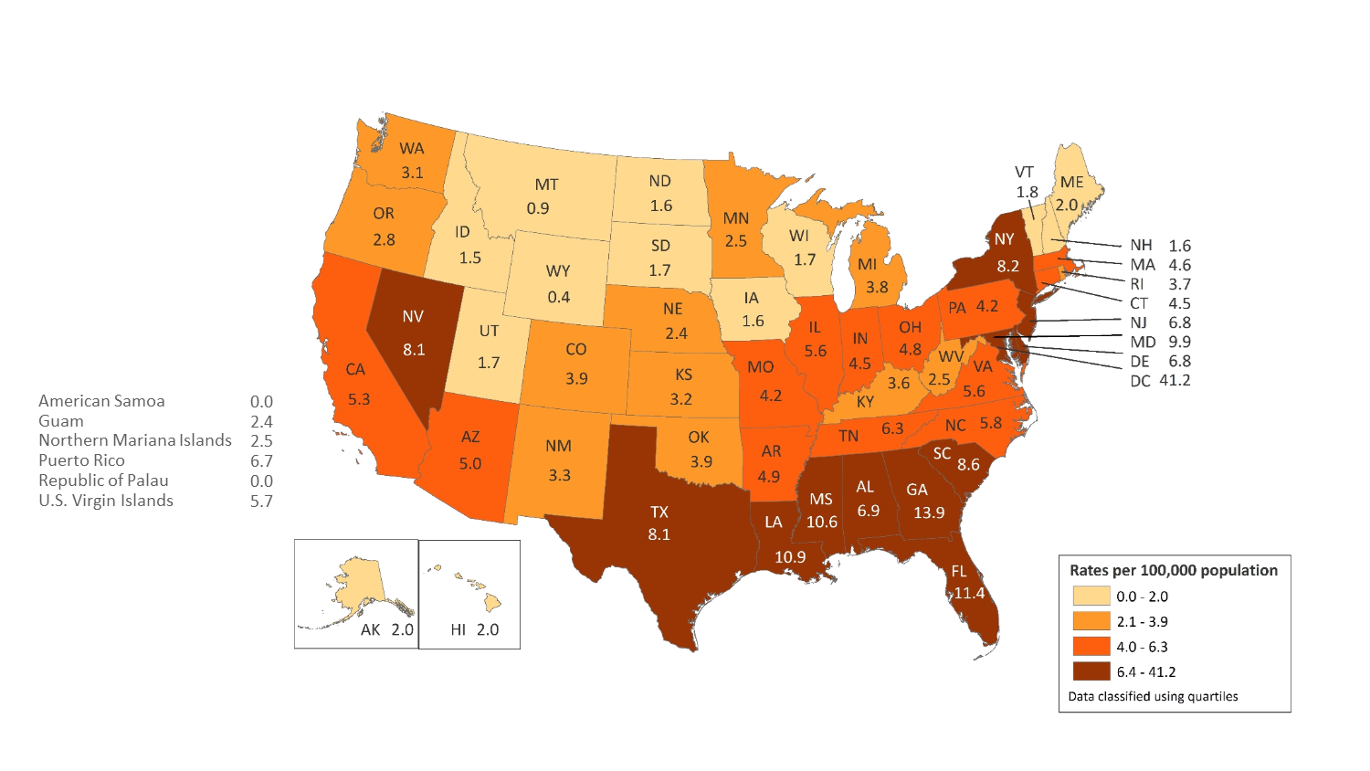
Rates of Diagnosed HIV Infection Classified as Stage 3 (AIDS) among Adults and Adolescents, by Area of Residence, 2018—United States and 6 Dependent Areas
N = 17,186 Total Rate: 6.2
Note. Data for the year 2018 are considered preliminary and based on 6 months reporting delay.
Notes:
In 2018, in the United States and 6 dependent areas, the rate of stage 3 (AIDS) classifications among adults and adolescents with HIV Infection was 6.2 per 100,000 population. The rates of stage 3 (AIDS) classifications ranged from 0.0 per 100,000 in American Samoa and the Republic of Palau to 41.2 per 100,000 in the District of Columbia.
The District of Columbia (i.e., Washington, DC) is a city; use caution when comparing the rate of people living with diagnosed HIV infection in DC with the rates in states.
Data for the year 2018 are considered preliminary and based on 6 months reporting delay.

Slide 8
Overview of HIV/AIDS in Minnesota

Slide 9
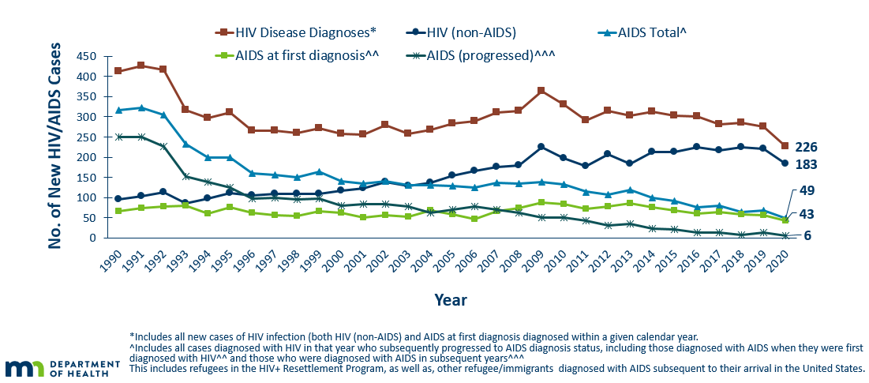
New HIV Diagnoses, HIV (non-AIDS) and AIDS Cases by Year of HIV Diagnosis, 1990-2020
Notes:
Nationally, Minnesota is considered within the low to moderate risk of HIV and AIDS infections as defined by the Centers for Disease Control and Prevention (CDC). The annual number of new HIV and AIDS cases increased steadily from the beginning of the epidemic to the early 1990s. Beginning in 1996, both the number of newly diagnosed AIDS cases and the number of deaths among AIDS cases declined sharply, primarily due to the success of new antiretroviral therapies including protease inhibitors. These treatments do not cure, but can delay progression to AIDS among people with HIV (non-AIDS) infection and improve survival among those with AIDS. These treatments have been shown to be effective at preventing transmission of HIV.
Over the past five years since 2015, the number of HIV/AIDS cases diagnosed has remained relatively stable with an average of almost 300 cases diagnosed each year. However, In 2020, there was a decrease of new HIV diagnoses to 226 infections from 276 in 2019. Of these 226 diagnoses, 183 of these were new HIV infections, with an additional 43 diagnoses being HIV-and AIDS diagnosed at the same time.
By the end of 2020, an estimated 9,422 people with HIV/AIDS were assumed to be living in Minnesota.
This number includes people whose most recently reported state of residence was Minnesota, regardless of residence at time of diagnosis. This estimate does not include people with undiagnosed HIV infection.

Slide 10
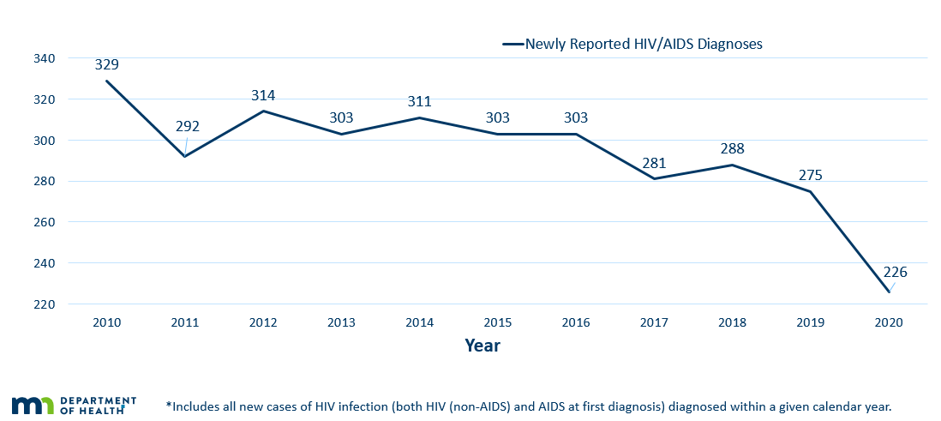
New HIV Disease Diagnoses*
HIV/AIDS Cases by Year, 2010-2020
Notes:
In this report, the term “new HIV diagnoses” refers to Minnesota residents living with who were diagnosed in a particular calendar year and reported to MDH. This includes people whose first diagnosis of HIV infection is AIDS (AIDS at first diagnosis). HIV diagnoses data are displayed by earliest known date of HIV diagnosis.
In 2020 there were 226 newly diagnosed cases compared to 275 cases in 2019. This represents a decrease of about 17% compared to 2019. In reviewing newly diagnosed cases since 2016, 226 cases for 2020 is below the 5-year average of 274 cases per year. In reviewing newly diagnosed cases since 2010, 226 cases for 2020 represents a 31% decrease in new cases since 2010.
We acknowledge that 2020 was an exceptional year, due to the COVID-19 pandemic. It is currently unclear whether this is a true decrease in new HIV infections. We continue to monitor and provide updates as more information is collected.

Slide 11
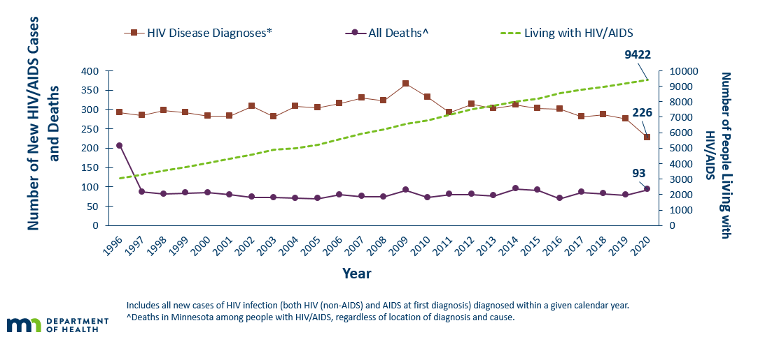
New HIV Diagnoses, Deaths and Prevalent Cases by Year, 1996-2020
Notes:
Since 1996, the number of new diagnoses has remained relatively stable in Minnesota at around 300 cases per year. During this same time, deaths among HIV positive people in Minnesota has decreased dramatically. As people with HIV are living longer and healthier lives, the number of people living with HIV in Minnesota continues to grow as seen in the Red line here.
At the end of 2020, there were 9,422 people were estimated to be living with HIV or AIDS in Minnesota.
This number does not include 1,629 people who were first reported with HIV or AIDs in Minnesota and subsequently moved out of the state. Although it does include 2,540 people who were first reported with HIV or AIDS elsewhere and subsequently moved to Minnesota.

Slide 12
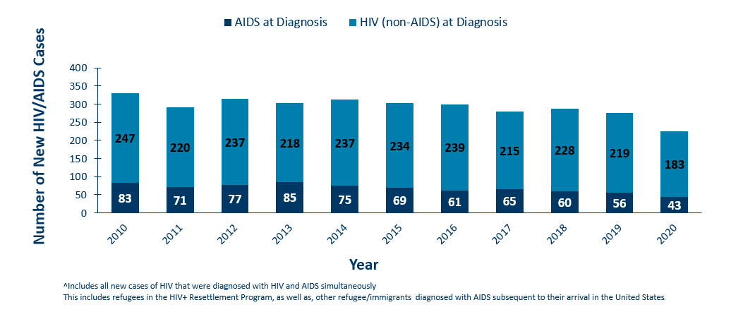
HIV (non-AIDS) and AIDS^ at Diagnosis by Year, 2010-2020
Notes:
During the past 10 years, the proportion of cases being diagnosed with AIDS at initial HIV diagnosis has remained the same at about 25% of all new cases.
For 2020, the proportion of cases diagnosed with AIDS at initial HIV diagnosis was low at 19% and consistent with observations in 2019 (20%).

Slide 13
HIV Diagnoses in Minnesota by Person, Place, and Time

Slide 14
Place

Slide 15
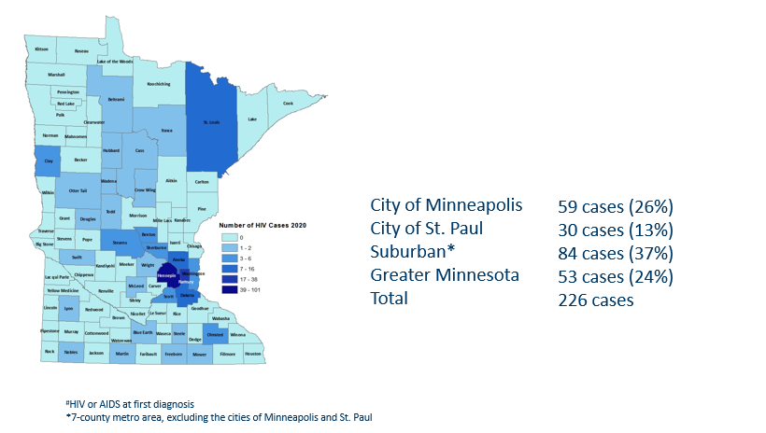
HIV Diagnoses# by County of Residence at Diagnosis, 2020
Notes:
Historically, about 80% of new HIV infections diagnosed in Minnesota have occurred in Minneapolis, St. Paul and the surrounding seven-county metropolitan area.
In 2020, of 226 total HIV diagnoses, 76% of the cases located in the seven county Twin Cities metro region with 26% in Minneapolis, 13% in St. Paul, and 37% in the remaining suburban area (excluding Minneapolis/St. Paul). In greater Minnesota, there were 53 newly diagnosed HIV cases in 33 counties.

Slide 16
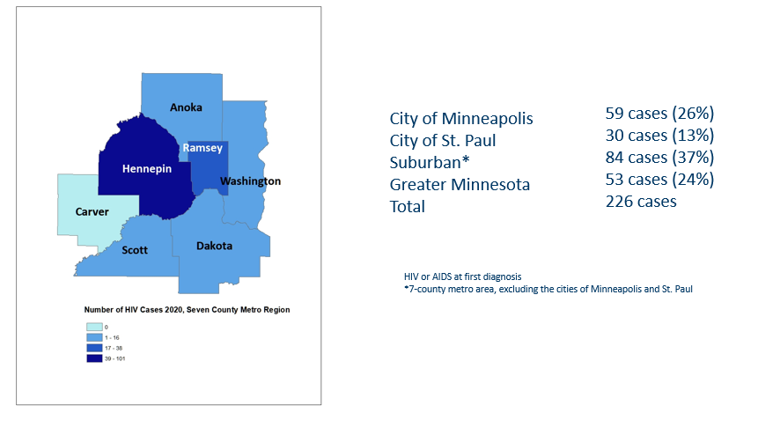
2020 Minnesota HIV New Diagnoses by Metro County
Notes:
While 76% of all new HIV diagnoses in Minnesota occur in the Twin Cities Seven County metropolitan area, the cases in the metro area are concentrated in Hennepin and Ramsey counties.

Slide 17
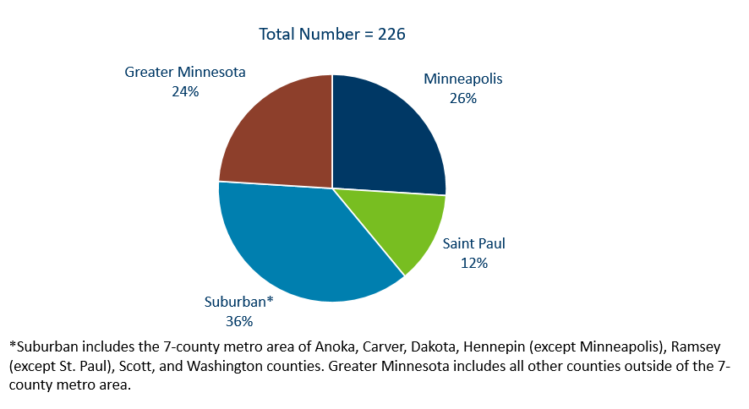
HIV Diagnoses* in Minnesota by Residence at Diagnosis, 2020
Notes:
Overall, of the 226 HIV diagnoses in Minnesota in 2020, 76% were among residents of suburban seven-county metro area. Of this proportion, 29% were residents of Minneapolis and 14% were residents of St. Paul. The remaining 19% were residents of Greater Minnesota at the time of diagnosis. This distribution was similar to the prior year.

Slide 18
Sex at Birth, Gender, and Race/Ethnicity

Slide 19
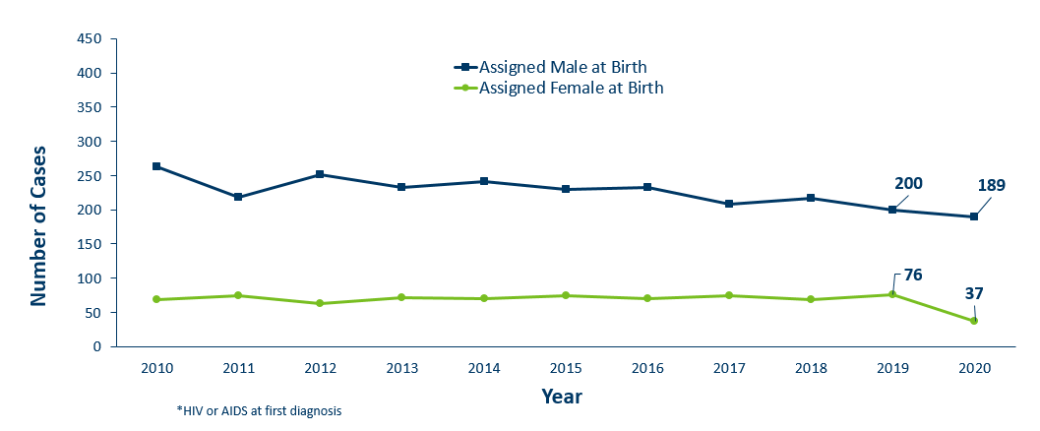
HIV Diagnoses* by Sex Assigned at Birth and Year of Diagnosis
2010 - 2020
Notes:
By sex assigned at birth….
The number of cases among people assigned male at birth have remained stable, with 189 of 226 new HIV cases. However, In 2020, the number of infections among people assigned female at birth decreased from 76 cases in 2019 to 37 cases in 2020. The reason for this decrease is currently unknown.
As a result, people assigned male at birth represent 84% of all new HIV diagnoses- which is an increase from previous years.

Slide 20
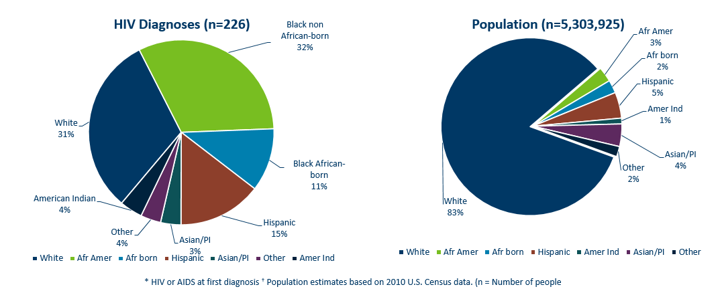
HIV Diagnoses* in Year 2020 and General Population in Minnesota by Race/Ethnicity
Notes:
When you look at the racial/ethnic distribution of new HIV diagnoses [at LEFT] compared to the corresponding racial/ethnic distribution of the general population of Minnesota [at RIGHT], it is apparent that disparities continue to exist among people of color. Non-Hispanic African-American and Black African-born Minnesotans jointly make up about 5% of the population in Minnesota, yet account for 43% of the newly diagnosed cases of HIV in 2020. Similarly, Hispanics of any race also account for approximately 5% of the population, but account for 15% of the newly diagnosed cases.

Slide 21
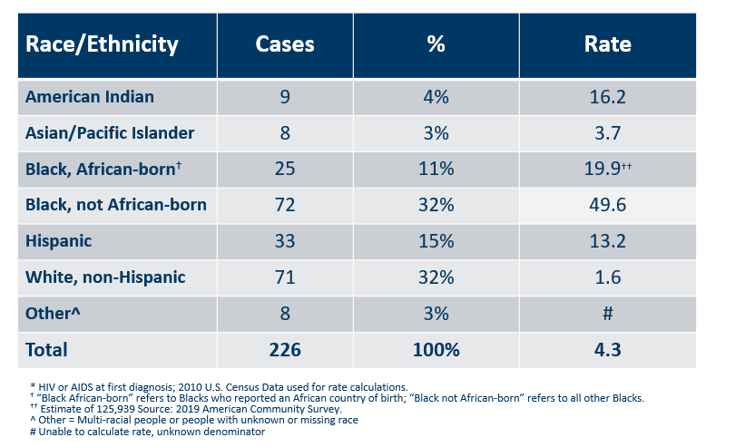
Number of Cases and Rates (per 100,000 people) of HIV Diagnoses* by Race/Ethnicity† Minnesota, 2020
Notes:
Each year we calculate the rate of diagnosis for each racial/ethnic group represented in the surveillance system to assess the impact of HIV within each community. The rate takes into account the size of the population of each group.
Non-Hispanic black, African-born and African-Americans had the highest rate of diagnoses in 2020 with 19.9 HIV diagnoses per 100,000 population and 49.6 HIV diagnoses per 100,000 population respectively. For African-Americans who are not African born, this represents a rate that is 31 times higher than the white non-Hispanic population in Minnesota. The rate among African-born, population is nearly 12 times higher than white non-Hispanic population.
Hispanic people of any race have the next highest rate of newly diagnosed HIV cases in Minnesota at 13.2 per 100,000 people; this is a rate 8 times higher than white, non-Hispanic people.
American Indians have a rate of people newly diagnosed with HIV of 16.2 per 100,000 people, over ten times the rate of white, non-Hispanic people.

Slide 22
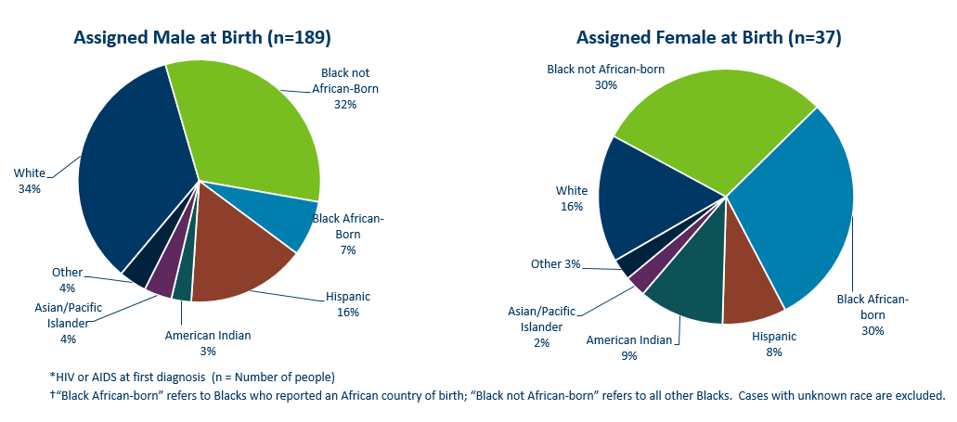
HIV Diagnoses* Diagnosed in Year 2020 by Sex Assigned at Birth and Race/Ethnicity†
Notes:
There are differences in the racial/ethnic distribution by sex assigned at birth. Left to right are data for people assigned Male and Female at birth.
On the LEFT, Among 189 people assigned the sex of male at birth, 34% of the 2020 cases diagnosed in Minnesota are Non-Hispanic white [seen in dark BLUE]. Non-Hispanic Black non-African born [In light GREEN] and black, African-born males [light BLUE] made up 39% of cases and Hispanic males of any race accounted for 16% of cases.
ON the RIGHT, Among the 37 people assigned the sex of female at birth, the disparities of new HIV diagnoses are even more apparent among people of color. They represent 81% of new HIV cases assigned female at birth vs 62% of new HIV cases assigned male at birth. Greater than half of female infections, or 60% combined, are Black, African-born and non-African born.

Slide 23
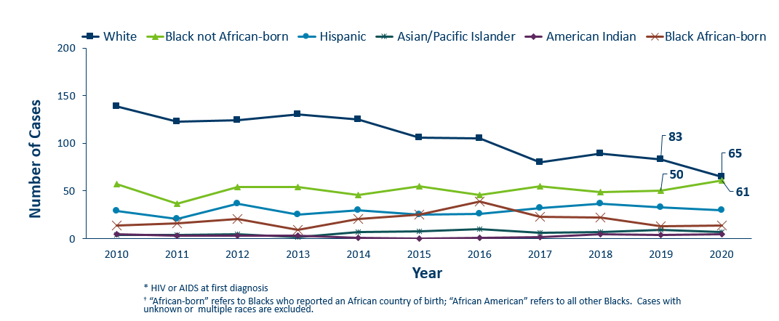
HIV Diagnoses* Among People Assigned Male Sex at Birth by Race/Ethnicity† and Year of Diagnosis 2010 - 2020
Notes:
Trends in the annual number of new HIV infections diagnosed among people assigned male sex at birth differ by racial/ethnic group.
White and black non-African born people accounted for the largest number of new infections, with numbers becoming relatively the same in 2020.
In 2020, white people [in DARK BLUE] assigned male sex at birth accounted for (65 of 189) 34% (decreased from 42% in 2019) of the new HIV diagnoses among people assigned male sex at birth, with 84 diagnoses. [In GREEN] Cases among African-American people assigned male sex at birth has fluctuated over the past 10 years, and increased in 2020 to 61 (32%) new HIV diagnoses in 2020 (from 50 cases in 2019).
In other words… if in 2020 you drew 3 newly diagnosed HIV infections among people assigned male at birth , 1 person would likely be white and 1 person would likely be Black non-African born.
The annual number of HIV infections diagnosed among Hispanic people assigned male sex at birth has remained relatively stable, with small fluctuation from year to year. HIV infections in Hispanic people assigned male sex at birth was similar to the previous year with 30 cases in 2020. African-born people assigned male sex at birth diagnosed with HIV declined in 2020 to 14 cases, like 2019 (n=13), relatively low compared to the previous years.

Slide 24
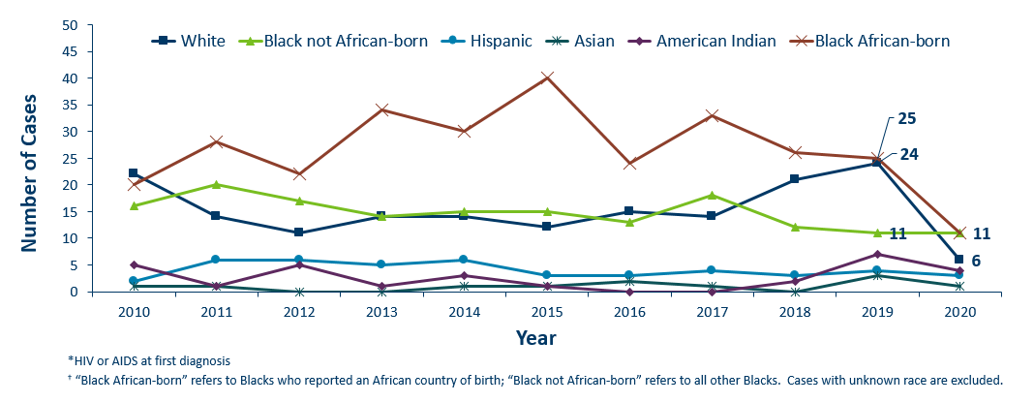
HIV Diagnoses* Among People Assigned Female Sex at Birth by Race/Ethnicity† and Year of Diagnosis 2010 - 2020
Notes:
Next, let’s look at newly diagnosed HIV among people assigned female sex at birth. We again note that these Female cases decreased by 50% over 2020, from 76 cases in 2019 to 37 cases in 2020.
While the exact reasons for the 2020 50% decrease in cases among people assigned female at birth is not yet understood at this time, it does appear that the reductions in 2 key racial populations attribute to this decrease.*
With regards to racial distribution in 2020 among people assigned female sex at birth, Both African-born black cases [In RED] and White cases [in Dark BLUE] decreased most notably. Black African born cases, which typically experience the highest counts, decreased more than half… from 25 in 2019 to 11 cases in 2020. It is now the same count as Black, not-African born cases [in GREEN]. White cases also dropped dramatically by 75% from 24 cases in 2019 to 6 cases in 2020.
* In 2020, we note that there was approximately 6,000 population decrease in the estimate for the general black, African-born population in Minnesota since 2019 (From 131,832 in 2019 to 125,939 in 2020).

Slide 25
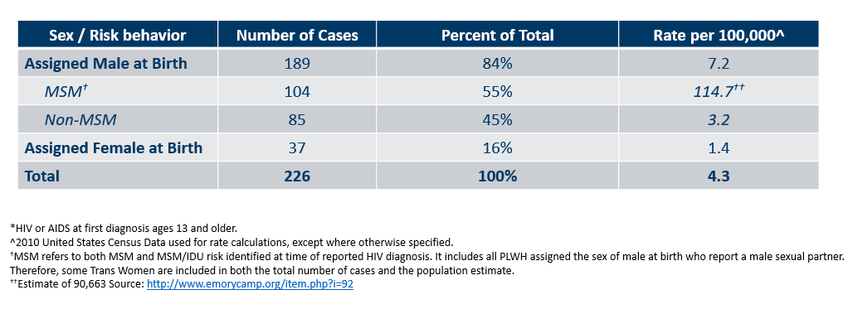
Number of Cases and Rates (per 100,000 people) of Adults and Adolescents* Diagnosed with HIV/AIDS by Sex Assigned at Birth and Risk† in Minnesota, 2020
Notes:
Here we look at cases and rates of the 226 new HIV infections by sex assigned at birth and reported sexual behavior.
By sex assigned at birth….
The number of cases among people assigned male at birth have remained stable, with 189 of 226 new HIV cases. However, In 2020, the number of infections among people assigned female at birth decreased from 76 cases in 2019 to 37 cases in 2020. The reason for this decrease is currently unknown.
As a result, people assigned male at birth represent 84% of all new HIV diagnoses- which is an increase from previous years.
Looking further at data by risk behavior….
Men who have Sex with Men, or MSM, have the highest rate of HIV diagnosis than any other sub-category. In 2020, the estimated rate of HIV diagnosis among MSM was 114.7 per 100,000 population. This is nearly 38 times higher than the rate among non-MSM men.
It’s important to note that MSM contains cases from all racial/ethnic categories and therefore, cannot be directly compared to the rates on the previous slide. For more information on how this rate was estimated, see the HIV Surveillance Technical Notes which are available on our website.

Slide 26
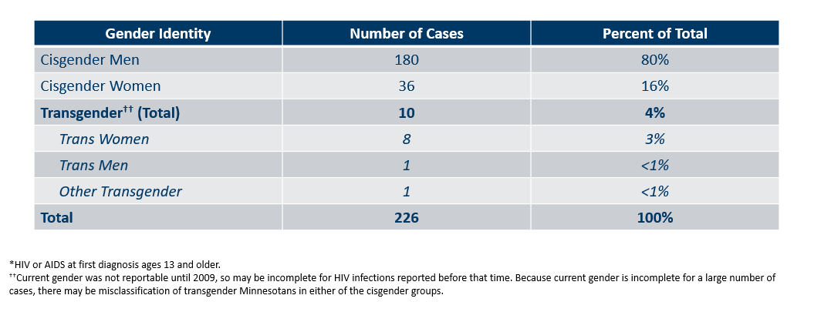
Number of Cases of Adults and Adolescents* Diagnosed with HIV/AIDS by Gender Identity in Minnesota, 2020
Notes:
This slide shows the number of people living with HIV/AIDS by gender identity. In 2020, there were 10 transgender newly reported HIV cases in Minnesota (8 Trans Women, 1 Trans Man, and 1 additional Transgender identities). This represents 4% of new cases reported in the state.

Slide 27
Age

Slide 28
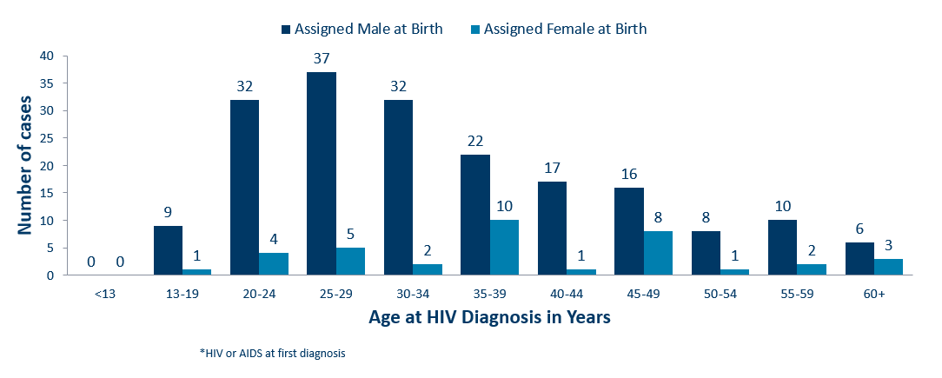
Age at HIV Diagnosis* by Sex Assigned at Birth, Minnesota, 2020
Notes:
In 2019, there were 111 cases diagnosed under the age of 30. This accounts for 40% of all cases. Most of these cases were among young people assigned the sex of male at birth, where 82% of cases under the age of 30 were male. The age groups from 25-34 had the largest number of cases in 2019.
In 2020, there were 88 cases diagnosed under the age of 30. This accounts for 39% of all cases. Most of these cases were among young people assigned the sex of male at birth, where 82% of cases (78 of 88) under the age of 30 were male. As expected, the age groups from 25-34 had the largest number of cases in 2020.

Slide 29
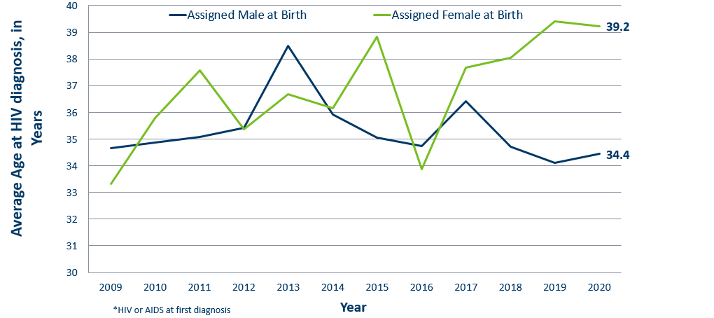
Average Age at HIV Diagnosis* by Sex Assigned at Birth, 2009-2020
Notes:
Looking at The average age at diagnosis in 2020, people assigned female sex at birth [In GREEN] were 5 years older on average (at 39 years of age) compared to people assigned male at birth.

Slide 30
Mode of Exposure

Slide 31
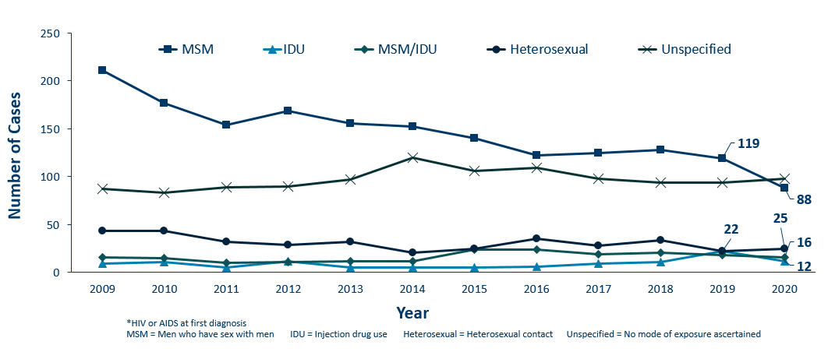
HIV Diagnoses* by Mode of Exposure and Year, 2009 – 2020
Notes:
This slide depicts risk for all people diagnosed with HIV in Minnesota during the past decade and since the beginning of the epidemic. Men who have sex with Men continue to be the most commonly reported risk factor. In 2020, MSM accounted for 39% of all new HIV diagnoses in Minnesota with 88 cases diagnosed (of 226 total cases).
The number of cases among people who inject drugs (IDU only) was 12 cases in 2020, down from 2019 (n=22) and similar to 2018 (n=11). However, Minnesota recently declared an ongoing outbreak among people who inject drugs for Duluth are in St. Louis County, with cases dating back to 2019. Hennepin-Ramsey counties are also experiencing an ongoing outbreak among people who inject drugs, with some cases dating back to 2018. More details on these outbreaks later in this slide presentation.

Slide 32
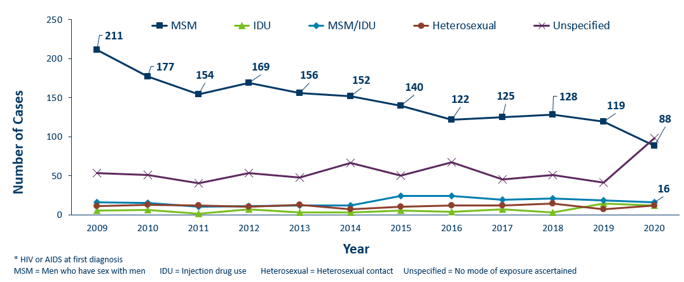
HIV Diagnoses* Among People Assigned Male Sex at Birth by Mode of Exposure and Year 2009 - 2020
Notes:
By gender,
Among people assigned male sex at birth, same-sex sexual relations in male-sex with males (MSM) continues to be a leading risk, with 88 of 189 cases in 2020 (47%).
IDU are 12 of 189 cases (6%)
MSM-IDU are 16 of 189 cases (8%).
Heterosexual contact is 12 of 189 cases (6%).

Slide 33
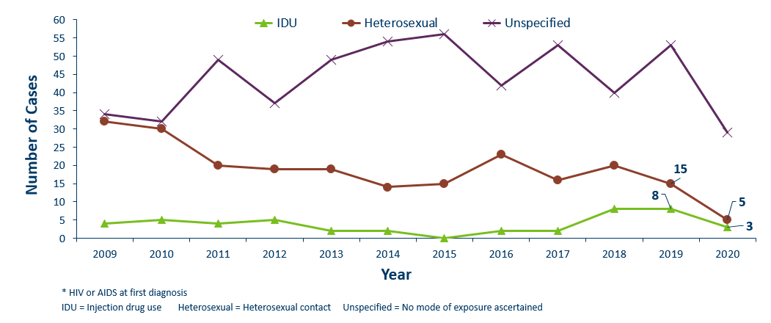
HIV Diagnoses* Among People Assigned Female Sex at Birth by Mode of Exposure and Year of Diagnosis 2010 - 2020
Notes:
For people assigned female sex at birth, the most known common mode of exposure for the past decade has been Heterosexual contact (with a person of known HIV infection), as seen in RED. In 2020, the number of cases decreased from 53 in 2019 to 29 in 2020.

Slide 34
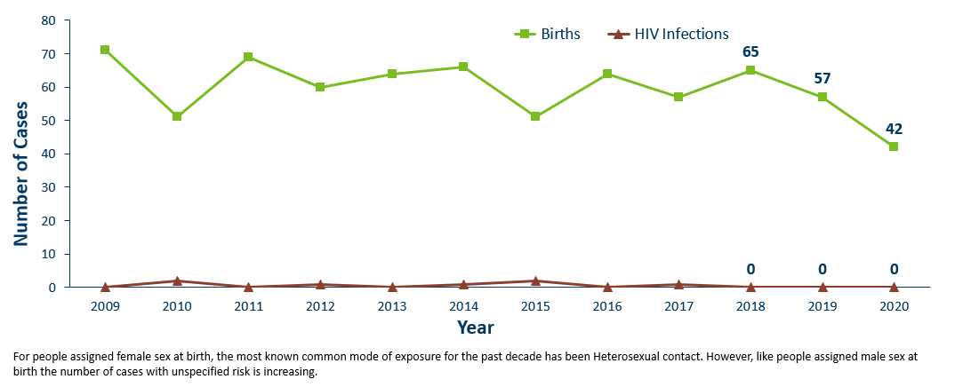
Births to Pregnant People living with HIV and Number of Perinatal Acquired HIV Infections* by Year of Birth, 2009- 2020
Notes:
The ability to interrupt the transmission of HIV from pregnant person to child via antiretroviral therapy and appropriate perinatal care is an important accomplishment in the history of the HIV/AIDS epidemic. Without antiretroviral therapy, newborn HIV infection rates range from 25-30%, but decrease to 1-2% with appropriate medical intervention. The rate of transmission has decreased from 15% between 1994 and 1996 to 0.0% in the past three years (2018-2020).
For the past decade, the number of births to pregnant parents living with HIV has ranged between 51-69 births (2010-2019).
For 2020, there was a decrease to 42 births to pregnant parents living with HIV. with no perinatal HIV cases baby born to a HIV-positive pregnant person in Minnesota in 2020.

Slide 35
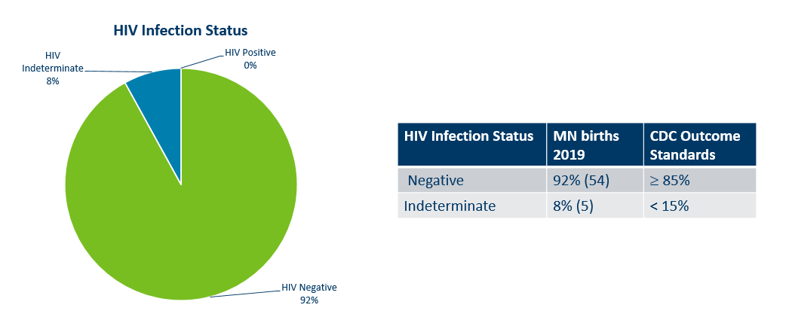
Outcome for Perinatal HIV-Exposed Infants born in 2019
Notes:
Starting in 2018, CDC HIV Surveillance required that all HIV surveillance jurisdictions conduct follow-up of perinatal HIV-exposed infants every 6 months until 18 months of age or until HIV infection status is determined.
Infants exposed to HIV at birth may or may not be infected with HIV. Because of placental transfer of HIV maternal antibodies, HIV tests at birth will be positive, regardless of the infant’s true HIV status. Therefore, perinatal exposures need to be followed up over the next 18 months until the child’s diagnostic status is known (usually with lab results after two months of age and then every six months).
The pie chart above shows the HIV infection status for infants born in 2019. Data on infants born in 2020 are not available until those infants are 18 months of age (which will close in 2022).
IN 2019, Of the 59 perinatal HIV-exposed infants born in 2019, 92% (n=54) have a HIV infection status determination of HIV negative (n=54) and HIV positive (n=0). Minnesota is above the CDC outcome standard of greater than or equal to 85% of HIV-exposed infants that have HIV infection status determined by 18 months of age. Only five infants (8%) had a HIV indeterminate status.

Slide 36
Adolescents & Young Adults (Ages 13-24)*

Slide 37
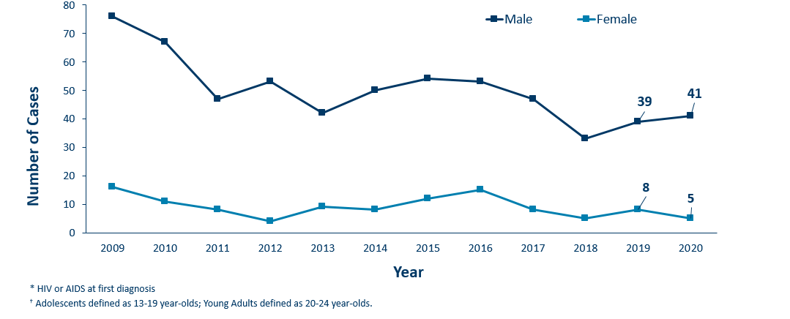
HIV Diagnoses* Among Adolescents and Young Adults† by Sex Assigned at Birth and Year 2009 - 2020
Notes:
Between 2006 and 2009 the number of new HIV diagnoses among people assigned male sex at birth aged 13-24 increased rapidly. Since 2009, we’ve seen a promising trend of a decreasing number of new diagnoses in this age/sex group.
In 2020, the number of cases were slightly higher from the previous year with 41 cases in 2020 compared to 39 cases in 2019.
In 2020, among adolescent and young adults assigned female sex at birth, there were 5 cases compared to 8 cases in 2019.

Slide 38
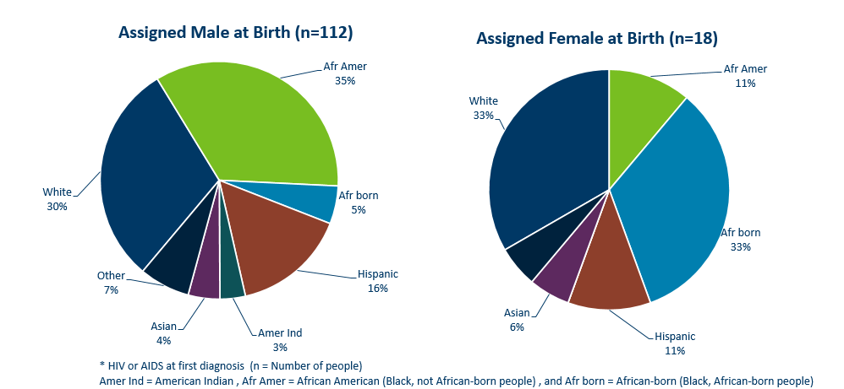
HIV Diagnoses* Among Adolescents and Young Adults† by Sex Assigned at Birth and Race/Ethnicity, 2018 - 2020 Combined
Notes:
Looking at racial distribution among adolescents by sex assigned at birth.
Between the years 2018 and 2020 we had 112 cases assigned male sex at birth [LEFT Graph] reported among adolescents and young adults, and 18 females reported in the 13-24 age group. For people assigned male sex at birth, Non-Hispanic white [DARK BLUE] and African-American people [GREEN] each accounted for one-third, and Hispanic people of any race [RED] accounted for 16% in the 13-24 age group. Among people with female sex assigned at birth [RIGHT], Non-Hispanic black African-born [LIGHT BLUE] and African-Americans [GREEN] together accounted for 44% of the cases; while non-Hispanic white people [DARK BLUE] accounted for 33%, and Hispanic people of any race [RED] accounted for 11% of cases.

Slide 39
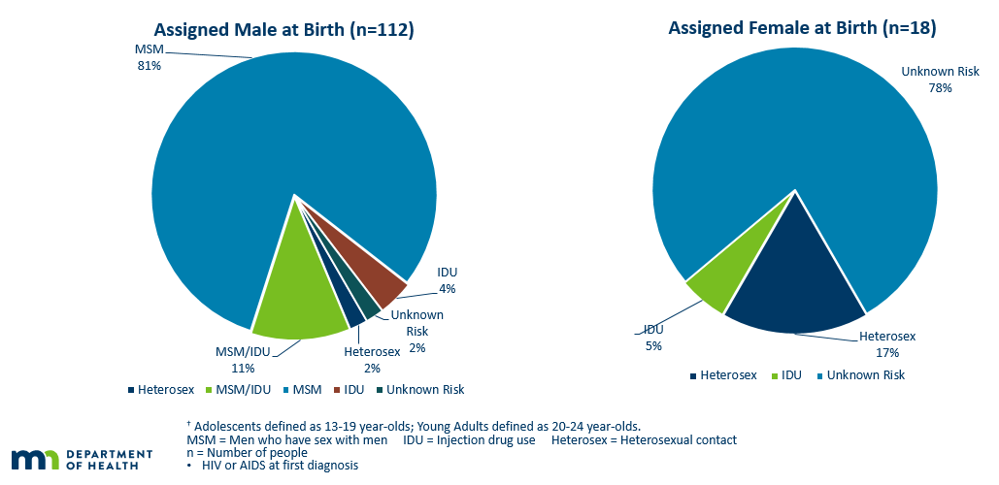
HIV Diagnoses* Among Adolescents and Young Adults† by Sex at Birth and Exposure Group 2018 – 2020 Combined
Notes:
For mode of exposure among people assigned male sex at birth in the 13-24 age group [LEFT] , Male to Male sex was found to account for 81% of the cases, while the combined risk of MSM and IDU was estimated to account for 11% of the cases and 2% was attributed to heterosexual contact.
Among adolescent people assigned female sex at birth [RIGHT], Most women HIV risk is unknown (78%) [LIGHT BLUE]. 14% of cases were found to have heterosexual contact as their mode of exposure [DARK BLUE], while 5% were attributed to injection drug use [LIGHT GREEN].

Slide 40
Foreign-born Cases

Slide 41
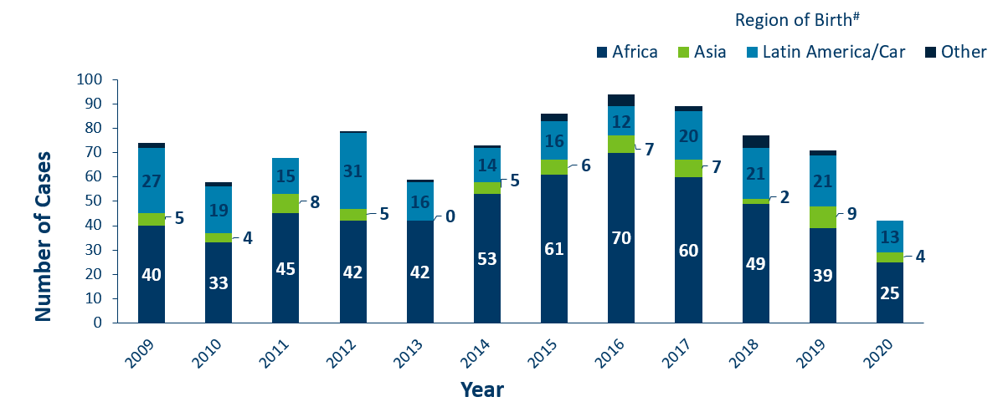
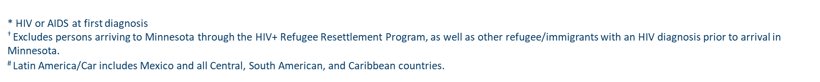
HIV Diagnoses* Among Foreign-Born People† in Minnesota by Year and Region of Birth
2009 - 2020
Notes:
This slides describes HIV diagnoses by global region of birth among foreign-born people. In general, the number of new HIV infections diagnosed among foreign-born people in Minnesota has steadily increased from 20 cases in 1990 to an average of 83 cases in the previous 5 years (since 2015). This increase has been largely driven by the increase of cases among African-born people, as well as people from Mexico, Central and South America and the Caribbean.
In 2020, there were 44 cases of newly reported HIV among foreign-born people. Although in general foreign-born cases are a relatively small number, this is a decrease of 38% since 2019 (n=71). This is about one out of five of all new cases. The majority of foreign-born cases in 2020 were from Africa, followed by Latin America and the Caribbean. Among new HIV infections diagnosed in 2020, 44 people (18%) were among foreign-born people.

Slide 42
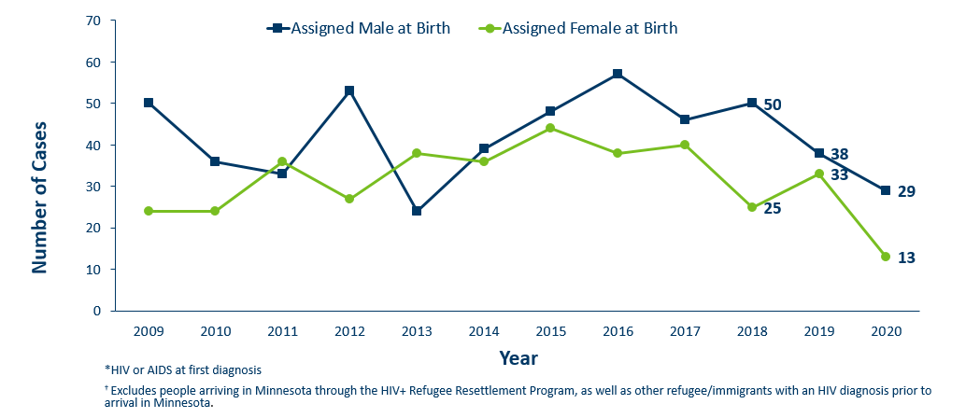
HIV Diagnoses* Among Foreign-Born People† by Sex Assigned at Birth and Year
2009 – 2020
Notes:
In 2020, the number of foreign-born people assigned male sex [in DARK BLUE] at birth decreased further from 38 cases in 2019 to 29 in 2020.
There was a sizable decrease for foreign-born people assigned female sex [in GREEN] at birth from 33 in 2019 to 13 in 2020.

Slide 43
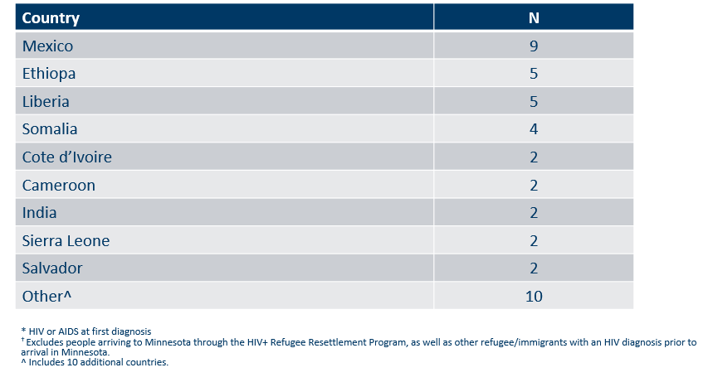
Countries of Birth Among Foreign-Born People† Diagnosed with HIV*
Minnesota, 2020
Notes:
Three countries (Mexico, Ethiopia, Liberia) accounted for 40 percent of new infections among foreign-born people, however there are over 31 countries represented among the 71 new foreign-born cases in 2020.

Slide 44
Late-Testers
(AIDS Diagnosis within one year of initial HIV Diagnosis)

Slide 45
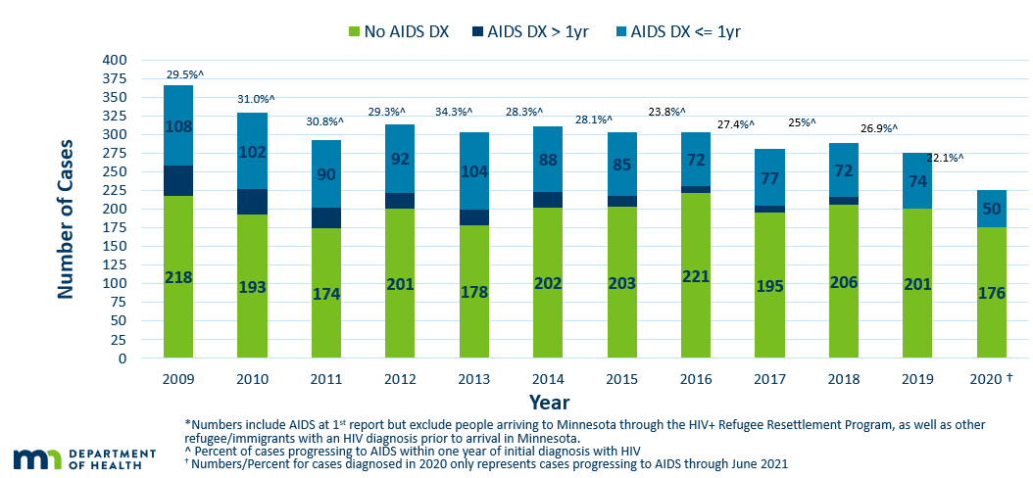
Time of Progression to AIDS for HIV Diagnoses in Minnesota*
2009 - 2020†
Notes:
Now, let’s look at Time of Progression to AIDS and “late testers”. Historically, foreign-born people have had a higher proportion of late-testers.
This statistic helps MDH monitor whether new HIV infections are detected early, before AIDS diagnosis. When people get diagnosed early they have the ability to get on treatment that can reduce their viral load to undetectable levels… and ultimately… reduce community transmission risk. Known as U=U or undetectable equals untransmittable, the science is clear: when people have undetectable viral loads, they can't pass HIV through sex to their partners.
[In BLUE] Late testers are defined as anyone with an AIDS diagnosis within one year of their initial HIV diagnosis. They represent missed opportunities for early intervention.
In 2019, 26.9% of new cases were late testers (2019 data followed-up to June 2020. Currently being updated with 2020 follow-up data). This proportion of cases has remained relatively the same over the past 10 years, ranging between 23-34%. Most late testers, about 85%, are diagnosed with AIDS at the same time they are initially diagnosed with HIV infection.
For 2020. 22% (or 50 of 226) of new HIV cases were “late testers” to date, which represents only a partial follow-up year through April 2021. Please note that cases diagnosed in 2020 may not encompass all cases diagnosed – since a full year of observation is required to capture progress to AIDS within a year (which would end later this year in December 2021).

Slide 46
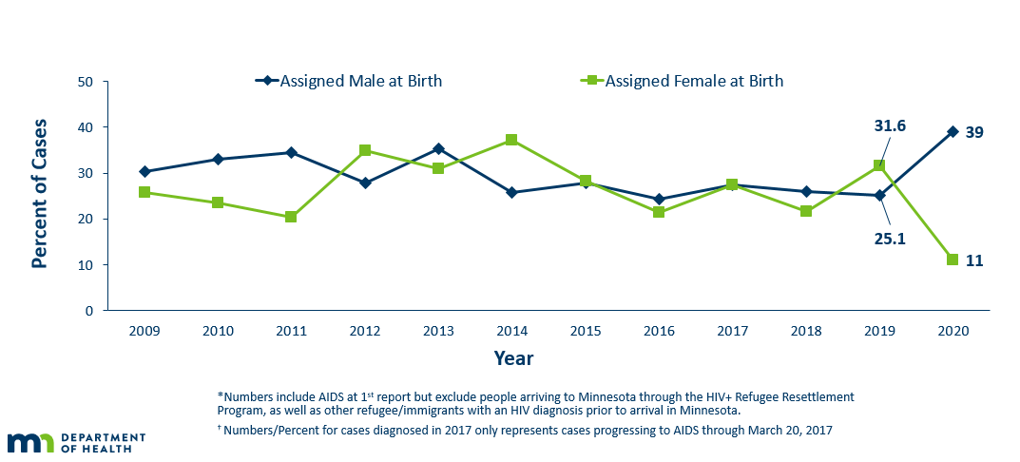
Progression to AIDS within 1 year of initial HIV Diagnosis* by Sex Assigned at Birth 2009 - 2020†
Notes:
The proportion of late testers can vary by sex assigned at birth. In 2020, among 50 late testers, the proportion of late testers among people assigned male sex at birth increased to 39 of 50 late testing cases (78%) [DARK BLUE], reversing to the majority. Conversely, people assigned female sex at birth decreased in count to 11 cases of the 50 late testers (22%) [GREEN].
Percentage of late testers for 2020 includes only those progressing to AIDS through April 2021. As such, this percentage is likely to increase as additional reports are made to the MDH.

Slide 47
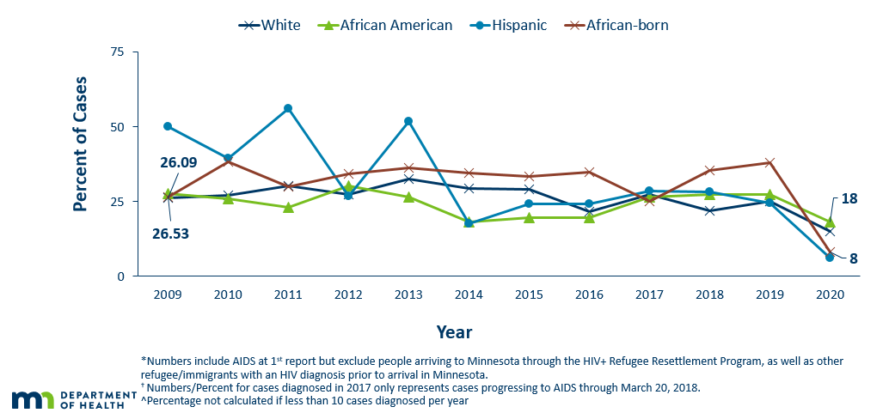
Progression to AIDS within 1 year of initial HIV Diagnoses* by Race/Ethnicity^ 2009 - 2020†
Notes:
As with other characteristics of the HIV epidemic in Minnesota, the proportion of late testers varies by demographic characteristics. Differences occur by race/ethnicity, with all races experiencing a decrease in late testers. The proportions of late testers in 2020 was among whites (32%), African Americans (38%), African-born black (17%), and Hispanic (13%). Similar data for American Indians and Asian/Pacific Islanders in a single year had fewer than 10 cases and are considered not stable and are therefore not represented here.
Percentage of late testers for 2020 includes only those progressing to AIDS through April 2021. As such, this percentage is likely to increase as additional reports are made to the MDH.

Slide 48
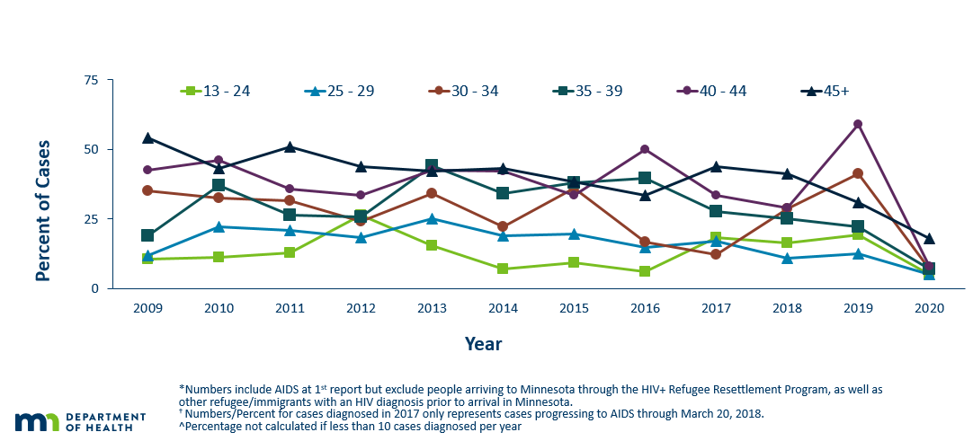
Progression to AIDS within 1 year of initial HIV Diagnosis* by Age
2009 - 2020†
Notes:
Differences by age are as expected with the percentage of late testers increasing with age at time of diagnosis. In 2020, all age groups experienced notable decreases in proportion of late testers. The groups 40-44 (59% in 2019 to 8% in 2020) and 30-34 (41% in 2019 to 7% in 2020) experienced the largest decreases following unusually high proportions in 2019. Younger age groups had lower percentages of late testers, 13-24 (5%), 25-29 (5%), and older groups had higher percentage of late testers, 30-34 (7%), 35-39 (7%), 40-44 (8%), and 45+ category (18%).
Percentage of late testers for 2020 includes only those progressing to AIDS through April 2021. As such, this percentage is likely to increase as additional reports are made to the MDH. Caution should be used due to smaller numbers by age group when interrupting the data.

Slide 49
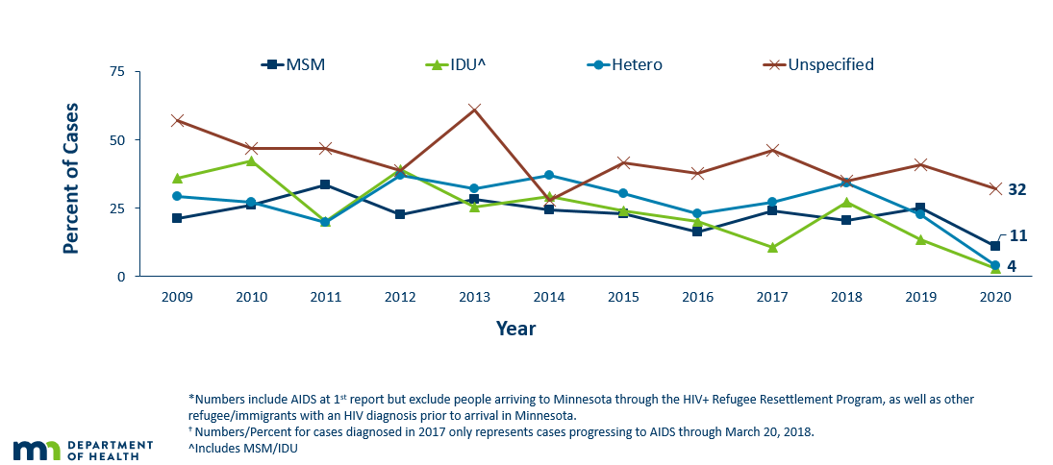
Progression to AIDS within 1 year of initial HIV Diagnosis* by Mode of Transmission 2009 - 2020†
Notes:
In 2020, people with a risk category of unspecified risk had the highest proportion of late testers at 32% [RED X’s], followed by MSM contact at 11% [DARK BLUE], and finally IDU [GREEN] and heterosexual contact [LIGHT BLUE] had the lowest proportion of late testers at 4% each.
Percentage of late testers for 2020 includes only those progressing to AIDS through April 2021. As such, this percentage is likely to increase as additional reports are made to the MDH.

Slide 50
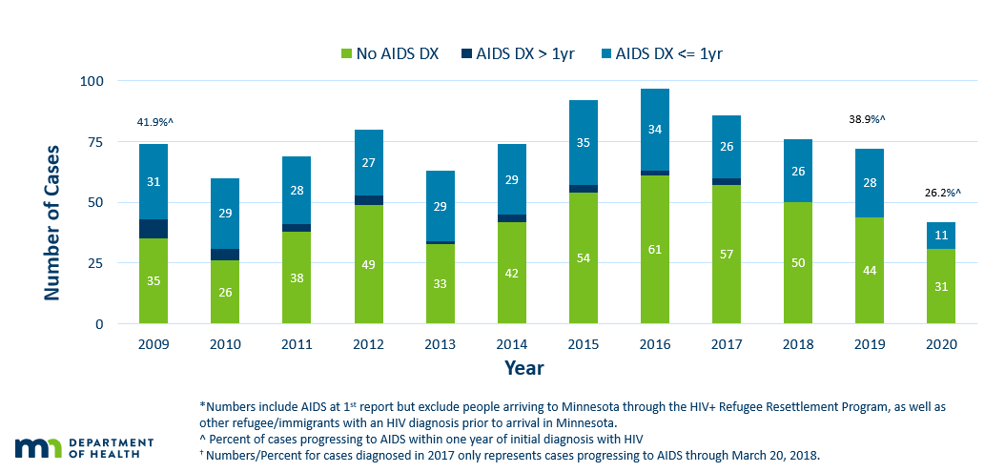
Time of Progression to AIDS for HIV Diagnoses* Among Foreign-Born People
Minnesota 2009 - 2020
Notes:
During the past decade, foreign-born cases have a higher rate of late testers [LIGHT BLUE] compared to US-born cases. In 2020, Among 42 foreign-born cases, 11 (26%) of foreign-born cases were late testers compared to 22% of US-born cases.
Percentage of late testers for 2020 includes only those progressing to AIDS through April 2021. As such, this percentage is likely to increase as additional reports are made to the MDH.

Slide 51
Additional Topics

Slide 52
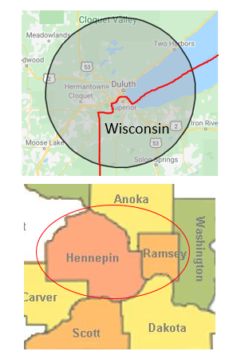
HIV Outbreaks in Hennepin/Ramsey Counties
& Duluth Region
Duluth area Outbreak
Declared 3/2021
Cases (N=15)*
Hennepin/Ramsey Counties Outbreak
Declared 2/2020
People who inject drugs
Cases (N=71)*
* Data counts as of 6/2/21
People at high-risk in the current outbreaks:
  People who use injection drugs (PWID) or share needles/works
  People experiencing homelessness or unstable housing
  People who exchange sex for income or other items they need
Notes:
Minnesota has seen an increase of HIV in the Duluth area (30 mile radius) and *among certain populations in Hennepin and Ramsey Counties. The Duluth area declared an outbreak in 2021 with cases dating back to 2019; MDH is coordinating investigations with Wisconsin. An outbreak was declared in Hennepin and Ramsey counties among people who inject drugs (PWID) in 2020 with cases dating back to 2018.
Minnesota's outbreak-associated cases have risk factors consistent with the national outbreaks.
People at high risk in the current outbreaks include:
People who use injection drugs or share needles/works.
People experiencing homelessness or unstable housing.
People who exchange sex for income and other items they need.
For more information, please see our updated HIV statistics website, described at the end of the presentation.

Slide 53
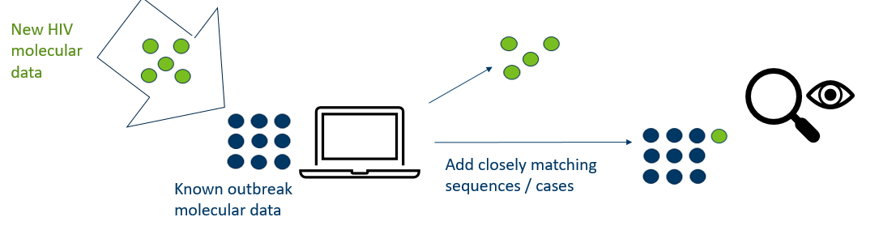
Molecular Tools for Outbreak Monitoring
To address data privacy concerns:
Molecular data is from the HIV virus, and is not a person’s genetic material
Cannot infer causal directionality of infection
HIV virus sequences securely housed at the health department
Notes:
In addition to monitoring the number of cases reported in certain populations, molecular data can also be used to supplement existing outbreak investigation methods. We have been doing this with our current outbreaks. This approach compares HIV virus data collected from routine, patient-care laboratory tests.
As illustrated in the slide, imagine that each dot represents a person with diagnosed HIV infection, and their HIV virus molecular data. [in GREEN], as new people with HIV are reported in Minnesota, we compare virus molecular data to existing outbreak cases [in BLUE] using scientifically-established methods and computer software. When new HIV sequences closely match within our threshold, we prioritize those people for interview and linkage to care and treatment.
We can then examine the shared characteristics of matching data, which represent a social network, to more effectively target our outreach efforts moving forward.
At MDH, we understand that this method may be concerning for some community members. We want to address potential concerns about data privacy. First, this small portion of molecular data are from the HIV virus only, and are not a person’s molecular information. Further, one cannot infer causal directionality. However, we continue to take the utmost care in data collection, and HIV virus molecular data are securely-housed at the health department.
For more information, please see the link on our website for a more in-depth presentation about this topic.

Slide 54
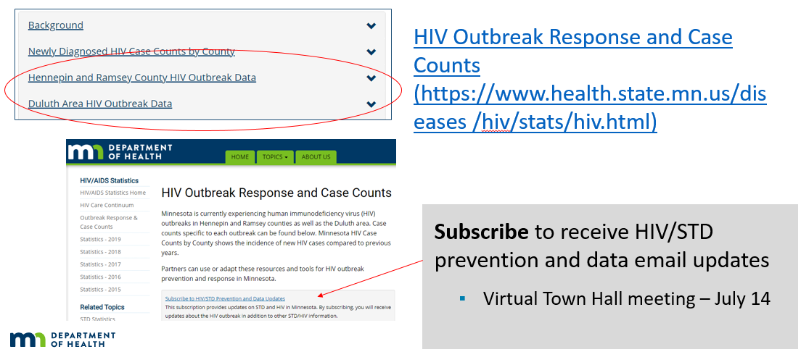
Updated webpage: HIV Outbreak Data
Notes:
In addition to newly diagnosed HIV case counts by county, we recently updated our statistics web page to include information on outbreak data.
Please visit the Minnesota Department of Health HIV pages at www.health.state.mn for additional details.
While you’re here, you can subscribe to our GovDelivery email listserv to receive HIV/STD prevention updates to your email. Please stay tuned via our listserv for the upcoming Town Hall, proposed for July 14.

Slide 55
Thank you.
HIV Surveillance Team
Health.HIV.Surveillance@state.mn.us
651-201-4040

