Slide 1


Highlights from the Minnesota HIV Surveillance Report, 2019
HIV/AIDS Surveillance System
Notes:
Thank you for listening to our 2019 annual HIV data release. I’m Jared Shenk, an epidemiologist at the Minnesota Department of Health. I will be primarily discussing highlights from data about new HIV diagnoses reported to the health department during 2019, as well as updates to HIV prevalence in the state, our recent HIV outbreak, and molecular HIV data. The information that we will present is just a snapshot of the data available on our website at the link on this slide.

Slide 2
New HIV diagnoses in Minnesota, 2019
Notes:
We will first discuss highlights from data about new HIV diagnoses reported during 2019.

Slide 3
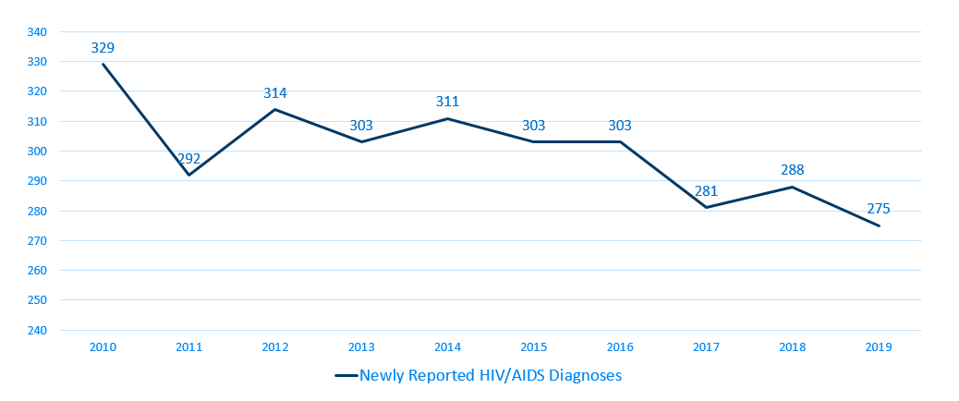
New HIV Disease Diagnoses*, HIV/AIDS Cases by Year, 2010-2019
Notes:
In this report, the term “new HIV diagnoses” refers to Minnesota residents living with HIV who were diagnosed in a particular calendar year and reported to MDH. This includes persons whose first diagnosis of HIV infection is AIDS (AIDS at first diagnosis). HIV diagnoses data are displayed by earliest known date of HIV diagnosis.
In 2019, there was a slight decrease of new HIV diagnoses from 2018. In 2019 there were 275 newly diagnosed cases compared to 288 cases in 2018. This represents a decrease of about 5% compared to 2018. In reviewing newly diagnosed cases since 2015, 275 cases for 2019 is below the 5 year average of 290 cases per year. In reviewing newly diagnosed cases since 2010, 275 cases for 2019 represents a 16% decrease in new cases since 2010.

Slide 4
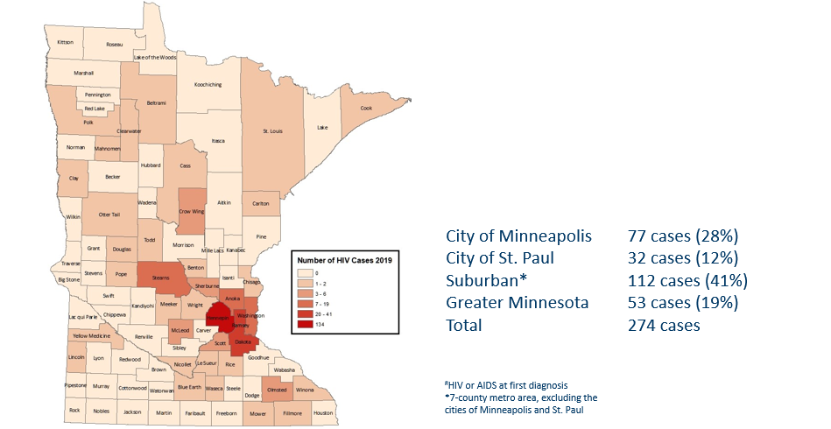
HIV Diagnoses# by County of Residence at Diagnosis, 2019
Notes:
Historically, about 80% of new HIV infections diagnosed in Minnesota have occurred in Minneapolis, St. Paul and the surrounding seven-county metropolitan area.
In 2019, geographically, the new cases were concentrated in the Twin Cities metropolitan area, with 81% of the cases located in the seven county Twin Cities metro region with 28% in Minneapolis, 12% in St. Paul, and 41% in the remaining suburban area (excluding Minneapolis/St. Paul). In greater Minnesota, there were 53 newly diagnosed HIV cases in 33 counties.

Slide 5
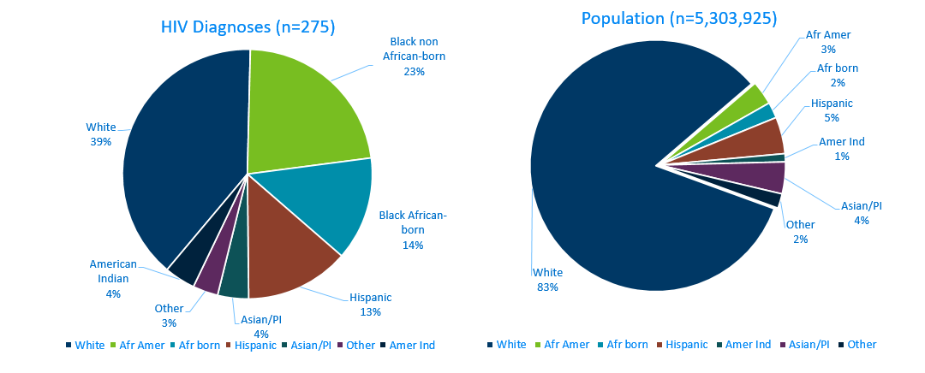
HIV Diagnoses* in Year 2019 and General Population in Minnesota by Race/Ethnicity
Notes:
When you look at the racial/ethnic distribution of new HIV diagnoses compared to the racial/ethnic distribution of the general population of Minnesota, it is apparent that disparities continue to exist among persons of color. Non-Hispanic African-American and Black African-born Minnesotans jointly make up about 5% of the population in Minnesota, yet, account for 37% of the newly diagnosed cases of HIV in 2019. Similarly, Hispanics of any race also account for approximately 5% of the population, but account for 13% of the newly diagnosed cases.

Slide 6
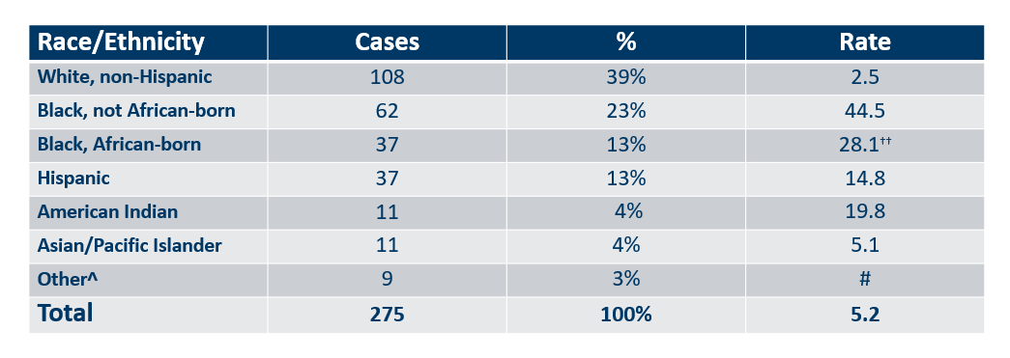
Number of Cases and Rates (per 100,000 persons) of HIV Diagnoses* by Race/Ethnicity†
Minnesota, 2019
Notes:
Each year we calculate the rate of diagnosis for each racial/ethnic group represented in the surveillance system to assess the impact of HIV within each community. The rate takes into account the size of the population of each group.
Non-Hispanic black, African-born and African-Americans had the highest rate of diagnoses in 2019 with 28.1 HIV diagnoses per 100,000 population and 44.5 HIV diagnoses per 100,000 population respectively. This represents a rate of HIV diagnosis among the black, African-born community that is 11 times higher than the white non-Hispanic population in Minnesota. The rate among African-American non-Hispanic population is nearly 18 times higher than white non-Hispanic population. (Note: Rates for black, African-American and black, African-born are not comparable to previous years due to an increase in the estimate for black, African-born population.)
American Indians have the next highest rate of newly diagnosed HIV cases in Minnesota at 19.8 per 100,000 persons; this is a rate of nearly 8 times higher than white, non-Hispanic persons.
Hispanic persons of any race have a rate of persons newly diagnosed with HIV of 14.8 per 100,000 persons, nearly 6 times the rate of white, non-Hispanic persons.

Slide 7
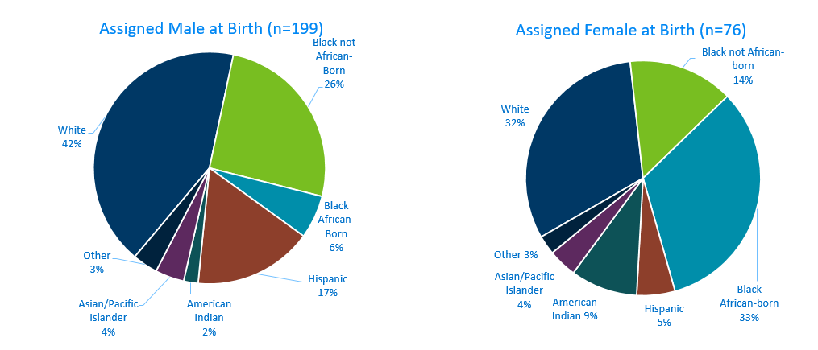
HIV Diagnoses* Diagnosed in Year 2019 by Sex Assigned at Birth and Race/Ethnicity†
Notes:
There are differences in the racial/ethnic distribution by sex assigned at birth. Among those assigned the sex of male at birth, 42% of the 2019 cases diagnosed in Minnesota are Non-Hispanic white. Non-Hispanic African-American and black, African-born males made up 32% of cases and Hispanic males of any race accounted for 17% of cases.
Among those assigned the sex of female at birth, the disparities are even more apparent with women of color representing 68% of all the newly diagnosed females in 2019, with black, African-born women accounting for a third (33%) of cases and Non-Hispanic African-American women accounting for 14% of cases.

Slide 8
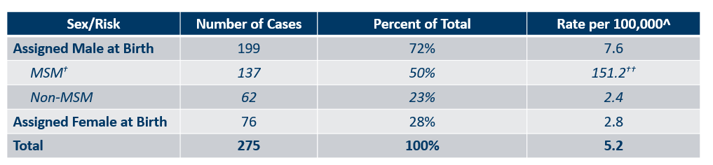
Number of Cases and Rates (per 100,000 persons) of Adults and Adolescents* Diagnosed with HIV/AIDS by Sex Assigned at Birth and Risk† in Minnesota, 2019
Notes:
Men who have Sex with Men have the highest rate of HIV diagnosis than any other sub-category. In 2019, the estimated rate of HIV diagnosis among MSM was 151.2 per 100,000 population. This is 63 times higher than the rate among non-MSM men.
It’s important to note that MSM contains cases from all racial/ethnic categories and therefore, cannot be directly compared to the rates on the previous slide. For more information on how this rate was estimated, see the HIV Surveillance Technical Notes which are available on our website.

Slide 9
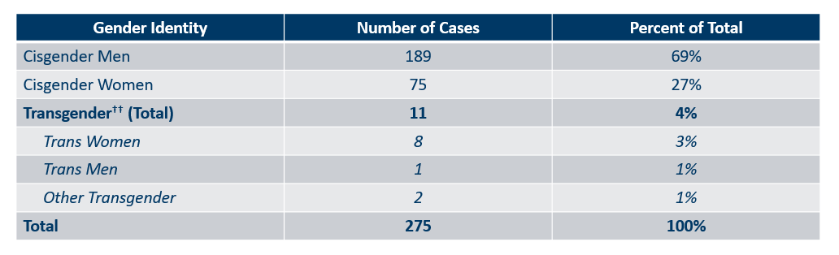
Number of Cases of Adults and Adolescents* Diagnosed with HIV/AIDS by Gender Identity in Minnesota, 2019
Notes:
This slide shows the number of people living with HIV/AIDS by gender identity.
In 2019, there were 11 transgender newly reported HIV cases in Minnesota (8 Trans Women, 1 Trans Man, and 2 additional Transgender identities). This represents 4% of new cases reported in the state.

Slide 10
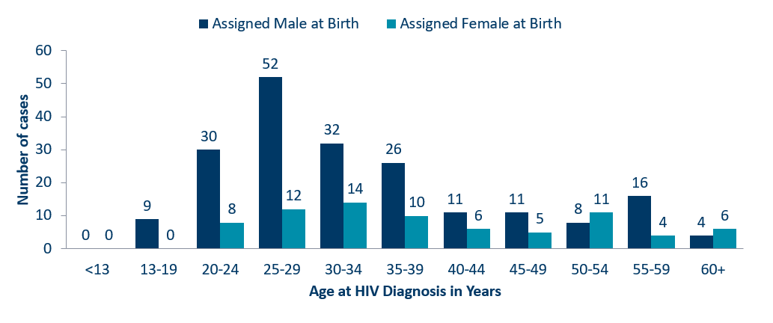
Age at HIV Diagnosis* by Sex Assigned at Birth, Minnesota, 2019
Notes:
In 2019, there were 111 cases diagnosed under the age of 30. This accounts for 40% of all cases. Most of these cases were among young people assigned the sex of male at birth, where 82% of cases under the age of 30 were male. The age groups from 25-34 had the largest number of cases in 2019.

Slide 11
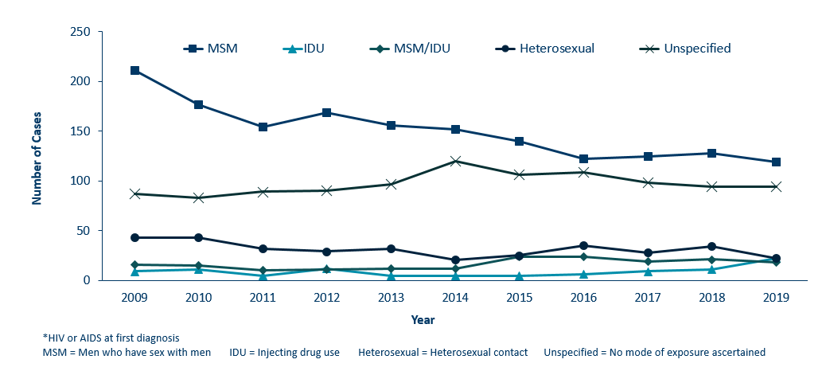
HIV Diagnoses* by Mode of Exposure and Year, 2009 - 2019
Notes:
This slide depicts risk for all persons diagnosed with HIV in Minnesota during the past decade and since the beginning of the epidemic, Men who have sex with Men has been the most commonly reported risk factor. In 2019, MSM accounted for 43% of all new HIV diagnoses in Minnesota with 119 cases diagnosed.
The number of cases among people who inject drugs (IDU only) has doubled with 22 cases in 2019 compared to 11 cases in 2018. In February 2020, a MDH Health Alert Network notice was released about a HIV outbreak among persons who inject drugs for Hennepin and Ramsey counties.

Slide 12
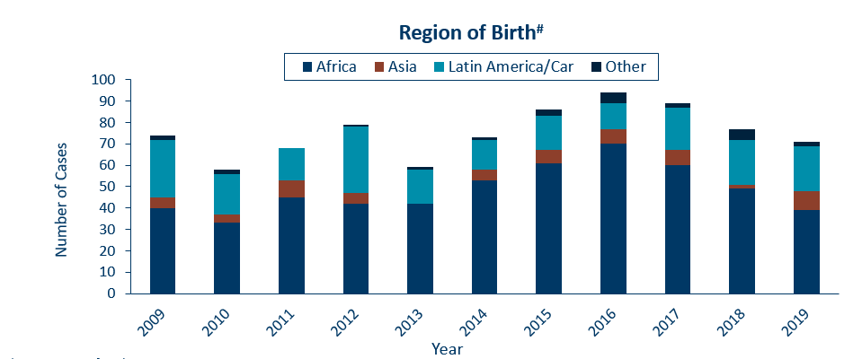
HIV Diagnoses* among Foreign-Born Persons† in Minnesota by Year and Region of Birth
2009 - 2019
Notes:
The number of new HIV infections diagnosed among foreign-born persons in Minnesota has steadily increased from 20 cases in 1990 to 71 cases in 2019. This increase has been largely driven by the increase of cases among African-born persons from 8 cases in 1990 to 39 cases in 2019, as well as, persons from Mexico, Central and South America and the Caribbean from 6 cases in 1990 to 21 cases in 2019. Among new HIV infections diagnosed in 2019, 26% were among foreign-born persons. Based on 2010-2012 American Community Survey data, foreign-born persons make up 7% of the total Minnesota population and are, therefore, disproportionately affected by HIV. Among African-born this disparity is even more evident, while African-born persons make up just over 1% of the Minnesota population they accounted for 14% of new HIV infections in 2019.
In 2019, there were 71 cases of newly reported HIV among foreign-born persons, over one out of four of all new cases. The majority of foreign born cases in 2019 were from Africa, followed by Latin America and the Caribbean.

Slide 13
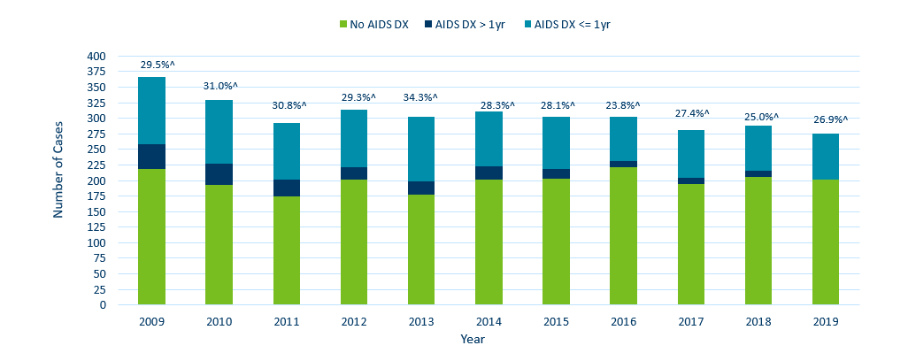
Time of Progression to AIDS for HIV Diagnoses in Minnesota*
2009 - 2019†
Notes:
In 2018, 25% of new cases were late testers. This proportion of cases has remained relatively the same over the past 10 years, ranging between 24-34%. Most late testers, about 85%, are diagnosed with AIDS at the same time they are initially diagnosed with HIV infection.
For 2019, 27% of new cases were late testers so far, which represents only a partial follow-up year to only June, 2020.
As with other characteristics of the HIV epidemic in Minnesota, the proportion of late testers varies by demographic characteristics. Historically, foreign-born persons have had a higher proportion of late-testers.

Slide 14
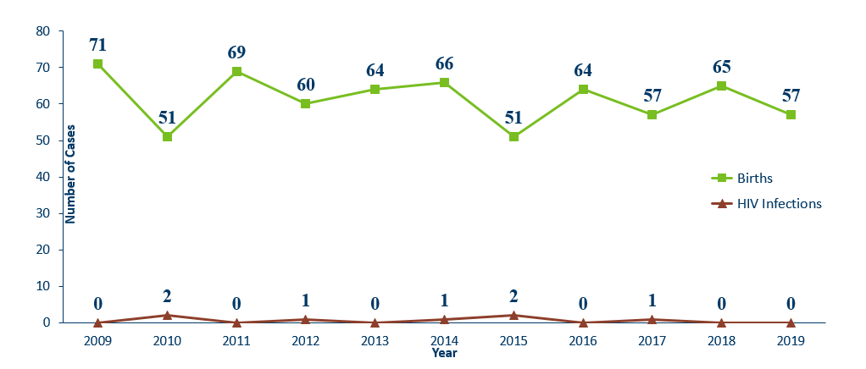
Births to Pregnant people living with HIV and Number of Perinatal Acquired HIV Infections* by Year of Birth, 2009- 2019
Notes:
The ability to interrupt the transmission of HIV from birthing parent to child with antiretroviral therapy and appropriate perinatal care is an important accomplishment in the history of the HIV/AIDS epidemic. Newborn HIV infection rates range from 25-30% without antiretroviral therapy, but decrease to 1-2% with appropriate medical intervention.
For the past decade the number of births to birthing parents living with HIV has ranged between 51-71 births. For 2019, there were 57 births to birthing parents living with HIV. The rate of transmission has decreased from 15% between 1994 and 1996 to 0.6% in the past three years (2017-2019), with 1 HIV positive baby born to an HIV positive pregnant person in Minnesota in 2017.

Slide 15
Persons Living with HIV/AIDS in Minnesota
Notes:
Now we will talk about prevalence, or the cumulative number of people diagnosed with HIV and reported to the Minnesota Department of Health, and still believed to be living in the state. The HIV surveillance system is dynamic, with information being entered on a daily basis. These numbers are a snapshot as of the end of 2019, based on what was reported to the health department.

Slide 16
Estimated Number of Persons Living with HIV/AIDS in Minnesota
As of December 31, 2019 9,193* persons are assumed alive and living in Minnesota with HIV/AIDS. This includes:
  5,094 (55%) living with HIV infection (non-AIDS)
  4,099 (45%) living with AIDS
This number includes 2,418 persons who were first reported with HIV or AIDS elsewhere and subsequently moved to Minnesota
This number excludes 1,612 persons who were first reported with HIV or AIDS in Minnesota and subsequently moved out of the state
Notes:
As of the end of 2019, 9,193 people were believed to be alive and still living with HIV in the state of Minnesota. This number includes 5,094 (55%) living with HIV infection that had not progressed to an AIDS diagnosis, and 4,099 (45%) that had progressed to a clinical AIDS diagnosis. This total number also includes 2,418 people who were first reported with HIV or AIDS elsewhere and subsequently moved to Minnesota, and excludes 1,612 people who were first reported with HIV or AIDS in Minnesota and subsequently moved out of the state.

Slide 17
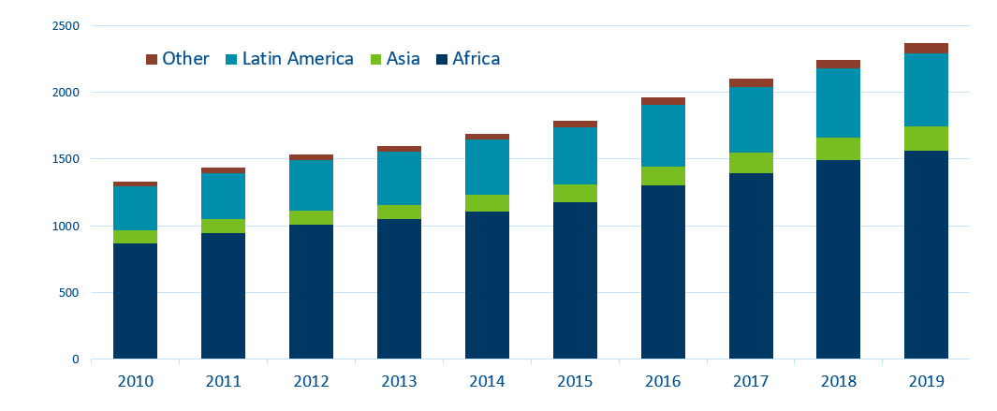
Foreign Born Persons Living with HIV/AIDS in Minnesota* by Region of Birth, 2008-2019
*This number includes persons who reported Minnesota as their current state of residence, regardless of residence at time of diagnosis. It also includes state prisoners and refugees arriving through the HIV+ Refugee Resettlement Program, as well as HIV+ refugees/immigrants arriving through other programs.
Notes:
One particular population of interest in Minnesota that sets us apart from other states is our larger foreign-born HIV-positive population. Between 1990 and 2019, the number of foreign-born people living with HIV/AIDS in Minnesota increased substantially, especially among the African-born population. In 1990, 50 foreign-born people were reported to be living with HIV/AIDS in Minnesota, and by 2007 this number had increased to 1,126 people. In 2019, the total number of foreign-born people living with HIV/AIDS in Minnesota was 2,367, a 5% increase from 2018. The majority of these people immigrated to the United States from Africa and Latin America. This trend illustrates the growing diversity of the HIV-positive population in Minnesota and the need for culturally appropriate HIV care and prevention efforts.

Slide 18
Additional Topics
Notes:
Now we’ll discuss a couple additional topics of particular relevance this year.

Slide 19
HIV Outbreak in Hennepin and Ramsey Counties
In February 2020, a MDH Health Alert Network notice was released about a HIV outbreak among persons who inject drugs (PWID) in Hennepin and Ramsey counties.
Currently, there are 26 cases among PWID associated with the outbreak, with many individuals experiencing homelessness and diagnosed with hepatitis C virus.
Persons likely to be at high risk include:
  Sex partners or syringe-sharing partners of people known to be living with HIV
  PWID and their sex partners and needle/equipment sharing partners
  Persons who exchange sex for income or other items they need
Notes:
In February 2020, a MDH Health Alert Network notice was released about an HIV outbreak among persons who inject drugs (PWID) in Hennepin and Ramsey counties.
Currently, there are 26 cases among PWID associated with the outbreak (17 of the cases were diagnosed with HIV in 2019).
Many of the individuals were also diagnosed with hepatitis C virus and were experiencing homelessness at time of diagnosis.
Persons likely to be at high risk include:
Sex partners or syringe-sharing partners of people known to be living with HIV,
PWID and their sex partners and needle/equipment sharing partners, and
Persons who exchange sex for income or other items.

Slide 20
HIV Molecular Data
Analysis of the genetic sequence of an HIV virus to identify when and where HIV is spreading quickly
An additional tool to make traditional public health methods more effective – partner services has been doing this work for decades
A CDC requirement for all health departments:
  Role of HIV surveillance offices is largely set by CDC
  HIV prevention and partner services have some more flexibility
For more information: https://www.health.state.mn.us/diseases/hiv/stats/index.html
Notes:
One recent change in HIV data collected at state health departments involves HIV molecular data, which is also known as molecular epidemiology. This is a technology already used by CDC and state health departments for other reportable infections (like tuberculosis and food-born illnesses).
The collection of DNA sequences of an individual HIV virus can be used to identify when and where HIV is spreading quickly within populations. It is an additional tool to help make traditional public health methods more effective, though partner services programs have been collecting data about HIV case relation and clustering for decades. HIV molecular data cannot prove the direction in which HIV transmission occurred – it can only identify groups of HIV infections that are closely related. This is a new CDC requirement for all health departments. The role that the HIV surveillance unit will play in molecular data collection is largely set and controlled by CDC, but what the HIV prevention and partner services units at the health department do with those data has some more flexibility. At MDH, we understand and respect that this intervention may be concerning for some community members, so the link on our website includes a more in-depth presentation about this topic.

Slide 21
Thank you!
Cheryl Barber, Jared Shenk, and Trent Daugherty, MDH HIV Epidemiologists
Cheryl.Barber@state.mn.us
Jared.Shenk@state.mn.us
Trent.Daugherty@state.mn.us
Notes:
Thank you for your time. If you have questions regarding the slides and annual report you can contact us at the e-mail addresses here on the slide. And again, the full set of slides, text and tables are also available on our website for you to use.

