Slide 1

HIV Incidence Report, 2018
Sexually Transmitted Diseases, HIV and Tuberculosis Section, Epidemiology and Surveillance Unit

Slide 2
Introduction (I)
These two introduction slides provide a general context for the data used to create this slide set. If you have questions about any of the slides please refer to HIV Surveillance Technical Notes.
This slide set describes new HIV diagnoses (including AIDS at first diagnosis) in Minnesota by person, place, and time.
The slides rely on data from HIV/AIDS cases diagnosed through 2018 and reported to the Minnesota Department of Health (MDH) HIV/AIDS Surveillance System.
The data are displayed by year of HIV diagnosis.

Slide 3
Introduction (II)
Data analyses exclude people diagnosed in federal or private correctional facilities, but include state prisoners (number of state prisoners believed to be living with HIV/AIDS (n=30).
Data analyses for new HIV diagnoses exclude people arriving to Minnesota through the HIV+ Refugee Resettlement Program (number of primary HIV+ refuges in this program living in MN as of December 31, 2018 = 169), as well as, other refuges/immigrants reporting a positive test prior to their arrival in Minnesota (n=164).
Some limitations of surveillance data:
Data do not include HIV-infected people who have not been tested for HIV
Data do not include people whose positive test results have not been reported to MDH
Data do not include HIV-infected people who have only tested anonymously
Case numbers for the most recent years may be undercounted due to delays in reporting
Reporting of living cases that were not initially diagnosed in Minnesota is known to be incomplete

Slide 4
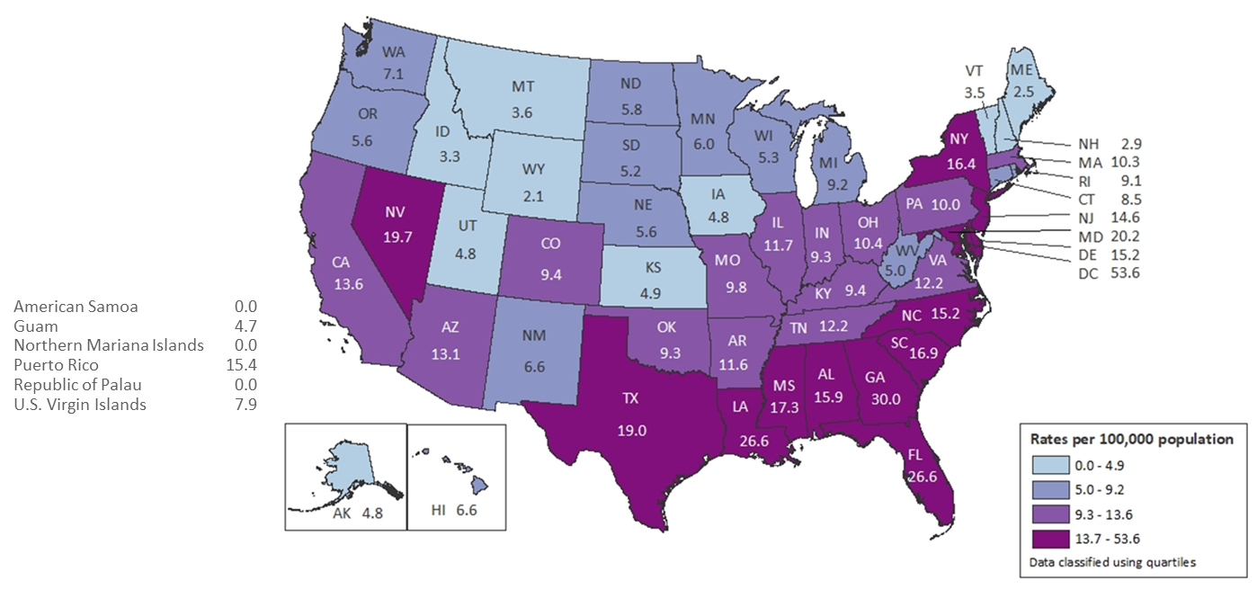
National Context (I)
Rates of Diagnoses of HIV Infection among Adults and Adolescents 2017- United States and 6 Dependent Areas
Note. Data for the year 2017 are considered preliminary and based on 6 months reporting delay.
Notes:
In the United States and 6 dependent areas, the rate of diagnoses of HIV infection among adults and adolescents was 14.0 per 100,000 population in 2017. The rate of diagnoses of HIV infection for adults and adolescents ranged from zero per 100,000 in American Samoa, the Northern Mariana Islands, and the Republic of Palau to 53.6 per 100,000 in the District of Columbia.
The District of Columbia (i.e., Washington, DC) is a city; use caution when comparing the HIV diagnosis rate in DC with the rates in states.
Data for the year 2017 are considered preliminary and based on 6 months reporting delay.

Slide 5
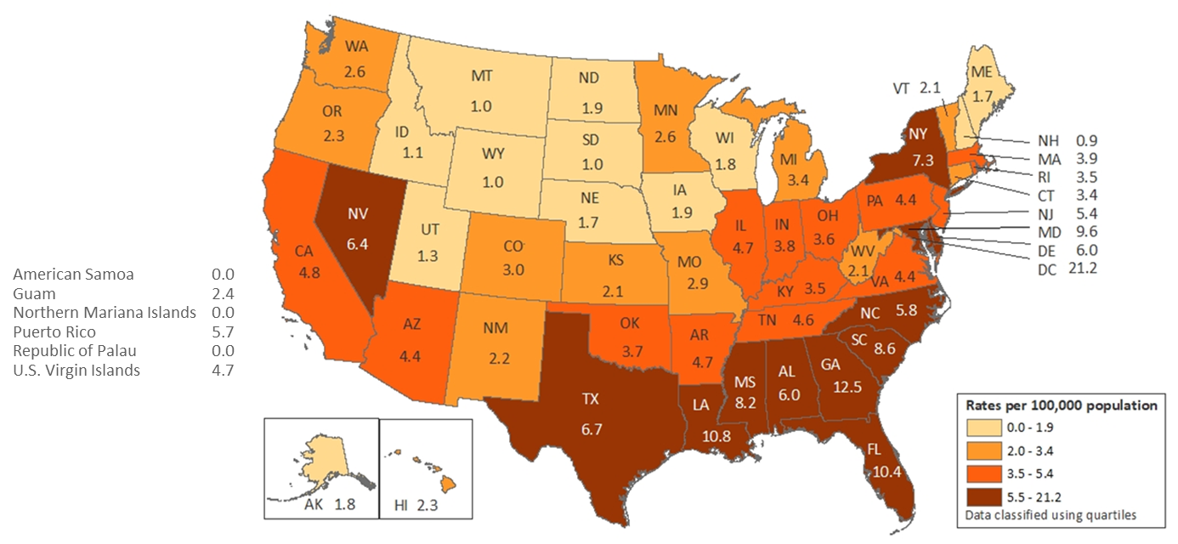
National Context (II)
Rates of Diagnosed HIV Infection Classified as Stage 3 (AIDS) 2017- United states and 6 Dependent Areas
Note. Data for the year 2017 are considered preliminary and based on 6 months reporting delay.
Notes:
The rates (per 100,000 population) of stage 3 (AIDS) classifications in 2017 for people (all ages) with diagnosed HIV infection are shown for each state, the District of Columbia, American Samoa, Guam, the Northern Mariana Islands, Puerto Rico, the Republic of Palau, and the U.S. Virgin Islands.
Areas with the highest rates of stage 3 (AIDS) in 2017 were the District of Columbia (21.2), Georgia (12.5), Louisiana (10.8), and Florida (10.4).
The District of Columbia (i.e., Washington, DC) is a city; use caution when comparing the stage 3 (AIDS) rate in DC with the rates in states.
Data for the year 2017 are considered preliminary and based on 6 months reporting delay.

Slide 6
Overview of HIV/AIDS in Minnesota

Slide 7
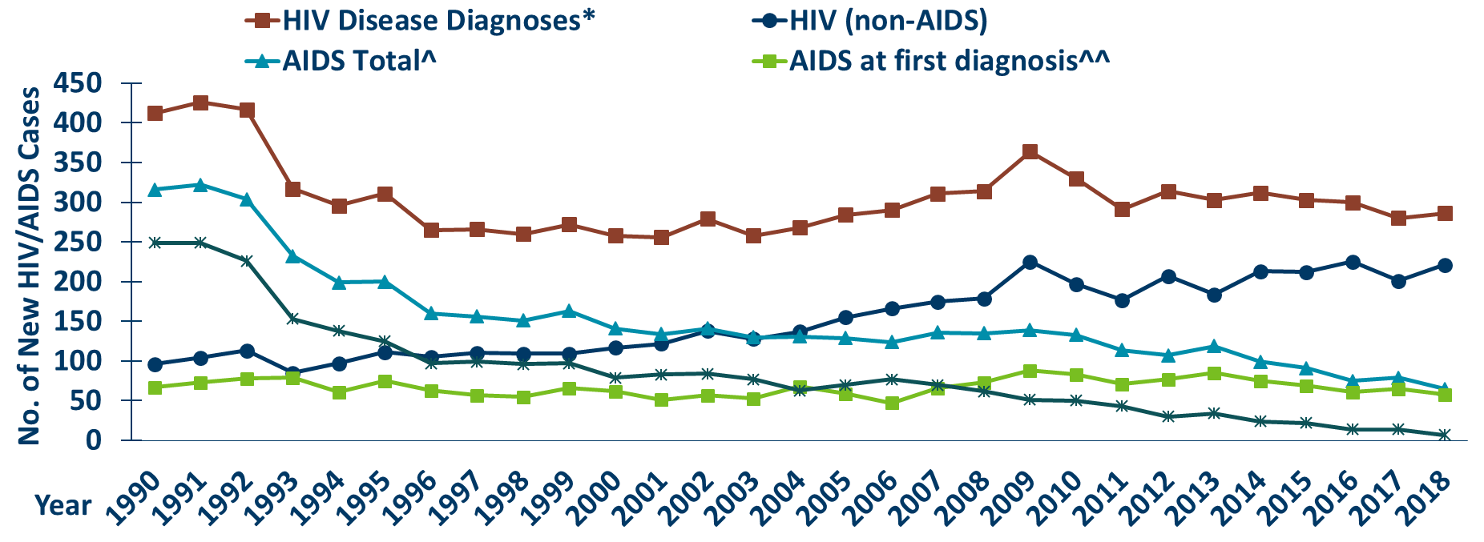
New HIV Diagnoses, HIV (non-AIDS) and AIDS Cases by Year of HIV Diagnosis, 1990-2018
Notes:
Nationally, Minnesota is considered within the low to moderate risk of HIV and AIDS infections as defined by the Centers for Disease Control and Prevention (CDC). The annual number of new HIV and AIDS cases increased steadily from the beginning of the epidemic to the early 1990s. Beginning in 1996, both the number of newly diagnosed AIDS cases and the number of deaths among AIDS cases declined sharply, primarily due to the success of new antiretroviral therapies including protease inhibitors. These treatments do not cure, but can delay progression to AIDS among people with HIV (non-AIDS) infection and improve survival among those with AIDS. These treatments have been shown to be effective at preventing transmission of HIV. Over the past five years, the number of HIV/AIDS cases diagnosed has remained relatively stable with an average of almost 300 cases diagnosed each year. By the end of 2018, an estimated 8,981 people with HIV/AIDS were assumed to be living in Minnesota.
This number includes people whose most recently reported state of residence was Minnesota, regardless of residence at time of diagnosis. This estimate does not include people with undiagnosed HIV infection.

Slide 8
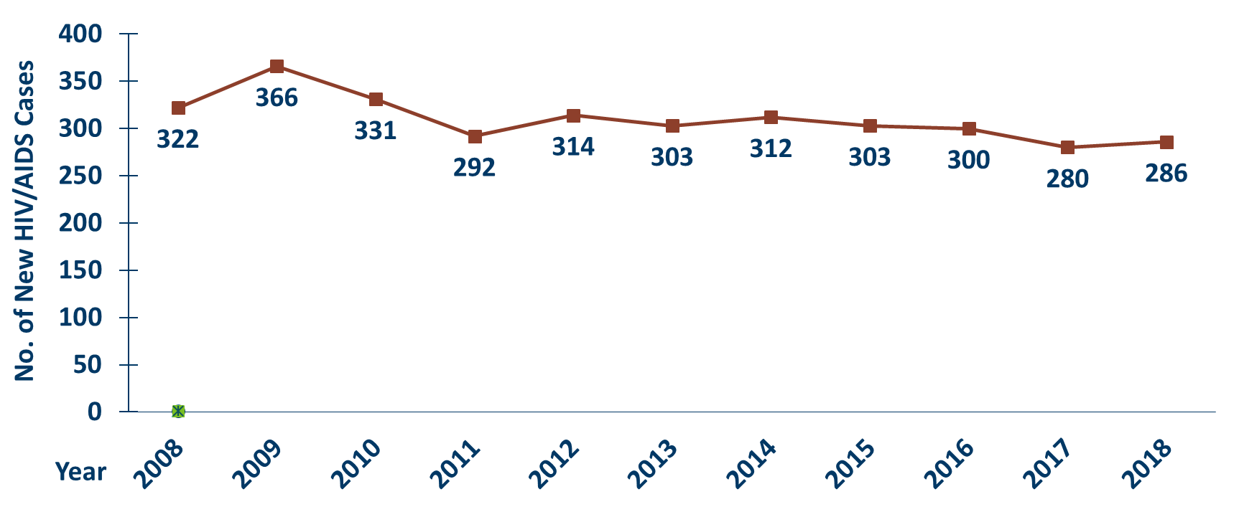
New HIV Disease Diagnoses*, HIV/AIDS Cases by Year, 2008-2018
Notes:
In this report, the term “new HIV diagnoses” refers to HIV-infected Minnesota residents who were diagnosed in a particular calendar year and reported to MDH. This includes people whose first diagnosis of HIV infection is AIDS (AIDS at first diagnosis). HIV diagnoses data are displayed by earliest known date of HIV diagnosis.
In 2018, there was a slight increase of new HIV diagnoses from 2017. In 2018 there were 286 newly diagnosed cases, as compared to 280 cases in 2017. This represents an increase of about 2% compared to 2017. In reviewing newly diagnosed cases since 2014, 286 cases for 2018 is below the 5 year average of 296 cases per year.

Slide 9
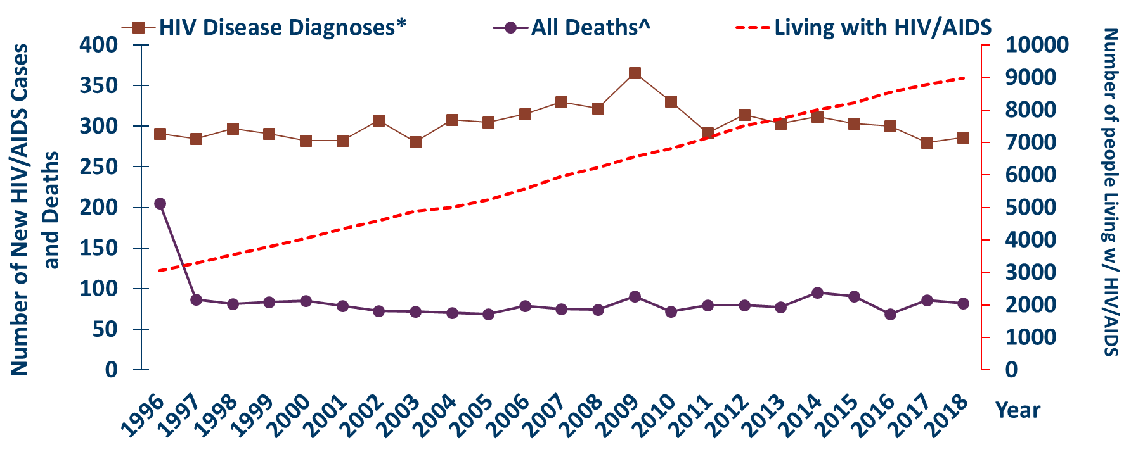
New HIV Diagnoses, Deaths, and Prevalent Cases by Year, 1996-2018
Notes:
Since 1996, the number of new diagnoses has remained relatively stable in Minnesota at around 300 cases per year. During this same time, deaths among HIV positive people in Minnesota has decreased dramatically. As people with HIV are living longer and healthier lives, the number of people living with HIV in Minnesota continues to grow as seen in the Red line here. At the end of 2018, 8,981 people were estimated to be living with HIV or AIDS in Minnesota.
This number does not include 1,560 people who were first reported with HIV or AIDs in Minnesota and subsequently moved out of the state. Although it does include 2,331 people who were first reported with HIV or AIDS elsewhere and subsequently moved to Minnesota.

Slide 10
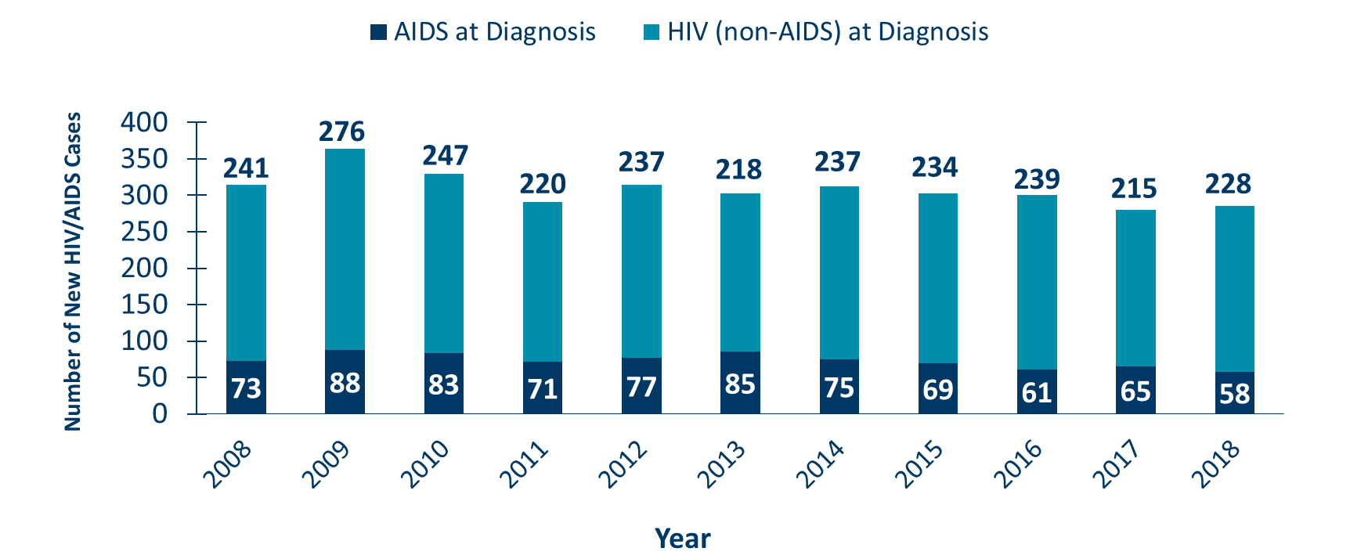
HIV (non-AIDS) and AIDS at Diagnosis by Year, 2008-2018
Notes:
During the past 10 years, the proportion of cases being diagnosed with AIDS at initial HIV diagnosis has remained the same at about 25% of all new cases. For 2018, the proportion of cases diagnosed with AIDS at initial HIV diagnosis was slightly lower at 20%.

Slide 11
HIV Diagnoses* in Minnesota by Person, Place, and Time

Slide 12
Place

Slide 13
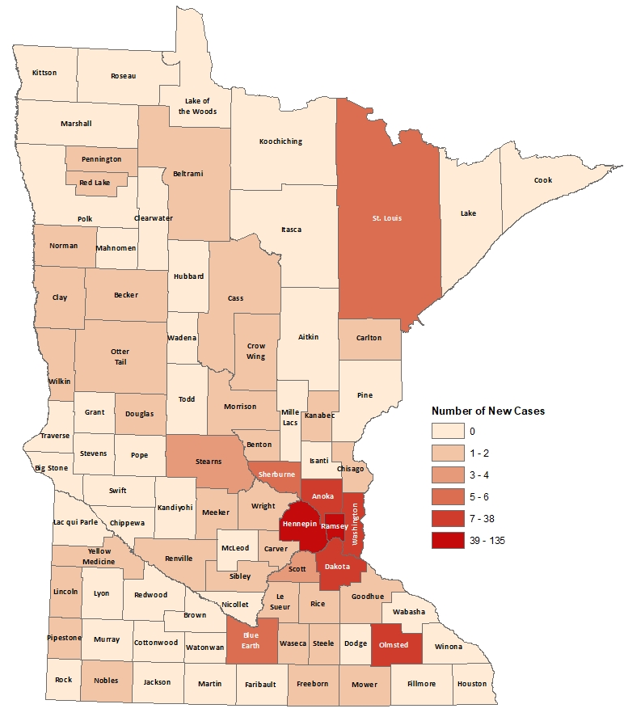
HIV Diagnoses# by County of Residence at Diagnosis, 2018
City of Minneapolis: 75 cases (26%)
City of St. Paul: 33 cases (11%)
Suburban*: 113 cases (40%)
Greater Minnesota: 65 cases (23%)
Total: 286 cases
#HIV or AIDS at first diagnosis
*7-county metro area, excluding the cities of Minneapolis and St. Paul
Notes:
Historically, about 80% of new HIV infections diagnosed in Minnesota have occurred in Minneapolis, St. Paul and the surrounding seven-county metropolitan area.
In 2018, geographically, the new cases were concentrated in the Twin Cities metropolitan area, with 77% of the cases located in the seven county Twin Cities metro region with 26% in Minneapolis, 11% in St. Paul, and 40% in the remaining suburban area (excluding Minneapolis/St. Paul). In greater Minnesota, there were 65 newly diagnosed HIV cases in 35 counties.

Slide 14
Notes:
While 77% of all new HIV diagnoses in Minnesota occur in the Twin Cities Seven County metropolitan area, the cases in the metro area are concentrated in Hennepin and Ramsey counties.

Slide 15
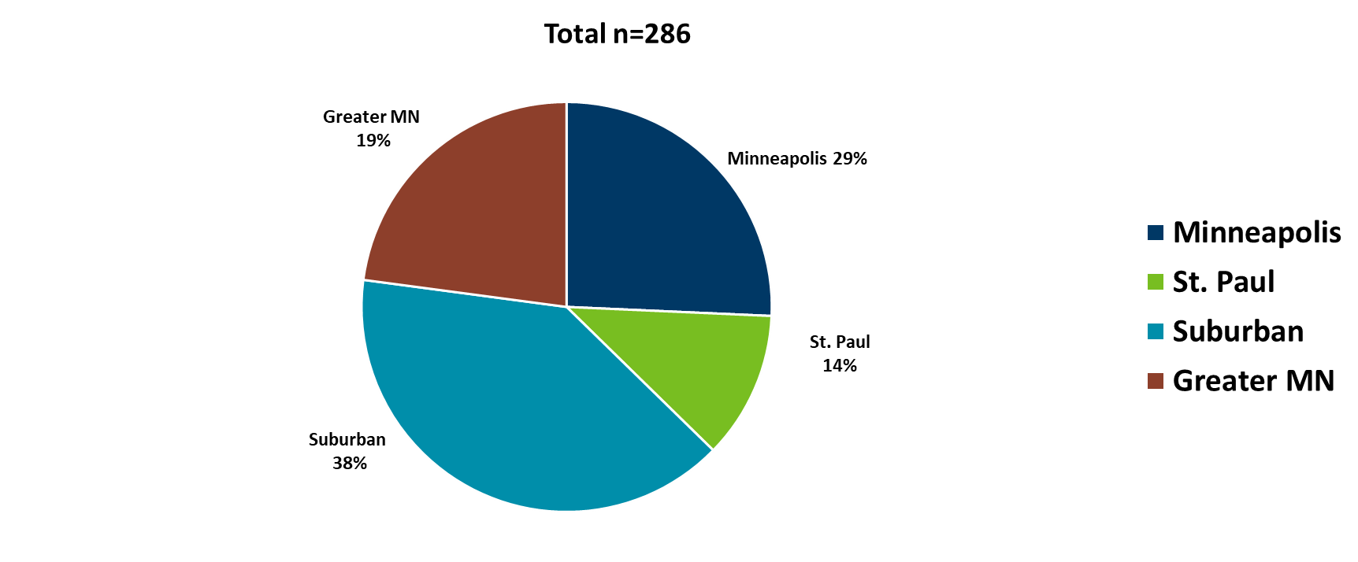
HIV Diagnoses* in Minnesota by Residence at Diagnosis, 2018
Notes:
Overall, of the 286 HIV diagnoses in Minnesota in 2017, 38% were among residents of suburban seven-county metro area, 29% were residents of Minneapolis and 14% were residents of St. Paul, and 19% were residents of Greater Minnesota at the time of diagnosis. This distribution was similar to the prior year.

Slide 16
Sex at Birth, Gender and Race/Ethnicity

Slide 17
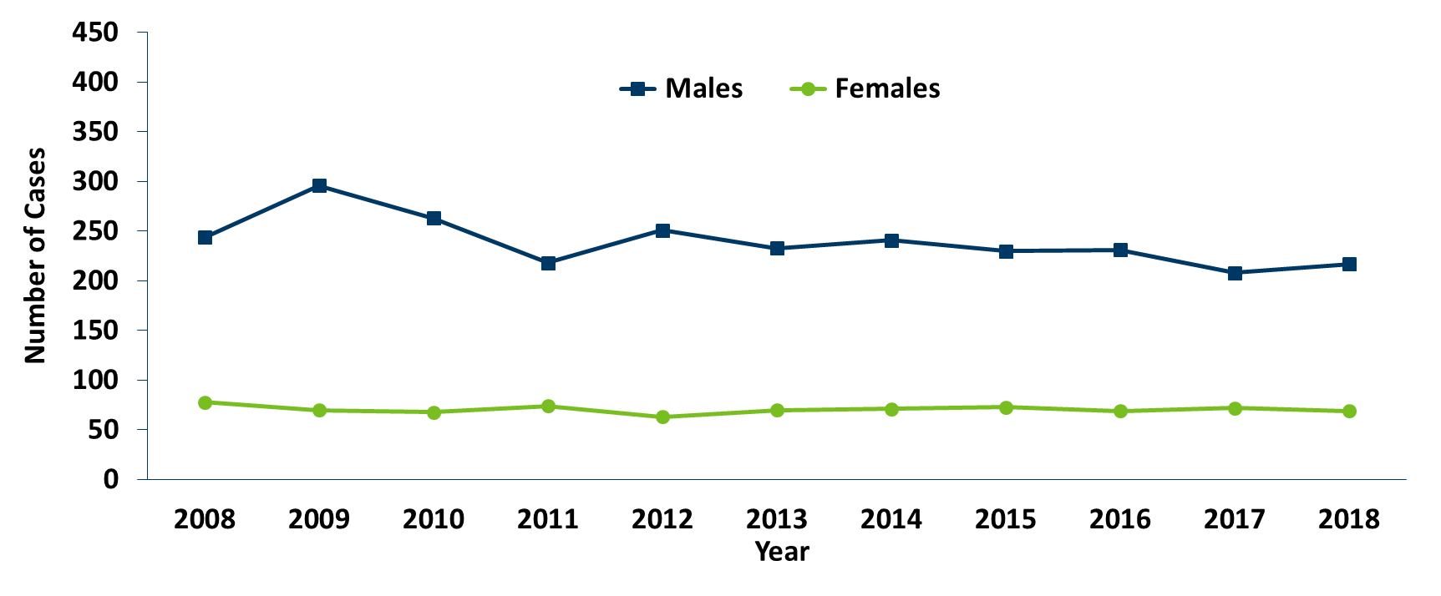
HIV Diagnoses* by Sex Assigned at Birth and Year of Diagnosis, 2008 - 2018
Notes:
In 2018, people with male sex assigned at birth made up 76% of newly reported cases while people with female sex assigned at birth made up 24%. The number of people assigned male sex at birth diagnosed with HIV increased from 208 in 2017 to 217 in 2018. The number of people assigned female sex at birth diagnosed with HIV decreased from 72 in 2017 to 69 in 2018.

Slide 18
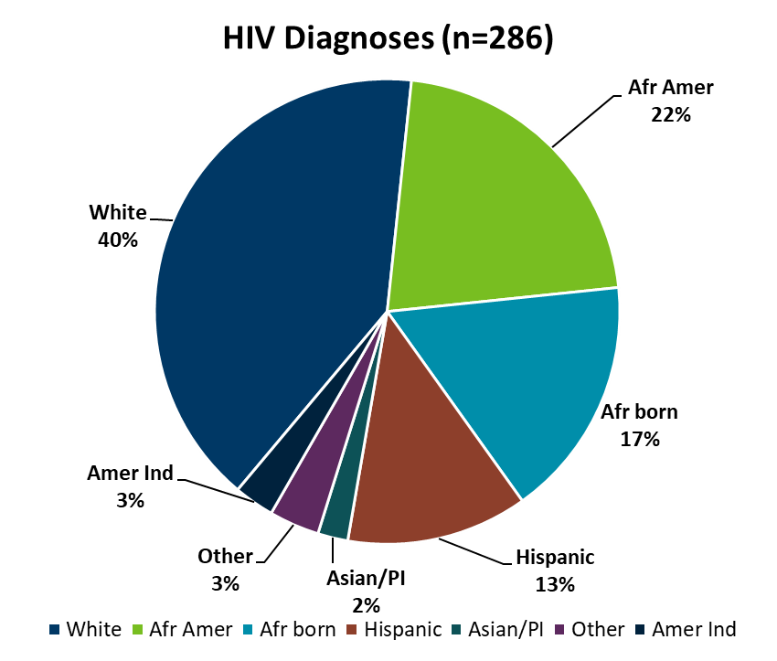
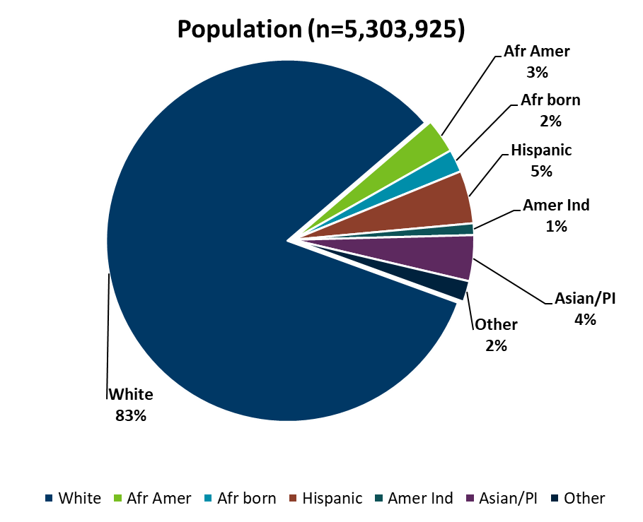
HIV Diagnoses* in 2018 and General Population in Minnesota by Race/Ethnicity
Notes:
When you look at the racial/ethnic distribution of new HIV diagnoses compared to the racial/ethnic distribution of the general population of Minnesota, it is apparent that disparities continue to exist among people of color. Non-Hispanic African-American and Black African-born Minnesotans jointly make up about 5% of the population in Minnesota, yet, account for 38% of the newly diagnosed cases of HIV in 2018. Similarly, Hispanics of any race also account for approximately 5% of the population, but account for 13% of the newly diagnosed cases.

Slide 19
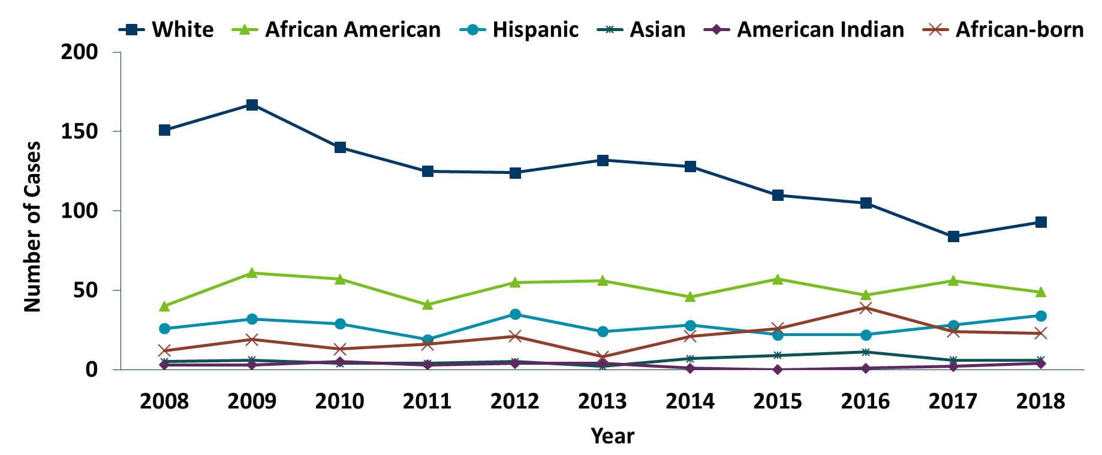
HIV Diagnoses* Among People Assigned Male Sex at Birth by Race/Ethnicity† and Year of Diagnosis, 2008 - 2018
Notes:
Trends in the annual number of new HIV infections diagnosed among people assigned male sex at birth differ by racial/ethnic group. White people assigned male sex at birth account for the largest number of new infections, but the proportion of cases that white people assigned male sex at birth account for has decreased over time. In 208, white people assigned male sex at birth accounted for 43% of the new HIV diagnoses among people assigned male sex at birth, with 93 diagnoses. During the past decade, the number of cases among African-American people assigned male sex at birth has fluctuated from year to year, with 49 new HIV diagnoses in 2018, which is almost a quarter of new HIV infections among people assigned male sex at birth (23%).
The annual number of HIV infections diagnosed among Hispanic people assigned male sex at birth has remained relatively stable, with small fluctuation from year to year. HIV infections in Hispanic people assigned male sex at birth was similar to the previous year with 34 cases in 2018. African-born people assigned male sex at birth diagnosed with HIV was stable in 2019 at 25 cases as compared to the previous year at 24 cases.

Slide 20
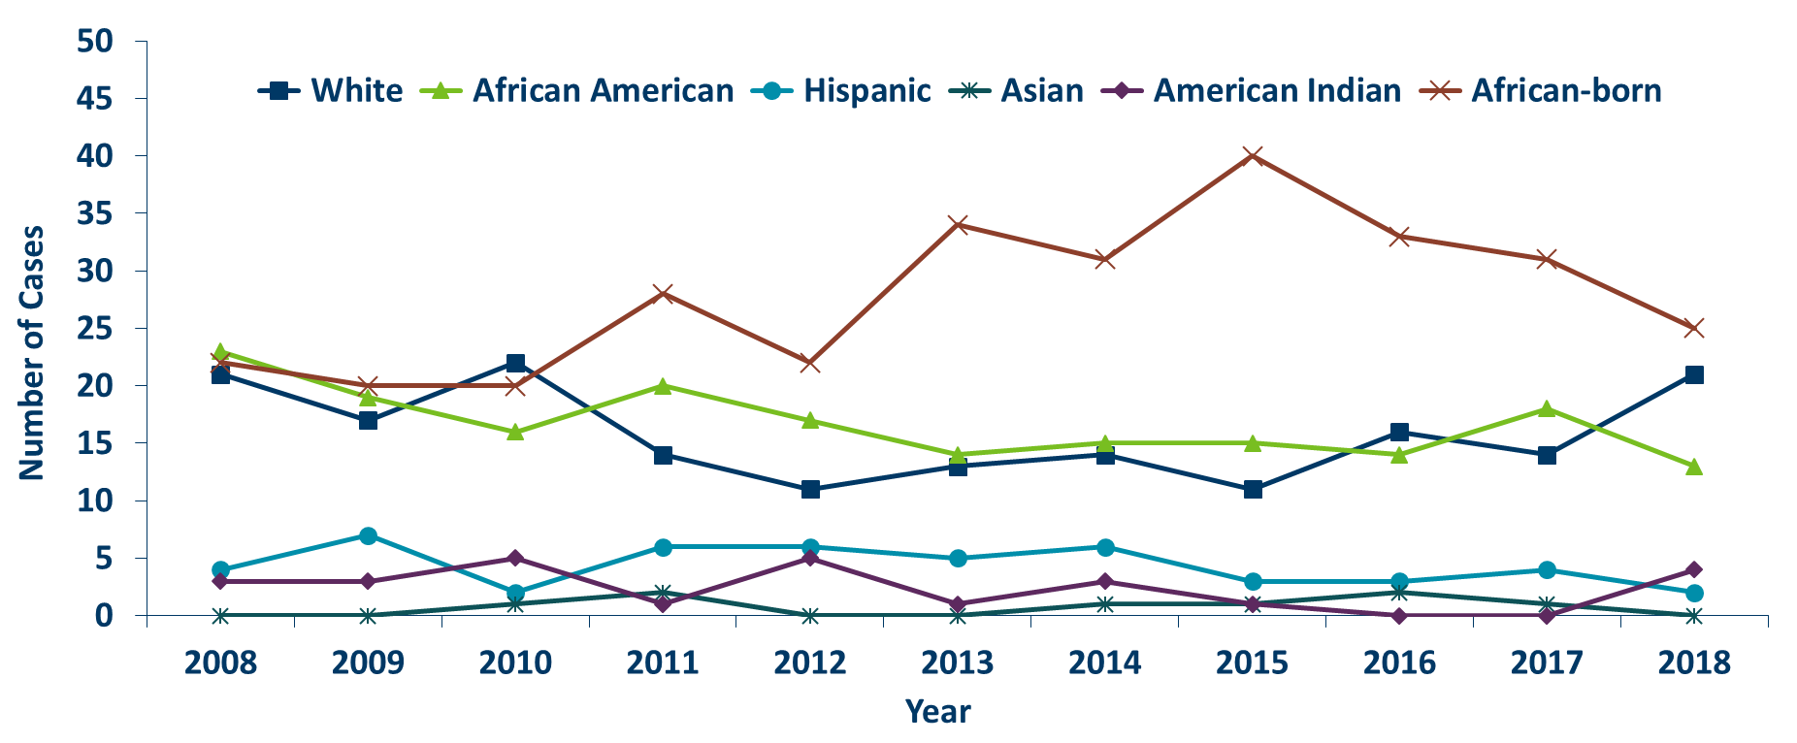
HIV Diagnoses* Among People Assigned Female Sex at Birth by Race/Ethnicity† and Year of Diagnosis, 2008 - 2018
Notes:
Similarly, trends in the annual number of HIV infections diagnosed among people assigned female sex at birth differ by racial/ethnic group. In 2018, people assigned female sex at birth of color accounted for nearly 70% of the new diagnoses in Minnesota, with 46 new cases, while non-Hispanic white people assigned female sex at birth accounted for only 31% of new diagnoses (21 cases).
The number of diagnoses among African-born people assigned female sex at birth has been increasing over the past decade. In 2018 the number of new cases among African-born people assigned female sex at birth was 25, accounting for 37% of all new diagnoses among people assigned female sex at birth. In 2018, there were 13 cases (19%) diagnosed among African American people assigned female sex at birth, compared to 18 (25%) in 2017. The annual number of new infections diagnosed among Hispanic, American Indian, Asian, and multi-racial people assigned female sex at birth continues to be quite small (7 cases or fewer per year for each of these groups).

Slide 21
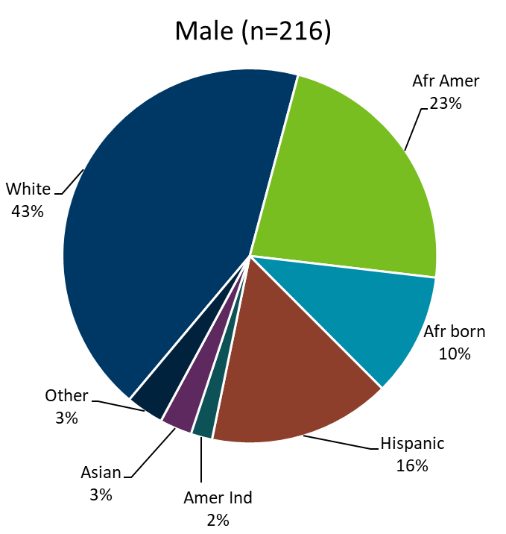
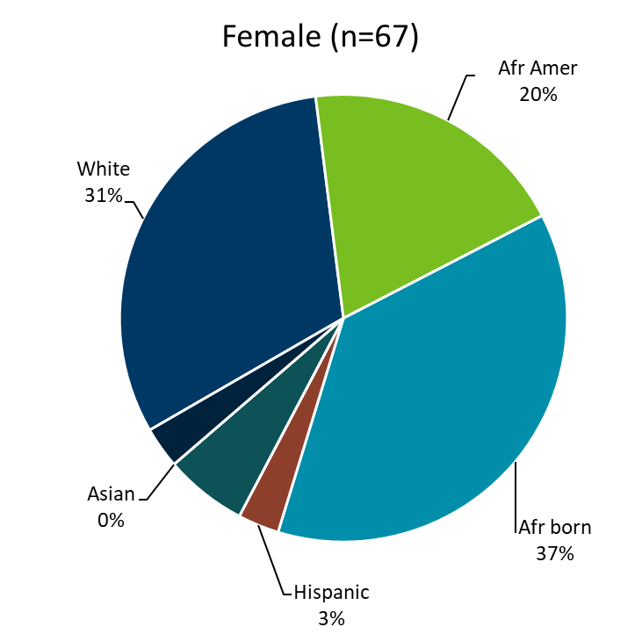
HIV Diagnoses* Diagnosed in 2018 by Sex Assigned at Birth and Race/Ethnicity
Notes:
There are differences in the racial/ethnic distribution by sex assigned at birth. Among those assigned the sex of male at birth, 43% of the 2018 cases diagnosed in Minnesota are Non-Hispanic white. Non-Hispanic African-American and black, African-born males made up 33% of cases and Hispanic males of any race accounted for 16% of cases.
Among those assigned the sex of female at birth, the disparities are even more apparent with women of color representing 70% of all the newly diagnosed females in 2018, with black, African-born women accounting for over a third (37%) of cases and Non-Hispanic African-American women accounting for 20% of cases.

Slide 22
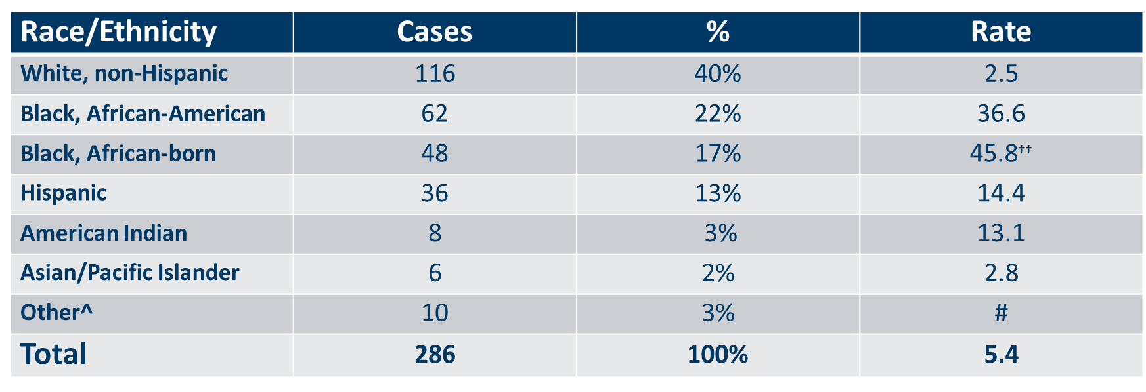
Number of Cases and Rates (per 100,000 people) of HIV Diagnoses* by Race/Ethnicity†, Minnesota, 2018
Notes:
Each year we calculate the rate of diagnosis for each racial/ethnic group represented in the surveillance system to assess the impact of HIV within each community. The rate takes into account the size of the population of each group.
Non-Hispanic black, African-born and African-Americans had the highest rate of diagnoses in 2018 with 45.8 HIV diagnoses per 100,000 population and 36.6 HIV diagnoses per 100,000 population respectively. This represents a rate of HIV diagnosis among the black, African-born community that is 18 times higher than the white non-Hispanic population in Minnesota. The rate among African-American non-Hispanic population is nearly 15 times higher than white non-Hispanic population. (Note: Rates for black, African-American and black, African-born are not comparable to previous years due to an increase in the estimate for black, African-born population.)
Hispanic people of any race have the next highest rate of newly diagnosed HIV cases in Minnesota at 14.4 per 100,000 people; this is a rate of nearly 6 times higher than white, non-Hispanic people.
American Indians have a rate of people newly diagnosed with HIV of 13.1 per 100,000 people, over five times the rate of white, non-Hispanic people.

Slide 23
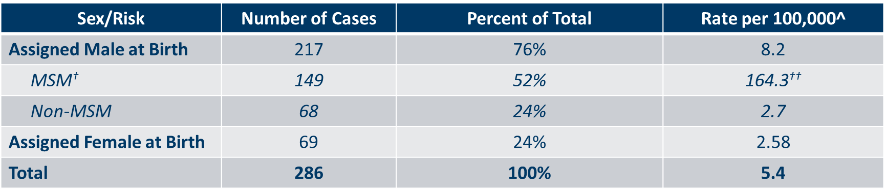
Cases & Rates (per 100,000) of Adults & Adolescents* Diagnosed With HIV/AIDS by Sex Assigned at Birth and Risk† in MN, 2018
Notes:
Men who have Sex with Men have the highest rate of HIV diagnosis than any other sub-category. In 2018, the estimated rate of HIV diagnosis among MSM was 164.3 per 100,000 population. This is more than 60 times higher than the rate among non-MSM men.
It’s important to note that MSM contains cases from all racial/ethnic categories and therefore, cannot be directly compared to the rates on the previous slide. For more information on how this rate was estimated, see the HIV Surveillance Technical Notes which are available on our website.

Slide 24
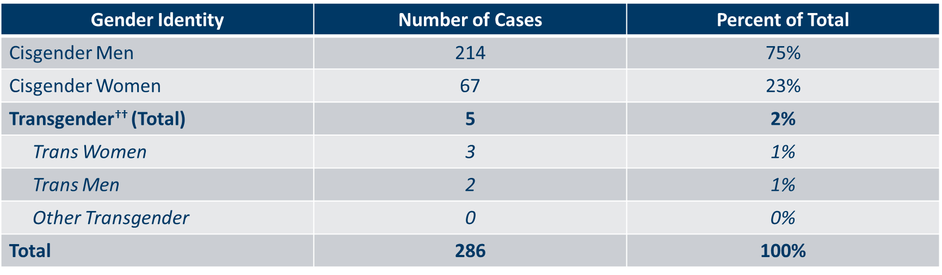
Number of Cases of Adults and Adolescents* Diagnosed with HIV/AIDS by Gender Identity in Minnesota, 2018
Notes:
This slide shows the number of people living with HIV/AIDS by gender identity.
In 2018, there were 5 transgender newly reported HIV cases in Minnesota (3 Trans Women and 2 Trans Men). This represents 2% of new cases reported in the state.

Slide 25
Age

Slide 26
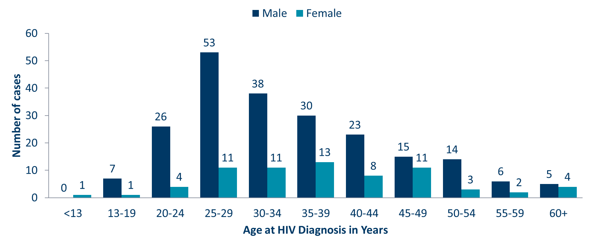
Age at HIV Diagnosis* by Sex Assigned at Birth, Minnesota, 2018
Notes:
In 2018, there were 103 cases diagnosed under the age of 30. This accounts for 36% of all cases. Most of these cases were among young people assigned the sex of male at birth, where 83% of cases under the age of 30 were male. The age groups from 25-34 had the largest number of cases in 2018, a change from 2017 when the most cases were seen in 20-29 age group.

Slide 27
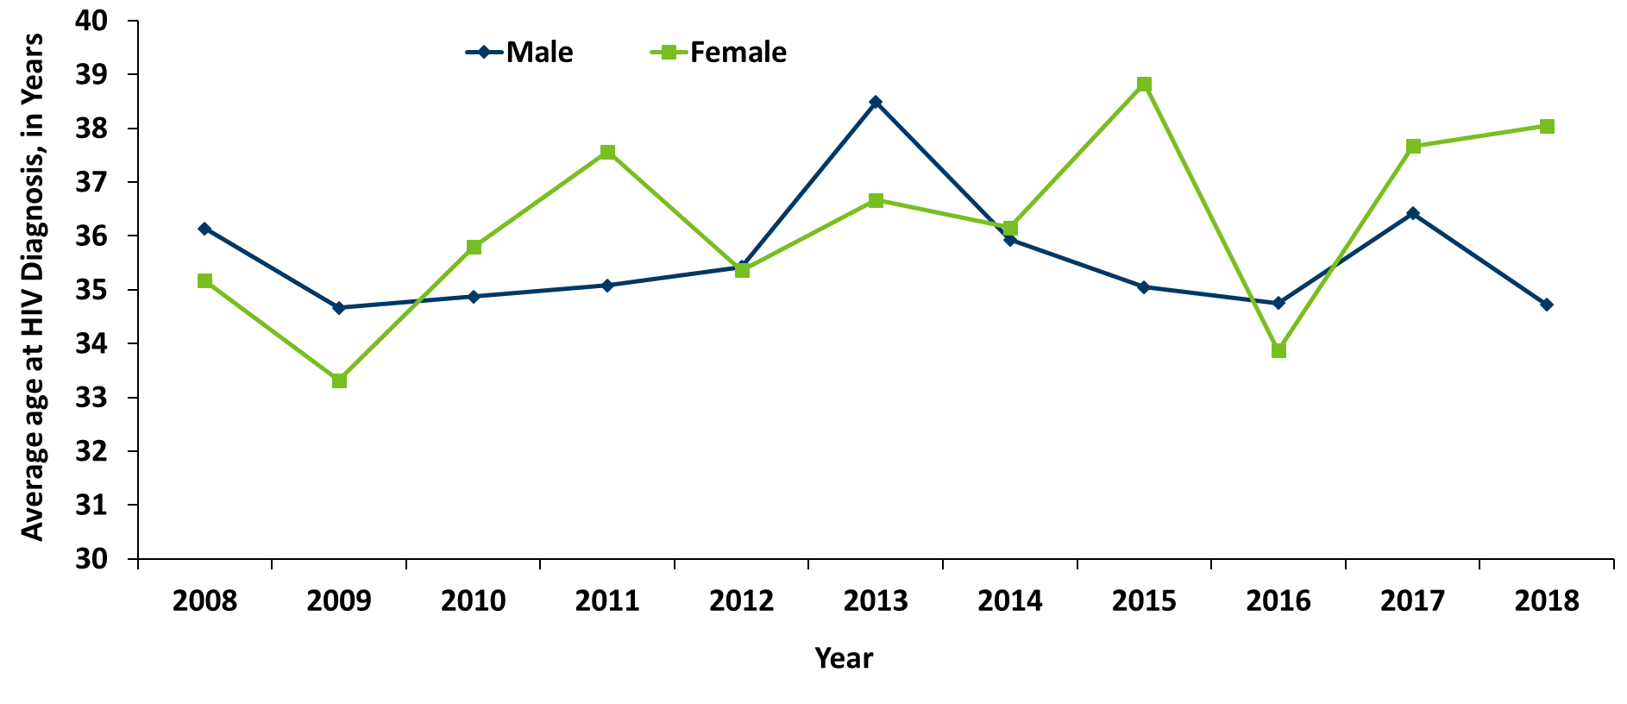
Average Age at HIV Diagnosis* by Sex Assigned at Birth, 2008-2018
Notes:
The average age at diagnosis among people assigned male sex at birth in 2018 was 34 years. The average age at diagnosis among people assigned female sex at birth was 38 years in 2018.

Slide 28
Mode of Exposure

Slide 29
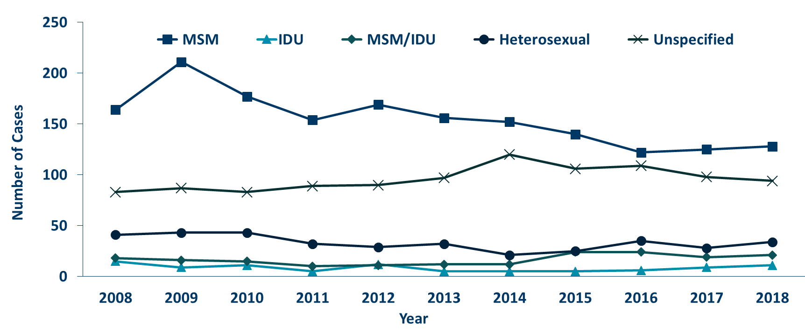
HIV Diagnoses* by Mode of Exposure and Year, 2008 - 2018
Notes:
This slide depicts risk for all people diagnosed with HIV in Minnesota during the past decade and since the beginning of the epidemic, Men who have sex with Men has been the most commonly reported risk factor. In 2018, MSM accounted for 45% of all new HIV diagnoses in Minnesota with 128 cases diagnosed.
The number of cases among people who inject drugs (MSM/IDU and IDU (bottom 2 lines on the graph)) has remained similar over the past three years with 32 cases in 2018 compared to 28 cases in 2017, which indicates a continued pattern of increased HIV infection among IDUs in the state.

Slide 30
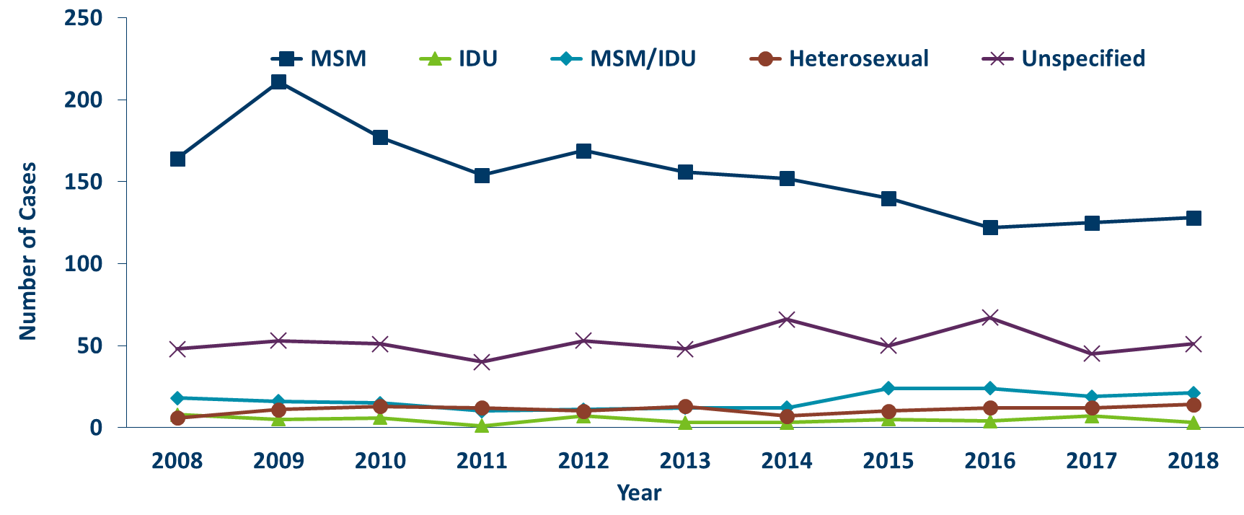
HIV Diagnoses* Among People Assigned Male Sex at Birth by Mode of Exposure and Year, 2008 - 2018
Notes:
When we look at HIV diagnoses only among people assigned male sex at birth, MSM accounts for a larger proportion of the new diagnoses. In 2018, MSM and MSM/IDU accounted for 59% of the newly diagnosed cases among people assigned male sex at birth. Throughout the past decade and again in 2018, unspecified risk is the second most common mode of exposure and has been accounting for an increasing proportion of cases since 2011.
There has been a stable increased number of cases of people who inject drugs(including IDU only and MSM/IDU) in recent years with 24 cases in 2018.

Slide 31
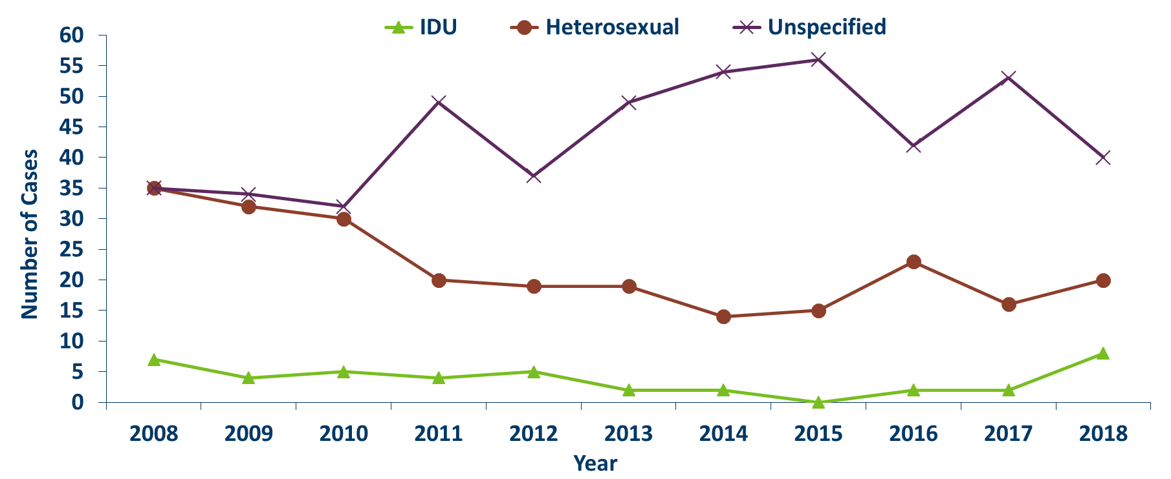
HIV Diagnoses* Among People Assigned Female Sex at Birth by Mode of Exposure and Year of Diagnosis, 2008 - 2018
Notes:
For people assigned female sex at birth, the most known common mode of exposure for the past decade has been Heterosexual contact. However, like people assigned male sex at birth the number of cases with unspecified risk is increasing.

Slide 32
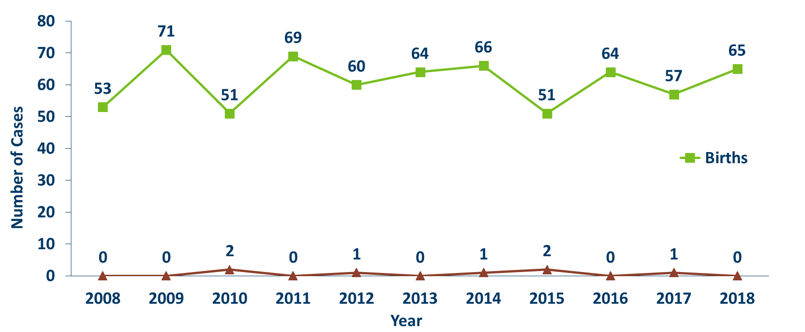
Births to HIV-Infected Pregnant people and Number of Perinatal Acquired HIV Infections* by Year of Birth, 2008- 2018
Notes:
The ability to interrupt the transmission of HIV from mother to child via antiretroviral therapy and appropriate perinatal care is an important accomplishment in the history of the HIV/AIDS epidemic. Newborn HIV infection rates range from 25-30% without antiretroviral therapy, but decrease to 1-2% with appropriate medical intervention.
For the past decade the number of births to HIV-infected pregnant parents has ranged between 51-71 births (2008-2018). For 2018, there were 65 births to HIV-infected pregnant parents. The rate of transmission has decreased from 15% between 1994 and 1996 to 0.6% in the past three years (2016-2018), with 1 HIV positive baby born to a HIV positive pregnant person in Minnesota in 2017.

Slide 33
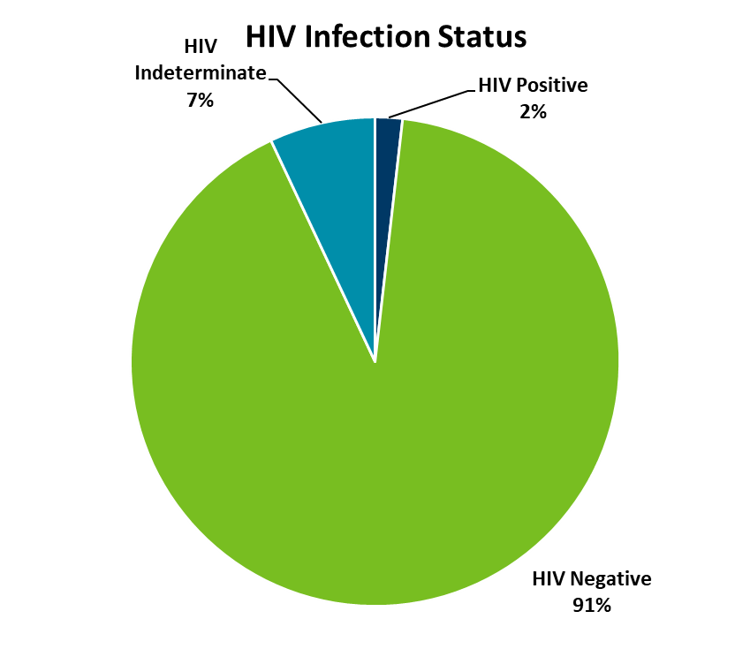
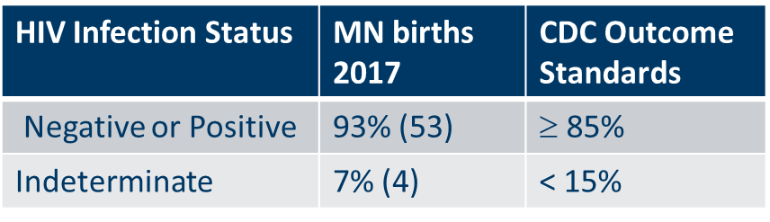
Outcome for Perinatally HIV-Exposed Infants Born in 2017
Notes:
Starting in 2018, CDC HIV Surveillance required that all HIV surveillance jurisdictions conduct follow-up of perinatally HIV-exposed infants every 6 months until 18 months of age or until HIV infection status is determined.
Infants exposed to HIV at birth may or may not be infected with HIV. Because of placental transfer of HIV maternal antibodies, HIV tests at birth will be positive, regardless of the infant’s true HIV status. Therefore, perinatal exposures need to be followed up over the next 18 months until the child’s diagnostic status is known (usually with lab results after two months of age and then every six months).
The pie chart above shows the HIV infection status for infants born in 2017. Of the 57 perinatally HIV-exposed infants born in 2017, 93% (n=53) have a HIV infection status determination of HIV negative (n=52) and HIV positive (n=1). For the first year, Minnesota is above the CDC outcome standard of greater than or equal to 85% of HIV-exposed infants that have HIV infection status determined by 18 months of age. Only four infants (7%) had a HIV indeterminate status.
Data on infants born in 2018 are not available until those infants are 18 months of age.

Slide 34
Adolescents & Young Adults (Ages 13-24)*
* Case numbers are too small to present meaningful data separately for adolescents and young adults

Slide 35
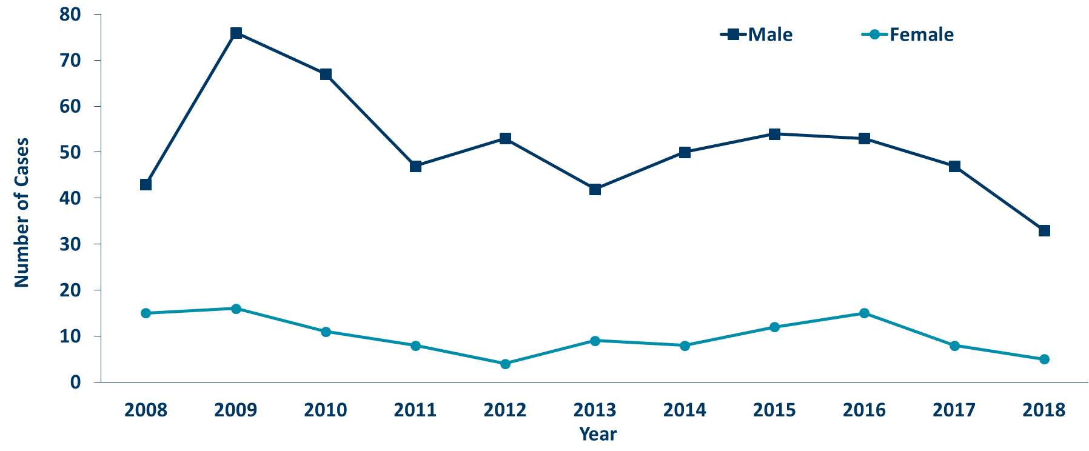
HIV Diagnoses* Among Adolescents and Young Adults† by Sex Assigned at Birth and Year, 2008 - 2018
Notes:
Between 2006 and 2009 the number of new HIV diagnoses among people assigned male sex at birth aged 13-24 increased rapidly. Since 2009, we’ve seen a promising trend of a decreasing number of new diagnoses in this age/sex group. In 2018, the number of cases were lower from the previous year with 33 cases in 2018 compared to 47 cases in 2017.
The annual number of new HIV infections diagnosed among adolescent and young adults assigned female sex at birth fluctuates due to smaller numbers. In 2018, there were 5 cases compared to 8 cases in 2017.

Slide 36
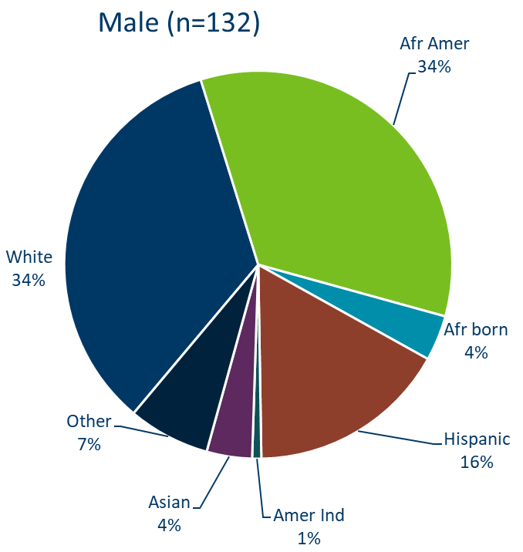
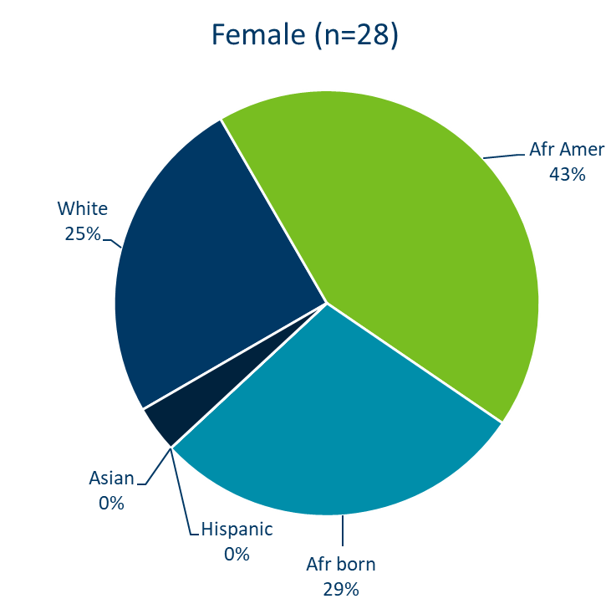
HIV Diagnoses* Among Adolescents and Young Adults† by Sex Assigned at Birth and Race/Ethnicity, 2016 - 2018 Combined
Notes:
Between the years 2016 and 2018 we had 132 cases assigned male sex at birth reported among adolescents and young adults, and 35 females reported in the 13-24 age group. For people assigned male sex at birth, Non-Hispanic white and African-American people each accounted for 34%, and Hispanic people of any race accounted for 18% in the 13-24 age group. Among people with female sex assigned at birth, Non-Hispanic black African-born and African-Americans together accounted for 72% of the cases; while non-Hispanic white people accounted for 25%, and Hispanic people of any race accounted for 0% of cases.

Slide 37
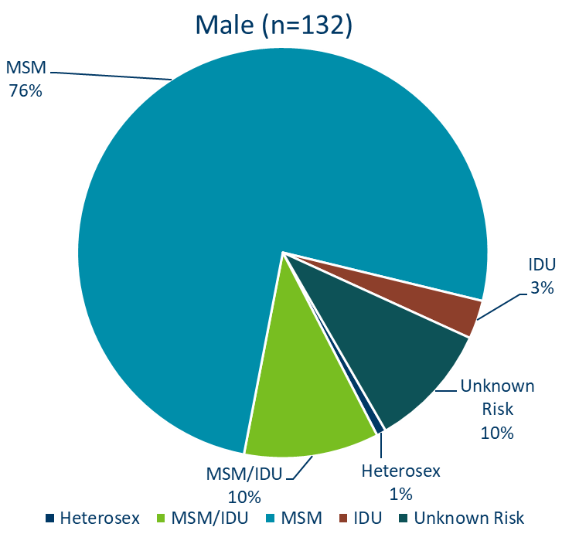
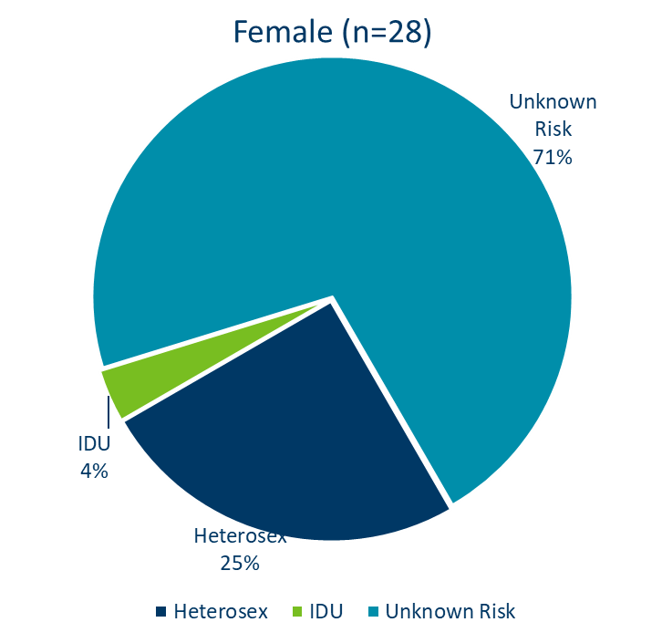
HIV Diagnoses* Among Adolescents and Young Adults† by Sex at Birth and Exposure Group 2016 - 2018 Combined
Notes:
For mode of exposure among people assigned male sex at birth in the 13-24 age group, Male to Male sex was found to account for 76% of the cases, while the combined risk of MSM and IDU was estimated to account for 10% of the cases and 1% was attributed to heterosexual contact.
Among people assigned female sex at birth, 25% of cases were found to have heterosexual contact as their mode of exposure, while 4% were attributed to injection drug use and risk among 71% remains unknown.

Slide 38
Foreign-born Cases

Slide 39
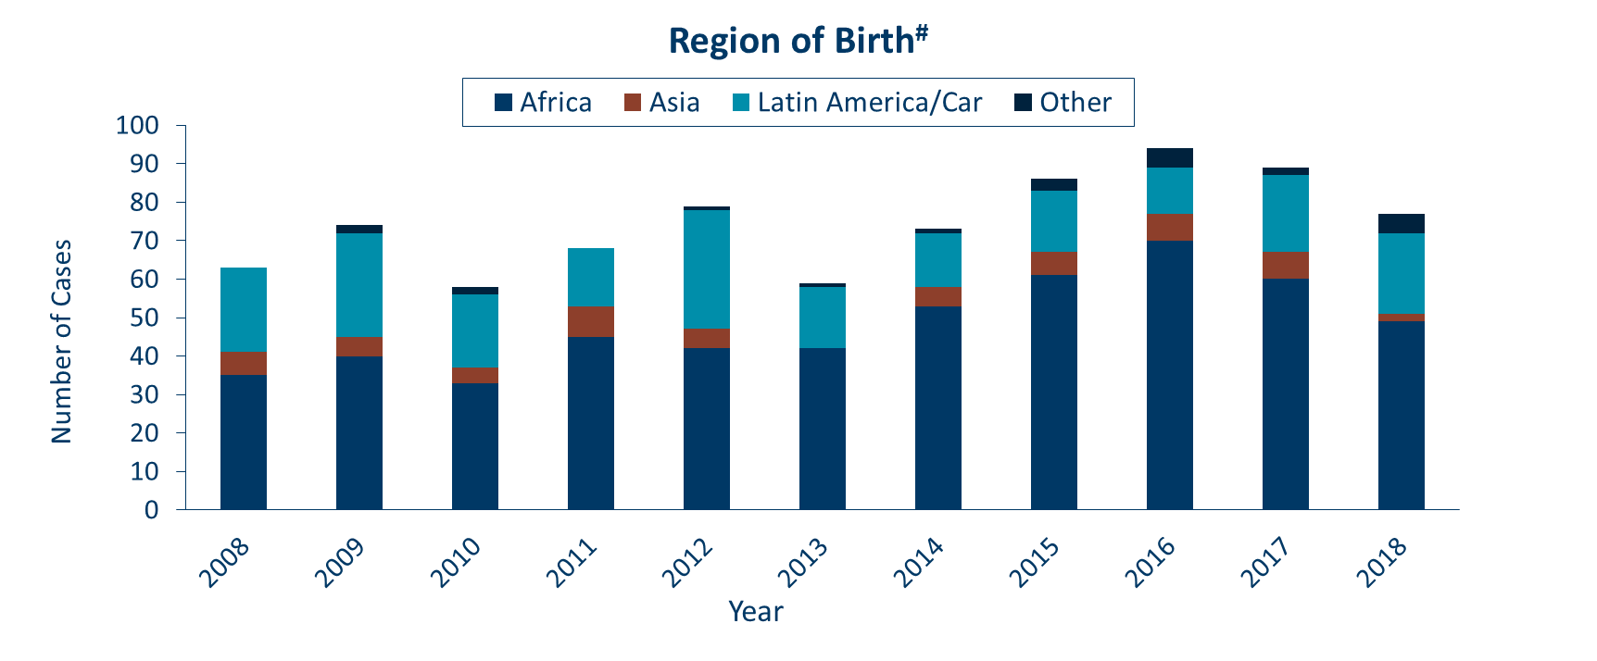
HIV Diagnoses* among Foreign-Born People† in Minnesota by Year and Region of Birth, 2008 - 2018
Notes:
The number of new HIV infections diagnosed among foreign-born people in Minnesota has steadily increased from 20 cases in 1990 to 77 cases in 2018. This increase has been largely driven by the increase of cases among African-born people from 8 cases in 1990 to 49 cases in 2018, as well as, people from Mexico, Central and South America and the Caribbean from 6 cases in 1990 to 21 cases in 2018. Among new HIV infections diagnosed in 2018, 27% were among foreign-born people. Based on 2010-2012 American Community Survey data, foreign-born people make up 7% of the total Minnesota population and are, therefore, disproportionately affected by HIV. Among African-born this disparity is even more evident, while African-born people make up just over 1% of the Minnesota population they accounted for 17% of new HIV infections in 2018.
In 2018, there were 77 cases of newly reported HIV among foreign-born people, over one out of four of all new cases. The majority of foreign born cases in 2018 were from Africa, followed by Latin America and the Caribbean.

Slide 40
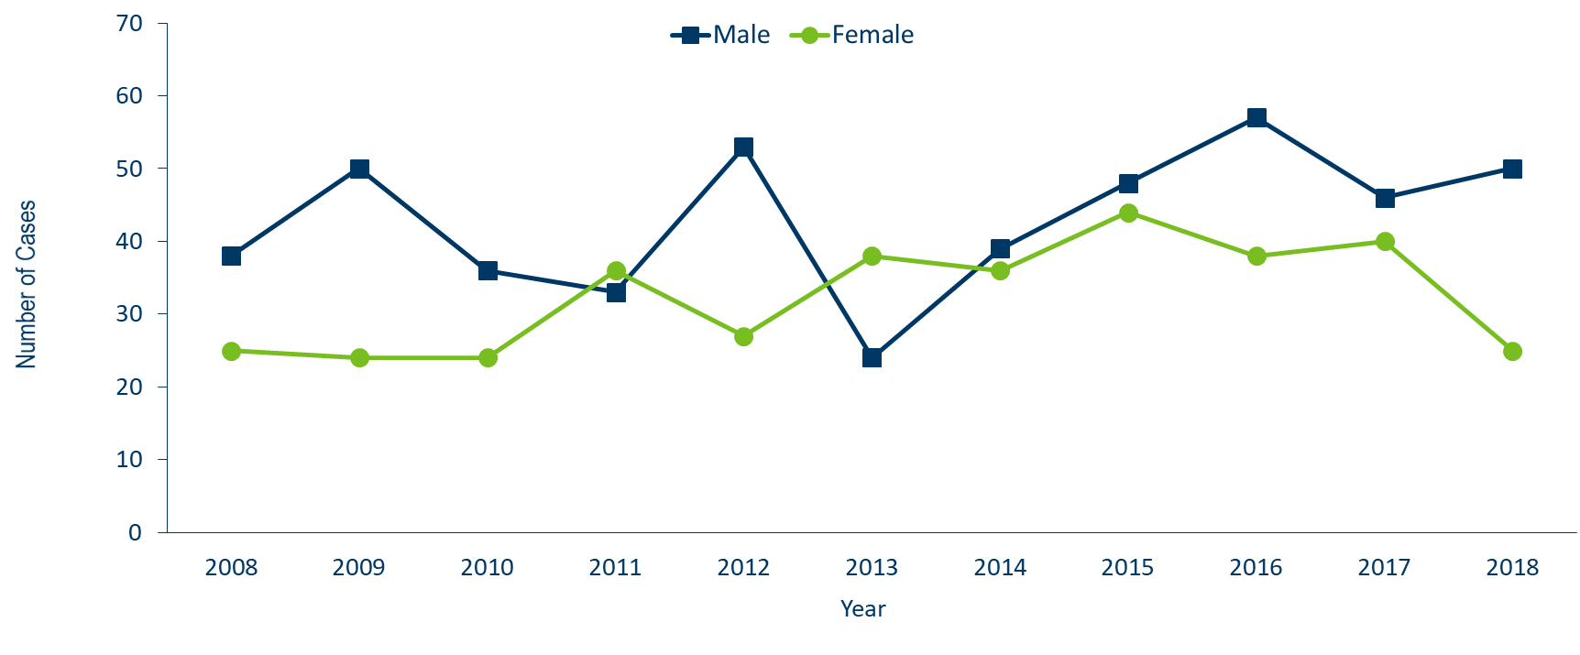
HIV Diagnoses* Among Foreign-Born People† by Sex Assigned at Birth and Year, 2008 – 2018
Notes:
In 2018, the number of foreign-born people assigned male sex at birth increased from 46 cases in 2017 to 50 in 2018.
There was a decrease for foreign-born people assigned female sex at birth from 40 in 2017 to 25 in 2018.

Slide 41
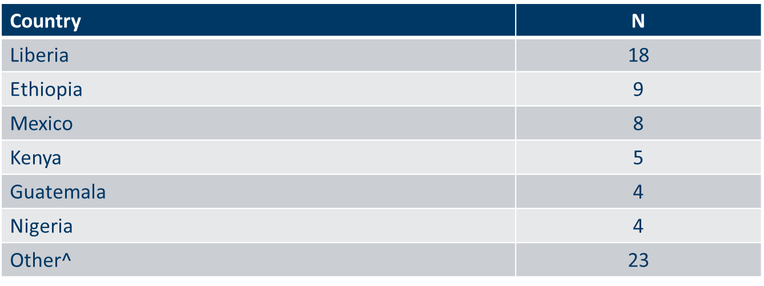
Countries of Birth Among Foreign-Born People† Diagnosed with HIV* Minnesota, 2018
Notes:
Four countries (Liberia, Ethiopia, Mexico and Kenya) accounted for a majority of new infections among foreign-born people, however there are over 28 countries represented among the 77 new foreign born cases in 2018.

Slide 42
Late-Testers (AIDS Diagnosis within one year of initial HIV Diagnosis)
Notes:
Late testers are defined as anyone with an AIDS diagnosis within one year of their initial HIV diagnosis. This is an important trend to watch as people who progress to AIDS within one year of their HIV diagnosis represent people who are likely diagnosed well after their initial infection and represent missed testing opportunities earlier in the course of their infection.

Slide 43
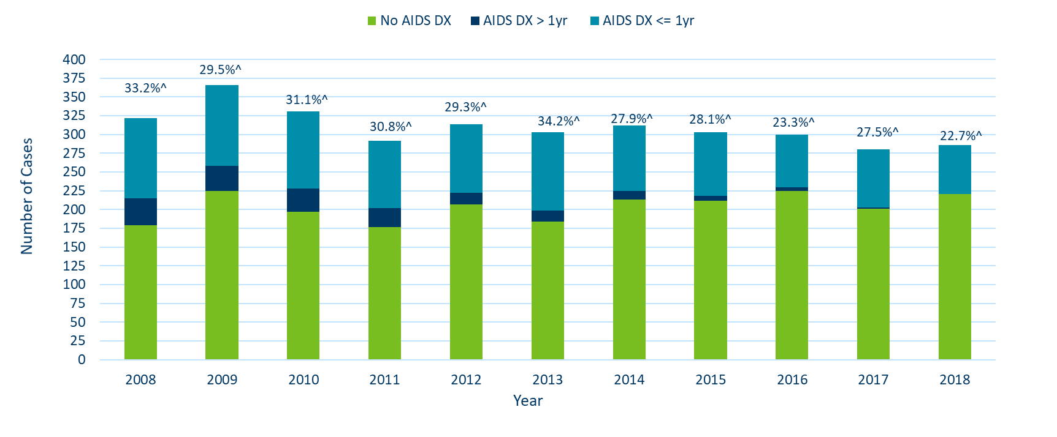
Time of Progression to AIDS for HIV Diagnoses in Minnesota* 2008 - 2018†
Notes:
In 2017, 28% of new cases were late testers. This proportion of cases has remained relatively the same over the past 10 years, ranging between 23-34%. Most late testers, about 85%, are diagnosed with AIDS at the same time they are initially diagnosed with HIV infection.
For 2018, 23% of new cases were late testers so far, which represents only a partial follow-up year to only April 1st, 2018.
As with other characteristics of the HIV epidemic in Minnesota, the proportion of late testers varies by demographic characteristics. Historically, foreign-born people have had a higher proportion of late-testers.

Slide 44
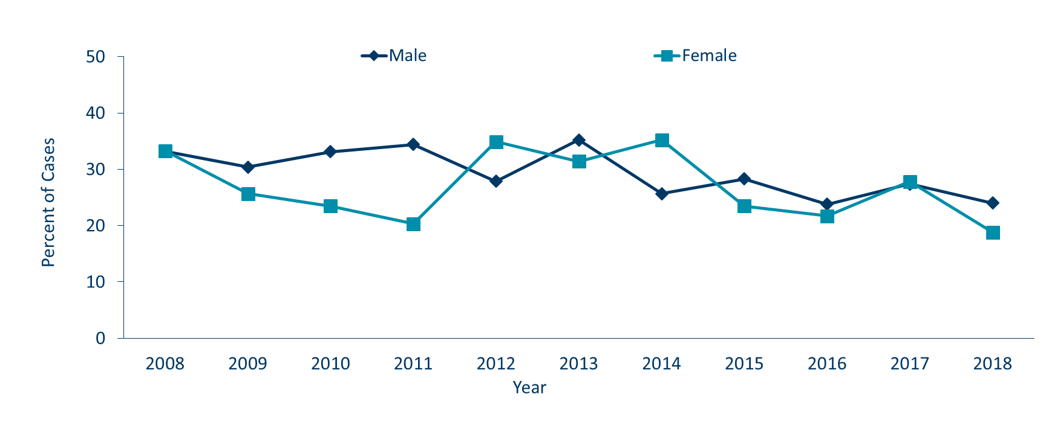
Progression to AIDS within 1 year of initial HIV Diagnosis* by Sex Assigned at Birth, 2008 - 2018†
Notes:
The proportion of late testers can vary by sex assigned at birth. In 2018, the proportion of late testers among people assigned female sex at birth (19%) and people assigned male sex at birth (24%) were similar and decreased slightly from the previous year.
Percentage of late testers for 2018 includes only those progressing to AIDS through March 2018. As such, this percentage is likely to increase as additional reports are made to the MDH.

Slide 45
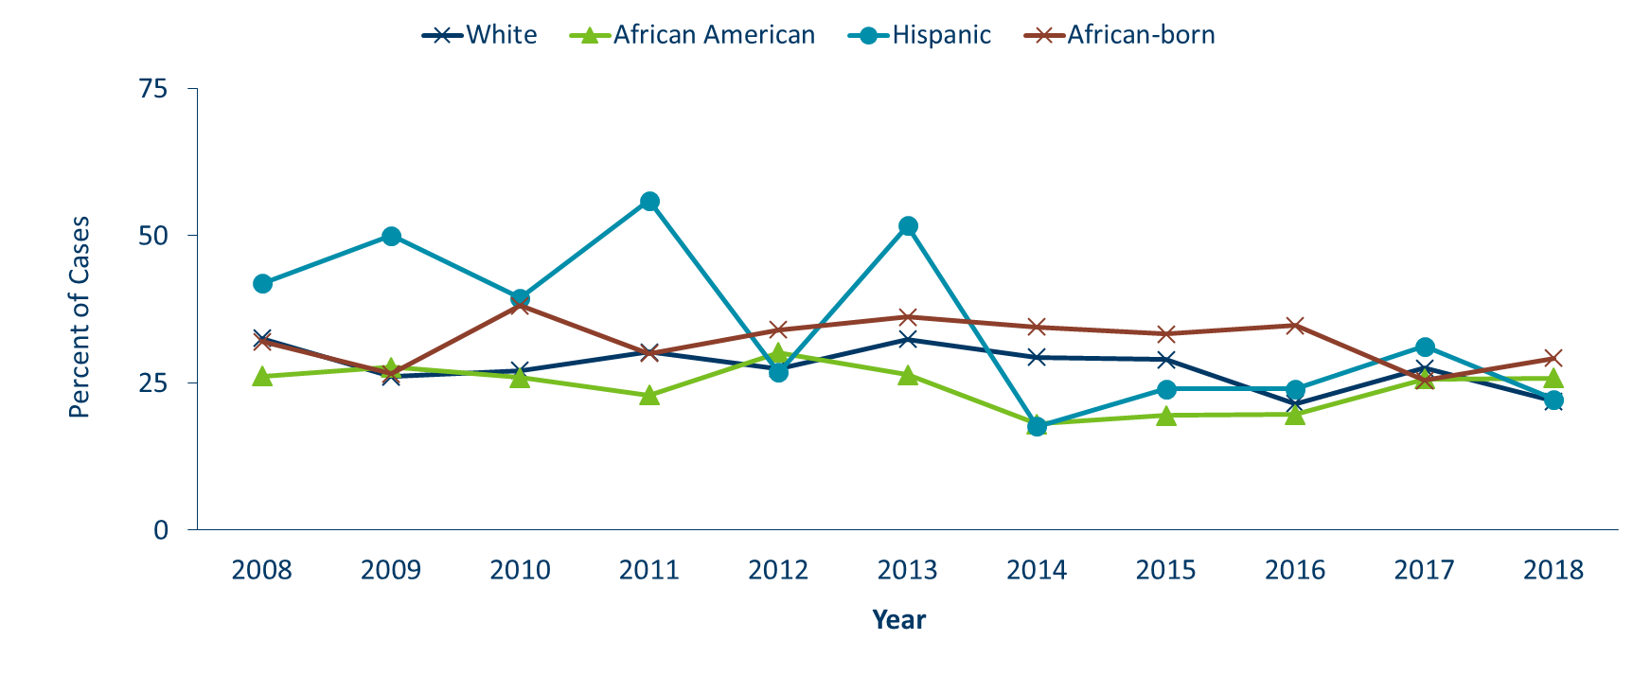
Progression to AIDS within 1 year of initial HIV Diagnoses* by Race/Ethnicity^ 2008 - 2018†
Notes:
As with other characteristics of the HIV epidemic in Minnesota, the proportion of late testers varies by demographic characteristics. Differences occur by race/ethnicity, with the proportion of late testers in 2018 among whites (22%), African Americans (26%), African-born black (29%), and Hispanic (22%). Similar data for American Indians and Asian/Pacific Islanders in a single year had fewer than 10 cases and are considered not stable and are therefore not represented here.
Percentage of late testers for 2018 includes only those progressing to AIDS through March 2019. As such, this percentage is likely to increase as additional reports are made to the MDH.

Slide 46
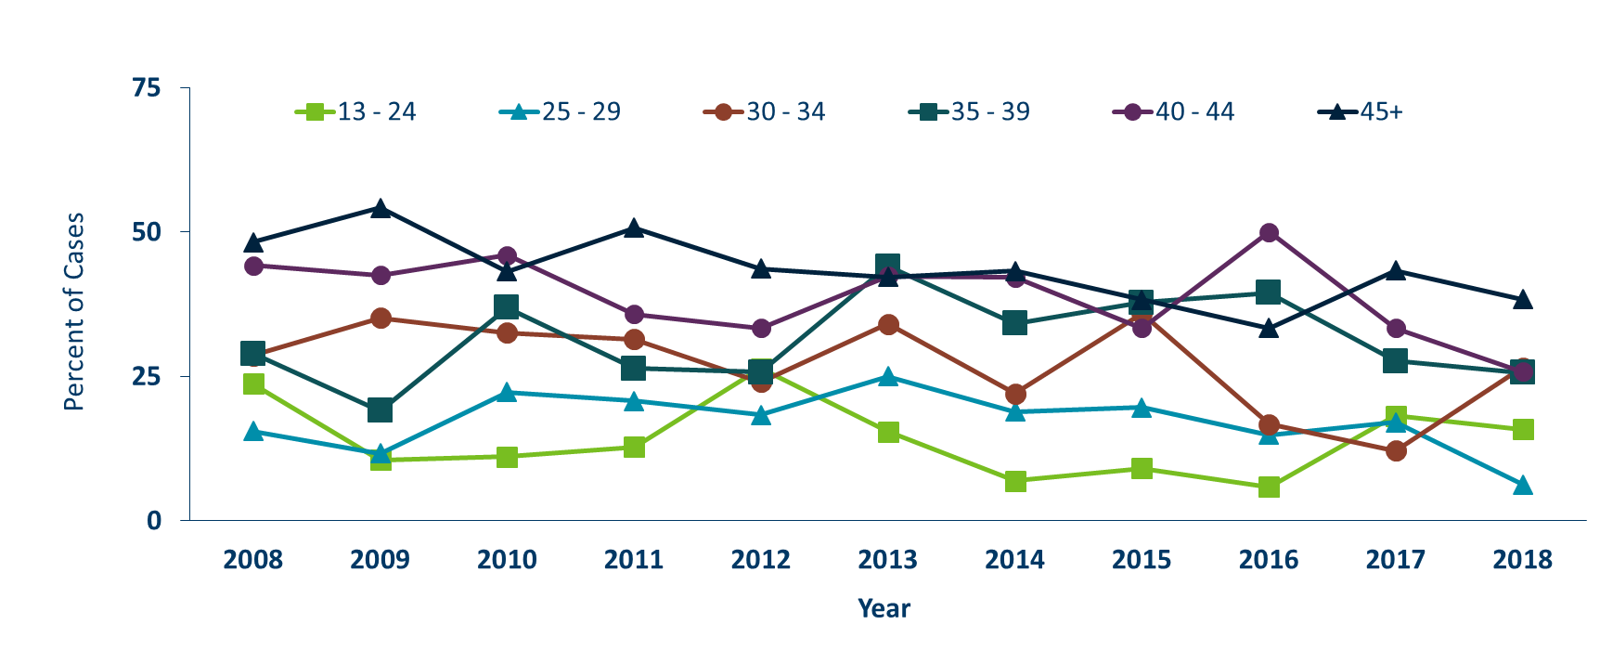
Progression to AIDS within 1 year of initial HIV Diagnosis* by Age, 2008 - 2018†
Notes:
Differences by age are as expected with the percentage of late testers increasing with age at time of diagnosis. In 2018, younger age groups had lower percentages of late testers, 13-24 (16%), 25-29 (6%), and older groups had higher percentage of late testers, 30-35 (27%), 35-39 (26%), 40-44 (26%), with a marked increase in the 45+ category (38%).
Percentage of late testers for 2018 includes only those progressing to AIDS through March 2019. As such, this percentage is likely to increase as additional reports are made to the MDH. Caution should be used due to smaller numbers by age group when interrupting the data.

Slide 47
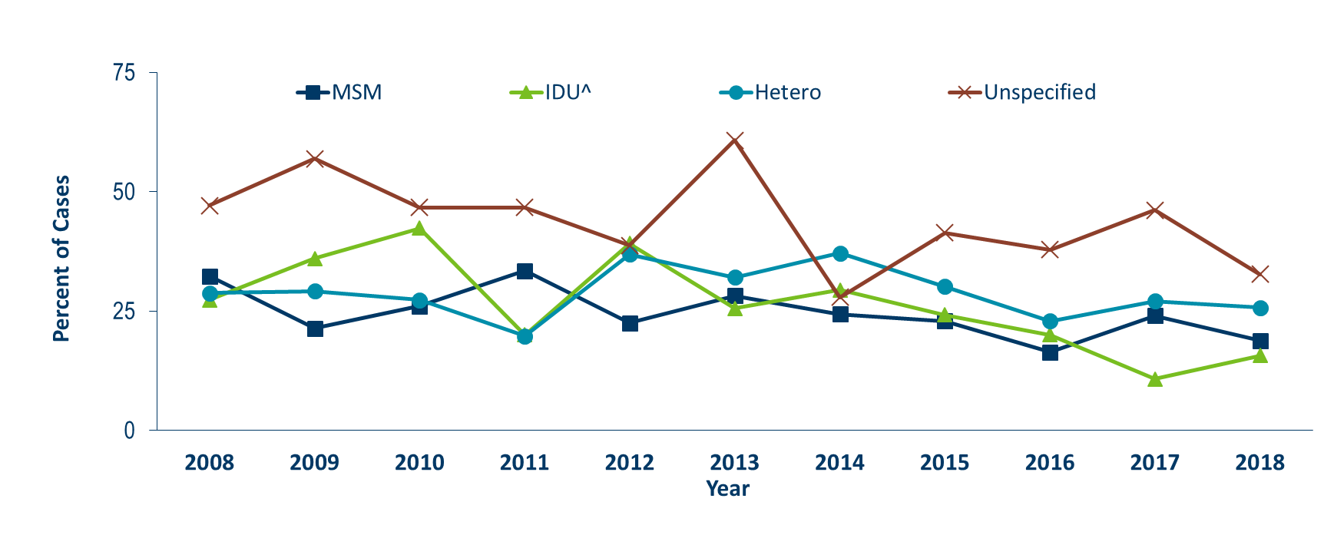
Progression to AIDS within 1 year of initial HIV Diagnosis* by Mode of Transmission, 2008 - 2018†
Notes:
In 2018, people with a risk category of unspecified risk had the highest proportion of late testers at 33%, followed by heterosexual contact at 26%, MSM at 19%, and finally IDU had the lowest proportion of late testers at 16%.
Percentage of late testers for 2018 includes only those progressing to AIDS through March 2019. As such, this percentage is likely to increase as additional reports are made to the MDH.

Slide 48
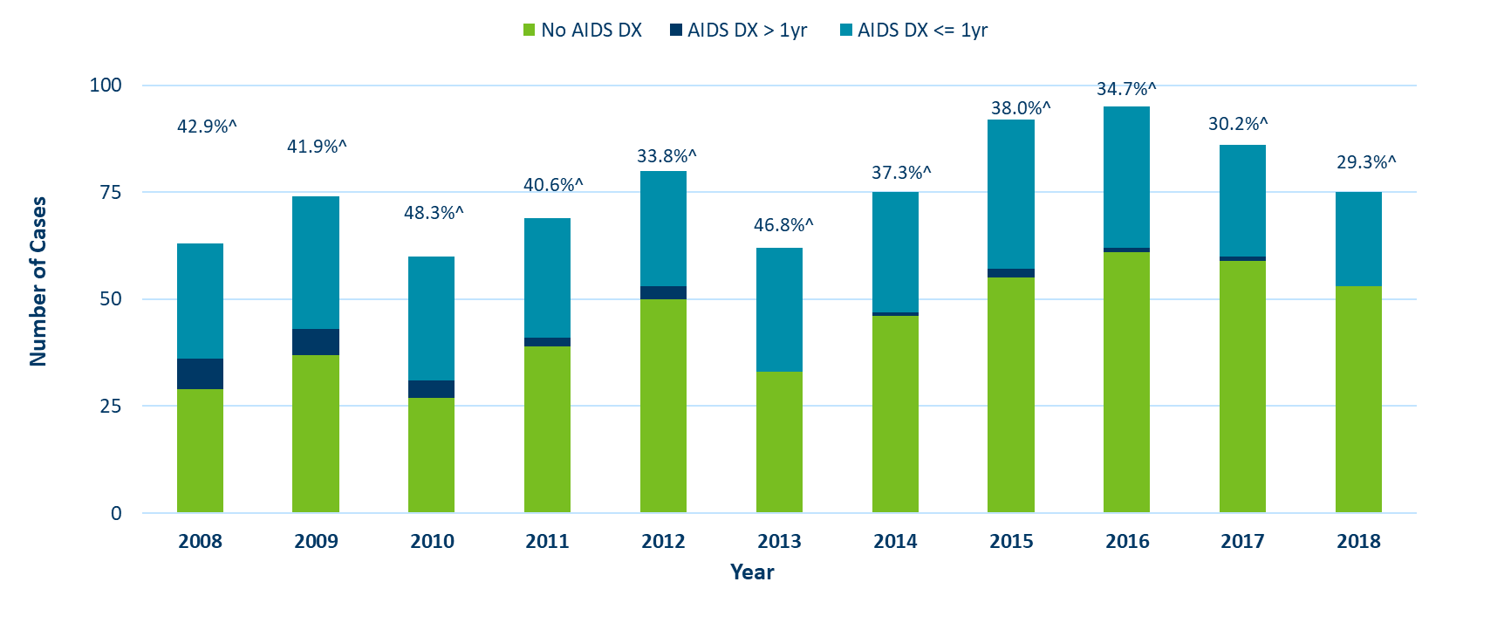
Time of Progression to AIDS for HIV Diagnoses* Among Foreign-Born People, Minnesota 2008 - 2018†
Notes:
During the past decade, foreign-born cases have a higher rate of late testers compared to US-born cases. In 2018, 29% of foreign-born cases were late testers compared to 20% of US-born cases.
Percentage of late testers for 2018 includes only those progressing to AIDS through March 2019. As such, this percentage is likely to increase as additional reports are made to the MDH.

Slide 49
Thank you!
HIV Surveillance Team
Health.HIV.Surveillance@state.mn.us
651-201-4040

