Slide 1


STD, HIV and Hepatitis C 2017 Data Release
April 24,2018
Notes:
Good Afternoon and welcome to the STD, HIV and Hepatitis C 2017 data release webinar. My name is Krissie Guerard and I am the STD/HIV/TB section manager for the Minnesota Department of Health.
I would like to begin with a few announcements. We will have a series of presentations and we will hold all questions until the end, but you can type in questions for us that we will address at the conclusion of the webinar, lines will be muted until the conclusion of all presenters. Contact information for all of the speakers will be provided at the end so individuals can follow up with the speakers more directly if additional information is needed. This presentation is available on our website as a narrated PowerPoint or a PDF with speakers notes.

Slide 2
Acronyms
MDH = Minnesota Department of Health
STD = Sexually transmitted disease
MSM = Men who have sex with men
HCV = Hepatitis C virus
HBV =Hepatitis B virus
IDU =Injection drug use
SSuN = STD Surveillance Network
Notes:
Before we begin I would like to define some common acronyms that will be used in todays presentation.
MDH = Minnesota Department of Health
STD = Sexually transmitted disease, also know as STI or sexually transmitted infection
MSM = Men who have sex with men
HCV = Hepatitis C virus
HBV = Hepatitis B virus
IDU = Injection drug use
SSuN = STD Surveillance Network

Slide 3
Agenda
STD Surveillance Data
  Dawn Ginzl, STD Surveillance Coordinator and Epidemiologist
  Laura Tourdot, SSuN Coordinator
HIV Surveillance Data
  Cheryl Barber, HIV Specialist Epidemiologist
  Jared Shenk, HIV Care and Prevention Epidemiologist
Hepatitis C Surveillance Data
  Kristin Sweet, Hepatitis Epidemiology Supervisor
Notes:
The webinar will begin with Dawn Ginzl, the STD Surveillance Coordinator and Epidemiologist with MDH, and Laura Tourdot, the SSuN Coordinator highlighting the 2017 STD surveillance data report, next will be Cheryl Barber, the HIV Specialist Epidemiologist and Jared Shenk the HIV Care and Prevention Epidemiologist presenting the 2017 HIV data report. Lastly, a presentation on the 2017 Hepatitis C data by Kristin Sweet, the Hepatitis Epidemiology Supervisor.
Thanks to everyone for joining us today. I will now turn it over to Dawn to begin the 2017 STD surveillance report.

Slide 4
Highlights from the Minnesota STD Surveillance Report, 2017
STD Surveillance System
http://www.health.state.mn.us/divs/idepc/dtopics/stds/stats/index.html

Slide 5
STDs in Minnesota
Rate per 100,000 by Year of Diagnosis, 2007-2017
* P&S = Primary and Secondary
Notes:
The rate of chlamydia in MN reached an all time high at 444 per 100,000. This is a rate increase of 4% from 2016.
The rate of gonorrhea in MN increased 28% to 123 per 100,000 compared to 96 per 100,000 in 2016.
The rate of primary and secondary syphilis is at 5.5 per 100,000. This is an decrease of 5% from 2016.

Slide 6
STDs in Minnesota:
Number of Cases Reported in 2017
Total of 30,981 STD cases reported to MDH in 2017:
  23,528 Chlamydia cases
  6,519 Gonorrhea cases
  934 Syphilis cases (all stages)
  0 Chancroid cases

Slide 7
Syphilis
Minnesota Department of Health STD Surveillance System

Slide 8
Syphilis Rates by Stage of Diagnosis Minnesota, 2007-2017
* P&S = Primary and Secondary
Notes:
The overall syphilis rate is now up to 17.6 per 100,000. Compared to the low of 3.6 back in 2007.
Of concern is the rate of primary and secondary syphilis which is 5.5 per 100,000.

Slide 9
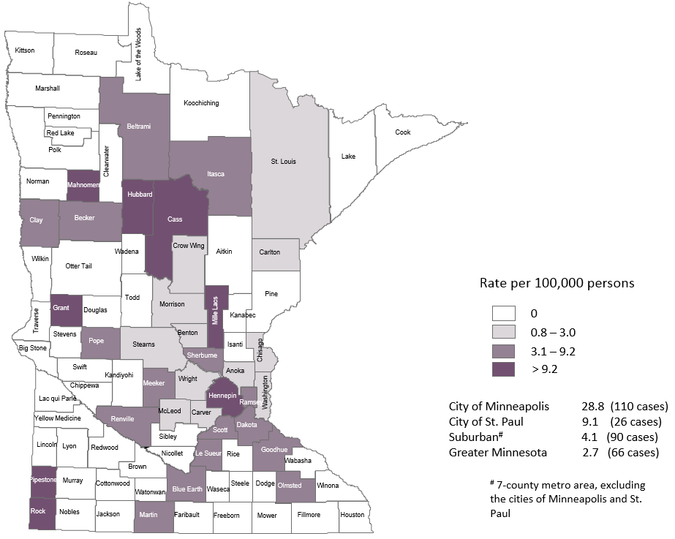
2017 Minnesota Primary & Secondary Syphilis Rates by County
Notes:
The highest rate of primary and secondary syphilis remains in the City of Minneapolis at 28.8 cases per 100,000 population.
The City of St. Paul has the second rate at 9.1 per 100,000.

Slide 10
Age-Specific Primary & Secondary Syphilis Rates by Gender Minnesota, 2017
Notes:
Males have higher rates of primary and secondary syphilis than females in all age groups. The rate in males is 7 times higher than females.
The 25-29 yr. old males have the highest rate at 31.5 per 100,000
The 20-24 yr. old females have the highest rate of the female population at 5.7 per 100,000

Slide 11
Primary & Secondary Syphilis Rates by Race/Ethnicity
Minnesota, 2007-2017
* Persons of Hispanic ethnicity can be of any race.
Notes:
The rates of primary and secondary syphilis are 14 times higher in the American Indian populations than that of the White, Non-Hispanic population.
The rates of primary and secondary syphilis are 6 times higher in the Black/African American, Non-Hispanic than that of the White, Non-Hispanic population.
The rates of primary and secondary syphilis in the America Indian population are 47.5 per 100,000 compared to 3.3 per 100,000 in the White, Non-Hispanic population.
The rates of primary and secondary syphilis in the Black/African American, Non-Hispanic population are 19.6 per 100,000 compared to 3.3 per 100,000 in the White, Non-Hispanic population.
The rates in the Hispanic/Latino population are 12.4 per 100,000 which is 4 times higher than the White, Non-Hispanic population.
The rates in the Asian/Pacific Islander population are 6.8 per 100,000 which is 2 times higher than the White, Non-Hispanic population.

Slide 12
Early Syphilis† by Gender and Sexual Behavior
Minnesota, 2007-2017
Year | Early Syphilis Cases | Male Cases (%) | MSM Cases (% of males)
2007 | 114 | 111 (97) | 103 (93)
2008 | 163 | 158 (97) | 140 (89)
2009 | 117 | 106 (91) | 96 (91)
2010 | 221 | 207 (94) | 185 (89)
2011 | 260 | 246 (95) | 218 (89)
2012 | 214 | 196 (92) | 158 (81)
2013 | 332 | 298 (90) | 261 (88)
2014 | 416 | 374 (90) | 283 (76)
2015 | 431 | 341 (79) | 222 (65)
2016 | 557 | 468 (84) | 359 (77)
2017 | 605 | 511 (84) | 426 (83)
MSM=Men who have sex with men
† Early Syphilis includes primary, secondary, and early latent stages of syphilis.

Slide 13
Early Syphilis† Cases Among MSM by Age
Minnesota, 2017 (n=426)
Mean Age = 35 years
Range: 15 to 65 years
MSM=Men who have sex with men
† Early Syphilis includes primary, secondary, and early latent stages of syphilis.
Notes:
The average age of MSM with early syphilis 35 years of age.
Ages ranged from 15 – 65 years of age
The 25-29 year old age group had the highest number of cases at 89.

Slide 14
Early Syphilis† (ES) Cases Co-infected with HIV
2007-2017
MSM=Men who have sex with men
† Early Syphilis includes primary, secondary, and early latent stages of syphilis.
Notes:
Thirty-three percent of all early syphilis cases were co-infected with HIV.
Forty-six percent of all MSM early syphilis cases were co-infected with HIV.

Slide 15
Female Early Syphilis Cases

Slide 16
Early Syphilis Infections in Women in Minnesota by Residence at Diagnosis, 2017
Total Number of Cases = 91
Suburban = Seven-county metro area including Anoka, Carver, Dakota, Hennepin (excluding Minneapolis), Ramsey (excluding St. Paul), Scott, and Washington counties. Greater MN = All other Minnesota counties outside the seven-county metro area.
Notes:
Fourty-seven percent of female early syphilis cases were residents of Greater Minnesota
Twenty-six percent of female early syphilis cases were residents of the Suburbs of the seven-county metro area
Nineteen percent were City of Minneapolis residents, and 8% were St. Paul residents.

Slide 17
Early Syphilis Cases in Females by Race
Minnesota, 2017
Total Number of Cases = 91
*Includes persons reported with more than one race
Notes:
There are large disparities in women with syphilis. Thirty-five percent of all early syphilis cases in females are found in the American Indian population and 23% in the Black, African American population.

Slide 18
Chlamydia
Notes:
Hello I am Laura Tourdot the SSuN Coordinator and Epidemiologist with the Minnesota Department of Health. I will be highlighting the 2017 chlamydia and gonorrhea surveillance data and the CDC funded STD Surveillance Network (SSuN).

Slide 19
Chlamydia in Minnesota Rate per 100,000 by Year of Diagnosis 2007-2017
Notes:
As mentioned previously, the rate of chlamydia in MN reached an all time high at 440 per 100,000. This is a rate increase of 4% from 2016.

Slide 20
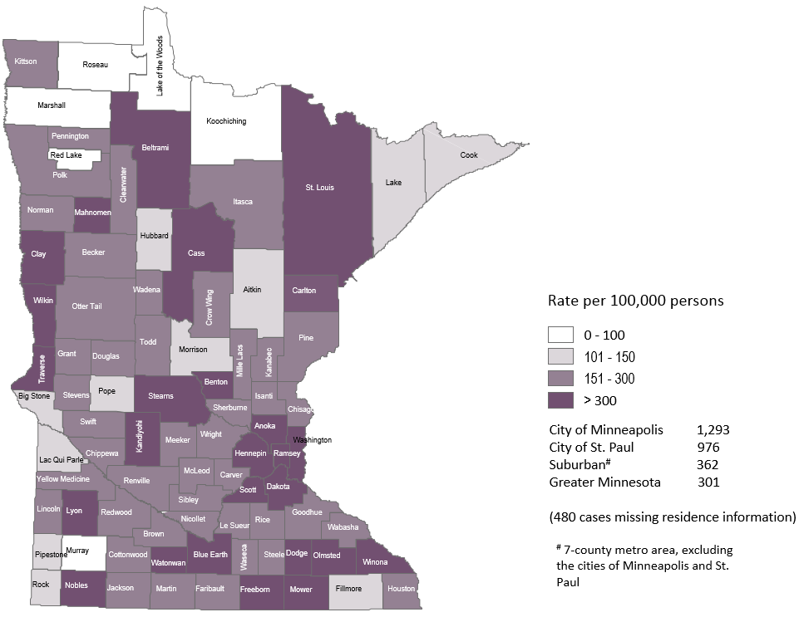
2017 Minnesota Chlamydia Rates by County
Notes:
All counties in Minnesota are affected by chlamydia. There were at least 2 cases in all counties in 2017.
The city of Minneapolis continues to have the highest rates of chlamydia at 1,293 per 100,000, followed by the city of St. Paul at 976 per 100,000, the suburban area (7-county metro excluding Minneapolis & St. Paul) at 362 per 100,000 and Greater Minnesota at 301 per 100,000.
The seven county metro Suburban area and Minneapolis had the greatest increase in rates between 2016 and 2017 at 8%. The City of St. Paul an increase of 7%, and Greater Minnesota had an 1% increase.

Slide 21
Age-Specific Chlamydia Rates by Gender
Minnesota, 2017
Notes:
The age group with the largest increase in rate was males 50+ at a 47% increase over 2016.
The rates of chlamydia went up in both males and females in 2017.
Females continue to have higher rates of chlamydia than males in age groups 39 and under.
In 2017 males have higher rates in the 40 and over age groups.
The rate in males increased more than the rate in females in 2017.
The highest rates of chlamydia continue to be in females 20-24 year of age at 3,353 per 100,000.

Slide 22
Chlamydia Rates by Race/Ethnicity
Minnesota, 2007-2017
2017 rates compared with Whites:
Black, Non-Hispanic = 9.7x higher
American Indian = 5x higher
Asian/PI = 2x higher
Hispanic* = 3x higher
* Persons of Hispanic ethnicity can be of any race
Notes:
There continues to be disparities in rates of chlamydia.
The Black/African American, Non-Hispanic population has rates that are 9.7 times higher than that of whites. The rate in the Black/African American population was 2,020 per 100,000 compared to the rate in the White, Non-Hispanic population at 209 per 100,000.
The American Indian population had a rate that was 5 times higher at 1,083 per 100,000
The Asian/Pacific Islander population had a rate that was 2 times higher at 391 per 100,000
The Hispanic/Latino population, which can be of any race, had a rate that was 3 times higher at 649 per 100,000

Slide 23
Gonorrhea

Slide 24
Gonorrhea in Minnesota: Rate per 100,000 by Year of Diagnosis, 2007-2017
Notes:
As mentioned previously, the rate of gonorrhea in MN reached an all time high at 123 per 100,000. This is a rate increase of 28% from 2016.

Slide 25
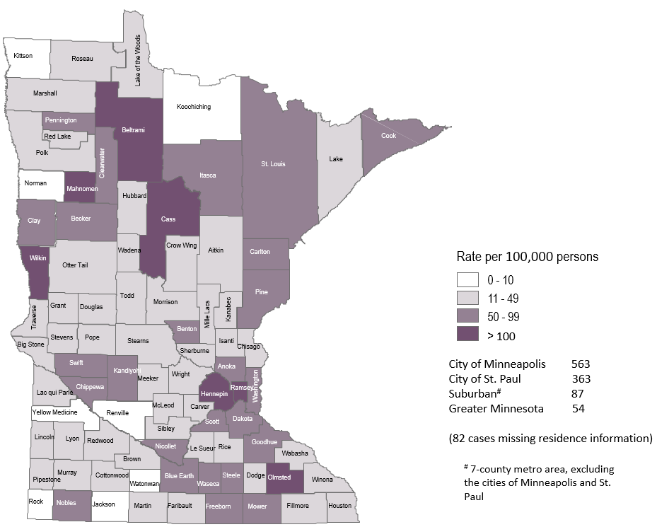
2017 Minnesota Gonorrhea Rates by County
Notes:
The city of Minneapolis continues to have the highest rates of gonorrhea at 563 per 100,000, followed by the city of St. Paul at 363 per 100,000, the suburban area (7-county metro excluding Minneapolis & St. Paul) at 87 per 100,000 and Greater Minnesota at 54 per 100,000.
Greater Minnesota area had the highest increase at 39%, followed by the City of St. Paul with a 35% increase. The seven county metro Suburban area and the City of Minneapolis had the smallest increase both at 26%.

Slide 26
Age-Specific Gonorrhea Rates by Gender Minnesota, 2017
Notes:
The rates of gonorrhea went up in both males and females in 2017. Females continue to have higher rates of gonorrhea than males in age groups 19 and under. In 2017 males have higher rates in the 20 and over age groups. The rate in females increased more than the rate in males in 2017.
The highest rates of gonorrhea are in males 20-24 at 500 per 100,000.

Slide 27
Gonorrhea Rates by Race/Ethnicity
Minnesota, 2007-2017
2017 rates compared with Whites:
Black, Non-Hispanic = 20x higher
American Indian = 13x higher
Asian/PI = 2x higher
Hispanic* = 3x higher
Notes:
There continues to be disparities in rates of gonorrhea.
The Black/African American, Non-Hispanic population has rates that are 20 times higher than that of whites. The rate in the Black/African American population was 875 per 100,000 compared to the rate in the White, Non-Hispanic population at 44 per 100,000.
The American Indian population had a rate that was 13 times higher at 563 per 100,000
The Asian/Pacific Islander population had a rate that was 2 times higher at 90 per 100,000
The Hispanic/Latino population, which can be of any race, had a rate that was 3 times higher at 135 per 100,000

Slide 28
Chlamydia Disproportionately Impacts Youth
MN Population in 2010
(n = 5,303,925)
Chlamydia Cases in 2017
(n = 23,528)
Notes:
Chlamydia continues to disproportionately impact youth. The 15-24 year olds make up only 14% of the population, but account for 62% of all chlamydia cases reported.
The <15 yrs old population account for 0.63% of Chlamydia cases in 2017

Slide 29
Gonorrhea Disproportionately Impacts Youth
MN Population in 2010
(n = 5,303,925)
Gonorrhea Cases in 2017
(n = 6,519)
Notes:
Gonorrhea also disproportionately impacts youth. The 15-24 year olds make up only 14% of the population, but account for 45% of all gonorrhea cases reported.

Slide 30
SSuN
Notes:
The Minnesota Department of Health is participating in the CDC funded STD Surveillance Network (SSuN). SSuN is an enhanced STD surveillance project that focuses on collecting additional gonorrhea surveillance information from both patients and providers. Gonorrhea cases reported to the MDH are randomly selected for enhanced surveillance. The randomized sample is created to be a representative pictures of gonorrhea morbidity throughout the state of Minnesota.
The MDH is using the collected surveillance data to created targeted gonorrhea prevention in MN and to help develop a comprehensive picture of gonorrhea nationwide.

Slide 31
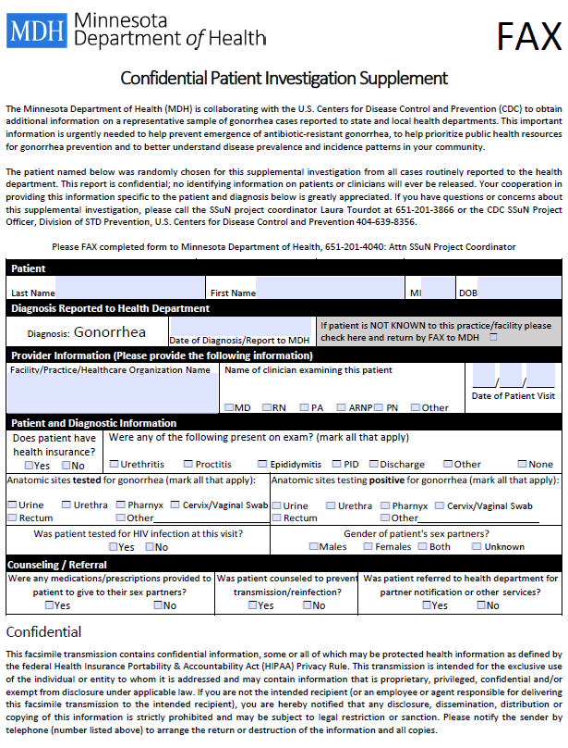
Provider Investigation
Notes:
For the gonorrhea cases who are randomly selected for SSuN, providers will receive a standard fax form requesting additional surveillance information including: classification of treating provider, does the patient have health insurance, symptoms present during exam, all anatomic sites tested for GC, was the patient test for HIV and gender of sex partner.
Example of SSuN “Confidential Patient Investigation Supplement form”
Providers Investigations are required for the gonorrhea cases that are randomized for the SSuN enhanced surveillance project. In 2017 we had an overall response rate of 77%. We prefer to send the fax forms to providers so providers can fill out the few extra questions for SSuN cases during a convenient time.
If clinics would like to have these fax forms sent with any specification, please contact me.

Slide 32
Patient Investigation
Notes:
Randomized gonorrhea cases will receive a follow up phone call from MDH, to collect additional surveillance data. The phone questionnaire generally takes about 5-10 minutes.
In 2017, 1,080 gonorrhea cases were randomized and 412 completed the phone interview.

Slide 33
Gonorrhea is a notifiable condition in MN
Please remember to notify all patients after any STD diagnosis that their name and information is required by law to be reported to the Minnesota Department of Health.
Please ensure all STD case and lab reports are submitted to the MDH with proper contact information, including telephone number.
Please inform your patients, after a STD diagnosis, that they have a chance of being contacted by the MDH for additional follow up.
Notes:
Many SSuN cases are surprised when they received a call from the MDH regarding their gonorrhea infection. They did not know their name was required by law to be reported to the Minnesota Department of Health.
We are one of 10 sites across the United States participating in the SSuN enhanced surveillance project. With the 28% increase in reported gonorrhea cases from 2016-2017 we plan to use SSuN data for creating targeted gonorrhea prevention in MN. SSuN is an unique opportunity to collect additional surveillance data, as most gonorrhea cases would not be eligible for additional follow up and data collection without the SSuN project.

Slide 34
Patient Investigation Interview
Notes:
The SSuN patient interview asks a variety of questions regarding self identified race/ethnicity, insurance status, reason for visiting treating provider, EPT, HIV testing history, patient prep usage, gender and number of recent sex partner(s) along with demographic information regarding the SSuN case’s most recent sex partner(s).
SSuN data allows MDH to compare provider reported information from the gonorrhea case report with self reported information from the SSuN interview. Of the 412 SSuN cases who were interviewed, 29/412 (7%) reported a different race(s) compared to provider report from the gonorrhea case report. The SSuN interview also allows for the collection of multi-race data.

Slide 35
Gender of Sex Partner
Notes:
Gender of sex partner data are very frequently missing from std case reports, and with increasing frequency over recent years.
SSuN is the only additional source the MDH can use to determine gender of sex partner, when the information is missing on the case report
Of the 412 SSuN cases who were interviewed, 23/302 (5.58%) reported a different gender(s) of sex partner compared to provider report from the gonorrhea case report.

Slide 36
Summary of STD Trends in Minnesota
From 2007-2017, the chlamydia rate increased by 71%. The rate of gonorrhea increased by 84%. Rates of reported syphilis increased in 2017 compared to 2016 by 10%.
Minnesota has seen a resurgence of syphilis over the past decade, with men who have sex with men and those co-infected with HIV being especially impacted. However, the number of females is near the record high for the last decade.
Persons of color continue to be disproportionately affected by STDs.
STD rates are highest in the cities of Minneapolis and Saint Paul. However, chlamydia and gonorrhea cases in the Twin Cities suburbs and Greater Minnesota account for 62% of the reported cases in 2017.
Between 2016 and 2017, early syphilis cases increased by 9%. Men who have sex with men comprised 83% of all male cases in 2017; cases among women are continuing to rise.

Slide 37
Future Updates to STD Reporting and Current Follow-Up
New case report form to accommodate changes in treatment guidelines, requesting HIV testing status, and PrEP (Pre-Exposure Prophylaxis) usage.
The case report form can be filled out on a computer and printed or faxed into MDH
All cases co-infected with HIV (diagnosed in the last year)/Gonorrhea, HIV/Syphilis, and Early Syphilis will continue to be assigned to MDH Partner Services for follow-up
All Gonorrhea cases continue to have the potential for being contacted by MDH for additional follow-up

Slide 38
Thank you
Laura Tourdot, Laura.Tourdot@state.mn.us, 651-201-3866
Dawn Ginzl, Dawn.Ginzl@state.mn.us, 651-201-4041
Notes:
Please contact myself or Dawn if you have any questions regarding SSuN or STD surveillance

Slide 39
Highlights from the Minnesota HIV Surveillance Report, 2017
HIV/AIDS Surveillance System
http://www.health.state.mn.us/divs/idepc/diseases/hiv/stats/index.html
Notes:
Thank you for participating in the webinar today. I’m Cheryl Barber, a specialist epidemiologist at the Minnesota Department of Health. Today we are releasing our annual HIV surveillance report for 2017. During the webinar, I will be primarily discussing highlights from data on new HIV diagnoses reported to the health department during 2017. Jared Shenk, the HIV care and prevention epidemiologist, will briefly cover updates to HIV prevalence in the state, as well as ongoing Data2Care activities. The information that we will present is just a snapshot of the data we are releasing today and the full slide set, as well as accompanying tables, are all are available on our website at the link on this slide.

Slide 40
New HIV diagnoses in Minnesota, 2017
Notes:
We will first discuss highlights from data on new HIV diagnoses that occurred during 2017.

Slide 41
New HIV Disease Diagnoses, HIV (non-AIDS) and
AIDS Cases by Year, 2007-2017
*Includes all new cases of HIV infection (both HIV (non-AIDS) and AIDS at first diagnosis) diagnosed within a given calendar year.
^Includes all new cases of AIDS diagnosed within a given calendar year, including AIDS at first diagnosis^^ and AIDS ((progressed)^^^ previous diagnosis of HIV).
This includes refugees in the HIV+ Resettlement Program, as well as, other refugee/immigrants diagnosed with AIDS subsequent to their arrival in the United States.
Notes:
In this report, the term “new HIV diagnoses” refers to HIV-infected Minnesota residents who were diagnosed in a particular calendar year and reported to MDH. This includes persons whose first diagnosis of HIV infection is AIDS (AIDS at first diagnosis). HIV diagnoses data are displayed by earliest known date of HIV diagnosis.
In 2017, there was a slight decrease of new HIV diagnoses from 2016. In 2017 there were 284 newly diagnosed cases, as compared to 290 cases in 2016. This represents a decrease of about 2% compared to 2016. In reviewing newly diagnosed cases since 2013, 284 cases for 2017 is below the 5 year average of 297 cases per year.

Slide 42
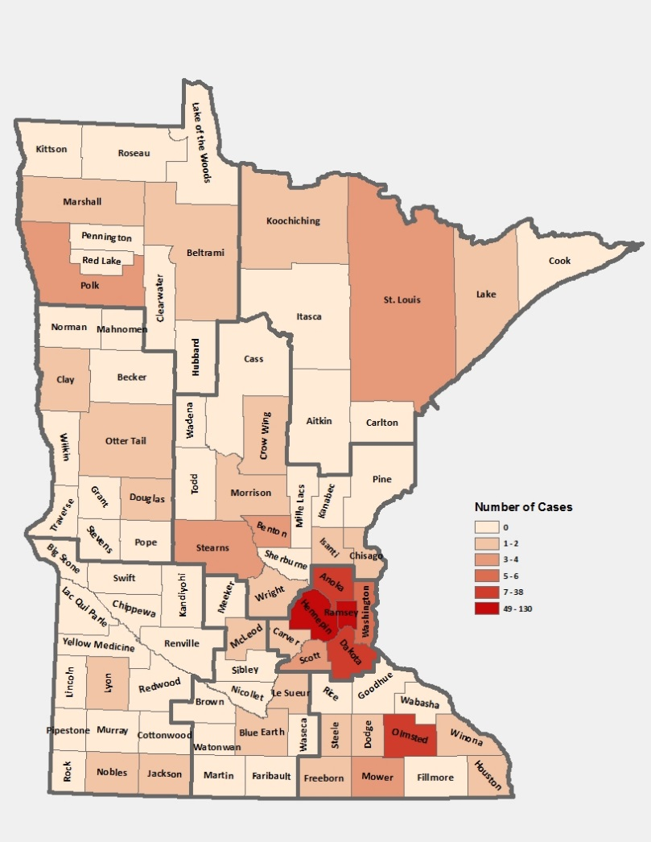
HIV Diagnoses* by County of Residence at Diagnosis, 2017
City of Minneapolis – 83 (29%)
City of St. Paul – 39 (14%)
Suburban# – 107 (38%)
Greater Minnesota – 55 (19%)
Total number = 284
*HIV or AIDS at first diagnosis
# 7-county metro area, excluding the cities of Minneapolis and St. Paul
Notes:
Historically, about 90% of new HIV infections diagnosed in Minnesota have occurred in Minneapolis, St. Paul and the surrounding seven-county metropolitan area.
In 2017, geographically, the new cases were concentrated in the twin cities metropolitan area, with 81% of the cases located in the seven county twin cities metro region with 29% in Minneapolis, 14% in St. Paul, and 38% in the remaining suburban area (excluding Minneapolis/St. Paul). In greater Minnesota, there were 55 newly diagnosed HIV cases in 29 counties.

Slide 43
HIV Diagnoses* in Year 2017 and General Population in Minnesota by Race/Ethnicity
* HIV or AIDS at first diagnosis (n = Number of persons)
Amer Ind = American Indian , Afr Amer = African American (Black, not African-born persons) , and Afr born = African-born (Black, African-born persons)
Notes:
When you look at the racial/ethnic distribution of new HIV diagnoses for both genders compared to the racial/ethnic distribution of the general population of Minnesota, it is apparent that disparities continue to exist among persons of color. Non-Hispanic African-American and Black African-born Minnesotans jointly make up about 5% of the population in Minnesota, yet, account for almost half (48%) of the newly diagnosed cases of HIV in 2017. Similarly, Hispanics of any race also account for approximately 5% of the population, but account for 12% of the newly diagnosed cases.

Slide 44
Number of Cases and Rates (per 100,000 persons) of
HIV Diagnoses* by Race/Ethnicity† Minnesota, 2017
Race/Ethnicity | Cases | % | Rate
White, non-Hispanic | 98 | 35% | 2.2
Black, African-American | 76 | 27% | 46.6
Black, African-born | 60 | 21% | 55.6††
Hispanic | 33 | 12% | 13.2
American Indian | 2 | 0.7% | #
Asian/Pacific Islander | 8 | 3% | 3.7
Other^ | 6 | 2% | 6.0
Total | 283 | 100% | 5.3
* HIV or AIDS at first diagnosis; 2010 U.S. Census Data used for rate calculations.
† “African-born” refers to Blacks who reported an African country of birth; “African American” refers to all other Blacks.
†† Estimate of 107,880 Source: 2010-2012 American Community Survey. Additional calculations by the State Demographic Center.
(Note: Rates for black, African-American and black, African-born are not comparable to previous years due to an increase in the estimate for black, African-born population.)
^ Other = Multi-racial persons or persons with unknown or missing race
# Number of cases too small to calculate reliable rate
Notes:
Each year we calculate the rate of diagnosis for each racial/ethnic group represented in the surveillance system to assess the impact of HIV within each community. The rate takes into account the size of the population of each group.
Non-Hispanic black, African-born and African-Americans had the highest rate of diagnoses in 2017 with 55.6 HIV diagnoses per 100,000 population and 46.6 HIV diagnoses per 100,000 population respectively. This represents a rate of HIV diagnosis among the black, African-born community that is 25 times higher than the white non-Hispanic population in Minnesota. The rate among African-American non-Hispanic population is 21 times higher than white non-Hispanic population. (Note: Rates for black, African-American and black, African-born are not comparable to previous years due to an increase in the estimate for black, African-born population.)
Hispanic persons of any race have the next highest rate of newly diagnosed HIV cases in Minnesota at 13.2 per 100,000 persons; this is a rate of more than 6 times higher than white, non-Hispanic persons.
Finally Asian/Pacific Islanders have a rate of persons newly diagnosed with HIV of 3.7 per 100,000 persons, slightly higher than white, non-Hispanic persons.

Slide 45
HIV Diagnoses* Diagnosed in Year 2017 by Gender and Race/Ethnicity
* HIV or AIDS at first diagnosis (n = Number of persons)
Amer Ind = American Indian , Afr Amer = African American (Black, not African-born persons) , and Afr born = African-born (Black, African-born persons)
Notes:
There are differences in the racial/ethnic distribution by gender. Among males, 39% of the 2017 cases diagnosed in Minnesota are Non-Hispanic white. Non-Hispanic African-American and black, African-born males made up 40% of cases and Hispanic males of any race accounted for 14% of cases.
Among women, the disparities are even more apparent with women of color representing 80% of all the newly diagnosed females in 2017, with black, African-born women accounting for almost half (47%) of cases and Non-Hispanic African-American women accounting for 24% of cases.

Slide 46
Number of Cases of Adult and Adolescent HIV Diagnoses** by Gender Identity and Risk† Minnesota, 2017
Gender/Risk | Cases | % | Rate
Men (Total) | (204) | 72% | 7.8
MSM† | 136 | (67%) | 150.0
Non-MSM | 68 | (33%) | 2.7
Women | 70 | 25% | 2.6
Transgender ^ (Total) |  | 3% | x
Male to Female | 6 | (67%) | x
Female to Male | 3 | (33%) | x
Total | 283 | 100% | 5.3
**HIV or AIDS at first diagnosis over the age of 13
† “MSM” refers to both MSM and MSM/IDU. Estimate of 90,663
^ No current transgender estimate available
Notes:
This slide shows the number of new adult HIV cases by gender identity (male, female, or transgender (male to female or female to male)).
Men who have Sex with Men have the highest rate of HIV diagnosis than any other sub-category. In 2017, the estimated rate of HIV diagnosis among MSM was 150.0 per 100,000 population. This is more than 56 times higher than the rate among non-MSM men.
It’s important to note that MSM contains cases from all racial/ethnic categories and therefore, cannot be directly compared to the rates on the previous slide. For more information on how this rate was estimated, see the HIV Surveillance Technical Notes which are available on our website.
In 2017, there were 9 transgender newly reported HIV cases in Minnesota (6 male to female and 3 female to male transgender). This represents 3% of new cases reported in the state.

Slide 47
Age at HIV Diagnosis* by Sex at Birth, Minnesota, 2017
*HIV or AIDS at first diagnosis
Notes:
In 2017, there were 109 cases diagnosed under the age of 30. This accounts for 38% of all cases. Most of these cases were among young males, where 76% of cases under the age of 30 were male. The age groups from 20-29 continue to be the highest as was also seen in the previous year of 2016.

Slide 48
HIV Diagnoses* among Foreign-Born Persons† in Minnesota by Year and Region of Birth 2007 - 2017
* HIV or AIDS at first diagnosis
† Excludes persons arriving to Minnesota through the HIV+ Refugee Resettlement Program, as well as other refugee/immigrants with an HIV diagnosis prior to arrival in Minnesota.
# Latin America/Car includes Mexico and all Central, South American, and Caribbean countries.
Notes:
The number of new HIV infections diagnosed among foreign-born persons in Minnesota has steadily increased from 20 cases in 1990 to 89 cases in 2017. This increase has been largely driven by the increase of cases among African-born persons from 8 cases in 1990 to 60 cases in 2017, as well as, persons from Mexico, Central and South America from 6 cases in 1990 to 20 cases in 2017. Among new HIV infections diagnosed in 2017, 31% were among foreign-born persons. Based on 2010-2012 American Community Survey data, foreign-born persons make up 7% of the total Minnesota population and are, therefore, disproportionately affected by HIV. Among African-born this disparity is even more evident, while African-born persons make up just over 1% of the Minnesota population they accounted for 21% of new HIV infections in 2017.
In 2017, there were 89 cases of newly reported HIV among foreign-born persons, representing nearly one out of three of all new cases. The majority of foreign born cases in 2017 were from Africa, followed by Latin America and the Caribbean.

Slide 49
Time of Progression to AIDS for HIV Diagnoses in Minnesota* 2007 - 2017†
27.7%^
27.8%^
23.5%^
27.8%^
*Numbers include AIDS at 1st report but exclude persons arriving to Minnesota through the HIV+ Refugee Resettlement Program, as well as other refugee/immigrants with an HIV diagnosis prior to arrival in Minnesota.
^ Percent of cases progressing to AIDS within one year of initial diagnosis with HIV
† Numbers/Percent for cases diagnosed in 2017 only represents cases progressing to AIDS through March 20, 2018.
Notes:
In 2016, 24% of new cases were late testers. This proportion of cases has remained relatively the same over the past 10 years, ranging between 24-34%. Most late testers, about 85%, are diagnosed with AIDS at the same time they are initially diagnosed with HIV infection.
For 2017, 27% of new cases were late testers so far, which represents only a partial follow-up year to only March 20, 2017.
As with other characteristics of the HIV epidemic in Minnesota, the proportion of late testers varies by demographic characteristics. Historically, foreign-born persons have had a higher proportion of late-testers.

Slide 50
Births to HIV-Infected Women and Number of Perinatal Acquired HIV Infections* by Year of Birth, 2007- 2017
* HIV or AIDS at first diagnosis for a child exposed to HIV during mother’s pregnancy, at birth, and/or during breastfeeding.
Notes:
The ability to interrupt the transmission of HIV from mother to child via antiretroviral therapy and appropriate perinatal care is an important accomplishment in the history of the HIV/AIDS epidemic. Newborn HIV infection rates range from 25-30% without antiretroviral therapy, but decrease to 1-2% with appropriate medical intervention.
For the past decade the number of births to HIV-infected women has ranged between 50-71 births (2007-2017). For 2017, there were 50 births to HIV-infected women. The rate of transmission has decreased from 15% between 1994 and 1996 to 1.8% in the past three years (2015-2017), with 1 HIV+ baby born to HIV+ mother in Minnesota in 2017.

Slide 51
People Living with HIV/AIDS in Minnesota
Notes:
Now we will talk about prevalence, or the cumulative number of people diagnosed with HIV and reported to the Minnesota Department of Health, and still believed to be living in the state. The HIV surveillance system is dynamic, with information being entered on a daily basis. These numbers are a snapshot as of the end of 2017, based on what was reported to the health department.

Slide 52
Estimated Number of Persons Living with HIV/AIDS in Minnesota
As of December 31, 2017 8,789* persons are assumed alive and living in Minnesota with HIV/AIDS. This includes:
  4,751 (54%) living with HIV infection (non-AIDS)
  4,038 (46%) living with AIDS
This number includes 2,219 persons who were first reported with HIV or AIDS elsewhere and subsequently moved to Minnesota
This number excludes 1,449 persons who were first reported with HIV or AIDS in Minnesota and subsequently moved out of the state
Notes:
As of the end of 2017, 8,789 people were believed to be alive and still living in the state of Minnesota. This number includes 4,751 (54%) living with HIV infection that had not progressed to an AIDS diagnosis, and 4,038 (46%) that had progressed to a clinical AIDS diagnosis. This total number also includes 2,219 people who were first reported with HIV or AIDS elsewhere and subsequently moved to Minnesota, and excludes 1,449 people who were first reported with HIV or AIDS in Minnesota and subsequently moved out of the state.

Slide 53
Foreign Born Persons Living with HIV/AIDS in Minnesota by Region of Birth, 2007-2017
*This number includes persons who reported Minnesota as their current state of residence, regardless of residence at time of diagnosis. It also includes state prisoners and refugees arriving through the HIV+ Refugee Resettlement Program, as well as HIV+ refugees/immigrants arriving through other programs.
Notes:
One particular population of interest in Minnesota that sets us apart from other states is our larger foreign-born HIV-positive population. Between 1990 and 2017, the number of foreign-born people living with HIV/AIDS in Minnesota increased substantially, especially among the African-born population. In 1990, 50 foreign-born people were reported to be living with HIV/AIDS in Minnesota, and by 2007 this number had increased to 1,126 people. In 2017, the total number of foreign-born people living with HIV/AIDS in Minnesota was 2,101, a nearly 7% increase from 2016. The majority of these people immigrated to the United States from Africa and Latin America. This trend illustrates the growing diversity of the HIV-positive population in Minnesota and the need for culturally appropriate HIV care and prevention efforts.

Slide 54
Data2Care Activities
Notes:
As mentioned earlier, the HIV surveillance system is dynamic and includes many different pieces of information from a variety of sources who report to the health department. One major project during the last year has been Data2Care, or the use of HIV surveillance data to support linkage to care for newly identified HIV diagnoses and re-engagement services for people who have fallen out of care.

Slide 55
What causes a Care Link Investigation?
Regular HIV care
CD4 and viral load results reported to MDH
Neither CD4 nor viral load received within 15 months
Patient contact from Care Link Services staff
Re-engagement in HIV care
Notes:
This chart shows the flow of HIV surveillance information as it specifically relates to re-engagement in HIV care services. The Minnesota Disease Reporting Rule requires submission of all CD4 and viral load results to the health department. These labs are used as a proxy for medical care for all people in the state HIV surveillance system. Whenever a patient has not had either a CD4 or viral load reported within 15 months, Care Link Services staff reach out to the patient to help them re-engage in care and provide additional referrals and counseling to overcome barriers to care.

Slide 56
MDH Care Link Services Program
The Care Link Services (CLS) program conducts activities to facilitate linkage or re-engagement to medical care and other services for HIV positive persons who may be in need of these services and who reside in Minnesota outside of Hennepin County.
The CLS team consists of:
  Supervisors: Marcie Babcock and Brian Kendrick
  Lead CLS Disease Intervention Specialist (DIS): George Kraus
  CLS DIS: Anna Bosch, Mady Ekue-Hettah, Jose Ramirez
For information contact George Kraus, George.Kraus@state.mn.us or 651-201-4010
Hennepin County residents are serviced by the Red Door Data2Care program. For information contact Scott Bilodeau scott.bilodeau@hennepin.us or 612-596-7905
Notes:
The Care Link Services program at the Minnesota Department of Health consists of Marcie and Brian, who are the supervisors for the unit; George, the lead worker for the unit, and Anna, Mady, and Jose, who are the Care Link DIS who contact patients for re-engagement services. George’s contact information is included on this slide, should you have any questions. Any Hennepin County residents who are identified as out of care by HIV surveillance data are served by the Red Door Clinic Data2Care program, which is staffed by Scott. His contact information is also included on this slide. Many thanks to this team for all of their hard work over the last year working with patients to re-engage and stay in HIV care.

Slide 57
Conclusions
Total HIV diagnoses for 2017 slightly lower than 2016
Men who have sex with men continue to have high rates of new HIV infections
More than half of newly reported HIV infections were among communities of color
More than one-third of newly reported HIV infections were under 30 years of age
There is a continuing pattern of increased HIV infection among injection drug users (IDU)
HIV prevalence increased by 235 during 2017, some as a result of Data2Care activities
Notes:
To conclude, the number of new HIV infections in 2017 are down 2% from 2016. Most of the new infections were concentrated in the seven county Twin Cities metro region.
Men who have sex with men and persons of color continue to have higher rates of new infections. More than half, four of every six (66%) of newly reported HIV cases were among persons of color.
More than one-third (38%) of newly reported HIV infections were under 30 years of age.
There is a continuing pattern of increased HIV infection among injection drug users (IDU).
HIV prevalence increased by 235 during 2017, which is considerably lower than our 10-year average of 285 per year. Some of this is a result of Data2Care activities in the state, which have helped us identify patients who moved from Minnesota and we had not been previously notified at the health department.
Of note: the next presentation will review Hepatitis infections in Minnesota, and will include some data about HIV and Hepatitis B/C co-infections in the state.

Slide 58
Thank you!
Cheryl Barber and Jared Shenk, HIV Epidemiologists
Cheryl.Barber@state.mn.us
Jared.Shenk@state.mn.us
Notes:
Thank you for your time. If you have questions regarding the slides and annual report you can contact us at the e-mail addresses here on the slide. And again, the full set of slides, text and tables are now available on our website for you to use.

Slide 59
Highlights from the Hepatitis Surveillance Report, 2017
Hepatitis Surveillance System
http://www.health.state.mn.us/divs/idepc/diseases/hepc/stats/index.html

Slide 60
Introduction
Data in this presentation are current through 2017
Definitions:
  Acute case:
    Infected within the last six months
    Symptomatic OR negative test in six months before diagnosis
  Chronic case:
    Infected for over six months
    Asymptomatic or symptomatic
  Resolved cases:
    No evidence of current infection
    Evidence of past infection
Notes:
Before we start going through the viral hepatitis data, I will review the definitions I will be using throughout the presentation. First, acute cases are those cases where the person was infected in the last six months. These cases were either symptomatic or had a documented seroconversion from negative to positive. Second, a chronic cases is a person who has been infected for at least six months. These cases can be either symptomatic or asymptomatic. Last, resolved cases are those with no evidence of current infection but who do have evidence of past infection.

Slide 61
Data limitations
The slides rely on data from HCV and HBV cases diagnosed through 2017 and reported to the Minnesota Department of Health (MDH) Hepatitis Surveillance System.
Some limitations of surveillance data:
  Data do not include hepatitis-infected persons who have not been tested
  Data do not include persons whose positive test results have not been reported to the MDH
Persons are assumed to be alive unless the MDH has knowledge of their death. Most recent match with Minnesota death records was in 2016.
Persons whose most recently reported state of residence was Minnesota are assumed to be currently residing in Minnesota unless the MDH has knowledge of their relocation.
Notes:
There are a number of limitations to the data I will present today. The slides rely on data from HCV and HBV cases diagnosed through 2017 and reported to MDH. Data do not include hepatitis-infected persons who have not been tested or positive test results not reported to MDH
Persons are assumed to be alive unless the MDH has knowledge of their death and the most recent match with Minnesota death records was in 2016.
Persons whose most recently reported state of residence was Minnesota are assumed to be currently residing in Minnesota unless MDH has knowledge of their relocation.

Slide 62
Acute Viral Hepatitis
Acute case:
  Infected within the last six months
  Symptomatic OR negative test within 6 months before diagnosis
Notes:
I will start be reviewing trends in acute cases over time.

Slide 63
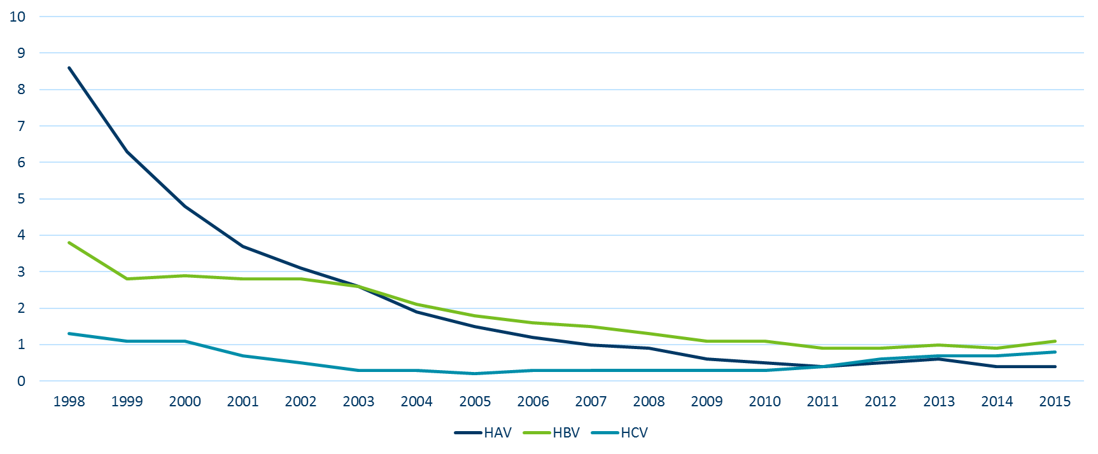
Reported rate per 100,000 population of acute viral hepatitis
United States, 1998-2015
Notes:
In the United States, over the last 15 years acute hepatitis A and B cases have decreased. These are both vaccine preventable infections and vaccination rates have also increased over time.
From 1998 through the early 2000s we also saw a decrease in acute hepatitis C infections. Unfortunatly starting in 2011 we saw an increase in acute hepatitis C cases in the U.S.

Slide 64
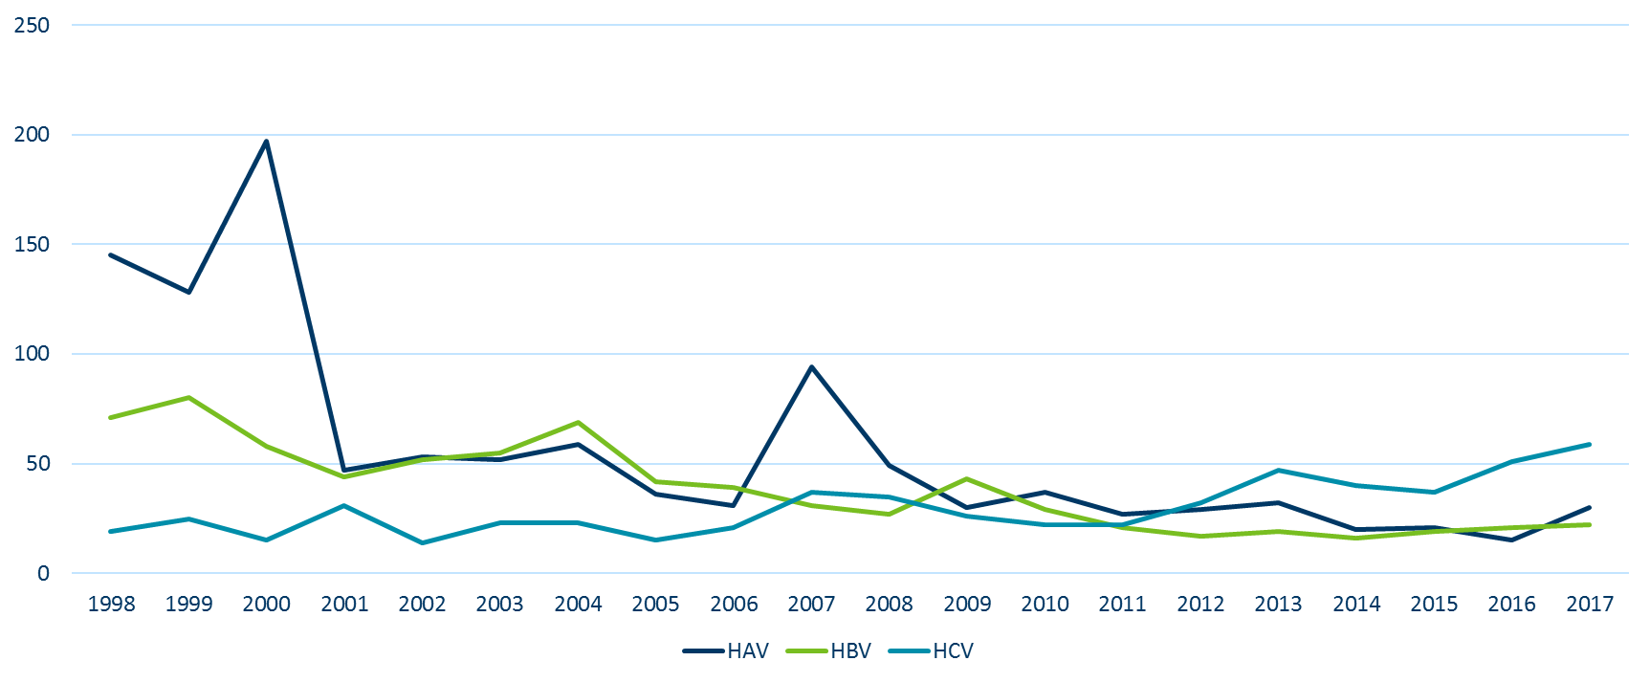
Number of Acute* Cases per year Minnesota
1998-2017
*Acute cases include seroconverters for all years for HBV and HCV
Notes:
In Minnesota, over the last 15 years we see the same trend for acute hepatitis A and B case.
In the past few years we have seen an increase in acute hepatitis C cases as well, with 59 cases reported in 2017. This is the most cases of acute hepatitis C that we have seen in the past 15 years.

Slide 65
Chronic Viral Hepatitis

Slide 66
Overview of HCV in Minnesota
A hepatitis C case is defined as current infection with hepatitis C and includes:
Chronic cases:
  Probable – anti-HCV + alone
  Confirmed – HCV RNA +
Notes:
Most of the cases of hepatitis C reported to MDH are chronic infections. For the remaining slides, I will share data on these cases.
A chronic hepatitis C infection is defined as either probable, a person with only a positive antibody test, or confirmed, HCV RNA positive.

Slide 67
Changes in Case Counting, 2016
Removed resolved infections from case counts
Completed match with death registry for 1997 through 2016
Notes:
In 2016 we changed the way we counted hepatitis C cases in Minnesota and the United States.
Because of these changes, we removed resolved infections from case counts.

Slide 68
Reported Number of Persons Living with HCV in MN
As of December 31, 2017, 34,720* persons are assumed alive and living in MN with HCV
Note: Includes all acute, chronic, probable chronic, and resolved cases
*Includes persons with unknown city of residence.
Notes:
At the end of 2017, 34,720 persons are assumed alive and living in MN with HCV. This number decreased from 35,623 2016 as more people with hepatitis C were treated and cured than were newly reported to MDH.

Slide 69
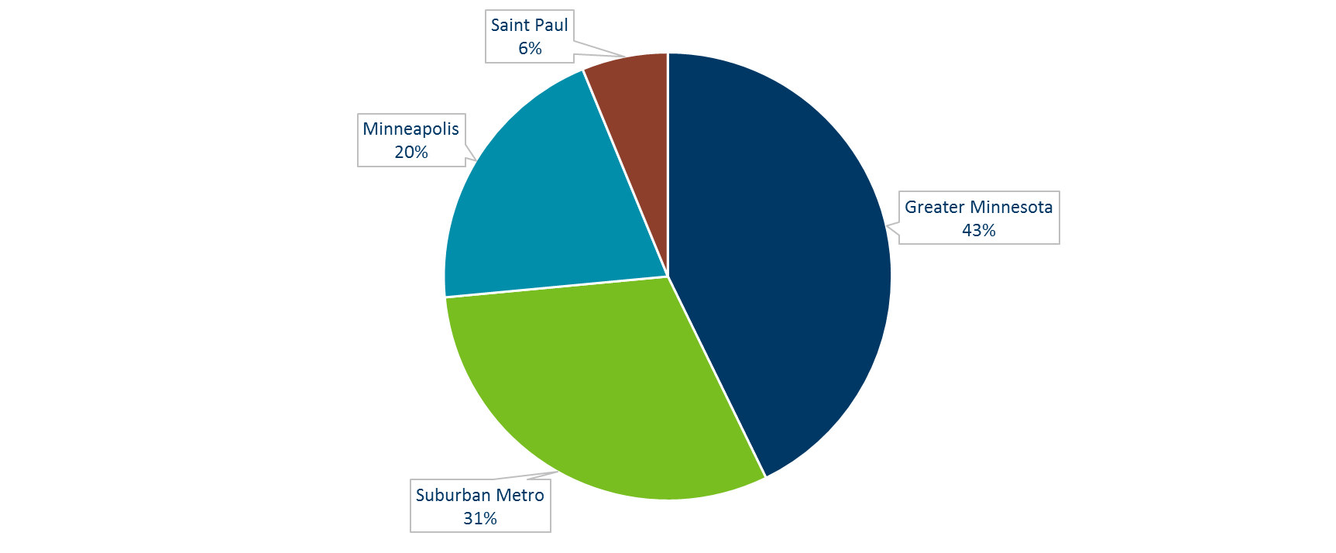
Persons Living with HCV in MN by Current Residence, 2017
Total number with residence information = 33,897
(823 missing residence information)
Suburban = Seven-county metro area including Anoka, Carver, Dakota, Hennepin (except Minneapolis), Ramsey (except St. Paul), Scott, and Washington counties including those in Hennepin County or Ramsey County with unknown city. Greater MN = All other Minnesota counties, outside the seven-county metro area.
Notes:
Hepatitis C cases are distributed through the state. 43% of cases are in Greater Minnesota, 31% are the seven-county metropolitan area outside of Minneapolis and Saint Paul, 20% in Minneapolis ,and 6% in Saint Paul.

Slide 70
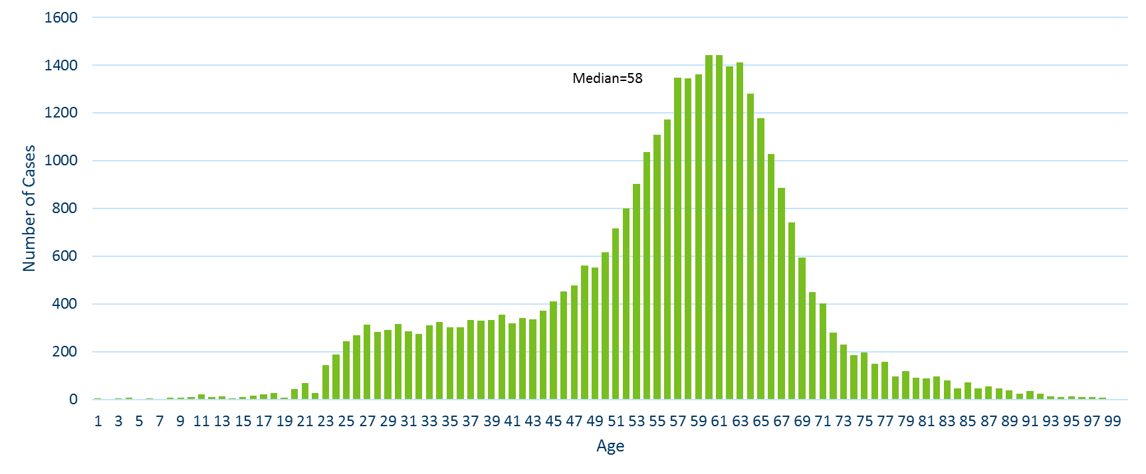
Persons Living with HCV in MN by Age, 2017
Notes:
The median age of cases is 58 years. The largest proportion of cases are in those born between 1945 and 1965 which is consistent with national infection rates in that cohort.

Slide 71
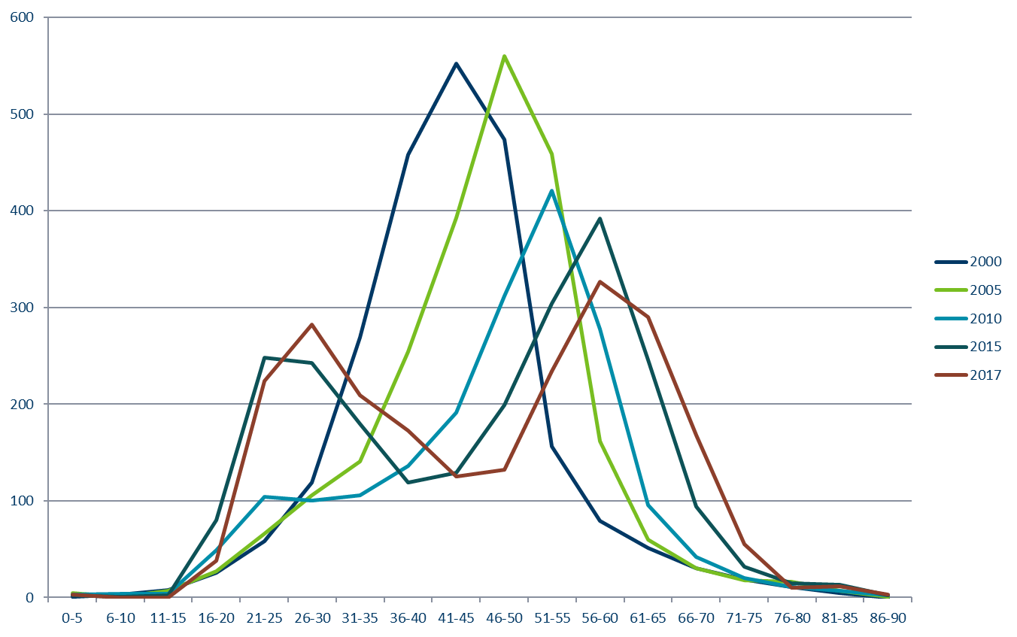
New Reports of HCV in Minnesota by Age Group, 2017
Notes:
This graph shows the number of reports of hepatitis C in persons by age at 4 different points in time. As you can see, in 2000 and 2005 there were not many cases in those under 30 years of age. In 2010, there was a slight increase, and in 2015 there was a peak of cases in the 21 to 30 year old age groups. I have added newly reported cases from 2017 in red. This line shows a continued trend with two peaks in the baby boomer cohort and young adults. This is concerning as these are likely recent infections and are occurring in age groups where we have not historically seen much hepatitis C.

Slide 72
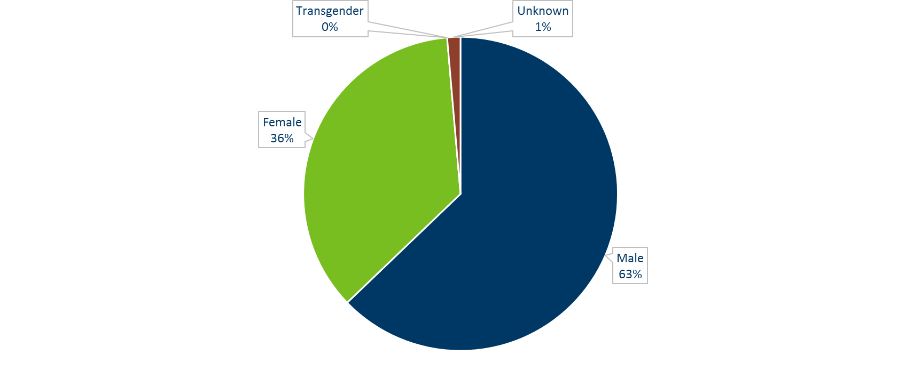
Persons Living with HCV in MN by Gender*, 2017
*Includes anonymous methadone patients
Notes:
More cases are male than female with 63% of all chronic infections in Minnesota reported in men.

Slide 73
Persons Living with Chronic HCV in Minnesota by Race, 2017
Afr Amer = African American /Black Asian=Asian or Pacific Islander
Amer Ind = American Indian
Other = Multi-racial persons or persons with other race
Notes:
The largest proportion of HCV cases are white followed by African American or black. 32% of cases do not have a race reported.

Slide 74
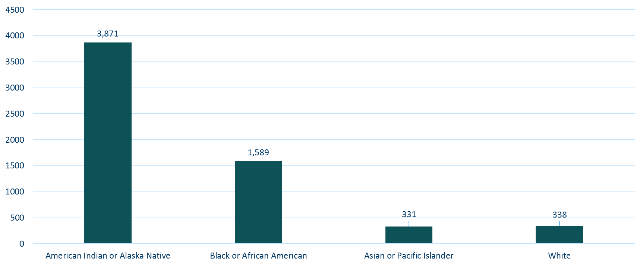
Persons Living with HCV in Minnesota by Race rates (per 100,000 persons*), 2017
*Rates calculated using 2015 U.S. Census ACS data
Excludes persons with multiple races or unknown race, n=23,385
Notes:
If we look at race rates per 100,000 population, we can see that hepatitis C disproportionately impacts American Indian and African American or Black Minnesotans.

Slide 75
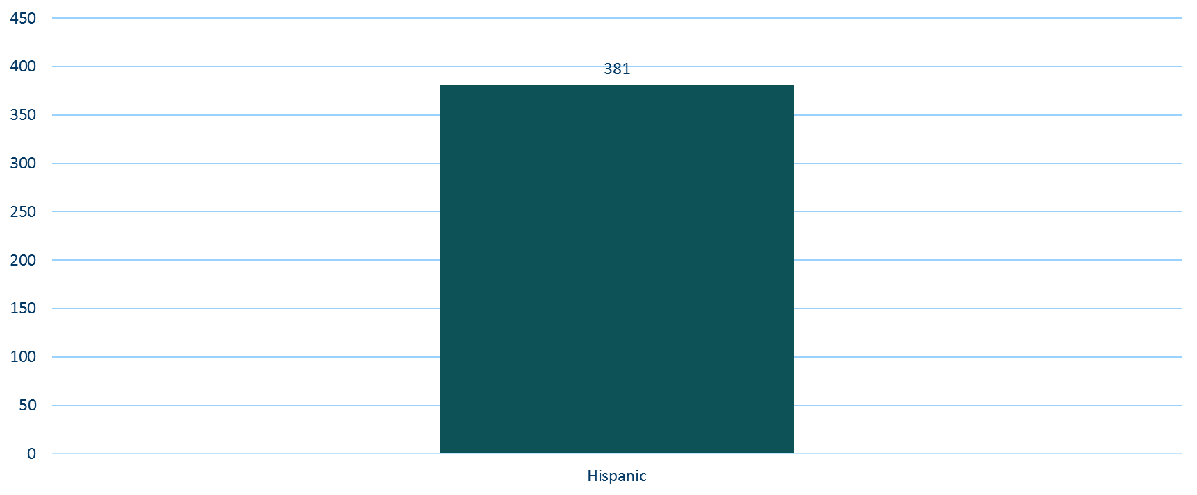
Persons Living with HCV in Minnesota by Ethnicity rates (per 100,000 persons*), 2017
*Rates calculated using 2014 U.S. Census ACS data
Excludes persons with unknown ethnicity, n=20,068
Notes:
The rate of HCV in those reporting Hispanic or Latino ethnicity 381 per 100,000.

Slide 76
Resolved HCV Infection
Previously included in overall HCV case counts
Defined as:
  A positive HCV RNA test followed by a negative HCV RNA test
Does NOT include:
  Anti-HCV positive with a negative HCV RNA with NO past positive HCV RNA
Notes:
Because of the change to the case definition in 2016, resolved HCV infections were removed from the registry. These cases were previously included in overall HCV case counts. These cases are defined as a positive HCV RNA test followed by a negative HCV RNA test and does NOT include those with an anti-HCV positive with a negative HCV RNA with NO past positive HCV RNA.

Slide 77
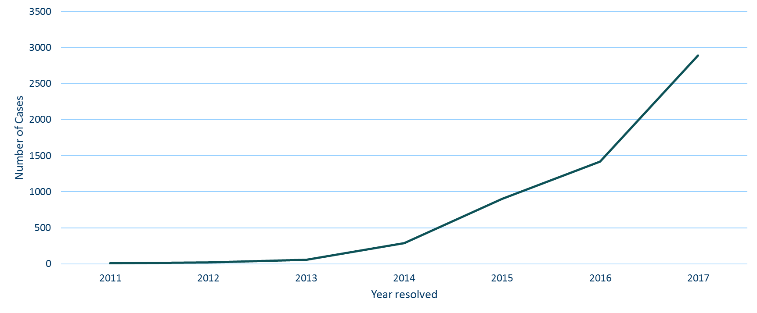
Resolved hepatitis C, 2017
Notes:
In 2017, 2,892 persons with hepatitis C were removed from the registry because their infections resolved. This was over double the number of resolved cases removed in 2016.

Slide 78
HIV and Hepatitis B and C
As of December 31, 2017, 8,789 persons are assumed alive and living in Minnesota with HIV/AIDS
Of these 8,789 persons, 890 (10%) are co-infected with either Hepatitis B or C
    Of the 8,789, 412 (4.7%) are living with HIV and HBV
    Of the 8,789, 430 (4.9%) are living with HIV and HCV
    Of the 8,789, 48 (0.5%) are living with HIV, HBV, and HCV
HIV/AIDS in Minnesota: Annual Review
Notes:
Each year we match the viral hepatitis registry to our HIV registry. In 2017, 10% of all HIV cases were also infected with hepatitis B or hepatitis C.

Slide 79
Thank you!
Kristin Sweet, PhD, MPH
kristin.sweet@state.mn.us
651-201-4888

