Slide 1

HIV/AIDS Prevalence and Mortality Report, 2017
HIV/AIDS Surveillance System

Slide 2
Introduction (I)
These three introduction slides provide a general context for the data used to create this slide set. If you have questions about any of the slides, please refer to the Surveillance Technical Notes.
This slide set displays estimates of the number of persons living with HIV/AIDS (prevalence) and mortality in Minnesota by person, place, and time.
The slides rely on data from HIV/AIDS cases diagnosed through 2017 and reported to the Minnesota Department of Health (MDH) HIV/AIDS Surveillance System.

Slide 3
Introduction (II)
Data analyses exclude persons diagnosed in federal or private correctional facilities, but include state prisoners (number of state prisoners believed to be living with HIV/AIDS = 104).
Data analyses for new infections exclude persons arriving to Minnesota through the HIV+ Refugee Resettlement Program (number of primary HIV+ refugees in this program living in Minnesota as of December 31, 2017 = 170), as well as other refugees/immigrants reporting a positive test prior to their arrival in Minnesota (n = 166).
Some limitations of surveillance data:
Do not include HIV-infected persons who have not been tested for HIV
Do not include persons whose positive test results have not been reported to MDH
Do not include HIV-infected persons who have only tested anonymously
Case numbers for the most recent years may be undercounted due to delays in reporting
Reporting of living cases that were not initially diagnosed in Minnesota is known to be incomplete

Slide 4
Introduction (III)
Persons are assumed to be alive unless MDH has knowledge of their death.
Persons whose most recently reported state of residence was Minnesota are assumed to be currently residing in Minnesota unless MDH has knowledge of their relocation. Our ability to track changes of residence, including within the state, is limited.
Vital status and current residence are updated through one or more of the following methods:
Standard case reporting
Correspondence with other health departments
Active surveillance
Death certificate reviews (annually)
Birth certificate reviews (annually, women only)

Slide 5
National Context
Data source: CDC Preliminary Data for 2016

Slide 6
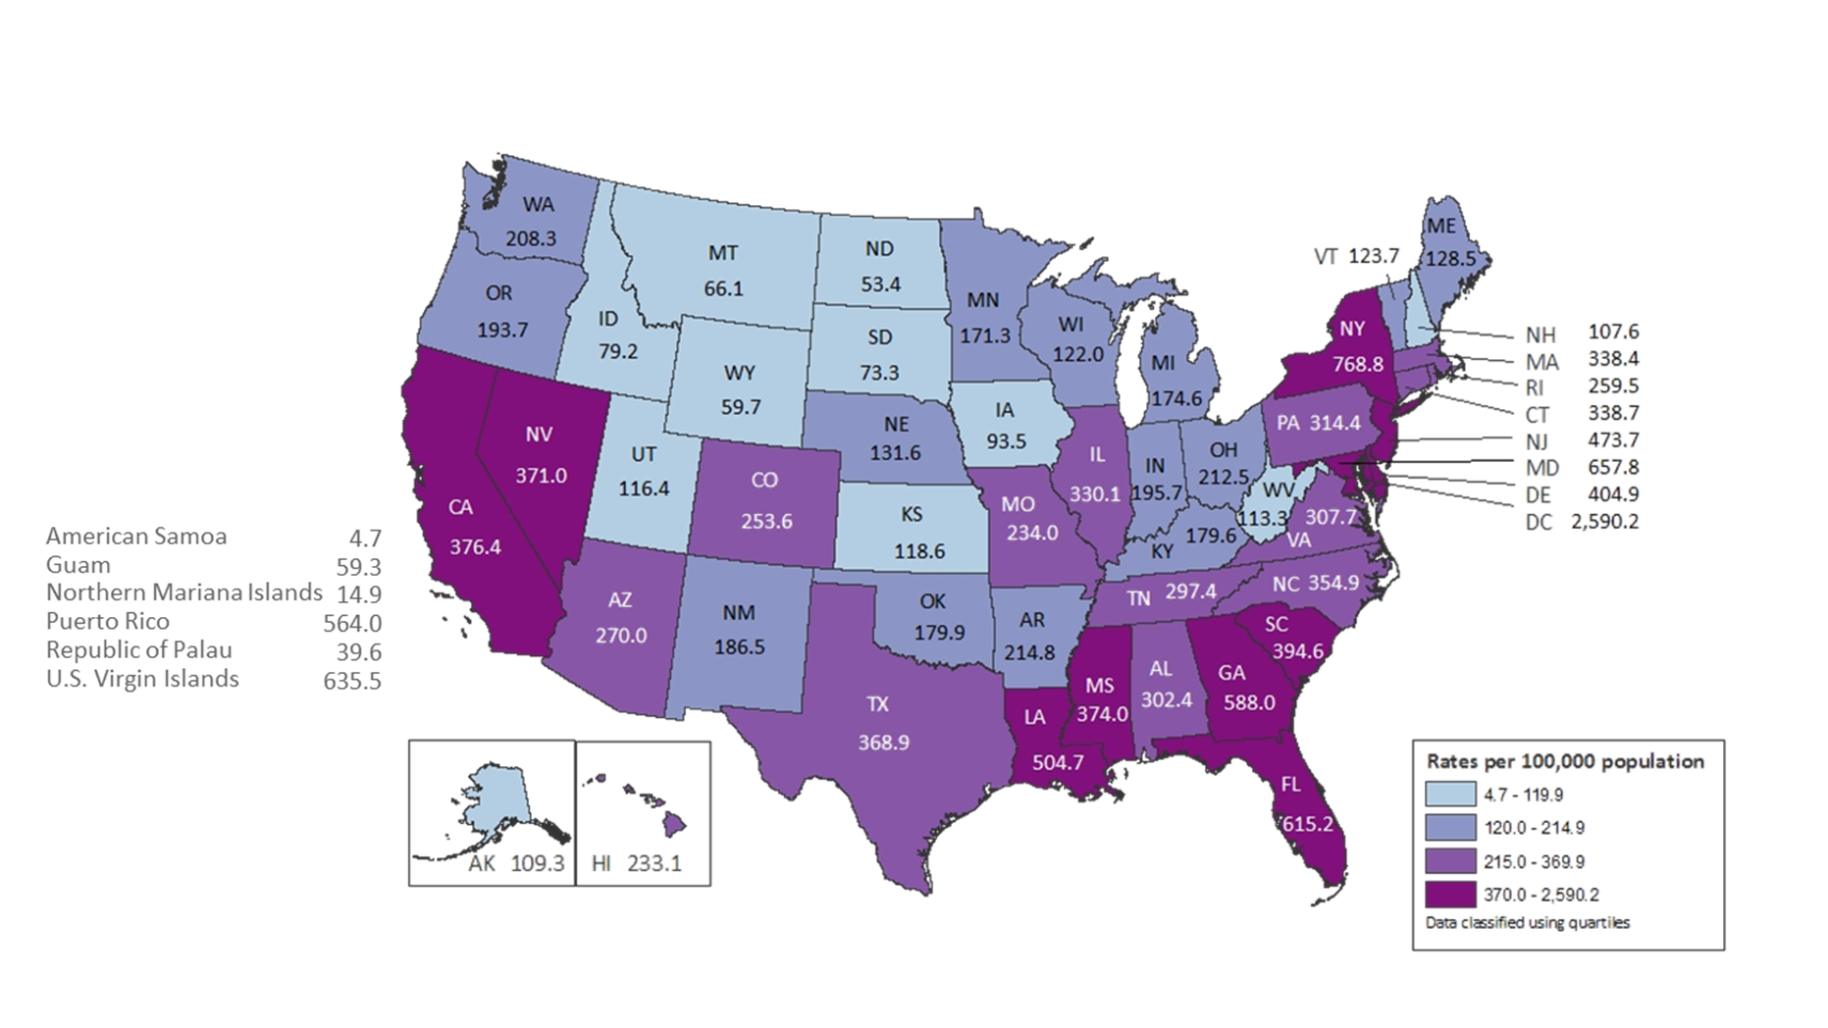
Rates of Adults and Adolescents Living with Diagnosed HIV Infection, by Area of Residence, Year-end 2015 — United States and 6 Dependent Areas
N = 988,955 Total Rate: 364.3
Data are based on address of residence as of December 31, 2015 (i.e., most recent known address).
Notes:
At the end of 2015, the rate of adults and adolescents in the United States living with diagnosed HIV infection ever classified as stage 3 (AIDS) was 195.8 per 100,000. The rates of adults and adolescents living with diagnosed HIV infection ever classified as stage 3 (AIDS) ranged from 2.3 per 100,000 in American Samoa to 1,393.6 per 100,000 in the District of Columbia.
The District of Columbia (i.e., Washington, DC) is a city; use caution when comparing the rate of persons living with diagnosed HIV infection in DC with the rates in states.
Data are based on address of residence as of December 31, 2015 (i.e., most recent known address).

Slide 7
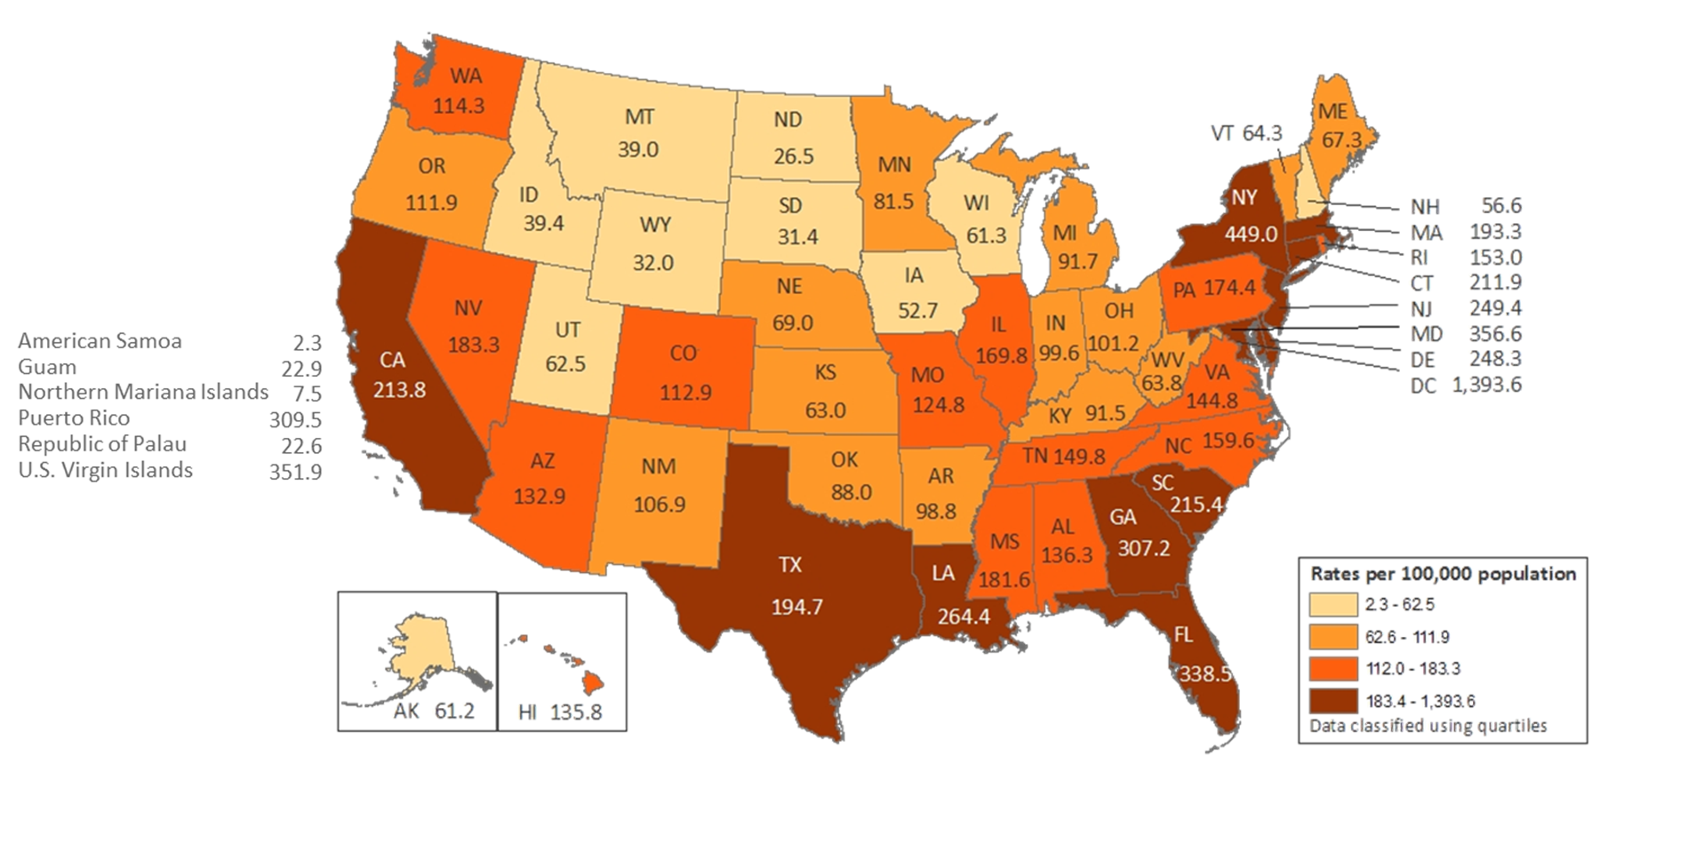
Rates of Adults and Adolescents Living with Diagnosed HIV Infection Ever Classified as Stage 3 (AIDS), by Area of Residence, Year-end 2015— United States and 6 Dependent Areas
N = 531,564 Total Rate: 195.8
Data are based on address of residence as of December 31, 2015 (i.e., most recent known address).
Notes:
At the end of 2015, the rate of adults and adolescents in the United States living with diagnosed HIV infection ever classified as stage 3 (AIDS) was 195.8 per 100,000. The rates of adults and adolescents living with diagnosed HIV infection ever classified as stage 3 (AIDS) ranged from 2.3 per 100,000 in American Samoa to 1,393.6 per 100,000 in the District of Columbia.
The District of Columbia (i.e., Washington, DC) is a city; use caution when comparing the rate of persons living with diagnosed HIV infection in DC with the rates in states.
Data are based on address of residence as of December 31, 2015 (i.e., most recent known address).

Slide 8
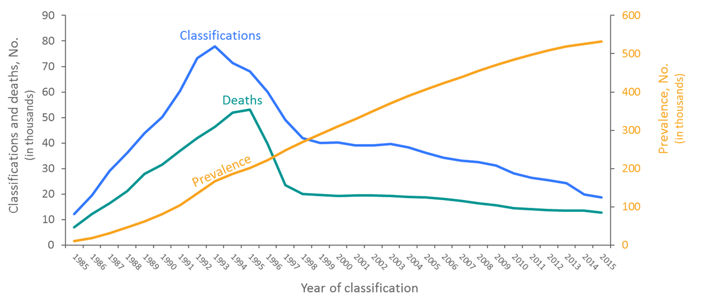
Stage 3 (AIDS) Classifications, Deaths, and Persons Living with Diagnosed HIV Infection Ever Classified as Stage 3 (AIDS) 1985–2015—United States and 6 Dependent Areas
Deaths of persons with HIV infection, stage 3 (AIDS) may be due to any cause.

Slide 9
Overview of HIV/AIDS in Minnesota

Slide 10
New HIV Disease Diagnoses, HIV (non-AIDS) and AIDS Cases by Year, 1991-2017
Notes:
Nationally, Minnesota is considered within the low to moderate risk of HIV and AIDS infections as defined by the Centers for Disease Control and Prevention (CDC). The annual number of new HIV and AIDS cases increased steadily from the beginning of the epidemic to the early 1990s. Beginning in 1996, both the number of newly diagnosed AIDS cases and the number of deaths among AIDS cases declined sharply, primarily due to the success of new antiretroviral therapies including protease inhibitors. These treatments do not cure, but can delay progression to AIDS among persons with HIV (non-AIDS) infection and improve survival among those with AIDS. These treatments have been shown to be effective at preventing transmission of HIV. Over the past five years, the number of HIV/AIDS cases diagnosed has remained relatively stable with an average of 300 cases diagnosed each year. By the end of 2017, an estimated 8,789 persons with HIV/AIDS were assumed to be living in Minnesota.
This number includes persons whose most recently reported state of residence was Minnesota, regardless of residence at time of diagnosis. This estimate does not include persons with undiagnosed HIV infection.
In 2017, there was a slight decrease of new HIV diagnoses from 2016. In 2017, there were 284 newly diagnosed cases, as compared to 294 cases in 2016. This represents a decrease of about 3% compared to 2016.

Slide 11
Persons Living with HIV/AIDS in Minnesota

Slide 12
Estimated Number of Persons Living with HIV/AIDS in Minnesota
As of December 31, 2017 8,789* persons are assumed alive and living in Minnesota with HIV/AIDS. This includes:
4,751 (54%) living with HIV infection (non-AIDS)
4,038 (46%) living with AIDS
This number includes 2,219 persons who were first reported with HIV or AIDS elsewhere and subsequently moved to Minnesota
This number excludes 1,449 persons who were first reported with HIV or AIDS in Minnesota and subsequently moved out of the state

Slide 13
Place

Slide 14
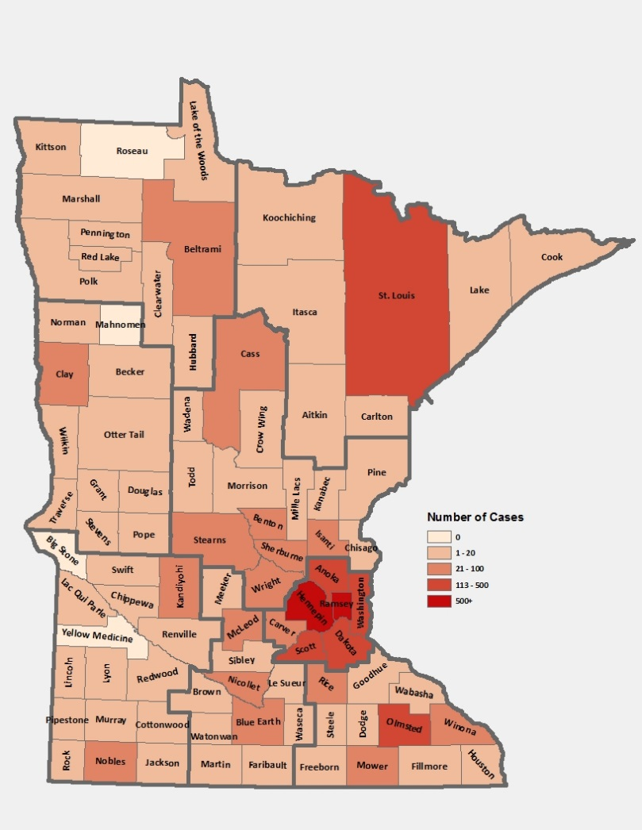
Living HIV/AIDS Cases by County of Residence, 2017
Notes:
The majority (83%) of prevalent cases reside in the seven-county metropolitan area surrounding the Twin Cities of Minneapolis and St. Paul (Hennepin, Ramsey, Anoka, Carver, Dakota, Scott, and Washington counties). Although HIV infection is more common in communities with higher population densities and greater poverty, there are people living with HIV or AIDS in 95% of counties in Minnesota.

Slide 15
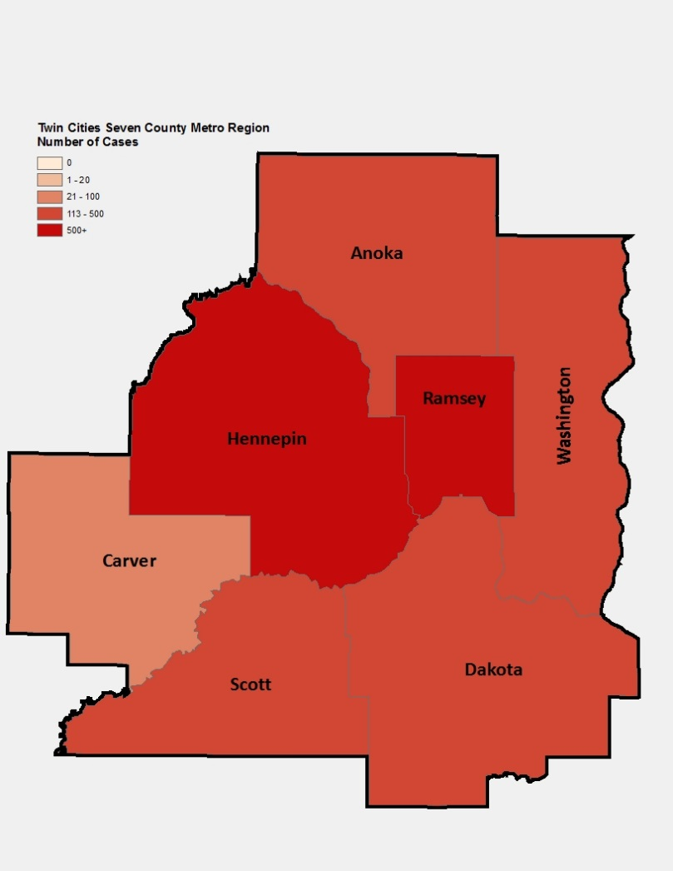
Map of Metro Area: Living HIV/AIDS Cases by County of Residence, 2017
Notes:
While 83% of all people living with HIV/AIDS in Minnesota reside in the metro area, the cases in the metro area are concentrated in Hennepin and Ramsey counties, which both had a prevalence of 4,613 and 1,413 in 2017, respectively.

Slide 16
Persons Living with HIV/AIDS in Minnesota by Current Residence, 2017
Notes:
Overall, of the 8,789 people living with HIV/AIDS for whom residence information is available, 36% of all people living with HIV/AIDS in Minnesota live in the city of Minneapolis, followed by 35% living in the surrounding suburban area. People living with HIV/AIDS in Greater Minnesota account for 16% of all people living with HIV/AIDS. Finally, people living with HIV/AIDS in St. Paul account for 13% of all people living with HIV/AIDS.

Slide 17
Sex Assigned at Birth and Race/Ethnicity

Slide 18
Persons Living with HIV/AIDS in Minnesota by Sex Assigned at Birth, 2017
Notes:
Seventy-five percent (75%) of prevalent HIV/AIDS cases are males, while twenty-five percent (25%) are females.

Slide 19
Persons Living with HIV/AIDS in Minnesota by Sex Assigned at Birth and Race/Ethnicity, 2017
Notes:
Seventy-five percent (75%) of prevalent HIV/AIDS cases are males. Broken down by race/ethnicity, 55% of male cases are white, 20% Black not African-born, 10% Hispanic, 9% African-born, 1% American Indian, 2% Asian/Pacific Islander, and 3% are persons of multiple or unknown race. In total, 45% of males living with HIV/AIDS are among men of color; whereas only 17% of the general male population are people of color. Among female cases, the distribution is even more skewed toward women of color: 37% African-born, 26% Black not African-born, 22% white, 7% Hispanic, 2% American Indian, 3% Asian/Pacific Islander, and 3% persons of multiple or unknown race. Thus, 78% of prevalent female HIV/AIDS cases are among women or color whereas only 17% of the general female population in Minnesota is comprised of women of color.
Please note that race is not considered a biological reason for disparities related to HIV/AIDS experienced by persons of color. Race, however, can be considered a marker for other personal and social characteristics that put a person at greater risk for HIV exposure. These characteristics may include, but are not limited to, lower socioeconomic status, less education, and less access to health care.

Slide 20
Number of Cases and Rates (per 100,000 persons) of Persons Living with HIV/AIDS by Race/Ethnicity in Minnesota, 2017
Race/Ethnicity | Number of Cases | Percentage of Total | Rate per 100,000^
White, non-Hispanic | 4,119 | 47% | 93.4
Black, non African-born | 1,885 | 21% | 1,155.5
Black, African-born* | 1,368 | 16% | 1,268.1††
Hispanic | 852 | 10% | 340.4
American Indian | 113 | 1% | 203.2
Asian/Pacific Islander | 191 | 2% | 88.0
Other† | 249 | 3% | X
Total | 8,777 | 100% | 165.4
Notes:
While white persons account for the greatest number of persons living with HIV/AIDS in Minnesota (4,119 cases), they have one of the lowest rates of people living with HIV/AIDS (93.4 per 100,000 persons). Black, African-born persons account for 1,368 cases living with HIV/AIDS in Minnesota, however since this population makes up a small proportion of the overall population in Minnesota, the rate of people living with HIV/AIDS in this community is higher than other races and ethnicities. The rate of African-born persons living with HIV/AIDS is 1,268.1 per 100.000 persons; this is a rate of more than 13 times greater than white, non-Hispanic persons. Black, non African-born persons have the second highest rate of people living with HIV/AIDS at 1,155.5 per 100,000 persons; this is 12 times higher than the rate among white people. Hispanic persons have the next highest rate of people living with HIV/AIDS in Minnesota at 340.4 per 100,000; this is a rate of more than 3 times higher than white, non-Hispanic persons. American Indians have a rate of people living with HIV/AIDS of 203.2 per 100,000 persons; this is a rate two times higher than white non-Hispanic persons. Finally, Asian/Pacific Islanders have a rate of people living with HIV/AIDS of 88.2 per 100,000; this accounts for an HIV/AIDS rate similar to the rate among white non-Hispanic persons.

Slide 21
Number of Cases and Rates (per 100,000 persons) of Adults and Adolescents* Living with HIV/AIDS by Sex and Risk† in Minnesota, 2017
Sex/Risk | Number of Cases | Percent of Total | Rate per 100,000^
Men (Total) | 6,548 | 76% | 248.8
MSM† | 4,770 | 55% | 5,261.2††
Non-MSM | 1,778 | 21% | 70.0
Women | 2,082 | 24% | 77.9
Total | 8,630 | 100% | 162.7
Notes:
Beginning in 2012, MDH began estimating the number of MSM living in Minnesota. This number was updated in 2017 with more recent data from Emory University. Men who have sex with Men have the highest rate of persons living with HIV/AIDS than any other sub-group. In 2017, the estimated rate of people living with HIV/AIDS among MSM was 5,261.2 per 100,000 population. This is more than 75 times higher than the rate among non-MSM men (70.0 per 100,000 population). It’s important to note that MSM contains cases from all racial/ethnic categories and therefore cannot be directly compared to the rates by race/ethnicity. For more information on how this was estimated, see the HIV Surveillance Technical Notes.

Slide 22
Number of Cases of Adults and Adolescents* Living with HIV/AIDS by Gender Identity and Risk† in Minnesota, 2017
Gender Identity/Risk | Number of Cases | Percent of Total
Men (Total) | 6,486 | 75%
MSM† | 4,708 | 73%
Non-MSM | 1,778 | 27%
Women | 2,064 | 24%
Transgender†† (Total) | 80 | 1%
Male to Female | 62 | 78%
Female to Male | 18 | 22%
Total | 8,630 | 100%
Notes:
This slide shows the number of people living with HIV/AIDS by gender identity [male, female, or transgender (male to female or female to male)].
As of 2017, there are 80 transgender people living with HIV/AIDS in Minnesota, of which the majority are male to female (78%) and 22% transgender female to male. This represents about 1% of people living with HIV/AIDS in the state.

Slide 23
Age

Slide 24
Persons Living with HIV/AIDS in Minnesota by Age Group*, 2017
Notes:
Seventy-one percent (71%) of persons living with HIV/AIDS as of 2017 are currently 40 years of age or older. As with new cases, there are differences by gender in the age of living cases.

Slide 25
Persons Living with HIV/AIDS in Minnesota by Age* and Sex, 2017

Slide 26
Mode of Exposure at Time of Diagnosis
Notes:
In 2017, MDH used a risk re-distribution method to estimate the mode of exposure among cases with unknown risk. For additional details on how this was done, please read the HIV Surveillance Technical Notes. All mode of exposure numbers referred to in the text are based on the risk re-distribution.

Slide 27
White Males Living with HIV/AIDS in Minnesota by Estimated Mode of Exposure*, 2017
Notes:
The proportion of cases attributable to a certain mode of exposure differs not only by gender, but also by race. Of the 3,635 white males living with HIV/AIDS in Minnesota in 2016, MSM or MSM/IDU accounted for an estimated 94% of cases; Injection Drug Use (IDU) accounted for 3% of cases, heterosexual contact accounted for 2% of cases, and other risk accounted for the remaining 1% of cases.

Slide 28
Black, non African-born Males Living with HIV/AIDS in Minnesota by Estimated Mode of Exposure*, 2017
Notes:
Of the 1,321 Black, non African-born males living with HIV/AIDS in Minnesota in 2017, MSM or MSM/IDU accounted for an estimated 78% of cases; Injection Drug Use (IDU) accounted for 11% of cases, heterosexual contact accounted for 9% of cases, and other risk accounted for the remaining 2% of cases.

Slide 29
Hispanic Males Living with HIV/AIDS in Minnesota by Estimated Mode of Exposure*, 2017
Notes:
Of the 703 Hispanic males living with HIV/AIDS in Minnesota in 2017, MSM or MSM/IDU accounted for an estimated 84% of cases; Injection Drug Use (IDU) accounted for 7% of cases, heterosexual contact accounted for 8% of cases, and other risk accounted for the remaining 1% of cases.

Slide 30
Black, African-born Males Living with HIV/AIDS in Minnesota by Estimated Mode of Exposure*, 2017
Notes:
Of the 579 Black, African-born males living with HIV/AIDS in Minnesota in 2017, heterosexual contact accounted for 80% of cases, MSM or MSM/IDU accounted for an estimated 14% of cases; Injection Drug Use (IDU) accounted for 1% of cases, and other risk accounted for the remaining 5% of cases.

Slide 31
Multi-Racial Males Living with HIV/AIDS in Minnesota by Estimated Mode of Exposure*, 2017
Notes:
Of the 167 multi-racial males living with HIV/AIDS in Minnesota in 2017, MSM or MSM/IDU accounted for an estimated 93% of cases; heterosexual contact accounted for 3% of cases, Injection Drug Use (IDU) accounted for 3% of cases, and other identified risks accounted for 1% of cases.

Slide 32
Asian/Pacific Islander Males Living with HIV/AIDS in Minnesota by Estimated Mode of Exposure*, 2017
Notes:
Of the 137 Asian/Pacific Islander males living with HIV/AIDS in Minnesota in 2017, MSM or MSM/IDU accounted for an estimated 92% of cases; heterosexual contact accounted for 3% of cases, Injection Drug Use (IDU) accounted for 2% of cases, and other risk accounted for the remaining 3% of cases.

Slide 33
American Indian Males Living with HIV/AIDS in Minnesota by Estimated Mode of Exposure*, 2017
Notes:
Of the 64 American Indian males living with HIV/AIDS in Minnesota in 2017, MSM or MSM/IDU accounted for an estimated 82% of cases; heterosexual contact accounted for 4% of cases, and Injection Drug Use (IDU) accounted for 14% of cases.

Slide 34
White Females Living with HIV/AIDS in Minnesota by Estimated Mode of Exposure*, 2017
Notes:
Among the 480 white females living with HIV/AIDS in Minnesota in 2016, an estimated 82% of cases were attributed to heterosexual contact, 16% of the cases were attributed to injection drug use (IDU) and other risk accounted for the remaining 2% of cases.

Slide 35
Black, non African-born Females Living with HIV/AIDS in Minnesota by Estimated Mode of Exposure*, 2017
Notes:
Among the 564 Black, non African-born females living with HIV/AIDS in Minnesota in 2017, an estimated 83% of cases were attributed to heterosexual contact, 13% of the cases were attributed to injection drug use (IDU) and other risk accounted for the remaining 4% of cases.

Slide 36
Hispanic Females Living with HIV/AIDS in Minnesota by Estimated Mode of Exposure*, 2017
Notes:
Among the 149 Hispanic females living with HIV/AIDS in Minnesota in 2017, an estimated 88% of cases were attributed to heterosexual contact, 9% of the cases were attributed to injection drug use (IDU) and other risk accounted for the remaining 3% of cases.

Slide 37
Black, African-born Females Living with HIV/AIDS in Minnesota by Estimated Mode of Exposure*, 2017
Notes:
Among the 788 Black, African-born females living with HIV/AIDS in Minnesota in 2017, an estimated 96% of cases were attributed to heterosexual contact, 1% of cases were attributed to Injection Drug Use (IDU), and other risk accounted for the remaining 3% of cases.

Slide 38
Multi-Racial Females Living with HIV/AIDS in Minnesota by Estimated Mode of Exposure*, 2017
Notes:
Among the 68 multi-racial females living with HIV/AIDS in Minnesota in 2017, an estimated 81% of cases were attributed to heterosexual contact, 15% of the cases were attributed to injection drug use (IDU) and the remaining 4% were attributed to other risk.

Slide 39
Asian/Pacific Islander Females Living with HIV/AIDS in Minnesota by Estimated Mode of Exposure*, 2017
Notes:
Among the 54 Asian/Pacific Islander females living with HIV/AIDS in Minnesota in 2017, an estimated 89% of cases were attributed to heterosexual contact, 9% of the cases were attributed to other risk and the remaining 2% were attributed to injection drug use (IDU).

Slide 40
American Indian Females Living with HIV/AIDS in Minnesota by Estimated Mode of Exposure*, 2017
Notes:
Among the 49 American Indian females living with HIV/AIDS in Minnesota in 2017, an estimated 79% of cases were attributed to heterosexual contact, and the remaining 21% of the cases were attributed to injection drug use (IDU).

Slide 41
HIV and Hepatitis B/C Co-infection

Slide 42
HIV/AIDS and Hepatitis Co-infections in Minnesota
As of December 31, 2017 8,789* persons are assumed alive and living in Minnesota with HIV/AIDS. Of these 8,789 persons, 890 (10%) are co-infected with either Hepatitis B, C, or both:
412 (46%) are living with HIV and Hepatitis B
430 (48%) are living with HIV and Hepatitis C
48 (5%) are living with HIV and both Hepatitis B/C

Slide 43
Foreign Born Populations

Slide 44
Foreign Born Persons Living with HIV/AIDS in Minnesota by Region of Birth, 2007-2017
*This number includes persons who reported Minnesota as their current state of residence, regardless of residence at time of diagnosis. It also includes state prisoners and refugees arriving through the HIV+ Refugee Resettlement Program, as well as HIV+ refugees/immigrants arriving through other programs.
Notes:
One particular population of interest in Minnesota that sets us apart from other states is our larger foreign-born HIV-positive population. Between 1990 and 2017, the number of foreign-born people living with HIV/AIDS in Minnesota increased substantially, especially among the African-born population. In 1990, 50 foreign-born people were reported to be living with HIV/AIDS in Minnesota, and by 2007 this number had increased to 1,126 people. In 2017, the total number of foreign-born people living with HIV/AIDS in Minnesota was 2,101, a nearly 7% increase from 2016. The majority of these people immigrated to the United States from Africa and Latin America. This trend illustrates the growing diversity of the HIV-positive population in Minnesota and the need for culturally appropriate HIV care and prevention efforts.

Slide 45
African-Born* Persons Living with HIV/AIDS Compared to Other Minnesota Cases by Sex, 2017
Notes:
The characteristics of foreign-born persons living with HIV/AIDS in Minnesota differ from U.S.-born, especially in gender. While females account for 18% of cases among U.S.-born persons, they account for 45% of foreign-born cases. This is especially noticeable among African-born cases, where women account for 58% of those living with HIV/AIDS in Minnesota.

Slide 46
Latin American/Caribbean* Persons Living with HIV/AIDS Compared to Other Minnesota Cases by Sex, 2017
Notes:
The gender distribution among cases born in Latin America/the Caribbean is similar to that of U.S.-born cases, where 16% of prevalent cases are among women.

Slide 47
Countries of Birth Among Foreign Born Persons* Living with HIV/AIDS in Minnesota, 2017
Country of Birth | Number of Prevalent Cases | Percent of Total
Ethiopia | 315 | 15%
Mexico | 273 | 13%
Liberia | 235 | 11%
Kenya | 173 | 8%
Somalia | 143 | 7%
Cameroon | 113 | 5%
Sudan | 70 | 3%
Nigeria | 56 | 3%
Vietnam | 31 | 1%
El Salvador | 30 | 1%
Other* Countries | 664 | 31%
Notes:
Ten countries (Ethiopia, Mexico, Liberia, Kenya, Somalia, Cameroon, Sudan, Nigeria, Vietnam, and El Salvador) account for nearly 70% of living foreign-born cases, however there are nearly 100 additional countries represented among the 2,101 foreign-born persons living with HIV infection in Minnesota.

Slide 48
Mortality

Slide 49
Reported Deaths Among Persons living with HIV/AIDS in Minnesota, 1984-2017
Notes:
The number of deaths among all people living with HIV infection in Minnesota decreased dramatically between 1995 and 1997 and has remained relatively constant over the past decade. In 2017, a total of 75 deaths were reported among people living with HIV infection in Minnesota. The total number of deaths reported in Minnesota for those living with AIDS was 56 (75% of all deaths) in 2017.

