Slide 1
HIV Incidence Report, 2017
Sexually Transmitted Diseases, HIV and Tuberculosis Section, Epidemiology and Surveillance Unit

Slide 2
Introduction (I)
These two introduction slides provide a general context for the data used to create this slide set. If you have questions about any of the slides please refer to the Companion Text to the Minnesota HIV Surveillance Report, 2017 or HIV Surveillance Technical Notes.
This slide set describes new HIV diagnoses (including AIDS at first diagnosis) in Minnesota by person, place, and time.
The slides rely on data from HIV/AIDS cases diagnosed through 2017 and reported to the Minnesota Department of Health (MDH) HIV/AIDS Surveillance System.
The data are displayed by year of HIV diagnosis.

Slide 3
Introduction (II)
Data analyses exclude persons diagnosed in federal or private correctional facilities, but include state prisoners (number of state prisoners believed to be living with HIV/AIDS (n=162).
Data analyses for new HIV diagnoses exclude persons arriving to Minnesota through the HIV+ Refugee Resettlement Program (number of primary HIV+ refuges in this program living in MN as of December 31, 2017 = 170), as well as, other refuges/immigrants reporting a positive test prior to their arrival in Minnesota (n=166).
Some limitations of surveillance data:
  Data do not include HIV-infected persons who have not been tested for HIV
  Data do not include persons whose positive test results have not been reported to MDH
  Data do not include HIV-infected persons who have only tested anonymously
  Case numbers for the most recent years may be undercounted due to delays in reporting
  Reporting of living cases that were not initially diagnosed in Minnesota is known to be incomplete

Slide 4
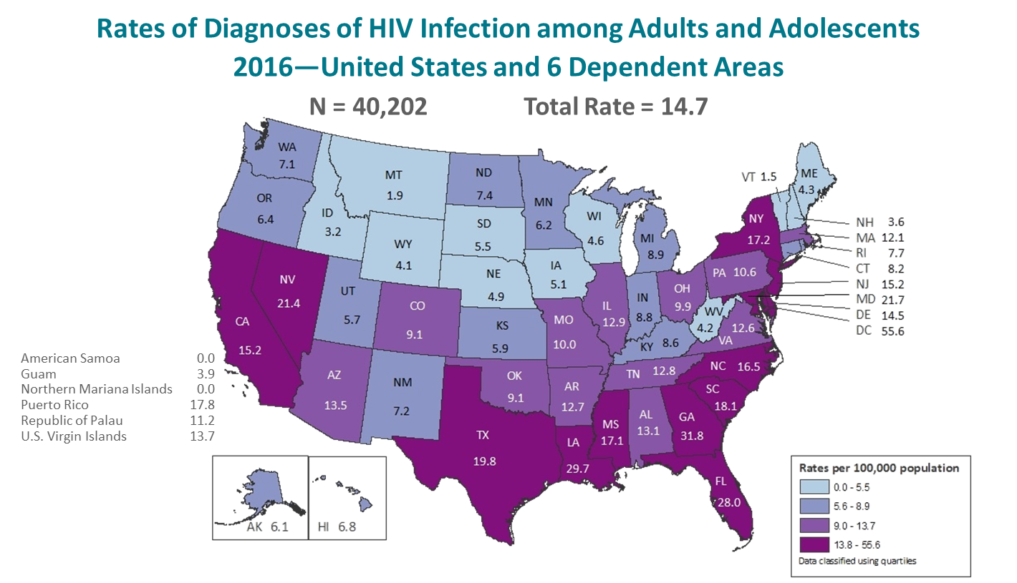
National Context (I)
Data source: CDC Preliminary Data for 2016
Notes:
In the United States and 6 dependent areas, the estimated rate of diagnoses of HIV infection among adults and adolescents was 14.7 per 100,000 population in 2016. The rate of diagnoses of HIV infection for adults and adolescents ranged from zero per 100,000 in American Samoa and the Northern Mariana Islands to 55.6 per 100,000 in the District of Columbia.
The District of Columbia (i.e., Washington, DC) is a city; use caution when comparing the HIV diagnosis rate in DC with the rates in states.
Data include persons with a diagnosis of HIV infection regardless of stage of disease at diagnosis. All displayed data are estimates. Estimated numbers resulted from statistical adjustment that accounted for reporting delays, but not for incomplete reporting.

Slide 5
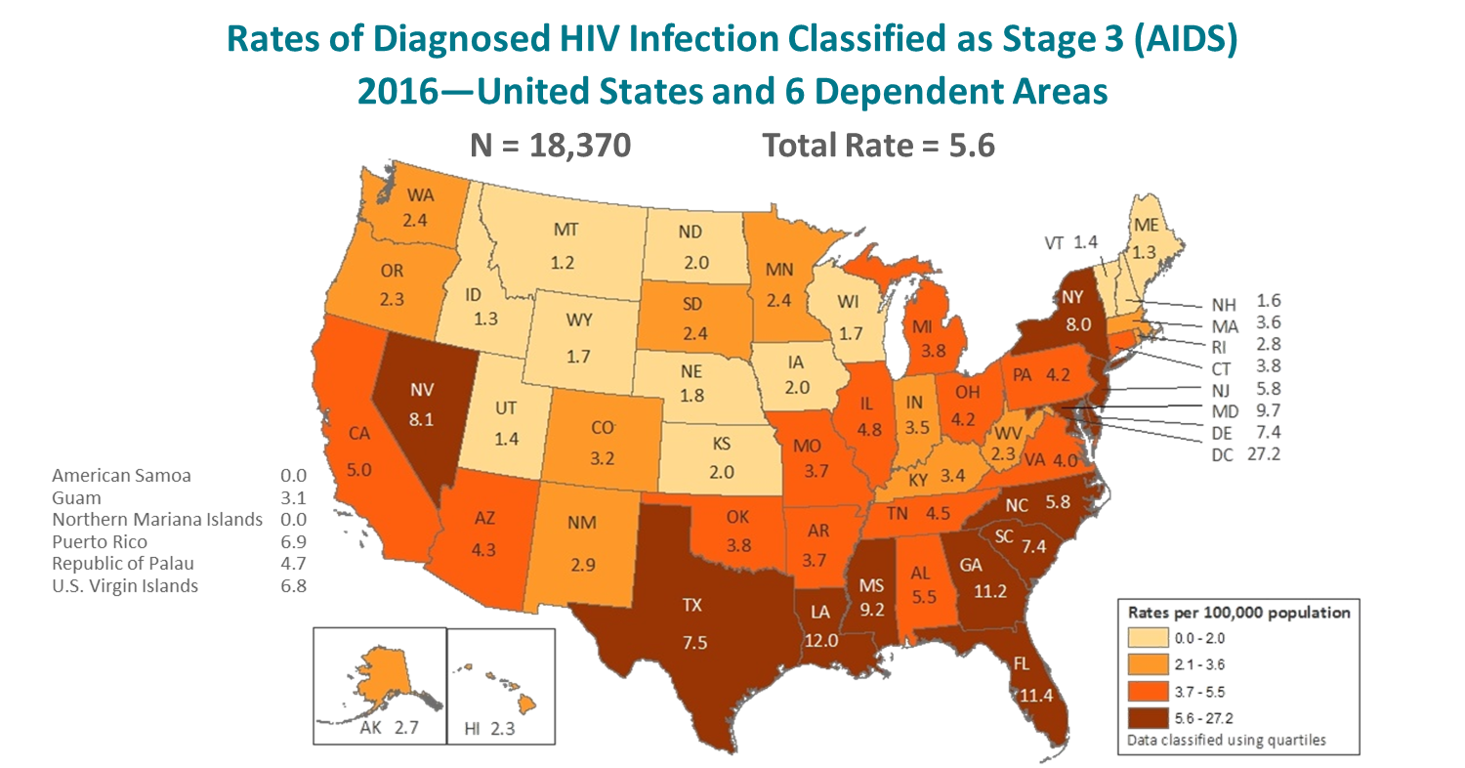
National Context (II)
Data source: CDC Preliminary Data for 2016
Notes:
The estimated rates (per 100,000 population) of stage 3 (AIDS) classifications in 2016 for persons (all ages) with HIV infection are shown for each state, the District of Columbia, American Samoa, Guam, the Northern Mariana Islands, Puerto Rico, the Republic of Palau, and the U.S. Virgin Islands.
Areas with the highest rates of stage 3 (AIDS) in 2016 were the District of Columbia (27.2), Louisiana (12.0), Florida (11.4), Georgia (11.2), Maryland (9.7), and Mississippi (9.2). The District of Columbia (i.e., Washington, DC) is a city; use caution when comparing the stage 3 (AIDS) rate in DC with the rates in states.
All displayed data are estimates. Estimated numbers resulted from statistical adjustment that accounted for reporting delays, but not for incomplete reporting.

Slide 6
Overview of HIV/AIDS in Minnesota

Slide 7
New HIV Disease Diagnoses, HIV (non-AIDS) and
AIDS Cases by Year, 1990-2017
Notes:
Nationally, Minnesota is considered within the low to moderate risk of HIV and AIDS infections as defined by the Centers for Disease Control and Prevention (CDC). The annual number of new HIV and AIDS cases increased steadily from the beginning of the epidemic to the early 1990s. Beginning in 1996, both the number of newly diagnosed AIDS cases and the number of deaths among AIDS cases declined sharply, primarily due to the success of new antiretroviral therapies including protease inhibitors. These treatments do not cure, but can delay progression to AIDS among persons with HIV (non-AIDS) infection and improve survival among those with AIDS. These treatments have been shown to be effective at preventing transmission of HIV. Over the past five years, the number of HIV/AIDS cases diagnosed has remained relatively stable with an average of almost 300 cases diagnosed each year. By the end of 2017, an estimated 8,789 persons with HIV/AIDS were assumed to be living in Minnesota.
This number includes persons whose most recently reported state of residence was Minnesota, regardless of residence at time of diagnosis. This estimate does not include persons with undiagnosed HIV infection.

Slide 8
New HIV Disease Diagnoses, HIV (non-AIDS) and AIDS Cases by Year, 2007-2017
Notes:
In this report, the term “new HIV diagnoses” refers to HIV-infected Minnesota residents who were diagnosed in a particular calendar year and reported to MDH. This includes persons whose first diagnosis of HIV infection is AIDS (AIDS at first diagnosis). HIV diagnoses data are displayed by earliest known date of HIV diagnosis.
In 2017, there was a slight decrease of new HIV diagnoses from 2016. In 2017 there were 284 newly diagnosed cases, as compared to 290 cases in 2016. This represents a decrease of about 2% compared to 2016. In reviewing newly diagnosed cases since 2013, 284 cases for 2017 is below the 5 year average of 297 cases per year.

Slide 9
New HIV Diagnoses, Deaths and Prevalent Cases by Year, 1996-2017
Number of Persons Living w/ HIV/AIDS
Notes:
Since 1996, the number of new diagnoses has remained relatively stable in Minnesota at around 300 cases per year. During this same time, deaths among HIV positive people in Minnesota has decreased dramatically. As people with HIV are living longer and healthier lives, the number of people living with HIV in Minnesota continues to grow as seen in the Red line here. At the end of 2017, 8,789 people were estimated to be living with HIV or AIDS in Minnesota.
This number does not include about 1400 persons who were first reported with HIV or AIDs in Minnesota and subsequently moved out of the state. Although it does include about 2000 persons who were first reported with HIV or AIDS elsewhere and subsequently moved to Minnesota.

Slide 10
HIV (non-AIDS) and AIDS at Diagnosis by Year, 2007-2017
Notes:
During the past 10 years, the proportion of cases being diagnosed with AIDS at initial HIV diagnosis has remained the same at about 25% of all new cases. For 2017, the proportion of cases diagnosed with AIDS at initial HIV diagnosis was slightly higher at 28%.

Slide 11
HIV Diagnoses* in Minnesota by Person, Place, and Time

Slide 12
Place

Slide 13
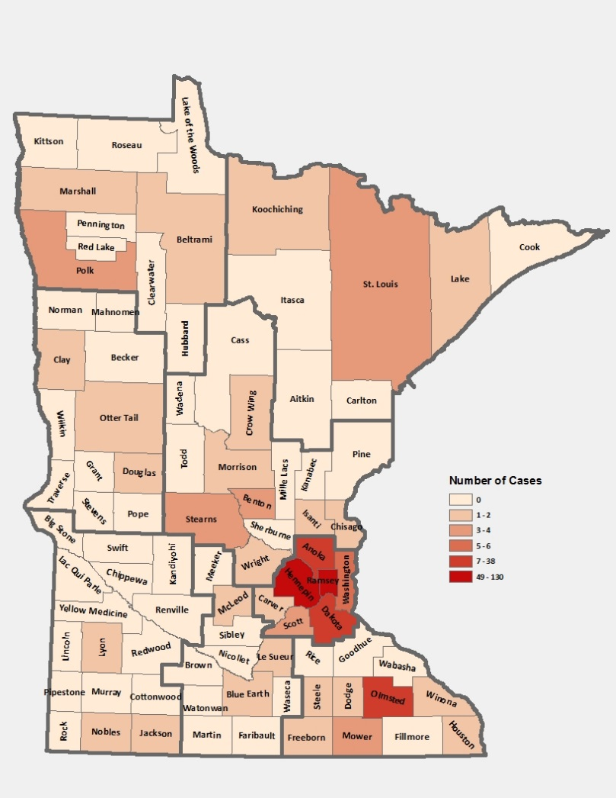
HIV Diagnoses* by County of Residence at Diagnosis, 2017
City of Minneapolis – 83 (29%)
City of St. Paul – 39 (14%)
Suburban# – 107 (38%)
Greater Minnesota – 55 (19%)
Total number = 284
*HIV or AIDS at first diagnosis
# 7-county metro area, excluding the cities of Minneapolis and St. Paul
Notes:
Historically, about 90% of new HIV infections diagnosed in Minnesota have occurred in Minneapolis, St. Paul and the surrounding seven-county metropolitan area.
In 2017, geographically, the new cases were concentrated in the twin cities metropolitan area, with 81% of the cases located in the seven county twin cities metro region with 29% in Minneapolis, 14% in St. Paul, and 38% in the remaining suburban area (excluding Minneapolis/St. Paul). In greater Minnesota, there were 55 newly diagnosed HIV cases in 29 counties.

Slide 14
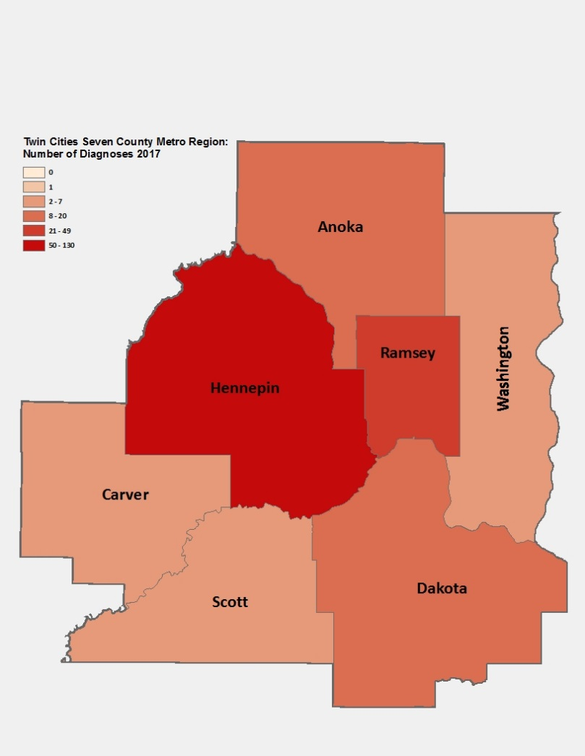
HIV Diagnoses* by County of Residence at Diagnosis, 2017 Seven-County Metro Area
City of Minneapolis – 83
City of St. Paul – 39
Suburban# – 107
Total number (metro-region) = 229
*HIV or AIDS at first diagnosis
# 7-county metro area, excluding the cities of Minneapolis and St. Paul
^Counties in which a state correctional facility is located.
Notes:
While 81% of all new HIV diagnoses in Minnesota occur in the Twin Cities Seven County metropolitan area, the cases in the metro area are concentrated in Hennepin and Ramsey counties.

Slide 15
HIV Diagnoses* in Minnesota by Residence at Diagnosis, 2017
Notes:
Overall, of the 284 HIV diagnoses in Minnesota in 2017, 41% were among residents of suburban seven-county metro area, 32% were residents of Minneapolis and 10% were residents of St. Paul, and 18% were residents of Greater Minnesota at the time of diagnosis. This distribution was similar to the prior year.

Slide 16
HIV Diagnoses* in Minnesota by Gender and Residence at Diagnosis, 2017
Suburban = Seven-county metro area including Anoka, Carver, Dakota, Hennepin (except Minneapolis), Ramsey (except St. Paul), Scott, and Washington counties. Greater MN = All other Minnesota counties, outside the seven-county metro area.
*HIV or AIDS at first diagnosis
Notes:
In 2017, the geographic distribution of cases differed by gender. A greater proportion of males resided in Minneapolis (32%) as compared to females (20%) at diagnosis. While, a greater proportion of females resided in St. Paul (19%) as compared to males (12%) at diagnosis.
In Greater Minnesota, there was a greater proportion of females (23%) as compared to males (18%) at diagnosis.

Slide 17
Gender and Race/Ethnicity

Slide 18
HIV Diagnoses* by Gender and Year of Diagnosis
2007 - 2017
Notes:
In 2017, males made up 74% of newly reported cases while females made up 26%. The number of male cases decreased from 225 in 2016 to 210 in 2017. The number of female cases increased from 65 in 2016 to 74 in 2017, which is a increase of 12% for females.

Slide 19
HIV Diagnoses* in Year 2017 and General Population in Minnesota by Race/Ethnicity
Notes:
When you look at the racial/ethnic distribution of new HIV diagnoses for both genders compared to the racial/ethnic distribution of the general population of Minnesota, it is apparent that disparities continue to exist among persons of color. Non-Hispanic African-American and Black, African-born Minnesotans jointly make up about 5% of the population in Minnesota, yet, account for almost half (48%) of the newly diagnosed cases of HIV in 2017. Similarly, Hispanics of any race also account for approximately 5% of the population, but account for 12% of the newly diagnosed cases.

Slide 20
HIV Diagnoses* Among Males by Race/Ethnicity† and Year of Diagnosis 2007 - 2017
Notes:
Trends in the annual number of new HIV infections diagnosed among males differ by racial/ethnic group. White males account for the largest number of new infections, but the proportion of cases that white males account for has decreased over time. In 2017, white males accounted for 39% of the new HIV diagnoses among men, with 83 diagnoses. During the past decade, the number of cases among African-American males has fluctuated from year to year, with 58 new HIV diagnoses in 2017, which is more than a quarter of new HIV infections among males (28%).
The annual number of HIV infections diagnosed among Hispanic has remained relatively stable, with small fluctuation from year to year. HIV infections in Hispanic males was similar to the previous year with 29 cases in 2017. African-born males diagnosed with HIV was lower in 2017 at 25 cases as compared to the previous year at 38 cases.

Slide 21
HIV Diagnoses* Among Females by Race/Ethnicity† and Year of Diagnosis 2007 – 2017
Notes:
Similarly, trends in the annual number of HIV infections diagnosed among females differ by racial/ethnic group. In 2017, women of color accounted for 80% of the new diagnoses in Minnesota, with 59 new cases, while non-Hispanic white women accounted for only 20% of new diagnoses (15 cases).
The number of diagnoses among African-born women has been increasing over the past decade. In 2017 the number of new cases among African-born women was 35, accounting for 47% of all new diagnoses among women. In 2017, there were 18 cases (24%) diagnosed among African American women, compared to 13 (20%) in 2016. The annual number of new infections diagnosed among Hispanic, American Indian, Asian, and multi-racial females continues to be quite small (7 cases or fewer per year for each of these groups).

Slide 22
HIV Diagnoses* Diagnosed in Year 2017 by Gender and Race/Ethnicity
Notes:
There are differences in the racial/ethnic distribution by gender. Among males, 39% of the 2017 cases diagnosed in Minnesota are Non-Hispanic white. Non-Hispanic African-American and African-born males made up 40% of cases and Hispanic males of any race accounted for 14% of cases.
Among women, the disparities are even more apparent with women of color representing 80% of all the newly diagnosed females in 2017, with black, African-born women accounting for almost half (47%) of cases and Non-Hispanic African-American women accounting for 24% of cases.

Slide 23
Number of Cases and Rates (per 100,000 persons) of HIV Diagnoses* by Race/Ethnicity† Minnesota, 2017
Race/Ethnicity | Cases | % | Rate
White, non-Hispanic | 98 | 35% | 2.2
Black, African-American | 76 | 27% | 46.6
Black, African-born | 60 | 21% | 55.6††
Hispanic | 33 | 12% | 13.2
American Indian | 2 | 0.7% | #
Asian/Pacific Islander | 8 | 3% | 3.7
Other^ | 7 | 2% | 6.0
Total | 284 | 100% | 5.3
Notes:
Each year we calculate the rate of diagnosis for each racial/ethnic group represented in the surveillance system to assess the impact of HIV within each community. The rate takes into account the size of the population of each group.
Non-Hispanic Black, African-born and African-Americans had the highest rate of diagnoses in 2017 with 55.6 HIV diagnoses per 100,000 population and 46.6 HIV diagnoses per 100,000 population respectively. This represents a rate of HIV diagnosis among the black, African-born community that is 25 times higher than the white non-Hispanic population in Minnesota. The rate among African-American non-Hispanic population is 21 times higher than white non-Hispanic population.
Hispanic persons of any race have the next highest rate of newly diagnosed HIV cases in Minnesota at 13.2 per 100,000 persons; this is a rate of more than 6 times higher than white, non-Hispanic persons.
Finally Asian/Pacific Islanders have a rate of persons newly diagnosed with HIV of 3.7 per 100,000 persons, slightly higher than white, non-Hispanic persons.

Slide 24
Number of Cases of Adult and Adolescent HIV Diagnoses** by Gender Identity and Risk† Minnesota, 2017
Gender/Risk | Cases | % | Rate
Men (Total) | (204) | 72% | 7.8
MSM† | 136 | (67%) | 150.0
Non-MSM | 68 | (33%) | 2.7
Women | 70 | 25% | 2.6
Transgender ^ (Total) |  | 3% | x
Male to Female | 6 | (67%) | x
Female to Male | 3 | (33%) | x
Total | 283 | 100% | 5.3
Notes:
This slide shows the number of new adult HIV cases by gender identity (male, female, or transgender (male to female or female to male)).
Men who have Sex with Men have the highest rate of HIV diagnosis than any other sub-category. In 2017, the estimated rate of HIV diagnosis among MSM was 150.0 per 100,000 population. This is more than 56 times higher than the rate among non-MSM men.
It’s important to note that MSM contains cases from all racial/ethnic categories and therefore, cannot be directly compared to the rates on the previous slide. For more information on how this rate was estimated, see the HIV Surveillance Technical Notes which are available on our website.
In 2017, there were 9 transgender newly reported HIV cases in Minnesota (6 male to female and 3 female to male transgender). This represents 3% of new cases reported in the state.

Slide 25
Age

Slide 26
Age at HIV Diagnosis* by Sex at Birth, Minnesota, 2017
Notes:
In 2017, there were 109 cases diagnosed under the age of 30. This accounts for 38% of all cases. Most of these cases were among young males, where 76% of cases under the age of 30 were male. The age groups from 20-29 continue to be the highest as was also seen in the previous year of 2016.

Slide 27
Average Age at HIV Diagnosis* by Sex at Birth, 2007-2017
Notes:
The average age at diagnosis among males in 2017 was 36 years. The average age at diagnosis among women was 39 years in 2017.

Slide 28
Mode of Exposure
Notes:
Starting in 2004, MDH has used a risk re-distribution method to estimate mode of exposure among those cases with unknown risk. For additional details on how this was done please read the HIV Surveillance Technical Notes. All mode of exposure numbers referred to in the text are based on the risk re-distribution.

Slide 29
HIV Diagnoses* by Mode of Exposure and Year, 2007 - 2017
Notes:
This slide depicts risk for all persons diagnosed with HIV in Minnesota during the past decade and since the beginning of the epidemic, Men who have sex with Men has been the most commonly reported risk factor. In 2017, MSM accounted for 49% of all new HIV diagnoses in Minnesota with 140 cases diagnosed.
In 2017, females comprised 86% of heterosexual mode of exposure for HIV diagnoses.
The number of cases among injection drug users (IDUs) (MSM/IDU and IDU (bottom 2 lines on the graph) has remained similar over the past three years with 26 cases in 2017 compared to 27 cases in 2016, which indicates a continued pattern of increased HIV infection among IDUs in the state.

Slide 30
HIV Diagnoses* Among Males by Mode of Exposure and Year
2007 - 2017
Notes:
When we look at HIV diagnoses only among males, MSM accounts for a larger proportion of the new diagnoses. In 2017, MSM and MSM/IDU accounted for 67% of the newly diagnosed cases among men. Throughout the past decade and again in 2017, unspecified risk is the second most common mode of exposure and has been accounting for an increasing proportion of cases since 2011.
There has been a stable increased number of cases of injection drug users (including IDU only and MSM/IDU) since 2017 at 24 cases for 2017 among males.

Slide 31
HIV Diagnoses* Among Females by Mode of Exposure and Year of Diagnosis 2007 - 2017
Notes:
For women, the most common mode of exposure for the past decade has been Heterosexual contact. However, like men the number of cases with unspecified risk is increasing.

Slide 32
HIV Diagnoses*: White Males by Estimated Mode of Exposure† 2015–2017 combined
Notes:
The proportion of cases attributable to a certain mode of exposure differs not only by gender, but also by race. Of the 297 new HIV infections diagnosed among white males between 2015 and 2017, MSM or MSM/IDU accounted for an estimated 94% of cases; Injection Drug Use (IDU) (including IDU only and MSM/IDU) accounted for 22% of cases, and heterosexual contact accounted for the remaining 2% of cases.

Slide 33
HIV Diagnoses*: African American Males by Estimated Mode of Exposure† 2015–2017 combined
Notes:
Of the 159 new HIV infections diagnosed among African-American males between 2015 and 2017, MSM or MSM/IDU accounted for an estimated 91% of cases; IDU risk (including IDU only and MSM/IDU) accounted for 9% of cases, heterosexual contact accounted for 6% of cases.

Slide 34
HIV Diagnoses*: Hispanic Males by Estimated Mode of Exposure† 2015–2017 combined
Notes:
Of the 73 new HIV infections diagnosed among Hispanic males between 2015 and 2017, MSM or MSM/IDU accounted for an estimated 90% of cases; heterosexual contact accounted for 7% of cases and IDU risk (including IDU only and MSM/IDU) accounted for the 10% of cases.

Slide 35
HIV Diagnoses*: African-born Males by Estimated Mode of
Exposure† 2015–2017 combined
Notes:
Of the 90 new HIV infections diagnosed among African-born males between 2015 and 2017, MSM or MSM/IDU accounted for an estimated 40% of cases; heterosexual contact accounted for 60% of cases.

Slide 36
HIV Diagnoses*: American Indian Males by Estimated Mode of Exposure† 2015–2017 combined
Notes:
Of the 3 new HIV infections diagnosed among American Indian males between 2015 and 2017, MSM or MSM/IDU accounted for an estimated 71% of cases; heterosexual contact accounted for 29% of cases. However, the number of cases among American Indian men during this time period is insufficient to make generalizations regarding risk. These numbers should be interpreted carefully.

Slide 37
HIV Diagnoses*: Asian Males by Estimated Mode of
Exposure† 2015–2017 combined
Notes:
Of the 24 new HIV infections diagnosed among Asian males between 2015 and 2017, MSM or MSM/IDU accounted for all cases. However, the number of cases among Asian men during this time period is insufficient to make generalizations regarding risk. These numbers should be interpreted carefully.

Slide 38
HIV Diagnoses*: African-born Females by Estimated Mode of
Exposure† 2015–2017 combined
Notes:
Of the 93 new HIV infections diagnosed among African-born females between 2015 and 2017,Heterosexual contact accounted for an estimated 98% of cases and Other risk accounted for the remaining 2% of cases.

Slide 39
HIV Diagnoses*:African American Females by Estimated Mode of Exposure† 2015–2017 combined
Notes:
Of the 46 new HIV infections diagnosed among African American females between 2015 and 2017, Heterosexual contact accounted for an estimated 98% of cases and IDU risk accounted for the remaining 2% of cases.

Slide 40
HIV Diagnoses*: White Females by Estimated Mode of
Exposure† 2015–2017 combined
Notes:
Of the 39 new HIV infections diagnosed among white females between 2015 and 2017, Heterosexual contact accounted for an estimated 86% of cases, IDU accounted for an estimated 8% of cases and other risk accounted for the remaining 6%.

Slide 41
HIV Diagnoses*: Hispanic Females by Estimated Mode of
Exposure† 2015–2017 combined
Notes:
Of the 9 new HIV infections diagnosed among Hispanic females between 2015 and 2017, Heterosexual contact accounted for an estimated 100% of cases. However, the number of cases among Hispanic women during this time period is insufficient to make generalizations regarding risk. These numbers should be interpreted carefully.

Slide 42
HIV Diagnoses*: American Indian Females by Estimated Mode of Exposure† 2015–2017 combined
Notes:
Of the 1 new HIV infections diagnosed among American Indian females between 2015 and 2017, Heterosexual contact accounted for an estimated 100% of cases. However, the number of cases among American Indian women during this time period is insufficient to make generalizations regarding risk. These numbers should be interpreted carefully.

Slide 43
HIV Diagnoses*: Asian Females by Estimated Mode of
Exposure† 2015–2017 combined
Notes:
Of the 4 new HIV infections diagnosed among Asian females between 2015 and 2017, Heterosexual contact accounted for an estimated 100% of cases. However, the number of cases among Asian women during this time period is insufficient to make generalizations regarding risk. These numbers should be interpreted carefully.

Slide 44
Births to HIV-Infected Women and Number of Perinatal Acquired HIV Infections* by Year of Birth, 2007- 2017
Notes:
The ability to interrupt the transmission of HIV from mother to child via antiretroviral therapy and appropriate perinatal care is an important accomplishment in the history of the HIV/AIDS epidemic. Newborn HIV infection rates range from 25-30% without antiretroviral therapy, but decrease to 1-2% with appropriate medical intervention.
For the past decade the number of births to HIV-infected women has ranged between 50-71 births (2007-2017). For 2017, there were 50 births to HIV-infected women. The rate of transmission has decreased from 15% between 1994 and 1996 to 1.8% in the past three years (2015-2017), with 1 HIV+ baby born to HIV+ mother in Minnesota in 2017.

Slide 45
Adolescents & Young Adults (Ages 13-24)*
* Case numbers are too small to present meaningful data separately for adolescents and young adults

Slide 46
HIV Diagnoses* Among Adolescents and Young Adults† by Gender and Year 2007 - 2017
Notes:
Between 2006 and 2009 the number of new HIV diagnoses among males aged 13-24 increased rapidly. Since 2009, we’ve seen a promising trend of a decreasing number of new diagnoses in this age group. In 2017, the number of cases were lower from the previous year with 53 cases in 2016 and 47 cases in 2017.
The annual number of new HIV infections diagnosed among adolescent and young adult women fluctuates due to smaller numbers. In 2017, the number of cases were lower to the previous year with 14 cases in 2016 and 8 cases in 2017.

Slide 47
HIV Diagnoses* Among Adolescents and Young Adults† by Gender and Race/Ethnicity, 2015 - 2017 Combined
Notes:
Between the years 2015 and 2017 we had 152 males cases reported among adolescents and young adults, and 35 females reported in the 13-24 age group. For males, Non-Hispanic white and African-American males each accounted for 35% and 39% respectively, and Hispanic males of any race accounted for 12% in the 13-24 age group. Among females, Non-Hispanic black African-born and African-Americans together accounted for 71% of the cases; while non-Hispanic white females accounted for 20%, and Hispanic women of any race accounted for 6% of cases.

Slide 48
HIV Diagnoses* Among Adolescents and Young Adults† by Gender and Estimated Exposure Group# 2015 - 2017 Combined
Notes:
For mode of exposure among males in the 13-24 age group, Male to Male sex was estimated to account for 86% of the cases, while the combined risk of MSM and IDU was estimated to account for 10% of the cases and 1% was attributed to heterosexual contact.
Among females, 87% of cases were estimated to have heterosexual contact as their mode of exposure, while 3% were attributed to injection drug use and 10% other risk in the 13-24 age group.

Slide 49
Foreign-born Cases

Slide 50
HIV Diagnoses* among Foreign-Born Persons† in Minnesota by Year and Region of Birth 2007 - 2017
* HIV or AIDS at first diagnosis
† Excludes persons arriving to Minnesota through the HIV+ Refugee Resettlement Program, as well as other refugee/immigrants with an HIV diagnosis prior to arrival in Minnesota.
# Latin America/Car includes Mexico and all Central, South American, and Caribbean countries.
Notes:
The number of new HIV infections diagnosed among foreign-born persons in Minnesota has steadily increased from 20 cases in 1990 to 89 cases in 2017. This increase has been largely driven by the increase of cases among African-born persons from 8 cases in 1990 to 60 cases in 2017, as well as, persons from Mexico, Central and South America from 6 cases in 1990 to 20 cases in 2017. Among new HIV infections diagnosed in 2017, 31% were among foreign-born persons. Based on 2010-2012 American Community Survey data, foreign-born persons make up 7% of the total Minnesota population and are, therefore, disproportionately affected by HIV. Among African-born this disparity is even more evident, while African-born persons make up just over 1% of the Minnesota population they accounted for 21% of new HIV infections in 2017.
In 2017, there were 89 cases of newly reported HIV among foreign-born persons, representing nearly one out of three of all new cases. The majority of foreign born cases in 2017 were from Africa, followed by Latin America and the Caribbean.

Slide 51
HIV Diagnoses* Among Foreign-Born Persons† by Gender and Year 2007 – 2017
Notes:
In 2017, the number of foreign-born males decreased from 56 cases in 2016 to 47 in 2017.
There was a increase for foreign-born females from 36 in 2016 to 42 in 2017.

Slide 52
Countries of Birth Among Foreign-Born Persons† Diagnosed with HIV* Minnesota, 2017
Country | N
Liberia | 14
Ethiopia | 14
Mexico | 12
Somalia | 6
Cameroon | 5
Kenya | 4
Viet Nam | 3
South African | 3
Other^ | 28
Notes:
Four countries (Liberia, Ethiopia, Somalia, and Mexico) accounted for a majority of new infections among foreign-born persons, however there are over 31 countries represented among the 89 new foreign born cases in 2017.

Slide 53
Late-Testers
(AIDS Diagnosis within one year of initial HIV Diagnosis)
Notes:
Late testers are defined as anyone with an AIDS diagnosis within one year of their initial HIV diagnosis. This is an important trend to watch as people who progress to AIDS within one year of their HIV diagnosis represent persons who are likely diagnosed well after their initial infection and represent missed testing opportunities earlier in the course of their infection.

Slide 54
Time of Progression to AIDS for HIV Diagnoses in Minnesota* 2007 - 2017†
27.7%^
27.8%^
23.5%^
27.8%^
Notes:
In 2016, 24% of new cases were late testers. This proportion of cases has remained relatively the same over the past 10 years, ranging between 24-34%. Most late testers, about 85%, are diagnosed with AIDS at the same time they are initially diagnosed with HIV infection.
For 2017, 27% of new cases were late testers so far, which represents only a partial follow-up year to only March 20, 2017.
As with other characteristics of the HIV epidemic in Minnesota, the proportion of late testers varies by demographic characteristics. Historically, foreign-born persons have had a higher proportion of late-testers.

Slide 55
Progression to AIDS within 1 year of initial HIV Diagnosis* by Sex at Birth 2007 - 2017†
Notes:
The proportion of late testers can vary by gender. In 2017, the proportion of late testers among females (27%) and males (28%) were similar and increased slightly from the previous year..
Percentage of late testers for 2017 includes only those progressing to AIDS through March 2018. As such, this percentage is likely to increase as additional reports are made to the MDH.

Slide 56
Progression to AIDS within 1 year of initial HIV Diagnoses* by Race/Ethnicity^ 2007 - 2017†
Notes:
As with other characteristics of the HIV epidemic in Minnesota, the proportion of late testers varies by demographic characteristics. The most significant differences occur by race/ethnicity, with the proportion of late testers in 2017 among whites (34%), African Americans (25%), African-born black (22%), and Hispanic (13%). Similar data for American Indians and Asian/Pacific Islanders in a single year had fewer than 10 cases and are considered not stable and are therefore not represented here.
Percentage of late testers for 2017 includes only those progressing to AIDS through March 2018. As such, this percentage is likely to increase as additional reports are made to the MDH.

Slide 57
Progression to AIDS within 1 year of initial HIV Diagnosis* by Age 2007 - 2017†
Notes:
Differences by age are as expected with the percentage of late testers increasing with age at time of diagnosis. In 2017, there was a linear age-based increase of late-testers, where 16-18% of those diagnosed in age groups 13-24 (18%), 25-29 (16%), and 30-34 (16%) were late testers. There was a steady increase of late-testers in older age groups, with 27% in age group 35-39, 32% in age group 40-44, and 45% in age group 45 and older.
Percentage of late testers for 2017 includes only those progressing to AIDS through March 2018. As such, this percentage is likely to increase as additional reports are made to the MDH. Caution should be used due to smaller numbers by age group when interrupting the data.

Slide 58
Progression to AIDS within 1 year of initial HIV Diagnosis* by Mode of Transmission 2007 - 2017†
Notes:
In 2017, persons with a risk category of unspecified risk had the highest proportion of late testers at 45%, followed by heterosexual contact at 28%, MSM at 23%, and finally IDU had the lowest proportion of late testers at 12%.
Percentage of late testers for 2017 includes only those progressing to AIDS through March 2018. As such, this percentage is likely to increase as additional reports are made to the MDH.

Slide 59
Time of Progression to AIDS for HIV Diagnoses* Among Foreign-Born Persons, Minnesota 2007 - 2017†
38.0%^
35.1%^
30.3%^
33.8%^
41.9%^
41.4%^
37.8%^
42.9%^
46.8%^
47.5%^
Notes:
During the past decade, foreign-born cases have a higher rate of late testers compared to US-born cases. In 2017, 30% of foreign-born cases were late testers compared to 27% of US-born cases, which is only slightly higher for foreign-born cases as compared to US-born cases during 2017.
Percentage of late testers for 2017 includes only those progressing to AIDS through March 2018. As such, this percentage is likely to increase as additional reports are made to the MDH.

Slide 60
Thank you!
Cheryl Barber
Cheryl.Barber@state.mn.us
651-201-5624

