Slide 1
Is the Diabetes Prevention Program Right for Your Organization?

Slide 2
Agenda
Diabetes and prediabetes facts
Health and financial cost of diabetes
How the Diabetes Prevention Program (DPP) works
How you can get involved
Notes:
Our presentation today will share important facts about diabetes and prediabetes, introduce you to the Diabetes Prevention Program (or DPP), and help you understand how to take advantage of programs to help prevent or delay type 2 diabetes.

Slide 3
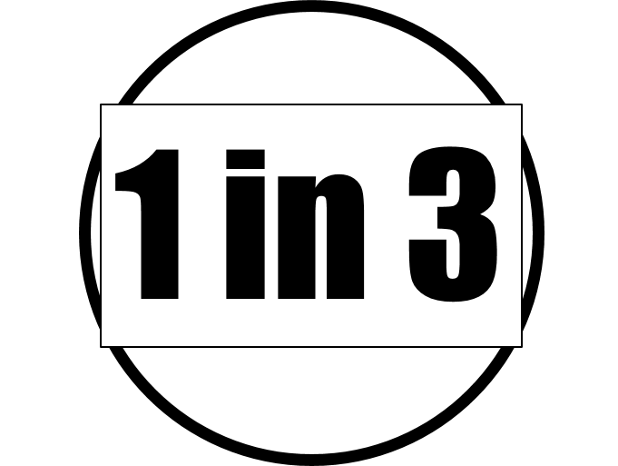
Americans are living with diabetes
Roughly one of every 11 adult Americans is living with diabetes (type 1 and type 2).
And one in three has prediabetes.
Notes:
Roughly one of every 11 adult Americans is living with diabetes (type 1 and type 2); that’s about 29.1 million people¹. About 320,000 or 7.6 percent, of Minnesota adults², reported they had diabetes in 2015 – double the percent reported in 1995
1. CDC National Diabetes Statistics Report, 2014
2. CDC, Behavioral Risk Factor Surveillance Study
Today, one in three American adults has prediabetes…¹

Slide 4
The rise in prediabetes
If one in three people have prediabetes, that is 86 million adults in the U.S.!
And within five years, one in three of those people move from pre-diabetes to diabetes!
86 million adults equals:
Everyone in the top 100 U.S. cities, PLUS everyone in:
Minnesota
Wisconsin
Illinois
North Dakota
South Dakota
Notes:
Prediabetes is a condition where people have higher than normal blood glucose levels, but not high enough to be classified as diabetes. They are at high risk for developing type 2 diabetes.
Today, An estimated 86 million people, or one in three, were reported to have prediabetes in 2014 – up from 79 million in 2010. Left untreated, 15-30 percent of those with prediabetes will develop type 2 diabetes. So, what does 86 million look like? It’s the equivalent of everyone in the top 100 major U.S. cities…and that’s just for starters.
It would also include every person living in Minnesota...
…And all of Wisconsin…
…both Dakotas…
…and everyone in Illinois.
As you look around the room, consider that every third person in this room has prediabetes…but fewer than 1 in 10 know they have it.
Sources:
diabetes.org/diabetes-basics/statistics/
cdc.gov/diabetes/prevention/index.html
Centers for Disease Control and Prevention: National Diabetes Surveillance System. http://apps.nccd.cdc.gov/DDTSTRS/default.aspx

Slide 5
Diabetes: A costly proposition
Average HC Costs
$5,500
With chronic conditions
$11,700
With diagnosed co-morbidities
$16,779
Notes:
In terms of cost, an MDH report called the New Estimates of Prevalence, Cost and Geographic Variation for Insured Minnesotans, 2012 analyzes All Payer Claims Data for all state health plans. When you look at the data, you can see there is a marked difference in cost when chronic conditions and then additional diseases, called comorbidities, are added.
Average yearly health care costs tend to be about $5,500 and when a person has a chronic condition and receives services, it more than doubles to $12,800 per person, per year. And if a person has a comorbidity, which is an additional disease, the cost rises to $16,779. Diabetes with another disease more than triples the cost!
It adds up quickly.
The data link is:
http://www.health.state.mn.us/divs/hpsc/hep/publications/costs/20160127_chronicconditions.pdf
Average health care spending for residents who used services and had no chronic condition was appx. $1,600 (page 13 of study) Health care spending for a resident with diabetes= $16,300 (page 16 of study).
The cost of treating diabetes continues to grow and may become unmanageable for employers. We used the more conservative costs for our purposes today.

Slide 6
Average health care spend by use
Notes:
Here is another way to look at this information by looking at health care spending depending on HOW health care is being used.
Please note that in the third column, people who use the health care system for preventive services and minor issues (not chronic diseases) cost only $1,600 per person per year!
Spending for Health Care Services in Minnesota
On average, annual per-person spending for health care services and prescription drugs for Minnesota residents in 2012 was $5,500. When the roughly 12 percent of health plan enrollees who did not use health services in 2012 were excluded from the analysis, average per-person health care spending increased to $6,300.
Chronic conditions contributed significantly to health care spending. Annual health care spending for residents who used services and had no chronic condition was approximately $1,600 in 2012. Residents who had at least one chronic condition accounted, on average, for $12,800 in health care spending.

Slide 7
Minnesota: Average health care spend
Per person cost.
From Report: New Estimates of Prevalence, Cost and Geographic Variation for Insured Minnesotans, 2012. MN All Payor Claims Data, Minnesota Department of Health.
Notes:
This graph shows that Minnesota residents who used the health care system with diagnosed diseases in 2012 cost 3x the amount of those residents who do not have those diseases.
This is why we want to avoid diabetes and the chronic conditions and diseases that go with a lifestyle that brings about diabetes.
And it’s not only about health care costs – people with diabetes and other diseases have a lower quality of life, are absent more often, and in most severe cases, can’t work!

Slide 8
Stages of Diabetes
As blood glucose rises, that measure places the patient in one of three categories (normal, prediabetes and diabetes).
As an added side effect, a person’s risk of heart disease and other chronic issues increase.
Prevention goals:
Normal glucose: Strive for prevention and/or early detection
Prediabetes: Prevent progression to Type 2 diabetes
Diabetes: Minimize complications
Notes:
Our Objective? In each category, the objective is different – for those with normal blood glucose markers, prevention and early detection are key. For those with prediabetes, the objective is to prevent the progression to Type 2 diabetes but lowering blood glucose, often through lifestyle changes. And once you have diabetes, the objective is to minimize complications and keep it under control.
Risk factors for prediabetes include being overweight or obese, having a family history of diabetes, being over age 45, being physically inactive, having high blood pressure, and being of a race other than non-Hispanic white.
Screening Questions: The CDC offers a simple checklist to determine the level of risk, which includes the questions you see here.
Actions: The objective of addressing the prediabetes epidemic is to delay or prevent the onset of type 2 diabetes. The good news is that we have a great resource available to us in the National Diabetes Prevention Program [or I can Prevent Diabetes]. This evidence-based program is proven to cut diabetes risk in half, with over a decade of data as proof.
Employer Actions: Employers can offer healthy choices at the workplace, support glucose testing, and offer the DPP to our employees. And for those with diabetes, we can support them through allowing time off for medical appointments or even paying 100% for testing and monitoring equipment.

Slide 9
Risk factors for prediabetes
Obesity
Family history
Physical activity
High blood pressure
Race other than non-Hispanic white.
Diet
Screening Questions:
Male or female?
Mother, father, sister or brother with diabetes?
Ever diagnosed with high blood pressure?
Are you over the age of 45?
Are you physically active?
What is your body mass index (BMI)?
Notes:
Risk factors for prediabetes include being overweight or obese, having a family history of diabetes, being over age 45, being physically inactive, having high blood pressure, and being of a race other than non-Hispanic white.
Screening Questions: The CDC offers a simple checklist to determine the level of risk, which includes the questions you see here.
Actions: The objective of addressing the prediabetes epidemic is to delay or prevent the onset of type 2 diabetes. The good news is that we have a great resource available to us in the National Diabetes Prevention Program [or I can Prevent Diabetes]. This evidence-based program is proven to cut diabetes risk in half, with over a decade of data as proof.

Slide 10
Four convenient paths to access
Mobile: Offered electronically by vendors and insurance companies
Clinical: Trained coaches employed by health care systems may offer the program locally
On-site: DPP provider offers program at employer sites or employee trained to offer program. Or, employer has trained an employee to be a coach and offer internally.
Community: YMCA, MN Extension Services, health departments, faith-based communities, community centers offer program at their locations.
Notes:
Diabetes prevention programs are available via four convenient paths. Several vendors offer the program electronically through computers and smartphones. Health care systems in your area have trained coaches who offer the program through local clinics.
Many community groups, such as the YMCA, care systems, extension services, health departments and others offer approved diabetes prevention programs.
Some employers have trained their own staff members to lead the DPP. Or, they contract with local providers to deliver the DPP on-site.

Slide 11
Employer Actions
As employers, we can offer the DPP to our employees.
And for those with diabetes, we provide access to a diabetes self-management program.
Additional Support:
Offer healthy choices at the workplace
Support glucose testing
Allow time off for medical appointments
Pay 100% for testing and monitoring equipment

Slide 12
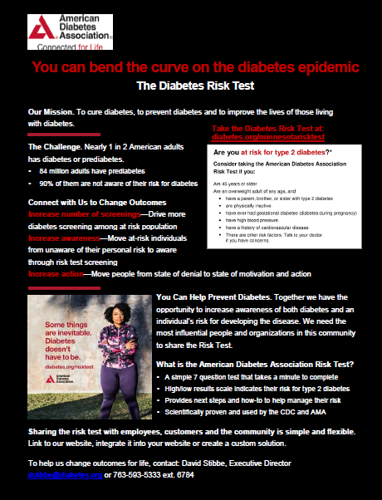
Diabetes Risk Test
Take the Diabetes Risk Test at:
Diabetes.org/minnesotarisktest
Notes:
The ADA in Minnesota is encouraging all Minnesotans to take the Diabetes Risk test to find out if you are at risk for prediabetes and then, diabetes.
Employers can use the link and share with their employees, who can learn about their risk levels. Once employees understand they may be at risk, they will become more interested in learning about the lifestyle changes needed to prevent diabetes.

Slide 13
Let’s get started!
Here’s what I, AS AN EMPLOYER, will do to help prevent type 2 diabetes:
I will take the prediabetes self-test and, if I am at risk for type 2 diabetes, I will make an appointment with my doctor.
I will ask my health insurance broker or health plan account manager whether a prediabetes class can be offered to my organization.
I will sign up for the DPP when offered at my organization.
I will promote the DPP with my coworkers.
I’d like to learn more and will follow up with MN Department of Health with my questions at
Notes:
If you have questions or comments, please call us to learn more about the DPP.

Slide 14
We’re here for you
MDH can help you with:
Connecting employees to resources and available programs
Assisting with ongoing support and encouragement
Identifying DPP community resources
Notes:
If you have questions or comments, please call us to learn more about the DPP.

Slide 15
Thank you for doing your part to reverse the diabetes epidemic!

