Slide 1
Cardiovascular Health & Diabetes: A Public Health Role for Minnesota Pharmacists
James Peacock, PhD, MPH

Slide 2
Cardiovascular Disease & Diabetes in Minnesota
Heart Disease (2nd), Stroke (6th), and Diabetes (7th) are leading causes of death
Deaths are rising or flat for all three conditions
Disparities: American Indians and African-Americans die at much higher rates, especially in middle age; Asians die much more often from Stroke
Heart Disease hospitalizations increasing since 2014, with bigger increases in young and middle-aged adults
Higher hospitalization rates in many rural counties

Slide 3
One in Four: Hypertension as a Public Health Problem
1 in 4 Minnesota adults has Hypertension (~1 million), many in communities of concern:
African-Americans, Younger adults, Rural residents
1 in 4 Minnesota adults with Hypertension does not have it under control – very slow improvement over time (MN Community Measurement)
1 in 4 Minnesota adults with Hypertension are not adherent to their blood pressure medications, especially:
Younger adults, Medicaid beneficiaries
In 2014, almost $4.5 billion was spent on patients with Hypertension
In 2014, per person spending for those with Hypertension was $14,454, almost $9,000 more than those without

Slide 4
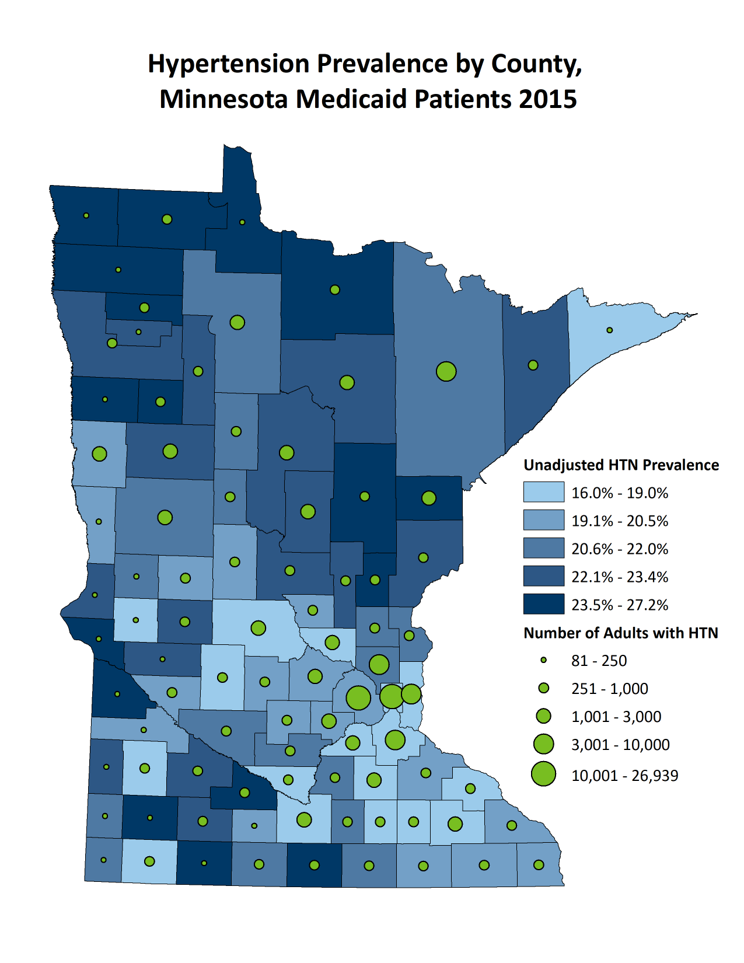
Map: Hypertension in Medicaid
County
High prevalence does not necessarily equal large number of hypertension patients
Many counties in the highest prevalence category have fewer then 250 hypertension patients
Even low prevalence counties with large populations can have more than 3,000 patients

Slide 5
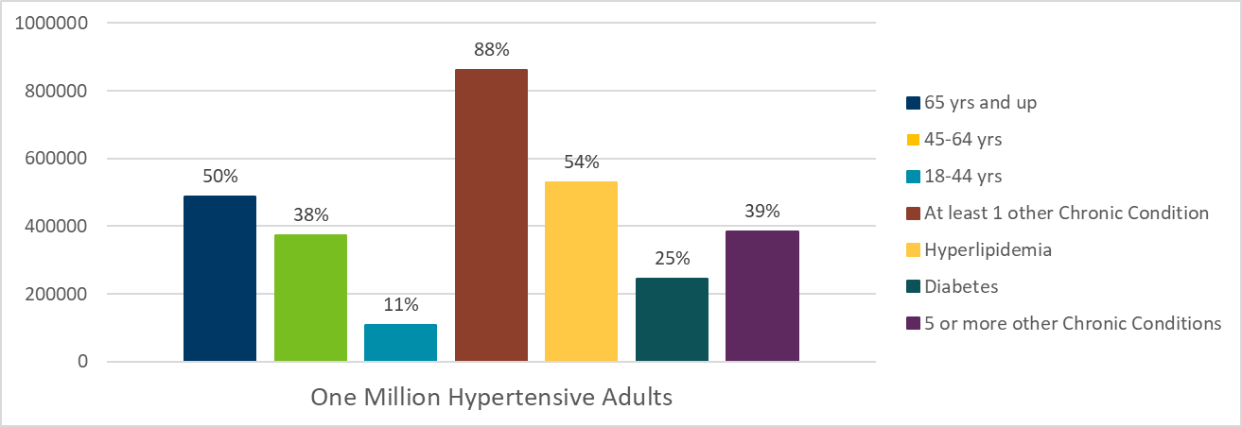
Complexity of the Hypertension Population
Prevalence is highest in small towns and rural areas
Medicaid population is both younger and more likely to have hypertension than the commercial population

Slide 6
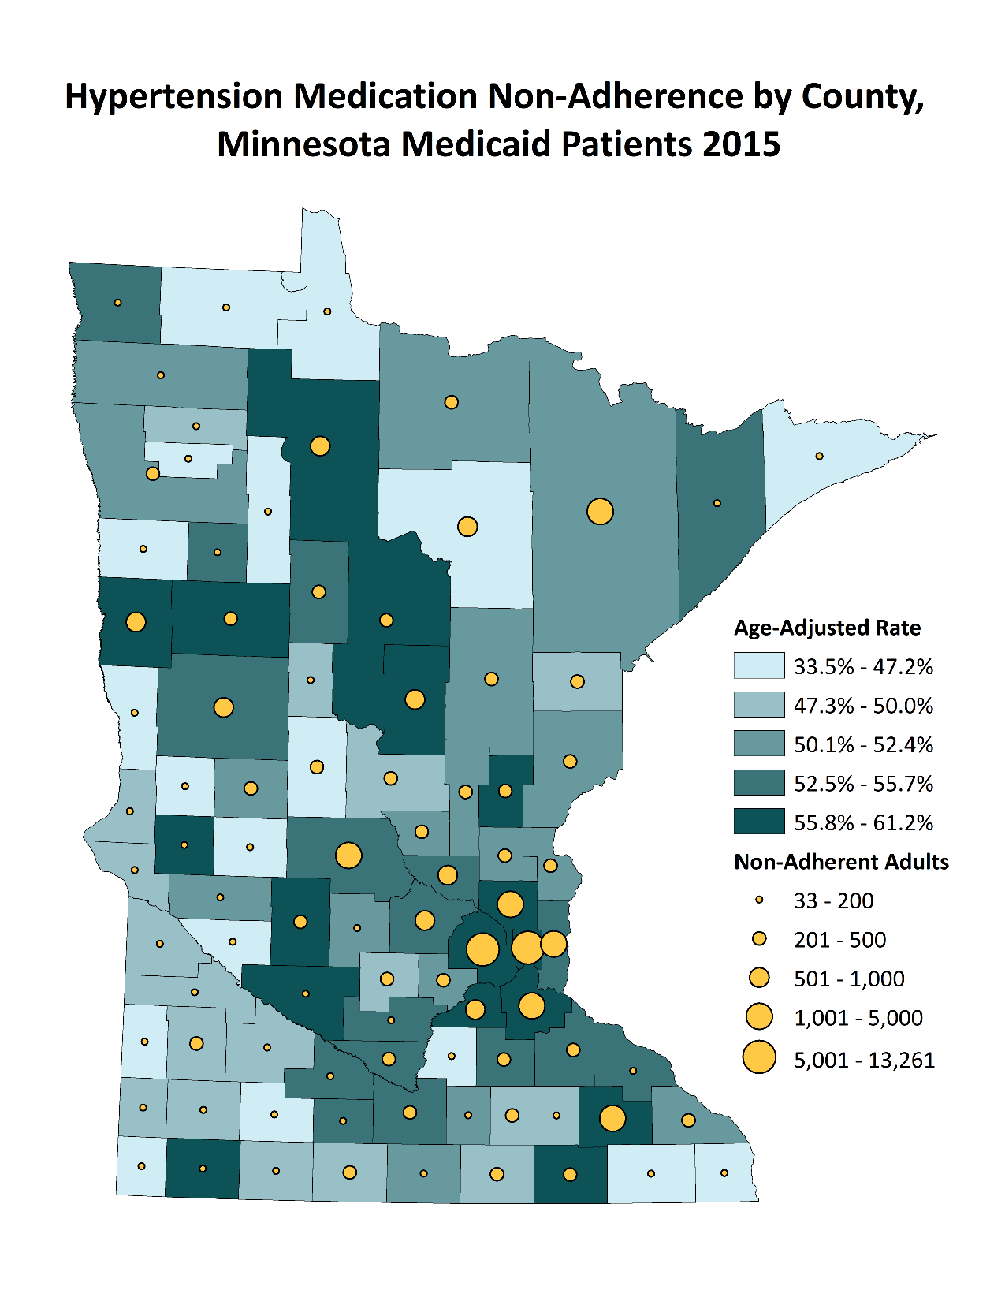
Map: Hypertension Medication Non-Adherence
Statewide
Crude Non-Adherence in 2015: 29.2% (248K Minnesotans)
Medicaid-covered adults: 51.4% (52K Minnesotans)
County-level
Overall non-adherence highest in Hennepin & Ramsey Counties, radiating north to the Canadian border
For Medicaid-covered adults, Twin Cities Metro is the epicenter, with St. Cloud and Rochester joining
Northern Minnesota Counties have better Medication adherence in Medicaid populations

Slide 7
MTM for Minnesota Medicaid Patients
576,585 Adults with Medicaid Claims in 2015 (excludes dually-eligible)
114,303 with Hypertension (19.8%)
101,291 on a Hypertension Medication (88.6% of HTN patients)
52,083 non-adherent to Hypertension Medication (51.4%)
Only 2,080 Individuals with at least 1 MTM claim (4.0%)
Essentially the same as a 2011 analysis of Minnesota Medicaid MTM claims – only 3.7% of eligible patients getting the service, albeit with stricter criteria of 3 meds

Slide 8
Pharmacists are Key Players in Hypertension Management
Pharmacist-delivered Medication Therapy Management is a key strategy to improve the health of Minnesotans
Highly-accessible to patients
Self-management education
Lifestyle counseling
Assessment of medication therapy problems
Counseling to support improved medication adherence
2019: Community Preventive Services Task Force recommendation for tailored pharmacy-based adherence interventions for cardiovascular disease (CVD) prevention (https://www.thecommunityguide.org/findings/cardiovascular-disease-tailored-pharmacy-based-interventions-improve-medication-adherence?deliveryName=USCDCCG_25-DM5152)

Slide 9
MN Health Care Programs: MTM is a Covered Benefit
MTM is a Minnesota DHS Covered Benefit since 2007
Medical Assistance (MA) and Minnesota Care (fee-for-service and managed care) beneficiaries are eligible
At risk population, with higher hypertension rates, higher health care utilization, lower medication adherence
Low threshold for eligibility:
Outpatient setting
Not eligible for Medicare Part D
Taking a prescription medication to treat or prevent at least one chronic condition

Slide 10
Reimbursement structure
Level | Assessment of Drug-related needs | Identification of Drug Therapy Problems | Complexity-of-Care Planning & FU Evaluation | Approximate Face-to-Face Time | Bill CPT Code and Units | Bill CPT Code and extra units permitted | Rate
1 | Problem-focused - at least 1 medication | Problem-focused - 0 drug therapy problems | Straightforward – 1 medical condition | 15 min. | 99605 or 99606 1 unit | 99607 No units permitted | $52.00 or $34.00
2 | Expanded Problem – at least 2 medications | Expanded Problem – at least 1 drug therapy problem | Straightforward – 1 medical condition | 16-30 min. | 99605 or 99606 1 unit | 99607 1 unit permitted | $76.00 or $58.00
3 | Detailed – at least 3-5 medications | Detailed – at least 2 drug therapy problems | Low complexity at least 2 medical conditions | 31-45 min. | 99605 or 99606 1 unit | 99607 Up to 2 units permitted | $100.00 or $82.00
4 | Expanded Detailed – at least 6-8 medications | Expanded Detailed – at least 3 drug therapy problems | Moderate Complexity – at least 3 medical conditions | 46-60 min. | 99605 or 99606 1 unit | 99607 Up to 3 units permitted | $124.00 or $106.00
5 | Comprehensive –- 9 medications | Comprehensive – at least 4 drug therapy problems | High Complexity – at least 4 medical conditions | 60+ min. | 99605 or 99606 1 unit | 99607 Up to 4 units permitted | $148.00 or $130.00

Slide 11
Identifying a Potential Target Population
Loosely following Medicare Part D Guidelines
Medicaid patient
Diagnosis of Hypertension
Non-adherent to Hypertension medications
Has not had an MTM visit
Has at least one other CMS-defined chronic condition, such as:
Arthritis, Asthma, Cancer, CKD, COPD, Depression, Diabetes, Heart Failure, Hyperlipidemia, Ischemic Heart Disease, Schizophrenia/Psychosis

Slide 12
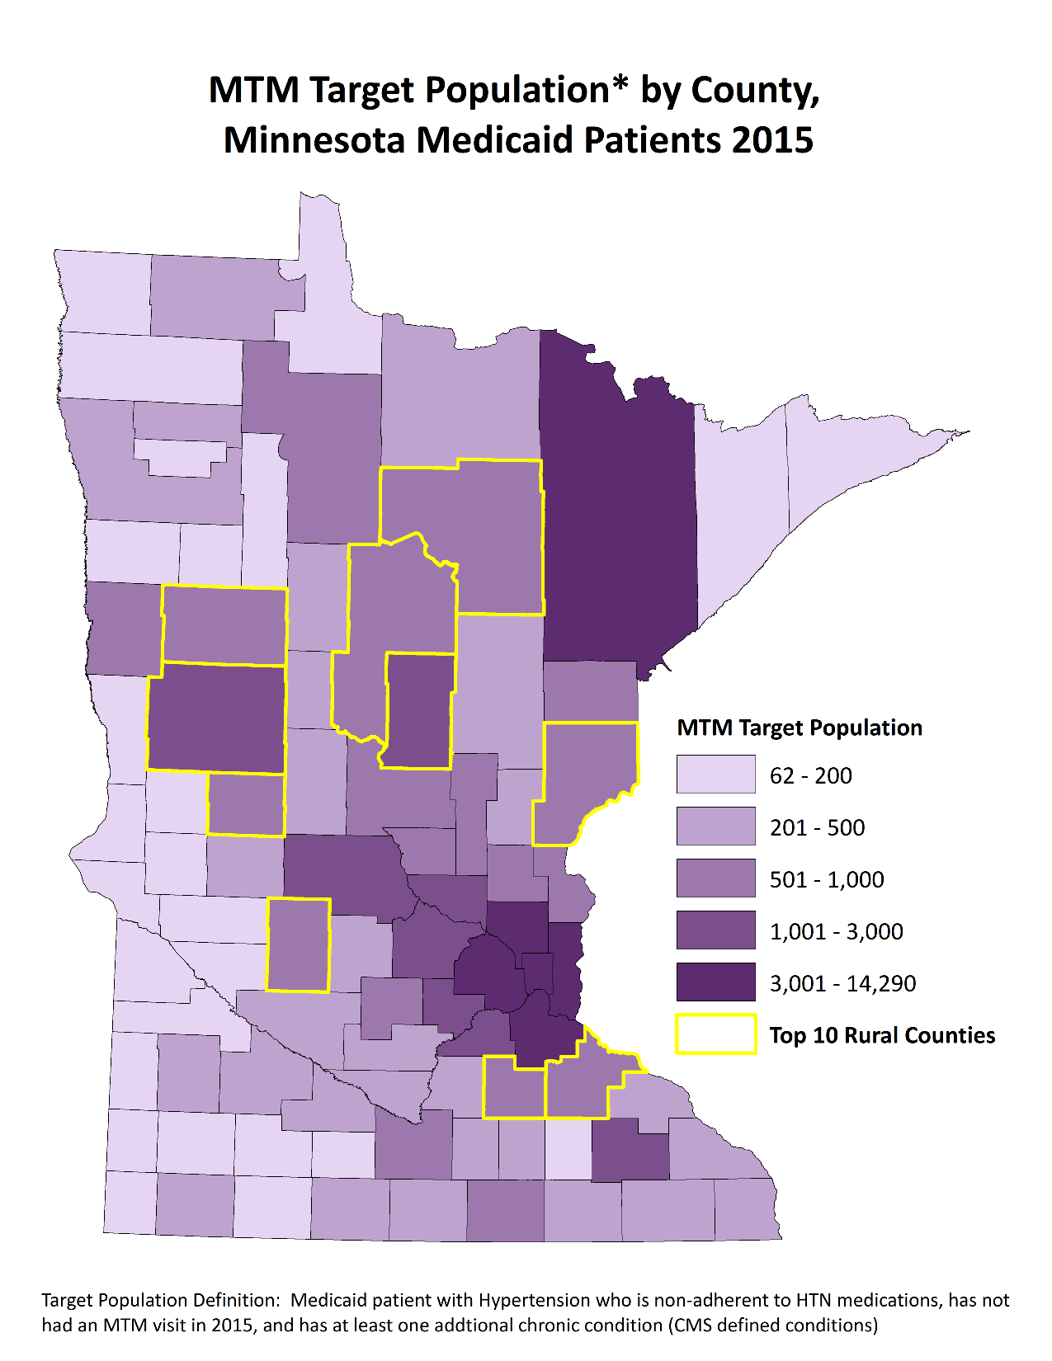
Map: Potential MTM Target Population
10 Rural Counties with the most potential MTM Patients
Crow Wing
Otter Tail
Itasca
Rice
Goodhue
Pine
Douglas
Cass
Kandiyohi
Becker

Slide 13
Data-driven approaches for your pharmacy
Targeted maps and tables describing the communities that you serve, including sub-county data
Reimbursement Calculator to estimate potential Medicaid revenue by each community or pharmacy
Return on Investment calculator to estimate break even point
Use state data or your own pharmacy data
Adjust percent of population reached
Adjust complexity of population reached
Coming Soon: Online education to help understand billing for MTM services to Minnesota Medicaid

Slide 14
Thank you!
James Peacock
james.peacock@state.mn.us
651-201-5405

