Slide 1

Alzheimer's Awareness Grants
Aging and Healthy Communities Unit | January 13, 2025
health.state.mn.us

Slide 2
Tribal-State Relations Acknowledgement Statement
The​ State of Minnesota is home to eleven (11) federally recognized Indian Tribes with elected Tribal government officials.​ The State of Minnesota acknowledges and supports the unique status of the Minnesota Tribal Nations and their​ absolute right to existence, self-governance, and self-determination.​ The United States and the state of Minnesota have a unique relationship with federally recognized​ Indian Tribes, formed by the Constitution of the United States, treaties, statutes, case law, and agreements.​ The state of Minnesota and the Minnesota Tribal governments significantly benefit from working​ together, learning from one another, and partnering where possible.
The Minnesota Department of Health (MDH) recognizes, values, and celebrates the vibrant and unique relationship between the eleven Tribal Nations and the State of Minnesota. MDH believes that the partnerships formed, through a government-to-government relationship, with the eleven tribal nations will effectively address health disparities and lead to better health outcomes for all of Minnesota.

Slide 3
Announcements
Please stay on mute if you are not talking
Type any questions you have in the chat so we can capture it in the FAQ – All questions will be posted on the FAQ page.

Slide 4

Agenda
Welcome and Introductions
Alzheimer's Awareness Grants Request for Proposal
Questions
Aging and Healthy Communities Unit Overview
Application Process and Instructions

Slide 5
Welcome
Introduce yourself in the chat:
  Name
  Role
  Organization/Affiliation
  What is your favorite winter activity?
Notes:
Hello to Patty, Maiyia, and Andrea

Slide 6
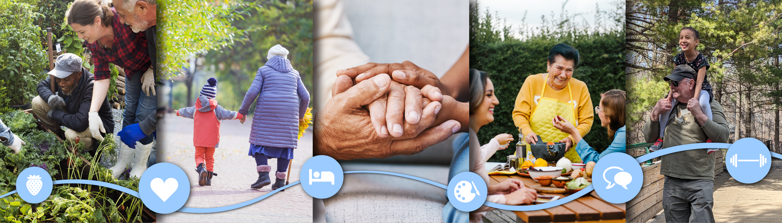
Aging and Healthy Communities Unit

Slide 7
MDH’s Aging and Healthy Communities Unit Overview
Alzheimer’s Awareness Campaign
Minnesota Healthy Brain Initiative
  MDH initiative focused on ADRD, risk reduction education, early detection, caregiver support
  5-year CDC Funding for BOLD
    "Building our Largest Dementia" (BOLD) Infrastructure on Alzheimer's Act
    Healthy Brain Community Grants
  Minnesota Dementia Strategic Plan

Slide 8
Alzheimer's Awareness Grants Overview

Slide 9
Chapt. 70 Alzheimer’s Public Information Campaign
The appropriation law calls for the Commissioner of Health to:
“The commissioner of health shall design and make publicly available materials for a statewide public information program that: (1) promotes the benefits of early detection and the importance of discussing cognition with a health care provider; (2) outlines the benefits of cognitive testing, the early warning signs of cognitive impairment, and the difference between normal cognitive aging and dementia; and (3) provides awareness of Alzheimer's disease and other dementias.
The commissioner shall include in the program materials, messages directed at the general population, as well as messages designed to reach underserved communities including but not limited to rural populations, Native and Indigenous communities, and Communities of Color. The program materials shall include culturally specific messages developed in consultation with leaders of targeted cultural communities who have experience with Alzheimer's disease and other dementias...
…The public information campaign must be implemented by July 1, 2025.”

Slide 10
2025 Alzheimer's Awareness Grant RFP
[Estimated]Grant timeline: March 3, 2025 – June 30, 2025 (all funds must be spent by this date)
All work under this grant should include promotion of culturally responsive content and materials that address:
    Awareness of ADRD and what causes it.
    Benefits of early detection and cognitive testing, including the importance of discussing memory and other cognition concerns with a health care provider.
    The early warning signs of cognitive impairment.
    The difference between normal aging and symptoms of ADRD.
Fund up to 4 grantees with an estimated $20,000/grantee
  Maximum award is $80,000 over the course of three months.
    There may be a chance to amend the agreement

Slide 11

Grant Request for Proposal Details

Slide 12
Timeline
6 Jan. 2025
Alzheimer's Awareness Grants Request for Proposal Release
13 Jan. 2025
Informational Session
5 Feb. 2025
Alzheimer's Awareness Grant Application Due
10 Feb. 2025
Notify Grantees
3 Mar. 2025 – 30 June 2025
Estimated Grant Period

Slide 13
Alzheimer's Awareness Grants Funding
Funding | Estimate
Minimum Award Amount | $20,000
Estimated Number of Awards | 1-4
Maximum Award Amount | $80,000

Slide 14
Eligibility
Eligible Applicants
  Community-based organizations
  Tribal governments
  Nonprofit organizations
  Faith-based organizations
  Social service organizations
  Clinics or healthcare organizations
  Community Health Boards/Local Public Health
  Local government
  Community Coalitions
  Media and Marketing Companies
We cannot fund research with this grant.
Applicants who have received the Healthy Brain Community Grants in the past 2 years are not eligible to apply.
Notes:
Organizations or entities that do not have state or federal recognition can still apply by working with a fiscal agent. Applicants must be located in and conduct grant activities in the state of Minnesota, but fiscal agents may be located outside of Minnesota. Eligible applicants who wish to work together but have not formed a legal partnership may designate one organization as a fiscal agent.

Slide 15
What are we willing to fund?
  Priority on Focus Populations
    This grant is focused on supporting populations affected by health inequities related to dementia, including BIPOC, LGBTQ+, American Indian, people living with disabilities, and communities in Greater Minnesota.
  Culturally responsive
  Creative, adaptable, and community-informed promotional strategy
  Alignment with MN Dementia Strategic Plan
    Education and Awareness: dementia risk reduction, importance of early detection/diagnosis
  Promotional strategy must be implementation ready at grant start date

Slide 16
Eligible Projects
Applicants must use diverse channels to educate their community. Diverse channels are including but not limited to:
  Community events or one-day workshops
  Social media advertising
  Digital media advertising
  Print flyers and infographics
Videos
Television and radio
And other relevant promotional tactics

Slide 17
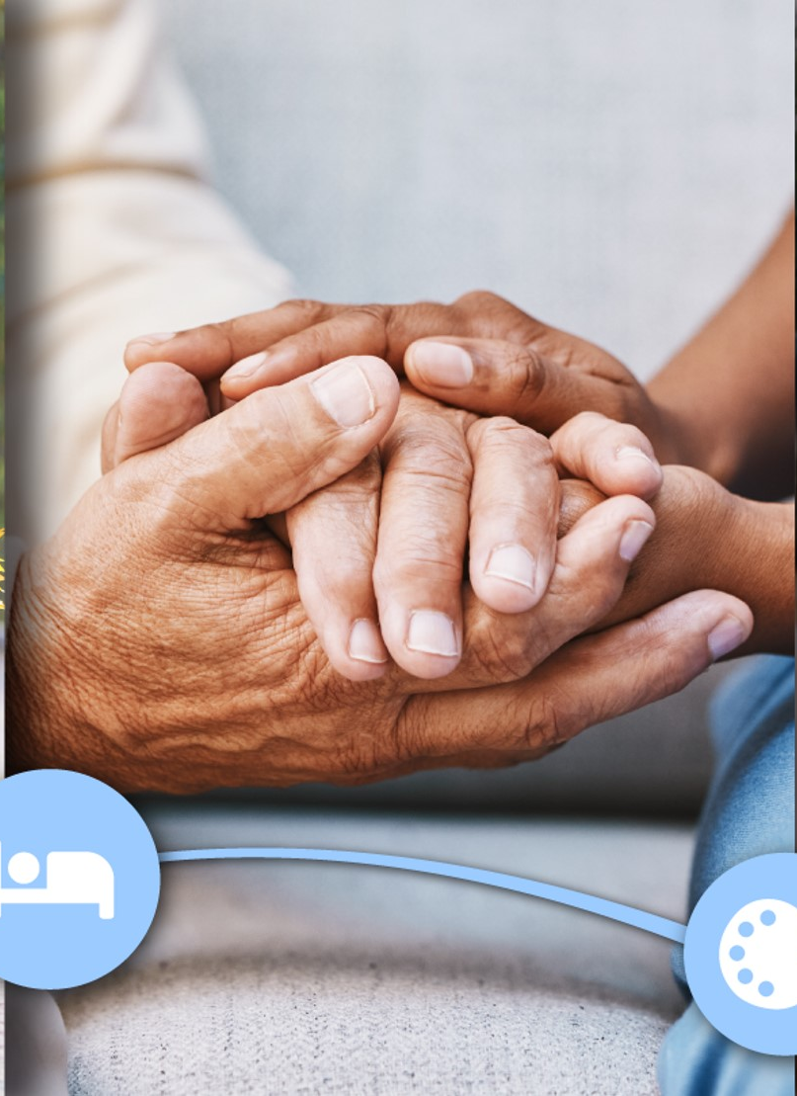
MN Dementia Strategic Plan
The plan is organized into four main areas:
Educate and Activate
Develop Policies and Partnerships
Ensure Culturally Responsive Care Teams
Accountability, Monitoring and Evaluation
MN Dementia Strategic Plan www.health.state.mn.us/diseases/alzheimers/docs/dementiaplan.pdf
Notes:
There are 4 domains in the MN Dementia Strategic Plan. These domains align with the CDC Healthy Brain RoadMap domains and actions.

Slide 18
Educate and activate strategies
Raise Awareness: Teach people about dementia, including what causes it, how early detection and diagnosis can help, and the importance of caregiver health and well-being.
Educate Providers: Inform health care and social service providers about local, culturally responsive resources for dementia.
Support People with Dementia: Help people living with dementia and their care partners understand the disease, plan for future changes, and find services that can help.
Reduce Stigma: Work with communities to create messages that address misinformation and provide an accurate understanding about dementia.
Eliminate Discrimination: Work with communities to address discrimination and build welcoming spaces, programs, and care for people living with dementia and their care partners.

Slide 19
Community Engagement
Make sure your application describes how you engaged the community you serve in shared decision-making.
• Co-creation of materials, health education, or programming
• Actively seeking feedback or guidance from the community the project aims to serve
• Gathering community members for listening sessions, forums, or planning purposes
• Engaging community members as leadership or guides for project scope
• Supporting outreach events or activities to excite, engage, or connect with community members
• Using community health assessments, surveys, or other existing community-developed resources to guide work

Slide 20
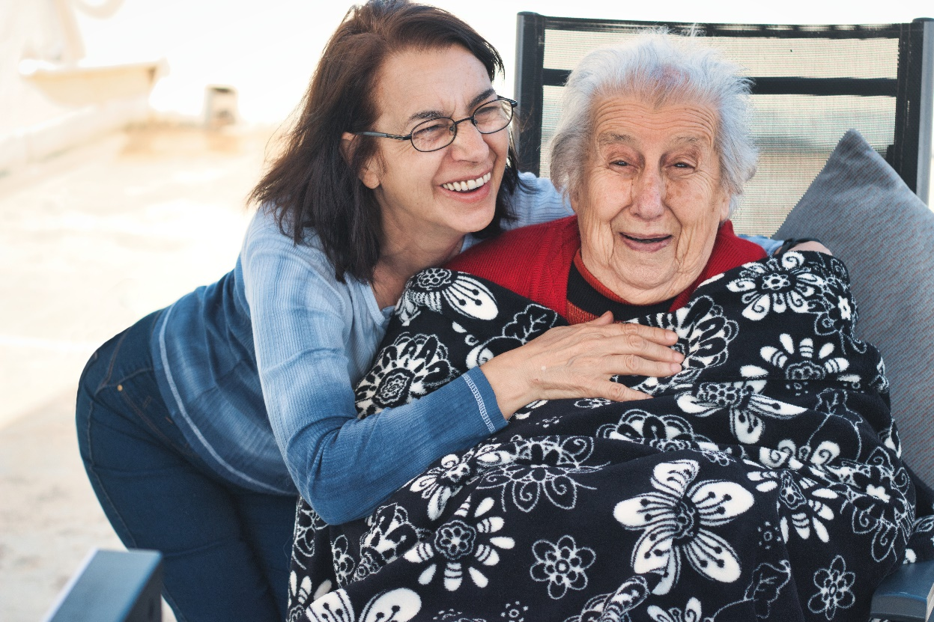
Grant Outcomes
Proposals must be implementation ready to meet the grant deadline of June 30, 2025.
The primary purpose of this request is to receive proposals from organizations that can promote culturally-relevant ADRD materials to a statewide Minnesota audience and the organization’s own relevant communities.

Slide 21
Grantee Activities
Submit an Activity Tracker and Final Report on grant activities. MDH staff will provide template for Activity Tracker and report. The report will include successes, reach, and challenges experienced.
Participate in biweekly check-ins with assigned grant manager to cover topics such as: grant management support; invoicing, reporting, and timeliness of communications.
Co-develop simple evaluation plan with MDH staff to identify activities and ways to measure their impact.

Slide 22
Technical Assistance
Workplan
Partnership Development
Budgeting
Invoicing
Evaluation Plan

Slide 23

Application Process and Instructions

Slide 24
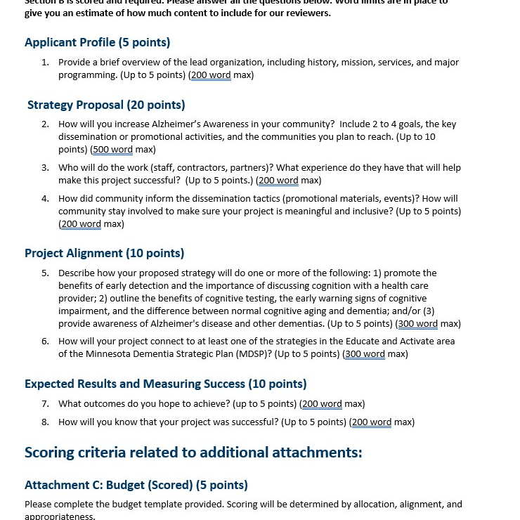
Application Section
You must submit all the following for your application to be considered complete:
Application Form-Attachment A (Microsoft Word Template)
Budget-Attachment C (Microsoft Excel Template)
Due Diligence Review Form-Attachment D (Use the form provided)
Conflict of Interest Disclosure Form-Attachment E (Use the form provided)
Work Samples (No template, submitted by applicant)

Slide 25
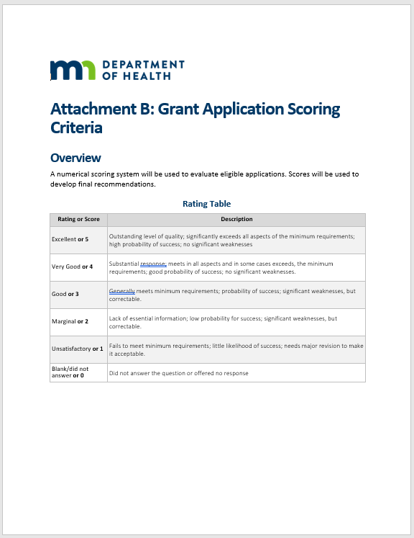
Application Scoring
All scoring information can be found on the website in Attachment B: Grant Application Scoring Criteria
Numerical scoring system out of 60 possible points
  Applicant Profile (5 pts)
  Strategy Proposal (20 pts)
  Project Alignment (10 pts)
  Expected Results and Measuring Success (10 pts)
  Budget and Budget Justification (5 pts)
  Alzheimer's Awareness Examples (10pts)
Please stay within the word limit for each section
Notes:
Strategy proposal: key dissemination or promotional tactics? How did the community inform the promotional tactics?
Project Alignment: How does it align with MDSP
What outcomes do you hope to achieve, how do you know it will be successful

Slide 26
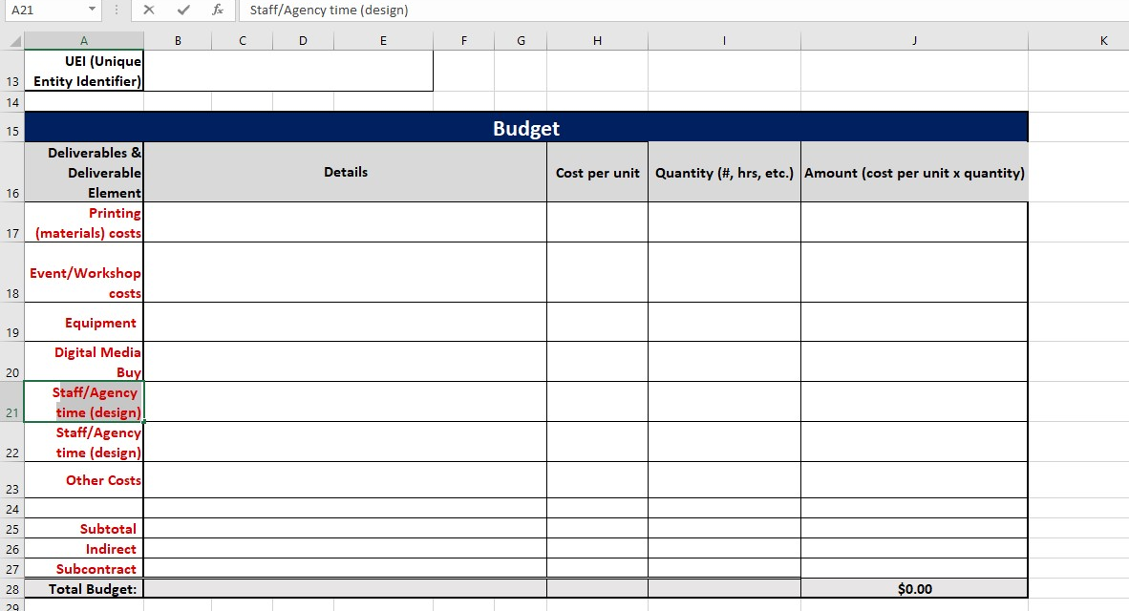
Budget

Slide 27
Application Submission Instructions
Submit via email to health.healthybrain@state.mn.us
Subject line: “Alzheimer's Awareness Grant Application – [lead organization name]”
Submit applications no later than Wednesday, February 5, 2025, at 11:59 p.m. CT
Please plan ahead and do not wait until the last minute to submit!

Slide 28
Application Review and Selection Process
Funding will be allocated through a competitive process with review by a committee representing content and community specialists with specific knowledge of and experience with brain health and related dementias, MDH staff, agency partners, and other state agency staff.
The review committee will evaluate all eligible and complete applications received by the deadline.

Slide 29
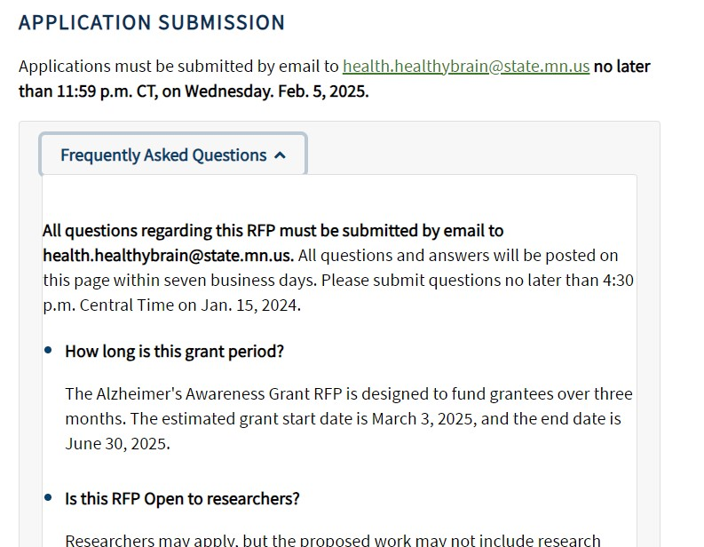
Find answers to your questions on the FAQ webpage
Alzheimer's Awareness Grant Frequently Asked Questions
https://www.health.state.mn.us/diseases/alzheimers/funding/awareness/index.html

Slide 30
Questions

Slide 31
Thank You!
Healthy Brain Initiative
Health.healthybrain@state.mn.us

