Slide 1
Health in all policies as a health equity practice
Health Equity Learning Community
September 2018

Slide 2
Focus: Health in all policies
Equip staff
Influence public and private policy
Authentic community engagement
Health equity practice
Spread the word about what creates health
Collect and use data for change
Show organizational commitment
Notes:
Our focus today is Health in All Policies. We’ve talked about the health equity practices before, shown here in the circles. Over the course of the past year, we have touched on many of these, but we haven’t yet talked about policy. You’ve done Health In All Policies work through the State Health Improvement Partnership, so this isn’t completely new territory, but we are going to build on that foundation by adding some focus specifically on advancing equity through policy and by expanding the universe of what “policy” is.
So our meeting objectives today are to 1) Connect health issues with the relevant polices that affect them; 2) Understand public health’s role as a policy influencer and the assets needed to be effective; and 3) Share helpful resources with each other.
Let’s pause here and take a minute to think about what it means to advance equity by influencing policy and why it’s such an important practice when it comes to advancing equity. First, the root causes of inequities – the social conditions that shape health – are complex, and they are baked into our social, economic, and political systems. It’s hard to create equity without this practice. Policies shape our social conditions and determine the distribution of resources. Working with individual clients is important work—it can’t and shouldn’t be discounted—AND we also need to move upstream to improve conditions for populations experiencing inequities. If we don’t, we’ll continue to pull people out of the river one at a time. To truly advance equity for more people we need to be working on policies that shape the conditions of our lives.

Slide 3

Health in all policies as a health equity practice
Notes:
I’d like to show you a short video describes what we mean by Health In All Policies. Some of the policies they describe will sound familiar to you because they reflect your SHIP work. While noting those areas that you have some familiarity with, I’d encourage you to be open to and consider any new areas of policy that you might not have thought about before.
https://www.youtube.com/watch?v=thYj8AlB3ms

Slide 4
What is a policy?
A policy is a law, regulation, procedure, administrative action, or voluntary practice of government or private sector that affects groups or populations and influences resource allocation.
Notes:
Let’s talk about the word “policy,” because it can mean a lot of different things.
A policy is…
So that means policies can be laws, rules, or procedures. They can be formal or informal, and set by the public sector – by government – or they can be private sector policies, like those in a workplace. They can be formal or informal. Sometimes we think of policy in a really narrow way, but that then limits the options available to us for action. For our purposes, “policy” is broadly construed.

Slide 5

How do we identify a policy opportunity?
Notes:
How do we identify a policy opportunity?
Today we’re going to talk about two paths you can take to policy work. One is to start from a health issue, and consider the policies that shape it, and the other is to consider strategic opportunities that might exist in the local or state policy environment and ways you can influence that effort.

Slide 6
Starting from a health issue
Outcomes | Relevant policies | Partners
Example: Improved rates of breastfeeding | Baby-friendly hospitals (private) Building codes (public) Workplace policies (private/public) Paid leave/parental leave (public/private) Health insurance policies (private/public)
Notes:
This is a tool I learned about when I participated in a national Maternal and Child Health Conference
They asked us to think about an outcome we cared about, and then asked us to brainstorm all of the different policies that might affect that issue. For the purposes of the exercise, brainstorming rules apply: there’s no right/wrong, and you should not limit your thinking with any constraints, challenges, or other barriers or considerations. Just stream of consciousness thinking about what policies affect the outcome.
So I started with breastfeeding, and thought through the relevant policies. You can see here that I identified… [Describe.]
Does anyone have any questions about this worksheet, or about my process?

Slide 7
Work in your group
Find your worksheet that was sent to you for the meeting today.
Work through the first two identified health outcomes, and then add one of your own.
Create your own list of the relevant policies that affect outcomes for groups or populations. Note if they are private or public policies.
Identify some partners you could work with on those policy issues.
Which of the policies might have the most powerful impact on health equity?
Notes:
Debrief
What would be the most powerful influencer on your goal?
What were the policies that your team thought of?
Take a minute to review: Do your policy lists include both public and private? Do they address root causes and social/economic conditions? What partners did you identify?
Are there things you are already doing?
Where do you have existing partnerships?
Who would could be new partners? Who could you reach out to?
Would this be something that you could do on your own? Or would you join an existing effort?

Slide 8

Another example
Notes:
Another Example
Here’s an example that I like from the World Health Organization. They created an infographic about addressing air pollution as a health issue.
One in eight deaths is linked to air pollution exposure – mostly from heart and lung disease, and stroke.
http://www.who.int/social_determinants/publications/health-policies-manual/HiAP_Infographic.pdf?ua=1
Who are the partners/sectors that public health would have to collaborate with?

Slide 9
Reducing air pollution: Cross-sector partnerships
Household energy
Energy
Transportation
Urban planning
Housing
Waste management
Industry
Global agreements
Municipalities
Forestry
Notes:
For me, one of the most important takeaways is about the different sectors that public health would need to collaborate with on this issue. Here’s my list.
Now take a minute to revisit the health issues you identified in your worksheet. Do any new partners come to mind?
http://www.who.int/social_determinants/publications/health-policies-manual/key-messages-en.pdf?ua=1

Slide 10

Another path: Identifying strategic opportunities
Notes:
Another path: Identifying strategic opportunities
MDH staff describe how the Healthy Minnesota Partnership identifies strategic priorities and potential action steps.

Slide 11
Team discussion
What are the local or regional policy discussions in your area that could have a potential impact on health?
What are the statewide policy discussions that could have an impact on the health of people in your jurisdiction?
What could LPH bring to these policy discussions?
Notes:
Have people type into Chat box
Who else in your community is working on issues? How could you amplify their efforts? Strengthen their efforts?

Slide 12

Assets
Cross-sector partnerships
Data: Qualitative and quantitative
Health expertise
Relationships
Notes:
Before we wrap up, I want to say a few things about the assets and competencies that you need to do health in all policies work effectively.
Cross Sector Partnerships
Data – qualitative and quantitative
Relationships
Health expertise
Organized people
Organized resources – data
Organized narrative

Slide 13

Skills
You need to be able to:
  Expand the conversation about health
  Convene people with different interests
  Embrace complexity
  Amplify community voices
You need to have:
  Flexibility
  Humility and confidence
  Curiosity
  Willingness to learn
  Commitment

Slide 14
Moving into health in all policies
Collect and share data on health determinants
Monitor the activities of other sectors that impact on health
Include policy change in your CHIP
Create opportunities to talk to community and governmental partners across sectors
  One-on-ones
  Regular check-ins
  Coalitions or committees
Notes:
http://www.who.int/social_determinants/publications/health-policies-manual/key-messages-en.pdf?ua=1

Slide 15
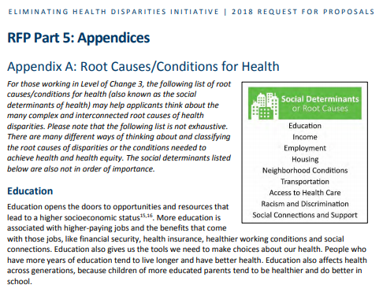
Resource: MDH request for proposals
Notes:
Resource: MDH Request for Proposals
Eliminating Health Disparities Initiative
http://www.health.state.mn.us/divs/che/funding/rfp2018/rfp.pdf

Slide 16
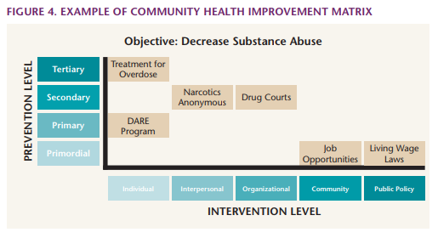
Tool: NACCHO matrix
Notes:
http://www.health.state.mn.us/communities/practice/resources/equitylibrary/naccho-chimatrix.html

Slide 17
Resource: Moving upstream
Determinant | Upstream | Midstream | Downstream
Income | Advocate for living wage policies, wage capping, progressive taxation | Link clients with welfare, social assistance, or back-to-work programs | Ensure that chronic disease prevention programs are accessible to low-income people
Education | Create opportunities for educators, law enforcers, and employers to work together to reduce barriers to education for youth | Support adult high school completion programs | Expand mental health promotion and early intervention programs
Housing | Meet with elected officials and citizen groups to push for more affordable housing | Bring stakeholders together to improve the enforcement of regulations to improve substandard housing | Increase the availability of allergy and asthma treatment to vulnerable populations
Notes:
http://nccdh.ca/images/uploads/Moving_Upstream_Final_En.pdf
6 page document from Canada
Helpful grid on the SDOH

Slide 18
Main points
Policy has a powerful impact on health
There are a lot of ways to think about “policy”
Consider different pathways into working at the policy level
LPH has some key assets and competencies for this work
Public health can’t go it alone
Notes:
Policy can have a powerful impact on health
Public health has data, cross sector partnerships and other assets to bring to collective efforts to impact policy
Starting places and pathways
Public health cannot “go it alone” – it takes relationships and partnerships

Slide 19

Share
Notes:
Before we wrap up, let’s take some time to share any tools, videos, readings, or other things about advancing equity that you might have seen since the last webinar. What have you see, heard, or read that made an impression on you, or that might be helpful to others to know about?

Slide 20
Next steps
Complete a brief webinar evaluation, coming shortly
In-Person Meeting 10/29 at the Arboretum
Connect with your coaches
Think about where your community health board’s health equity work might go next
Notes:
Thanks everyone – we’ll see you in next month. Have a great rest of your day.

