Slide 1
Reviewing organizational policies with an equity lens
Health Equity Learning Community
July 2018

Slide 2

Show organizational commitment
Notes:
One of the health equity practices we wanted to address during the learning community is related to showing organizational commitment to health equity. This practice is, in essence, walking the talk. We say health equity is important but how are we demonstrating that?
One thing we can do is examine our organizations to see if -- intentional or not – what we do is consistent with our commitment to equity. One way we’ve touched on this already was in the early conversation at the in-person meeting when we talked about our mission, vision, and values. But that’s just a first step. It’s also important to look at our policies and procedures. It’s important to see if our policies/procedures may be getting in the way of advancing equity. We, and the people before us, have built systems and structures and programs and rules from our own perspective. This is an opportunity to be responsible for our blind spots. This is where our values become evident in how we work.
So today we’re going to use a health equity review tool to practice intentionally reviewing some organizational policies. We know that policies are developed for a lot of reasons, and there are a lot of considerations in the process – some of which might be competing considerations. Equity isn’t the only one. Things like budget, risk, stakeholder needs/interests, accountability are some of the typical considerations that come to mind. Our interest here is in helping bring equity into the conversation, so it’s considered alongside other matters with some intentionality.
So we’re not here to evaluate policies as “good” or “bad” – but to be explicit about the implications. To have our eyes open, and to have the opportunity to account for our blind spots.

Slide 3
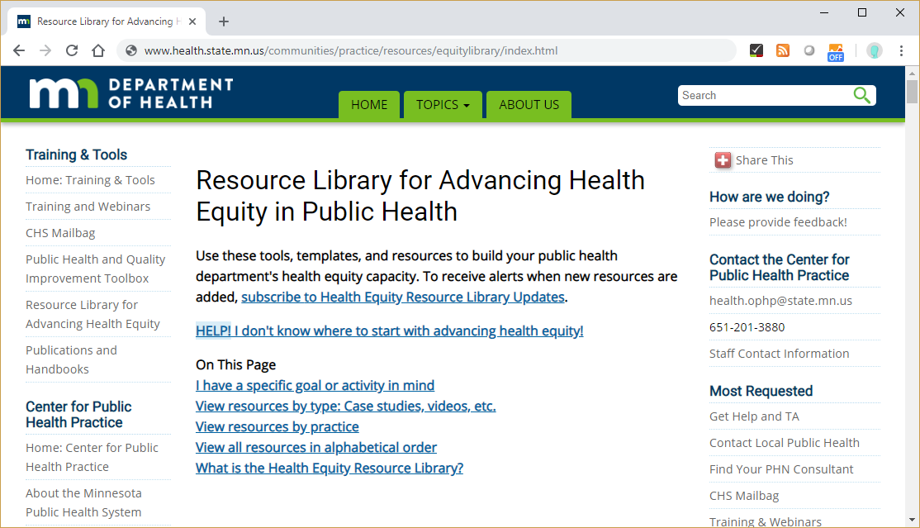
Finding tools and resources
Notes:
First, before we dive into the work, I want to introduce the tool we’ll be using.
There are several different tools that have been developed to help guide people though intentional review of policies, programs, decisions, etc. Many of the questions they ask overlap – very much along the lines of the health equity lens questions we introduced to you early in the learning community.
For our purpose today, we’re using a tool developed by our neighbors in Madison, Wisconsin. It’s one of a few different tools available in our online resource library. I’m sure most of you are familiar with the library already, but we’ll put a link in the chat box and you can see it in the notes for the presentation today. If you want any guidance on how to use it, your coaches would be more than happy to give you a brief orientation to it. http://www.health.state.mn.us/communities/practice/resources/equitylibrary/index.html
For now, you can find the tool for this exercise in the email you should’ve received this morning. If you pull that up, the review questions start on p. 2.
We like this particular tool for it’s simplicity and ease of use. Depending on what you’re reviewing, you may want a tool that is more nuanced or more detailed. But one thing to keep in mind – that Susan has helped me to understand – you don’t necessarily have to have an answer for every question in order for the tool to be useful. If a particular question doesn’t seem to be relevant, don’t get hung up on it. Just skip it for now.

Slide 4

Before we dive in
Notes:
Before we dive in – just a reminder that we’re all on a journey in developing our knowledge and skills around equity. None of us is an expert; none of us has this health equity thing all figured out. So as we practice this policy review together, know that there’s no single right answer to the review questions, and be open to the ideas of others. Our goal isn’t to find the “right” answer but to strengthen our “equity muscle” and develop a habit of routinely asking these questions of ourselves and others.

Slide 5

Practice Exercise 1
Notes:
OK, so let’s practice together a few times.
Instructions for facilitating this exercise:
Before the meeting, find a sample policy to share with the group that relates in some way to operations: budgets, human resources, etc. Describe it at a high level, and give participants 3 minutes to read it quickly. It should be no more than about ~3-4 pages.
Review p. 2 of the Review Tool with participants. Identify the series of questions – What, Who, Why, and How questions. Have participants ignore the very topmost question for the purposes of our exercise – it just asks you to note who is participating in the analysis, which we don’t need to do.
Instructions for participants: With your team or on your own, depending on how you are participating today, review the policy and answer the questions on the tool, starting with #1. Think through the What, Who, and Why questions. If we have time, we’ll think about the “How” question together at the end. And as a reminder: if you get hung up on a question, it’s OK not to answer it and move to the next. Come back to it if you have time.
Give participants 7-8 minutes to answer what they can. Have them share observations in the chat box, then debrief as a full group.
Group debrief questions: what did you notice? (5 minutes.) Share high points of the chat box; share what we noticed, too. ]
If time allows, talk about the HOW question.

Slide 6

Practice Exercise 2
Notes:
Instructions for facilitating this exercise:
Before the meeting, find a sample policy to share with the group that relates in some way to public health programs. Describe it at a high level, and give participants 3 minutes to read it quickly. It should be no more than about ~3-4 pages.
Review p. 2 of the Review Tool with participants. Identify the series of questions – What, Who, Why, and How questions. Have participants ignore the very topmost question for the purposes of our exercise – it just asks you to note who is participating in the analysis, which we don’t need to do.
Instructions for participants: With your team or on your own, depending on how you are participating today, review the policy and answer the questions on the tool, starting with #1. Think through the What, Who, and Why questions. If we have time, we’ll think about the “How” question together at the end. And as a reminder: if you get hung up on a question, it’s OK not to answer it and move to the next. Come back to it if you have time.
Give participants 7-8 minutes to answer what they can. Have them share observations in the chat box, then debrief as a full group.
Group debrief questions: what did you notice? (5 minutes.) Share high points of the chat box; share what we noticed, too. ]
If time allows, talk about the HOW question.

Slide 7
Team time
Use the review tool on the policy or procedure you brought with you.
If you don’t know an answer, just skip it for now. Go back to it later if you have time.
If you forgot a policy/procedure, or don’t have one, we’ll send you one. Send a chat message to Susan and we’ll get you a policy you can use.
Notes:
Now what we’d like you to do is talk with your teams about a policy/procedure that you’ve brought to the meeting today, that’s specific to your health department or your county. Use the review tool and spend a little more time than we did before on each question. We’ll give you about 20 minutes, which should be enough time to do some work and then some time to talk with each other about your observations. We’ll reconvene at [time].
Group discussion:
What happened in your review? What did you observe/notice?
What surprised you?
Where were the sticky points, or difficult moments? How did you work through that?
How might you incorporate a process like this in your organizations?

Slide 8
Questions?
Notes:
So I hope this exercise has given you a flavor of what we mean by showing organizational commitment. As a practice, this is about making it a routine – making it a habit – to review policies and procedures with equity in mind, and making adjustments where and if we can.
Questions about this practice or this activity?

Slide 9

Share
Notes:
Share
Open the floor – anyone seen, read, heard, or experienced something related to equity that would be of interest or helpful to others?

Slide 10
Next steps
Complete a brief webinar evaluation, coming shortly
Review your stories and make any necessary edits
Note the final in-person meeting date: Monday, October 29
Keep your own work going and stay connected to your coaches

