Slide 1
Community engagement as a health equity practice
Health Equity Learning Community
March 2018
Notes:
Good afternoon and welcome, everyone, to our March meeting.
If you are having any difficulty with the audio or the WebEx technology, send us a quick message. We are going to wait a few minutes to make sure everyone’s connected before we get started.
Facilitator introduce themselves and others in the room.
Let us know you’re with us by entering your name and the name of your department in the chat box.
While you’re doing that, we’ll be recording today’s webinar to make sure we can capture the rich discussion adequately, without having to rely on my bad memory, so we’ll take a minute to press “Record” and get that started.

Slide 2

Community engagement as a health equity practice
Notes:
Opening Remarks -- Community Engagement as a HE Practice (5 minutes; end by 10:40)
Introductory Remarks: CE as a HE Practice
Stepping away from individual projects; talk about how CE as a HE practice
We chose to focus on 3 practices in the learning community – organizational alignment with a commitment to health equity, community engagement, and health in all policies. We’re going to focus on community engagement today and plan to do a similar webinar on health in all policies and organizational policies in the future.
This is NOT to give you something new/different to do, or to send you down a different path than the one you’re on with your local action steps, but about helping you think about how you might strengthen your CE practice more broadly.
Sharing two tools to support this practice. The first one I want to talk about is the Community Engagement Continuum.

Slide 3
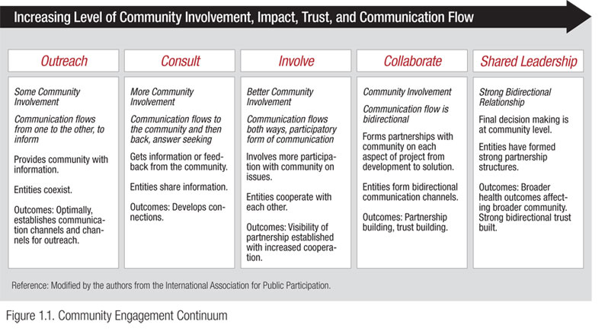
Community engagement continuum
Notes:
[10 minutes; end by 10:50]
Connect common LPH activities to the different levels of engagement.
Ask teams; use arrows (WebEx feature)
Different forms of engagement needed for different things and THAT’S OK
And: we want to see PH do more down at the empowerment end of the continuum because…(connect to HE)
List common PH activities
Community health improvement planning
Promote healthy eating
Health Equity Data Analysis Survey/Public input process
Who participates? Who benefits? Whose power is built?
What are some other examples of collaborative or shared leadership activities?
Provide mini-grants for resident-driven and led initiatives
Train community breastfeeding coaches
Breast feeing coalitions
Early childhood councils
Community leadership teams
Food networks

Slide 4

Principles of authentic engagement
Notes:
Principles of Authentic Engagement [35 Minutes; end by 11:25]
Overview
How they were developed
How they are being used
Review the principles/highlight a few.
Video illustration + Team discussion [1] – 15 min
Video illustration + Team discussion [2] – 12 min
Use Housing and Hawaii (food sovereignty) videos from here: https://nam.edu/programs/culture-of-health/driving-health-equity/

Slide 5
Video illustrations
As you watch the videos, identify one or more of the principles of authentic engagement that are relevant in the story.
Each team will be asked to share one principle that stood out to them.
Notes:
https://nam.edu/programs/culture-of-health/driving-health-equity/

Slide 6
Local story
Building new relationships
Notes:
A participant shares a story of building a new relationship.

Slide 7
Principles in action
Thinking about the levels of engagement, the authentic engagement principle, and Jessica’s story:
How might your health department strengthen community engagement practices so that they support health equity?
How might your health department stretch itself in its CE practice? What is a “leading edge” you can move into?
Notes:
[25 Minutes; end by 11:50]
Small Group Discussion (8 minutes):
Thinking about the levels of engagement, about the principles, and about what Jessica shared, talk with your team about:
How might you strengthen practices you already have?
How might you stretch yourself in your CE practice? What is the “leading edge” you can move into? Where could you push yourselves?
Report back:
Share an observation or a question that came up for you in your small conversation.
Call on teams to report back if necessary.

Slide 8

Share
Notes:
Share: 11:50-11:57
Before we wrap up, let’s take some time to share any tools, videos, readings, or other things about advancing equity that you might have seen since the last webinar. What have you see, heard, or read that made an impression on you, or that might be helpful to others to know about?

Slide 9
Main points
Community engagement is contextual
Shift away from doing things for communities to with communities
Authentic engagement starts with an asset-based approach

Slide 10
Next steps
Complete a Community Engagement Knowledge, Skills and Abilities Assessment and identify areas for development
Complete a brief webinar evaluation, coming shortly
After each step, pause and reflect: So what? Now what?
Stay connected to your coaches
Notes:
One thing you might do next is take a Community Engagement Knowledge/Skills/Abilities assessment available through our office. It can be used for individual development purposes or team development purposes (how well do the skills of your team match the needs you have). A survey link will come via separate email on Thursday.
You’re all doing good work and hard work. Keep taking steps towards working differently, and as you take steps, pause & reflect and think about the “so what” and “now what” – changing the way we work is iterative as we act and learn.
Thanks everyone – we’ll talk with you again soon. Have a great rest of your day.

