Slide 1
Strengthening our skills: Applying a health equity lens
Health Equity Learning Community
January 2018
Notes:
Good afternoon and welcome, everyone, to our January meeting.
[Introductions of facilitator/presenter]
Let us know you’re with us by entering your names and the name of your department in the chat box.
While you’re doing that, we’ll be recording today’s webinar to make sure we can capture the rich discussion adequately, without having to rely on memory, so we’ll take a minute to press “Record” and get that started.

Slide 2
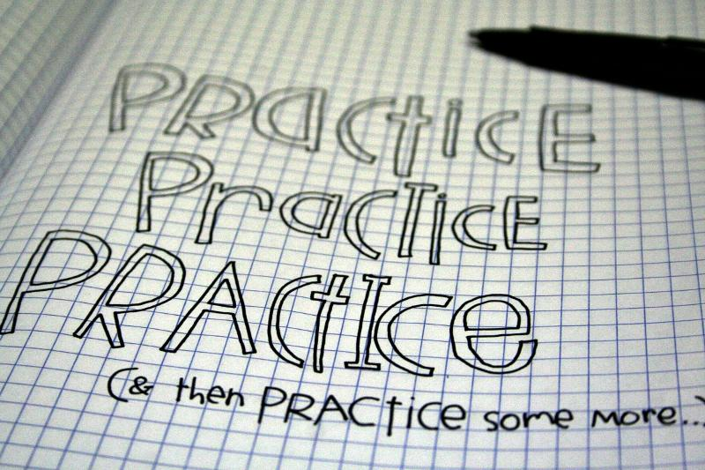
Practice, practice, practice (and then practice some more)
Notes:
So when we last met, it was November. It feels like a long time ago!
We watched a series of videos from Camara Jones to help us better understand equity and how applies to our work.
You’ll remember Dr. Jones explained inequity using the allegory of the Gardner’s tale, where different seeds in different flower boxes don’t have the same opportunity to grow;
She shared the Cliff analogy, where she talked about common health interventions and helped us to see a bigger picture about the conditions that contribute to health disparities;
And she shared the story of the conveyer belt to describe what it can feel like when you’re working on equity and trying to create change.
This time, we’re going to continue this process of shifting how we see things, but this time we’ll be using scenarios instead of videos. To be clear, the scenarios are not intended as instructions, or to give you something else for your to-do lists. Our hope is that these scenarios will help us strengthen our skills for using a health equity lens and will help us see how asking a different set of questions can shift how we do our work.

Slide 3
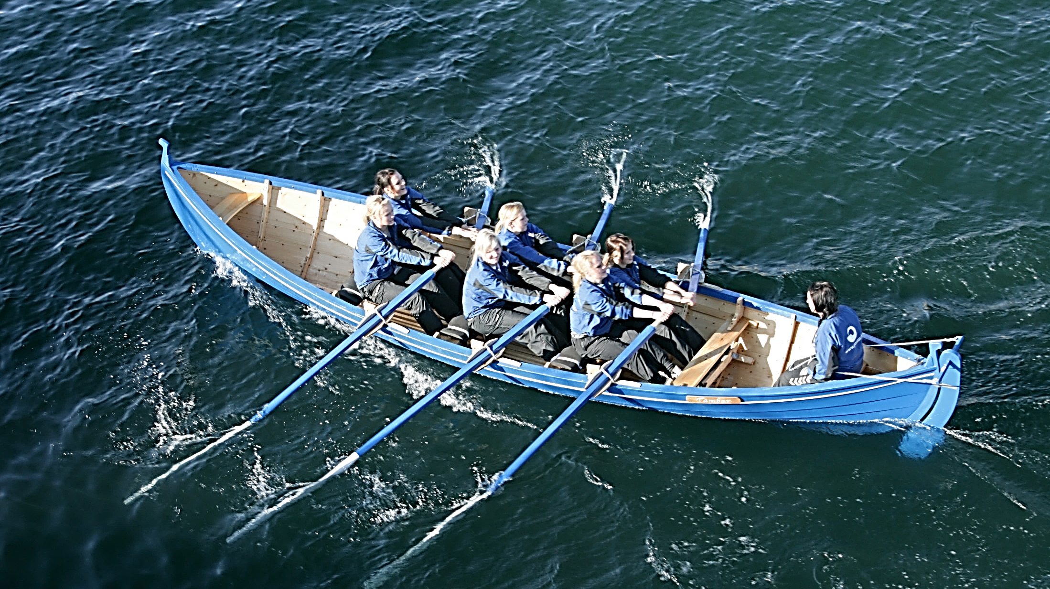
We’re all in this together
Notes:
We’re all in this together
Before we dive in – a quick reminder that we’re all in this together. None of us is an expert; none of us has this health equity thing all figured out. We’re all learning together as we go. There’s no single right answer to the discussion questions. There are a lot of possibilities, and a lot of nuances.
We’re working through scenarios like this here at the state level, too, and present these scenarios as a vehicle for open inquiry and exploration.

Slide 4

Scenario 1: Parks and recreation
Notes:
What we’d like you to do is, with your teams, take the next 15 minutes to read and discuss Scenario 1 – Parks and Recreation. Then we’ll come back together and we’ll hear from a few teams about the high points of your conversations. We’ll mute the phones to give you a chance to talk with each other, and we’ll reconvene to talk as a full group.
WHITEBOARD to capture ideas/full group conversation
Full group discussion:
Would any teams like to kick off the conversation and share with us the highlights of your discussion? [Probes: What were some of the questions your team came up with that could be asked about the situation? What assumptions did you identify, either about the problem or the solution? Where did you see action steps that might have been handled differently?]
Probe: If you wanted to try to approach this situation with equity in mind, what might get in the way of doing it differently?
Reflect back/summarize some key points
We do have one example of how a health department handled the same issue in a different way, and I’ll share with you the high points of what they did, in case it’s helpful to you to hear the steps they took.
One health department saw some local data about use of local parks and recreation facilities and saw that communities of color weren’t using these facilities at the same rates as others in their community
Collaborated with Parks and Rec director and staff on a few different strategies
Three “cultural” open house events; community members were able to tour the community center and use the facility at no cost. Families received a ten-session punch card to come back in the future at no cost; and part of the event was dedicated to get them familiar with the catalog of offerings.
Used grant funds to pilot the use of “cultural liaisons” to help promote the facilities and their classes/opportunities. These were folks who represented the racial/ethnic minority groups or were highly culturally competent and they became the welcoming/inviting face. [focus: SE Asians, Latinos, West Africans]
150 participants attend the cultural open house events.
Of those, 100% of the Southeast Asians, 46% of Latinos and 50% of West African families had never been at the Community Center before or participated in park programing.
Approx. 90% of the families participating in the events never had seen the park catalog before (online or printed).
Within a month of the events, 40% of the ten-session punch cards had been used. 50% of swimming class spots were filled with kids/youth attending the cultural events (more demand than spots available).
Changes were made to the class registration process to make the classes more accessible.

Slide 5
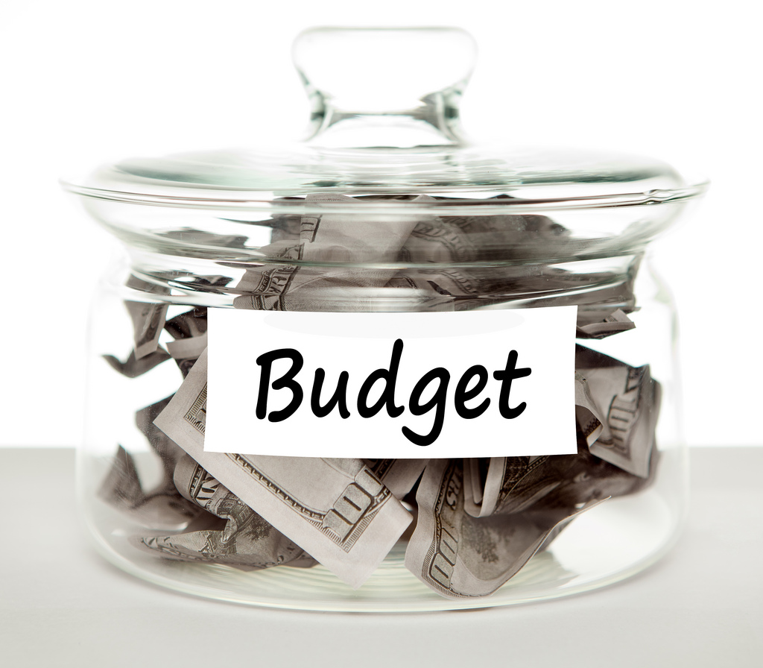
Scenario 2: Grant writing
Notes:
Let’s work through another one. Flip the page over to the back, and with your team, read and discuss Scenario 2. We’ll mute the phone lines so that if you need to call folks on another line, you can, and we’ll reconvene at [11:30] to share our conversations.
WHITEBOARD to capture ideas/full group conversation
Full group discussion: So let’s come back together and talk this one through. I’d like to hear from a team that hasn’t shared yet. What rose to the top in your discussion? [Probes: What were some of the questions your team came up with that could help bring equity into the conversations in this scenario? What blind spots might be operating in this scenario? Where did you see action steps that might have been handled differently?]
Follow-up probe: What steps could you take now to be ready when an opportunity like this comes up?
Reflect back/summarize some key points

Slide 6

Share
Notes:
Share
During the course of the learning community, I’m sure you’ve all seen, heard, read or otherwise experienced something that you found helpful or thought-provoking related to equity. It might be a blog post, an article, a speaker, or a side conversation with a friend or colleague.
I’ll give you an example: I recently listened to a few episodes of a radio program produced by Minnesota Public Radio called Counter Stories.
Facilitated panel discussion focused on race (topics range… current events, new research, policy issues)
Panel of 5 folks of different races and ethnicities.
Really helpful way to hear perspectives that are shaped by different life experiences than my own– it helps in a small way to counter my blind spots.
Recent conversation about racism and health that was eye-opening for me (how early young children experience racism; racism/stress/health]
Now I’ll turn it over to you: Have any of you seen or heard something recently that really resonated with you, or helped you think about equity?

Slide 7
Next steps
Complete a brief webinar evaluation, coming shortly
Send us 1-2 internal policies to help us plan the next webinar
Keep your own work going and stay connected to your coaches
Stay tuned for scheduling an in-person meeting
Practice using a health equity lens every day
Notes:
Thank you for sharing your time and your insights with us today. We truly do appreciate all that we learn together with you.
A few things you can do between now and our next meeting:
We know we need to dive a little deeper into organizational practices and how they might be impacted when you focus on equity. We’d love it if you could sent us one or two of your own internal policies that might help us create some concrete scenarios to work through together.
Keep your own work moving forward, and stay connected to your coaches.
Also: We’ve heard in our evaluation process that meeting in person is really helpful for a lot of you, so we’re going to try to plan a for an in–person meeting for the spring. Stay tuned for more information and scheduling for that.
Keep practicing. One thing I’ve learned on my own health equity journey is that advancing equity isn’t a project or a thing but is a way of working, and we work on equity every time we ask different questions, open ourselves to different perspectives, and consider how we might work differently. It’s something we can do every day, multiple times a day.
With that, we’ll sign off and wish you a good day. Thanks for being with us, and we’ll talk with you all again soon.
Thanks everyone – we’ll talk with you again soon. Have a great rest of your day.

