Slide 1
Using a health equity lens
Health Equity Learning Community
August 2017

Slide 2

Using a health equity lens
Notes:
Using a health equity lens
Advancing health equity requires us to work differently. A health equity lens requires us to look at things differently - sort of like my husband’s sunglasses that can see the fish in the water – without those lens – he wouldn’t be able to see this fish – a health equity lens let’s us see things we wouldn’t normally see

Slide 3
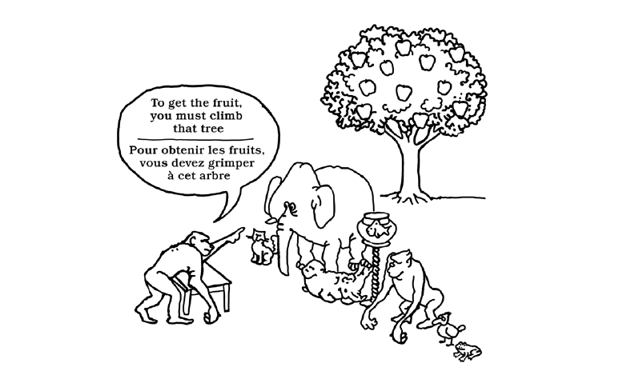
Check our assumptions
Notes:
In quality improvement work, we talk about the importance of checking out our assumptions – particularly with our customers – a health equity lens does the same thing – What are the assumptions taking place here? Put your answers in the chat box - – does this happen in our workplace, what about our services, our policies, the structure of the tree… – A health equity lens/assessment can help us check our assumptions
A health equity lens could be in org. alignment (evaluating a budgetary decision), could be in CE (evaluating a committee or coalition), in policy (evaluating potential policy impact).

Slide 4

It may be difficult to “see” the inequities
Notes:
Why Use a Health Equity Assessment/“Lens”? Every decision that an organization makes impacts people – internally and externally. Sometimes our internal policies and processes are so embedded in our organization that we can’t see the inequities. A good idea can inadvertently disadvantage certain groups. For example, when an agency focuses an improvement project on the efficiency of collecting money and decides to only take credit/debit cards, this may disadvantage some groups.
Link to community coach idea – people from outside your organization – whether they are someone who has experienced inequities, or they work in a different sector, or they have experience with advancing equity – people with different life experience and background will you see more things (expand your vision).

Slide 5
This slide is intentionally blank.
Notes:
Slide left intentionally blank.
So –What else did you see in the picture besides a young man walking – Cocktails – TGIF – balloons, man in a wheelchair, man with a bag, hotel sign, cobblestone street, old fashioned street lamp, banners hanging from buildings
Since we are often focused on other important items – like requirements, measures, etc. Using a lens ensures equity is brought into the conversation where it might otherwise not be considered.

Slide 7

Reflective questions
Notes:
Reflective questions
A health equity lens brings to focus the impact policies, practices, activities have on shaping our environments. But at its core, a health equity lens is really a set of reflective questions. While the questions may differ depending on how you will use it – they are very similar. For many of us, incorporating a health equity lens is a new practice, so we are going to give you some practice now. A set of questions you can start using tomorrow to inform your decision making
But before we move forward, are there are any questions?

Slide 8

Team activity
Notes:
Team activity
We asked if you could download the two scenarios that were added to the WebEx invitation and just to make sure, we also e-mailed the two scenarios with instructions to each of your leads. We would like to have Dakota, Pine and Goodhue use Scenario Worksheet 1 and have Rice, P4H and Washington use scenario worksheet 2. We will be putting the phones on mute again so you can as a team have this conversation together or use an additional phone line or e-mail to work on this as a team. Please follow the instructions on your Scenario worksheet and be prepared to report back a summary of your discussion to the larger group when we open the phone lines again. We will give you 10 – 15 minutes to complete your worksheet and then spend the last 15 minutes sharing what you learned.
Introduce the activity as not a judgment of our practices, but for helping us develop this new muscle. Anytime we do something like this with you, it is not from a place of judgment.

Slide 9

Group discussion
Notes:
Group discussion
DISCUSSION OF SCENARIOS
WRAP UP talking points:
How we anticipate them using this skill (in current activity of evaluating where they are now and identifying a starting place)
Connect to the assessment phase & coaching questions – helping CHBs think through their current operations & practices.
You’ve shared with us now, and maybe you’ve thought about or identified the role you might have in changing some of these practices. The accumulation of these practices, policies, or procedures that exclude or harm certain populations add up to major structural inequities. Using a health equity lens is just a start, but we hope you can see how a small action can lead to organizational change and contribute to social change by becoming the norm.
This might be a good transition to Jeannette’s theory of change.

