Slide 1
Overview of health equity practices
Health Equity Learning Community
October 2017

Slide 2
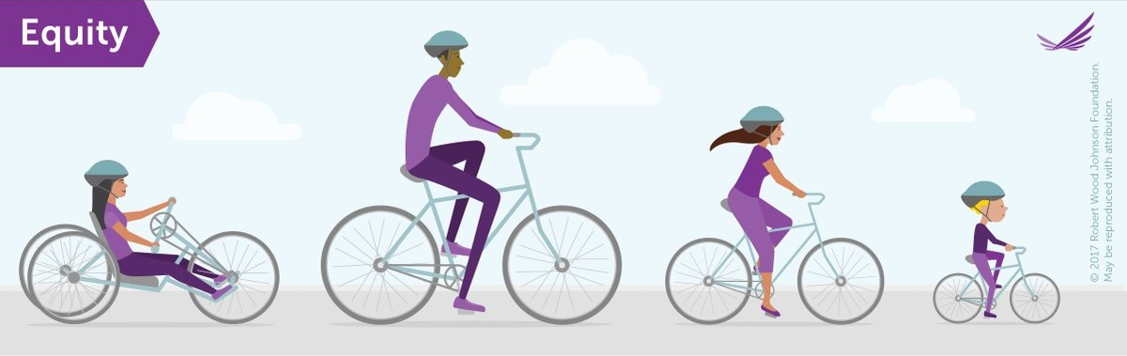
Advancing health equity: Our approach
“When every person has the opportunity to realize their health potential—the highest level of health possible for that person—without limits imposed by structural inequities. Health equity means achieving the conditions in which all people have the opportunity to attain their highest possible level of health.”
Notes:
First, let’s start with a basic definition. We define health equity this way:
When every person has the opportunity to realize their health potential—the highest level of health possible for that person—without limits imposed by structural inequities. Health equity means achieving the conditions in which all people have the opportunity to attain their highest possible level of health. (Source: Advancing Health Equity in Minnesota: Report to the Legislature) http://www.health.state.mn.us/divs/che/reports/ahe_leg_report_020114.pdf
Discussion: What words stand out to you?
What equity isn’t – it is not sameness. It is not everyone getting the same bike, for example.
This definition focuses our attention on structures and conditions.

Slide 3
Equity work…
Asks a different set of questions and seeks different perspectives
Requires systems thinking and risk taking
Involves personal growth and investment
Becomes more routine through action and learning reinforcing each other
Is a journey, not a destination
Notes:
When we look at the health inequities in our communities, inequities that have persisted over time, it forces us to think critically about our work. How are we making decisions? Who is affected by those decisions, and how? When we put equity at the center of what we do, we begin to ask different questions : who is at the decision-making table? Whose voices are heard? Who is left out? Who benefits? Who doesn’t?
And when we acknowledge that social conditions, more than access to health care or individual behavior, are at the root of health inequities, it becomes apparent that public health solve this alone. We need to be asking a different set of questions and seeking out different perspectives.
Because the root causes of inequities are complex and embedded in the social conditions that structure our everyday lives, addressing it requires systems thinking. We found a video that does a nice job describing systems thinking and what it requires of us. I’ll put the link in the chat box, and I’ll mute the lines, so that we can watch it independently of the webinar. We’ll come back to group discussion when it finishes.
https://vimeo.com/212281432
Just as important as the systems thinking piece is that equity work involves a personal journey. To understand and reckon with the way social conditions have historically afforded more opportunity to some and less to others is part of equity work. It’s work that involves head + heart.
The other thing we’ve observed is that strengthening our equity muscles is most effective when we’re both learning and doing. Like a lot of other things in life, you just have to start doing the work. You can go to training after training, but we get the most out of this journey and make the most difference when we put ideas into action.
One last point about our approach: we view this learning community as one part of your equity journey. Some of you have been working on equity for some time now, others are just starting. But working on equity is a journey, not a destination. As the video said, this isn’t about “mission accomplished.” To be clear: Here at MDH, we are not experts in equity – we are learning as we go, too – and we are in our own place on our journey (most of us in different places, too). We really are learning right alongside you.

Slide 4
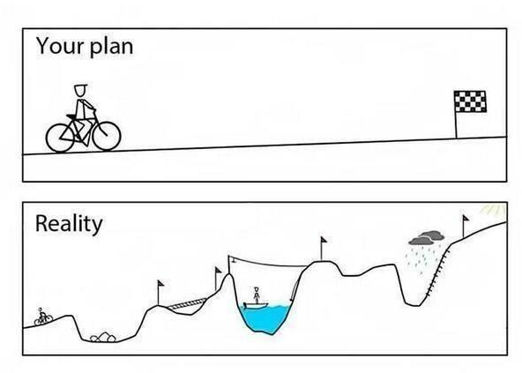
Few straight lines
Notes:
Few straight lines
Finally: as with most things in this life, there are few straight lines for getting there. There are no easy solutions to creating health equity. This is why systems thinking and ability to adapt are so important.

Slide 5

Six public health practices to advance health equity
Notes:
We have been hearing about the importance of health equity for quite a while. There are some persistent gaps in health outcomes and the causes for those gaps are really far upstream. In order to advance health equity and close those gaps in health outcomes we have to address the conditions that create health. But, many of us are left wondering - if this is about tackling the roots of inequities – if this is about housing, jobs, education, living wage, structural racism - what is the health department to do?
Minnesota’s State Community Health Services Advisory Committee (SCHSAC) convened a health equity workgroup in 2015 to address that question. Looking back at their charge, some of that language was about practical help, but it was also about how public health has critical role to play and changing public health practice so we can advance health equity.
The workgroup quickly realized they needed more information - Who else is doing this work and what can we learn from them? There were a number of health departments in the US and Canada who had done some work in this area and who were starting to figure out the role of a public health department. We pulled in the work from others and lined them up and it was obvious that although the different groups sliced and diced the work differently, essentially there was a set of similar ideas. The SCHSAC Health Equity workgroup massaged the language and put things in the buckets that made sense to them and these six health equity practices were born. I am going to give you a brief overview of each practice today.

Slide 6

Shifting our work
Notes:
Shifting our work
Have you heard the definition of ‘insanity’ -- Doing the same thing over and over again and expecting different results? These practices are really meant to help us shift our work. If you hear the Commissioner talk, if you look at the data, these gaps, these inequities, aren’t changing and they aren’t going to change unless we take a different track - How do we do our work differently so we get a different result?

Slide 7
Six public health practices to advance health equity
Equip staff
Influence public and private policy
Authentic community engagement
Health equity practice
Spread the word about what creates health
Collect and use data for change
Show organizational commitment
Notes:
The way we have talked about the practices originally identified in the SCHAC workgroup report has evolved as we’ve developed better ways to describe them. In essence, in order to advance health equity we have to:
Equip our staff – we have to give them the skills, knowledge and tools to do their work differently
We have to engage – not just engage, but authentically engage—with communities, especially those communities that may be experiencing inequities in your jurisdiction – it could be populations of color, but it could also be the working poor, elderly citizens, laborers
We have to collect and use data for change – this is about collecting data differently and using the data with the community to make change
We have to make sure our organization shows its commitment to health equity through actions – this is the “walk and talk”
We have to get out there and we have to start talking. We have to spread the word about what creates health
We need to influence public policies - we can influence policy conversations by connecting those policies about housing to health outcomes.
These practices are intended to be entry points. They were not intended to be sequential, individual buckets. When we say entry points, what we mean is: you might want to start with data and you dig into that practice and you might start doing that work. You will quickly find out that in collecting your data differently you are going to have to engage with the community. Your staff might need some skills. It is going to cause you to talk differently about your data. The practices overlap and connect. It is also important to know that while these practices are about a different way to approach our work, they are not a departure from core public health services. They are very much grounded in the ten essential services and the roots of public health and you can see all of them in the PHAB standards.

Slide 8

Equip staff: Knowledge and skills
Notes:
Let’s talk about equipping our staff. This is one area that people go to right away. You ask me to do something different, I need to be trained. We need to approach our work differently so it’s pretty obvious that there might be some skills or knowledge that we need to do that differently. It is also important to note here that maybe you just need some experiences that are different. Maybe some space and time to struggle with some hard issues.
It is not about training alone. It is about making sure people have what they need to do this work.
We have an online resource library that has a lot of different tools for helping others understand equity, including Ted Talks, Camara Jones’s allegories (which we’ll view together at a future meeting), readings, and other resources.

Slide 9
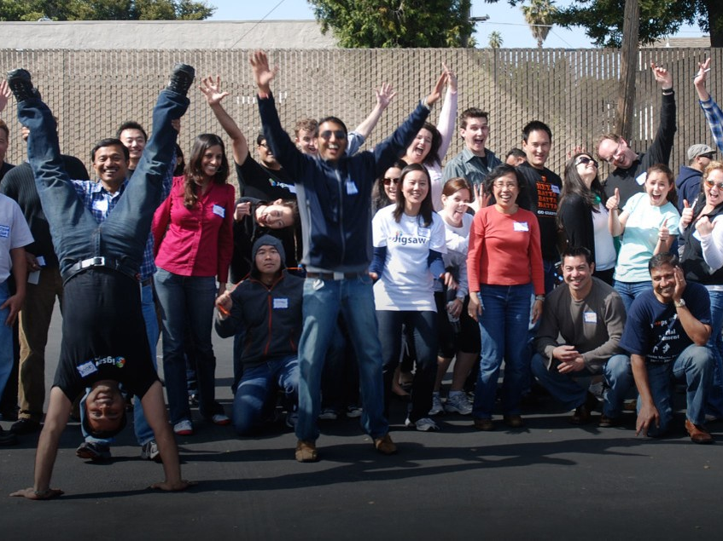
Authentic engagement
Notes:
The next practice is about authentic community engagement. All of us in public health have done community engagement for a long time, but the essence of this practice is really moving along the engagement continuum of bringing ideas to a community for input, to listening to needs first. Maybe co-creating solutions together. It is about who we engage with and explicitly including communities who are experiencing inequities, whoever that is in your jurisdiction. Reaching out and making sure folks have a voice at the table and have a say in what the issues and solutions are. It is also about honoring the communities’ expertise and wisdom to know what’s best and shifting the power where community members own and make the decisions that will lead to a greater impact.
Public health cannot advance health equity alone, the whole community is needed to address the conditions that create health.

Slide 10

Collect and use data for change
Notes:
We have always collected and presented data. What’s different here? At a very high level, it is about digging deeper and going underneath those averages. It may mean we have to have different ways to get input from communities who are not reached with a mail-in survey to get at what do we really need to understand here? What data will help lead to change in the community? This is also about reporting the data to elected officials, businesses, the community in a way that is understandable. The key point here is that data can lead to change and action, but it can also lead to inaction. If we are not collecting data that tells a story about communities experiencing inequities we are not building the case that there is a need for change.
Example: the Health Equity Data Analysis (HEDA) approach implemented through MDH’s Statewide Health Improvement Partnership.

Slide 11

Show commitment
Notes:
This practice is, in its essence, walking the talk. We say health equity is important but how are we demonstrating that?
How are we looking hard at ourselves and our actions – intentional or not – to see if it is consistent with our commitment in advancing health equity. This is also about looking at our policies and procedures to see if they may be getting in the way of doing our work differently. This practice is about asking ourselves –are we part of the problem? We, and the people before us, have built systems and structures and programs and rules from our own perspective. But do these systems and structures and rules work for those who experience inequities?
[Share examples.]
Over the years, we have made commitments to change our work when we knew people with disabilities couldn’t use our buildings. We have made commitments to include a new evidence based practice in our program because we were presented with the data. We made commitments to shift staff time for accreditation duties. This practice is about taking our commitment to health equity and making it real in our organization.

Slide 12

Spread the word about what creates health
Notes:
This practice is about really being intentional – shouting from the rooftops – about what we know about what creates health. Part of this is when we are out and about, when we are representing public health, are we presenting a story that health is only about healthcare and individual behaviors? Or are we presenting a story that our overall health is connected to how much money we make, to where we live and our education level?
This practice is about disseminating and sharing what we know – something public health has done for many years . If we know about health issues, about inequities, about problems, about whatever it is, how are we sharing that?
This practice is important because what we say and what we share has a role in either closing or opening opportunities for solutions. If we talk about health and health care, what are the solutions? They are all health care related. If we talk about health and incarceration, health and minimum wage, health and housing, it allows us to think of different actions and solutions. Public health cannot do this work alone so we must tell other people who a) care about it or b) can do something about it. That is what this practice is about.

Slide 13

Influence public and private policy
Notes:
The essence of this practice is, in order to address inequities, we need to focus on upstream public policy changes that address things like housing, jobs, education, transportation. We can also influence private policies, like corporate policies about sick leave or family leave. The key point is that we cannot service our way out of this. In order to affect the social conditions at the root of health inequities, we need to work at the policy level.
This practice is also about influencing other sectors – both private and public - to think about the actions and policies that may benefit or burden certain populations within the community. We may not have the authority to change economic policy, but we can provide the health perspective and advocate for health to be considered in policymaking. We can connect with other coalitions in our community to share what we know.
This practice builds on the long tradition of public health collaboration– working with worksites and government on tobacco policies, working with the schools to reduce drunk driving, working with law enforcement on seat belt use and public health nuisances. This is about looking for those windows of opportunity for policy change and making the link to health to all policies, not those just specific to health.

Slide 14
Where we are headed
People share an understanding of what creates health
Communities have power and resources to shape their own healthy futures
Health in all policies
Connected, inclusive communities
Notes:
Together these practices will lead us towards equity. Here are some of the indicators we envision:
* Health is considered in the development and implementation of all policies – not just those specific to health or health care, but policies in transportation, housing, education, employment, public safety or environmental protection.
* People everywhere understand that health comes from the conditions of our neighborhoods, what kinds of opportunities we have for education and employment, and the many other factors that shape our daily lives.
* Communities will have the power to shape their own healthy futures; communities will have the resources, ability to make decisions, and the power to create change that will allow them and their families to thrive and be healthy.
* Communities will be places of caring and connection, the kinds of places where everyone is included and no one faces structural barriers to their health and well-being.

