Slide 1
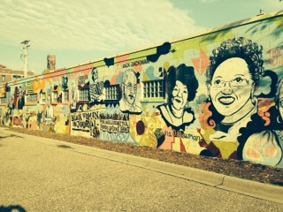
Community Walking Assessment

Slide 2
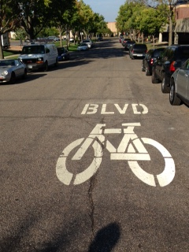
Why a walking assessment?
Experience a community first hand.
Document assets and opportunities:
Food access
Physical activity
Health
Notes:
A community walking assessment is an activity that allows participants to experience a community first hand and document assets and opportunities related to food access, physical activity, and health. A team of University of Minnesota Extension Health and Nutrition staff developed this activity to provide a format for professionals to practice the skills of assessing community environments and identifying how environments support or hinder healthy lifestyles. The Community Walking Assessment Participant Guide is based on an environmental assessment form developed in Minnesota.

Slide 3
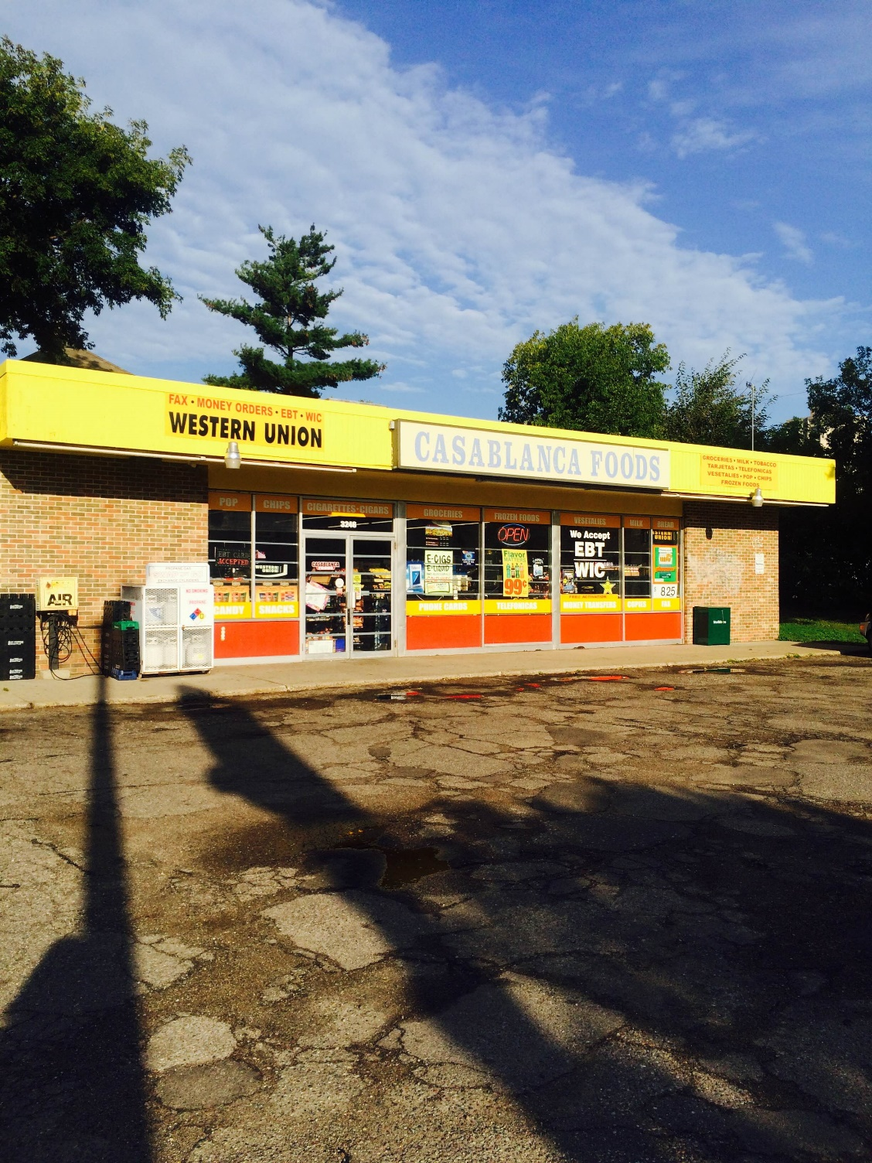
Overview
Preparation
Observation
Communication
Documentation
Reflection
Notes:
This presentation includes preparation for the community walking assessment experience and discussion of the various parts of the assessment: observation, communication, documentation, and reflection.

Slide 4
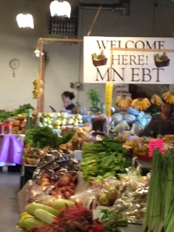
Purpose of activity
Participants will:
Look at a community from a different perspective.
Identify assets of a community.
Identify opportunities for improvement in a community.
Notes:
Why do a community walking assessment? For one thing, this activity gives participants the chance to take a look at a community from a different perspective.
Whether you spend a lot of time in the community or not, you always experience it from your own perspective. Maybe you always drive. Have you ever considered what it would be like if you didn’t have a car? Or maybe you frequently walk through the neighborhood. Have you ever thought about how you would get around if you were in a wheelchair? Or if you had several young children with you?
In this assessment, you’ll also have an opportunity to look for the assets of a community. Often, we notice the deficits, but it’s equally important to understand what is already there that can be built upon. In addition, you may also notice opportunities for change that could have a positive impact on community health.
This activity can be used individually or with a small group. It can be used individually to take a closer look at a community to identify opportunities to impact the health of residents. It can also be used with a group of community members or stakeholders to increase understanding of the need for systems-level work, or with a group such as a food network to inform decisions and priorities.

Slide 5
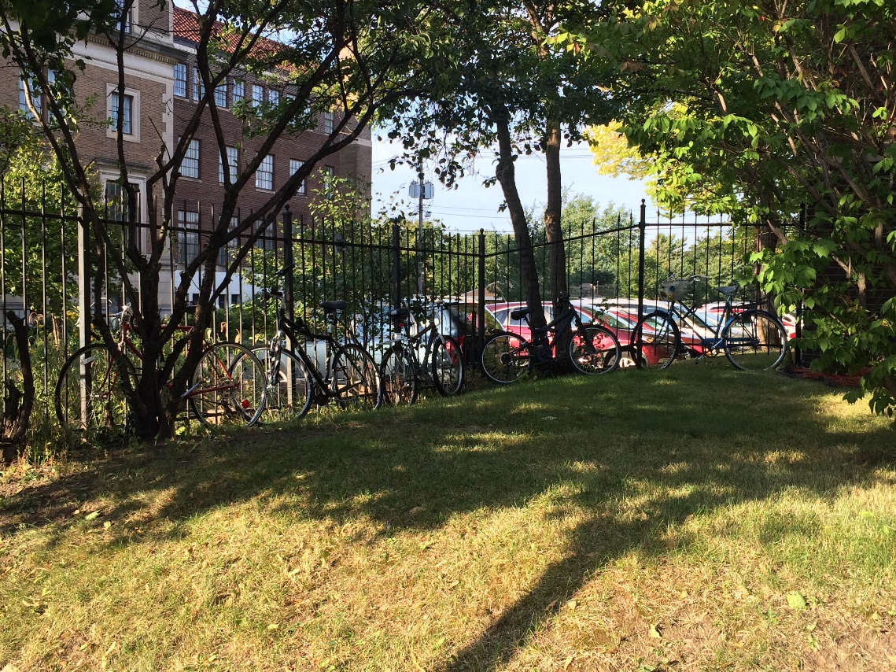
Preparation
Get grounded: understanding the purpose
Review Community Walking Assessment Participant Guide
Authenticity and respect
Getting there
Parking
Transportation
Notes:
Before you go out into the community, take a few minutes to get grounded. Reflect on the purpose for the experience, and your own personal reasons for being here.
As we just learned, the purpose of a community walking assessment is to:
Look at a community from a different perspective.
Identify assets in a community.
Identify opportunities for change in a community.
You’ll also want to look over the Community Walking Assessment Participant Guide, which we’ll go over in a minute, so you are familiar with it.
As part of getting grounded, think about how you can ensure that you personally approach this assessment with authenticity and respect. If you are going into a community that you are not a part of, think about how it would feel if someone came to do an activity like this in your community. Be respectful of the people who live there and the realities of their lives.
[add details about transportation, parking, etc. as needed here]

Slide 6
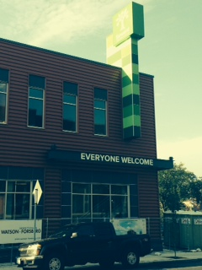
Observation
What’s the “feel” of the community?
What features stand out?
Assets and opportunities
Community Walking Assessment Participant Guide
Photos or video
Notes:
Throughout this experience, we encourage you to be a good observer. Keep your focus on the assets and opportunities for change that you observe.
Also ask yourself:
What are your overall impressions of the community?
What features stand out? What features contribute to the “feel” of the community?
The Community Walking Assessment Participant Guide provides prompts for your team to look for different things as you walk through the community. The word “guide” is used intentionally—please view it more as an general outline to conducting the assessment. It is not essential to complete the questions in order, or even to respond to every question. Instead, please use the guide to give you ideas of what to look for and help you document what you see in the community.
In fact, you may want to keep the guide in your pocket and just refer to it occasionally. There is no need to keep it in your hands and take notes the whole time.
Your team might have a chance to pause or sit down and jot some notes on the participant guide. If not, fill out the form when you’re done with your walk and have returned to a central location.
We’ll go over the participant guide a little later, and you’ll receive a paper copy. If it is appropriate, you can also snap a few photos of things that catch your eye. We’ll talk more about that soon.

Slide 7
Communication
Connect with a community member: What do people in the community think?
Visit an agency or program.
Participant guide has sample questions.
Notes:
If it feels right, if the opportunity arises, and if someone in your group is comfortable making small talk with people you see—such as someone on the street, in the supermarket, or on the bike path—we encourage you to start a conversation. You don’t need to ask personal questions. Instead, just mention or ask something about the neighborhood. For instance, ask what the best place is to visit in the neighborhood. Ask if there is somewhere to get a sandwich. Ask where the nearest park is. Simple questions can lead to interesting insights.
If there is a community agency in the area, stop in and see if there is someone you can talk to about the agency’s programs and the community in which the agency resides. You may wish to schedule a brief meeting in advance. With advance planning, this can be an opportunity to talk with representatives from the agency about the strengths of the community and neighborhood, and to ask where they feel there may be room for improvement.
See the Community Walking Assessment Participant Guide for sample questions that you can ask a community agency if you have time and if it feels right.
Take mental notes about what you learn from the people you speak to, and document those notes on the participant guide or elsewhere at a later time.

Slide 8
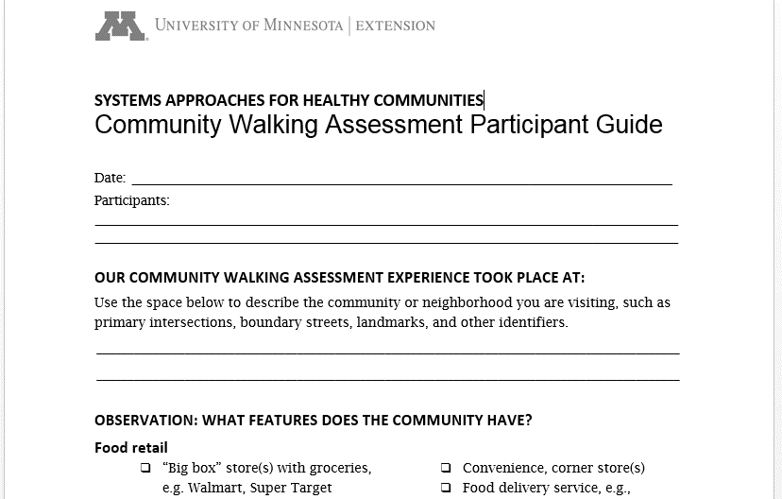
Documentation
Notes:
Let’s take a look at the Community Walking Assessment Participant Guide now. [Provide copies to all participants.]
Remember, this is just a guide. It is not a script. It is not an instruction packet. None of the questions are mandatory. All the questions should be used as a reference to inform your experience, but this sheet of paper should not define your experience.
The guide prompts you to look for various features in the community that impact people’s ability to live a healthy lifestyle. For instance [use examples from the guide]: What features of the community stand out to you? Businesses? Parks and green space? Schools? Empty lots? Where do people who live in this community get healthy food? What messages are they seeing and hearing about food and health? What are the challenges? What are the opportunities?
You’ll recall that the purpose of a community walking assessment is to experience a community first hand and document assets and opportunities related to food access, physical activity, and health. The purpose of the guide, in turn, is to help you remember these things and give you a space for notes for future reference. We encourage you to fill out what you can on your guide. Remember, though, you don’t need to keep the guide in your hands for the whole experience. You may wish to stop periodically or take time after your walk to make your notes, rather than doing so throughout.

Slide 9
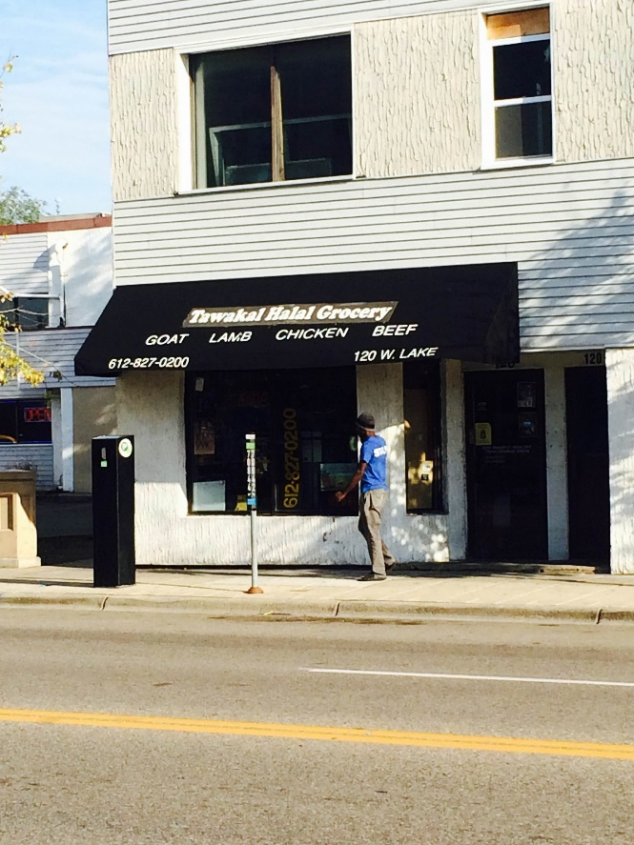
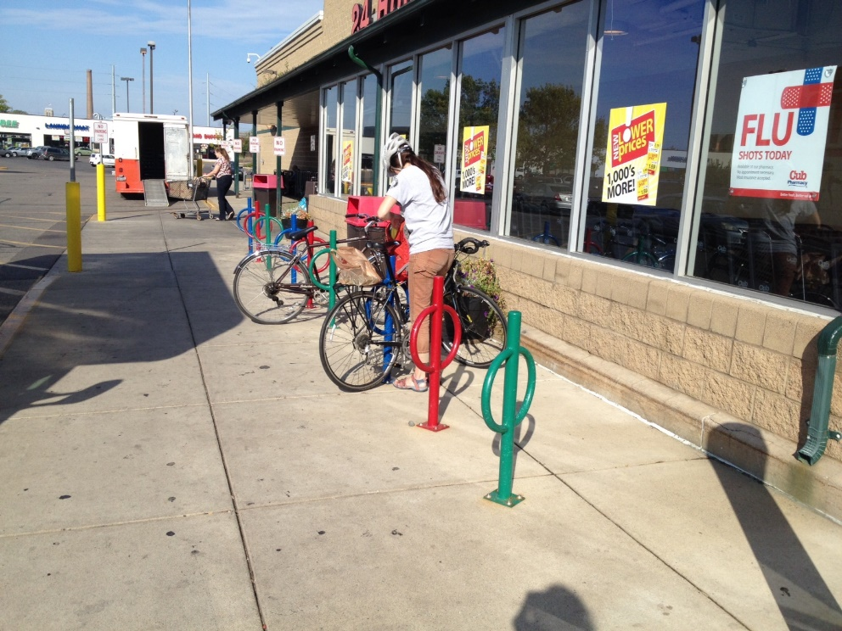
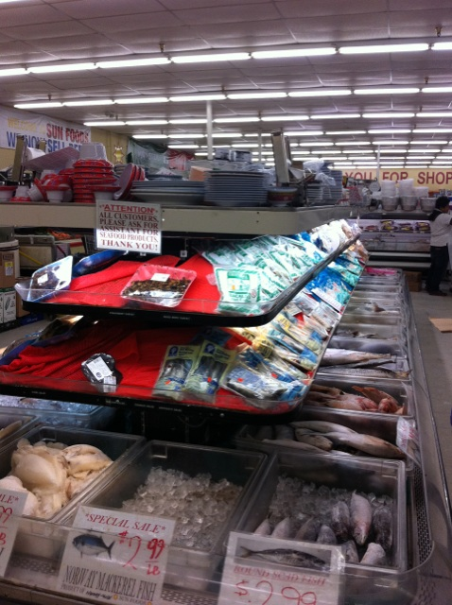
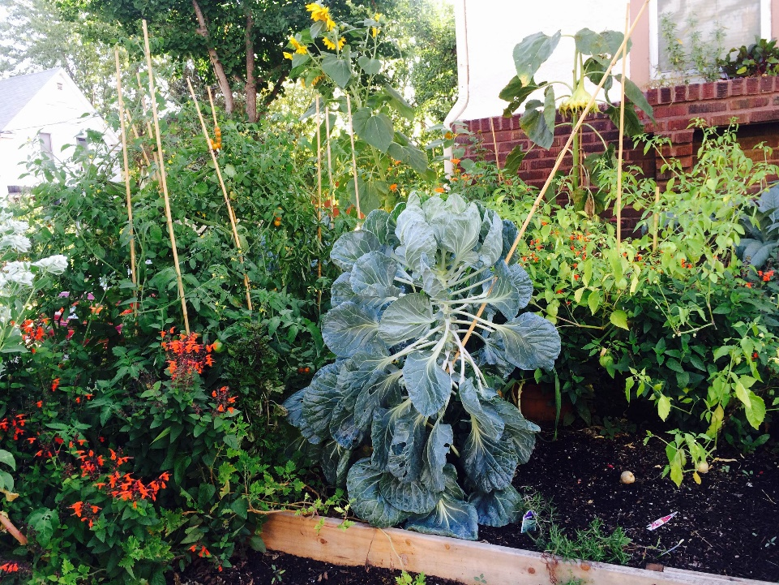
Photos and videos
Notes:
In addition, we encourage you to take photos if appropriate.
There is a good reason the expression “a picture is worth a thousand words” is so widely used. Taking photos or videos complements your written observations, and sometimes communicates more than words. We encourage you to take photos and videos with your phones or tablets. You may want to photograph notable landmarks, restaurants, grocery stores, streetscapes, or green spaces. Or you many want to capture interesting architecture or natural beauty in your photos. Finally, you may want to photograph billboards or other examples of advertising and marketing healthy foods and physical activity.
Feel free to photograph or videotape other members of your group, as long as they consent. Please do not photograph or take video of community members without their consent. If you do take pictures of people you meet on your walk, have them sign a consent form in case you want to use the photo in a future presentation or other setting.
[Refer to/include alternate photo and video consent policies as needed]

Slide 10
E-mail photos and videos
Notes:
[To request photos and videos by e-mail or other sharing tools, insert relevant information here]
We’d love to compile all of the photos and videos from our experience today. Please e-mail them to [e-mail] and include your [group number, location, other identifier].
Remember, please do not photograph or take video of community members without their consent.

Slide 11
Reflection
After your experience, you will reflect on what you have learned about:
A different perspective
Assets
Opportunities
Notes:
After your walk in the community, you and your group will take time to reflect on what you learned. Consider three things:
What you discovered by looking at the community from a different perspective?
What assets did you observe?
What opportunities for change did you notice?
I know that everyone has different levels of comfort in doing this kind of activity. That’s ok. There is no wrong or right way to feel any way about this experience.
We are hopeful the experience will provide with some insight about the communities you work with. Remember: Relax. Enjoy. Be authentic. Connect. Have fun.

Slide 12
Questions?

Slide 13
wrapup discussion
After the experience:
What did you observe?
What stood out to you?
What surprised you?
What interested you most?
What connections did you make?
What does this mean for our work?
Notes:
[After completing the community walking assessment activity, use these and other questions to generate discussion in pairs or small groups. Then, if you wish, provide opportunities for participants to share highlights in a large-group setting.]

Slide 14
USDA Information Statements (1/3)
In accordance with Federal civil rights law and U.S. Department of Agriculture (USDA) civil rights regulations and policies, the USDA, its Agencies, offices, and employees, and institutions participating in or administering USDA programs are prohibited from discriminating based on race, color, national origin, sex, religious creed, disability, age, political beliefs, or reprisal or retaliation for prior civil rights activity in any program or activity conducted or funded by USDA.
Persons with disabilities who require alternative means of communication for program information (e.g., Braille, large print, audiotape, American Sign Language, etc.), should contact the Agency (State or local) where they applied for benefits. Individuals who are deaf, hard of hearing or have speech disabilities may contact USDA through the Federal Relay Service at 1-800-877-8339. Additionally, program information may be made available in languages other than English.

Slide 15
USDA Information Statements (2/3)
To file a program complaint of discrimination, complete the USDA Program Discrimination Complaint Form (AD-3027) found online at: http://www.ascr.usda.gov/complaint_filing_cust.html, and at any USDA office, or write a letter addressed to USDA and provide in the letter all of the information requested in the form. To request a copy of the complaint form, call 1-866-632-9992.
Submit your completed form or letter to USDA by:
Mail:
U.S. Department of Agriculture Office of the Assistant Secretary for Civil Rights 1400 Independence Avenue, SW Washington, D.C. 20250-9410
Fax: 202-690-7442
Email: program.intake@usda.gov

Slide 16
USDA Information Statements (3/3)
This institution is an equal opportunity provider.
For any other information dealing with Supplemental Nutrition Assistance Program (SNAP) issues, persons should either contact the USDA SNAP Hotline Number at 1-800-221-5689, which is also in Spanish or call the MN Food HelpLine at 1-888-711-1151.
This resource was funded in part by USDA’s Supplemental Nutrition Program — SNAP. SNAP provides nutrition assistance to people with low income.

Slide 17
Copyright information
Visit www.extension.umn.edu/family/health-and-nutrition/ for more information on other Health and Nutrition materials and trainings.
© 2015, Regents of the University of Minnesota. All rights reserved.
University of Minnesota Extension is an equal opportunity educator and employer.
In accordance with the Americans with Disabilities Act, this resource is available in alternative formats upon request. Direct requests to 612-626-6602.

