Slide 1
Introduction to Exercises
What are they and how should
I plan them?
Chad Ostlund, CEM
Emergency Preparedness & Response
Health Partnerships Division
Notes:
Welcome.

Slide 2

Agenda
What are exercises and why should they be conducted?
What types of exercises exist?
How does the planning process work?
How should partners be identified and involved?
Q&A
Notes:
Agenda:
1 hour timeframe
What are exercises and why should they be conducted?
What types of exercises exist? During this segment, I will ask for volunteers to share some experiences with exercises so please be thinking about ideas to share with the group.
How does the planning process work?
How should partners be identified and involved?
Q&A

Slide 3
Learning Objectives
By the end of this webinar you will be able to:
Discuss basics of exercise planning
Describe types of exercises
Determine potential members of exercise planning teams
Identify partners that may be involved in your exercises
Notes:
Discuss basics of exercise planning and where you can find resources to help you with your exercise planning/development
Describe types of exercises
Determine potential members of exercise planning teams
Identify partners that may be involved in your exercises
This course is worth 1 hour of continuing education credits.

Slide 4
National Preparedness Goal
“A secure and resilient nation with the capabilities required across the whole community to prevent, protect against, mitigate, respond to, and recover from the threats and hazards that pose the greatest risk.”
Response
Recovery
Prevention
Protection
Mitigation
Notes:
The National Preparedness Goal defines what it means for the whole community to be prepared for all types of disasters and emergencies. The goal itself is: “A secure and resilient nation with the capabilities required across the whole community to prevent, protect against, mitigate, respond to, and recover from the threats and hazards that pose the greatest risk.”
The National Preparedness Goal is capabilities based (as is public health emergency preparedness) and organized into the five mission areas of Prevention, Protection, Mitigation, Response, and Recovery. The National Preparedness Goal also identifies core capabilities which serve as preparedness tools and provide a common language for preparedness activities.

Slide 5
15 Public Health Preparedness Capabilities
Community Preparedness
Community Recovery
Emergency Operations Coordination
Emergency Public Information & Warning
Fatality Management
Information Sharing
Mass Care
Medical Countermeasure Dispensing
Medical Materiel Management & Distribution
Medical Surge
Non-Pharmaceutical Interventions
Public Health Laboratory Testing
Public Health Surveillance and Epidemiological Investigation
Responder Safety and Health
Volunteer Management
Notes:
Well, the CDC has aligned public health preparedness around the Public Health Emergency Preparedness (PHEP) capabilities. This serves as our preparedness tool and provides a common language for public health preparedness.
As a step toward strengthened preparedness, the Department of Homeland Security developed and implemented an Exercise Evaluation Program, HSEEP, to enhance and support prevention, response, and recovery capabilities at federal, state, and local levels. The program seeks to “standardize the language and concepts used by various agencies and organizations in the exercise planning process” (DHS, 2002).
(Mention which of the capabilities locals have commonly exercised over the years)

Slide 6
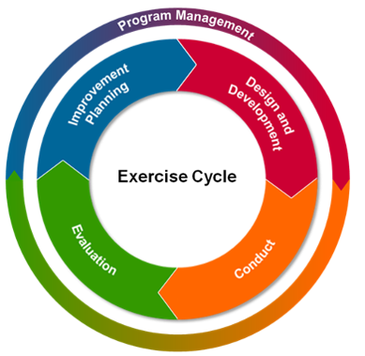
A Sheep? No, HSEEP! (Homeland Security Exercise & Evaluation Program)
HSEEP Preparedness Toolkit
https://www.preptoolkit.org/web/hseep-resources
Notes:
It is critical for all exercise participants to be able to recognize the terms used to describe various exercise roles and responsibilities as well as other important exercise terminology. You have a sheet of exercise terms and definitions that I sent you.
An emergency preparedness exercise program is meant to move an agency toward even better emergency preparedness. HSEEP is guidance. It’s a tool to use that is capability based and objective driven. It involves the “whole community” and it provides a common methodology for designing, developing, conducting, evaluating, and improving exercises and planning.
(A Whole Community approach attempts to engage the full capacity of the private and nonprofit sectors, including businesses, faith-based and disability organizations, and the general public, in conjunction with the participation of local, tribal, state, territorial, and Federal governmental partners. By using the “whole community” philosophy in preparedness, it provides for a more effective path to societal security and community resilience is built. )
Depending on the scope and scale of the emergency preparedness exercises, they may involve many individuals, both internal (from within local public health) and external (from other response sectors). (whole community)
Emergency preparedness exercises should be focused on the Public Health Preparedness Capabilities for emergency response. Exercises should be consistent with HSEEP, which serves as a framework for all emergency response disciplines and offers useful guidelines and formats for exercise development. Efforts should be made to coordinate exercise activities at the state and federal levels and with other partners and response disciplines.
And finally, exercise planning must include criteria that will allow assessment of how well a Local or Tribal Public Health Agency performs under the conditions of a specific public health emergency or disaster. They define various levels of response performance. Measures of these criteria will provide the basis for additional planning, training, conducting, and evaluation of public health response operations. This will be discussed in further detail in our 3rd and 4th webinars.
As we examine this graphic, we see that Program Management covers the entire cycle. Each of the internal segments, however, connect with the previous section as well as the next section.
Ultimately, the segments all work together to make the jurisdiction as a whole, stronger.

Slide 7


Always Successful?
Notes:
Are exercises always successful? Not for sure but they are certainly better than sitting around letting somebody or something else do the work or putting it off until tomorrow.
We always get something out of the process that could help us improve in the future. This series of webinars is designed to help you put together some plans to design exercises for your community and to improve the emergency preparedness for you and those you work with.
There are always lessons learned and no exercise is ever a failure.

Slide 8
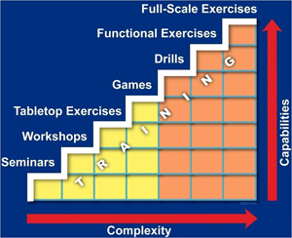
Types of Exercises
Notes:
Building block approach - Key Concept: Exercises should be planned in a cycle that increases in complexity. Each successive exercise should build on the scale and experience of the previous one.
There are seven accepted types of exercises in the building block approach. Each exercise type falls into one of two categories.
The most basic exercise type in the building block approach is the seminar, which involves brief discussions of preparedness strategies and goals.
At the other end of the spectrum, the most complex, full-scale exercises can involve thousands of participants in responder gear, using equipment, trucks, evacuation routes, and actors, to simulate real emergency procedures.

Slide 9

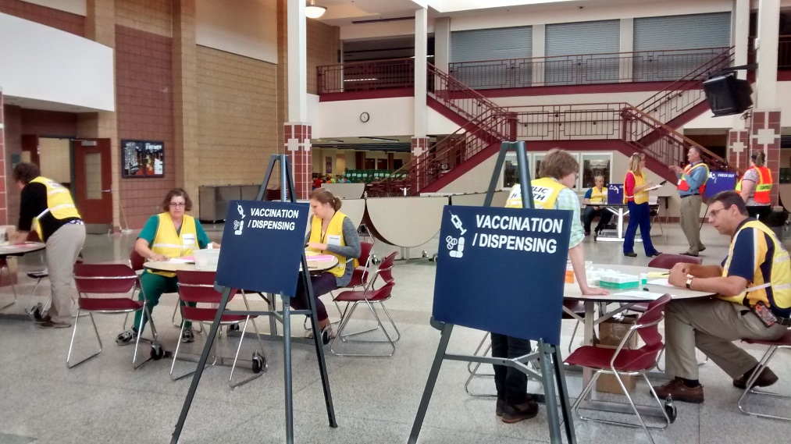
Types of Exercises
Discussion-based
Operations-based
Notes:
Exercise is the generic term for a range of activities that test emergency response readiness, evaluate an emergency response plan, and assess the success of training and development programs. There are 2 main groups or types of exercises: There are discussion based– such as Workshops, Seminars, and tabletop exercises. And there are Operations-based exercises like drills, functional exercises and full-scale exercises.

Slide 10
Discussion-based Exercises
Seminars
Workshops
Tabletop Exercise (TTX) and
Games
Notes:
Key Concept: Discussion-based exercises, as the name suggests, center on participant discussion.
These types of exercises:
Provide a forum for discussing or developing plans, agreements, training and procedures.
Are generally less complicated than operations-based types.
Typically focus on strategic, policy-oriented issues.
Include seminars, workshops, tabletops, and games.
Do not involve deployment of resources.
Quick Tip: A facilitator or a presenter usually leads the discussions in these exercises, helping to keep participants on track and ensuring that exercise objectives are met.
Let’s look at each in further detail.

Slide 11
Discussion-based Exercises
Seminars – orientation
  Department operations center
  Local emergency operations center
  Open house
Workshop- produce something
  Develop a job action sheet
  Create a policy or protocol
Notes:
Seminars- Key Concept: A seminar is an informal discussion-based exercise led by a presenter or facilitator, used to teach or orientate participants.
In a seminar:
Orientate participants to new or existing plans, policies, or procedures.
Research or assess interagency capabilities or inter-jurisdictional operations.
Construct a common framework of understanding.
Seminar examples: A Local or Tribal Public Health Agency may carry out an Seminar exercise by touring your local EOC, visiting the location where you plan on holding mass vaccination clinics or points of dispensing. Or touring your local 911 dispatch center.
Workshops - Key Concept: A workshop is a formal discussion-based exercise led by a facilitator or presenter, used to build or achieve a product.
In a workshop, participants:
Develop new ideas, processes, or procedures.
Develop a written product as a group in coordinated activities.
Obtain consensus.
Collect or share information.
Examples:
We are currently working with our I.T. group to conduct a workshop for the leads in their department as they initiate a new continuity plan. The workshop will involve staff members who have no familiarity with the new process.
DOC Orientation for every new member of the MDH response team.
DPMU Open House

Slide 12
Discussion-based Exercises
Tabletop Exercise
  Internal or with external partners
  Uses a scenario
  In-depth discussion
Games
  Allows practice
  Can involve teams
  Can be a simulation
Notes:
A TTX is a low-stress event to create discussion of a simulated situation. Participants discuss issues in depth and make decisions using slow-paced problem-solving methods in contrast to the fast-paced, spontaneous decision making typical of actual or simulated emergency conditions.
TTXs are designed as an early step along the way to functional and full-scale exercises. Constructive problem solving is the goal of such an exercise. A copy of the appropriate emergency plan and other pertinent materials are available for reference during a TTX. A staff person is assigned to act as recorder, documenting actions taken during a TTX; these notations serve as a reference tool for evaluating the exercise.
Tabletop Exercises - Key Concept: A tabletop exercise (TTX) involves senior staff, elected or appointed officials, or other key personnel in an informal group discussion centered on a hypothetical scenario.
Goals -In a TTX, participants:
Identify strengths and shortfalls.
Enhance understanding of new concepts.
Seek to change existing attitudes and perspectives.
Game- Key Concept: A game is a simulation of operations using rules, data, and procedures designed to depict an actual or assumed real-life situation.
Goals - In a game, participants:
Explore the processes and consequences of decision-making.
Conduct "what-if" analyses of existing plans.
Test existing and potential strategies.
There is an online game the MDH consulted on and worked with the University of Minnesota to help public health practice their knowledge and skills of the incident command system – specifically the roles in ICS. It’s a game that can be found in MN.TRAIN, it’s called Global Outbreak: A Public Health ICS Simulation Course ID 1043402

Slide 13

Discussion-based Exercises
Audience examples
Notes:
I want to hear from you. What have your experiences been with discussion based exercises? Have you had workshops? Games? Tabletops?

Slide 14
Operations-based Exercises
Drills
Functional Exercises (FE)
Full-scale Exercises (FSE)
Notes:
Operations-Based Exercises
These types of exercises:
Involve deployment of resources and personnel.
Are more complex than discussion-based types.
Require execution of plans, policies, agreements, and procedures.
Clarify roles and responsibilities.
Improve individual and team performances.
Include drills and both functional and full-scale exercises.
Operations based exercises include drills, FEs and FSEs. Let’s look at the 3 operations based exercises in further detail

Slide 15
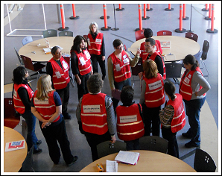
Drills
Purpose
What they test and when
Categories
Notes:
The purpose of a drill is to use repetition to instruct thoroughly. Drills can be used to test personnel training, response time, interagency cooperation and resources, and workforce and equipment capabilities. Drills optimally take place after orientation; staff should have an understanding of the agency function that will be tested in the drill and be given an opportunity to ask questions.
How a drill begins depends on the type of drill being conducted. Drill categories include but are not limited to notification, communication, command post, and evacuation. In most cases, a general briefing by the drill designer sets the scene and reviews the drill’s purpose and objectives. Operational procedures and safety precautions are reviewed before the drill begins. Personnel are required to report, either in person or by telephone or e-mail, to a designated drill site or contact location. Both planned and spontaneous messages sustain the drill’s action.
Example: Command & General Staff Notification and Assembly Drill

Slide 16

Functional Exercises (FE)
Purpose
Time transitions
Depend on reactions
Notes:
The purpose of an FE is to test and evaluate the capabilities of an emergency response system. Events and situations that would actually occur over an extended period of time are depicted or described.
Time transitions advance the activity while staying within the time allotted for the exercise (e.g., “It is now 24 hours later”). The objectives of an FE determine how it is to be organized. For example, a “no-notice” exercise does not have a start time; in such an exercise, the objectives would include testing staff members’ ability to move into their emergency response roles and activities quickly and efficiently. Other FEs, however, may be announced in advance.
Immediately before the start of the FE, participants are briefed on the objectives, procedures, time frame, and recording requirements. FEs depend on reaction to simulated information delivered by paper, telephone, or radio to individuals or agencies that must then coordinate responses with other players. These messages can be pre-scripted or developed by the simulation cell during the course of the exercise.
Recently I was involved in a Disaster Portable Morgue Unit Functional Exercise. This one was announced in advanced but involved the team setting up the unit without the full knowledge of the space allotted and the number of individuals that would be participating. Lessons learned involved space requirements needed, supplies that should be available and personnel working with unknown individuals.

Slide 17
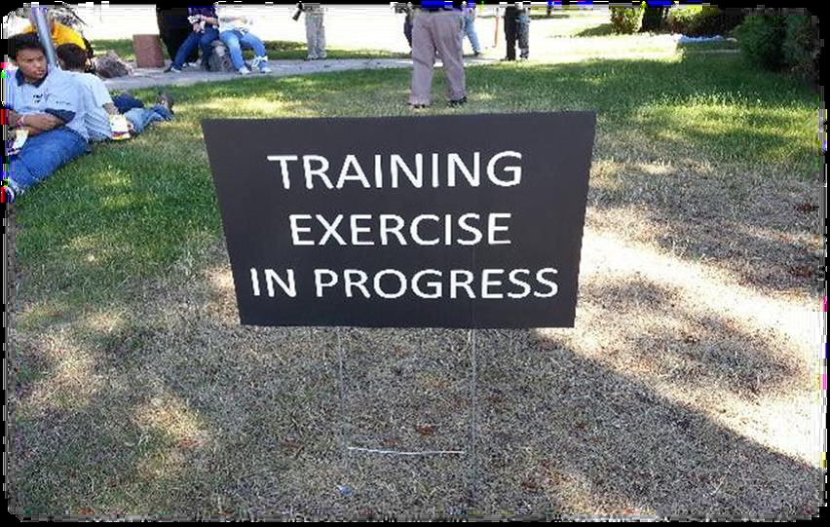
Full-scale Exercises (FSE)
Purpose
Physical reporting of personnel
Depend on actions in field
Notes:
The purpose of an FSE is to test and evaluate a major portion of the emergency operations plan in an interactive manner over an extended period. FSEs typically involve more than one agency. As with an FE, the objectives of an FSE must be specified, and the actual exercise begins with a simulated event that prompts the initiation of the plan. An FSE differs from a functional drill in that field personnel from the participating agencies physically proceed to the location of the mock emergency. The FSE includes all of the activities taking place at the emergency operations center (EOC) as well as on-scene use of simulated victims, equipment, and workforce. Activities at the scene serve as input and require coordination with the EOC.
An FSE combines the planned and spontaneous messages characteristic of FEs with actions from the field.

Slide 18

Examples
Group discussion on drill and exercise experience
Notes:
There are many samples that can be adapted to work within your community. Let’s talk about those and let’s share ideas about how you’ve all been involved in exercises in the past.

Slide 19

Exercise Planning Team
Neighboring jurisdictions
Subject matter experts
Internal agency members
Health Care Coalition members
MDH – Public Health Preparedness Consultants
Notes:
Your team may be a team of one or two people with some support from your agency staff. Or maybe you collaborate within your Community Health Board (CHB) structure, or a neighboring city, county or tribal community to design/develop your exercises. Or you may sometimes work with your health care coalition on designing and participating in exercises.
The Exercise Planning Team should be assembled from key participating agencies, organizations and jurisdictions. The scope and type of exercise or scenario should also help determine the team's membership. If your scenario is a flood, maybe you want some environmental health staff from the MDH district offices on your exercise planning team. If your scenario involves an infectious disease, then you might include your regional epidemiologist on your exercise planning team as a subject matter expert.
Maybe you are just testing one component of your plan, so all you need are internal staff members on your planning team.
Many of you may have teamed up with your local emergency manager for your exercise planning or you look to your coalition members to be part of an exercise planning team.
The team's size should be manageable and flexible - capable of expanding or shrinking, given the demands of the timeline and its associated tasks.

Slide 20



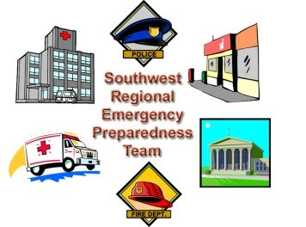

How to Identify & Involve Partners
Notes:
Red Cross
Faith-based Organizations
Healthcare entities
Schools
Law Enforcement
Fire
Most of these organizations or agencies love to participate as it really helps them find the areas for improvement in their current planning. Reach out to them locally or through your county emergency manager.
EMS, Hospitals, White Earth Nation, Public Health Coalitions, American Red Cross
Other examples from the audience?

Slide 21
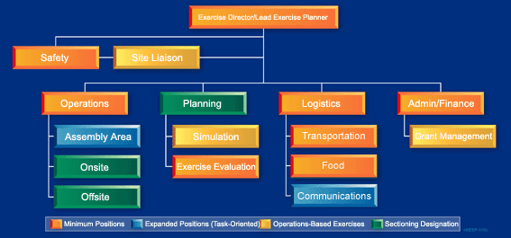

Exercise Planning
Team Organization
Notes:
The team’s size will depend on the functions and tasks involved in the exercise and also on the scope of a particular exercise. The roles and responsibilities for the planning team must be clearly defined and should include delegation of responsibilities among team members. An ICS system works best in planning exercises as well, especially if you are planning an large scale exercise such as for your coalition, or with your response partners within your county or CHB.
So, keeping in mind that we are planning for a large exercise, this graphic is helpful in demonstrating how the exercise planning team could be organized.
In this image, the orange boxes denote the minimum positions recommended on an exercise planning team. I would argue that for an internal agency tabletop exercise, you wouldn’t need “Transportation” or “Food”, but you would need Logistics; someone to find and reserve the room, obtain any equipment you need, make copies of exercise materials, etc. One person can play multiple roles.
Command Role or the Lead Planner and sometimes is the Exercise Director. Assigns tasks and responsibilities, establishes the timeline, and guides and monitors exercise development. Typically, this role consists of a single team leader—often the health director or the bioterrorism (BT) coordinator. In cases where large departments or large-scale exercises are involved, other staff members may assist the team leader.
Operations Group. Ensures scenario accuracy and applicability, and defines the evaluation criteria. Participants in this group typically include departmental subject matter experts and technical experts (e.g., epidemiologists for surveillance activities, environmental health specialists for environmental health sampling, and public health nurses for mass prophylaxis and immunization clinic set up).
Planning Group. Collects and reviews all policies and procedures applicable to the exercise. Also develops simulation and injects (i.e., intermediate changes or challenges to the exercise participants) needed to sustain exercise flow. Planning will also recruit evaluators and controllers and develop the EEGs, exercise evaluation guides and will provide the evaluator/controller training. In small departments or for small-scale exercises, the planning group may be combined with the operations group.
Logistics Group. Gathers all supplies, materials, equipment, services, and facilities required for the implementation of the exercise. For small-scale exercises, the logistics group may consist of a single senior administrative support person working closely with the planning group.
Administration/Finance Group. Keeps an account of the costs involved in conducting an exercise. For small agencies, this group may consist of a single individual, who may be the same administrative support person assigned to the logistics role.
Again, you don’t have to have all of these positions filled for every exercise you plan. This was just a demonstration of how you can use the ICS structure to help organize your exercise planning team.

Slide 22

Planning Conferences
Official meetings
  Concept & Objectives Conference
  Initial Planning Conference
  Mid-Term Planning Conference
Notes:
Planning Conferences are the official meetings held by the planning team to develop and coordinate an exercise. Following the HSEEP model helps guide you or your planning team through this exercise development process.
There are five different planning conferences and depending on the type of exercise you are doing and the scope and size of it, you may not need to have all of these meetings or conferences.
There are specific agendas for each of these conferences that help guide you in what you should accomplish at each conference.
The Concept and Objectives Conference is exactly what it sounds like– where you identify the type of exercise, scope, objectives and purpose of the exercise.
Initial Planning Conference- gather input from exercise planning team, start assigning tasks to members, firm up the exercise timeline…Here at MDH, we often combine the Concept and Objectives conference with the Initial Planning conference for our internal functional exercises we hold in our department operations center.
Mid-Term Planning Conference is Usually only for Operations-Based exercises- this conf is where you Resolve logistical and organizational issues, such as staffing, scheduling. May be held separately, or in conjunction with, Master Scenario Events List (MSEL) Conference.

Slide 23

Planning Conferences
Official meetings
  MSEL- Master Scenario Events List Conference
  Final Planning Conference
Notes:
It’s MSEL, not measles!
MSEL stands for Master Scenario Events List and it’s a chronological layout of the specific activities that will occur during your exercise that will prompt your exercise players to react.
You only need a MSEL Planning Conference for a functional or full scale exercise. There is no need for a MSEL for tabletop exercises. But at this conference, you have a draft of the MSEL and you review it, add injects to it, and ensure expected actions.
The Final Planning Conference is where the planning team will finalize and approve all of the exercise material and documents. Logistics for the exercise are finalized.

Slide 24
Planning the Exercise- Webinar #2
Exercise Planning Team Responsibilities
Objectives
Define exercise purpose & goal and set timeline
Create scenario
Prepare exercise documentation and communication
Training and pre-exercise briefing
Notes:
I’m going to highlight –briefly– the responsibilities of the Exercise Planning Team. I will go over these responsibilities much more in-depth in Webinar #2 Exercise Goals and Scenario. So the exercise Planning Team’s overall responsibilities include:
Establish the objectives for the exercise. Why are you exercising? What will you be testing? Remember to make the objectives SMART (which we will cover in Webinar #2)
Define the exercise purpose and goal.
Set a timeline for the planning process – using a Master Task List can come in handy for this– I gave you a template- this includes scheduling events, location, date, time, and duration of the exercise
The Planning Team creates the exercise scenario; – I like using real life incidents and reshaping them to make them relevant to our agency. You might choose a scenario based on your hazard vulnerability assessment. And there’s a wealth of exercise scenarios you can find on the web. (in your Resources)
Identifies controllers, evaluators and prepares all documentation and exercise materials (The situation Manual, the Exercise Plan, the MSEL, the EEGS, etc.)
If your exercise is big enough, the Planning Team is responsible for the exercise organization, including communication needs, rules of conduct, security and safety issues, and logistics, e.g., parking, assembly areas for observers or staging of equipment, transportation, restrooms, food/water for participants, maps and directions, etc.
And the members of the exercise planning team often are the exercise controllers, and evaluators and they provide training for other controllers, and evaluators recruited. Exercise Planning team members are NOT exercise players!
As I said, I will cover these responsibilities much more in-depth in Webinar #2 Exercise Goals and Scenario.

Slide 25
Wrap Up – Review
HSEEP
https://www.preptoolkit.org/web/hseep-resources
Exercise types
Exercise Planning Team
Notes:
Today we’ve discussed using the HSEEP exercise program as guidance to help you design your exercises– there’s a lot of templates available from the HSEEP preptoolkit website.
We’ve examined several different types of exercises. We’ve talked a bit about some examples of each types of exercise and had the chance to share a bit about what our experiences are.
And finally we reviewed how using an exercise planning team will help develop…

Slide 26
Upcoming Webinars
September 21: Identifying Goals and Developing a Scenario
October 4: Conducting the Exercise
October 19 or 20: Evaluating the Exercise and Creating an AAR/IP
Notes:
This was the first in a series of webinars that MDH will be presenting on exercises. The next webinar will be in 2 weeks and will discuss how to identify goals and develop a scenario. Please feel free to register for these if you are interested.

Slide 27

Questions
Notes:
A list of common exercise definitions and the list of the Public Health Preparedness Capabilities will be distributed following this session. Is there anything else that you would find useful to help you move forward in creating exercises for your community?
The next webinar, titled Identifying Goals and Developing a Scenario will be held in 2 weeks.
Thank you.

Slide 28
Contact Information
Chad Ostlund
651-201-5660
chad.ostlund@state.mn.us

