Slide 1
Exercises
Conducting the Exercise
Chad Ostlund, CEM
Emergency Preparedness & Response
Health Partnerships Division
Notes:
Welcome.

Slide 2

Today’s Objectives
By the end of this webinar you will be able to:
Identify steps required prior to the exercise
Identify roles of the facilitator and controller
Describe exercise control and the role of the SimCell
Explain roles of other exercise participants

Slide 3
Components of an Exercise
Briefings and preparations
Initiate, facilitate, and observe exercise activity
Terminate play
Hotwash of participants
Notes:
The actual conduct of the exercise provides opportunity for assessment of agency capacity, participant training, and validation of competency, depending on the goals of the specific event. The components of conducting an exercise consist of these general steps.
Through this presentation, we will further examine the construction of the briefings, the exercise activity stages, conclusion of play, and finally the hotwash or debriefing.

Slide 4
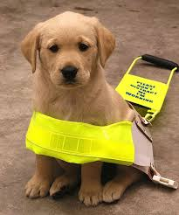
HSEEP Reminder
Homeland Security Exercise & Evaluation Program
Use the tools that work for you
https://www.preptoolkit.org/web/hseep-resources
Notes:
Use the tools that work for you and leave the rest.
Remember HSEEP is GUIDANCE.
Additional resources were sent to you prior to this call. Please use those to assist you in your exercise building.
Again, I’m including the new URL to the HSEEP PrepToolkit where you’ll find complete resources and templates for developing, conducting, and evaluating exercises.

Slide 5

Advance Steps
Location
Evaluator & observer preparation
Actor preparation
Signage
Equipment or handouts
Staff readiness
Notes:
Let’s start by looking at the steps that should be taken prior to the exercise.
In order to assure a focused event that can be evaluated and used for agency improvement, there are other steps that must be taken in advance. The exercise planning team must:
secure appropriate location with all essential equipment, (overhead projector, computer, white boards or easels with paper and markers for a Workshop or a Tabletop exercise). And for a functional, you might use a pre-equipped Emergency Operations Center
secure space for management of evaluators and observers, with appropriate communications equipment, orientation materials, identification, and debriefing planned
For a full scale, you’ll want to secure space for assembling any “actors,” with instructions and transportation to exercise site, if needed
prepare any special signage to direct individuals to assigned locations – for all types of exercises
arrange for equipment or handouts specific to the scenario and objectives (e.g., sample collection equipment for an exercise with contaminated water or food; mock medications for a mass dispensing exercise)
secure staff to support the exercise process, including any needed assistance for set up or communications (or to help copy handouts, sign in sheet, someone to take photos of the exercise, a facilitator, especially a safety director for full scale exercises to ensure no one gets hurt.)

Slide 6
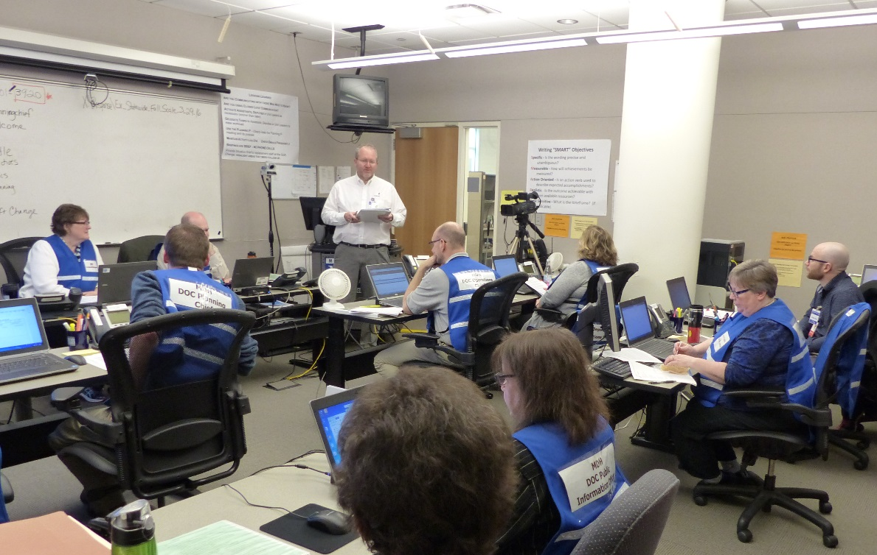
Facilitator/Controller
Planning is key
Initiating the exercise
Stimulate responses
Manage flow
Notes:
Advanced planning sets the stage for the smooth conduct of an exercise. Included in the resources I sent you is the MDH MSEL example. Since the exercise planning team has been using many of these exercise resource materials, it’s a great idea to have members of the exercise planning team to work as facilitator, controllers, and evaluators during the exercise. The facilitator/controller must assume responsibility for the conduct of the exercise. He/she must ensure that the exercise stays on track so that the agreed-upon objectives are tested.
To start with, a facilitator is most often used in discussion based exercises. A controller is used for operations based exercises.
The facilitator/controller’s job is to
Present the players with the exercise-initiating narrative.
Announce the first event of the scenario.
Stimulate player responses, without intervening in a way that assumes control of the play, unless it appears likely that the objective(s) of the exercise have been sidetracked.
Manage the flow and pace of the exercise by introducing the remaining events in sequence through the use of control messages (injects).
Have any of you had the opportunity to be facilitators of exercises? How about controllers? Can you share a bit of your experience with the rest of us?
Discussion based exercises and operations based exercises have some significant differences. Let’s quickly review the two so that we are clear on what is involved in each.

Slide 7

Discussion-based
Facilitator
Introductions
Ground rules
Moves/modules
Evaluation
Hotwash
Notes:
Conducting a Discussion-based Exercise
The participants/players and the facilitator(s) are introduced. The tabletop exercise process and flow are briefly described. Ground rules usually address the exercise objectives, the importance of participating, and issues participants should consider during play, such as time, roles, and assumptions. Special instructions may be provided, such as how participants will respond and if they will break up into discussion groups.
Episodes in the exercise scenario are described as modules. After each module is presented there is a facilitated discussion. The facilitator moves the participants through the scenario and participants respond with the decisions and actions they would take given the scenario. Many times the facilitator has a list of questions (prepared by the exercise planning team) to ask the players to help get the conversation going and to help keep players on track to achieve the exercise objectives. Each module takes the participants through the scenario chronologically. The tabletop exercise is concluded either when the time you allotted for the exercise is reached, or if you got through each of the questions you prepared to ask the players. The Facilitator will summarize the highlights of the exercise (any “AH HA!” moments) and will then lead the players through a hot wash.
Key Concept: Hotwashes are participant feedback sessions immediately following an exercise. They give players a chance to voice concerns and offer potential improvements while the experience is still fresh. It’s good practice to also provide the exercise players with a written participant feedback form to fill out. There may be something someone needs to say, but they are afraid to share it with the group. We have included a feedback form with the materials we sent prior to this.
The exercise evaluators may be called upon to either ask a question to clarify something they heard during the exercise, or comment on something they felt went especially well during the exercise.
The exercise planning team (controllers/evaluators) will hold a debriefing separate from the exercise players to begin developing the after action report and improvement plan. Key Concept: The debrief is a forum for planners, facilitators, controllers, and evaluators to review and provide feedback on the exercise.

Slide 8
Operations-based
Controller
  Demonstration
  Multiple briefings
  Safety is key
  Hotwash
Notes:
Conducting an Operations-based Exercise
These types of exercises allow actual demonstration of response capabilities and actions. The range and level of complexity depend on the objectives and scenario chosen to exercise.
The exercise begins with the briefings for the different participants who are either actors, players, or data collectors/observers. Briefing manuals are reviewed at this time (player manuals and controller/evaluator manuals will include the scenario, objectives, maps, communication and other information). Participants are given their assignment locations in a full scale.
Emphasis is on safety, including:
• where and when to report to the location
• how the exercise will be ended or terminated, if necessary
• whom to report to, and how to communicate with that person.
Materials and/or equipment are distributed as necessary including instructions on how and where to return them.
Instructions are given for when and where to report for the hot wash (debriefing), held immediately at the end of the exercise.
Participants report to their assigned location. Exercise play is begun and terminated according to the exercise plan.

Slide 9
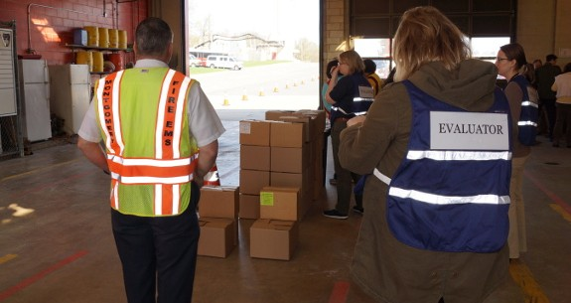
Exercise Control
Communication
Synchronization
SimCell
Tools
Notes:
The control structure for an operations-based exercise describes how controllers communicate and coordinate with one another and how they track exercise information.
These procedures should be detailed in the Controller/Evaluator handbook
During exercise play, controllers carry out these responsibilities and closely monitor exercise play to ensure a safe and effective exercise.
A successful exercise will include objectives and lead time. These create a quality product.
Exercise control synchronizes control staff structure, exercise scenario, delivery of injects, and player responses. It also ensures that players are staying in their own swim lanes and not getting too deep into unnecessary issues.
Here are some examples of what a controller does for MDH:
We had a controller tap a player on the shoulder and ask them NOT to call anyone who is not playing in the exercise to ask them questions about the scenario and resources they have. Too risky because that information can get misinterpreted and huge misunderstandings or alarm can ensue.
One player called the CDC to ask if this was the correct number to call to request the SNS. So controllers must be alert and watch exercise play and be ready to answer player questions.
If you are in the room where the exercise takes place, “Room Controller” or “Lead Controller”, you need to watch to make sure the injects get delivered --by phone, email, or you can hand them to the player written on a slip of paper.
The SimCell, which is defined as the entity that generates injects for, receives player responses for, and provides information in place of nonparticipating organizations that would likely participate if exercise events were real. Physically, the SimCell is a working location for a number of qualified professionals who portray these nonparticipating organizations.
An inject tracking system ensures injects are reaching their destination and players/controllers are appropriately “closing the loop”. We use our MSEL in the Sim Cell and the Sim Cell Controller sometimes plans ahead and copies and pastes the email injects to the players so they are ready to send with 1 click at the appropriate time.
Can use colors, * or a box to denote the inject goes to a certain group or organization.

Slide 10

SimCell
Who is in the SimCell?
Flow of information
Setup
Notes:
During functional/full-scale exercise play, Simcell control is particularly important.
FEs require a robust and detailed Master Scenario Events List and close communication between the site controllers and the SimCell.
Controllers should advise the SimCell on the pace of exercise play, and request more or fewer injects as necessary to maintain an appropriate pace. So, as you can see, it is wise to develop a large number of injects to be sure all players are adequately challenged.
We started using our ARMER radios during our DOC functional exercises. The room controller messages the Sim Cell controller on the pace of the exercise and asks if specific injects were given. Gives us good practice with the radios too.
Over the next few slides, we’ll talk about the following aspects of the SimCell setup, which is an integral part of the overall exercise experience.
Who is in the SimCell?
Flow of information to and from the SimCell
Physical setup options for the SimCell

Slide 11
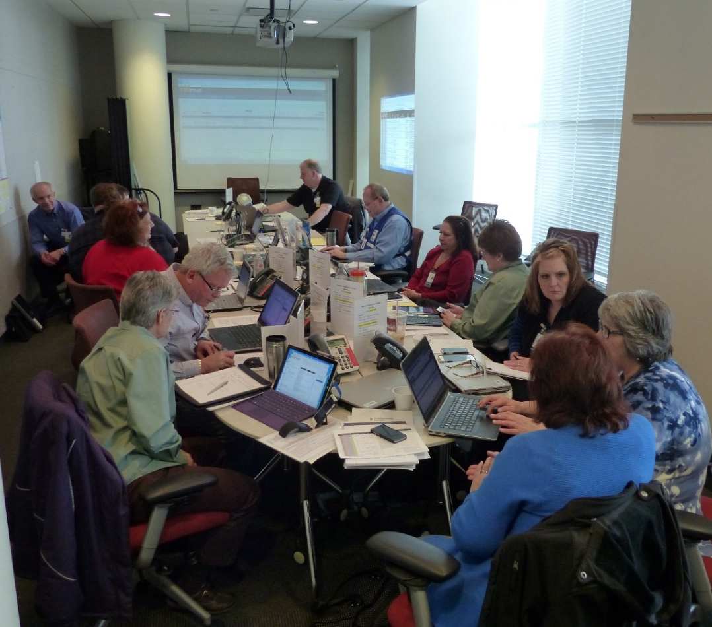
Who is in the SimCell?
Controllers and Simulators
  Senior/Lead controller
  Controllers
  Simulators
  Whole community representation
  Knowledgeable
Notes:
So, who should be in the SimCell? The person (or persons) in the Sim Cell should know the agency responsibilities very well. They should know what the role is of the public health agency. They should know what assets and resources the agency has and uses in a response. They should know their response partners’ roles, responsibilities and resources. Because the person in the Sim Cell might have to “play or “pretend” to be someone within the agency/city/county/tribal community or an external partner to help the exercise play. At MDH, for our internal functional exercises, we use the Sim Cell to play any other role/agency that is not playing.
Controllers and simulators
Controllers and simulators deliver planned messages and create new messages to prompt player actions. Ultimately, the Sim Cell can play any role that is not actually playing in the exercise. and include everything the players are not:
All personnel and equipment
Agencies, departments, individuals not physically in the player areas
Private companies and resources needed for the emergency
All citizens of the community
In the March 2016 Full Scale exercise that you all played in. MDH had a SimCell to support play at the state level. We included external partners in our Sim Cell to be subject matter experts so that we could play as realistically as possible. We have representatives from the Dept of Human Services, MN Homeland Security and Emergency Management, EMS Regulatory Board, MDH Health Facilities Regulation staff and EPR staff, along with our contracted exercise design team.

Slide 12
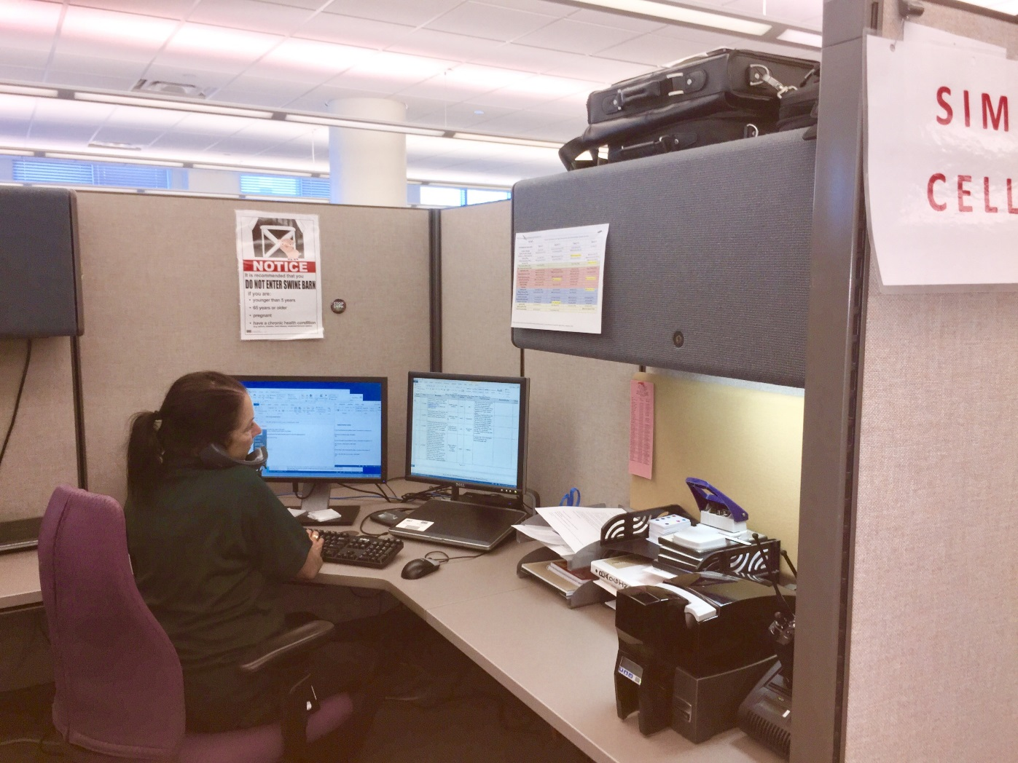

Who is in the SimCell?
Notes:
Ultimately though, 1 person can play multiple roles. The MDH SimCell Controller will often “play the part” of someone from HSEM asking MDH for a situation report, or will play a PHPC or RHPC making a request for something to our Local Public Health Group Supervisor or our Health Care Surge Group Supervisor. Sometimes they will play the part of the Commissioner of Health asking to see our Incident Action Plan or asking our Incident Manager to come to his office.

Slide 13
Lead Controller
Delivery person
Organizer
Monitor
Logistics
Notes:
Lead Controller
All controllers should be accountable to one Senior/Lead Controller
Primary responsibility is to manage the delivery of the information of the scenario to the players
Is responsible for the overall organization of the exercise
Monitors actions by controllers and exercise progress
Coordinates decisions regarding deviations or significant changes to the scenario caused by unexpected developments during play or if a player gets out of their swim lane.
Debriefs controllers and evaluators after the exercise (while it’s still fresh)
Oversees the setup and takedown of the exercise

Slide 14

Controllers
Manage play
Key data providers
Deliver injects
Quick thinking
Notes:
2. Controllers
Plan and manage exercise play
Set up and operate the exercise incident site
Take the roles of individuals and agencies not actually participating in the exercise, if necessary (Sim Cell or hand out an inject from an “external” entity)
Have the authority to modify or control the exercise per direction from the Lead Controller
Communicate identified issues to the Lead Controller in regard to pace, key events, player activities, etc.
Monitor the pace of exercise play
Prompt or initiate certain player actions and injects to the players as described in the MSEL to ensure exercise continuity, if necessary
Provide exercise materials to players as required
Monitor the exercise timeline
Supervise the safety of all exercise participants
Must be able to view the exercise as a whole and to think quickly on their feet
Are the only participants who should provide direction or information to the players
Are the only participants the players should reach out to if they have questions about the exercise conduct expectations or mechanics
Does the controller need to be in the SimCell? Absolutely not!

Slide 15
Simulators
Role players
Provide injects
Respond to player feedback
Follow MSEL
Notes:
3. Simulators
Simulators are control staff personnel who role play as nonparticipating organizations or individuals
Most often operate out of the SimCell but they may occasionally have face-to-face contact with players (i.e. media briefing or Senior Official)
Function semi-independently under the supervision of the Lead Simulator, enacting roles in accordance with instructions provided in the MSEL
Accountable to the Exercise Director and Lead Controller
Administer the exercise scenario (deliver the disaster)
Inject messages that represent events, resource requests, critical information, etc.
Respond to players’ feedback on decisions made and actions taken – can be tracked on a board so all can see what happened
May be required to think on the fly, develop new information, and ad lib messages as needed. But, they need to keep it as realistic as possible. Therefore, the SimCell must stay in communication with the Lead Controller, and must immediately inform controllers of any actual or potential deviations from the planned scenario or MSEL
Use the MSEL to know when an inject/communication should be sent to the players, but not deliver messages or injects until directed by the Lead Simulator
Should be familiar with the organizations they are simulating

Slide 16

Whole Community
Government
Media
Citizens
Notes:
Whole Community Representation
Everyone that might be involved in these situations could be represented/simulated in the SimCell:
Government
Media/Public Information
Emergency Management
Law Enforcement
Fire Service
Health and Medical
Public Works/Utilities
Community/Human Services
Concerned Citizens and Others

Slide 17

Flow of Information
Two-way flow
Rules for contacting
Directory in the EXPlan
Notes:
Players must contact the SimCell to:
Deploy any and all equipment
Order supplies or materials
Request mutual aid
Disseminate information to field personnel
Find out what is going on in the field
Get a description of the incident
Bottom line: If a needed resource is not physically participating in the exercise, players must contact the SimCell to acquire it
Before the exercise, be sure to develop a directory that contains:
Telephone numbers and email addresses
Radio frequencies
Communications procedures

Slide 18
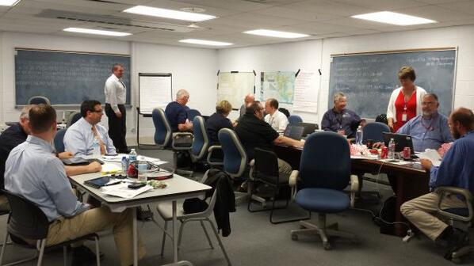
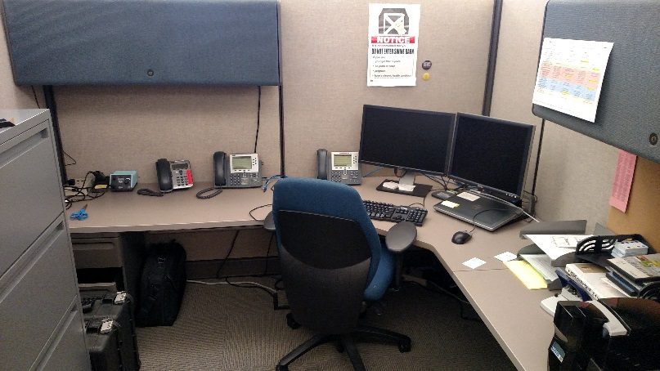
SimCell Setup
Size
Communication
Notes:
The SimCell setup should be large enough to hold all participants and allow simulators to contact players in the way they would typically receive and send information.
Ensure all means of communications are working properly, including:
Telephones
Radios
Computers
Email
Texting
Social Media sites
Has anyone participated in a simcell before? Can you share a little about the experience?

Slide 19
Reminder
“This is a drill” or “This is an exercise”
Notes:
Clearly identify all communication as exercise related!
Any time the players interact, they need to be clear.
As an example, we’ll pretend I’m in the SimCell and I’m calling the logistics chief in the DOC. I would say “Hello, this is an exercise. I am calling from St. Paul Public Health. We are in need of 5 behavioral health staff to assist at our disaster recovery center. Can you help make arrangements for that? This is an exercise.”

Slide 20
Other Participants
The following individuals may be involved in drills or exercises:
Evaluators
Players
Actors
Notes:
Let’s talk about the additional

Slide 21
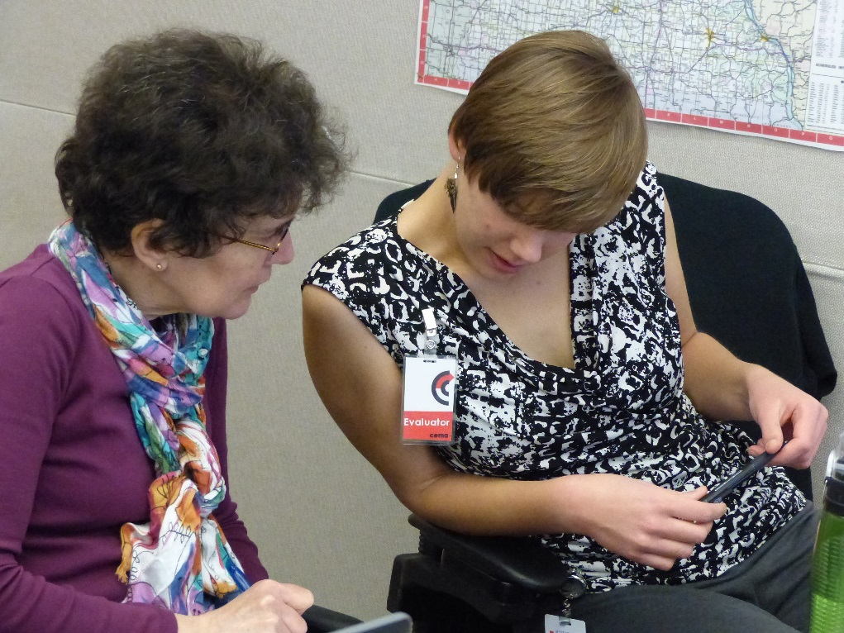
Evaluators
Actions:
Before…
During…
After…
Notes:
Player performance must be observed and analyzed against plans, policies, procedures, and practices, using criteria established before the exercise. Evaluators document player performance by using Exercise Evaluation Guides (EEGs) and information obtained during the Hotwash. The evaluations, documentation, Hot Wash, and debriefing discussions provide important information that substantiates exercise conduct and performance. The AAR/IP will summarize the overall results of the exercise and provide a comprehensive assessment of capabilities and plans that were demonstrated.
How do we know they are evaluators? They should be wearing vests that indicate their position.
Let’s take a look at the actions they should be taking before, during and after the exercise.

Slide 22
Evaluators should
Before
Know the exercise objectives
Review plans
Attend training
Review and understand the Exercise Evaluation Guides (EEGs)
Notes:
Before the Exercise
Know and understand the exercise objectives.
Review appropriate plans, procedures, and protocols.
Attend required evaluator training and other briefings.
Review appropriate exercise materials, including the exercise schedule and evaluator instructions.
Review the EEGs and other supporting materials for your area of responsibility.
Report to the exercise check-in location at the time designated in the exercise schedule, and meet with the exercise staff.
Be at the appropriate location at least 15 minutes before the exercise starts. If you are not assigned to a specific site, be in place to deploy as necessary at least 15 minutes before the exercise starts.
Obtain or locate necessary communications equipment, and test it to ensure that you can communicate with other evaluators and the Exercise Director.

Slide 23
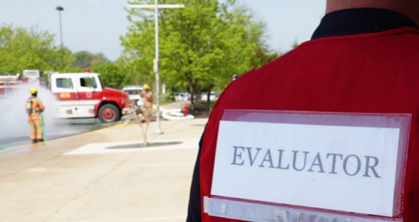
Evaluators should
During
Identification
No prompting
Document
Notes:
During the Exercise
EEGs should be used.
Wear evaluator identification items (e.g., badges). Evaluator badges [and any additional identification items] will be issued at the Controller and Evaluator Briefing on [Date].
Avoid personal conversations with exercise players but certainly clarify actions or information if necessary.
Do not prompt players with specific responses or interfere with player performance in any way.
Your primary duty is to document player discussions, decisions, and actions. After the exercise, that information will be used to determine whether the exercised capabilities and plans were effectively implemented or demonstrated and to identify strengths and improvement items.
Let’s look at a sample EEG

Slide 24
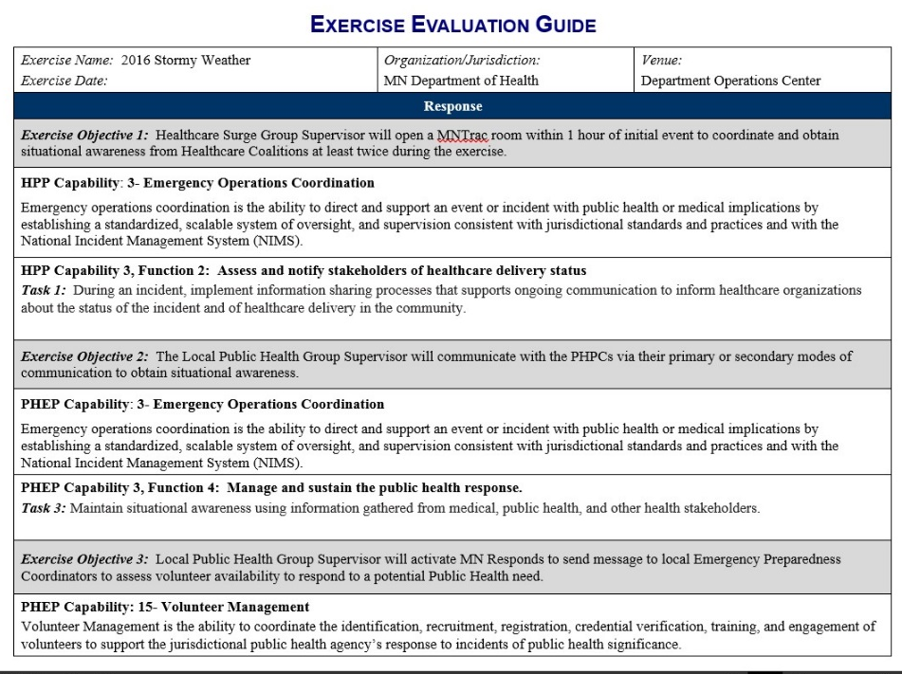
EEG
Notes:
The first page of this sample EEG indicates the exercise that is being evaluated, the objectives of the exercise and the capabilities that are being assessed.
You can see here that Capability 3, functions 2 and 4 are part of this exercise, along with Capability 15

Slide 25
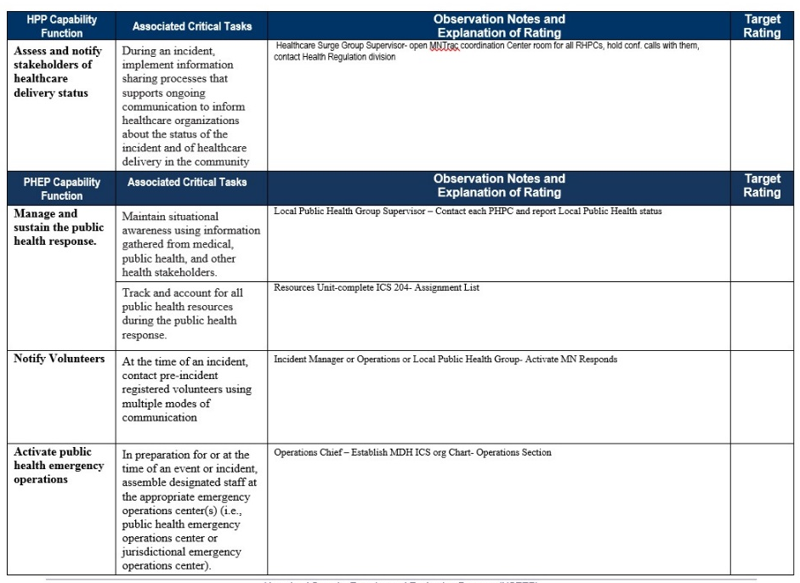
EEG
Notes:
In the second section of this sample EEG, the critical tasks for each function are described and a column for the evaluator to take notes is available. Here at MDH, for our internal exercises, we modified the EEG and we will add in the Evaluator’s notes area who they should be watching or what the expected action of the player should be. The column on the far right side is for the actual rating. We will discuss what should go here on the next slide.
A completed EEG should have notes regarding any function that was expected on that evaluators watch.

Slide 26
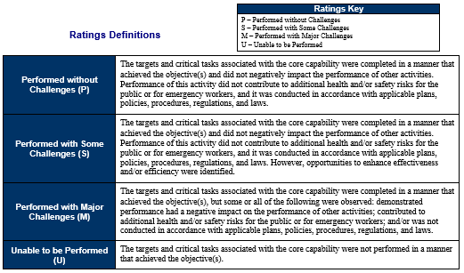
EEG
Notes:
The final section of the EEG is a definition of the rating system to be used. These ratings will be listed in the far right column of chart on the previous screen.

Slide 27
Evaluators should
After
Hotwash
Debrief
Summary
Notes:
After the Exercise
Participate in the Hot Wash, and take notes on findings identified by players. Before the Hot Wash, do not discuss specific issues or problems with participants. After the Hot Wash, summarize your notes (finish them up) and prepare for the Controller and Evaluator Debriefing. Have your summary ready for the Lead Evaluator.

Slide 28

Players
Expected actions
  Follow plan and procedures
Roles
  Subject matter expert
  Incident command role, or other?
Notes:
Players are expected to be following their plans and procedures to address the issues that are coming up during play.
In a tabletop exercise, players should bring their plans to refer to them. Helps their memory on their responsibilities, also can help identify what gaps are in the plan.
Questions regarding procedures and plans should be asked at this point if they have not been addressed during the previous stages building up to the functional or full-scale exercise.

Slide 29
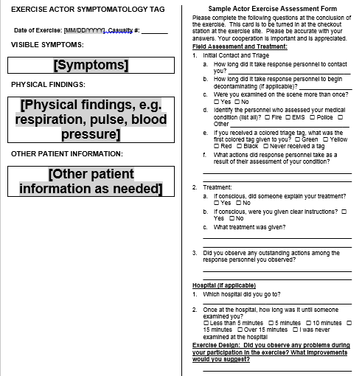
Actors – Symptomology Card
Notes:
Actors are often used in full-scale exercises. They pretend to be patients or other affected individuals.
This symptomology card can be used for an actor being attended to.
The left half of the symptomatology card is to be given to the actors before exercise play. The right half of the card can be used for a variety purposes, including:
Collecting assessment data from actors;
Soliciting general feedback from actors;
Providing administrative information (e.g., important phone numbers); and
Providing safety information.

Slide 30
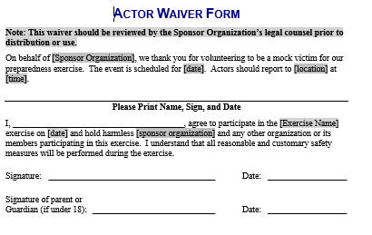
Actor Waiver Form
Notes:
Be sure to address the liability issues prior to the exercise as well. This tool is provided at the HSEEP website and should be used to keep your volunteers informed. Actors can play a major role in making exercises seem realistic.
Each of the roles we’ve listed has a significant role during exercise play and each is responsible for multiple functions. Before the exercise can be seen as complete, each must perform those functions.
So, how does an exercise end?

Slide 31

Terminate
Real-world emergency
Objectives met
Scheduled end
Notes:
An exercise must have a scheduled end time. That time, however, can change as things come about.
Exercise can be terminated by the exercise director in the event of a real world emergency.
If all objectives are met sooner than the expected completion time, the exercise can be terminated.
The scheduled end time can also be the time at which the exercise is terminated. The controllers should be following their MESL and guiding players to move toward accomplishing the objectives as is indicated but sometimes that just doesn’t happen.
Each of these pieces leads to improvement plans that can be discussed at later times.

Slide 32

Hotwash
20-30 minutes
Remain neutral
Five basic questions
Notes:
The exercise hotwash is a 20-30 minute discussion after the exercise to evaluate the policies, plans, and procedures in the exercise response.
For the MDH functional exercises, we basically ask:
What went well?
What didn’t go well?
What improvements can we make?
Try to keep the discussions focused on one topic at a time.
Help to keep one person from monopolizing the discussion, allowing everyone to express their concern.
Remain neutral and try not to add your perspective into the discussion.
Repeat back to them the key points to summarize the discussion.
For tabletop exercises we use the HSEEP Participant Evaluation Form– we often modify it.– it’s pretty lengthy.

Slide 33
Hotwash – 5 Questions
What went well during this exercise?
What were the key strengths you observed?
What could have worked better or what were the areas that could be improved?
What can we do to ensure it goes better next time?
What tools or training do you need that could have helped you?
Notes:
Questions to ask:
What went well during this cycle/exercise/event?
OR
2. What were the key strengths you observed?
3. What could have worked better?
4. What were the areas that could be improved?
Follow-up: What can we do to ensure it goes better the next time?
5. What tools or training do you need that could have helped you?

Slide 34
Summary
Today we discussed:
Steps required prior to the exercise
Roles of the facilitator and controller
Exercise control and the role of the SimCell
Roles of other exercise participants

Slide 35

Upcoming Webinar
October 19 & 20: Evaluating the Exercise and Creating an AAR/IP
Notes:
We’ve discussed
The next webinar, titled Evaluating the Exercise and Creating an AAR/IP will be held in 2 weeks.
Thank you.

Slide 36
Contact Information
Chad Ostlund
651-201-5660
chad.ostlund@state.mn.us
Notes:
There are many samples that can be adapted to work within your community. Let’s talk about those and let’s share ideas about how you’ve all been involved in exercises in the past.

Slide 37

Questions

