Slide 1
Healthcare Facility Sheltering, Relocation, and Evacuation

Slide 2
Healthcare Facility Sheltering, Relocation and Evacuation
Developed because a need as seen in recent events.
Team Effort!!

Slide 3
The Team
John Hick MD - HCMC/MDH
Don Sheldrew - MDH
Janice Jones - MDH
Carol Sele - NW RHPC
Eric Weller – SC RHPC
Chris Chell – Metro RHPC
Julie Johnson – SW RHPC
Cheryl Stephens – NE RHPC
Chuck Hartsfield – Central / WC RHPC
Katherine Grimm – Healtheast Care System
Donna Blomquist – Metro RHPC
Mark Lappe – Metro RHPC
Angie Koch – SE RHPC / MDH
Pam Schultz – Children's Hospitals and Clinics of MN

Slide 4
Background – Stuff Happens
Recent Events
2009 – Red River Floods
Meritcare Hospital Evacuation
Eventide Nursing Home and Assisted Living
2010 – New Richland Nursing Home Evacuation
Other less well known possibilities that almost happened

Slide 5
Issues
Inconsistent and confusing terminology
Differences between hospital and long-term care settings
Lack of standardized decision-making regarding evacuation
Lack of standardized processes and tagging/tracking of patients
Inconsistency regarding the types and quantity of information sent with the patients
Product for both Hospitals and LTC facilities

Slide 6
Decision making
How
When
Triggers
Who to call
When to call
Roles and responsibilities

Slide 7
Decision making continued
Who has authority
Command decisions
Unit based decisions
Command responsibility

Slide 8
Terms / Definitions
Urgent / emergent
Shelter in Place / Evacuation
Relocation?? – where’s that fit?
Full or partial evacuations

Slide 9
Triggers
Types of incidents
Threat to patients / residents
Time / duration / proximity…

Slide 10
Patient Triage
Who’s going?
Who’s going when?
Who’s going where?
Room clear
Is standard triage assumed or should there be alternatives?

Slide 11
Patient / Resident Tracking
Floor / unit to triage or other unit
Transport
Facility to facility
Multiple facilities

Slide 12
What to send
Documentation – how much
Medical necessities – meds / durable medical supplies
Personal Items?
Lots of Questions regarding the previous slides!

Slide 13
Process
Reviewed existing plans – Central region template already in use and contained key structural elements
Defined new terms
Refined and re-wrote plan sections
Introduced decision algorithm
Developed job aids and tag recommendations

Slide 14
Process Continued
Introduced to RHPC’s and others for comment and feedback
Developed training materials
Ongoing process – review and modification as needed
Availability – how and when

Slide 15
Plan Specifics
Template – not proscriptive – must be adapted to institutional needs however facilities should not change definitions or base organization in order to maintain consistency.

Slide 16
Terminology – Shelter in Place
Shelter in place - Shelter In Place assures the maximal safety of individuals in their present location when the dangers of movement exceed the relative risk from the threat or movement cannot be safely completed in a reasonable timeframe .

Slide 17
Terminology - Relocation
Relocation - movement of patients to an area of relative safety in response to a given threat or movement to staging areas within the institution in preparation for evacuation.
Horizontal - movement to a safe location on the same floor, preferably nearer to an emergency exit.
Vertical - movement of individuals to a safe location on a different floor when a horizontal evacuation cannot meet the service or safety needs of the patients or is unsafe

Slide 18
Terminology - Evacuation
Evacuation - movement of patients out of the affected facility when the facility cannot maintain a safe environment of care. Evacuations may be emergent (fire or other immediate life safety threat) or non-emergent (delayed life-safety threat or anticipated evacuation)

Slide 19
Evacuation – Complete or Partial
Complete evacuation – complete evacuation of a facility due to an unsafe environment of care – usually will involve facility shutdown actions
Partial evacuation – Evacuation of a subset of facility patients – this may involve patients requiring specialized care that can no longer be safety delivered at the affected facility (intensive care, dialysis)

Slide 20
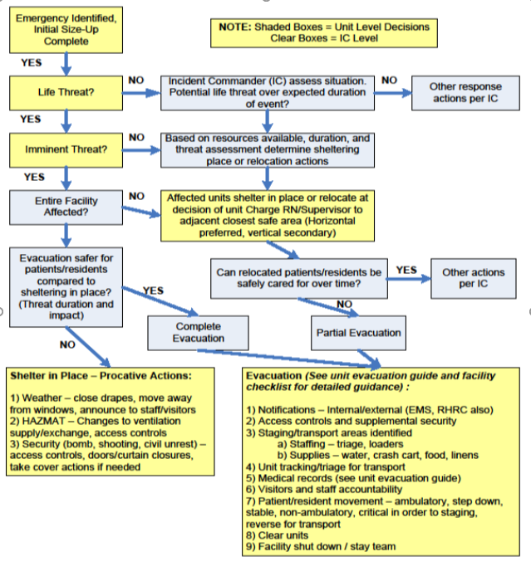
Sheltering, Relocation, and Evacuation Decision Tree
Note: decisions can be unit level or Incident command level.
Decision tree starts with Emergency identified Initial Size-UP. Unit level
After size up determine if it is a life threat. Unit level.
Yes it is a life threat, is it an imminent threat? Unit level
Yes it is an immanent threat? Is the entire facility affected? Incident command
Yes the entire facility is affected? Is Evacuation safer for Patients/residents compared to sheltering in place? (Thread duration and impact) incident command
Yes evacuation is safer? Complete Evacuation (see below) unit level
No? Shelter in place – (see below)
No It is not an immanent threat. based on resources available, duration, and threat assessment determine sheltering place or relocation actions.
Affected units shelter in place or relocate at the decision of unit charge RN/supervisor to adjacent closest safe are (horizontal preferred, vertical secondary). Can relocated patients/residents be safely cared for over time? If yes, incident commander will make decisions. If no, do a partial evacuation (see below).
No it is not a life threat. Incident commander assess the situation. Is there a potential thread over the expected duration of the event?
No, incident command will evaluate what action to take
Yes it is a life threat– based on resources available, duration, and threat assessment determine sheltering place or relocation actions.
Affected units shelter in place or relocate at the decision of unit charge RN/supervisor to adjacent closest safe are (horizontal preferred, vertical secondary) Can relocated patients/residents be safely cared for over time? If yes, incident commander will make decisions. If no, do a partial evacuation (see below).
Shelter in place: Proactive Actions. 1. Weather – close drapes, move away from windows, announce to staff/visitors. 2. HAZMAT – Changes to ventilation supply/exchange, access controls. 3. Security (bomb, shooting, civil unrest) – access controls, doors/curtains closures, take cover actions if needed. Unit level
Full or partial Evacuation (see unit evacuation guide and facility checklist for detailed guidance):
Notifications – internal/external (EMS, RHRC also)
Access controls and supplemental security
Staging/transport areas identified
Staffing – triage, loaders
Supplies – water, crash cart, food, linens
Unit tracking/triage for transport
Medical records (see unit evacuation guide)
Visitors and staff accountability
Patient/resident movement – ambulatory, step down, stable, non-ambulatory, critical in order to staging, reverse for transport
Clear units
Facility shut down/stay team

Slide 21
Command / Coordination / Communication
Incident Command vs. unit-level decisions
Coordination with RHPC and outside agencies
Communication – internal and external

Slide 22
Triage – Traditional or Reverse
Triage Level | Priority for Evacuation off nursing unit – REVERSED START PRIORITY | Priority for Transfer to another healthcare facility – TRADITIONAL START PRIORITY
RED- STOP | These patients require maximum assistance to move. In an evacuation, these patients move LAST from the inpatient unit. These patients may require 2-3 staff members to transport. | These patients require maximum support to sustain life in an evacuation. These patients move FIRST as transfers from your facility to another healthcare facility.
YELLOW – CAUTION | These patients require some assistance and should be moved SECOND in priority from the inpatient unit. Patients may require wheelchairs or stretchers and 1-2 staff members to transport. | These patients will be moved SECOND in priority as transfers from your facility to another facility.
GREEN - GO | These patients require minimal assistance and can be moved FIRST from the unit. Patients are ambulatory and 1 staff member can safely lead sever patients who fall into this category into the staging area. | These patients will be moved LAST as transfers from your facility to another healthcare facility.
Adapted from Continuum Health Partners – Evacuation Planning for Hospitals (2006)
Notes:
Graphic representation of ‘reverse triage’ for movement off the unit, then ‘usual triage’ once in staging. Note green patients may be moved by bus or other asset and not ambulance.

Slide 23
Job Aids
Included are additional Job Aids used as a compliment to HICS Job Action Sheets
Inpatient, outpatient, support and administration
Pre – event assessment tools
Facility shutdown / stay team considerations

Slide 24
Templates
Unit Templates – Considerations for various types of units such as medical gases, specialized equipment, preferred /secondary relocation area
Transportation needs / resources
Block diagram for relocation movement

Slide 25
Training Matrix
Included
Suggested Training
Awareness/All (floor / unit staff)
Knowledge/Operations (Unit Supervisor / Charge Nurse)
Proficiency/Command (Command and General Staff

Slide 26
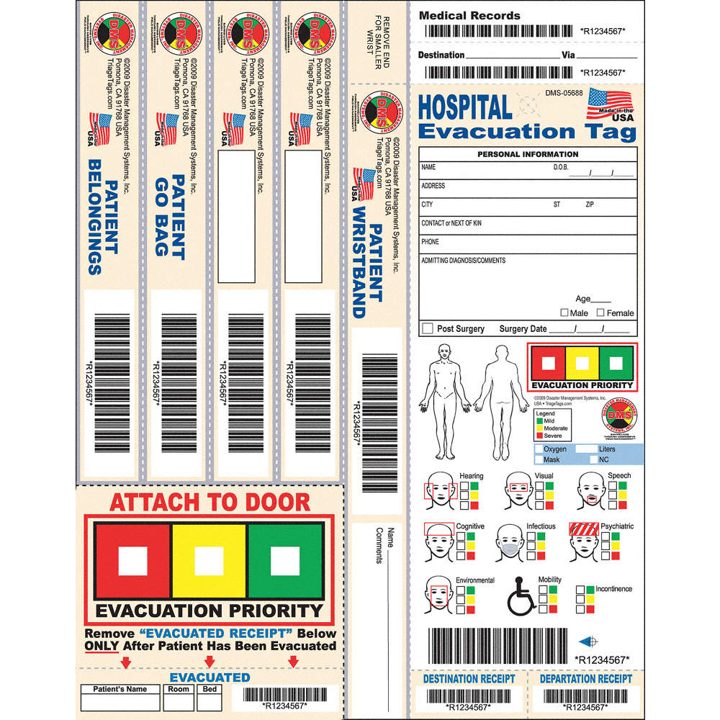
Disaster Tags - DMS
Notes:
The DMS hospital evacuation tag contains a number of tear-off bands to be used for durable equipment (walkers, etc) and belongings bags. The triage priority can be indicated and a sticker peeled off to put on the patient’s door. A variety of impairments can be noted that must be considered by transporting/receiving staff including dementia, etc. The same tag may be used by extended care. This is not a required tag, but the workgroup recommends this tag based on review of available products and ability to address areas of concern in prior evacuation events.

Slide 27
Summary
Overview
Hospital / LTC
Reasons why
Issues found
Process
Terminology
Modifiable
Decision points / makers / authority
Tools and templates

Slide 28
Thank you.

