Slide 1
Should I stay or should I go now?
Healthcare Facility Sheltering, Relocation, and Evacuation

Slide 2

If I go there will be trouble…
Notes:
Music

Slide 3

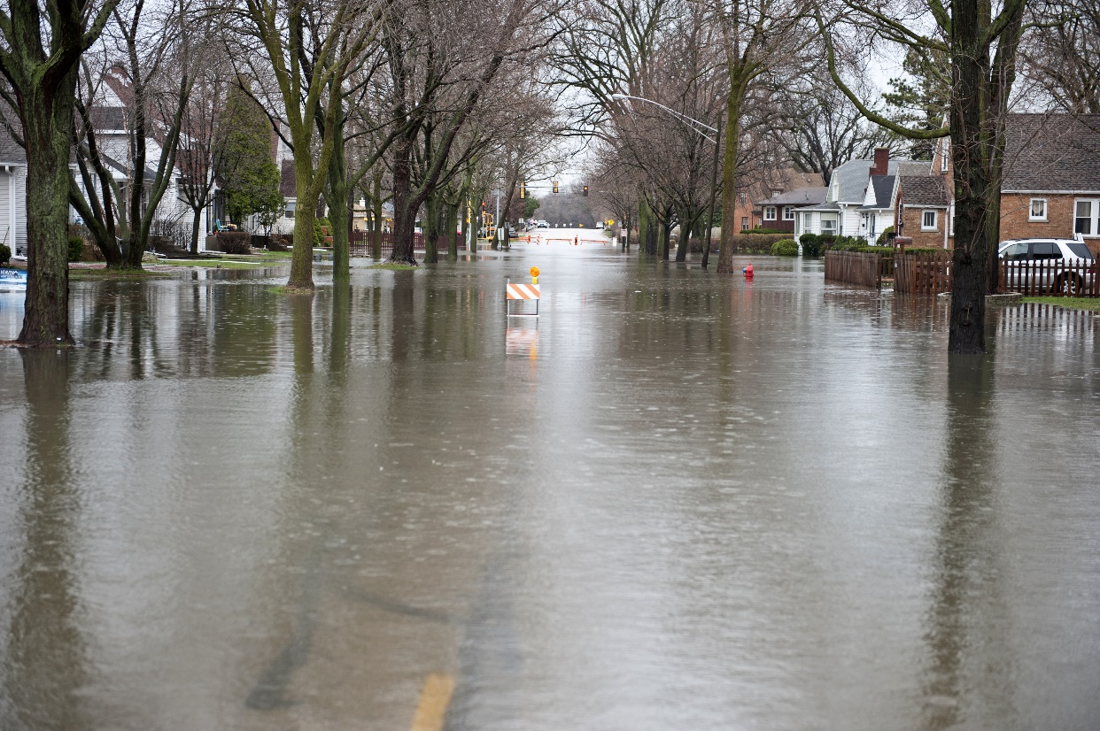
If I Stay it will be double…
Notes:
Music

Slide 4
Overview
Incidents that may require sheltering, relocation, or evacuation
Definitions
Unit-based actions
  Sheltering and relocation
Command issues and actions
  Considerations and decision-making
  Staging and transportation
Patient documentation and movement
Transportation and Tracking

Slide 5
Potential Triggers
Fire
Flooding
Severe Weather
Chemical leak
Utilities systems failure
Notes:
These are the most common factors nationally that prompt protective actions, but by no means the only ones. Institution / regionally appropriate threats should be added and emphasized according to the hazard vulnerability analysis.

Slide 6
Evacuation by the numbers
1971-1999 – 275 self-reported hospital evacuations
Peak 33/year (Northridge), Average 21 in 1990s
Causes:
  Internal fire- 23%
  HAZMAT internal – 18%
  Hurricane – 14%
  Human threat – 13%
  Earthquake – 9%
  External fire – 6%
  Flood – 6%
  Utility Failure – 5%
More than 50% of hospital evacuations occurred due to INTERNAL incidents
Notes:
Emphasize that the majority of evacuations were due to internal incidents. MN is fortunate in that large-scale evacuations such as those that would be required following a catastrophic earthquake or hurricane are unlikely. But facilities may be damaged, threatened, or isolated by many types of incidents.

Slide 7


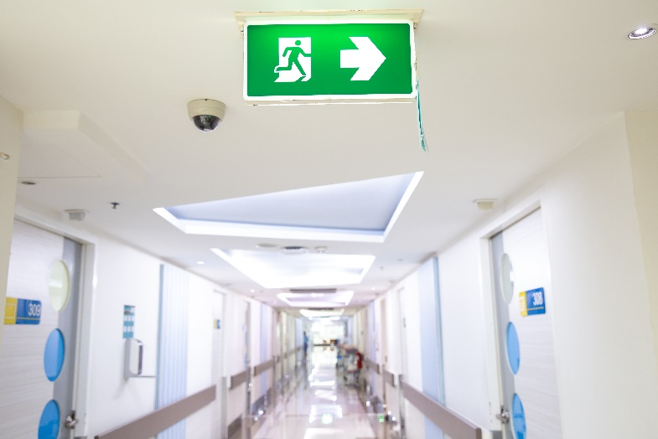
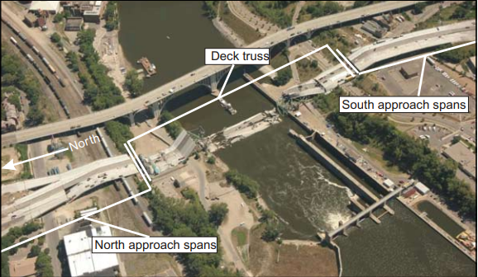
Recent experiences…
Notes:
Upper L – Winona county floods Aug.14, 2007. Upper R – sandbagging, Red River floods 2008. Lower L – evacuation of Meritcare Fargo – threatened by Red River floods 2008. Lower R: Aug. 1, 2007 - Note that the 35W bridge incident did not result in compromise of hospitals, but had this occurred in another area of the state, loss of infrastructure around the hospital could cause operations to be affected.

Slide 8
Definitions
Shelter in place – patients sheltered on the same unit within a facility (though minimal movement may be necessary to move them away from a specific hazard)
Relocation – patients are moved to other units within the same facility (i.e. on that facility campus) - horizontal (preferred) or vertical within the facility.
Evacuation – patients are moved to another healthcare facility for continued care due to unsafe conditions
  Subset of patients – partial evacuation (e.g. dialysis patients moved due to unsafe water following flooding)
  All patients – complete evacuation.
Notes:
Note that ‘evacuation’ is reserved for movement outside of the current campus/facility and the term ‘re-location’ used for movements within the physical space of the facility. Emphasize that these are also actions that may be taken in ANY facility. Shelter in place is easiest, but may offer limited protection, relocation may be problematic if the same level of care is not available on the unit the patients relocate to. Evacuation may pose significant dangers to patients both due to decompensation and due to the risk of travel (time and physical stressors)

Slide 9
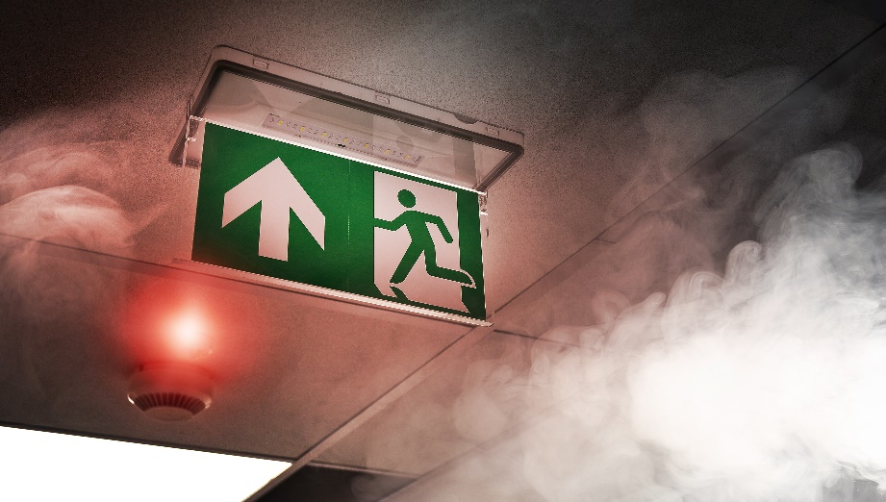
Types of actions
No-notice or emergency evacuation – for example, a fire within the facility may require immediate evacuation depending on the scope
Urgent evacuation – evacuation that must occur within a matter of hours – for example, in anticipation of flooding or in response to another evolving hazard
Notes:
Picture is of a hospital laundry fire in New Zealand – fortunately no injuries

Slide 10
Factors influencing actions
Proximity - Time to event
Duration of event
Gravity - Impact of event – potential life-threat
Impact of actions taken
  Evacuation of outpatient clinic area
  Evacuation of ICU
    Evacuation via elevators
    Evacuation via stairwells
Notes:
None of these factors is all-controlling – these have to be considered in balance – time to organize resources vs. duration vs. impact vs. risk of actions taken – very high risk if you have to evacuate ICU patients down stairwells – thus would be a last resort – the threat to unstable patients posed by an evacuation, or even relocation, may be very high. Evacuation of an outpatient area though would generally be quite easy and low risk.

Slide 11
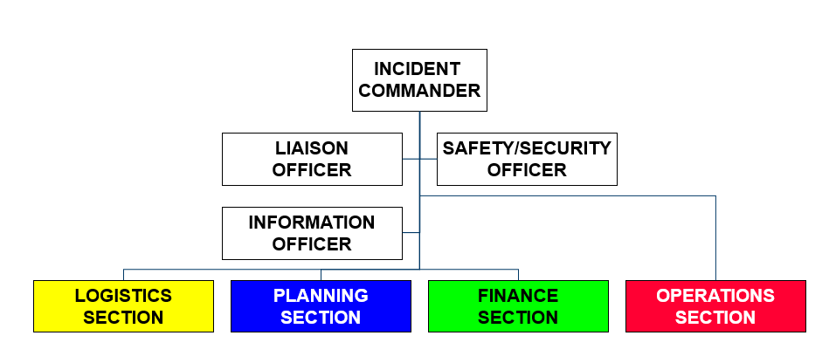
ICS Framework
Chart starts with Incident commander. Reporting to the commander is the Liaison officer, safety/security officer, information officer, logistics section, planning section, finance section, and operations section.
Notes:
Picture flowchart made by MDH
The core of any hospital emergency response is utilization of ICS – the incident command system. Many hospitals use HICS – the hospital incident command system. Assuring that an IC is appointed early, understanding the decision-making authorities and process, and utilizing the ICS framework both within the hospital and in joint operations with community and regional resources is critical to decision-making, resource requests, and communications.

Slide 12
Unit-based actions
Shelter
  Weather
  Security
  Chemical
Re-locate
  Risk of movement vs. threat
  Pre-identified primary and secondary locations
    Horizontal strongly preferred
Patient movement
  Move those at greatest risk from the threat first
  Do not take belongings, records, etc. in emergency
Notes:
It is critical that the unit staff understand the actions that they will take in response to a given threat (e.g. security – close fire doors, close patient doors, stay out of hallways, etc.) and where their designated relocation areas are. Horizontal movement is much faster and less risky than vertical, especially in situations when elevators cannot be used. In urgent situations, gathering records and belongings is critical to assuring ongoing safe medical care. The graver and more immediate the risk however, the less time that should be spent on these activities.

Slide 13
Unit-based actions Continued
Unit leader (charge RN) has authority to initiate shelter and relocation actions (as would any staff recognizing an unsafe situation)
Unit leader should activate incident command system / notifications appropriate to the event
Each unit should have a clearly identified pack with vest, ‘room clear’ labels, tracking tags, and other supplies
Following any unit-based actions and based on the event, the unit leader may begin triaging and preparing patients for movement to a staging area for evacuation awaiting instructions from incident command
Notes:
Even though ICS must be used, certain decisions must be made at the unit level. A threat recognized by unit staff that requires immediate action to shelter or relocate is ALWAYS within the scope of authority of the unit staff. These actions should prompt activation of the facility emergency operations plan as well, and consideration of further actions to be taken. Institutional-specific supplies and procedures should be highlighted here. The use of pictures is encouraged – unit staff will need to have hands-on practice with these materials and processes on a regular basis. If the unit leaders anticipate that evacuation is possible/likely, they may begin triaging patients for transport to the staging area and begin organizing staff and resources on the unit for patient movement.

Slide 14
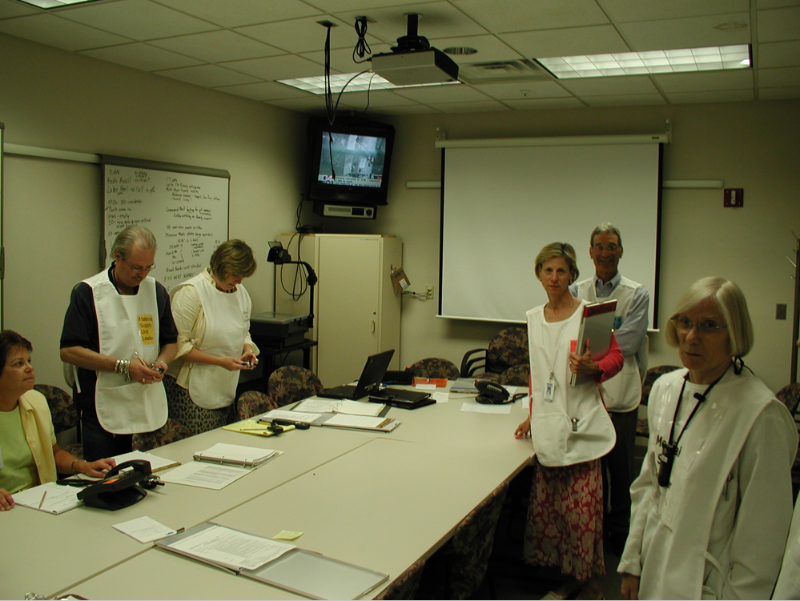
Medical Supply image
Notes:
Photo taken by Nancy Carlson

Slide 15
Command Decisions
Situational awareness
  Impact, timeline (onset and duration), facility resources
  May require ongoing analysis (flood)
  May be impacted by outside factors (potable water, ability to deliver supplies)
Action analysis
  Potential for safe relocation (floor patients vs. ICU)
  Timeline to evacuate – transport resources and transport time
  Community resources to aid with evacuation (adequate available now? Adequate available if evacuation required later in event?)
  Partial or complete evacuation?
Notes:
Command staff needs to rapidly obtain situational awareness in order to make decisions. These situations may be extremely dynamic, and though one strategy may be chosen at one time, planning for further actions is highly recommended. Additionally, the ‘right’ action to be taken may vary by unit due to either the impact of the event or the type of patients on the unit that would be affected. Command should always consider the effects of the event on other facilities in the area and on outside resources (especially supply and EMS transportation) that may drastically affect evacuation time, transport time to other facilities, etc.

Slide 16
Evacuation
When relocation is not sustainable or possible
When the risk to the patients of movement is less than staying in the facility
When the safety of the facility or its supporting utilities cannot be assured
Partial
  Patients in a subset of the facility are evacuated
    Portion of affected building(s)
    Evacuation of a subset of patients
        Intensive care
        All BUT intensive care (least stable)
Notes:
Good news is that most ‘no-notice’ evacuations do not affect entire facilities – this can happen, but urgent full evacuation is much more common than no-notice.

Slide 17
Decision-making
May need to consider input from:
  External technical experts (weather, toxicology, hydrology)
  Internal command structure / experts (facilities, medical director, safety/security)
  Community emergency management (public works, law enforcement, fire department)
  Emergency Medical Services
Notes:
This information can rapidly change. Assure that you have access to technical experts in advance of an incident whenever possible (structural engineers, facilities/HVAC experts, hazmat expertise, etc).

Slide 18
Evacuation – Command actions
Once decision is made…
External
  Notifications and call in of staff
  Emergency Medical Services
  Other transport agencies (bus, WC, other)
  Receiving facilities
  RHPC for region

Slide 19
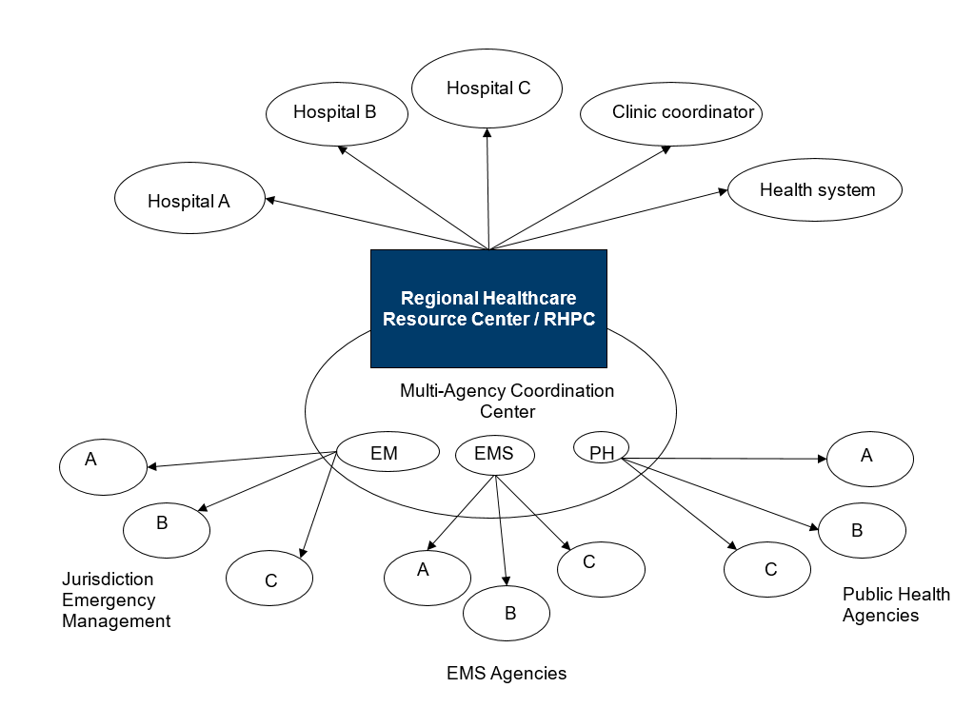
Regional Healthcare Resource Center/RHPC
Resource Center Coordination
Chart begins – Choose either Regional Healthcare Resource center/RHPC or Multi Agency Coordination Center.
Regional Healthcare Resource Center/RHPC
Option 1: Hospital A
Option 2: Hospital B
Option 3: Hospital C
Option 4: Clinic Coordination
Option 5. Healthsystem
Multi-Agency Coordination Center
Option 1. EM – Jurisdiction Emergency Management
1. A
2. B
3. C
Option 2. EMS – EMS Agencies
1. A
2. B
3. C
Option 3. PH – Public Health Agencies
1. A
2. B
3. C
Notes:
Flowchart made by MDH
This structure is generic, and may vary between regions and communities. However, the inter-dependence of healthcare, EM, EMS, and PH should not be under-estimated – these are often inter-dependent during an incident.

Slide 20
Evacuation – Command actions
Internal Notifications
  Affected Units – in emergency, overhead paging may be used
    Timeline and staging areas
    Begin patient triage and collection of belongings
  Pharmacy (meds for staging areas)
  Facilities (supplies for staging areas)
  Transporters (and supplies – carts, canvases, stair-chairs relevant to event)
  Nutrition services – water and other supplies for staging and enroute with patients
  Safety and Security – traffic control, EMS staging, entry control, etc.
Notes:
Clear, concise, multi-faceted communication is critical. PIO may be involved with internal as well as external communications. Institution-specific information should be included as appropriate on this slide.

Slide 21
Evacuation – HICS positions
Operations Chief – responsible for moving patients to staging and transportation in orderly fashion
  Evacuation Branch Director – may be appointed if evacuation is NOT the focus of the Ops Chief (fire, damage to facility)
  Staging Officer (and Manager, if >1 staging area)
  Transportation Officer (and Manager, if >1 staging area)
  Triage Officer – 1 per staging area
Planning Chief
  Identifies receiving facilities (may have assistance from RHPC, etc.)
  Arranges transfers
  Tracks transfers and assures clinical information transfer

Slide 22
Patient Triage
REVERSE TRIAGE on inpatient units
  Move ambulatory patients in a group or a few groups with escort FIRST (Green)
  Move stable non-ambulatory patients SECOND (Yellow)
  Move the least stable patients LAST (Red)
Once at staging…normal priority
  RED first to go
  YELLOW second
  GREEN last (and/or via bus, etc)
KEY POINT: Triage during evacuation reflects priority for EMS transport, NOT movement to staging
Notes:
This is a critical concept to understand – triage on the units reflects the priority for EMS transport, NOT movement to the staging area. Thus, green patients are first to leave the unit (easy to move), red last as they are least stable and should spend the least time in staging waiting for transport. So remember, GREEN = GO for movement to staging, then ‘usual’ triage applies for leaving the facility.

Slide 23
Patient Triage – graphic
Triage Level | Priority for Evacuation off nursing unit – REVERSED START PRIORITY | Priority for Transfer to another healthcare facility – TRADITIONAL START PRIORITY
RED- STOP | These patients require maximum assistance to move. In an evacuation, these patients move LAST from the inpatient unit. These patients may require 2-3 staff members to transport. | These patients require maximum support to sustain life in an evacuation. These patients move FIRST as transfers from your facility to another healthcare facility.
YELLOW – CAUTION | These patients require some assistance and should be moved SECOND in priority from the inpatient unit. Patients may require wheelchairs or stretchers and 1-2 staff members to transport. | These patients will be moved SECOND in priority as transfers from your facility to another facility.
GREEN - GO | These patients require minimal assistance and can be moved FIRST from the unit. Patients are ambulatory and 1 staff member can safely lead sever patients who fall into this category into the staging area. | These patients will be moved LAST as transfers from your facility to another healthcare facility.
Notes:
Graphic representation of ‘reverse triage’ for movement off the unit, then ‘usual triage’ once in staging. Note green patients may be moved by bus or other asset and not ambulance.

Slide 24
Unit – based actions during evacuation
Triage tag patient (DMS evacuation tag)
Urgent evacuation – provide list of patient transportation needs to hospital command center
Tag belongings with corresponding bands/number off DMS tag
Print patient summary per instructions of IC
  Emergency – Diagnosis, allergies, medications, advance directives
  Urgent – Add patient summary, med admin record, family contact information and primary physician
Notes:
Unit staff (especially charge RN / unit supervisors) need task-specific education on these items and exercise these processes. Institution specific information about mechanism for records transfer should be included here.

Slide 25
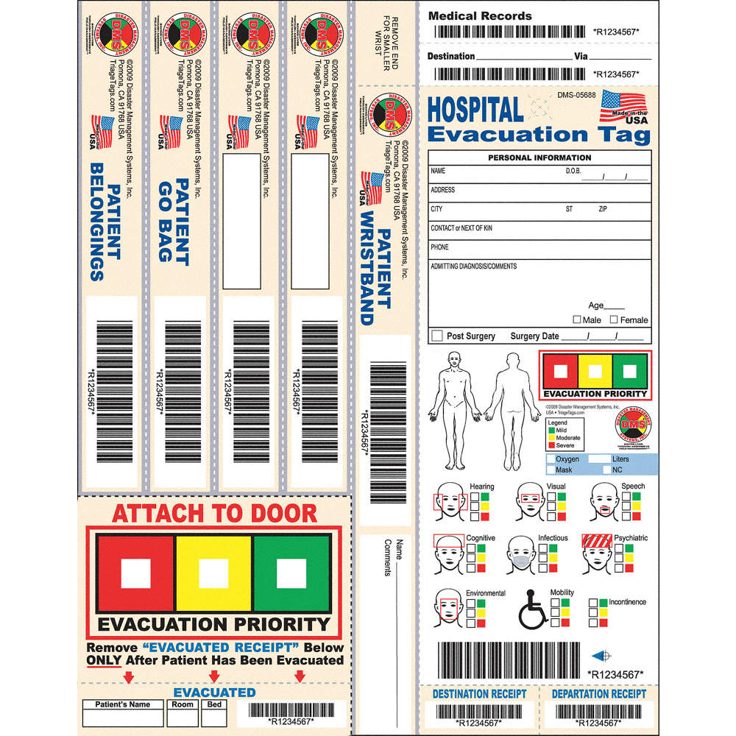
DMS tag
Notes:
The DMS hospital evacuation tag contains a number of tear-off bands to be used for durable equipment (walkers, etc) and belongings bags. The triage priority can be indicated and a sticker peeled off to put on the patient’s door. A variety of impairments can be noted that must be considered by transporting/receiving staff including dementia, etc. The same tag may be used by extended care. This is not a required tag, but the workgroup recommends this tag based on review of available products and ability to address areas of concern in prior evacuation events.

Slide 26
Unit – based actions during evacuation continued
Escort green patients to staging area (emergency – as soon as possible, urgent – when notified by staging/command center)
Move yellow patients
Move red patients
Sweep unit, tagging doors across door frame with ‘room clear’
Unit leader accounts for staff in staging area, facilitates support for patients until transported
Notes:
Green patients may be walked in a group (consider holding hands, etc). Yellow will require at least some assistance (WC, bed, carry), red plan 2 staff per patient at least, three if going down stairs, etc. Picture of ‘room clear’ is on next slide. Unit leader may want daily staffing sheet or alternate way to account for staff in addition to patient list. Patient movement can be time-consuming and risky – use care, especially on stairs / lifting

Slide 27

Sweeping rooms
All rooms that cannot be visually cleared (e.g. fully visible from hall – open cubicles in post-anesthesia area)
Place ‘room clear’ or similar sticker across door jamb
CLEAR
Notes:
Placing sticker across jamb allows for easy determination if re-entry has been made. Stickers may be kept with evacuation supplies or on posted clipboards on the unit. (Note, they can be printed from word processing programs onto commercially available 2x3 or other size flourescent stickers such as those made by Avery – standard inkjet and laserprinters work well)

Slide 28
Staging Officer
Assure supplies and staff requested to staging area
Clear furniture and otherwise prepare area for patients
Designate areas for ambulatory patients and carts/non-ambulatory (including clear floor space)
Work with transport officer to assure loading zone(s) designated and understand traffic flow, vehicle staging, patient loading plans
Distribute forms, supplies as necessary to unit leaders, transport officer, triage officer
Communicate / coordinate with hospital command center – especially if requesting patients from units in sequential fashion (keep the flow going)
Notes:
Pre-determined lists of supplies from pharmacy, central supply should be assembled and moved to staging area. May have to move furniture and account for potentially large numbers of green patients. Thus, nearby rooms may be needed for overflow holding areas for green patients especially. Facility-specific plans and education should account for this in advance of an incident depending on space needs. Loading zones should be pre-planned, but flexibile in case the event limits options for staging and transport loading. Transport officer is link to EMS Staging Officer (different from hospital staging – they are the ‘ambulance wranglers’ that stage and move ambulances and other vehicles into the patient loading area). If units are moving patients sequentially, coordination with the command center and/or the units themselves is critical to assure continued flow of patients through staging and reduce bottlenecks if multiple units move their patients at once.

Slide 29
Triage Officer
Assess patients entering staging area
Re-triage for transport as necessary
Work with transport officer to assure RED/YELLOW/GREEN patients (in that order if possible) moved in appropriate resources
Facilitate any necessary patient care in staging area, re-triage as needed
Notes:
Triage officer should check tag priority and assess patient for any changes in movement to staging, re-triaging as needed and facilitating any necessary patient care in the area. The triage officer should have a job aid, additional triage tags, and access to the pharmacy and other supply lists for the staging area. Triage officer and transport officer should work closely to assure flow of highest priority patients to loading area maintained.

Slide 30
Transport Officer
Liaison with EMS
  Determine staging area for transport resources
  Determine loading area
  Determine process for summoning resources to loading area
Triage interface
  Call up appropriate transport for next patient(s)
Tracking
  Assure tracking of patients evacuated (unit number, patient, destination, time left)
  Assure belongings loaded – enlist unit leaders (charge RNs) to assist.
Notes:
Transport officer works closely with EMS and is the person accountable for linking the patient to the transporting unit (i.e. james smith went in Willmar ambulance 472 to Centracare St. Cloud). Also, a final check for belongings should be performed and if the transport unit cannot take certain things (motorized wheelchair) the transport officer should assure that this is noted and alternative arrangements made when possible.

Slide 31
Facility Shut-Down / Essential Personnel
Essential operations
  Facilities
  Communications
  Security operations / Safety
Expectations by unit type
  Business
  Outpatient areas
  Inpatient areas
Checklist of shut-down, lockdown procedures
What if patients still come?
Notes:
Depending on the scope of the evacuation, the facility may not shut down at all, may shut down certain units, may evacuate patients but maintain all life support and other systems to assure rapid return to business, or may have to shut down entirely, with all staff leaving the site. The facility must have plans for a ‘stay team’ or other group that can manage the transition of evacuation and then re-opening. Also, each unit should have a sheet of instructions on what to do if the unit is evacuated (particularly important for areas housing hazardous or radiologic materials, medications, etc.) Essential operations are rarely completely abandoned. In some cases, patients may still make their way to the facility, and contingency plans should account for this, even if the facility is ‘closed’. Institution-specific policies may be discussed briefly here, but tabletop exercises and scenario-based discussions should be carried out with relevant members of the command staff and those likely to be on a ‘stay team’ (facilities, safety/security, etc.)

Slide 32
Considerations for transport
Oxygen
Water
Food
Unanticipated delays in transport / transfer
Weather

Slide 33
Scenario-based discussions
Unit-level actions should be default
This slideset emphasizes command-level decisions rather than unit-level decisions
Understanding of decision process and authority at your institution
Algorithm
Community / regional resources
  EMS
  RHPC / RHRC
Notes:
The following slides encourage the audience to think through the specifics of common scenarios that require protective actions. They should consider what should happen at the unit level first (at the bedside) and then command-level decisions. Due to the audience, this slideset does NOT get into detail about the actions taken at the unit level. Operations or awareness materials should include more detailed discussions of these issues, and less detail about the command level decisions. The audience should have a printout of the evacuation algorithm for reference. Interactions between the facility and community EMS/EM and the RHPC/RHRC should be emphasized. Institution-specific information should be introduced in the discussions as needed.

Slide 34
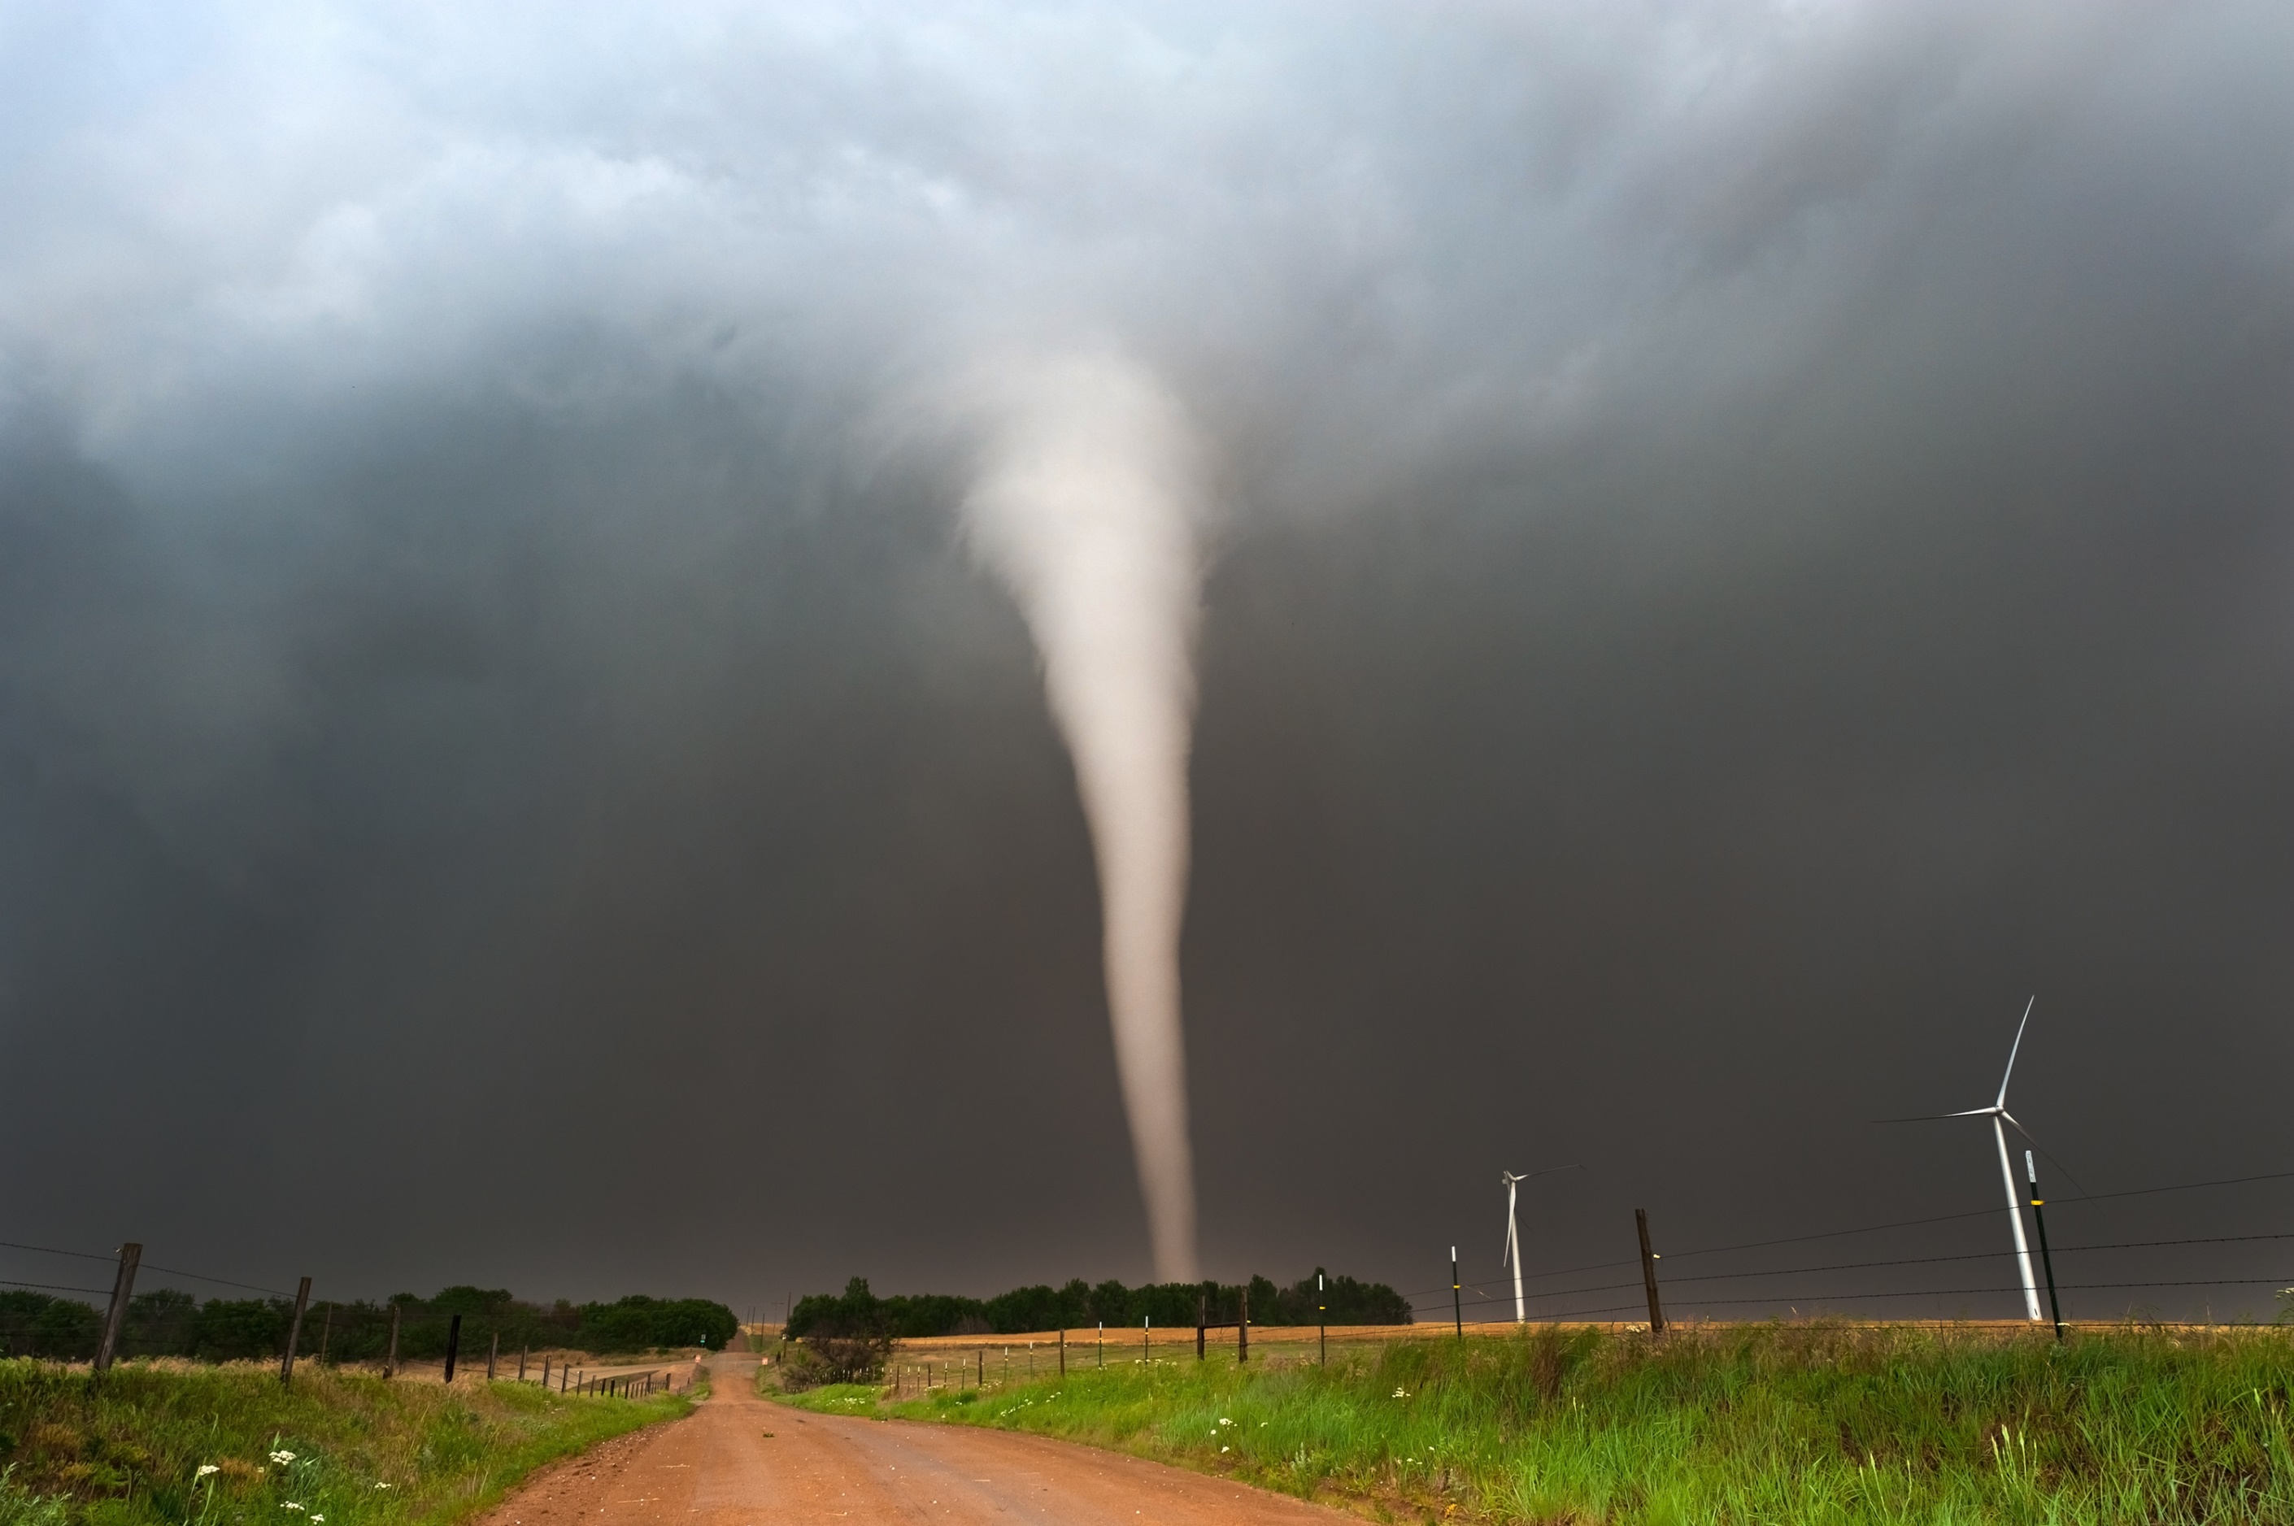
Tornado Picture
Wadena, 2010
Heather Haman

Slide 35
Scenario #1
Severe weather threat
Warning time? Impact?
Duration of impact?
Appropriate actions to take now?
Anticipate possible actions after impact…..
Notes:
Song clip – ‘rock you like a hurricane’ scorpions
Threat: Do you have any specific actions for a tornado watch? Most institutions have actions to take for a tornado warning, but are they complied with? (are patients moved to hallways, for example?)
Time: No time to re-locate and more dangerous to evacuate. Some warning is possible for these events, but a matter of minutes. Pre-education of sheltering (close curtains, do you move patients to halls and which ones), communication
Duration of impact depends on what was damaged at facility and in community. after incident- systems and facility assessment is critical. Access to institution may be a problem (roads, electric wires down), general safety of neighborhood is an issue. Staff may not be able to reach institution. Automatic actions at unit level – close drapes, etc. are taken without ICS input. Expectations on moving patients? Communications – cell phones are down, difficult to communicate with EMS and other agencies. If the facility itself is damaged, partial or full evacuation may have to be considered – early hazards include live electrical lines, oxygen tubing disruption, gas line disruption, fires, water pipe damage, structural instability/collapse.

Slide 36

Picture of a blizzard

Slide 37
Scenario #2
Ice storm
Warning time? Impact?
Duration of impact?
Appropriate actions to take now?
Anticipate possible actions after impact…..
Additional discussion
  Power lost, difficulty getting staff and supplies in
  Appropriate actions?
    Shelter in place
    May have to consider evacuation over time, especially high-risk patients – how? Aeromedical? Other resources?
Notes:
Song clip – ice, ice baby
Blizzard or ice storm: Time to impact may be 1-2 days – or less… adequate to ramp up, obtain additional supplies, etc. Facility and systems assessments, pre-incident check fuel levels in generators (and obtain additional, etc). Impact on patient transport, staff access/EMS access, suppliers. Loss of power may be a big driver for decisions – understanding duration of impact is critical – BUT you may not be able to evacuate.
Duration of storm does NOT equal duration of impact – tabletop and prepare considering you may be on your own for 96h or more (consistent with Joint Commission exercise requirements).
Actions after impact: may have to shelter staff at the hospital and cycle staff shifts, may have to conserve food and other resources and implement contingency plans. Communications issues and demand on resources (EMS, etc) should be considered. Establish communications with other facilities to share information and determine regional strategies.
Additional discussion: power, staff, supply issues, note after ice storm air medical may be available before ground.

Slide 38

Picture of flood/road closed

Slide 39
Scenario #3
Local Wannafloodu river predicted crest
  Threatens hospital directly
  Threatens to cut off hospital from road access
  Threatens local water and power
Warning time? Impact?
Duration of impact?
Appropriate actions to take now?
Anticipate possible actions after impact…..
Additional discussion – dynamic event, impact on other facilities in area and on transport resources
Notes:
Song clip – who’ll stop the rain (CCR)
Time to impact – days
Magnitude of impact – discuss as above – hospital in predicted flooded area, may be isolated from usual access roads, local water supply may be compromised
Duration – flash (creek) vs. prolonged
Internal flooding discussion – relocation / partial evacuation – unit level actions – drag them from room, move to next unit, etc. Use of transportation tool in template.
Decision-makers – for example night shift – do you know who makes decisions?

Slide 40
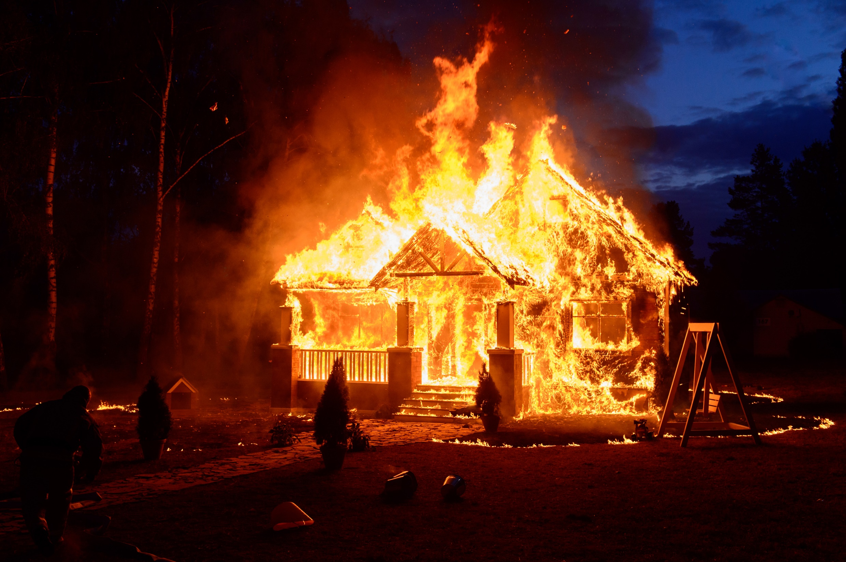
Picture of a building fire

Slide 41
Scenario #4
Fire
Warning time? Impact?
Duration of impact?
Appropriate actions to take now?
Anticipate possible actions after impact…..
Points for discussion:
  Relocation – emergent, unit based actions
  Relocation enough?
  Sustainable?
Notes:
Song clip – burnin’ down the house – talking heads
Warning time – none unless external fire that threatens facility
Impact – dependent on situation
Duration – not just until fire controlled – effects on critical systems, infrastructure
Unit-level actions – immediate patient movement / relocation (horizontal vs. vertical)
Institution level – priority is facility protection / fire containment, so evacuation may be assigned to different ops branch. Relocation may be ok, but may have to partial/full evac based on reports from facilities branch director and units. HVAC considerations, containment, assessments. After fire out, what is impact on essential services (medical gases, etc)? Can relocated patients be safely cared for on the units they were moved to? Is adequate equipment available?

Slide 42

Picture of Explosion

Slide 43
Scenario #5 – Explosion
Explosion and fire in central supply / sterile processing
Loss of oxygen system pressure
Loss of power to several patient care units
Unable to sterilize materials, instruments
Warning time? Impact?
Duration of impact?
Appropriate actions to take now?
Secondary actions? (partial evacuation vs. complete)
  Evacuation branch director (vs. ops chief)
Notes:
Song?
No warning time. Major impact on critical systems.
Actions: Command center open. Systems assessment including determine what relocation actions have been taken. Sustainable? Importance of COOP plans. Likely emergent relocations and then evacuation of most of facility (though administrative functions and outpatient care may be able to continue)
Discuss use of evacuation branch director in this situation as Ops is dealing with fire suppression, search and rescue, and other issues within the facility

Slide 44

Hazmat

Slide 45
Scenario #6 – HAZMAT
Chlorine gas leak from tanker truck overturned outside ED entrance
Warning time? Impact?
Duration of impact?
Appropriate actions to take?
Anticipate possible actions….
Notes:
Song clip – can’t touch this (MC Hammer)
Warning time: none
Impact: potentially profound / fatal – depends on size of leak, wind direction, whether or not the hospital is downhill, where air intakes are for facility, etc. (remember, chlorine is heavier than air) – remember massive chlorine leak in S. Carolina – 9 dead and 58 hospitalized. BN ammonia leak from RR car 2002 killed 1 and injured 300 in Minot, ND – these things can and do happen.
Duration – likely hours – size/rate of leak, time to hazmat team control of leak, etc. and weather are variables to consider.
Sheltering in place only real action to consider – relocation of patients if explosion risk, etc. HVAC and systems assessment – how long does it take to shut systems down? Look at your sheltering plans and contingencies….
Liaison with fire, EMS – don’t send rigs to the facility as the facility is in the contaminated area, get hazmat / plume information, etc.
Communications with staff, patients, etc. (and families, press – assure them everything is ok at the facility – advise the public of any limitations on services)

Slide 46
Thank you.

