Slide 1
How Prepared Are We? A Workshop for Pediatric Surge Preparedness

Slide 2
Objectives
After this workshop individuals will:
Be able to evaluate their facility’s disaster plan’s capability to handle a surge of pediatric victims.
Understand the impact of a surge of pediatric victims on their staff and facility.
Understand the unique aspects of a surge of pediatric victims
Know how to access help from other facilities during a disaster with many pediatric victims

Slide 3
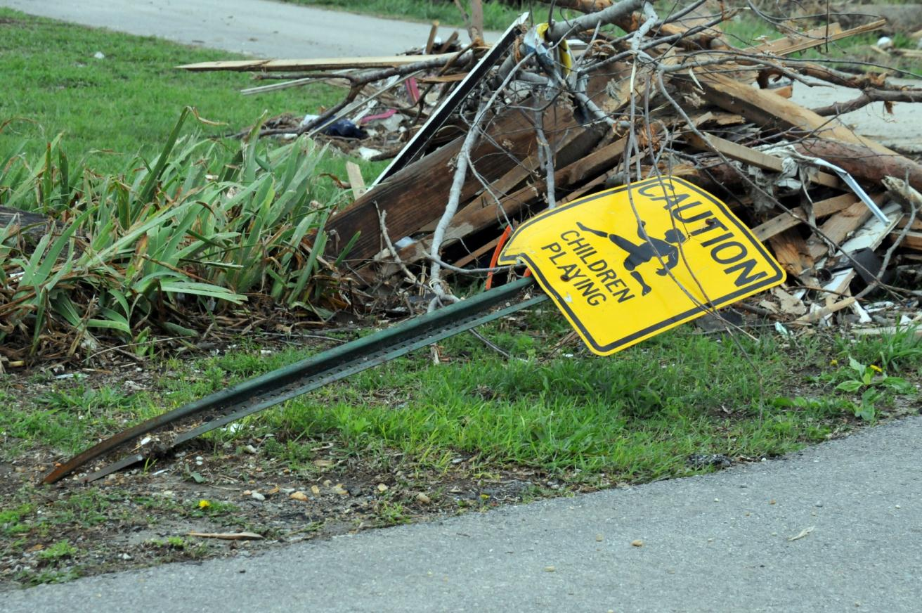
Children in Disasters
25% of the population
74 million impacted by disasters in last century

Slide 4
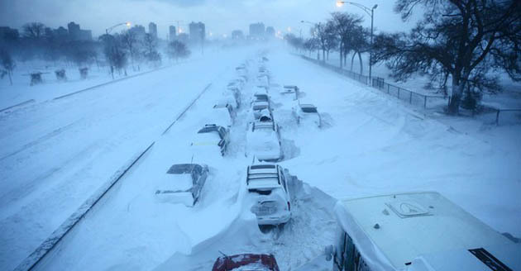
Scenario
Blizzard approaching
12-18” of snow
Increasing winds
Schools out early

Slide 5
Issue Identification
How would a blizzard impact hospital operations?
Staff
Supplies
Patient Care
Environment of care
Special Considerations

Slide 6
Scenario
EMS notifies your health care facility a school bus with children has been hit by a tractor trailer
Multiple injuries
At least 1 death
Mutual aid ambulance are on scene but they will also be sending some older children with minor injuries in other vehicles

Slide 7
Issue Identification
How would a school bus crash impact EMS operations?
Transport
Pre-hospital treatment
Safety
Environment

Slide 8
Scenario
EMS reports worsening weather and bad roads
Patients that would normally go to a pediatric trauma facility are headed your way!

Slide 9
Response
Alerting/Command
Activation of the disaster plan
Begin notification of hospital leaders
Who reports and are there some who aren’t on the list that might help?
What resources do you need?
Do you have pediatric specific equipment that you can draw on?
What resources can you get?

Slide 10
Response
Assign a Medical Branch Director/ Set up Triage
Who performs triage?
Divide up the ED/Clinic into zones of acuity
Where do you place victims?
Where do you put the minimally or non injured children?

Slide 11
Victims
1 DOA
6 Serious
3 Critical
10 Minor
8 No Injuries
5 year old
Unresponsive
Head injuries
8 year old
Severe SOB
6 year old
Unresponsive
Hypotensive
Open fractures
Lacerations
Small lacerations
Bumps
Sprains
Strains

Slide 12
Treatment
Space Issues
Who gets a bed?
Where do green triaged patients go?
Pediatric Safe Area (PSA)
Supplies
Staff
Special Considerations

Slide 13
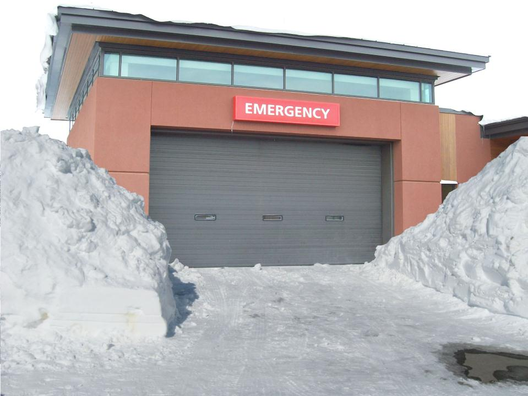
So your Emergency Department has 27 children in it…

Slide 14
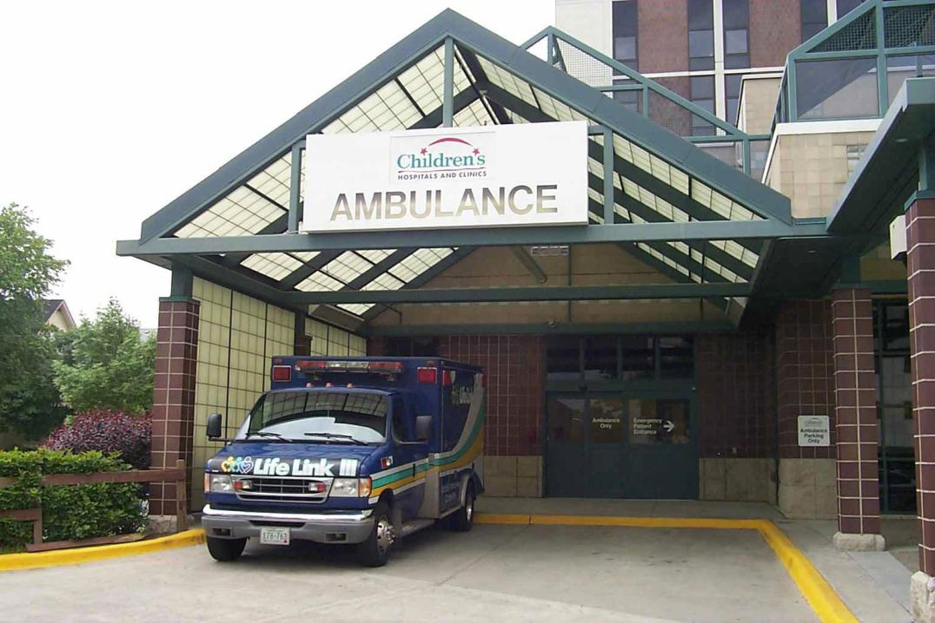
And you wish you could send them to a children’s hospital or trauma center…

Slide 15
But the roads are closed and it’s bad everywhere.

Slide 16
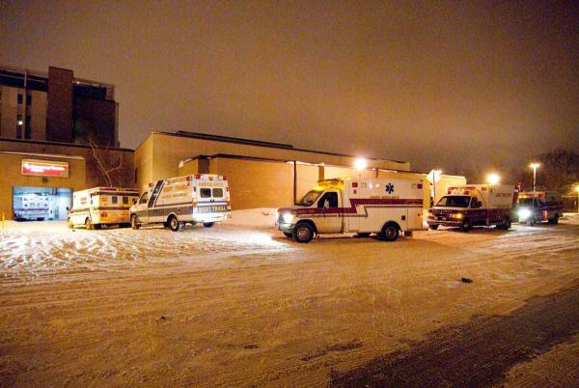
Transportation
How?
When?
Where?
Other measures?

Slide 17
Big issues for small kids?
Preparedness
Space
Supplies
Staff
Special

Slide 18
Questions?

Slide 19
Thank you!
Firstname Lastname
firstname.lastname@email.com
555-555-5555

