Slide 1
Pediatric Surge Operations and Incident Management
Shawn Stoen | Mark Dascalos | Vicki Neidt
2018

Slide 2
Objectives
After viewing this module, the participant should be able to:
Understand the basics of a facility based incident command and how to incorporate it into your operations.
Discuss the resources available to support the health care facility during a pediatric surge event.
Identify the role and responsibility of the family assistance center.
Review facility based plans and identify any gaps or areas of improvement.

Slide 3
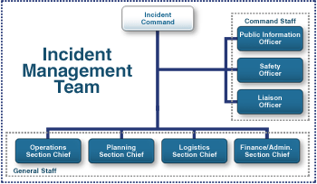
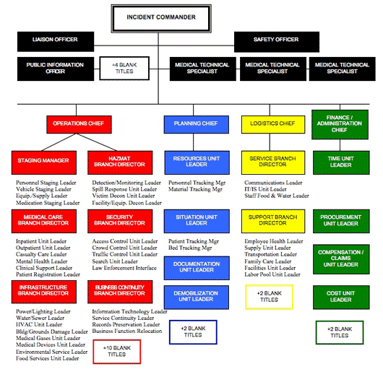
Incident Command
Remember -Incident Command is Scalable
Notes:
Incident Command can be as complex or as simple as the situation requires. You do not need to have a fully staffed Incident Command with every event….it is important to start simple and expand as necessary to fulfill the needs of the event.
Incident Command
Incident Commander
Leader
Nurse Leader
Supervisor
Operations
Nurse Manager
Maintenance/Plant Services
Nurse Supervisor
EMS Leader
Planning
Senior Leader
Nursing Officer
Risk/Safety Leader

Slide 4
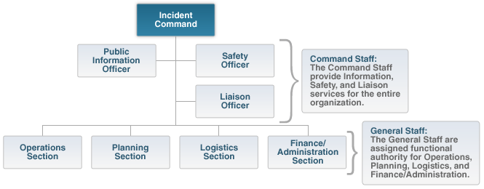
Command and General Staff
First on scene
Assign as
needed
Graphic by FEMA
Notes:
Once the functional support components have been identified we can assign them to a formal ICS Section based on functional objective.
Function and Corresponding ICS Section:
Do Stuff = Operations
Collect, Analyze, and Plan Stuff = Planning & Intelligence
Get Stuff = Logistics
Clerical Stuff = Administration & Finance
Lead & Manage = Incident Command

Slide 5
Incident Command
Span of Control
Section Leaders should have no more than 7 people they supervise
Ideally no more than 5
This Photo by Unknown Author is licensed under CC BY
Notes:
A tight or narrow span of control allows for:
More control/awareness of the situation
Increase in efficiency
Allows for simple decisions to be made at the lower level allowing for leadership to focus on the “big tasks”

Slide 6
When to Activate
How many patients do I need before I call it an incident?
When there are more patients than caregivers can safely take care of
When you have a report of more than 10 patients (or whatever number your hospital chooses) regardless of injury
When you rely primarily on on-call staff who will need to come from home to support your operations
Notes:
It is imperative to have a process in place to empower your staff to request support via incident command. Know who to call when assistance is needed.

Slide 7
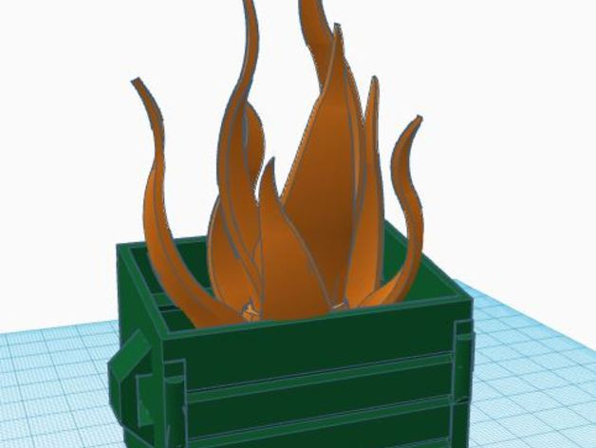
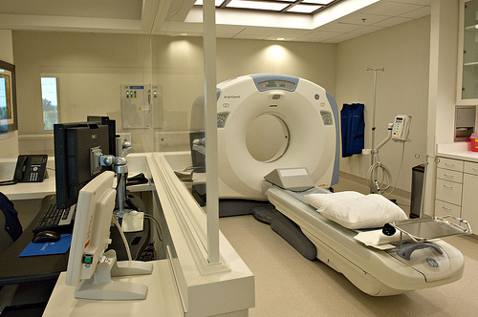
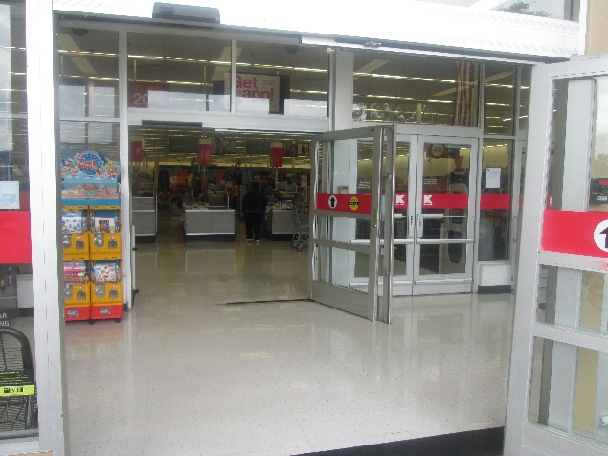
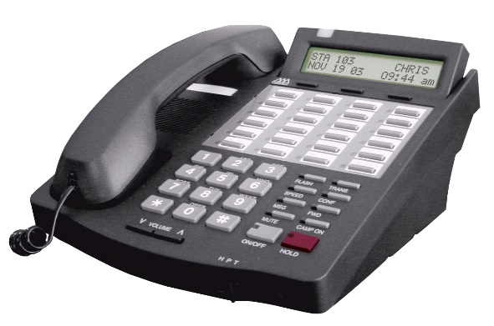
When to Activate
Activate your Incident Command for Typical Hospital Events to Exercise in Real Time.
It will make the activation process more natural for when there is an emergency.
This Photo by Unknown Author is licensed under CC BY-ND
This Photo by Unknown Author is licensed under CC BY
This Photo by Unknown Author is licensed under CC BY
This Photo by Unknown Author is licensed under CC BY-SA
Notes:
It may seem “foreign” to activate your ICS system for things you are doing already by yourselves, or your overnight nursing supervisor is routinely handling. However, a partial activation of your ICS structure will help in a situation that inadvertently extends overtime, and your staff wants or needs the support.
Daily Incidents that occur that will help you exercise your command structure and plan
VOIP phone system failure
Unknown down time, multiple departments affected, maintenance/contractor personnel off site
Trash Can Fire/Laundry Fire
Although is already out, assemble incident command to return to normal operations
CT Scanner down at Critical Access Hospital
Assemble for where to send patients, how to manage strokes, impact on emergency department
Automatic Main Door stuck in open position that cannot be resolved immediately by your maintenance team

Slide 8
Additional Resources Pediatric Surge Events May Need
Behavioral Health—Operations
Manage patients with special needs or staff that need debriefing
Family Assistance—Operations
Who would manage this function?
PIO? ER Nurse? Safety Leader? Plant Supervisor?
Interpreters—Operations
Have a plan to use current resources or a leader who can find community resources
Notes:
***Consider that you have resources in your maintenance staff, unit coordinator staff, nursing assistant staff, who have unrecognized leadership and community resource knowledge that you may be unaware of. Have your leaders do a knowledge inventory of staff members with; military experience, English as a second language, volunteer firefighters or EMT’s, Hobby enthusiasts.

Slide 9
What if I’m WRONG?
There are valuable lessons in every activation:
You will find out who will come when help is needed
You will end up with more support than you needed / less support than you needed
You will learn the capabilities of your team
You will learn when to expand your incident command structure to meet those needs

Slide 10
Pediatric Surge
Lets discuss your facility…

Slide 11
Pediatric Surge
Scenario
Your critical access hospital has an 5-bed emergency department, of which 3 beds are currently filled with patients.
You are on generator power due to a power failure.
You have been notified there has been a rollover accident with two critical victims that are being transported to your hospital.

Slide 12
Pediatric Surge
Resources:
Staff
(1) RN caring for the 3 patients in the ER
(2) RNs taking care of 8 low/medium care patients admitted on the floor
(1) ER Physician (Locum)
(2) Paramedics – Out at the Accident already
(1) Off Site Nursing Supervisor that covers two hospitals

Slide 13
Pediatric Surge
Questions:
Who can activate your plan and call in additional staff?
Who is the Incident Commander until more help arrives?
Do you have a call tree or automatic call back system?-- and who is going to make the calls?

Slide 14
Pediatric Surge
WHAT do you Do?...
You have a radiology supervisor and a maintenance staff member who live 2 miles away, and can be at the hospital in 20 minutes
Your manager lives 40 miles away, and will come in “if necessary”
The on-call manager thinks you can handle it with your current resources

Slide 15
Pediatric Surge
Security
Do you have security, and do they have a plan for surge?
If you don’t have security, and the local responders are your resource – do you have a plan/agreement?
Keep in mind that above groups may all be busy at scene
Notes:
If you are relying on local law enforcement, county sheriff, or fire department – you need to have a plan in place and they must be including in your planning preparation.
What role would you have your facility volunteers fulfill in a surge event? Is there a plan and have they been trained.

Slide 16
Pediatric Surge
Security Issues
Can you “lock down” your patient care areas?
How many people do you need if you don’t have a central locking station to secure your patient care areas?
Have staff members / volunteers been trained in incident response, crowd management, or de-escalation techniques?

Slide 17
Pediatric Surge
Volunteers
How are volunteers currently being used in your facility?
How can that be revised to support a surge incident?
Do you have back ground checks done on your facility employees?
Notes:
What role would you have your facility volunteers fulfill in a surge event? Is there a plan and have they been trained.

Slide 18
Pediatric Surge
Now, imagine that the scenario we discussed included 4 pediatric patients in the accident……..
How about 8 pediatric patients?

Slide 19
Pediatric “Stuff”
Do you know where your pediatric equipment is and how to get it?
Resuscitation equipment (including airway management)
IV supplies
C-collars
Medication
Diapers
Cribs
Formula/bottles
Books
Notes:
Consider developing rapid pediatric kits for facilities which don’t see a lot of pediatric patients

Slide 20
Unaccompanied Minors
Do you have policies for admitting/discharging unaccompanied minors?
Forms
Process to hold for guardian
Secure holding area
Sheltering patients in place
HIPAA issues

Slide 21
Specialized Care Resources
Do you have experts on staff? (pediatrics, burn, trauma, behavioral health, etc.)
Other options for help—
Telemedicine?
Over phone consult and advice?
Other?
Who can be a resource for the hospital?
Is there a hospital support center?
What resources would that center have?
Notes:
Are there agreements with support agencies?
Is there a list of contacts available 24/7 to staff to access?

Slide 22
Family Resources
Distraught parents and bystanders
You need:
An area where information is disseminated
An area that is secure and away from your patient treatment areas
A excellent community communicator
How many visitors are allowed in ED treatment areas? Policy?
Who may child be discharged to? Legal issues to consider?

Slide 23
Family Assistance Center
What does it do?
Perform Family Registration
Facilitate Reunification
Perform Family Notification
Offer Support Services
VIPs and Celebrities
Notes:
Typically if the incident is large enough to warrant a Family Assistance Center – the local emergency manager as well as public health would be involved in created the Family Assistance Center
Registration:
Document a process for registering families at the FAC and issuing them a distinctive badge or wristband
Include appropriate forms for family check-in, to include a FAC Sign-in and Tracking Form, Unaccompanied Minors Sign-In and Tracking Form, and FAC
Tracking Log
Discuss special registration considerations for unaccompanied minors, to include taking and distributing photographs
Develop a Fact Sheet to provide to families
Reunification:
Identify procedures for reunifying families with patients, to include the importance of accessing MNStar
Discuss the importance of contacting the local Emergency Manager/Local Public Health/ or Regional MAC to determine if there is a local family assistance center open and discuss coordination of same.
Notification:
Include procedures for notifying families of patient status, to include death notifications
Support Services
Discuss the support services to be included at the family assistance center IC and strategies for providing them
VIPS
Discuss methods for interacting with VIPs and celebrities, as well as the media

Slide 24
Family Assistance Center
Unaccompanied Minors
Discuss procedures for handling unaccompanied minors in the Family Assistance Center, to include the establishment of an Unaccompanied Minors Safe Area
Document process to notify county social services to determine appropriate legal guardian for discharge

Slide 25
Family Assistance Center
Long Term Planning Needs
Cultural Interactions
Food Needs
Space for Family members of admitted patients (cultural expectations)
Other types of visitors, i.e. pets, siblings, classmates
Good resource for family resource center set up: https://www.calhospitalprepare.org/sites/main/files/file-attachments/fic_planning_guide_final_062813_v62_0.pdf
Notes:
For large events, health care facilities are strongly encourage to coordinate response efforts with the local emergency manager/first responders to ensure all resources and needs are fulfilled.

Slide 26
Communications and Media
Provide detailed information about how communications will occur with respect to:
General procedures
Staff
Command Center, Local EOC, and MAC
Public media
Social media
Incidents resulting from intentional acts
Notes:
All Facilities are highly encouraged to have trained Public Information officers that can coordinate communications in an incident. This person will monitor social media as well as public media. Will work with the facility incident commander as well as local Emergency Manager and other responding agencies to ensure that messaging is accurate, timely, and consistent.

Slide 27
Demobilization
Determine Demobilization “Trigger”
Designate Authority
Notify Stakeholders/Community members
Prepare Messaging
Debriefing
Notes:
Trigger points should be clearly indicated however the decision to demobilize is subjective.
Encourage the creation of a demobilization checklist
Relevant information should be provided to the Public Information Officer to prepare messaging. FAC staff should particularly ensure that information is provided to specific needs populations
A debrief should be scheduled as soon as possible following demobilization to identify and document “lessons learned”

Slide 28
Pediatric Surge
Summarization
Health care facilities/agencies that incorporate incident command processes in day to day operations are more successful when implementing incident command in emergencies.
Recognize or think outside of the box who can be a resource to assist in a response to an emergent event and put measures/plans into place prior to the emergency.
It is important to review your existing plans to ensure that considerations are in place that address pediatrics as well as other vulnerable populations, including those with access and functional needs.
Communications need to be timely and accurate, using the family assistance center model will greatly assist in the ability to communicate with the public.

Slide 29
Thank you!
Pediatric Surge Project
Health.HPP@state.mn.us
651-201-5700

