Slide 1

Pediatric Surge Children with Special Needs
Tracy Larsen | Regions Hospital
2018

Slide 2
Objectives
After viewing this module, the participant will:
Be familiar with some common special pediatric patient populations
Understand basic resuscitation for children with special needs and complications they may have
Understand the common equipment these special populations may require
Notes:
2

Slide 3

Special Patient Populations
Congenital
Malformations
Diseases
Syndromes
Acquired
Diseases
Post injury
Notes:
3
These are the categories of special patient populations. Many are in-born like congenital heart defects and some are acquired like diabetes and Traumatic Brain Injury (TBI).

Slide 4

Congenital
Heart defects
Vessels, valves, chambers
Challenges
Easy fluid overloading
Changes in circulation
EKG
Vital signs
Notes:
4
Congenital (present at birth)
Name some common heart defects: Atrial/ventricle septal defect, transposition of the great vessels, Patent ductus arteriosus, Etc.
Look for sternotomy scar during exposure
3. Cardiac issues need slower fluid challenges, they may have poor circulation that is chronic so the extremities looked mottled, if children have their heart valves replaced, their EKG could look like a BBB or afib, Vital signs may not be within normal range but it is normal for the child.

Slide 5
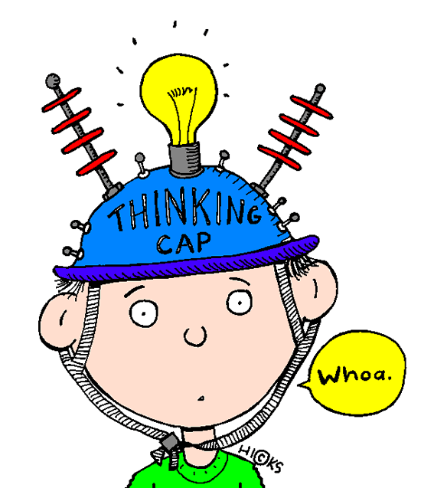
Congenital
Cerebral Palsy
Fine/gross motor limitations
Posture/balance problems
Feeding difficulties
Challenges
Positioning
Immobilization
Communication
Notes:
5
What is cerebral palsy?
Loss or impaired motor function as a result of brain injury or abnormal development. Many different levels of functioning in kids with CP.
Fine-writing, ADLs, brushing teeth. Gross-wheelchair bound, adaptive crutches. Oral-feeding tube, heavy secretions, uncontrolled noises.
Challenges: positioning/immobilization may be difficult if hypertone or low tone. Best position of comfort possible is optimal (this may be on their stomach). Communication: Just because they may not speak doesn’t mean they cannot be verbal with the use of communication boards

Slide 6
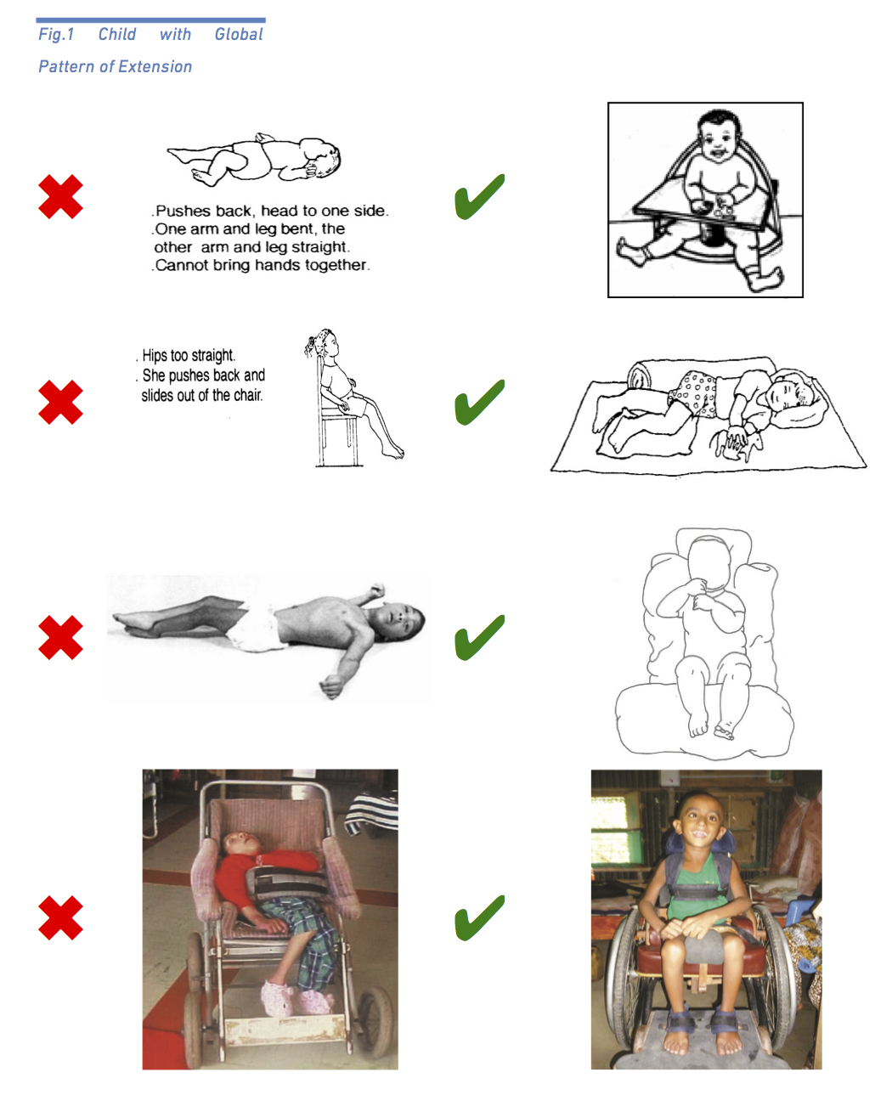
Congenital
Positioning Best Practice Examples
Notes:
6
These are some positioning examples.

Slide 7
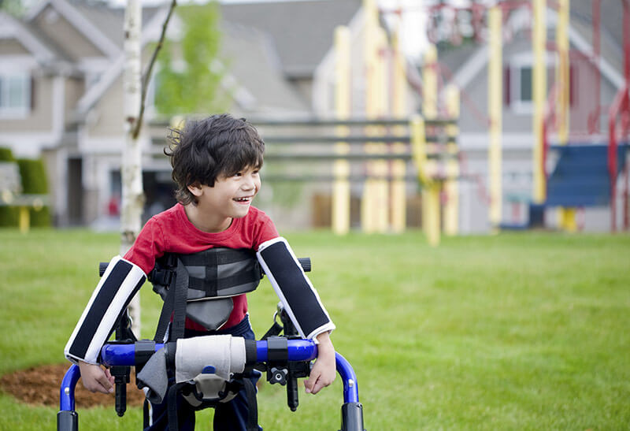
Congenital
Muscular Dystrophy
Genetic mutation
Progressive muscle weakness
Challenges
Wheelchair/scooter
Significant breathing/swallowing issues
Heart problems
Notes:
7
Muscular Dystrophy, which usually effects boys, causes progressive muscle weakness due to a genetic mutation. Duchenne muscular dystrophy is the most common.
Challenges:
If the child was diagnosed at an early age, the progression of muscle weakness may have left them wheelchair/scooter bound.
Progressive muscle weakness may effect their ability to breath appropriately. They may be vent dependent. One important thing to remember if you have to support their airway with intubation, succinylcholine is contraindicated in patients with neuromuscular disease. This may cause fatal hyperkalemia.
Muscular dystrophy may reduce the efficiency of the heart muscle so careful fluid resuscitation should be considered.

Slide 8
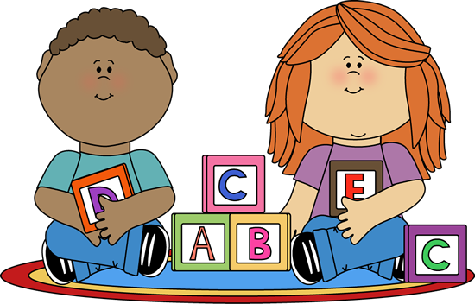
Congenital
Developmental delays
Autism spectrum disorder
Exposure to toxins
Premature birth
Challenges
Communication
Pain assessment
Appearances
Notes:
8
Autism spectrum disorder; Aspergers, ADD, ADHD, Autism,
Exposure-alcohol or toxins
Communication can be done with PECS-examples later in the slide deck
Pain assessments with FLACCS or FACES-examples later in the slide deck
Appearances are usually normal so assessments have to be thorough

Slide 9
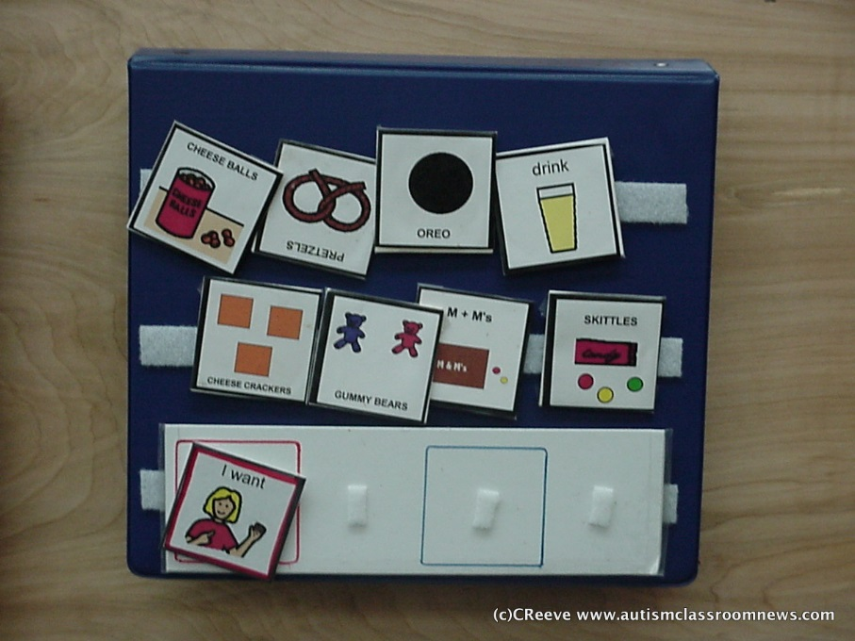
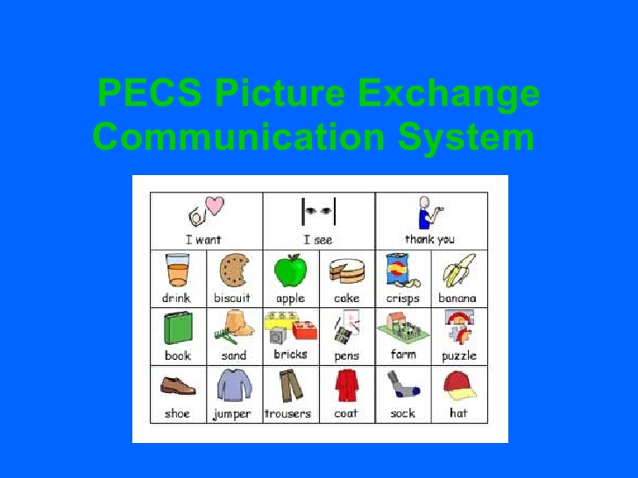
Congenital
Notes:
9
Example of Picture Exchange Communication (PECS)

Slide 10
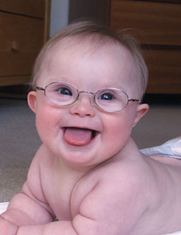
Syndromes
Down (Trisomy 21)
1/650
Turners
1/2500 female
DiGeorge
1/5000
Notes:
10
There are numerous syndromes that may cause developmental delays and/or physical impairments.
Emphasize that any syndrome can cause a variety of medical and developmental problems and not one person should be viewed as the same.

Slide 11
Syndromes
Medical/Develop
Complications vary from significant to minor
Low tone
Facial asymmetry
Equipment?
Meds?
Challenges
Assessment
PMHX
Pain
Scars
Communication
Verbal Vs. non-verbal
Notes:
11
Needs a thorough exam. Get care givers involved, IEP or IHP
Medical complications vary with everything from open heart surgeries/transplants to a benign heart murmur. Developmental may range from profound delays requiring total dependency on caregivers to mild delays which require some special education. Many children with syndromes are low tone so look for orthotics to extremities or spine. Facial asymmetry or body differences are common (flat nasal bridge, low set ears, long fingers, etc). Some children with syndromes may have a substantial list of meds and others may have zero.
Challenges: Needs a thorough exam. Get care givers involved, IEP or IHP. Pain and communication are addressed later in the slide deck.

Slide 12
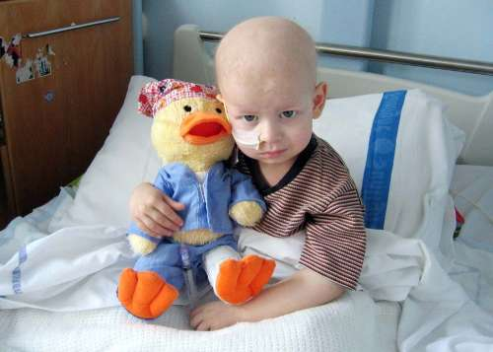

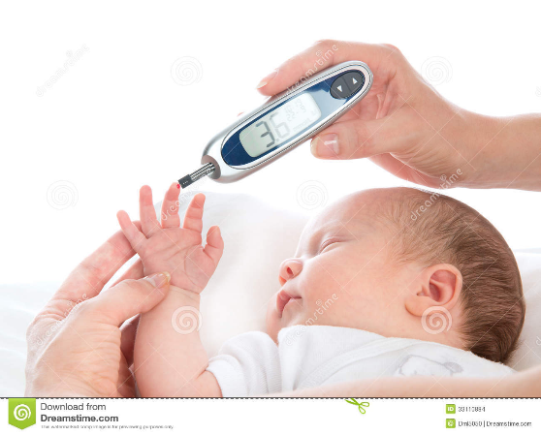
Acquired
Cancer
Diabetes
Post injury
Notes:
12
Acquired (developed after birth)
These are just examples of common pediatric acquired (developed) diseases. Other examples include: juvenile arthritis, Kawasaki disease, HIV, Influenza,
Traumatic brain injury

Slide 13
Acquired
Cancer
Blood/bone marrow
Solid tumors
Sarcomas
Challenges
Assessments
Ports, scars
Missing parts
Tumor resection
Immune deficient
Notes:
13
Leukemia is the most common blood/bone marrow cancer (ALL, AML)
2. Brain tumors are common solid tumors
3. Neuroblastomas (nerve cells), Wilms tumor, sarcomas, lymphomas etc.
Challenges: *must expose these patients to look for scars, ports, PICC lines, feeding tubes. Etc. Keep family involved to find out if actively going through chemo/radiation or in remission*, their skin may be pale or grey which may be normal if they are actively in chemo or radiology. Be aware if immunocomprised the providers needs to have masks.

Slide 14
Acquired
Diabetes
Type I
Juvenile
Insulin
Type II
Oral meds
Diet/exercise
Challenges
Insulin shock
Hypoglycemia
Diabetic coma
Hyperglycemia
DKA
Assessments
Mimics trauma/poisoning/illness
Notes:
14
Definition: body’s inability to produce insulin which is a hormone glucose get into the cells for energy. If glucose cannot get into the cells with insulin, too much stays in the blood causing hi blood sugars.
Hypoglycemia: weak, drowsy, rapid pulse, diaphoretic, pale, sense of hunger, trembling
Hyperglycemia: Headache, confusion, weak rapid pulse, unsteady gait, flushed skin, sweet breath, vomiting, dehydrated, coma.

Slide 15
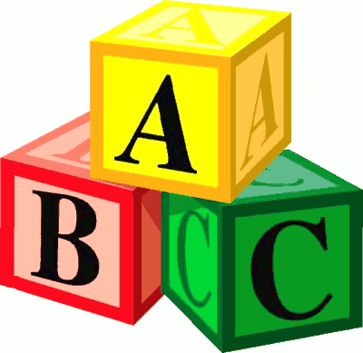
Basic Resuscitation
Systematic approach to pediatric resuscitation should be the same regardless of the special needs of the child
Notes:
15
This should pertain to trauma, burns, exposures, illnesses etc.

Slide 16
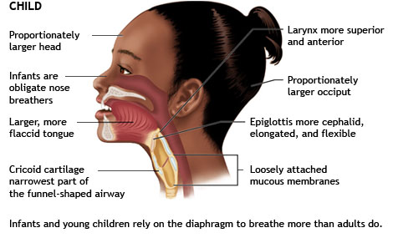
Airway
Notes:
16
Here are a few anatomical differences in a pediatric airway.

Slide 17
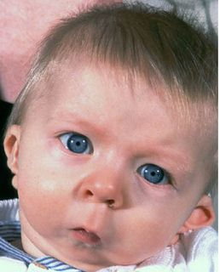
Airway Challenges
Tracheostomy
Ventilator dependent
Structural Differences
Larger tongue in Down’s patients
Cleft lip or pallet
Microcephalic
Small jaw
Notes:
17
Above may be some challenges when treating kids with special needs
Trach-scary to encounter if not familiar but a definitive airway. Maybe be vent dependent or not. Make sure you have a replacement trach nearby at all times.
Larger tongue for kids with syndromes. More prone to obstruction
Cleft-if the cleft has not been repaired, BVM may have to be a bigger size to include the nose so air cannot escape.
Microcephalic-may make sealing BVM more difficult with lack of mandible structures and receding chin and smaller airways
Tracheomalacia-floppy airway if intubated frequently as an infant. Easily occludes

Slide 18
Airway
Needs to be cleared/opened regardless if typical or atypical airway.
Positioning
Suctioning (mouth, nose, or tracheostomy)
Swelling of airway
Oral or nasal airways
Notes:
18
How do you position a 3 year old?
towel under shoulders, position of comfort, keep with parents/care givers
Suctioning may include mouth, nose, or trach. You may have to lavage the trach if secretions are thick. Kids with special needs may be prone to an inability to handle secretions.
Kids with special needs may have structural differences with their airways making them more susceptible to airway compromise with the smallest amount of edema or swelling.
Early intervention with airway adjuncts.

Slide 19
Breathing
Spontaneous
Rate/depth
Equal rise and fall
Lungs clear
Skin color
Work of breathing
Flaring
Retractions
Grunting
Notes:
19
When assessing the child’s breathing, you need to determine the effectiveness of breathing.
Assessing breath sounds, rate, depth, skin, color, and work of breathing will help determine respiratory distress or failure.

Slide 20
Breathing
Assessment
Baseline if you can
LOC/AVPU
Color
Work of breathing
Oxygen saturation
Adjuncts
High flow 02
BVM
CPAP/BiPAP
Supraglottic airway
Intubation of airway
Notes:
Potential equipment: smaller masks for facial anomalies, specialized equipment to bag via trach. Have airway supplies close by.

Slide 21
Breathing Challenges
History of heart disease
Increased O2 demands
Early cyanosis/pallor
Cerebral palsy
Positioning
Cystic Fibrosis
Thick secretions at baseline
Asthma
Close or longer monitoring
Inhaled medications
Limited reserve
Severe scoliosis
Skeletal deformities can limit chest expansion
Notes:
21
*know their baseline if you can*
Children with heart defects may exhibit signs and symptoms of respiratory distress sooner
Children with asthma may have a more severe reaction to an exposure than kids who do not have asthma and may need the above interventions sooner

Slide 22

No matter what the special needs of the patient are, providers need to assess the effectiveness of breathing and attempt to return the patient to their baseline.
Notes:
22

Slide 23
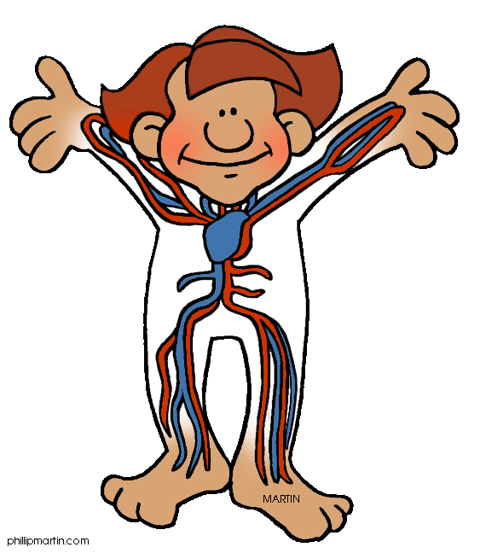
Circulation
Heart rate is primary compensatory mechanism for children to increase cardiac output
Rapid heart rate
Fear, trauma, fever
Dehydration or hypotension
Notes:
A child’s heart rate is their strongest compensatory mechanism they have to increase cardiac output.
In shock, child can lose up to 30% of their circulating blood volume before becoming decompensated.
There are several different reasons for an increased heart rate.
23

Slide 24

Circulation Challenges
Congenital anomalies
Heart
Vessels
Past surgeries
Chronic poor circulation
Placing an IV
Notes:
24

Slide 25
Circulation Assessment
Capillary refill
Color/temp of skin
Level of consciousness
Pulses
Central/Peripheral
Strong, weak, absent
Blood loss/fluid loss (burn)
Early shock is usually well compensated by children so recognition of early shock and treating it will prevent collapse.
It is much easier to treat shock early in a child then to try to recover after collapse.
Notes:
Knowing the patient’s baseline circulatory status will help you assess how effective your resuscitation is. If you do not know what the baseline is, continuous evaluation of color, central and peripheral pulses, and cap refill is essential.

Slide 26
Circulation
IV
IO
Ports
PICC/Central lines
Stop the bleed
Special considerations
Hemophilia
Dialysis
Heart disease
Notes:
Always assess to see if the child already has some sort of access. PICC lines and Port-o-Caths may indicate the child is currently receiving chemotherapy and infusion therapy of some kind.
Stopping the active bleeding is essential with direct pressure and/or tourniquets. Especially in child who have a clotting disorder like hemophilia.
Use caution when restoring circulation in children who have kidney or heart disease. This may have to be done slower and after expert consultation.

Slide 27
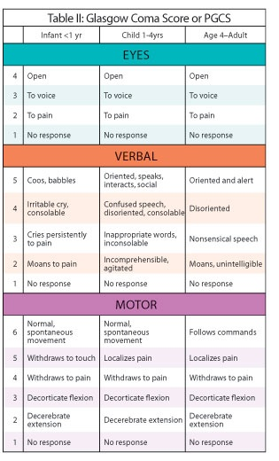
Assessment of Disability
What is Baseline?
Pediatric Glasgow
AVPU
Pupil changes
Notes:
Children with special health care needs may not be verbal or
have levels of interaction that you may expected based on age
and developmental stage.
• It is essential to ask the caregiver to describe their baseline
status and if their responsiveness is currently different. A good
way to get this information is to ask the caregiver to describe
his or her chief concern and reasons for presenting to the
emergency department. It may be different from what you
think by looking at the child.

Slide 28
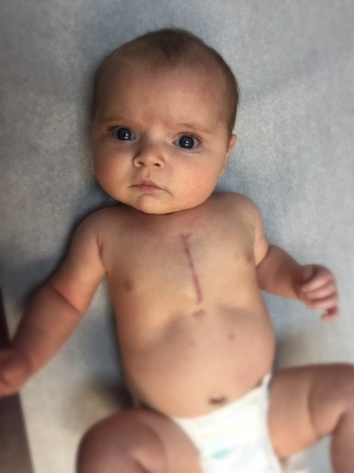
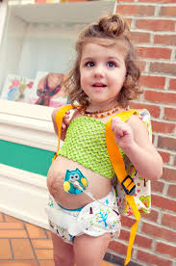
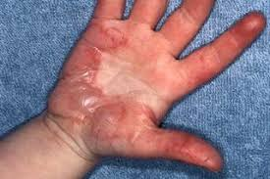
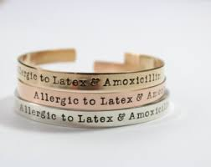
Assessment
Injuries
Scars
Feeding tubes
Shunts
Medical alert
Limit time of exposure to prevent hypothermia
Notes:
While exposing the child to identify any obvious injuries, also look for hints that the child may have special needs.
Scars-any sternotomy scar may indicate a heart surgery. Large scars to the chest and abdomen may indicate the removal of a cancerous tumor.
Feeding tubes-may indicate the inability to tolerate oral intake but also an easy way to administer meds if needed.
Shunts-may be due to hydrocephalus or CSF infection. Shunt malfunction may be the cause of mental status changes.
Look for any kind of medical alert bands that may indicate a PMHX of diabetes, seizures, anaphylaxis, etc.
**Must keep them covered to prevent hypothermia**

Slide 29
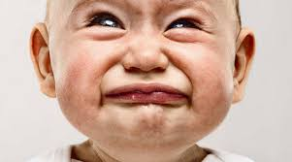
Pain in Kids with Special Needs
Verbal
Non-verbal: try to determine if it is pain or discomfort
Hunger
Thirst
Cold
Need to go to the bathroom
Notes:
This is how we usually encounter typical kids complaining of pain or scared or sick. These kids can show pain verbally or by non-verbal cues.

Slide 30
Pain (Verbal)
Self-reporting (scale 1-10)
Ask what words they use to talk about pain
Hurt, discomfort, sore, ache, etc.
Ask the best way to communicate pain
Tablet device
Communication board
Notes:
Self reporting is one example of how children who are verbal may complain of pain. There are may pain scales that we will look at over the next few slides.
Typical kids may have many different ideas of pain and how they describe it. Hurt, discomfort, sore, ache are just a few examples.
Kids with developmental disabilities/ASD can use IPads to draw and communicate where their pain is.
Children with CP may use their communication boards. Although they may not be able to speak, they can still be very verbal with their boards.

Slide 31
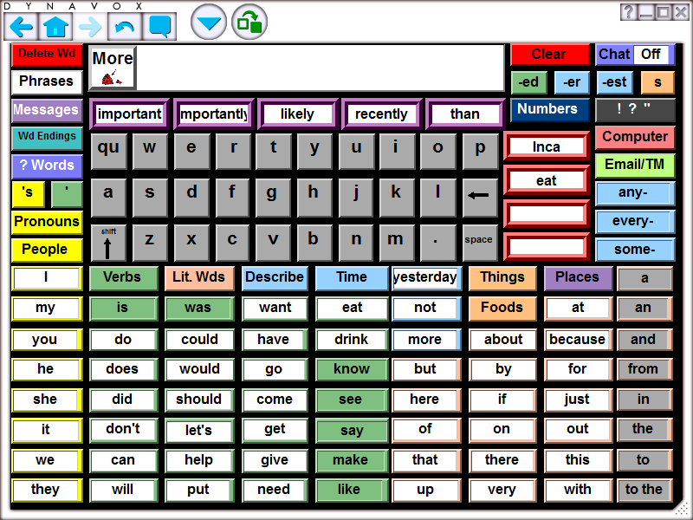
Pain (Verbal)
Notes:
Here is an example of a communication board

Slide 32
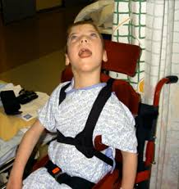
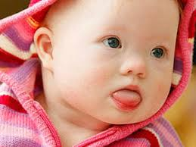
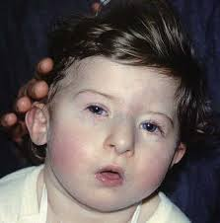
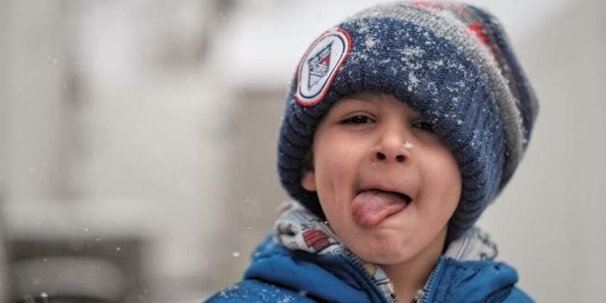
Pain (Non-verbal)
Notes:
For children that are non-verbal, rely heavily on facial expressions and behavioral cues, information from parents, teachers, caregivers, and other friends. Also, if there vital signs are abnormal from baseline, that may indicate pain.

Slide 33
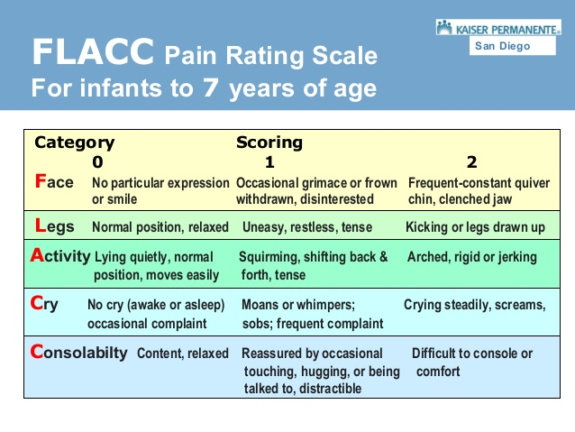
Pain (Non-verbal)
Notes:
This one can be used for infants and non-verbal kids, especially kids cognitive and/or developmental impairment.

Slide 34
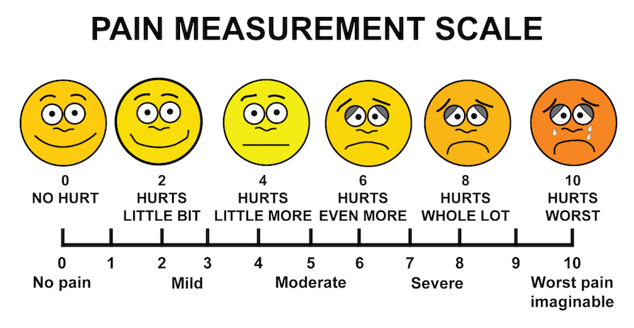
Pain (Non-verbal)
Notes:
This one represents the FACE Scale. Used in children who can relate to cartoon characters to identify the intensity of their pain. May be useful in non-English speaking or verbal/non-verbal children

Slide 35
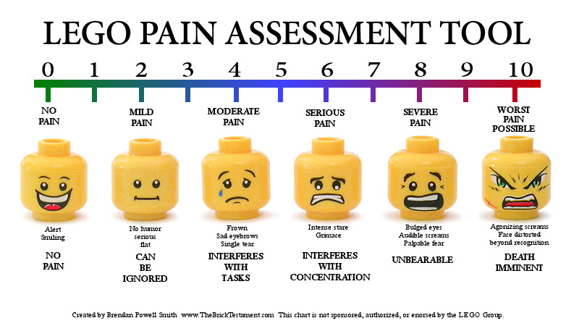
Pain (Non-verbal)
Notes:
Need to be creative with kids with special needs. Perhaps some non-verbal kids have a favorite movie they can relate to.

Slide 36
Pain (Non-verbal) Assessment
Clinical Assessment
Tears
Tachycardia
Moaning
Guarding
Behavioral Assessment
Facial grimacing
Withdrawn
Agitated
Fidgeting
Notes:
A thorough assessment of the clinical presentation, including vital signs and tears, along with a thorough behavioral assessment of non-verbal cues, withdrawn, agitated, should point you in the right direction on how to manage the child’s pain.
Including parents, caregivers, or teachers, (if available) is essential.

Slide 37
Pain Treatment
Pharmacologic
Non-opioids
Opioids
Adjunctive analgesics
Non-pharmacologic
Hot/cold
Music/relax techniques
Distraction
Family presence
Notes:
Non-opioids: Tylenol, NSAIDS.
Opioids: Narcotics, oxy. Morphine. Try to avoid combination drugs like Percocet.
Adjunctive: muscle relaxers, local anesthetics
Non-pharm: Ice or heat may alleviate some pain. Do not forget to elevate an injured extremity. distraction can include bubbles, movies, video games, fish tanks, coloring, etc. Family presence (if available) is a good distraction.

Slide 38


What is so different about kids?
Notes:
38
Just imagine the emotion that goes through your mind if you are a parent, caregiver, relative of a child, special needs or not, that has become of victim of a mass casualty event. These individuals are vulnerable, afraid, angry, concerned, you name it.
As long as they are not interfering with the care of your patient, parents and caregivers should be able to remain with their loved ones. They can be a source of calmness for you and the child.
Keep them involved and keep them informed. This may alleviate some stress in a high stressful situation.

Slide 39
Kids in a Nutshell, Special needs or not
Maintain a systematic approach to the ABCs in children whether the child has special needs, trauma, burns, or illness.
Everything in kids is weight based.
Seek baseline from parents, caregivers, medical records, teachers etc.
Utilize resources; pediatric references, expert consultation, medical direction, internet.
Keep caregivers involved.
Notes:
In summary; you need to have the same priorities, ABCs, when encountering children, special needs or not, who present as sick or injured.
Since almost everything for the basic resuscitation in children is weight-based, utilize your resources. This may include weight/length based resuscitation tapes, pediatric resuscitation apps for you personal devices, or expert consultation from your local pediatric hospital.
Keep parents and caregivers involved. This will help you determine the baseline of your patient so you can address their needs appropriately.
39

Slide 40
Thank you!
Pediatric Surge Project
Health.HPP@state.mn.us
651-201-5700

