Slide 1

Pediatric Surge
Crisis Standards of Care
Dr. John Hick| Hennepin County Medical Center
2018

Slide 2
Objectives
After viewing this module, the participant should be able to:
Explain what is crisis standards of care.
Summarize the exclusive pediatric issues that may present during a surge of pediatric patients necessitating a change in standards of care.
Know where to access the Minnesota Department of Health (MDH) Crisis Standards of Care Framework and available CSC Resources.

Slide 3
Crisis Standards of Care
During a disaster, the standard care of patients can be impacted and that standard of care may be adjusted to fit the circumstances.
Crisis standards of care is when the state and other agencies recognize and formalize operational changes to the care of patients to support a long term medical response.
Notes:
Would probably say the standard of care is adjusted to the circumstances – this is crisis care – crisis standards of care is when the state and other agencies recognize / formalize the operational changes that needed to be made to support a longer-term response.

Slide 4
Crisis Standards of Care
Care modes will progress from conventional standards through contingency standards into crisis standard
Example:
  Oxygen used for albuterol nebs
  Air used for albuterol nebs
  Inhalers used
MDH Website: http://www.health.state.mn.us/oep/healthcare/crisis/standards.pdf

Slide 5
Crisis Standards of Care: Pediatrics
Pediatric Care Units (Space)
  Prioritizing patient < 8 years old to pediatric hospitals and hospitals having pediatric units
  Surge to age appropriate units in general hospitals
  Non pediatric hospitals may need to keep and treat non-critical pediatric patients
  Expand outpatient units
  Consider transfer to other states
Notes:
Peds Primer reference has many suggestions on use of space.
Transfer to other states should be coordinated through the state HSEM/MDH unless it’s a usual partner – transport is an issue here too – like burn, you can’t mass transport pediatric patients very effectively

Slide 6
Crisis Standards of Care
Supplies
  AAP/ACEP equipment list
    http://aappolicy.aappublications.org/cgi/reprint/pediatrics;124/4/1233.pdf.
  Prioritize use of equipment according to size of patient
  Prioritize use of medications according to age patient
  Pediatric primer
    www.health.state.mn.us/oep/healthcare/surge/pedsprimer.docx
Notes:
Peds Primer has the list as well and it is classed by the number of patients.

Slide 7
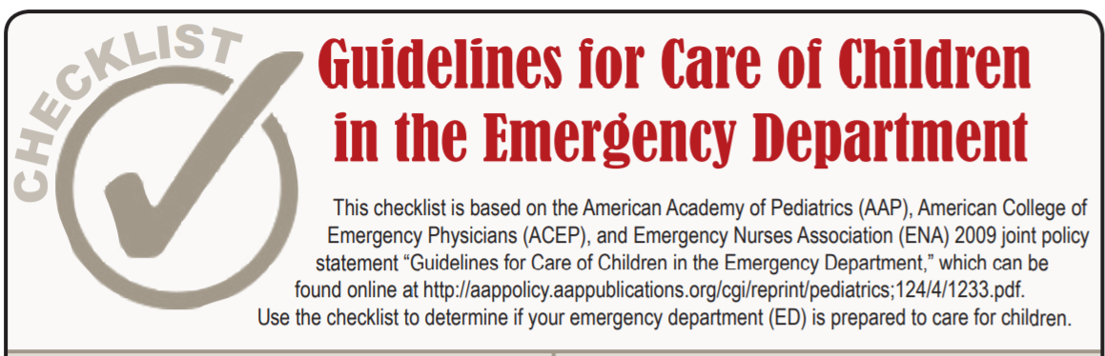
Crisis Standards of Care

Slide 8

Crisis Standards of Care
PedsReady tool kit evaluates how ready a hospital Emergency Department is ready for children
Website : https://emscimprovement.center/projects/pediatricreadiness/readiness-toolkit

Slide 9

Crisis Standards of Care
Staff
  Just in time instructions on treatment of pediatric patients
  Hotline to pediatric experts for clinical advise for non-pediatric providers
  Telemedicine for severe cases that cannot be transferred to pediatric specialty centers
Notes:
MDH will support creating and maintaining “hotlines” to pediatric specialists.

Slide 10

Crisis Standards of Care
Special Pediatric Issues
  Psychological support for patient/family and staff
  Patient tracking-unidentified minors
  Patient safety
  Autism concerns
  Children with special needs (technically dependent)
Notes:
Again the Peds Primer has information on the number of caregivers needed to monitor children of each age group.
Refer to the module on children with special needs.

Slide 11
Crisis Standards of Care
Treatment
  See clinical trauma and non-trauma segments
  Airway and Breathing most important for the stabilization of pediatric patients
Frequent assessment of patients

Slide 12

Crisis Standards of Care
Transport
  Pediatric surge plan
  Keeping families together when possible
  Behavioral health
Notes:
Facilities plan from ped surge work
Decisions will need to be made to care for families adults at children’s hospitals and children at primarily adult hospitals to keep them together.

Slide 13
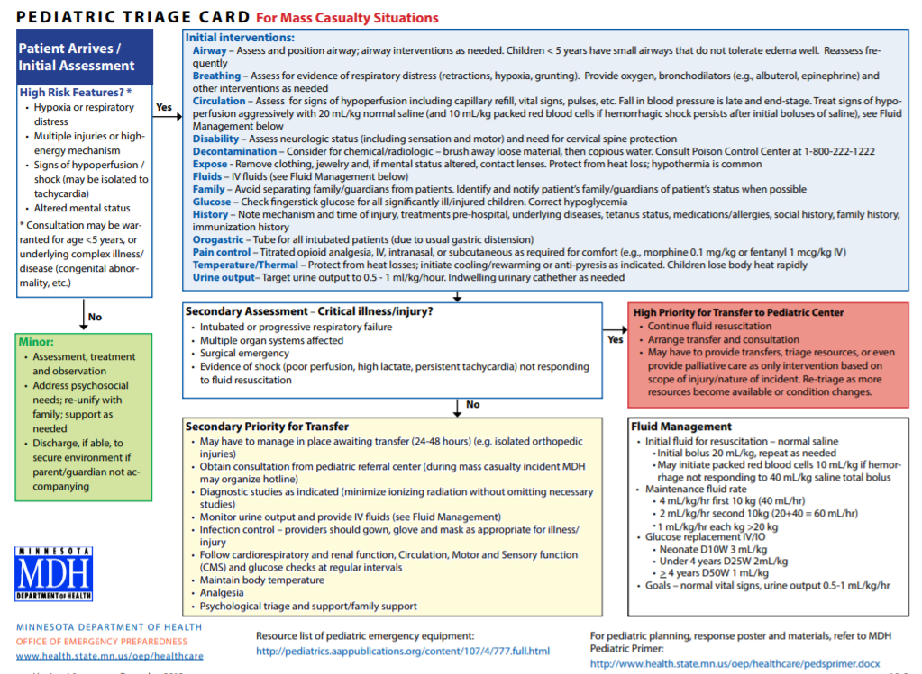
Notes:
Pediatric triage card from MDH Crisis standards of care

Slide 14
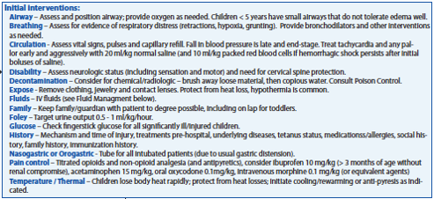
Pediatric Disaster Poster
Notes:
Poster is part of MDH Crisis standards of care. It is a basic guide on pediatric care.
This is acute stabilization.

Slide 15
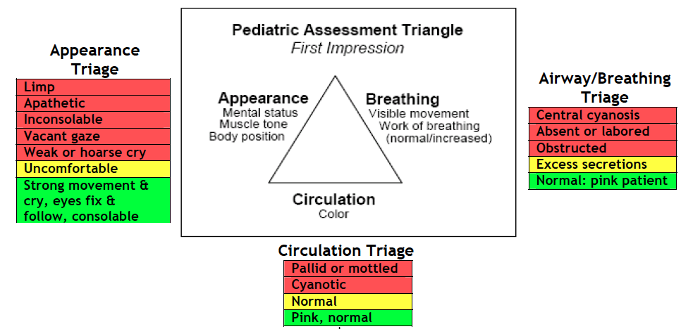
Pediatric Assessment Triangle
Notes:
Basic pediatric assessment

Slide 16
Conclusion
MDH Website Crisis Standards of Care: http://www.health.state.mn.us/oep/healthcare/crisis/standards.pdf
AAP PedsReady Website : https://emscimprovement.center/projects/pediatricreadiness/readiness-toolkit

Slide 17
Thank you!
Pediatric Surge Project
Health.HPP@state.mn.us
651-201-5700

