Slide 1

Pediatric Surge
Non-Traumatic Disaster
Dr. Paula Fink Kocken, Children’s Minnesota | Dr. Ashley Strobel, Hennepin County Medical Center
2018

Slide 2
Objectives
After viewing this module, the participant should be able to:
Illustrate the unique physiological problems children have during a mass poisoning incident.
List the common substances which could result in a mass poisoning incident.
Identify universal issues children have during infectious epidemics making them more vulnerable to illness.

Slide 3
Non-Traumatic Disaster: Overview
Poisoning
  Pediatric Unique Issues
  Poisoning types
    Neuro-toxic poisons
      Acetylcholinesterase inhibition
      Organophosphate insecticides
      Nerve gases (terrorism)
    Chemical Asphyxiants
      Cyanide
      Carbon monoxide
  Poisoning types (continued)
    Respiratory
      Hydrocarbons
      Corrosives
      Irritants
        Crowd control substances (tear gas)
        Chlorine/Ammonia
    Drug overdose
      Opioid derivatives
      Other (“spice”)
Notes:
This is an overview of the presentation.

Slide 4
Non-Traumatic Disaster: Overview
Infectious
  Pediatric Unique Issues
  Infectious types
      Terrorism
        Anthrax
        Botulism
      Epidemics
        Pertussis
        Influenza
        Highly Communicative Infectious Diseases (HCID)
Universal pediatric issues
  Family support
  Behavioral
  Scene safety
  Identification
Notes:
This is an overview of the presentation.

Slide 5

Poisoning
Children are curious and not self aware
  Naturally run towards disasters
  May not recognize they are ill
    Delay in seeking help when they feel sick
    May collapse without being seen
  Resist wearing personal protective equipment
    Result in a higher dose of poison
    Result in wider spread of poison
Notes:
Children are lower to the ground and will get a high dose of toxins which are often heavier than air.

Slide 6

Poisoning
“The Canary in the Coal Mine”
  More likely to become toxic
    Closer to the ground/inhale heavy gasses
    Faster respiratory rate/larger dose inhaled
    Faster rate of metabolism
    Faster absorption of poisons/thinner skin
    Greater susceptibility to seizures
    Greater ratio of surface area to size

Slide 7
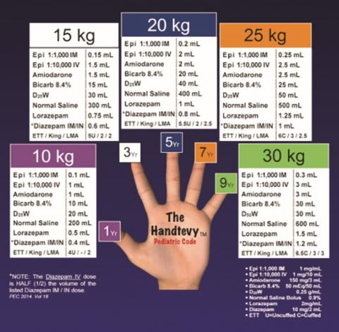
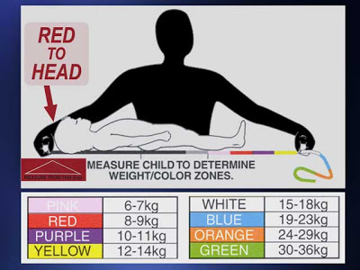
Poisoning Treatment
  Antidotes specific to size and age of child
    IV vs IM vs IN mode of medication delivery
    Dose medications as mg/kg
Notes:
-In a controlled situation, the intravenous route for medications is the common way to administer medications. During a disaster situation, alternate routes like intra nasal (IN) and Intra-muscular route should be used.
-Many medications can be given IN like Versed and fentanyl.
-Patient’s weights should be estimated by a length based method and antidotes given according to weight. Maximum dosage should be according to the adult maximum.

Slide 8

Poisoning Treatment
Need closer monitoring
  Empower family members
  Oxygen saturation and Heart rate monitoring
  Status changes faster
    Faster metabolic rate
    Loss of temperature faster
    Less able to handle shock
  Lower glucose stores
    Monitor frequently
    Give Glucose as needed
Notes:
-Children clinically change quickly and during a surge of patients, there will not be enough skilled staff to monitor each patient. Family members and friends should be impowered to monitor and maintain their family members.
-Children should be monitored closely for hypoxia and tachycardia since abnormalities in these signs can indicated deterioration of status.
-Hypoglycemia is common in children who are ill or injured. For glucoses less than 60 mg/dl, D10 can be given. 4-5 ml/kg as a bolus.

Slide 9
Cholinergic Poisoning
  Organophosphate (Insecticides)/Nerve gases (terrorism)
    Cholinergic Toxidrome
      SLUDGE
        Salivation
        Lacrimation
        Urination
        Defecation
        GI complaints (Cramps, Diarrhea, etc.)
        Expectorate (Vomiting/Spitting)
Notes:
Farm insecticides (Malathion and Diazinon) and nerve gases poison Acetyl-Cholinesterase resulting in the toxidrome of SLUDGE or DUMBELS

Slide 10
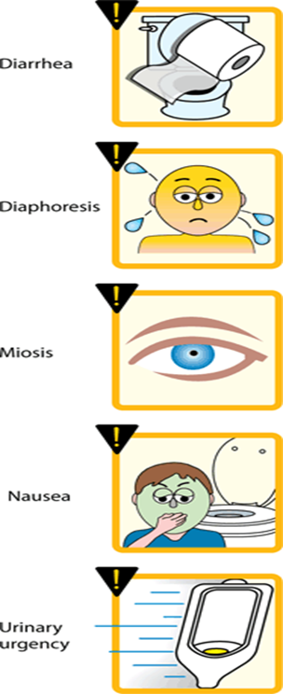
Cholinergic Poisoning
    Cholinergic Toxidrome
      DUMBELS
        Diarrhea
        Urination
        Miosis- small pupils
        Bradycardia
        Bronchorrhea
        Bronchospasm
        Emesis
        Lacrimation
        Salivation
        Secretion
        Sweating

Slide 11
Cholinergic Poisoning
  Organophosphate (Insecticides)/Nerve gases (terrorism)
    Decontaminate
      Wet vs. dry
      Pediatric concerns (water temp./picture instructions/stay with family)
    Treatment
      Atropine: give in repeat doses until secretions decrease and airway resistance lessens
      Pralidoxime: give once
      Benzodiazepines: for seizures and severe exposure
Notes:
-If the patient is visibly contaminated, they should be decontaminated before taken into an enclosed area or hospital. Most contamination, up to 90%, can be removed by having the patient remove their clothes. If there has been a wet contaminant or the patient has minimal clothes on, they may require wet decon. If contamination is a dry powder, brush it off rather than use wet decon.
Decon with children present many concerns covered in our module on decon and triage. The biggest concerns involve temperature control and anxiety.
-Atropine is used to reduce the secretions and reduces the difficulty breathing. Doses should be size specific (.1mg/kg, usually 3-5mg per dose) and repeated every 5 minutes.
-Pralidoxime is used to stop the action of the poison and the synapsis. Dose is usually given once (25mg/kg,1-2 g IV)

Slide 12
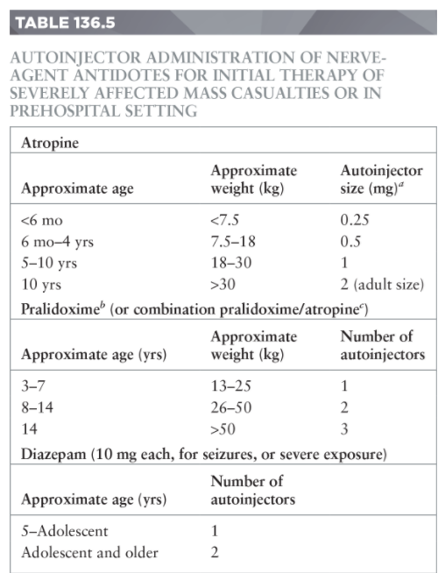
Notes:
Auto injectors, (Duodote or Mark1 kits) I kit for children 5-adolescent and 2 for adults.

Slide 13

Cyanide Poisoning
(Chemical Asphyxiants)
  Cyanide
    Sources
      Suicide, intentional or accidental poisoning
      Structural fires
    Toxidrome
      Cyanosis-”chocolate brown” blood
      Tachypnea
    Diagnose
      Sudden collapse
      Lactate level >8mmol
Notes:
You may see an surge of cyanide poisoning from house or apartment fires. The key is to be aware of this toxin if the patient is not improving with standard smoke inhalation treatment this poison may be the cause.

Slide 14
Cyanide Poisoning Treatment
(Chemical Asphyxiants)
Supportive care
  Oxygen/IV fluids
Cyanide Antidotes
  Cyanokit preferred antidote
    Hydroxocobalamin
  Cyanide Antidote Kit (second line treatment)
    Amyl Nitrite/Sodium Nitrite/Sodium Thiosulfate

Slide 15
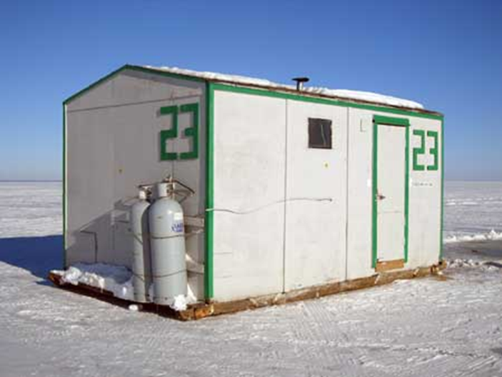
Carbon Monoxide Poisoning
(Chemical Asphyxiants)
Carbon monoxide
  Causes-poor ventilation
    Toxidrome
      Headache, vomiting, lethargy
    Antidote
      Oxygen
    Treatment
      Oxygen
      Consider hyperbaric treatment
      Contact tertiary care center
Notes:
Carbon monoxide poisoning can cause a large number of patients from poorly ventilated venues like hockey rinks. Once again, the key is to recognized the symptoms and treat.

Slide 16
Hydrocarbon Poisoning
(Respiratory Syndrome)
Hydrocarbons
  Causes-Gasoline
    Toxidrome
      Cardio toxic
      Agitation/Somnolence
      Vomiting
      Coughing/Dyspnea/Hypoxia
    Decontaminate
      Be aware, flammable
      Irrigate eyes
    Treatment/supportive
Notes:
Children are more prone to aspiration of hydrocarbon's.

Slide 17
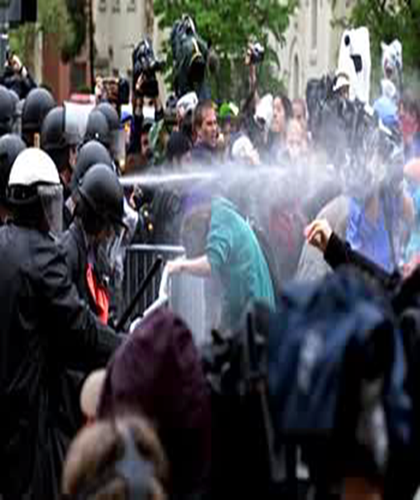
Irritants (Respiratory Syndrome)
Irritants
  Causes-Crowd control gases (tear gas), Chlorine
    Toxidrome
      Airway swelling
      Stridor
      Eye irritation
      Wheezing
    Diagnose
    Decontaminate
    Treatment
      Intubate/CPAP
Notes:
-Off gassing can result in contaminating caregivers. Consider decontamination before moving the patient into the hospital or ED.
-Similar to smoke and heat damage to the airways, irritants can cause edema and airway compromise. Patients may need early intubation and support

Slide 18
Corrosive Poisoning
(Respiratory Syndrome)
Corrosives-Acids and Alkalis
  Causes-Chemical spills (HF,HCL, NaOH,)
    Symptoms
      Pain
      Burns
    Decontaminate
      Irrigate
    Treatment
      Treat as a burn
      HF can bind with Calcium and cause hypocalcemia
Notes:
Powdered alkalis are often harder to wash away and may cause deep burns. Irrigate with water for an extended amount of time. Use pH paper to check to see that the pH has returned to 7-7.5.

Slide 19
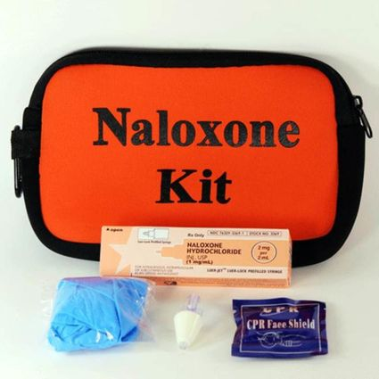
Drug Overdose Poisoning
Opioids
  Pain medications, heroin,
    Toxidrome
      Lethargy
      CNS and respiratory depression
      Hypoxia
      Miosis
    Antidote/treatment
      Naloxone
      Oxygen and ventilation
Notes:
-Multiple intoxications from parties can have a surge of patient to a hospital.
-Repeated doses of naloxone may be needed until the effects of the medication wears off.
-Care should be taken not to leave a patient who has resumed breathing since the naloxone will wear off before the opioid.
-ABC’s should be continued during the resuscitation.

Slide 20
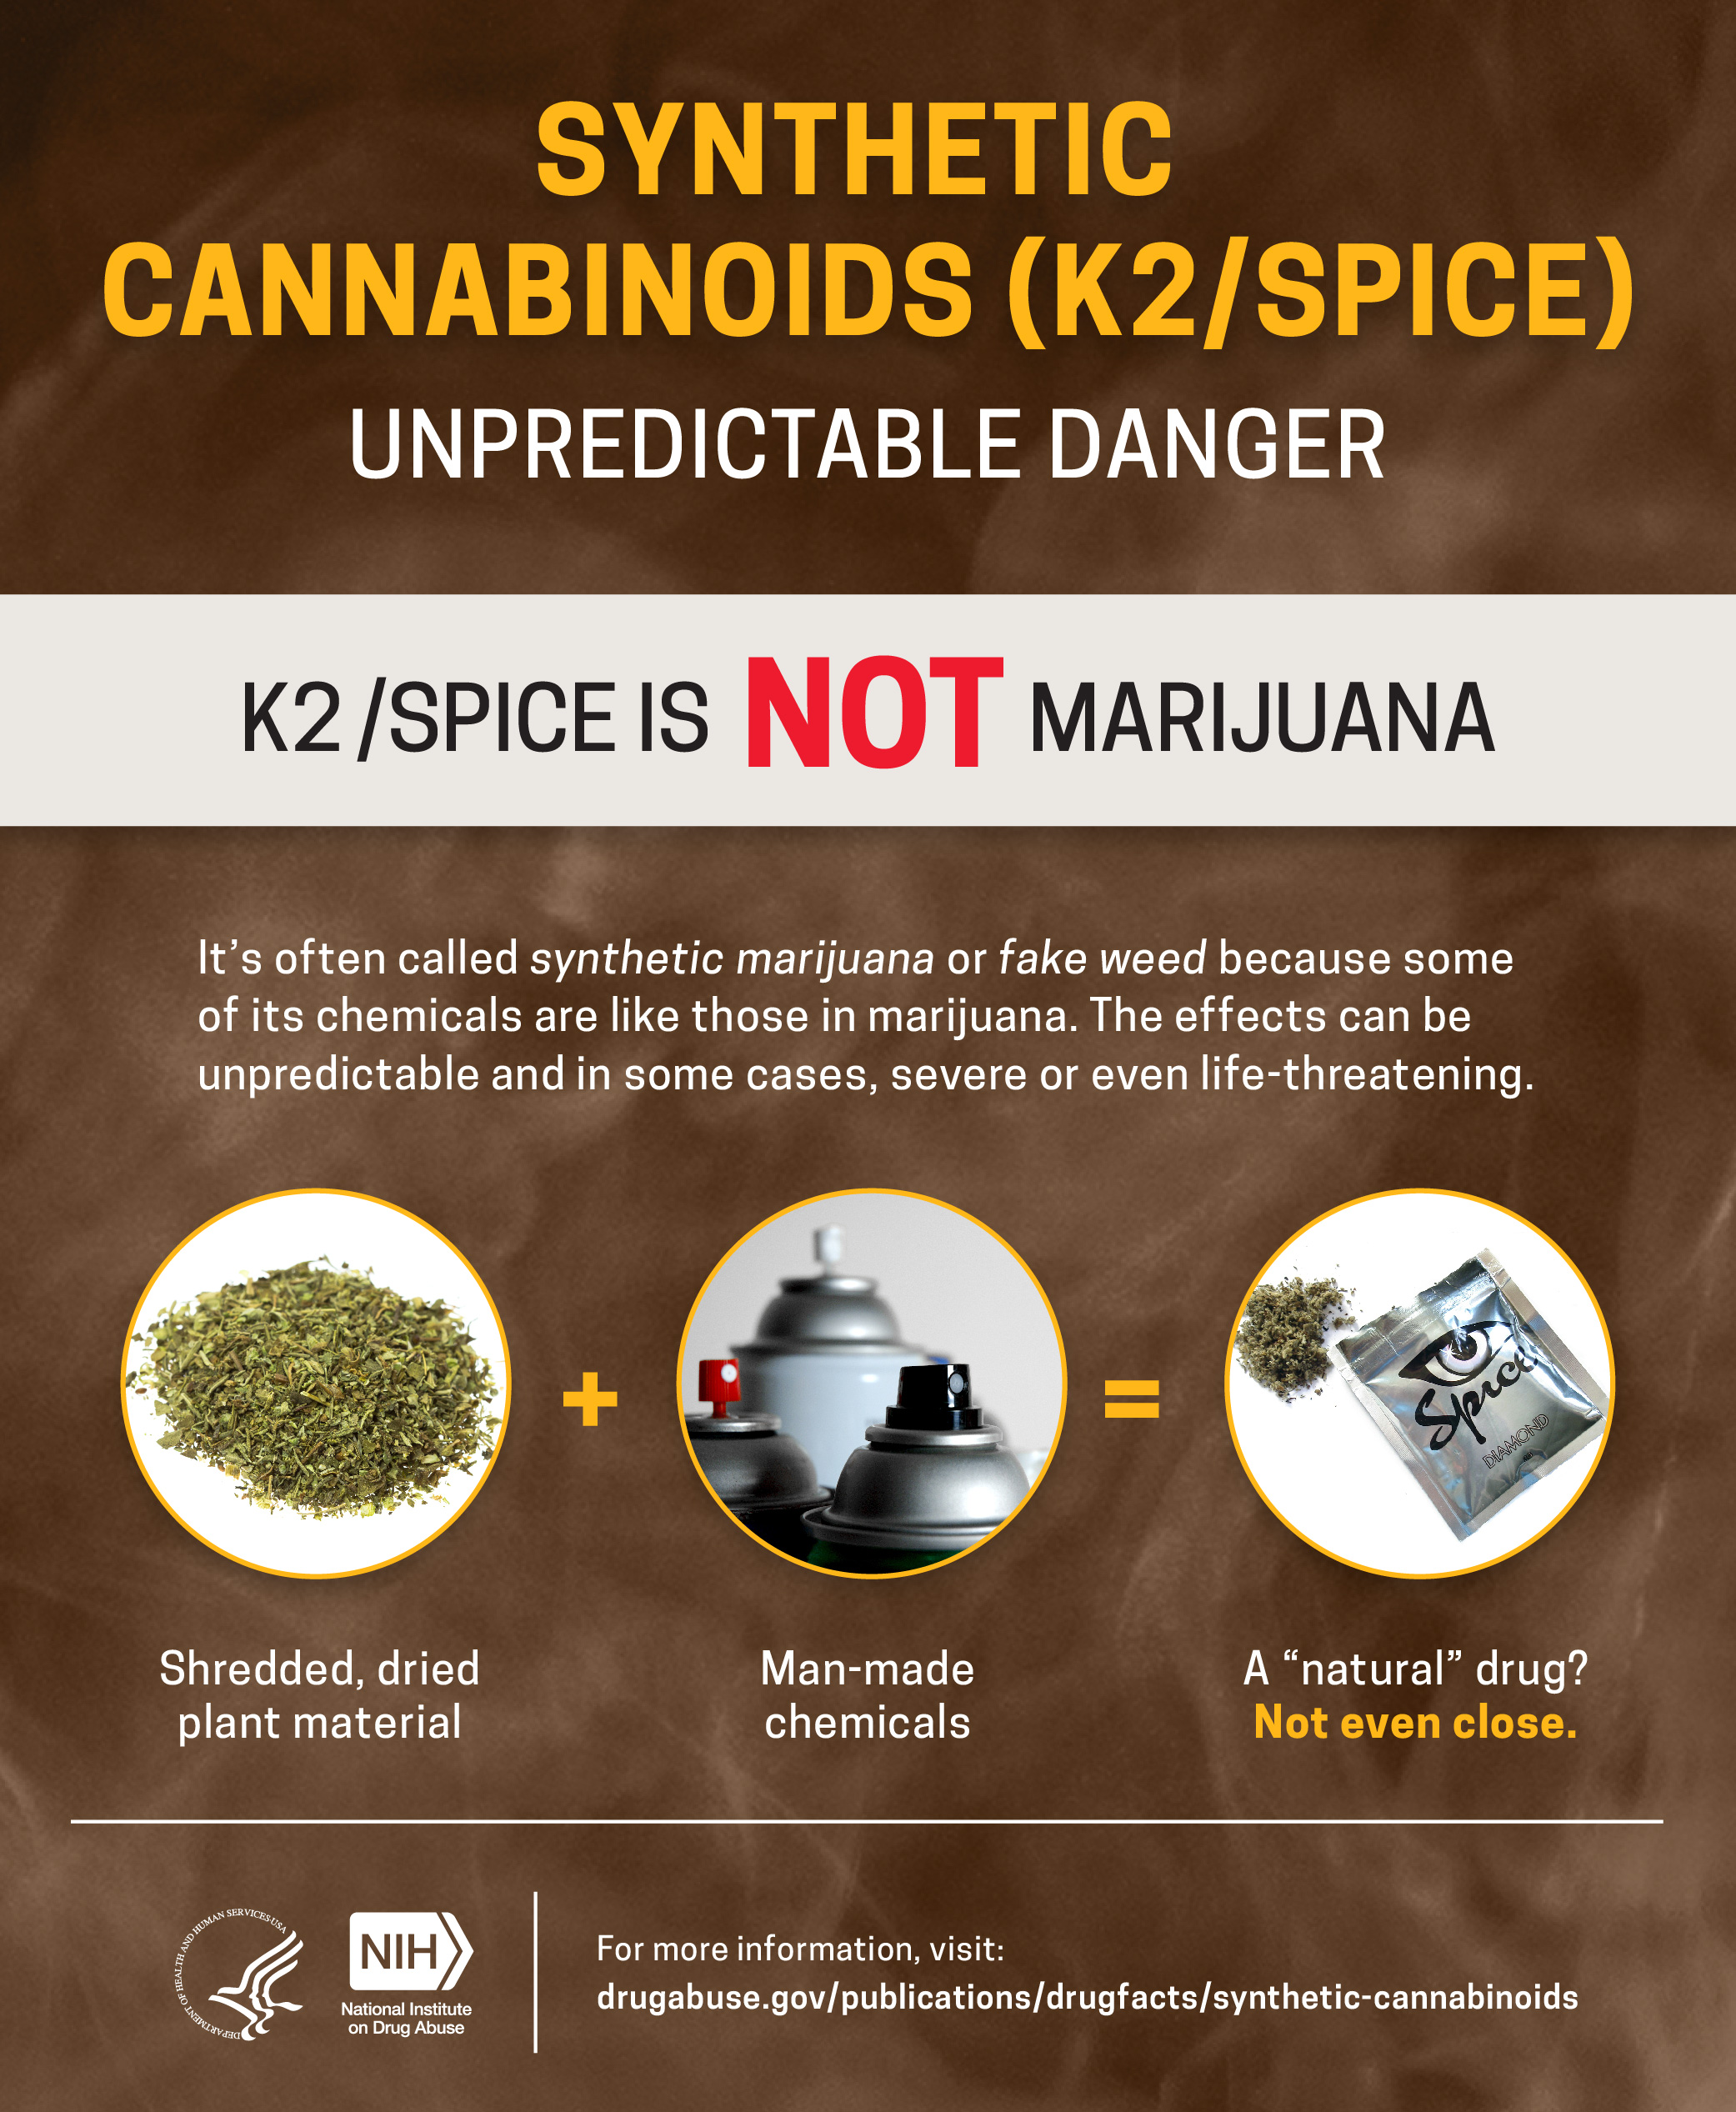
Drug Overdose Poisoning
Synthetic Cannabinoids
    Toxidrome
      No clear toxidrome
      Agitation/somnolence
      Cardiotoxic
      Seizures/Coma/Death
    Antidote
      None
    Treatment
      Supportive care
      Benzodiazepines for agitation and seizures
Notes:
-These can be mixed with a variety of medications so watch for mixed drug intoxications

Slide 21
Infectious Diseases
Pediatric Unique Issues
  May not recognize that they are ill
  Will resist wearing personal protective equipment
  More likely to become infected
    Faster metabolism,
    Faster respiratory rate
    Often held by adults, increasing infection risk
    Surface area greater ratio to size
Notes:
These are the universal pediatric attributes regarding children at stress.

Slide 22
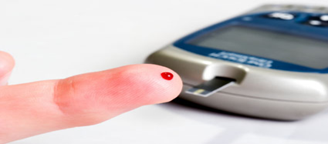
Infectious Diseases
Pediatric Unique Issues
  Antibiotics specific to size and age of child
    Some antibiotics should not be given to children
  Change status faster
    Faster metabolic rate
    Loss of temperature faster
    Become dehydrated faster
    Less able to handle shock
  Low glucose stores
Notes:
Dicloxacillin should not be given to children less than 8.
Frequent point of care glucose checks.
In pediatrics the only sign of shock and dehydration may be tachycardia for age. Once the blood pressure starts to drop, urgent resuscitation is needed

Slide 23
Terrorism
Infectious Diseases
Anthrax
  Powder dissemination
  Antibiotic treatment
    No Doxycycline for < 8 years of age
Botulism
  Contaminated food
  Dehydration
Plague
Small Pox
Notes:
-Anthrax can present with fever and chest pain that is acute onset in children. CXR can show a widened mediastinum. They can develop shock and progress to death within 36h from exposure. Treatment for anthrax in children is Doxycycline even if they are under 8 years of age
-Botulism presents with acute bilateral descending paralysis. Treatment is supportive
-Plague can be pneumonic or bubonic. Pneumonic plague present with severe pneumonia , hemoptysis, cyanosis and septic shock. Treatment is gentamycin and prophylaxis is doxycycline or ciprofloxacin. Bubonic plague presents with tender, enlarged lymph nodes. They can progress to DIC and sepsis. Treatment is the same as pneumonic plague.

Slide 24
Epidemic Agents
Infectious Diseases
Pertussis
  Support respiratory distress
  Contain spread of infection
Influenza
  Support respiratory distress
  Contain spread of infection
Notes:
Pertussis is spread via droplets. Patients can have the classic paroxysmal cough followed by a whoop. Some children can get cyanosis with paroxysms and may need additional respiratory support. Providers should use droplet precautions when taking care of patients with pertussis
-Influenza is most common in the winter months and is spread through droplets. Patient often have respiratory symptoms and can progress to pneumonia, myositis and sepsis. For patient with hypoxia or respiratory distress further support may be necessary. Providers should use droplet precautions.

Slide 25

Epidemic Agents
Infectious Diseases
High Consequence Infectious Diseases (HCID)
  Ebola, SARS, etc.
  Trigger to set off pathway
  Designated and Trained Hospitals
  Designated and Trained EMS
Notes:
State initiative to deal with HCID. Regional hospital is University of MN, state hospital is Mayo and Assessment hospital is Children’s MN.
Slow build/ large impact and long “tail”

Slide 26
Universal Pediatric Issues
Presentation to the Hospital
  Majority will come by family car or police
Family matters
  Keep family members together
  Empower family to monitor/care/advocate for their children
Notes:
When pediatric patients are being treated, many family and friends will come. Patients need to be treated while keeping in mind the need to help the family. When possible keep siblings and parents together if they are stable. Encourage parents or other family members to help watch for any deteriorations or changes in the patients condition

Slide 27
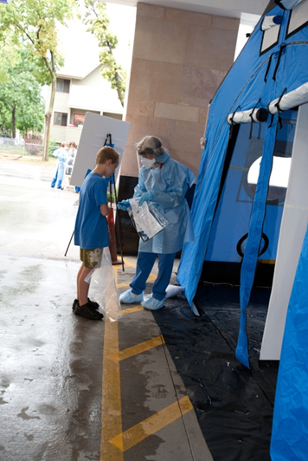
Universal Pediatric Issues
Decontamination
  Family can help decontamination children
  Heat loss
Emotional support
Isolation issues
Notes:
When a child comes in with potential for contamination the first step is decontamination. If the parents or caregivers are present they can help. Children feel more comfortable with a trusted adult present.
With decontamination, keep in mind children many lose heat more rapidly then an adult would. Try and keep the area warm and the patient warm when possible
If there is not a trusted adult present, often child life or volunteers can help stay with the child to provide support and company while caregivers are being treated.

Slide 28
Thank you!
Pediatric Surge Project
Health.HPP@state.mn.us
651-201-5700

