Slide 1

Pediatric Surge
Trauma
Dr. Denise B. Klinkner, Trauma Medical Director, Mayo Clinic | Dr. Michael D. McGonigal, Director of Trauma, Regions Hospital
2018
Notes:
Welcome to the educational segment reviewing pediatric focused trauma in the mass casualty setting. I am Dr. ***, and I will be presenting the key differences between the pediatric and adult trauma patients.

Slide 2
Disclaimer
This session focuses on the pediatric differences and is not inclusive of all trauma management.
Please contact your nearest pediatric trauma center for full support.
Notes:
Please note that this is meant to be a review of key features that affect the care of the pediatric patient and is not inclusive. The nearest pediatric trauma center will be able to provide full support.

Slide 3
Objectives
After viewing this module, the participant should be able to:
Identify the unique physiology of children and their unique vulnerabilities as they relate to trauma.
Identify and manage a pediatric airway.
Identify and manage the differences in pediatric circulation compared to adults.
Notes:
Pediatric patients are not little adults due to their unique anatomy and physiology. Fortunately, severe trauma is uncommon. Yet this means sites outside of a pediatric trauma center will rarely encounter patients who require rapid assessment and recognition of life-threatening injuries. This module will focus on these differences, highlighting airway and circulation in particular.

Slide 4
Assessing the Threat
Is there an existing/continued threat to medical personnel
  Lock down the hospital
Notes:
As with adult scenarios, any person providing aid to the patient must evaluate the safety of the situation. In the field, this may be structural or secondary to a perpetrator. A lock down may be necessary.

Slide 5
Type of Incidents
  Bombing
    Amputation
    Penetrating trauma
  Building collapse
    Crush injury
  Fire
    Burn management
      Pediatric body surface area
    Smoke inhalation
    CO₂
  MVC
    Restrained vs unrestrained
  Natural Disaster
  Shooting
    Penetrating trauma
    Blood loss
Notes:
The types of mass casualty events are similar. One may remember the Oklahoma bombing, which included a daycare with children. When the mechanism is known, one may begin to prepare for the types of injuries that will present. For example, a bombing situation may include blunt injuries from collapse or penetrating injuries from flying glass. A bomb may also start a fire, compounding injuries.

Slide 6
Initial Steps
Determine number of casualties and severity
Activate HICS/identify incident commander
Alert emergency management
Which incident specific resources will be needed?
Notes:
Final numbers of patients are often far different from the original estimates. As we have learned from other incidents, patients may be arriving by private vehicle with no pre-hospital aid given. Development of a process by which triage happens will be addressed in the Operations/Incident Management section.

Slide 7
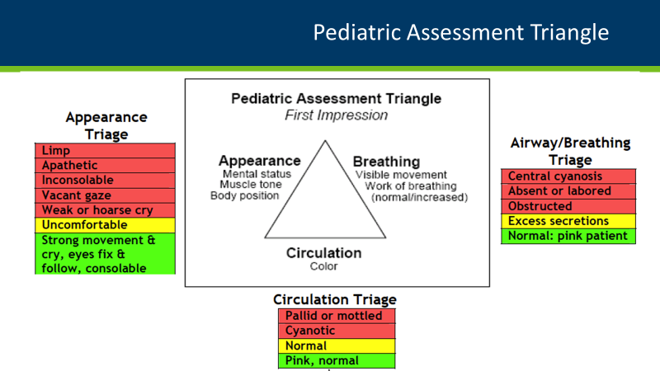
Notes:
The initial assessment of the patient is simplified here in the pediatric assessment triangle. This is our first impression as the patient comes through the door. Do they appear to be in distress? Are they too quiet? This is more concerning in a pediatric patient. Are they working to breathe? Finally, are there obvious signs of bleeding or poor perfusion?

Slide 8
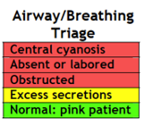
Airway
Airway: (open/clear)
  Abnormal: weak/absent cry or speech. Decreased response to parents or environmental stimuli.
  Normal: normal cry/speech. Responds to parents or to environmental stimuli such as lights, keys, or toys.
Notes:
In the pediatric population, airway compromise or loss quickly impacts circulation, which is why we continue to address airway first, as opposed to the ACLS algorithm CAB. Identification of an abnormal airway or concerning appearance leads to a hard stop and intubation, for example.

Slide 9
Work of Breathing
Visible Movement / Respiratory Effort
    Abnormal: Increased/excessive (nasal flaring, retractions or abdominal muscle use) or decreased/absent respiratory effort or noisy breathing.
    Normal: Breathing appears regular without excessive respiratory muscle effort or audible respiratory sounds.
Notes:
Abnormal findings may be more subtle, which is why exposure is critical. Evaluate for nasal flaring as well as accessory muscle use. Retractions and abdominal muscle use is more common in the pediatric patient.

Slide 10
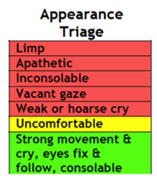
Appearance
Appearance: (muscle tone/body position)
  Abnormal: Floppy or rigid muscle tone or not moving.
  Normal: Good muscle tone. Moves all extremities well and symmetrically
Notes:
In the pediatric population, airway compromise or loss quickly impacts circulation, which is why we continue to address airway first, as opposed to the ACLS algorithm CAB. Identification of an abnormal airway or concerning appearance leads to a hard stop and intubation, for example.

Slide 11
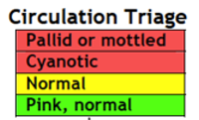
Circulation to Skin
Color / Obvious Bleeding
  Abnormal: Cyanosis, mottling, paleness/pallor or obvious significant bleeding. Delayed capillary refill.
  Normal: Color appears normal for racial group of child. No significant bleeding.
Notes:
Obvious sites of bleeding should be addressed with either a tourniquet on the extremities or compression. Scalp bleeding can be significant due to the excellent blood supply. Compression, hemostatic gauze, and special clips will typically stabilize this bleeding until definitive management. Cyanosis, mottling, and pallor are late findings of blood loss. Capillary refill will be delayed prior to those findings. Immediate access and volume resuscitation must be initiated when abnormal findings are noted.

Slide 12
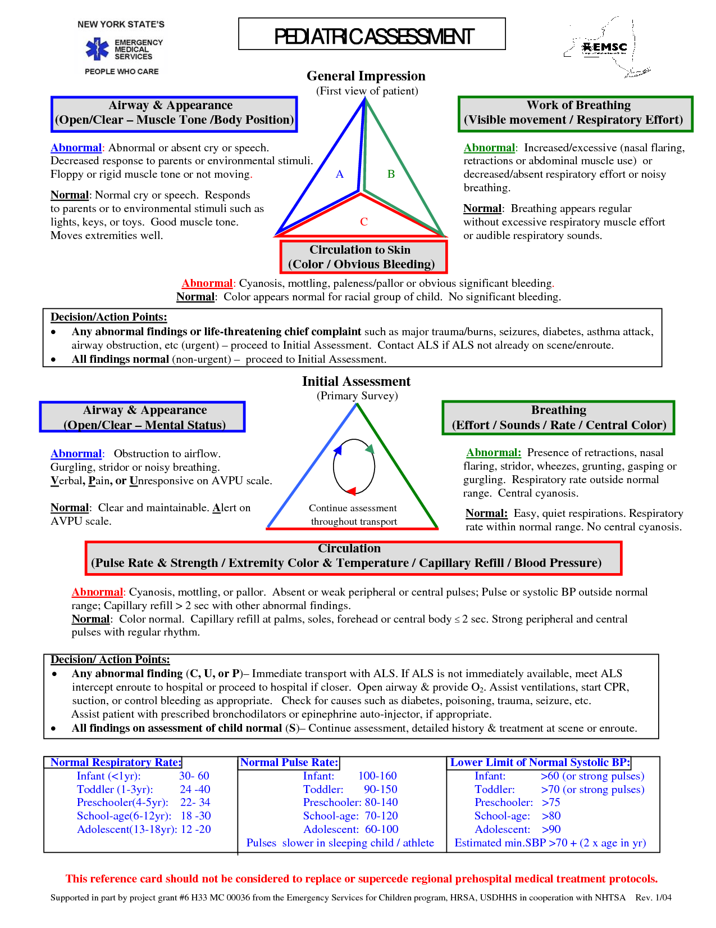
Notes:
New York State EMS has developed this reference card for pediatric assessment which apply to medical and traumatic patients. This or a similar reference guide are helpful when encountering the pediatric patient, particularly if this is not part of daily practice.

Slide 13

Focused Exam
Airway
Breathing
Circulation
Disability
Exposure
Notes:
In this next section, we will cover the specific anatomic and physiologic differences as we progress through the normal trauma primary survey.

Slide 14
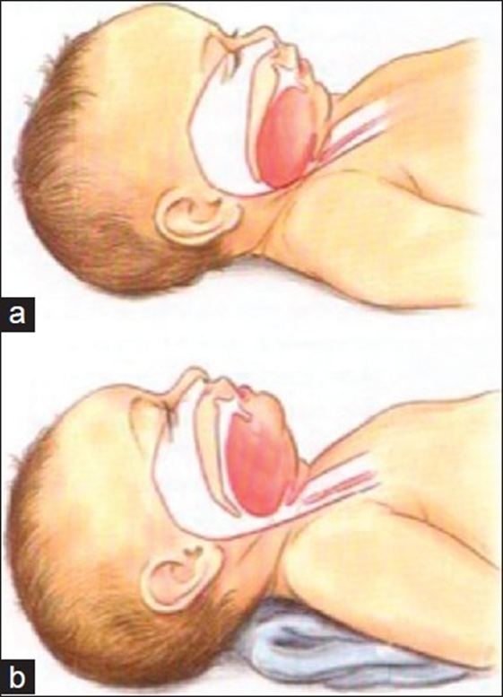
Airway
Small and anterior
Occiput
  Positioning using blankets under the back
Large Tongue
Consider oral airway
Oral suctioning
Notes:
The pediatric airway is smaller and more anterior than the adult airway. In addition, the larger occiput of a child causes flexion, more difficult exposure of the airway, and the larger tongue flops over, further compromising the airway. Since the spine has not been cleared in the trauma patient, it is critical to maintain neutral spinal alignment by placing blankets under the entire torso of the child in addition to protecting the cervical spine. The occiput may cause flexion up to 8 years of age, so recognition of its position is key. An oral airway lifts the tongue and allows for easier bagging in the somnolent child. No nasal airways or nasal suctioning should be performed if facial trauma is present. Oral suctioning and visualization of lost/missing teeth is a key step in protecting the child’s airway.

Slide 15
Adequate Oxygen Administration
O’s through the nose
  Low flow vs High flow
Non-invasive ventilation
  CPAP vs NCPAP
Supraglottic airways
BVM (Bag, Valve, Mask)
Intubation Size Formulas
  Uncuffed ETT Size = (Age in years ÷ 4) + 4
  Cuffed ETT Size = (Age in years ÷ 4) + 3.5
  Depth: 3x ETT size (i.e., 4.0 tube, 12 cm)
Emergency Airway
  Cricothyroidotomy
ECMO
Notes:
All trauma patients should have oxygen applied and then weaned when possible. As the need arises, care escalates from nasal cannula to bag-valve-mask ventilation and intubation. If a patient remains easy to bag, continue BVM until all necessary equipment is available. If CPAP is available, it may be considered. However, most trauma patients are at risk of swelling and require more support. Supraglottic airways have become an increasingly favored option for those who rarely perform pediatric intubations. The King device is limited by size to typically around age 12 and older, with size selected based on a height of at least 4 feet tall. A newer product, the i-Gel, has more size options and is easy to place. Once the patient is at the definitive care site, the supraglottic airway is exchanged for an endotracheal airway per institutional protocol. As with adult patients, GCS <8 means intubate. Uncuffed tubes are typically reserved for the neonatal intensive care unit and premature infants. If an uncuffed tube is used, the size is selected by age in years divided by 4, then adding 4. A cuffed tube is age in years divided by 4, then adding 3.5. The appropriate depth is three times the size of the tube. For example, a 4.0 tube should be placed at 12 cm at the gum/teeth. Emergency airways should be performed by trained personnel. For children <12 years of age, ATLS advocates for a needle cricothyroidotomy due to risk of stricture formation, or stenosis. A needle is only effective for 30 minutes, so a definitive plan must be implemented rapidly. In rare situations, extracorporal membrane oxygenation, or ECMO, may be the only option for oxygenation. This is available only at ECMO centers and must be carefully weighed against bleeding elsewhere.

Slide 16
Breathing
  Compliant chest
  Mediastinal shift
  Needle decompression for tension pneumothorax
  Chest tube vs pigtail
Age | Weight | Chest Tube (Fr)
Infant- 2 yr | Up to 10 kg | 12 or 16
Toddler/small child | 10-15 kg | 20
Child | 15-22 kg | 24
Large child/adult | >22 kg | 32 or 36
Notes:
The chest wall of the pediatric patient is significantly more compliant than that of the adult. Because the bone has not yet calcified, the patient may have few signs of a crush injury externally, yet significant pulmonary contusion on delayed imaging. In addition, the mediastinum is not fixed until approximately 14 years of age, which is why thoracic aortic injuries are rare. The lack of fixation, however, means a pneumothorax may quickly lead to tension physiology. Needle decompression uses the same landmarks as the adult patient, as does the subsequent chest tube placement. Of course, one cannot typically pass a finger into the chest of the small child, as the rib spaces are small. Pigtails are typically reserved for isolated pneumothoraces. Most trauma patients are at risk for hemothoraces, prompting placement of a standard tube. A quick guide to size is provided here, modified from the Broselow tape.

Slide 17
Circulation
Signs of circulatory compromise
  HR
  BP
  Capillary refill
  Peripheral Circulation
Notes:
Recognition of late shock is easy, but management becomes difficult. Thus, it is important to recognize early shock in a child, when management is more straightforward. The first abnormal finding will be tachycardia. A child will maintain blood pressure until nearly 30% of the circulating blood volume has been lost. After 45% blood loss, survival drops significantly. For perspective, a child’s blood volume is estimated to be 80 cc/kg, and giving 2 fluid boluses of 20 cc/kg of normal saline means giving nearly half of the circulating volume back as a crystalloid. We will review fluid resuscitation later in this presentation.
Capillary refill that is prolonged greater than 2 seconds is a secondary finding that is most consistent with moderate to severe volume loss. Children will clamp down, or increase their vascular resistance, so cold extremities are a sign of shock or hypothermia. The oxygen saturation probe will have poor to no waveform; changing it may help, but if no signal can be obtained, trust this as a sign of poor peripheral perfusion. In infants and small children, the femoral or brachial pulse is more reliable.

Slide 18
Normal Heart Rate (per minute) by Age
Age | Awake Pulse | Mean | Sleeping Pulse
Newborn-3months | 85-205 | 140 | 80-160
3months-2years | 100-109 | 130 | 75-160
2-10yo | 60-140 | 80 | 60-90
>10yo | 60-100 | 75 | 50-90

Slide 19
Normal Respiratory Rate by Age
Age | Breaths per Minute
Infant (<1yo) | 30-60
Toddler (1-3yo) | 24-40
Preschooler (4-6yo) | 22-34
School-age child (6-12yo) | 18-30
Adolescent (13-18yo) | 12-16

Slide 20
Normal Blood Pressure
Age | Systolic Pressure | Diastolic Pressure | Mean Arterial Pressure
Neonate | 67-84 | 35-53 | 45-60
Infant (1-12 mo) | 72-104 | 37-56 | 50-62
Toddler (1-2 yo) | 86-106 | 42-63 | 49-62
Preschooler (3-5yo) | 89-112 | 46-72 | 58-69
School-age child (6-7 yo) | 97-115 | 57-76 | 66-72
Preadolescent (10-12 yo) | 102-120 | 61-80 | 71-79
Adolescent (12-15yo) | 110-131 | 64-83 | 73-84

Slide 21
Threshold by Age of Systolic BP indicating Hypotension
Age | Systolic Blood Pressure
Term neonates (0-28days) | Less than 60
Infants (1-12 months) | Less than 70
Children 1-10 yo | Less than 70 + (age in years x 2)
Children >10yo | Less than 90

Slide 22
Vascular Access
Peripheral IV, ideally 2
Intra-osseous line (IO) if no IV in 5 minutes
Cut-downs and central lines rarely done in ED
Notes:
As in adult patients, two large bore IVs should be placed to assist with medication and fluid administration. When rapid placement is not possible, intraosseous access must be obtained and used to facilitate resuscitation. Unlike an IV, one does not need to be able to withdraw from the IO, but one should be able to flush it, carefully monitoring for stability, leaks and subsequent compartment syndrome when infusing. Consider giving lidocaine during the first infusion to treat the pain of infusion. An IO is used for transfusions, central medications, and may be used to infuse IV contrast. Common locations are in the proximal medial tibia, proximal humerus, distal femur, and iliac crest. The sternum is rarely used secondary to size and space limitations. The IO should be replaced with alternative access within 6-12 hours, although it may be used up to 72-96 hours. Due to the ease and speed with which an IO can be placed, cut-done venous access and central lines are now rarely performed in the emergency room.

Slide 23
Contraindications for IO
Fracture of the extremity you are going to place the IO
Previous attempt at the extremity
Inability to locate landmarks
Relative contraindications
  Cellulitis at the entry site
  Burning sensation at the entry site
Notes:
For the trauma patient, common contraindications include a fracture of that extremity and previous attempt to place an IO at that site. An attempt should not be made if the landmarks are not clear. Other considerations include diagnoses of osteogenesis imperfecta, osteopenia, and osteopetrosis. Infection at the entry site is a relative contraindication and less common in the acute trauma setting.

Slide 24
Managing Poor Circulation
Average pediatric blood volume 80 ml/kg
Fluid replacement should start with boluses of 20/kg normal saline or Ringer’s Lactate
Consider giving blood products early
Notes:
Remember that we may treat adult patients like pediatric patients, but not vice versa. The adult patient averages 70 ml/kg; 2 liters will give the 70 kg patient approximately 28 ml/kg. However, the 12 kg pediatric patient would receive 83 ml/kg, which is more than the average pediatric blood volume! Weight based resuscitation is necessary, and crystalloid is calculated as 20 ml/kg. Ringer’s Lactate is usually given for burn patients, with normal saline for the remainder. With obvious blood loss, blood transfusions are started at 10 ml/kg. A massive transfusion protocol uses the 1:1:1 rule, with all products calculated safely at 10 ml/kg. These patients require early recognition and transfer to a pediatric trauma center for definitive management if at all possible. Full imaging is not necessary. A chest x-ray or FAST exam performed in the emergency room may direct care.
Inotropes are reserved for patients who have findings concerning for spinal cord injury. These patients will be warm and pink as opposed to mottled and cold. A challenge with a fluid bolus is appropriate, and then initiation of the recommended inotrope by the receiving hospital may be the appropriate next step.
Fluid overload in the pediatric patient is a risk when weight based management is not used or in the massive transfusion setting. One may note new onset respiratory distress, crackles, new oxygen requirement, or a new murmur or gallop.

Slide 25
Managing Poor Circulation
Stop further blood loss
  Direct pressure to bleeding
  Tourniquet limb amputations
Inotropes should be used in when blood loss is not the cause of hypotension
  Spinal shock
  Cardiogenic shock
Signs of fluid overload

Slide 26
Disability
GCS – Age Dependant
Post-impact seizures common
PECARN: Indications for head CT
Spinal Cord Injury
Monitor electrolytes and glucose
Watch for signs of increase ICP
Notes:
The Glasgow Coma Scale is modified in the pediatric patient according to age. The next slide will have a guide for this. A seizure after a closed head injury is more common in the pediatric patient, but fortunately usually limited. You may need to treat with anti-convulsants. In the infant, seizures may be the presentation for non-accidental trauma, and this work up will need to be initiated but often completed at a pediatric trauma center. The indications for head CT have been developed and published by Pediatric Emergency C A Research Network. These are also shared in following slides.
Spinal cord injuries are less common in the pediatric population, but one must be aware that the c-spine injuries are typically higher and injuries may be present without radiographic evidence (SCIWORA). Maintain neutral spinal alignment until the patient can be fully evaluated, keeping in mind that the pediatric occiput is large and will cause flexion injury if the torso is not supported.
Finally, neurologic changes may be secondary to hypoglycemia, as infants in particular have little reserve. Monitor and correct glucose and other electrolyte abnormalities as necessary.

Slide 27
Glasgow Coma Scale
Eye Opening
Best Motor Response
Best Verbal Response
Score | 0-1year | >1years
4 | Spontaneously | Spontaneously
3 | To shout | To verbal command
2 | To pain | To pain
1 | No response | No response
Score | 0-1year | >1years
6 |  | Obeys Commands
5 | Localizes pain | Localizes pain
4 | Flexion Withdrawal | Flexion Withdrawal
3 | Flexion abnormal (decorticate) | Flexion abnormal (decorticate)
2 | Extension (decerebrate | Extension (decerebrate
1 | No response | No response
Score | 0-2 years | 2-5 years | >5 years
5 | Cries appropriately | Appropriate words | Oriented and converses
4 | Cries | Inappropriate words | Disoriented and converses
3 | Inappropriate crying/screaming | Screams | Inappropriate words; cries
2 | Grunts | Grunts | Incomprehensible sounds
1 | No response | No response | No response
Notes:
Here is the Pediatric Glasgow Coma Scale.

Slide 28
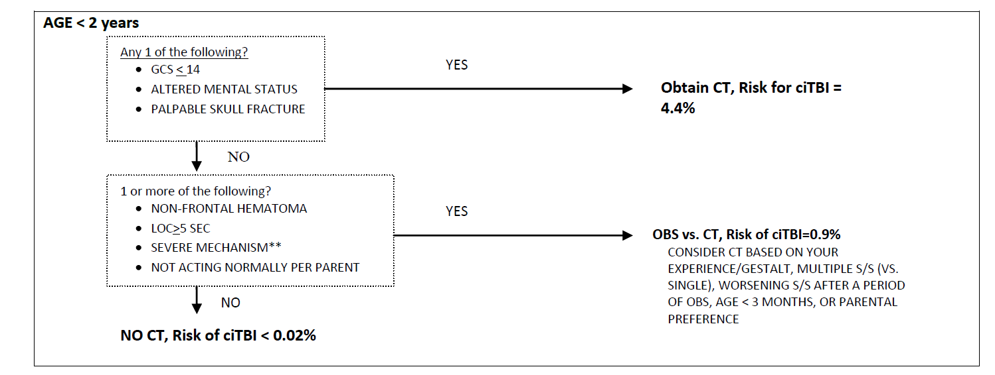
PECARN Head Injury Algorithm

Slide 29
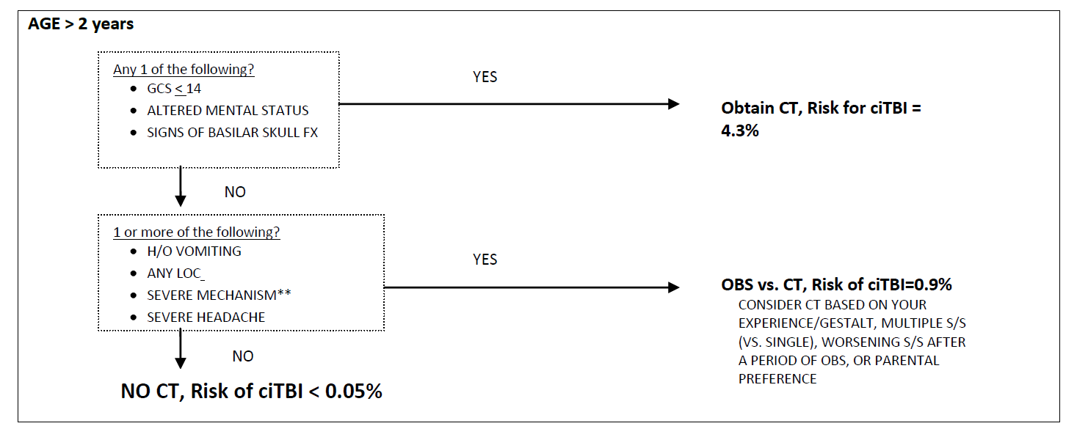
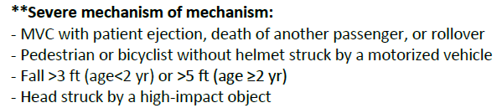
PECARN Head Injury Algorithm
Notes:
Consider anticonvulsant medication for risk of seizures

Slide 30
Spinal Cord Injury
Immobilize C-spine if injury indicates need
  Difficult with nonverbal children
  May need to keep immobilized during transfer
  Penetrating trauma victims may not need C-spine immobilization
Due to large occiput
  Ensure neutral spinal alignment by placing a blanket under the torso, in addition to cervical spine immobilization
  Patient <8 years old
AP/Lat Cervical XR - test of choice not neck CT
Notes:
Because this is unique to the pediatric population, we reiterate the need to recognize pediatric spinal cord protection. Spinal cord injuries are less common in the pediatric population, but one must be aware that the c-spine injuries are typically higher and injuries may be present without radiographic evidence (SCIWORA). Maintain neutral spinal alignment until the patient can be fully evaluated, keeping in mind that the pediatric occiput is large and will cause flexion injury if the torso is not supported. Plain films are the test of choice in pediatrics, and full imaging, if necessary, should be performed at the site that will provide definitive care. In some settings, this may be MRI rather than CT. Comprehensive testing is not needed prior to transfer.

Slide 31
Exposure
Remove all clothing, including diapers
Roll the patient to inspect the back
Children are more susceptible to temperature variation
  Use warming techniques
  More critical given surface area
Notes:
Exposure is the same as the adult trauma patient. However, children are more susceptible to temperature variation and must be covered and warmed as quickly as possible. Bair hugger systems are typically readily available, as are blankets. If at all possible, fluids and blood products should also be run through a warmer to avoid worsening the acidosis of the patient.

Slide 32
Stabilize and Transfer
Ideally, 2 PIV’s
Stable vital signs
Communicate with the receiving hospital
Limit radiological exams, avoid entire body scans
Splint fractures and give antibiotics if open fractures

Slide 33
Stabilize and Transfer
Secure all tubes and lines
Ready medications and blood products if necessary
Copy laboratory results, images and HPI for the receiving hospital
Family
  Give directions to transfer facility to family members
  If not present, sent all information on how to contact family with the child
Notes:
As with any patients transferring to another facility, prepare them by securing all tubes and lines to avoid dislodgement en route. Depending on the services available, medications and/or blood products may need to be sent with the patient. Have records ready to go with the patient, and if at all possible, note if family is available or not yet identified.

Slide 34
Conclusions
Airway: smaller, big tongue, occiput
Breathing: contusions, tension
Circulation: tachycardia→hypotension
Disability: modified
Exposure: keep the child warm
Notes:
In conclusion, the trauma process remains the same in the pediatric patient. One must remember the critical differences: the airway is smaller and easily affected by a large tongue and large occiput. Children are more likely to have contusions of the lungs with no external signs of trauma, and due to their mediastinum, may be more affected by tension physiology. Tachycardia is an early and important sign of volume loss. Hypotension is a late finding and more difficult to manage. The GCS is modified for the pediatric patient, and one must keep the child warm after exposure.
Thank you for your interest in caring for the pediatric patient. Their future depend on us.

Slide 35
Thank you!
Pediatric Surge Project
Health.HPP@state.mn.us
651-201-5700

