Slide 1

Psychological First Aid
A Minnesota Community Support Model
Teens

Slide 2
Why Should You Learn
Psychological First Aid (PFA)?
Helps you to understand stress, and what it does to your mind and body
Gives you simple tools to help yourself, your friends, and your family.
It can be used anytime, anywhere.
Uses skills you probably already have…
Notes:
To the Trainer: The Minnesota model of Psychological First Aid, Teens version, helps you to understand stress, and what it does to your mind and body. Gives you simple tools to help yourself, your friends, and your family. It can be used anytime, anywhere, and
uses skills you probably already have.

Slide 3

What is Stress?
“Stress is the effect of anything in life to which people must adjust.”
  Anything we consider difficult causes stress, even if it is something we want to do.
  The key is that stress forces us to make adjustments (changes) to our thoughts and behavior while at the same time making demands upon our mind & body’s energy.
Adapted from the international Red Cross Red Crescent Society
Notes:
3
To the Trainer: Slide provides a definition of stress

Slide 4
Psychosocial Stress Response
Fear and Distress
Response
Impact of Event
Behavior
Change
Psychiatric
Illness
Adapted from: Source: Butler AS, Panzer AM, Goldfrank LR, Institute of Medicine Committee on
Responding to the Psychological Consequences of Terrorism Board of on Neuroscience
and Behavioral Health. Preparing for the psychological consequences of terrorism:
A public health approach. Washington, D.C.: National Academies Press, 2003.
Notes:
To the Trainer: It is important to realize that the largest number of reactions are “common” in an UNCOMMON situation”. With the appropriate support and assisting techniques you will be able to assist a large number of survivors. A smaller number of reactions are going to be chronic and pathological and will need further professional help.

Slide 5
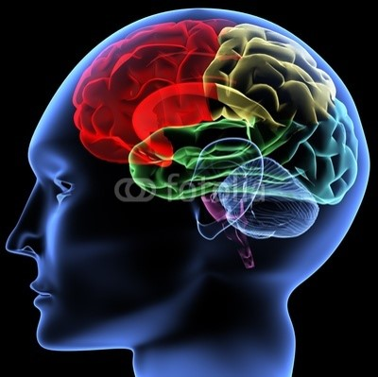
How Stress Works on Your Body
  Under extreme stress your frontal lobe turns off, and your limbic system (cave man brain) turns on.
Notes:
To the Trainer: In order to reduce stress, we need to understand what it does to our mind and body. Under stress, our “Cave man brain” is turned on – concerned only with survival (fight, flight, freeze, faint). Can’t perform higher functions such as reasoning because frontal lobe turns off.
Additionally, the frontal lobe is not fully developed until we are in our early 20’s so it under stress most teenagers easily fall back into a “cave man/woman” thinking mode.

Slide 6
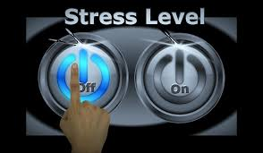
Threat & the Stress Response
  The Stress Response occurs Every Time our brain and body feel threatened
  Just thinking about something stressful can turn on the Stress Response
  When turned ON our brain starts to release over 1,400 chemicals and 30 different hormones that flood our whole body and help us in an emergency.
Adapted from: The Center for Mind-Body Medicine, Debra Kaplan, Lora Matz
Notes:
To the Trainer: This slide discusses what activates our stress response, and how even thinking about something stressful will begin the process of releasing chemicals and hormones throughout our body.

Slide 7


Fight, Flight, or Freeze
  Seen/Felt
  Pupils dilate
  Mouth goes dry
  Muscles tense
  Heart pumps faster
  Breathing becomes fast and shallow
  Unseen
  Brain gets body ready to act by:
  Releasing adrenaline
  Blood pressure rises
  Liver releases glucose for muscle energy
  Digestion slows
Notes:
To the Trainer: Discuss how the body prepares for the “Fight or Flight (or Freeze)” response. In cave man time, or in times when your life is in physical danger this response was necessary for survival, but now days that is not usually the case so the activating the “fight, flight, or freeze” response causes more problems than benefits

Slide 8

Common Physical Reactions Teens
  Sleep problems
  Constipation/diarrhea
  Stomach upset, nausea
  Headaches
  Rash/Acne
  Muscle aches/stiffness
  Sweaty palms
  Feeling out of control of your own body
Notes:
To the Trainer: There will be differences in the number of symptoms that will be manifested by
survivors-some more; some less; Some mild; some severe; some of short duration and others chronic. Often the physical symptoms become less evident with time, but extended physical stress reactions can result in suppression of immune system functioning. It is common for disaster relief workers to experience cold and flu like symptoms a couple of weeks after they finish a deployment. You probably have an experience in your life in which you experienced extreme stress and then after the situation was resolved you came down with a cold, some other physical ailment.
With severe symptoms always refer to a medical professional to determine if there is a underlying medical condition.

Slide 9
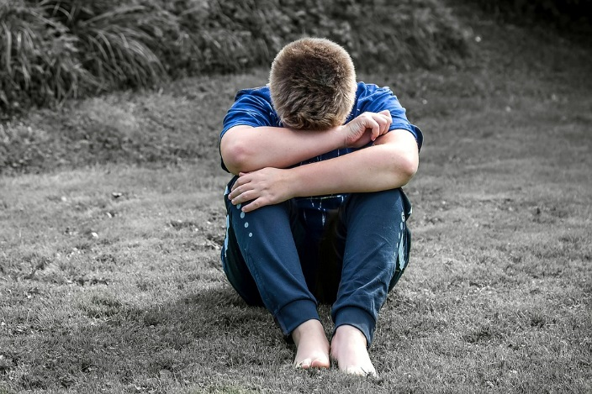
Common Emotional Reactions Teen
  Fear or Anxiety
  Sadness or Tearfulness
  Anger or Irritability
  Feelings of inadequacy or worthlessness
  Feeling of guilt
  Loss of sense of “Safety”
  Numb, withdrawn
  Lack of enjoyment in favorite activities
  Feelings of emptiness or hopelessness
Notes:
To the trainer: Emotional pain is a pervasive reaction to intense trauma and may last for many weeks expressed as distress, depression and helplessness. These emotions can be short lived and mild or they may linger for weeks. If symptoms persist after several months you should refer to a Behavioral Health Professional.

Slide 10
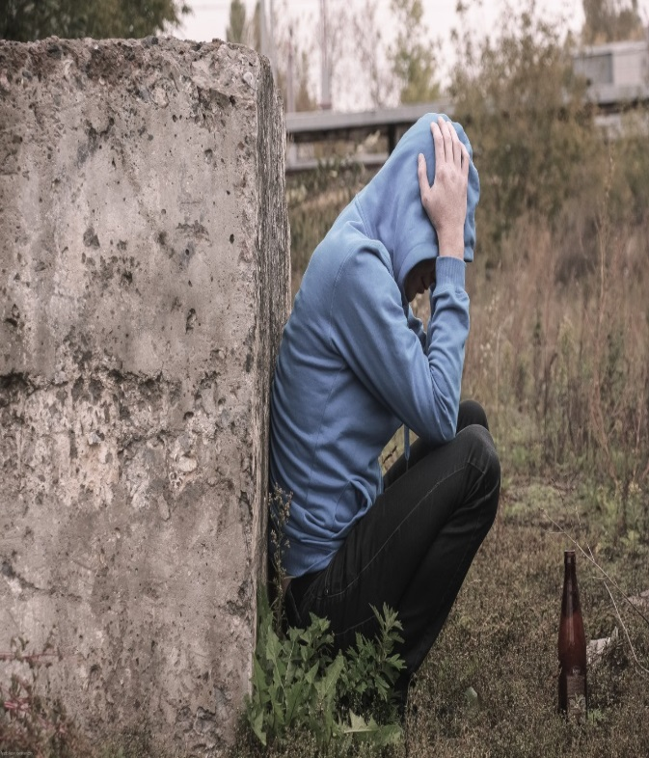
Common Behavioral Reactions Teens
  Impulsive behaviors
    Unsafe sex
    Alcohol/Drugs
  Aggressive behaviors
    Bullying
    Arguments with friends and family
  Isolation/avoidance
    Places, activities, or people that bring back memories
Notes:
To the Trainer: Help people understand that some coping behaviors can lead to increased risk: alcohol & drug use/abuse, risky behaviors, Hyper alertness (especially in returning soldiers), Denial or avoidance of disaster impact, and misplaced anger at loved ones and friends can occur that may lead to self harm or bullying behaviors.
. If you discover an danger to self or others situation (suicidal thoughts, abuse to a child or a vulnerable adult, or an expression of homicidal intentions) you must immediately report it to a trusted adult or refer to a behavioral health professional and/or law enforcement.
If symptoms persist after several months you should refer to a Behavioral Health Professional.

Slide 11

Common Cognitive Reactions Teens
  Difficulty concentrating, feeling spacey
  Difficulty with remembering things
  Not able to forget about it (Intrusive Memories)
  Day dreaming
  Recurring dreams, nightmares
  Feeling on edge/watching out for danger
Notes:
To the Trainer: Flashbacks are normal and differ from psychosis in that the individual is briefly re-experiencing an actual past traumatic event triggered by a new sensory exposure. – we will discuss sensory reactions in a latter slide. Due to difficulty with concentration, the worker should expect hesitation, silence, fragmented sentences and tangential associations in the conversation with survivors during the first week. At times you may be inpatient when the survivor is slow in establishing a relationship or answering your questions because you are aware of the time it is taking, but you need to be aware that the survivor is doing the best they can to oblige you.
To help people when they are experiencing cognitive reactions, and you need to impart medical information –
Ask them if they would like to have someone else present while you explain things, but remember that person may also be experiencing disaster reactions.
Provide the information in very simple language.
Repeat if you feel it is necessary.
Give the information to them to them in writing at a 6th. Grade language or less.
If symptoms persist after several months you should refer to a Behavioral Health Professional.

Slide 12
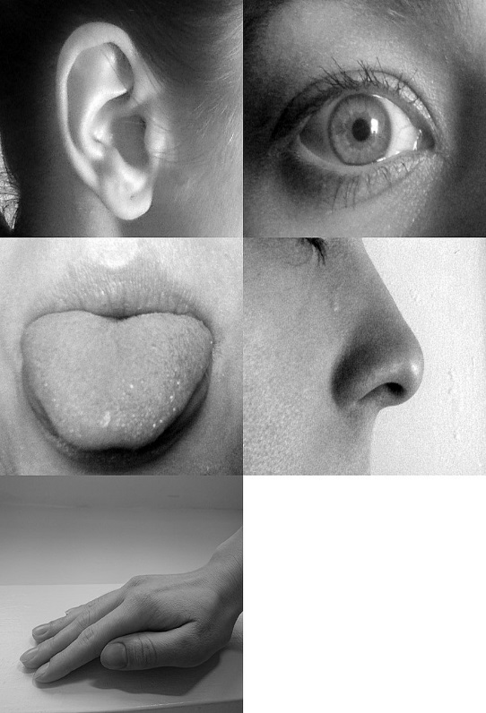
Common Sensory Reactions Teens
  Sight
  Sound
  Smell
  Taste
  Touch
Notes:
To the Trainer: Senses have the power to diminish or intensify stress responses.
Under stress, sensory responses are compromised, and can be imprinted with sensory memories of the event.
New sensory experiences can trigger these memories. Responders from 911 report that the smell of fuel and smoke brings back strong memories of the disaster. Certain songs remind us of key time frames in our life.
Many people that have gotten food poisoning or gotten sick after eating a meal (even if that meal was not in any way connected to their illness) feel physically ill at the thought or even the sight of that food. Certain textures elicit comfort – teddy bear therapy.

Slide 13

Common Spiritual Reactions Teens
  Comfort in our faith community
  Moving closer to our beliefs
  Moving away from our belief system
  Anger at what we see as an injustice
  Developing a new viewpoint of the world
Notes:
To the Trainer: We are a mixture of mind, body, and spirit, and as such we need to remember to address each of these aspects in dealing with our stress. Our spiritual beliefs can be our strongest source of stress in times of crisis, but when the crisis does not easily fit into our belief system it can turn us away.

Slide 14

What Helps Us Deal with Stress?
  Being able to look at what happened
  Without blame to self or others
  Understanding our stress reactions
  Feeling like we have some control over what is going on in our life.
Notes:
To the Trainer: People adjust to the changes that are forced upon them by finding ways to understand and accept our losses, understand our emotional reactions, and regain a sense of mastery and control of the situation.
Healthy adjustment can result in healthier behavior, increased functioning and self-confidence.
Unhealthy adjustment increases your risk of developing physical illness, a dependence on unhealthy coping mechanisms (addictive behaviors), and in some cases Clinical Depression or Post Traumatic Stress Disorder.
HOW CAN WE HELP? (transition to next slide)

Slide 15
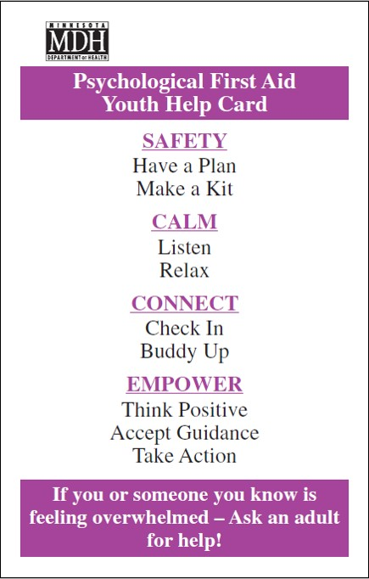
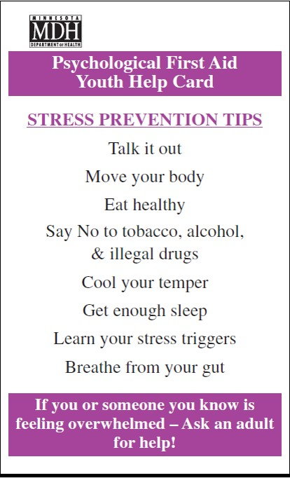
Youth PFA Card
Notes:
To the Trainer: Hand out the Youth PFA cards

Slide 16
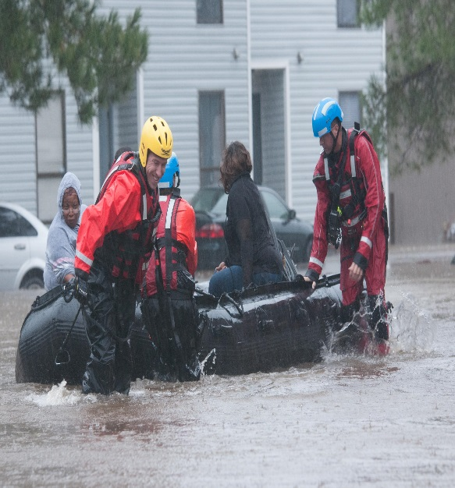
Promote Safety
  Remove from immediate danger area as soon as possible
  Meet basic survival needs
Notes:
To the Trainer: In all responses, SAFETY FIRST! Why is this important to psychological first aid?
Because the first psychological need people have is to be fed, clothed, warm and to know where they will be getting basic needs met. At these times it is not helpful to talk about common reactions to stress. People simply have too much noise in their heads to process the information. Initial responses involve helping people access their basic needs, or understand how to access them.

Slide 17
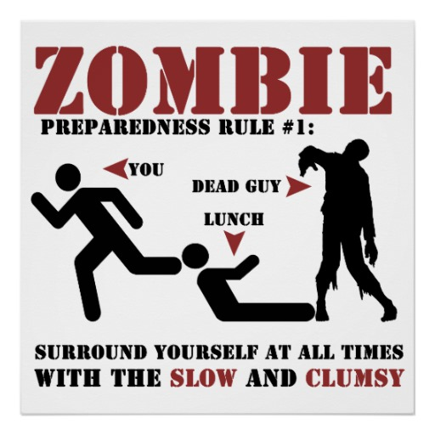
Safety
Remember Safety First!
Make a Plan
  Take steps for becoming prepared for emergencies
  Develop a family emergency communications plan
  Determine an emergency meeting place
  Learn about local resources & support services
Notes:
To the Trainer: In all responses, SAFETY FIRST! Why is this important to psychological first aid?
MAKE A PLAN-
Because the first psychological need people have is to be fed, clothed, warm and to know where they will be getting basic needs met. At these times it is not helpful to talk about common reactions to stress. People simply have too much noise in their heads to process the information. Initial responses involve helping people access their basic needs, or understand how to access them.

Slide 18
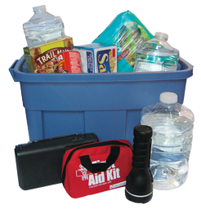
Safety
Make a Kit
  Be prepared to take care of yourself in an emergency
  Personal “To Go Kit”
  Safety tools
  Food/water
  Medication
  Entertainment
  Winter Car Kit
  DRAT! (Readiness Actions for Teens)
Notes:
To the Trainer: MAKE A KIT- having the supplies that you need on hand will increase safety and reduce stress.
DRAT! (Disaster Readiness Actions for Teens) teaches you haw to make a plan and a kit.

Slide 19
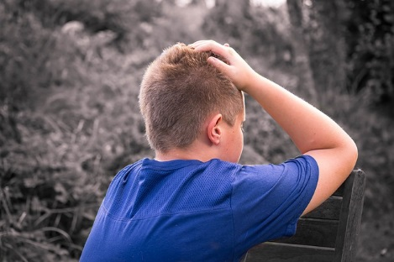
Calm
Listen
  Most often, people just need someone to talk to about their experience
  We all want to know someone to cares about us
  We all want someone to really listen, without judgment
  We all want someone to BE PRESENT WITH US!
Notes:
To the Trainer: LISTEN-What people most need is a caring presence – someone to really listen and be with them in the moment

Slide 20

Calm
Use Body Language
  Face the person & eye contact
  Show supportive facial expressions
  Nod your head to show you understand
  Stay relaxed
  Lean in toward the person
Notes:
You provide comfort by active listening.
ACTIVE LISTENING:
Make it clear that you are listening
Provide Vocal/Verbal Support
- Tone of voice (Not too loud)
- Encouraging prompts/head movement
- eye contact (if speaking to someone from another culture check to see if direct eye contact is appropriate)

Slide 21

Use Active Listening Skills
Verbal
  Silence is OK
  Let them tell their story their own way
  Don’t interrupt
  Ask questions to understand
  Don’t judge or ask “Why?” and “Why not?”
  Don’t give your opinion
    Remember it is not about you!
Source: Gerald Jacobs, U.DMHI, 2005
Notes:
To the Trainer: Active listening involves focusing your attention on the speaker in a caring empathic manner. This means showing respect and not interrupting them and asking questions for your own curiosity, or sharing your personal experiences. It is ok to ask clarifying questions so that you can ensure that you understand what you are being told, but it is also ok to just be a silent listening presence. It is also ok to just sit with a survivor and make no communication because your presence alone can provide comfort.

Slide 22

Calm
Relax
  Use Stress Reduction skills
  Deep Breathing
  Muscle relaxation
  Visualization
  Play/Laugh
  Get enough sleep
  Move your body
Notes:
To the Trainer :RELAX-
Provide basic relaxation techniques such as deep belly breathing., visualization or muscle relaxation. If someone is agitated or withdrawn you can use “Grounding” to calm and turn your attention back to the outside world. Sit in comfortable position. Breath slowly in and out. Look around and name 5 non-distressing objects that you can see – shoe, table, etc… Breath slowly in and out. Next name 5 non-distressing sounds you can hear –your breath, door. Clock, etc… Breath slowly in and out. Next name 5 non-distressing things that you can feel – toes in your socks, hands on your lap, etc… Then slowly breath in and out.

Slide 23
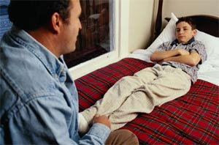
Connect
Check In
  Let people know how you are doing and if you need help
  Let your loved ones know that you are safe
  Talk out your problems with friends, family, and trusted adults
  Connect with crisis support services
  State-wide crisis hot-line (1-866-379-6367)
Notes:
To the Trainer: CHECK IN – it is important to feel connected to others –to know that someone cares about how you are doing . In a disaster the first thing you want to know is if your loved are okay, It is important to “check in” and let others know how you are doing, It is also important for you ‘check in” and let others know if you are struggling. Talking out your problems helps you feel better and get the support that you need.

Slide 24

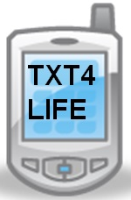

Alarm Bells/Get HELP Now!
Talk with a Trusted Adult
  If you or a friend are talking about:
  Harm to self
    Saying they want to:
    “End it all”
    “Go to sleep and never wake up again”
  Preoccupation with death
  Giving away possessions
  Excessive anger
  Use of substances
    Driving under influence
    Using at school
TEXTME:839863
Keyword: “Life”
Notes:
To the Trainer: Alarm Bells list contains verbal or non-verbal indicators that more help is needed than psychological first aid.
These would be signs that a HELP is needed and you should talk to a trusted adult immediately to make sure that help is provided. NO ONE NEEDS TO SUFFER! Help is always available.
TXT4LIFE – currently just available in the Northeastern MN ((Aitkin, Carlton, Cook, Itasca, Koochiching, Lake, and St. Louis). This suicide prevention program targets students in grades 7 through 12
- How Text Counseling Works
HSI-Crisis Connection uses the same communication procedures, policies and goals that have made telephone crisis support
successful over the years. Youth text into the line using the six-digit number (TEXTME: 839863) and a specific keyword (e.g. “Listen”,
“Life”) listed on social marketing materials. Trained volunteers and staff manage text communications using a secure, web-based
application and standard computer workstations. On a voluntary basis, demographics about the person texting, his/her issues of concern, and outcomes of the text conversation are captured by the counselor and input into our call center data management
system for reporting purposes.

Slide 25
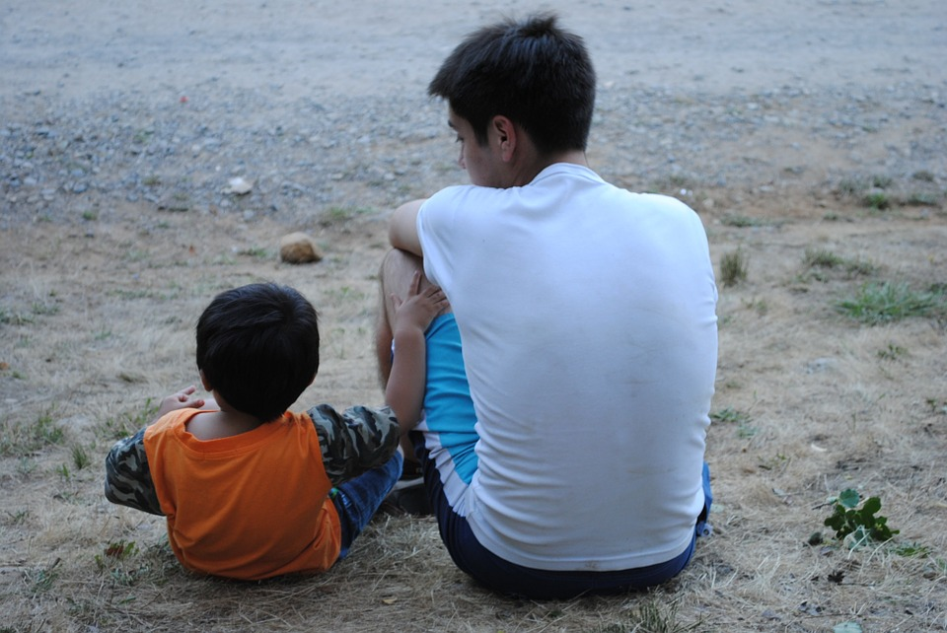
Connect
Buddy Up
  Don’t try to go it alone
  Reach out to others
  Help your friends, family and community
  Helping others makes you feel good too!
  Look out for younger kids or those that might need a little extra help
Notes:
To the Trainer: BUDDY UP- Restoring the individual bonds to the human supportive systems as one of the essential needs of survivors to regain the sense of being part of a community.
Reuniting family members is particularly important when someone has been injured or even killed. It is important also to help them find family to assist with reducing anxiety and promoting calming and soothing.
Helping others (friends, family community members) restores and strengthens self confidence while building both individual and community resilience.

Slide 26

Empowerment
Think Positive
  How we think shapes how we feel!
  Stressful negative thoughts – those “what ifs…..”
    Cause muscles to tense and send our mind a “Danger, Danger” signal
  Positive thoughts – “I can handle this…”
    Allow our body to stay relaxed and tells our mind that we are in control
Notes:
To the Trainer: THINK POSITIVE- How we think shapes how we feel. Negative thoughts create negative feelings and positive thoughts create positive feelings. It is easier to learn how to how to find a positive in a negative situation than it is to make ourselves feel better if we are thinking negative thoughts about yourself.. Even when you are faced with only negatives, you can create a positive by acknowledging that you have the power to decide how you will react to the situation.

Slide 27

Empowerment
Accept Guidance
  Sometimes we all need a helping hand
  Give yourself a break
  Allow other to help you with problem solving
  It is a sign of strength to know your own limits and to ask for help
  Learn from your past experiences
  the successes as well as the mistakes
Notes:
To the Trainer: ACCEPT GUIDANCE-It is okay to ask for help to address most pressing needs and to set an action plan of how to address that need. Helping others assists you in the recovery process – your own and your community’s.
Learning from your mistakes and successes helps to build individual resilience.

Slide 28

Empower
Take Action
  Learn what triggers stress for you
  Learn to be flexible with life
  Take care of your body and your physical health
  Take care of your mind by stretching your mental muscles
  Practice stress reduction and self care daily
Notes:
To the Trainer: TAKE ACTION- Understand how you react to stress. Do you feel it as: Shoulder pain, Headaches, Stomach problems? Learn to recognize when you reach your stress limit. Remember what are the common reactions to stress. Use healthy coping skills – what has worked for you in the past? Assisting others in physical or emotional pain may start to affect you so you should be constantly aware of your own reactions. Emotional pain and anxiety are “contagious” and will affect you so continue to monitor yourself for stress reactions.

Slide 29
Teen PFA Resources
Resilience for Teens: Got Bounce?
(American Psychological Association) http://www.apa.org/helpcenter/bounce.aspx
Minnesota Department of Health, Behavioral Health Web page https://www.health.state.mn.us/communities/ep/behavioral/index.html
Just-in-Time PFA Training video -11 minute video based on the MDH Adult PFA First Aid Card https://www.youtube.com/watch?v=sa7WiL1xwQg
Notes:
To the Trainer: Teen PFA resources and the MDH web page

Slide 30

For More Information
  Nancy Carlson
  Behavioral Health Preparedness Coordinator
  Minnesota Department of Health
  Center for Preparedness & Response
  Phone 651-201-5707
  Cell: 651-247-7398
  Nancy.J.Carlson@state.mn.us
  MDH Behavioral Health Web Sites:
  https://www.health.state.mn.us/communities/ep/behavioral/index.html
  2019

