Slide 1
Excessive alcohol use in Minnesota cost nearly $8 billion in 2019.
Notes:
Caption: Excessive alcohol use in Minnesota cost nearly $8 billion in 2019. Approximately $1,383 per person.
Alt text: In the upper left corner is the MDH logo--a dark navy-blue lowercase letter “m” with a lime green lowercase letter “n” budding from it, beneath “Department of Health” is written in dark navy-blue capital letters. Centered below, “Excessive alcohol use in Minnesota cost nearly $8 billion in 2019” is written in dark navy-blue letters. Below the text is a lime green shape of the state of Minnesota, with a dark navy-blue shadow peeking out from its jagged edges. Sprinkled across the state, at irregular intervals, are dark navy-blue beer steins.

Slide 2

Over 40% of the costs of excessive drinking were covered by government.
Notes:
Caption: Over 40% of the costs of excessive drinking were paid by tax dollars.
Alt text: In the upper left corner is the MDH logo--a dark navy-blue lowercase letter “m” with a lime green lowercase letter “n” budding from it, beneath “Department of Health” is written in dark navy-blue capital letters. In the center of the page is a dark navy-blue outline of a capitol building, filled in lime green 40% horizontally. Written beneath in dark navy-blue letters is “Over 40% of the costs of excessive drinking were borne by government.”

Slide 3
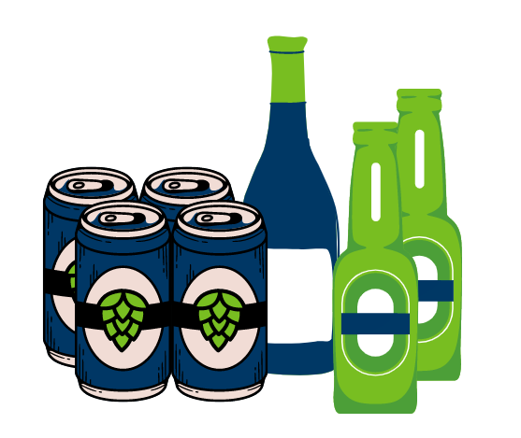
Nearly 75% of alcohol-related costs in MN were due to binge drinking.
Notes:
Caption: Almost three-fourths of alcohol-related costs were due to binge drinking.
Alt text: In the upper left corner is the MDH logo--a dark navy-blue lowercase letter “m” with a lime green lowercase letter “n” budding from it, beneath “Department of Health” is written in dark navy-blue capital letters. Centered below, “Nearly 75% of alcohol-related costs in MN were due to binge drinking.” is written in dark navy-blue letters. Below the text is a dark navy-blue four-pack of beer with a lime green hops logo on the front, a dark navy-blue bottle of wine with a lime green seal, and two lime-green bottles of beer with a dark navy-blue label across the front.

Slide 4

This cost is incurred in some of the following ways:
health care
lost productivity
crime
motor vehicle crashes
Notes:
Caption: The costs of excessive alcohol use includes costs related to health care, lost productivity, and other societal costs such as crime and motor vehicle crashes.
Alt text: In the upper left corner is the MDH logo--a dark navy-blue lowercase letter “m” with a lime green lowercase letter “n” budding from it, beneath “Department of Health” is written in dark navy-blue capital letters. Centered below, “This cost is incurred in some of the following ways:” is written in dark navy-blue letters. Below, flush with the left side of the page, there are four dark navy-blue horizontally oriented wine bottles, arranged vertically, like bullet points. “Health care,” “lost productivity,” “crime,” and “motor vehicle crashes” are listed, individually, at the spout of each bottle.

Slide 5

Take an assessment to reflect on your drinking habits and plan how to reach your goals.
Notes:
Caption: Do you drink too much alcohol? Take the quick assessment to find out and make a personalized plan for drinking less.
Alt text: In the upper left corner is the MDH logo--a dark navy-blue lowercase letter “m” with a lime green lowercase letter “n” budding from it, beneath “Department of Health” is written in dark navy-blue capital letters. In the middle of the page, “Take the assessment to reflect on your drinking habits and plan how to reach your goals.” is written in dark navy-blue letters. Two dark navy-blue hands stemming from the center bottom of the page cup a lime green heart shape.

