Slide 1
WATER QUALITY AND QUANTITY
2018
HEALTH AND CLIMATE CHANGE TRAINING MODULE SERIES
Minnesota Climate & Health Program | Environmental Impacts Analysis Unit
Notes:
This Water Quality and Quantity & Health climate change training module is one of seven one-hour introductions to the health effects of climate changes in Minnesota. The other training modules are:
Climate Change & Health 101
Agriculture & Food Security
Air Quality & Health
Extreme Heat Events & Health
Wellbeing & Health
Vectorborne Diseases
These modules have been designed for public health professionals, as well as others concerned about climate change, to provide a basic level of information about the observed climate changes in Minnesota and their health impacts.
The training modules generally focus on climate adaptation (preparing for and adjusting to new conditions to reduce harm or risk of negative health outcomes), and includes some references to climate mitigation (reducing harmful greenhouse gas emissions) as well.

Slide 2
NOTICE
The Minnesota Department of Health (MDH) developed this presentation based on scientific research published in peer-reviewed journals. References for information can be found in the relevant slides and/or at the end of the presentation.
Notes:
The Minnesota Department of Health (MDH) developed this presentation based on scientific research published in peer-reviewed journals. References for information can be found in the relevant slides and/or at the end of the presentation.

Slide 3
OUTLINE
Importance of water in Minnesota
Climate change impacts on Minnesota water sources
Public health issues related to:
Increases in water
Decreases in water
Increases in water temperature
Strategies: Public health and individuals
Notes:
This module will cover the following topics:
Importance of water in Minnesota
Climate changes in Minnesota and impacts on water
Public health issues related to climate change impacts on Minnesota’s water sources:
Increases in water
Decreases in water
Increases in water temperature
Strategies: Public Health and Individuals
The first section covers the Importance of water in Minnesota.

Slide 4
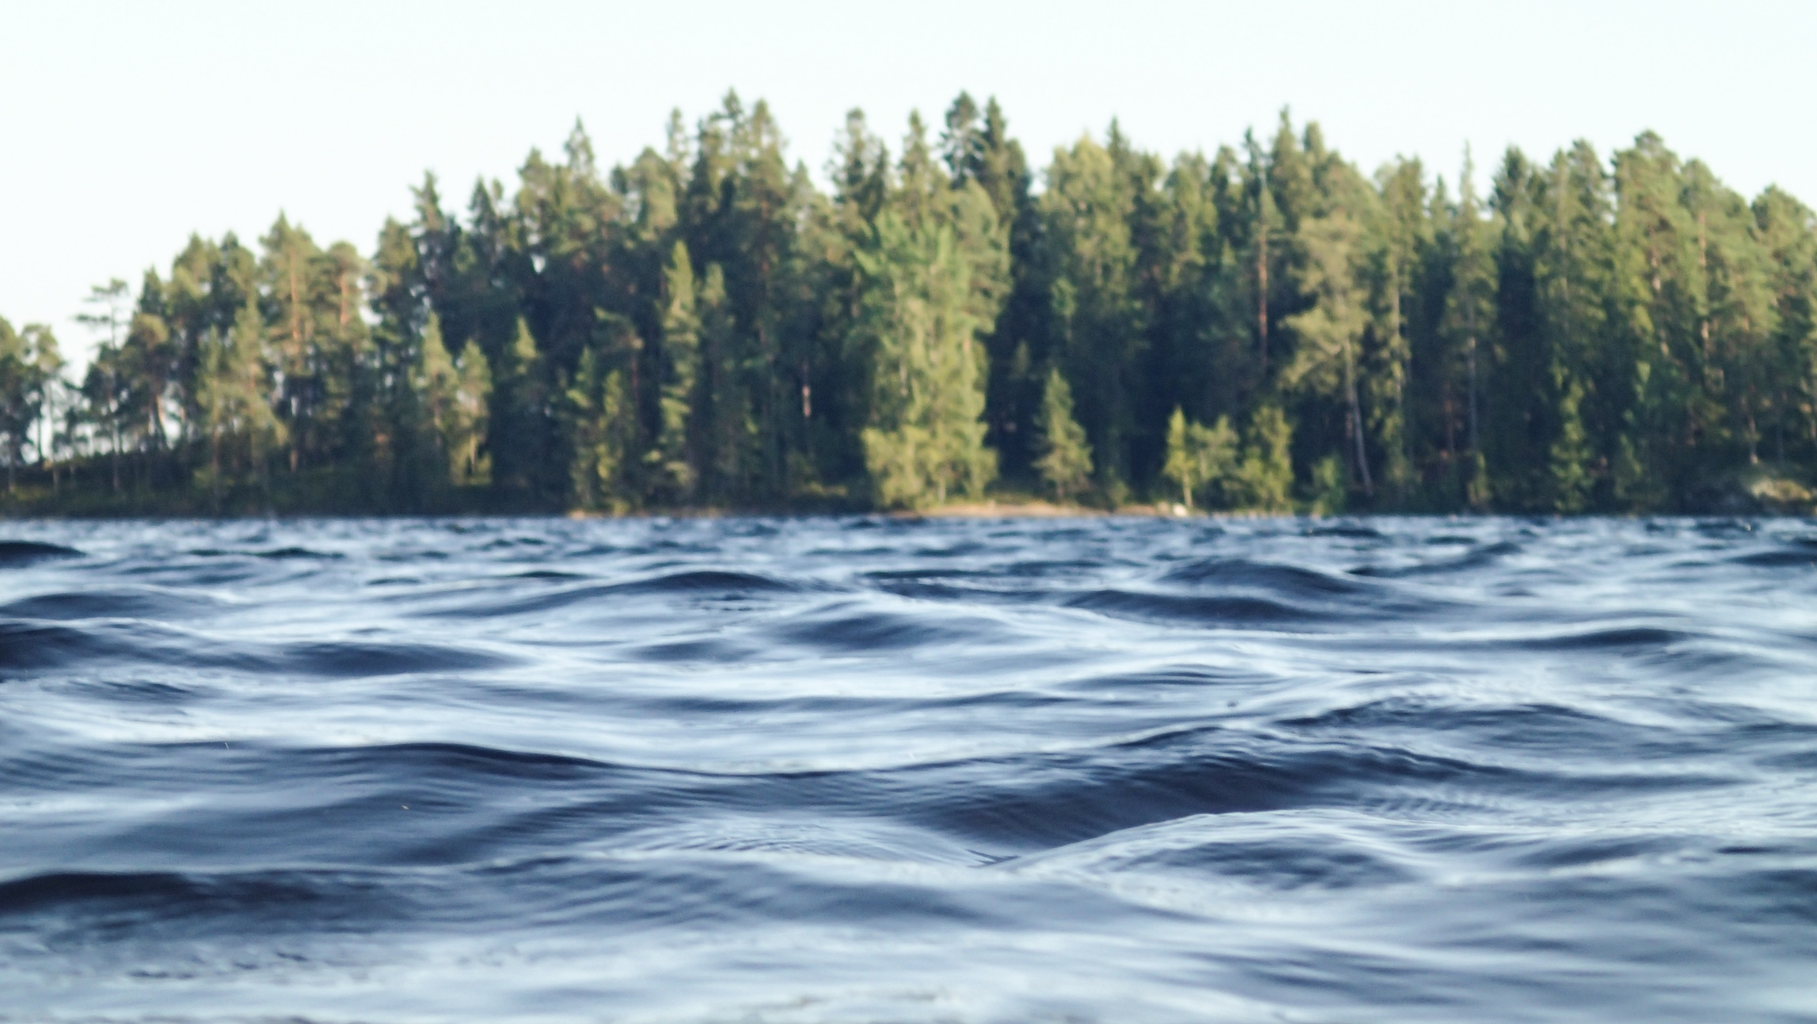
Water Cycle
Water Sources
Water Uses
IMPORTANCE OF WATER IN MINNESOTA
Notes:
Minnesota benefits from more freshwater than any of the other 48 contiguous U.S. states, serving the needs of many competing sectors. The viability of Minnesota’s industries, farms, utilities, and municipalities hinges on adequate provision of clean water through controlled, reliable systems. To understand how climate change could impact these systems and the associated health consequences, let’s review some basic details of the water cycle in Minnesota, including major sources and key uses.
Image: Pexels, https://www.pexels.com/photo/water-lake-trees-nature-28702/

Slide 5
MINNESOTA: A LAND OF WATER
SURFACE WATER
11,842 lakes
69,200 miles of rivers and streams
10.6 million acres of wetlands
GROUNDWATER
Aquifers across the state
Approximately 400,000 drinking water wells
Notes:
Minnesota is a land of water.
Water sources include surface water and groundwater.
Minnesota’s surface water resources include 11,842 lakes (greater than 10 acres), over 69,000 miles of rivers and streams, and over 10.6 million acres of wetlands
Minnesota’s groundwater resources include several aquifers across the state supplying about 75% of Minnesota’s drinking water and nearly 90% of the water used for agricultural irrigation.
The quality and quantity of the water that we use within our state and that leaves our state through rivers, lakes or underground sources is within our control and our responsibility. We should understand how our actions impact both quantity and quality of water to ensure that this vital resource remains abundant and clean.
Sources: MDNR, 2016a; University of Minnesota, 2011
Image source: University of Minnesota, 2011

Slide 6
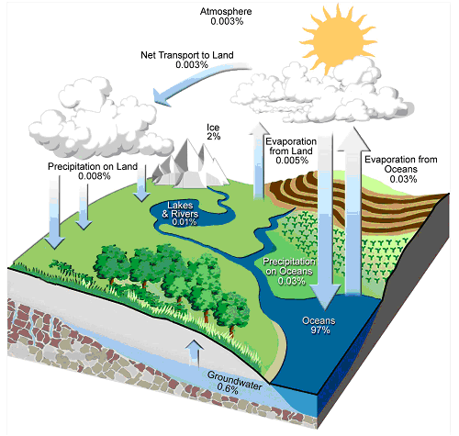
HYDROLOGIC CYCLE
The hydrologic cycle describes the continuous movement of water
Evaporation, Precipitation, Infiltration, and Discharge
Changes in climate can alter the hydrologic cycle:
Temperature affects water vapor, which affects precipitation
Notes:
This slide shows a diagram of the hydrologic cycle. The hydrologic (or water) cycle describes the existence and movement of water on, in, and above the Earth. As its name implies, the hydrologic cycle is a continuous process, and has no starting or end point. Surface water (e.g., oceans, lakes and rivers) evaporates into the air. Water also transpires from plants and evaporates from soils (these two processes combined are called evapotranspiration). This water vapor reaches the upper layers of the atmosphere and condenses to form clouds and eventually raindrops. Precipitation falls as rain or snow, and either runs off into surface water bodies or infiltrates into groundwater aquifers. Groundwater discharges into surface water bodies and the process continues.
As long as the land and the oceans are replenished with the water that is lost to the atmosphere, this water cycle is balanced.
Climate change can alter the hydrologic cycle because:
Increases in temperature lead to increases in the moisture-holding capacity of the atmosphere (increased water vapor).
Precipitation comes mainly from weather systems that feed on the water vapor stored in the atmosphere. This has generally increased precipitation intensity and the risk of heavy rain and snow storms.
The warmer climate can increase risks of both drought − where it is not raining − and floods − where it is − but at different times and/or places.
Sources: Solomon et al, 2007
Image source: University of Minnesota, 2011

Slide 7
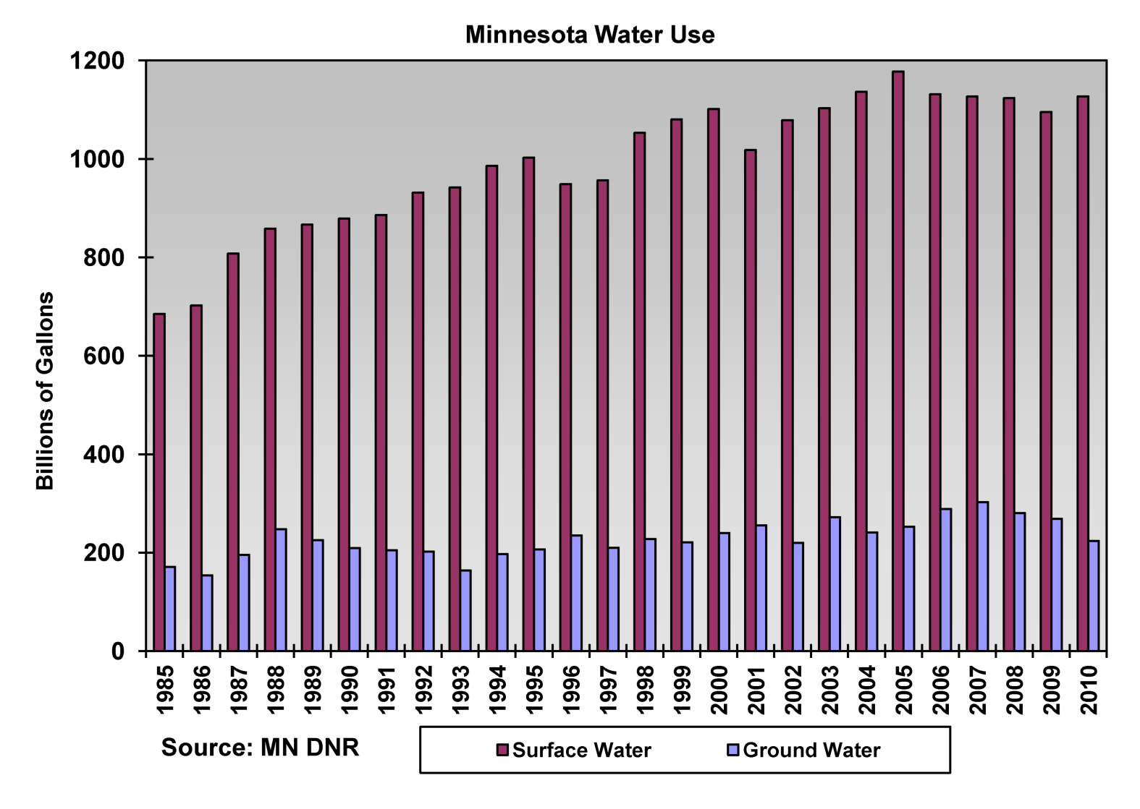
TOTAL WATER USE IN MINNESOTA
Total water use in Minnesota
1985 to 2010:
Ground water - 19%
Surface water - 81%
Notes:
On average, about 19% of Minnesota’s total water use comes from ground water. The remaining water used comes from surface water. You can also see from this chart that the total water use in Minnesota has been increasing since 1985. Surface water use has risen from 700 billion gallons per year in 1985 to 1100 billion gallons per year in 2010. Groundwater use has risen from 170 billion gallons in 1985 to 250 billion gallons in 2010.
Source: MDNR, 2016a

Slide 8
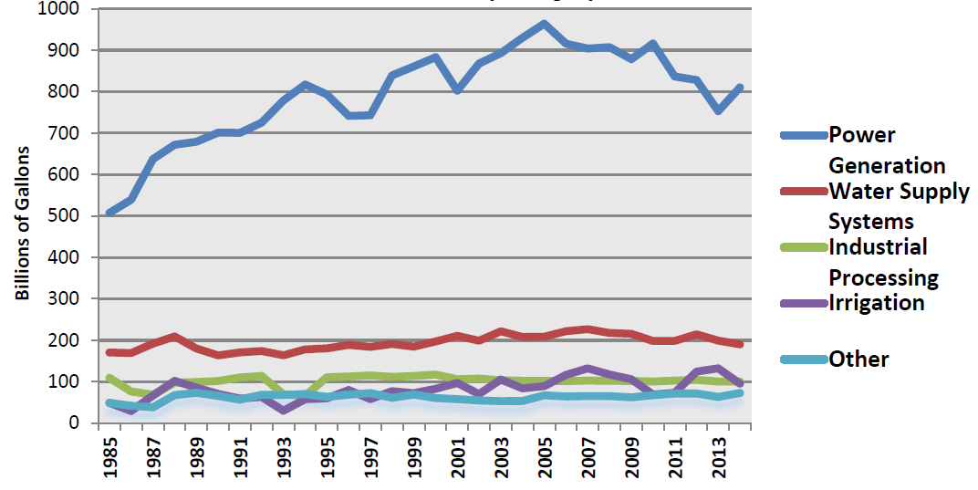
WATER USE BY CATEGORY
Minnesota Water Use by Category 1985-2014
Notes:
The largest portion of our water use is for power generation, which comes from surface water sources, and is illustrated as the dark blue line at the top of this chart. Power generation water use is mostly non-consumptive, meaning that the water is returned to its source immediately after use.
Public Water Supply, noted on the chart in red, and Industrial Processing, noted on the chart in green, account for the majority of non-power water use in Minnesota. The majority of the public water supply comes from groundwater resources. All ground water withdrawals are considered consumptive, which means that the water is not directly returned to the same source. Consumptive ground water uses pose a resource management concern because the amount of water available for use from that resource is reduced and is only replaced through recharge. Recharge amounts are dependent on climate, primarily precipitation, and the amount of recharge can be greatly affected by human actions, such as land use patterns.
Water use for Irrigation, indicated on the chart in purple, has increased over time with more acres regularly irrigated -– the amount of irrigated agriculture in Minnesota has increased by about 30% since the year 2000, which is about a 140,000 acre increase. Annual precipitation drives changes to irrigation demand on a yearly basis.
Source: MDNR, 2016a

Slide 9
78% of Minnesotans rely on public water (70% groundwater)
A small fraction of private homeowners use surface water
1.1 million Minnesotans rely on private wells
MINNESOTA DRINKING WATER
Notes:
78% of Minnesotans rely on public drinking water which is largely from groundwater (~70%)
1.1 million Minnesotans (~20%) rely on private wells for their household drinking water, most of which comes from groundwater
A small fraction of private homeowners in the state use surface water for their homes.
Sources: MDNR, 2016a; University of Minnesota, 2011
Image source: Pexels, https://www.pexels.com/photo/water-flows-from-the-tap-to-sink-6256/

Slide 10
WATER IS ESSENTIAL
Minnesota is rich in water resources
High quality, abundant water is essential for Minnesotans
Understanding the basic water cycle properties is fundamental to understanding the impacts of climate change on water
Notes:
Water is essential for Minnesotans.
Minnesota is rich in water resources
High quality, abundant water is essential to Minnesotans, for our economy, culture, and future
Understanding the basic properties of the water cycle and the atmosphere is fundamental to understanding impacts of climate change on water
Image source: Pexels, https://www.pexels.com/photo/blur-boat-boy-child-386003/

Slide 11
OUTLINE
Importance of water in Minnesota
Climate change impacts on Minnesota water sources
Public health issues related to:
Increases in water
Decreases in water
Increases in water temperature
Strategies: Public health and individuals
Notes:
The next section covers the Climate change impacts on Minnesota water sources.

Slide 12
WEATHER VERSUS CLIMATE
Weather: conditions of the atmosphere over a short period of time
Climate: conditions of the atmosphere over long periods of time
Notes:
Although related, the terms weather and climate are defined differently. Weather generally refers to conditions of the atmosphere over a short period of time (days or weeks), while climate refers to conditions of the atmosphere over long periods of time (30-year standard averaging period) (NASA, 2005).
Therefore, climate change refers to any significant change in the measures of climate lasting for an extended period of several decades (US EPA, 2016a).
Weather has always fascinated Minnesotans, perhaps because we have all kinds of it, but recently climate change has also become a leading topic of concern.
Source: NASA, 2005; US EPA, 2016a
Image source: Lightning bolt and sun – Microsoft Clip Art

Slide 13
DEFINITIONS
CLIMATE ADAPTATION: efforts to anticipate and prepare for the effects of climate change, and thereby to reduce the associated health burden
CLIMATE MITIGATION: efforts to slow, stabilize, or reverse climate change by reducing greenhouse gas emissions
Notes:
Actions to prevent the adverse health effects of climate change can be described as ‘adaptation efforts’ or ‘mitigation efforts,’ and some actions can be both.
Adapting to climate change means anticipating and preparing for the effects of climate change and reducing the associated health burden.
Mitigating climate change means taking on or supporting efforts that slow, stabilize or reverse climate change by reducing greenhouse gas emissions.
Image: Microsoft Clip Art

Slide 14
CLIMATE AND HEALTH ARE LINKED
Notes:
The Minnesota Department of Health is dedicated to understanding the links between climate changes and negative health impacts, and identifying strategies for addressing these health impacts in Minnesota communities.
Most climate scientists attribute our changing climate to the burning of fossil fuels, like coal and oil, to produce energy for everyday use. This burning adds heat-trapping gases into the air, like carbon dioxide, methane, and nitrous oxide. These heat-trapping gases are commonly known as greenhouse gases.
As this graphic shows, the rise in greenhouse gases is leading to increases in average temperature and changes in precipitation. These changes are disrupting our air quality, weather patterns, water quality and quantity, and ecosystems, which in turn, are leading to a future Minnesota with more air pollution, extreme heat, floods, droughts, and ecosystem threats.
Many of these changes impact people’s health, and some of the changes are happening right now.
Source: EQB, 2015; MDH, 2015; NASA, 2016

Slide 15
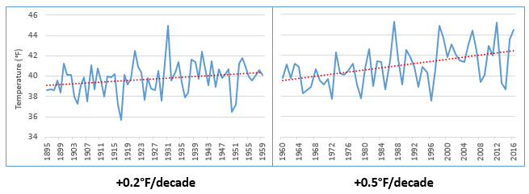
RISING TEMPERATURES
Minnesota Average Annual Temperature, 1895 -2016
Source: NOAA, 2017
Notes:
One of the main effects of Minnesota’s changing climate is that average temperatures are rising. Minnesota has gotten noticeably warmer, especially over the last few decades. This slide shows a shift in the rate of change of Minnesota’s annual average temperatures. The time frame is from 1895 to 2016, which is approximately the last 120 years.
The left side of the graph shows Minnesota temperatures for roughly the first 60 years, from 1895 to 1959, where temperatures increased by about two-tenths of a degree Fahrenheit per decade. The graph on the right side of the slide shows roughly the next 60 years, from 1960 to 2016, where Minnesota’s average temperature has accelerated to a rate of over a half of a degree Fahrenheit per decade. This would amount to an increase of 5 degrees Fahrenheit that we would experience by the end of this century – a significant accelerated rate.
Source: National Oceanic and Atmospheric Administration (NOAA). 2017a. NOAA National Centers for Environmental information, Climate at a Glance: U.S. Time Series, Average Temperature, published February 2017, retrieved on February 9, 2017 from http://www.ncdc.noaa.gov/cag/

Slide 16
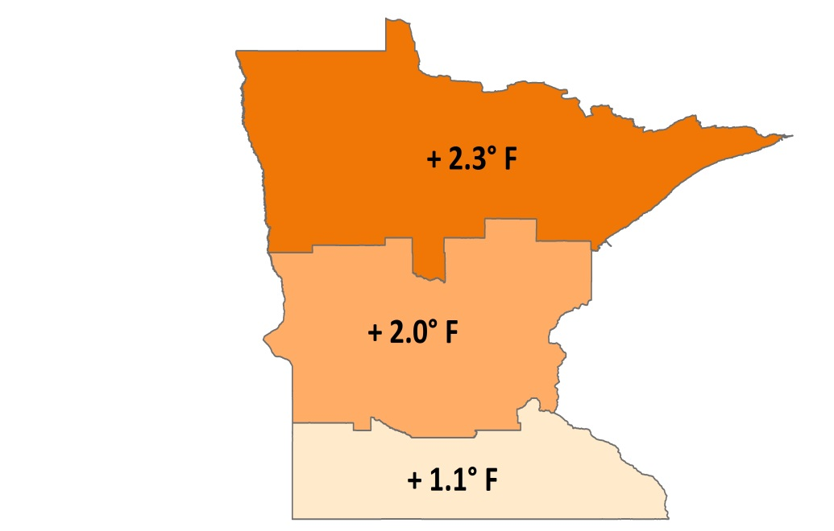
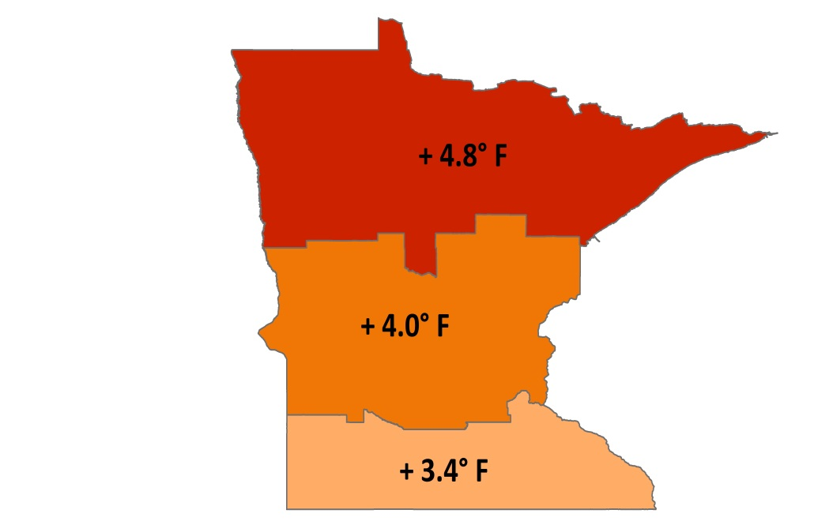
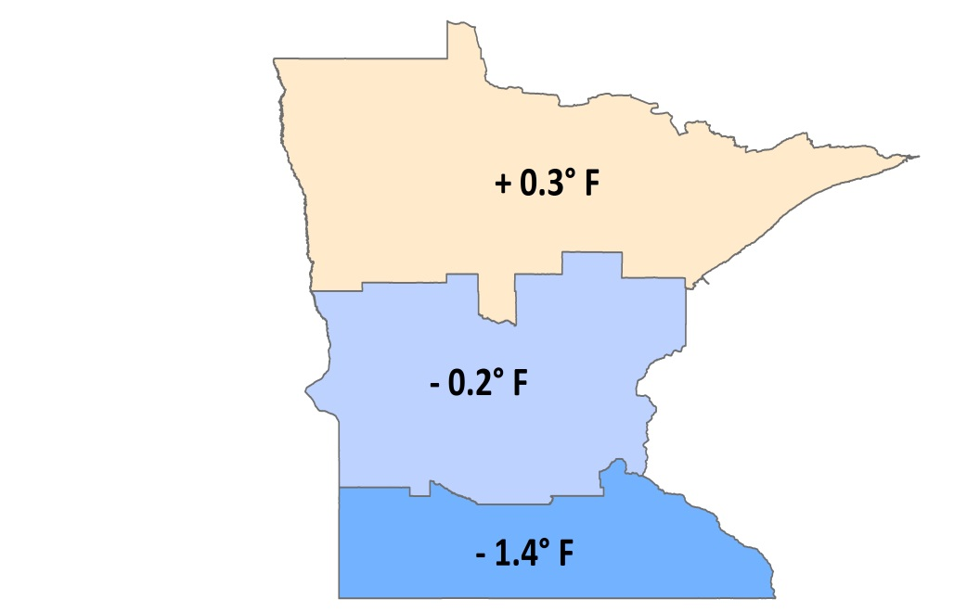
CHANGING TEMPERATURES BY GEOGRAPHY AND SEASON
Total Temperature Change, 1895-2015
Annual Average Winter Lows Summer Highs
Notes:
These maps show temperature changes since the beginning of the record for different parts of the state, and for annual average, winter low, and summer high temperatures.
As seen on the previous slide, annual average temperatures are increasing; however, winter low temperatures are rising much faster than the annual average temperatures. In fact, much of the observed warming we are experiencing in Minnesota can be explained by the warming of our winter low temperatures. In general, we are now having warmer winters, less snow and more winter rain.
Summer high temperatures have risen slightly in the north, but have fallen in the middle and southern part of the state.
And finally, the northern part of the state is warming faster than the southern part of the state. This is consistent with patterns seen across the Northern Hemisphere, where climate changes are occurring more rapidly at higher latitudes.

Slide 17
ENVIRONMENTAL CHANGES
Changing Plant Hardiness Zones
After USDA Plant Hardiness Zone Map, USDA Miscellaneous Publication No. 1475, Issued January 1990.
Arbor Day Foundation Plant Hardness Zone Map published in 2015.
Notes:
Rising winter temperatures are already causing substantial shifts in the environment. Maps of the plant hardiness zones from the US Department of Agriculture show what types of plants will survive well and where. Zones are based on the average annual minimum winter temperature over a 30-year period and each zone represents a 10-degree Fahrenheit increment of minimum temperatures.
The maps on this slide compare two points in recent times. The map on the left is from 1990 and the map on the right is from 2015. Look closely at the changes in Minnesota over this 25-year period. In 1990, Minnesota was predominantly zone 3 in the northern half of the state and zone 4 in the southern half of the state. By 2015, these zones shifted north substantially, and in fact, zones historically associated with areas like southern Iowa have now arrived in southern Minnesota. Minnesota is now predominantly zone 4 across the majority of the state, AND zone 5 has now emerged in the far southern part of the state.
Source: USDA Agricultural Research Service, 2012
Image source: Plant Hardiness Zones – Arbor Day Foundation, 2015

Slide 18
PRECIPITATION INCREASES
Minnesota Average Annual Precipitation, 1895-2016
-0.2”/decade
+0.5”/decade
Notes:
With a warming atmosphere, more evaporation occurs. Warmer air can also hold more water vapor than cool air. The water holding capacity of air increases by about 7% per 1°C warming.
The chart on this slide shows Minnesota's average annual precipitation from 1895 to 2016. The graph on the left highlights the trend for the early part of the last century, 1895-1959, while the graph on the right highlights the trend for the most recent half century, 1960-2016. For most of the first half of the 20th century, the trend in precipitation was slightly downward, at a loss of 0.2 inches per decade or the equivalent of -2 inches per century. This downward trend was influenced by the Dust Bowl years of the 1930s. However, the rate of precipitation across the state has increased by nearly 0.5 inches per decade or the equivalent of 5 inches per century over the last 50+ years.
Source: Trenberth, 2011; National Oceanic and Atmospheric Administration (NOAA). 2017. NOAA National Centers for Environmental information, Climate at a Glance: U.S. Time Series, Precipitation, published February 2017, retrieved on February 9, 2017 from http://www.ncdc.noaa.gov/cag

Slide 19
MORE EXTREME RAIN EVENTS
1860s
1870s
1880s
1900s
1910s
1920s
1930s
1940s
1950s
1960s
1970s
1980s
1990s
2000s
2010s
2020s
1890s
1
1
1
2
3
3
4
7 OF THE 15
MINNESOTA MEGA-RAIN EVENTS HAVE
OCCURRED SINCE 2002
Notes:
Overall our average annual precipitation is slightly increasing and this increase is being driven by heavy precipitation events. This timeline captures the historic mega-rain events in Minnesota that have occurred since 1858. These events constitute a six-inch rainfall that covers more than 1,000 square miles, with the core of the event topping eight inches. 15 mega-rain events have been identified in Minnesota since 1858 and 7 of these events have occurred since 2002.
A recent study of precipitation in Minnesota found that storms with 3+ inches of rainfall has increased 104% in last 50 years.
[Reference] These seven mega-rain events since 2002 include:
June 2002 – where rainfall topped 12 inches over 48 hours in Roseau and Lake of the Woods Counties of Northern MN
September 2004 – with more than 10 inches of rain in a 36-hour period in Faribault and Freeborn Counties of Southern MN
August 2007 – in South East Minnesota, after 15.1 inches of rain fell in 24 hours
September 2010 – in South Central Minnesota, after 9.5 inches of rain fell in one day
June 2012 – in North East Minnesota, after over 10 inches of rain fell over 2 days, causing severe flash flooding and river flooding; the St. Louis River crested at over 16 feet after rising 10 feet in 24 hours
July 2016 – in Central Minnesota, especially Pine County, with a two-day total of 9.3 inches
August 2016 – in Central and South East Minnesota, with rainfall rates of two-three inches per hour.
Source: MDNR, 2016

Slide 20
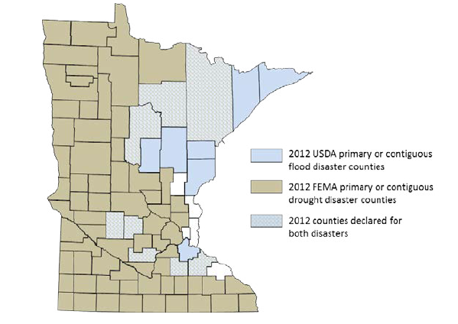
PRECIPITATION CHANGES
Blue counties were declared disaster areas due to flooding.
Brown counties were declared disaster areas due to drought.
Light blue, cross-hatched counties received both designations.
Notes:
However, more moisture in the atmosphere doesn’t necessarily mean a consistent rise in rain and snow. The character of precipitation in Minnesota is changing, increasing the potential for both extreme wet and dry spells. Minnesota is starting to experience increases in localized, heavy precipitation events, which have the potential to cause both increased flooding and drought, leaving some areas of the state drenched and other areas without any precipitation. For example, in 2012, 75 counties were declared primary or contiguous disaster areas for drought. However, in that same year 15 counties and three tribal reservations were declared disaster areas for flooding, with eight counties receiving disaster designation for both, underscoring the intensification of precipitation extremes in both directions.
Source: MDH, 2015

Slide 21
OUTLINE
Importance of water in Minnesota
Climate change impacts on Minnesota water sources
Public health issues related to:
Increases in water
Decreases in water
Increases in water temperature
Strategies: Public health and individuals
Notes:
As climate changes disrupt Minnesota’s water cycle, there will be repercussions for public health. The next section covers the Public health issues related to increases in water, decreases in water, and increases in water temperature.

Slide 22
PUBLIC HEALTH ISSUES: INCREASES IN WATER
Key Topics
Precipitation changes
Flooding
Humidity and dew point
Notes:
Let’s start with increases of water. Some of the impacts of increased water volumes that we’ll cover in this section include public health concerns from precipitation changes, flooding, and humidity and dew points.

Slide 23
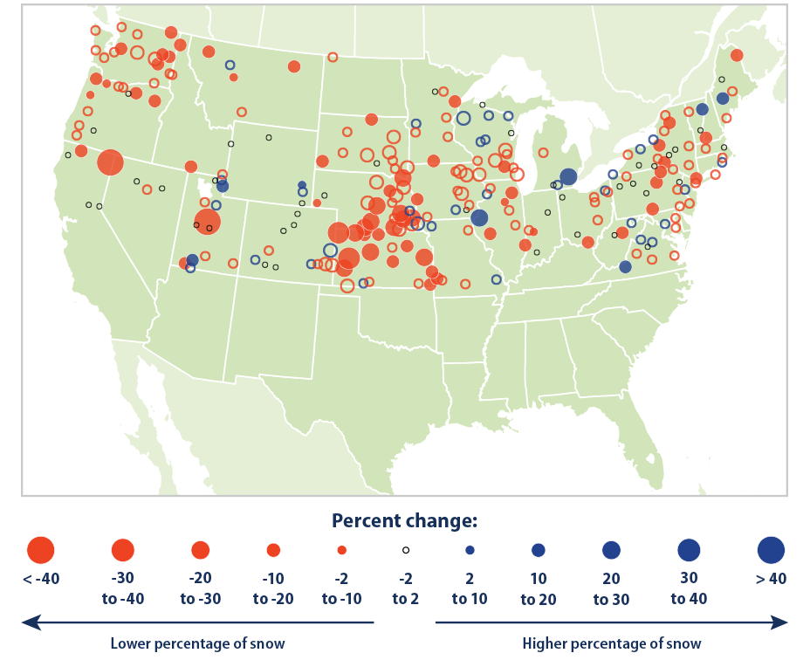
PUBLIC HEALTH ISSUES: INCREASES IN WATER
WINTERTIME PRECIPITATION CHANGES (1949-2015)
The amount of wintertime precipitation falling as
rain vs. snow
has increased during the last 50 years.
Notes:
The map on this slide shows that in most areas of the country, the amount of wintertime precipitation falling as rain versus snow has increased during the last 50 years. The consequences of increased precipitation falling as rain rather than snow include increased runoff and floods, as well as reduced snowpack which may impact water levels and cause drought later in the summer.
Note: Filled circles on the map represent statistically significant trends. Open circles represent trends that are not statistically significant.
Source: U.S. EPA, 2016b

Slide 24
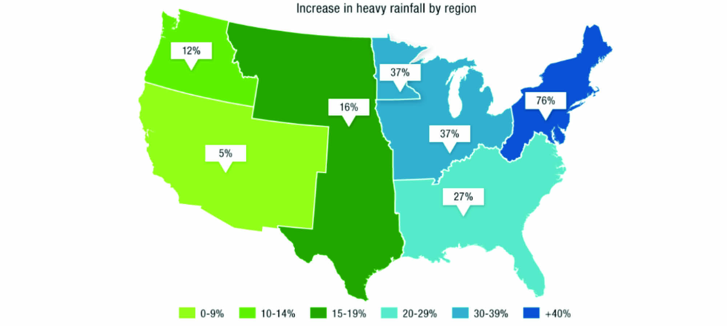
INCREASES IN WATER: PRECIPITATION CHANGES
Notes:
In addition to changes in precipitation type, we’re also seeing precipitation in heavier, more localized events. This map shows that there has been a 37 percent increase in the amount of very heavy precipitation events from 1958 to 2012 in Minnesota and the Midwest generally. Total precipitation in the Midwest is expected to increase, with the largest increases in very heavy precipitation events.
Source: Karl et al., 2009

Slide 25
PUBLIC HEALTH ISSUES: INCREASES IN WATER
Physical injuries and destruction of property
Extreme precipitation
Increased runoff: sediment, contaminants, nitrate, etc.
Contamination of surface water
Sewage overflows
Waterborne disease outbreaks from drinking water or recreational contact
Notes:
Precipitation, especially extreme precipitation events, can cause a number of public health issues, including physical injuries, destruction of property and waterborne disease outbreaks. This diagram demonstrates how heavy downpours can lead to increased sediment in runoff as well as sewage overflows that can cause outbreaks of waterborne diseases such as Giardiasis, E coli, and Cryptosporidium. Waterborne diseases can contaminate drinking water and endanger beachgoers.
Sources: Curriero et al., 2001; Ebi et al., 2008; Field et al., 2007; Karl et al., 2009

Slide 26
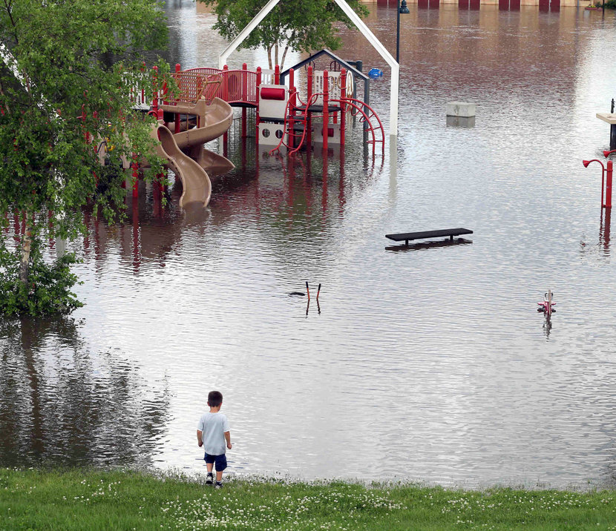
PUBLIC HEALTH ISSUES: FLOODING
Results from a combination of:
Land use changes that reduce infiltration
Undersized sewer and storm water pipes
Extreme precipitation and/or rapid snowmelt
Notes:
Minnesota may experience more flooding due to heavier precipitation events.
Flooding results from a combination of
Land use changes that reduce infiltration
Undersized sewer/stormwater pipes
Extreme precipitation and/or rapid snowmelt
Source: Field et al., 2007
Photo source: Jim Mone, Associated Press, https://www.nytimes.com/2014/06/25/us/much-of-minnesota-is-flooded-as-swollen-rivers-overflow.html?_r=0

Slide 27
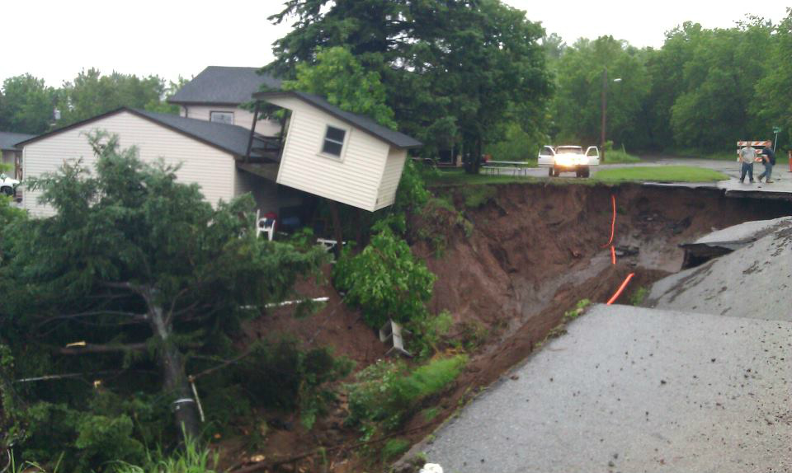
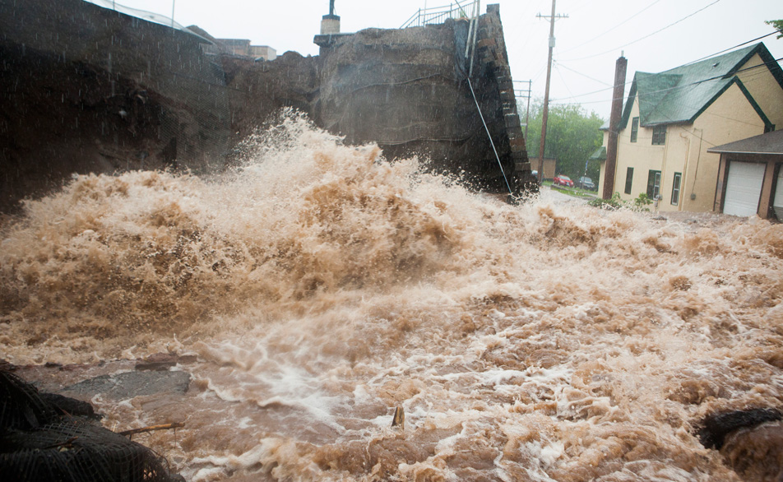
PUBLIC HEALTH ISSUES: FLOODING
2012 Duluth, Minnesota
More than 1,700 homes, 100 businesses impacted
Notes:
The 2010 Duluth area flood occurred as a result of severe storms and record rainfall from June 19 and June 20. This 500-year storm event dropped up to 10.1 inches of rain on some areas of northeastern Minnesota in a 48-hour period. Damages to public infrastructure including roads, bridges, and water and sewer systems, as well as electric utilities and communications infrastructure, exceeded $108 million. More than 1,700 private homes and over 100 businesses were impacted or damaged. Excess moisture increased mold growth following the disaster. Additional economic impacts include the effects on tourism (resorts reported up to 50% cancellation rates following the disaster), and local businesses were closed with some temporarily laying off staff.
Source: Governor Dayton, 2012
Photo sources: Left photo – Rachel Agurkis; right photo – Derek Montgomery, MPR

Slide 28
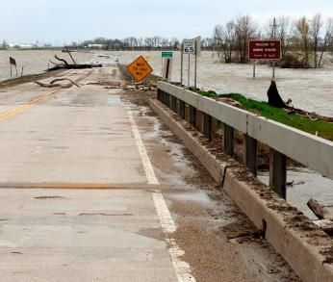
PUBLIC HEALTH ISSUES: FLOODING
Can lead to increases in:
Physical injuries (including drowning)
Allergies (mold)
Food and water-borne illnesses
Food security
Displacement
Mental health issues
Interruption of emergency services
Notes:
Flooding can cause potential increases in the following public health issues:
physical injuries (including drowning) and death
allergies or allergic reactions (from mold formed due to increased moisture)
food and water-borne illnesses (will be explained further on the next slide)
food security: intense precipitation can delay spring planting and damage crops
displacement: flooding can force people out of their homes and may even require the evacuation of entire portions of a community
mental health issues: primarily due to stress, explained further in a few slides
interruption of emergency services, particularly related to the disruption of transportation infrastructure, as show in the picture on this slide
Sources: SHELDUS, 2012; WHO, 2010
Photo source: Oslo, Minnesota – 35 days after the Red River Flood on May 14, 2009. Ed Erdahl, FEMA

Slide 29
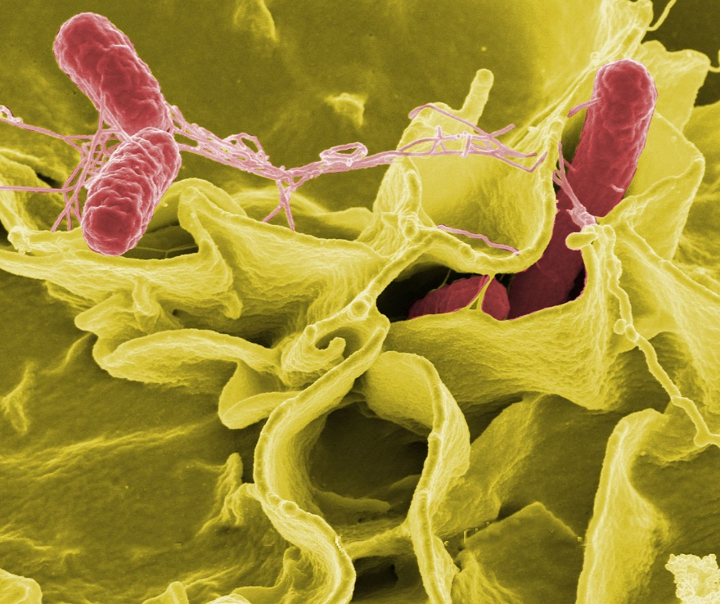
PUBLIC HEALTH ISSUES: FLOODING
Can lead to increases in:
Foodborne illnesses
e.g. Salmonellosis
Waterborne illnesses
e.g. Cryptosporidium and Giardia
Notes:
Flooding can lead to increases in:
Foodborne illnesses, like Salmonellosis
Waterborne illnesses like Cryptosporidium and Giardia
Sources: SHELDUS, 2012; WHO, 2010
Image source: Wikipedia

Slide 30
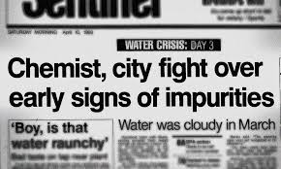
PUBLIC HEALTH ISSUES: FLOODING
1993 Milwaukee Cryptosporidium Outbreak
1.61 million people were affected
400,000+ people with significant symptoms
100 people died
Illness lasted 9 days on average
$31.7 million in medical costs
$64.6 million in lost productivity
Notes:
A good example was in Milwaukee, where flooding lead to a Cryptosporidium outbreak in 1993:
1.6 million people were affected
400,000+ people with significant symptoms
100 people died
Illness lasted 9 days on average
$31.7 million in medical costs
$64.6 million in lost productivity
Source: Milwaukee Sentinel, 1993
Image source: Milwaukee Sentinel, https://onmilwaukee.com/living/articles/ebolainmilwaukee.html

Slide 31
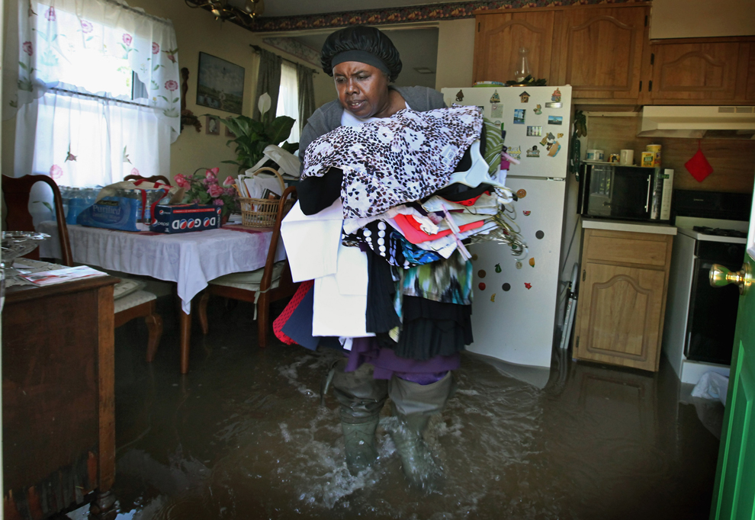
PUBLIC HEALTH ISSUES: FLOODING
MENTAL HEALTH
Anxiety disorders
Depression
Psychological effects
Notes:
Flooding can lead to a host of mental health issues:
Anxiety disorders
Depression
And other psychological effects
Sources: SHELDUS, 2012; WHO, 2010
Image source: Scott Olson, Getty Images

Slide 32
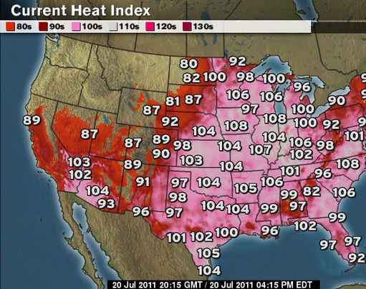
PUBLIC HEALTH ISSUES: INCREASES IN WATER
DEW POINT
July 19, 2011
Highest dew point temperature recorded in Minnesota history
88°F dew point in Moorhead, MN
Combined with 93°F air temperature, it felt like 130°F
Notes:
As already mentioned, dew point is a measure of water vapor in the air. The higher the dew point, the more difficult it is for people's sweat to evaporate, which is how they would otherwise shed body heat.
Most people are comfortable up to 60°F dew point. From 60° to 64°F, it is okay for most, but everyone perceives the humidity at the upper limit of 64°F. 65° to 69°F dew point is somewhat uncomfortable for most people. Above 70°F dew point is very humid and quite uncomfortable. 75°F dew point and above is extremely uncomfortable and oppressive.
July 19, 2011 set the state record dew point temperature at 88°F. With an air temperature of 93°F, the heat index reached 130°F. This record state dew point temperature was recorded at Moorhead Municipal Airport from 7pm to 9pm.
That date also saw an all-time heat index record for the Twin Cities. The dew point temperature was 82°F, combined with an air temperature of 95°F for a heat index of 119°F.
Sources: MPR, 2011a; Minnesota State Climatology Office, 2011
Image source: The Weather Channel, 2011

Slide 33
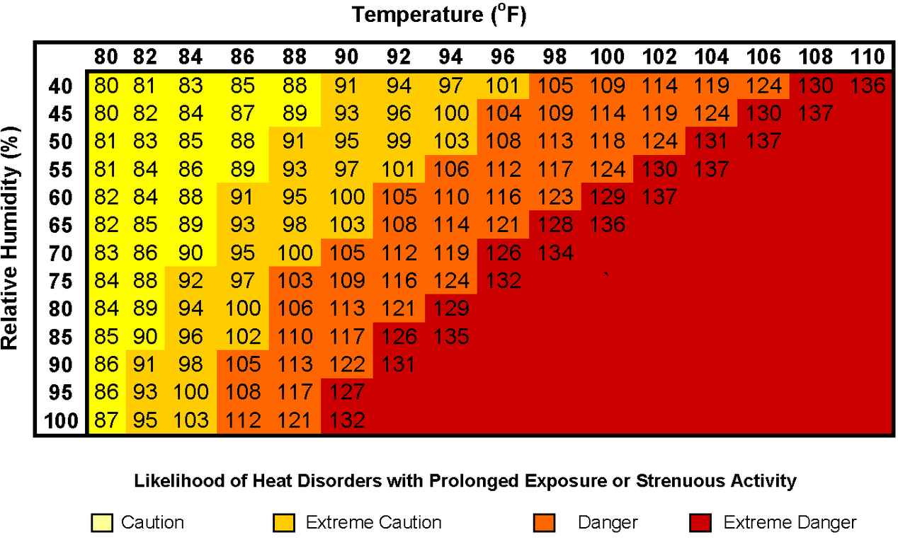
PUBLIC HEALTH ISSUES: INCREASES IN WATER
HEAT INDEX (HI): A measure of how hot it really feels when relative humidity is factored in with the actual air temperature.
NOAA’s National Weather Service Heat Index
Notes:
The heat index (HI) is an index that combines air temperature and dew point (or relative humidity in the case of the chart on this slide) to describe how they are perceived by the human body. The previous slide mentioned that Moorhead reached a head index of 130°F; that is considered extremely dangerous for health.
Source: NWS, 2011; Horstmeyer, 2008

Slide 34
PUBLIC HEALTH ISSUES: INCREASES IN WATER
EXTREME HEAT AND HUMIDITY
Human health issues:
Heat rash
Heat exhaustion
Heat stroke
Death
Stressed livestock
Algae blooms
Mold
Enhance vector and microorganism populations
Notes:
Human health issues of extreme heat and humidity include:
heat rash, heat exhaustion, heatstroke, death
Populations more at risk to heat-related illnesses include people with no access to air conditioning, elderly, children, persons on certain medications, athletes, and outdoor workers.
Stressed livestock:
Reduced milk production,
Reproduction problems,
Even death
Algae blooms
Mold
Enhance reproduction of certain vectors, like mosquitoes
Sources: Karl et al., 2009; NWS, 2011; Seeley, 2012
Image: Getty Images

Slide 35
PUBLIC HEALTH ISSUES: DECREASES IN WATER
Key Topics
Drought
Lower water levels
Notes:
The next section reviews some of the impacts of decreased water volumes, namely drought and lower water levels.

Slide 36
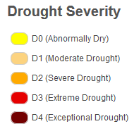
PUBLIC HEALTH ISSUES: DECREASES IN WATER
EXTREME HEAT AND HUMIDITY:
Data from the National Drought Mitigation Center reveal that large areas of Minnesota have been impacted by drought since the beginning of the century
Notes:
Some areas of the state will experience decreased precipitation. This is a result of localized large storm events, which leave some areas of the state drenched and others without any precipitation. An extended period of below-average precipitation can cause a drought, and it can be worsened by high temperatures or short, intense rainfalls that do not allow rainwater to soak into the ground.
The National Drought Mitigation Center provides drought outlooks and information for the U.S. The image on this slide shows how much of Minnesota was impacted by drought from the beginning of the NDMC data record for Minnesota (2000) to mid-2016. Sixteen years of data does not provide enough information to make statements about drought trends in the state, but the data record does reveal that large areas of the state have been impacted by drought over this time period.
Source: NDMC, 2016

Slide 37
PUBLIC HEALTH ISSUES: DECREASING LAKE LEVELS
Water Level of the Great Lakes (1860-2015)
Notes:
Water levels depend on the balance between precipitation and evaporation, which are both influenced by temperature and humidity. If evaporation is high and precipitation is low, lake levels can fall.
Water levels in the Great lakes have fluctuated since 1860. Over the last few decades, they appear to have declined for most of the Lakes. However, for Lake Superior, a rapid increase in water levels – about two feet between January 2013 and December 2014– ended an unprecedented 15-year period when lake levels fell below the long-term average. The rapid change underscores the challenges inherent in predicting drivers of regional climate variability that can significantly impact regional water budgets and lake water levels.
Sources: U.S. EPA, 2016c; Gronewold et al., 2015

Slide 38
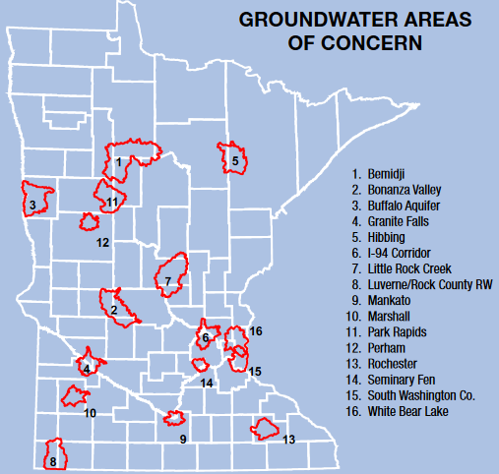
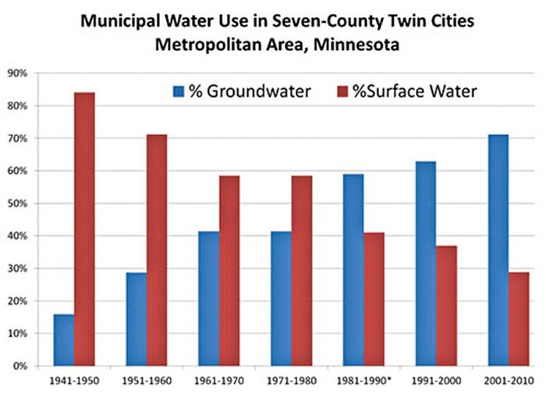
PUBLIC HEALTH ISSUES: GROUNDWATER
Groundwater levels are being negatively impacted by evaporation and precipitation while reliance on groundwater is rising.
Notes:
Groundwater levels are also impacted by evaporation and precipitation. The combination of shorter duration but more intense rainfall (meaning more runoff and less infiltration) combined with increased evapotranspiration (the sum of evaporation and plant transpiration from land surface to atmosphere) and increased irrigation is expected to lead to groundwater reduction. Concurrently, reliance on groundwater in many areas of the state is increasing. The figure here shows how the source of water for the Twin Cities metro area, where more than 60% of the state’s population resides, has shifted from surface water to groundwater. The level of the region’s most plentiful aquifer, the Prairie du Chien, has steadily declined as the metro area has become more densely populated. The Minnesota Department of Natural Resources has identified a number of other areas of the state where groundwater quality or quantity is threatened by contamination or depletion.
Source: MPCA, 2016; Freshwater Society, 2013

Slide 39
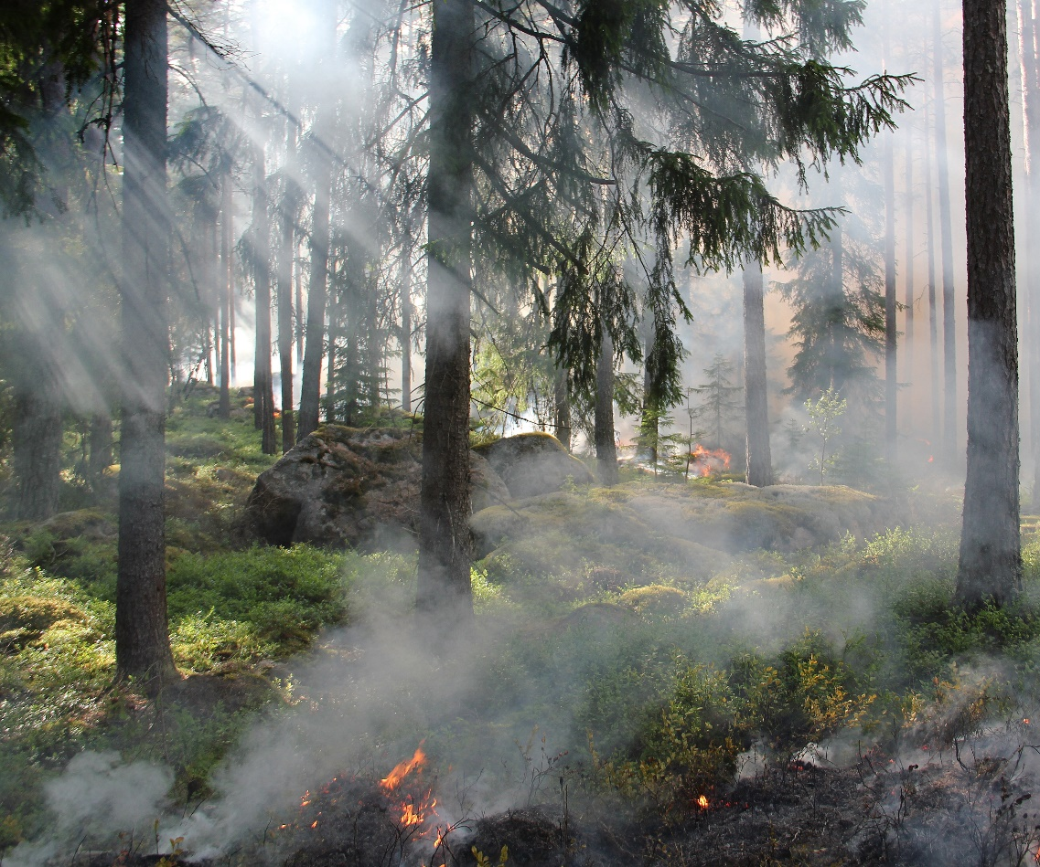
PUBLIC HEALTH ISSUES: DROUGHT & LOWER WATER LEVELS
PUBLIC HEALTH ISSUES:
Reduced soil moisture, groundwater, lakes, wetlands, and stream flows
Potential concentration of pollutants
Decreasing water supply for drinking water and agriculture
Adversely affects food supply
Wildfire dangers
Notes:
Drought and lower water levels are associated with the following public health issues:
Reduced soil moisture reserves, groundwater supplies, lake and wetland levels, and stream flows.
Potential concentration of pollutants. Effects of dry periods on water quality have not been adequately studied, although lower water availability can reduce dilution of pollutants.
Decreasing water supply for drinking water and agriculture
Decreased water supply for agriculture can adversely affect crop progress and soil moisture and therefore food supply
From 1996 to 2011, the U.S. lost $17.2 billion dollars in crop damage due to drought.
Wildfire dangers (e.g. Pagami Creek Fire, Boundary Waters Canoe Area Wilderness– started in August 18th 2011, 92,682 acres as of Oct. 13th 2011): which can exacerbate respiratory illnesses and cause injuries, property damage, and mental health impacts similar to those from flooding.
Sources: MDNR 2016a; Kundzewicz et al, 2007; MPR, 2011b; Minnesota State Climatology Office, 2017; U.S. EPA, 2011; US Forest Service Incident System, 2011; U.S. National Hazard Statistics, 2012
Image source: Pexels, https://www.pexels.com/photo/forest-tree-fire-hot-50700/

Slide 40
PUBLIC HEALTH ISSUES: INCREASES IN WATER TEMPERATURE
Key Topics
Changes in fish populations and mercury
Harmful algal blooms
Changes in vector populations
Invasive species
Notes:
This next section covers increases in water temperatures.
Lakes moderate temperature by absorbing heat in the summer and releasing it in the winter. With higher summer and winter temperatures, waters absorb more heat in the summer and release less heat in the winter, resulting in overall warmer waters. Warmer water has many implications.
Warmer water can have the following effects that will each be described in more detail:
Changes in fish populations & mercury levels
Algal blooms
Reduced dissolved oxygen
Incomplete mixing
Changes in the number of vectors, like ticks and mosquitoes
Invasive species
Image source: Pexels, https://www.pexels.com/photo/food-healthy-water-fish-92918

Slide 41
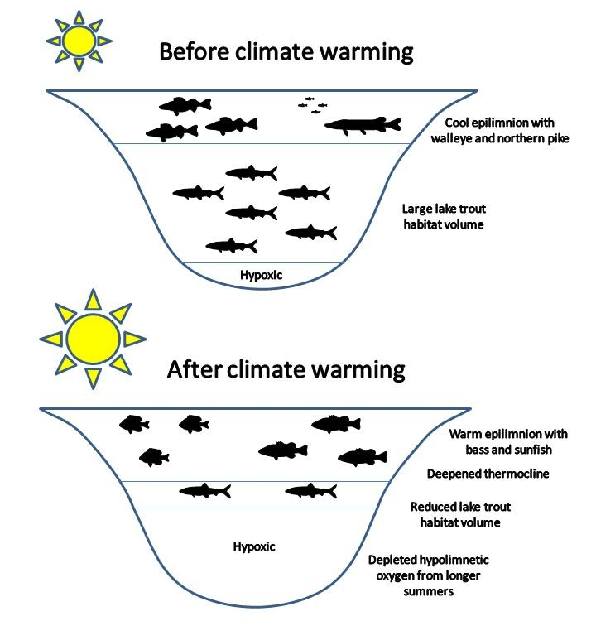
PUBLIC HEALTH ISSUES: INCREASES IN WATER TEMPERATURE
FISH AND MERCURY
Warmer waters could harm fish populations and biological activity of cold aquatic ecosystems
Warmer waters and increased rainfall intensity may be contributing to an increase in mercury concentrations in fish
Notes:
Climate change factors, such as increases in temperature, rainfall intensity, runoff, and water level fluctuations, may be contributing to an increase in mercury concentrations in piscivorous (fish eating) fish throughout Minnesota. Climate change factors could alter either the conversion of elemental mercury into methylmercury (more toxic form that enters the food chain) or the transport of methylmercury from the watershed. Increased temperature could enhance mercury bioaccumulation by increasing fish metabolism leading to higher uptake rates. Increased methylmercury production and export are associated with flooding events. Annual water level fluctuations are strongly correlated to mercury levels in young-of-year perch in northern Minnesota lakes.
Changing fish species and increases in mercury concentrations have recreational fishing consequences as well as important health impacts for people who eat fish.
Sources: Hayhoe et al, 2010; Kling et al, 2003; Konikow and Kendy, 2005; Monson, 2009
Image source: MDNR, Peter Jacobson, Fisheries Research Supervisor

Slide 42
PUBLIC HEALTH ISSUES: INCREASES IN WATER TEMPERATURE
Results of increased pollution and temperatures:
Increased harmful algae blooms and bacteria
Reduced dissolved oxygen
Notes:
The increase in water temperatures can lead to blooms in microbial populations that can have a negative impact on human health. Blue-green (cyanobacterial) algal blooms contain toxins or other noxious chemicals that can harm humans and pets. People or animals may develop skin irritation or upper respiratory problems from exposure to harmful algal blooms, and in extreme cases, dogs and other animals have even died after drinking lake water containing these toxins.
Additionally, the rise in water temperature can adversely affect different inhabitants of the ecosystem due to species' sensitivity to temperature. The health of a body of water, such as a river, is dependent upon its ability to effectively self-purify through biodegradation, which is hindered when there is a reduced amount of dissolved oxygen. This occurs when water warms and its ability to hold oxygen decreases.
Low oxygen stresses aquatic animals such as coldwater fish and their food supply. In summer 2012, warm temperatures caused the death of thousands of northern pike in several shallow southern Minnesota lakes. Northern pike are vulnerable because they're better suited to cooler temperatures and can't seek refuge in the depths when lakes and streams are less than 6 to 8 feet deep. The die-offs are most common in the largest and oldest of the northern pike and other fish species accustomed to colder waters.
In lakes with contaminated sediment, warmer water and low-oxygen conditions can more readily mobilize mercury and other persistent pollutants
Sources: Karnowski, 2012; Confalonieri et al., 2007; Karl et al., 2009; MPCA, 2011; Morel et al.,1998; Williamson et al., 2009
Photo source: Ohio EPA, http://epa.ohio.gov/ddagw/hab.aspx

Slide 43
PUBLIC HEALTH ISSUES: INCREASES IN WATER TEMPERATURE
CHANGES IN VECTOR POPULATIONS
Climate changes may lead to changes in mosquito and tick populations
Vectorborne disease risks will change too (some may increase, others may decrease)
Notes:
Many factors, including temperature, rainfall, duration of the warm season, and severity of winter, have the potential to impact the range and incidence of vectorborne diseases in the U.S. Several other factors, such as land use, population density, and human behavior can also affect the geographic distribution of disease vectors and disease risk. The primary tickborne diseases endemic to Minnesota include Lyme disease, human anaplasmosis, and babesiosis. Endemic mosquitoborne diseases include West Nile virus disease, La Crosse encephalitis, Jamestown Canyon virus, and western equine encephalitis.
Photo source: Pexels, www.pexels.com/photo/black-white-mosquito-86722

Slide 44
PUBLIC HEALTH ISSUES: INCREASES IN WATER TEMPERATURE
INVASIVE SPECIES & NORTHERN EXPANSION OF ORGNAISMS
Asian carp
Zebra mussels
Sea lamprey
Notes:
Lastly, climate change may favor invasive aquatic species in Minnesota waters with repercussions for public health.
Native species may be stressed, like trout and salmon (cold water fish) may not survive in warming waters
Invasive species by nature tend to be more successful than natives at adapting to new temperatures
While already stressed by the changing environment, native species will have to compete with invasive species for food and habitat, further impacting their survival
Many Minnesotans rely on native fish species to supplement their diet, and fishing as a recreation, benefits one’s health through physical activity and promotes mental well-being through time spent in nature and relaxation. Yet, Minnesota has seen a number of invasive aquatic species in recent years threatening our native fish stock and related economies. Asian carp have moved northward into the St. Croix and Mississippi Rivers, competing for food resources with native fish and other aquatic species. We’ve also seen an influx of zebra mussels and sea lamprey in Minnesota that may impact our native food chain and local fishing-related economies, which are crucial for many rural communities across the state.
Sources: Kemble et al, 2012; MDNR, 2017; Dukes and Mooney, 1999; Huff, A. and A. Thomas, 2014 (Lake Superior Climate Change Impacts and Adaptation. Prepared for the Lake Superior Lakewide Action and Management Plan – Superior Work Group)
Photo source: U.S. Fish and Wildlife Service http://www.100thmeridian.org/photobank

Slide 45
OUTLINE
Importance of water in Minnesota
Climate change impacts on Minnesota water sources
Public health issues related to:
Increases in water
Decreases in water
Increases in water temperature
Strategies: Public health and individuals
Notes:
The final section covers Public health and individual strategies that address water quality and quantity issues related to our changing climate.

Slide 46
STRATEGIES: PUBLIC HEALTH
GREEN INFRASTURCTURE
Rely on natural process:
Evaporation: trees, plant cover
Infiltration: rain gardens, pervious pavers, wetlands
Notes:
Green infrastructure uses vegetation and soil to manage rainwater where it falls. By weaving natural processes into the built environment, green infrastructure provides not only stormwater management, but also flood mitigation, air quality management, and much more.
Strategies for green infrastructure include
Increasing water storage (such as, retention ponds and wetlands)
Increasing pervious surfaces (such as, rain gardens and pervious pavers) to increase infiltration and reduce flooding.
Sources: Kessler, 2011; MPCA, 2017
Photo source: The Kestrel Design Group,

Slide 47
STRATEGIES: PUBLIC HEALTH
GREY INFRASTRUCTURE
Increase capacity of storm water pipes, storage tanks, and wastewater treatment facilities to accommodate larger rain events
Notes:
Another strategy for adapting to changes in water quantity is grey infrastructure. Examples of grey infrastructure include increasing capacity of stormwater pipes, storage tanks and wastewater treatment facilities to accommodate larger rain events.
Photo source: Water & Wastes Digest. Available online: http://www.wwdmag.com/sites/wwdmag.com/files/12.14%20pipes-1197632-1280x960.jpg?1481811313

Slide 48
STRATEGIES: PUBLIC HEALTH
WATER MANAGEMENT SOLUTIONS
Protect natural drainage patterns
Infiltrate and collect water
Plant native, drought-resistant plants
Conserve water
Reuse water
Notes:
Often times, the opportunity lies in a combined approach that leverages both green and grey infrastructure strategies. The chart on this slide illustrates how change in land cover, vegetation and impervious surfaces affect the ability of water to infiltrate into the ground and how much water runs off. Moving from the top left to the bottom right, as vegetation is reduced and roads and buildings increase, less and less water is infiltrated and more is shed via runoff.
This shift introduces a challenge, where space is at a premium, and the most effective strategy entails utilizing a combination of green and grey stormwater management solutions. These could include:
Protecting natural drainage patterns, watersheds and water bodies,
Infiltrating and collecting water,
Planting native, drought-resistant plants,
Conserving water, for example by installing low to no irrigation plantings, and
Reusing water
Source: MDNR, 2011

Slide 49
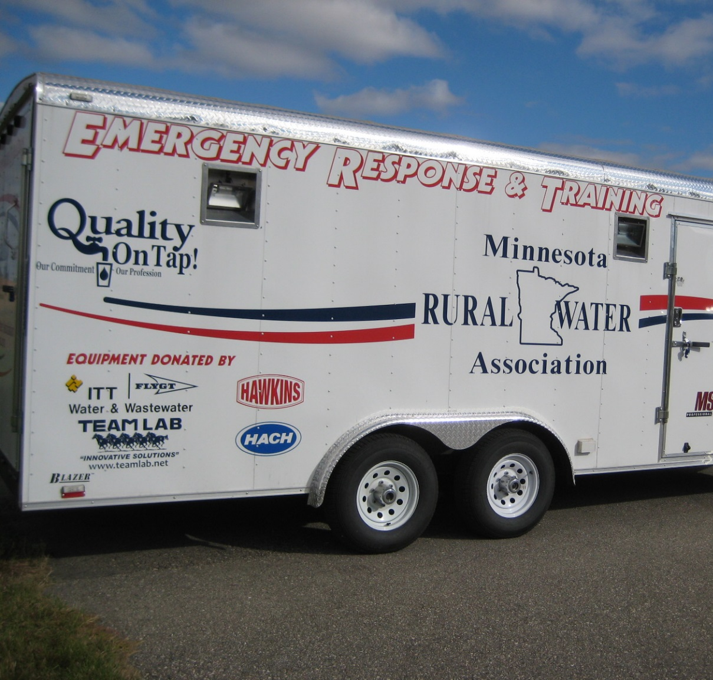
STRATEGIES: PUBLIC HEALTH
EMERGENCY PREPAREDNESS
Plan for floods and extreme weather events
Minnesota Water/Wastewater Agency Response Network (MnWARN) (www.mnwarn.org/)
Minnesota Pollution Control Agency (MPCA) on preparing for floods (www.pca.state.mn.us/waste/floods-minimizing-pollution-and-health-risks)
Minnesota Department of Health (MDH) on protecting private wells from floods (www.health.state.mn.us/divs/eh/wells/natural/floodprecautions.html)
Federal Emergency Management Agency (FEMA) National Flood Insurance Program (www.fema.gov/business/nfip/)
Notes:
Emergency preparedness strategies can include identifying risk of water quality and water quantity issues such as water-borne diseases, flooding, and drought-induced wildfires. This slide provides some resources for more information on preparing for floods and extreme weather events.
MnWARN, the Minnesota Water/Wastewater Agency Response Network, is a formal emergency response program in Minnesota whose mission is to promote and support a statewide response to utility emergencies and disasters through mutual assistance for water, wastewater, and stormwater utilities in Minnesota. Law enforcement and fire departments have been organized for many years. MnWARN is an initiative to organize the water and wastewater professionals to be prepared to respond to water, wastewater, and storm water entities in a professional and timely manner. MnWARN assists members utilities with:
Emergency assessment, emergency response, and recovery.
Mutual Aid Agreement for sharing emergency resources with members.
Resources to help recover from a disaster.
Emergency contact network.
Voluntary participation.
The Minnesota Pollution Control Agency (MPCA) provides resources for preparing for and repairing after a flood. Preparation strategies for citizens include storage of hazardous household materials, preparing heating oil tanks, drinking water well contamination, and asbestos. Strategies for after a flood include guidance cleanup for basements, oil, sewage-soaked debris, fuel oil tanks and septic systems. Preparation strategies for businesses include guidance for manure-storage facilities, underground and aboveground storage tanks, industrial hazardous wastes (storage and disposal), and wastewater treatment facilities.
The Minnesota Department of Health (MDH) provides resources on protecting private wells from floods and preventing water-borne disease outbreaks from contaminated water sources. One example: The MDH Public Health Laboratory (PHL) shipped 1,950 well water test kits to areas impacted by the June 2012 flooding in Aitkin, Carlton, Lake, Pine, and St. Louis counties. MDH Staff also distributed 50 sample kits at Disaster Recovery Centers held on July 6-9, 2012. As of July 20, 2012, 444 samples were received and analyzed by the MDH PHL. Approximately 38% of the samples analyzed were positive for coliform bacteria and 8% of the analyzed samples were positive for e-coli. MDH Well Management staff contacted well owners if the samples tested positive to discuss the results and next steps. MDH PHL staff contacted well owners with negative results, so all well owners who sent in samples received confirmation of test results.
The Federal Emergency Management Agency (FEMA) runs the National Flood Insurance Program, the only flood insurance available to homeowners. The link not only describes the program available to homeowners but also provides resources for responding to floods.
Local hazard mitigation plans as well as local emergency operations plans can provide the guidance and opportunity to prepare for floods and other extreme weather events.
Sources: Kessler, 2011; MPCA, 2017

Slide 50
STRATEGIES: PUBLIC HEALTH
CONTAMINATED WATER
If community members are on a private well, advise them to drink bottled water during and/or after a flood or outbreak.
Get their well tested: (www.health.state.mn.us/divs/eh/wells/waterquality/index.html)
Treat contaminated well water: (www.health.state.mn.us/divs/eh/wells/waterquality/disinfection.html)
Seek information on beaches prior to swimming, avoid visibly contaminated waters
Beach info: (www.health.state.mn.us/divs/eh/beaches/index.html)
Blue-green algae: (www.health.state.mn.us/divs/idepc/diseases/hab/index.html)
If community members consume fish:
Track fish consumption advisories: (www.health.state.mn.us/divs/eh/fish/)
Notes:
Public health strategies for dealing with contaminated water include the following:
Drink bottled water during and/or after a flood or outbreak if community members rely on a private well
Get private well tested
http://www.health.state.mn.us/divs/eh/wells/waterquality/index.html
Treat contaminated water
http://www.health.state.mn.us/divs/eh/wells/waterquality/disinfection.html
Seek information on beaches prior to swimming and avoid visibly contaminated waters. MDH oversees the Minnesota Lake Superior Beach Monitoring Program for 41 beaches along the north shore of Lake Superior. Many local public health departments monitor beach water quality. MDH maintains a listing of contact information for county/city local health departments in Minnesota.
Beach info: http://www.health.state.mn.us/divs/eh/beaches/index.html
Blue-green algae: http://http://www.health.state.mn.us/divs/idepc/diseases/hab/index.html
Track fish consumption advisories
http://www.health.state.mn.us/divs/eh/fish/
MDH, MDNR and MPCA all actively work to reduce contaminants, improve water quality, and notify public about potential outbreaks and activate public health response
MDH Programs include source water protection, drinking water protection, well construction and well sealing, fish consumption advisories, and others.

Slide 51
What can individuals do to address climate change?
Notes:
We as individuals can play many roles in mitigating and adapting to climate change. The next slides list actions each of us can take to make a difference.

Slide 52
Energy
1
Notes:
Energy production is one of the big three contributors to our changing climate because burning oil, coal, and natural gas to generate electric power puts a lot of GHGs into the air.

Slide 53
Energy
INDIVIDUAL ACTIONS
Use less energy to heat or cool homes
Use energy-efficient appliances and lightbulbs
Reduce, reuse, recycle what we buy and use on a daily basis
COLLECTIVE ACTIONS
Use more renewable energy (solar, wind, and biofuels)
Use less fossil fuel energy (oil, coal, natural gas)
Support policy change for renewable energy
Notes:
As individuals, we can each reduce the amount of GHG emissions we cause in a number of ways, like using less energy to heat or cool our homes; using energy-efficient appliances and light bulbs; and reducing, reusing, and/or recycling what we buy and what we use on a daily basis.
However, what is really going to make a difference is having all of us rely more on renewable energy sources like solar and wind, and less on fossil fuel energy sources like oil, coal, and natural gas. As individuals, we can support public and private sector policies that lead to more renewable energy production. A policy example is Minnesota’s Next Generation Energy Act of 2007, which has achievable GHG reduction targets for the Year 2025 and beyond.

Slide 54
Transportation
2
Notes:
Transportation is the second big contributor to our changing climate because burning fuel to power vehicles emits a lot of GHGs into the air.

Slide 55
Transportation
INDIVIDUAL ACTIONS
Burn less gasoline or diesel fuel
Walk, bike, use transit, carpool, and telecommute when possible
Drive an electric vehicle (powered by wind or solar energy)
COLLECTIVE ACTIONS
Support public and private sector policies
To increase gas and diesel mileage standards
Incentivize the production of electric vehicles
Build more transit options
Notes:
We each can reduce the amount of GHG emissions we cause by using transportation options that burn less gasoline or diesel fuel like walking, biking, using transit, and carpooling or telecommuting when possible. Another option would be to drive an electric car powered by wind or solar energy.
But, what would really have an impact is if we all have more transportation options that either burn less or don’t use any gasoline or diesel fuel. This can be done by supporting public and private sector policies like increasing fuel efficiency standards, incentivizing the production and purchase of electric vehicles, building more transit options where sufficient population density exists, and adopting policies that support telecommuting.

Slide 56
Agriculture
3
Notes:
Agriculture is the third big contributor to GHG emissions because it takes a lot of energy to produce, process, and transport food.

Slide 57
Agriculture
INDIVIDUAL ACTIONS
Buy more locally grown foods
Eat fewer processed foods and less meat
Grow some of our own food
COLLECTIVE ACTIONS
Support policies that incentivize:
Foods produced with fewer chemicals
Food that are less processed
Food that are transported shorter distances
Notes:
As individuals, we can each reduce the amount of GHG emissions we cause by buying more locally grown foods, eating fewer processed foods and less meat, and even growing some of our own food.
However, what is really going to make a difference is if we all have access to foods that are produced, processed, and transported using less energy. As individuals, we can support public and private sector policies that incentivize foods produced with fewer chemicals, foods that are less processed and closer to their natural state, and foods that are transported shorter distances.

Slide 58
SUMMARY
Water has always been an important and abundant resource in Minnesota
Minnesota’s climate is predicted to change in the future with consequences for water quality and quantity
There are serious public health issues related to:
Increases in water
Decreases in water
Increases in water temperature
There are strategies to prevent harms to our health from climate change, including infrastructure changes, public health strategies, and collective and individual actions
Notes:
To summarize,
Water has always been an important and abundant resource in Minnesota
Minnesota’s climate is predicted to change in the future with consequences for water quality and quantity
There are serious public health issues related to:
Increases in water
Decreases in water
Increases in water temperature
Strategies to prevent injury and illness include infrastructure adaptation and public health planning and response

Slide 59
ACKNOWLEDGEMENTS
This work was supported by cooperative agreement 5UE1EH000738 from the Centers for Disease Control and Prevention.
Special thanks to the following people for their contributions to the creation of this training module:
Anita Anderson, MDH
Patti Craddock, Short Elliott Hendrickson Inc. (SEH)
Chris Elvrum, MDH
Tannie Eshenaur, MDH
Ann Pierce, DNR
Angela Preimesberger, MPCA
Lih-in Rezania, MDH
Andrew Sullivan, Eden Prairie

Slide 60
Questions?
Contact Minnesota Climate and Health Program
health.climatechange@state.mn.us
651-201-4898

Slide 61
REFERENCES: 1 of 7
Arbor Day Foundation. 2017. Everyone Can Plant a Tree & Help Fight Climate Change. Available online: www.arborday.org/trees/climatechange/plantatree.cfm
Blumenfeld, K. 2016. Minnesota Department of Natural Resources, State Climatology Office; personal communication on August 9, 2016.
Confalonieri U, Menne B, Akhtar R, Ebi KL, Hauengue M, Kovats RS, Revich B and Woodward A. 2007. Human health. Climate Change 2007: Impacts, Adaptation and Vulnerability. Contribution of Working Group II to the Fourth Assessment Report of the Intergovernmental Panel on Climate Change. Cambridge University Press, Cambridge, UK, 391-431.
Curriero FC, Patz JA, Rose JB, Lele S. 2001. The association between extreme precipitation and waterborne disease outbreaks in the United States, 1948-1994. American Journal of Public Health, 91(8): 1194-1199.
Do It Green Minnesota. 2017a. Eating Low: Back to Basics. Available online: https://doitgreen.org/topics/food/eating-low-back-basics
Do It Green Minnesota. 2017b. The Connection Between Recycling and Global Warming. Available online: https://doitgreen.org/topics/climate-change/connection-between-recycling-and-global-warming
Do It Green Minnesota, 2017c. Save the Rainwater! Available online: https://doitgreen.org/topics/gardening/save-rainwater
Do It Green Minnesota. 2017d. Achieving a Sustainable Lawn. Available online: https://doitgreen.org/topics/gardening/achieving-sustainable-lawn
Dukes JS and Mooney HA. 1999. Does global change increase the success of biological invaders? Trends in Ecology & Evolution (4) 135-139
Ebi KL, Balbus J, Kinney PL, Lipp E, Mills D, O’Neill MS, and Wilson M. 2008. Effects of global change on human health. In: Analyses of the Effects of Global Change on Human Health and Welfare and Human Systems [Gamble JL (ed.), Ebi KL, Sussman FG, and Wilbanks TJ (authors)]. Synthesis and Assessment Product 4.6. U.S. Environmental Protection Agency, Washington, DC, pp. 39-87.

Slide 62
REFERENCES: 2 of 7
Environmental Quality Board. 2015. Minnesota and climate change: our tomorrow starts today. Available online: https://www.eqb.state.mn.us/content/climate-change
Field CB, Mortsch LD, Brklacich M, Forbes DL, Kovacs P, Patz JA, Running SW, and Scott MJ. 2007. North America. In: Climate Change 2007: Impacts, Adaptation and Vulnerability. Contribution of Working Group II to the Fourth Assessment Report of the Intergovernmental Panel on Climate Change [Parry ML, Canziani OF, Palutikof JP, van der Linden PJ, and Hanson CE(eds.)]. Cambridge University Press, Cambridge, UK, and New York, pp. 617-652.
Freshwater Society. 2013. Minnesota’s Groundwater: Is our use sustainable? Available online: http://freshwater.org/wp-content/uploads/2013/04/Updated-MNs-Groundwater-Paper-lo-res.pdf
Governor Dayton, M. 2012. Individual Assistance request to President Barak Obama. July 19, 2012.
Gronewold, A.D., Clites, A.H., J. Bruxer, K.A. Kompoltowicz, J.P. Smith, T.S. Hunter, and C. Wong. 2015. Water levels surge on the Great Lakes. Available online: https://eos.org/project-updates/water-levels-surge-on-great-lakes
Hayhoe, K., VanDorn, J., Croley, T., Schlegal, N., & Wuebbles, D. 2010. Regional climate change projections for Chicago and the U.S. Great Lakes. Journal of Great Lakes Research, 36, 7-21.
Horstmeyer, SL. 2008. Relative humidity . . . Relative to what? The dew point temperature . . . a better approach. Available online: http://www.shorstmeyer.com/wxfaqs/humidity/humidity.html
Karl TR, Melillo JM, and Peterson TC, (eds.) 2009. Global Climate Change Impacts in the United States. Cambridge University Press. Available online: http://downloads.globalchange.gov/usimpacts/pdfs/climate-impacts-report.pdf

Slide 63
REFERENCES: 3 of 7
Karnowski, S. 2012. Summer's heat taking toll on fish in Minnesota, Wisconsin, Dakotas. Associated Press, July 2012. Reprinted July 11, 2012 by St. Paul Pioneer Press: http://www.twincities.com/localnews/ci_21062734/heat-wave-takes-toll-minnesotas-fish
Kemble, et al. 2012. Fatal Naegleria fowleri infection acquired in Minnesota: possible expanded range of a deadly thermophilic organism. Clin Infect Dis. 2012 Mar;54(6):805-9. Epub 2012 Jan 11.
Kessler R. 2011. Stormwater Strategies: Cities prepare aging infrastructure for climate change. Environmental Health Perspectives. Vol 119, Num 12.
Kling, GW, Hayhoe, K, Johnson, LB, Magnuson, JJ, Polasky, S, Robinson, SK, Shuter, BJ, Wander, MM, Wuebbles, DJ, and Zak, DR. 2003. Confronting Climate Change in the Great Lakes Region: Impacts on Our Communities and Ecosystems. A Report of the Union of Concerned Scientists and The Ecological Society of America, April 2003. Available online: http://www.ucsusa.org/sites/default/files/legacy/assets/documents/global_warming/greatlakes_final.pdf
Konikow, L.F., and Kendy, E., 2005, Groundwater depletion: A global problem. Hydrogeology Journal, v. 13, p. 317-320.
Kundzewicz ZW, Mata LJ, Arnell NW, Döll P, Kabat P, Jiménez B, Miller KA, Oki T, Sen Z and Shiklomanov IA. 2007. Freshwater resources and their management. Climate Change 2007: Impacts, Adaptation and Vulnerability. Contribution of Working Group II to the Fourth Assessment Report of the Intergovernmental Panel on Climate Change, [Parry ML, Canziani OF, Palutikof JP, van der Linden PJ, and Hanson CE(eds.)]. Cambridge University Press, Cambridge, UK, and New York, pp. 617-652.
Milwaukee Sentinel. 1993. Chemist, city fight over early signs of impurities. April 10, 1993.
Minnesota Department of Health (MDH). 2015. Minnesota Climate and Health Profile Report. Available online: http://www.health.state.mn.us/divs/climatechange/docs/mnprofile2015.pdf
Minnesota Department of Natural Resources (MDNR). 2011. Watershed Assessment Tool – Geomorphology Concepts. Available online: http://www.dnr.state.mn.us/whaf/index.html

Slide 64
REFERENCES: 4 of 7
Minnesota Department of Natural Resources (MDNR). 2016a. Water Resources. Available online: http://www.dnr.state.mn.us/waters/index.html
Minnesota Department of Natural Resources (MDNR), 2016b. Historic Mega-Rain Events in Minnesota. Available online: http://www.dnr.state.mn.us/climate/summaries_and_publications/mega_rain_events.html
Minnesota Department of Natural Resources (MDNR), 2017. Invasive Species in Minnesota. Available online: http://www.dnr.state.mn.us/invasives/index.html
Minnesota Pollution Control Agency (MPCA). 2011. Blue-green algae and harmful algal blooms. Available online: https://www.pca.state.mn.us/water/blue-green-algae-and-harmful-algal-blooms
Minnesota Pollution Control Agency (MPCA). 2016. The threats to Minnesota’s groundwater. Available online: https://www.pca.state.mn.us/water/threats-minnesotas-groundwater
Minnesota Pollution Control Agency (MPCA). 2017. Floods: Minimizing pollution and health risks. Available online: https://www.pca.state.mn.us/waste/floods-minimizing-pollution-and-health-risks
Minnesota Public Radio (MPR). 2011a. Crazy record! Highest dew point ever at MSP Airport (82!). Available online: http://minnesota.publicradio.org/collections/special/columns/updraft/archive/2011/07/another_48_hours_of_relentless.shtml
Minnesota Public Radio (MPR). 2011b. Pagami Creek Fire in BWCA now estimated at 100,000 acres. Available online: http://minnesota.publicradio.org/display/web/2011/09/13/pagami-fire-60000-acres-evacuations-underway
Minnesota Public Radio (MPR) News. 2012. Is cooling the house heating up the planet? August 27, 2012. Available online: www.mprnews.org/story/2012/08/25/regional/air-conditioning-global-warming
Minnesota State Climatology Office. 2011. A Technical Analysis of the July 19th, 2011 Dew Point Measurement at Moorhead Municipal Airport, MN. Available online: http://www.climate.umn.edu/pdf/july_19_2011_technical.pdf

Slide 65
REFERENCES: 5 of 7
Minnesota State Climatology Office. 2017. Drought Information Resources. Available online: http://www.dnr.state.mn.us/climate/drought/index.html
Monson, B. 2009. Trend Reversal of Mercury Concentrations in Piscivorous Fish from Minnesota Lakes. 1982#2006. Environ. Sci. Technol., 43 (6), 1750-1755.
Morel FMM, Kraepiel AML, and Amyot M. 1998. The chemical cycle and bioaccumulation of mercury. Annual Review of Ecology and Systematics, 29, 543-566.
National Aeronautics and Space Administration (NASA). 2005. What’s the Difference Between Weather and Climate? Available online: https://www.nasa.gov/mission_pages/noaa-n/climate/climate_weather.html
National Aeronautics and Space Administration (NASA). 2016. Global Climate Change: Vital Signs of the Planet. Available online: http://climate.nasa.gov/causes
National Drought Mitigation Center (NDMC). 2016. Drought Monitor. Available online: http://droughtmonitor.unl.edu/Home.aspx
National Oceanic and Atmospheric Administration (NOAA). 2017a. National Centers for Environmental Information, Climate at a Glance: U.S. Time Series, Average Temperature, February 2017. Available online: http://www.ncdc.noaa.gov/cag/
National Oceanic and Atmospheric Administration (NOAA). 2017b. National Centers for Environmental Information, Climate at a Glance: U.S. Time Series, Precipitation, February 2017. Available online: http://www.ncdc.noaa.gov/cag/
National Weather Service (NWS). 2011. Practice HEAT SAFETY Wherever You Are. Available online: http://www.nws.noaa.gov/os/heat/index.shtml
Seeley M. 2012. Climate Trends and Climate Change in Minnesota: A Review. Minnesota State Climatology Office. Available online: http://climate.umn.edu/seeley/ASABE_2012.pdf

Slide 66
REFERENCES: 6 of 7
Solomon S, Qin D, Manning M, Alley RB, Berntsen T, Bindoff NL, Chen Z, Chidthaisong A, Gregory JM, Hegerl GC, Heimann M, Hewitson B, Hoskins BJ, Joos F, Jouzel J, Kattsov V, Lohmann U, Matsuno T, Molina M, Nicholls N, Overpeck J, Raga G, Ramaswamy V, Ren J, Rusticucci M, Somerville R, Stocker TF, Whetton P, Wood RA and Wratt D. 2007. Technical Summary. In: Climate Change 2007: The Physical Science Basis. Contribution of Working Group I to the Fourth Assessment Report of the Intergovernmental Panel on Climate Change [Solomon S, Qin D, Manning M, Chen Z, Marquis M, Averyt KB, Tignor M and Miller HL (eds.)]. Cambridge University Press, Cambridge, United Kingdom and New York, NY, USA.
Spatial Hazard Events and Losses Database for the United States (SHELDUS). 2012. Data downloaded April 2012. Available online: http://hvri.geog.sc.edu/SHELDUS
Trenberth, K.E. 2011. Changes in precipitation with climate change. Available online: http://www.int-res.com/articles/cr_oa/c047p123.pdf
United States Department of Agriculture (USDA) Agricultural Research Service. 2012. USDA Plant Hardiness Zone Map. Available online: http://planthardiness.ars.usda.gov
United States Environmental Protection Agency (U.S. EPA). 2011. Agriculture and Food Supply. Available online: http://epa.gov/climatechange/effects/agriculture.html
United States Environmental Protection Agency (U.S. EPA). 2016a. Climate Change: Basic Information. Available online: https://www3.epa.gov/climatechange/basics
United States Environmental Protection Agency (U.S. EPA). 2016b. Climate Change Indicators: Snowfall. https://www3.epa.gov/climatechange/science/indicators/snow-ice/snowfall.html

Slide 67
REFERENCES: 7 of 7
United States Environmental Protection Agency (U.S. EPA). 2016c. Great Lakes Water Levels and Temperatures. Available online: https://www.epa.gov/climate-indicators/great-lakes
United States Environmental Protection Agency (U.S. EPA) 2016d. Climate Change, What You Can Do: At Home. Available online: www.epa.gov/climatechange/what-you-can-do-home=
United States Forest Service Incident Information System. 2011. Pagami Creek Fire. Accessed 7/30/2012. Available online: http://www.inciweb.org/incident/2534/
United States National Hazard Statistics. 2012. Accessed 7/30/2012. Available online: http://www.nws.noaa.gov/om/hazstats.shtml
University of Minnesota, 2011. Minnesota Water Sustainability Framework. University of Minnesota Water Resources Center. Available online: https://www.wrc.umn.edu/sites/wrc.umn.edu/files/mwsframeworkcompletefinal1_201.pdf
What’s Your Impact. 2017. Available online: http://whatsyourimpact.org/fight-climate-change/drive-less
Williamson CE, Saros JE, and Schindler DW. 2009: Sentinels of change. Science, 323(5916), 887-888.
World Health Organization (WHO). 2010. Climate change and health. Fact sheet N°266. Available online: http://www.who.int/mediacentre/factsheets/fs266/en/
Xcel Energy. 2017. Renewable Energy Options – Residential. Available online: www.xcelenergy.com/programs_and_rebates/residential_programs_and_rebates/renewable_energy_options_residential
Zandlo, J. 2008. Observing the climate. Minnesota State Climatology Office. Available online: http://climate.umn.edu/climateChange/climateChangeObservedNu.htm

Slide 68
PHOTO AND IMAGE CREDITS: 1 of 2
Slide 4 Lake and tress – Pexels. Available online at: https://www.pexels.com/photo/water-lake-trees-nature-28702/
Slide 5 Minnesota map of lakes and streams – University of Minnesota Water Resources Center, 2011. Available online at: https://www.wrc.umn.edu/sites/wrc.umn.edu/files/mwsframeworkcompletefinal1_201.pdf
Slide 6 Diagram of the hydrologic cycle – University of Minnesota Water Resources Center, 2011. Available online at: https://www.wrc.umn.edu/sites/wrc.umn.edu/files/mwsframeworkcompletefinal1_201.pdf
Slide 9 Kitchen sink with water faucet – Pexels. Available online at: https://www.pexels.com/photo/water-flows-from-the-tap-to-sink-6256/
Slide 10 Child fishing from boat – Pexels. Available online at: https://www.pexels.com/photo/blur-boat-boy-child-386003/
Slide 12 Lightning bolt and sun – Microsoft Clip Art
Slide 13 Leaves – Microsoft Clip Art
Slide 14 Climate and health graphic – MDH, 2016
Slide 17 Annual average minimum temperatures for Minnesota – MDH, 2015
Slide 18 Plant Hardiness Zones – Arbor Day Foundation, 2015
Slide 20 Minnesota mega-rain events graphic – MDH, 2017
Slide 21 Flood and drought map – MDH, 2015
Slide 22 Highest annual dew points chart – MNDNR State Climatology Office
Slide 25 Precipitation changes map – U.S. EPA, 2016
Slide 26 Water increase map – Karl et al., 2009
Slide 28 Flooded playground – Jim Mone, Associated Press. Available online at: https://www.nytimes.com/2014/06/25/us/much-of-minnesota-is-flooded-as- swollen-rivers-overflow.html?_r=0
Slide 29 Washed-out road next to house – Rachel Agurkis
Slide 29 Rushing water – Derek Montgomery, MPR
Slide 30 35 days after Red River Flood in Oslo, MN on May 14, 2009 – Ed Erdahl, FEMA
Slide 31 Electron micrograph showing Salmonella typhimurium invading cultured human cells – Wikipedia. Available online at: http://en.wikipedia.org/wiki/Salmonella
Slide 32 Newspaper headlines – Milwaukee Sentinel. Available online at: https://onmilwaukee.com/living/articles/ebolainmilwaukee.html
Slide 33 Sally Nance walks through floodwater as she helps her neighbors remove clothes from their home – Scott Olson, Getty Images. Available online at: http://www.nbcnews.com/slideshow/weather/flooding-along-mississippi-42899212

Slide 69
PHOTO AND IMAGE CREDITS: 2 of 2
Slide 34 Heat index across U.S. – The Weather Channel, July 20, 2011
Slide 35 National weather service heat index – NOAA, 2011
Slide 36 Jack Sock receives assistance from trainer – Getty Images. Available online at: http://www.skysports.com/tennis/news/32833/9977948/stan-wawrinka-eases- through-but-jack-sock-collapses-with-heat-exhaustion
Slide 37 Desert – Pexels. Available online at: https://www.pexels.com/photo/earth-field-desert-dry-96865/
Slide 38 Drought graphic – National Drought Mitigation Center, 2016
Slide 39 Water level charts – EPA, 2016
Slide 40 Municipal water use chart – MPCA, 2016
Slide 40 Groundwater areas of concern map – Freshwater Society, 2013
Slide 41 Wildfire smoke – Pexels. Available online at: https://www.pexels.com/photo/forest-tree-fire-hot-50700/
Slide 42 Fish in bucket – Pexels. Available online: https://www.pexels.com/photo/food-healthy-water-fish-92918
Slide 43 Minnesota fish communities before and after climate warming – Peter Jacobson, Fisheries Research Supervisor, Minnesota Department of Natural Resources (MDNR)
Slide 44 Harmful algal bloom – Ohio Environmental Protection Agency. Available online at: http://epa.ohio.gov/ddagw/hab.aspx
Slide 45 Mosquito – Pexels. Available online at: www.pexels.com/photo/black-white-mosquito-86722
Slide 46 Zebra mussels – U.S. Fish and Wildlife Service. Available online at: http://www.100thmeridian.org/photobank
Slide 48 Target Center green roof – The Kestrel Design Group. Available online at: http://www.greenroofs.com/projects/pview.php?id=1000
Slide 49 Water pipes – Water & Wastes Digest. Available online at: http://www.wwdmag.com/sites/wwdmag.com/files/12.14%20pipes-1197632- 1280x960.jpg?1481811313
Slide 50 Water management solutions graphic – MNDNR, 2011
Slide 54 Person biking – Pexels. Available online at: https://www.pexels.com/photo/person-wearing-black-and-gray-sleeveless-dress-riding-a-step-through- bicycle-112588/
Slide 55 Light bulbs – Pexels. Available online at: https://www.pexels.com/photo/shallow-focus-photography-of-yellow-string-light-185699/
Slide 56 Food – Pexels. Available online at: https://www.pexels.com/photo/lemon-orange-red-berries-ginger-peanut-on-wooden-table-103649/
Slide 57 Plant – Pexels, Available online at: https://www.pexels.com/photo/agriculture-ball-shaped-ecology-environment-82728/
Slide 58 Windmill – Pexels, Available online at: https://www.pexels.com/photo/road-street-desert-industry-932/
Slide 60 Rain – Pexels. Available online at: www.pexels.com/photo/rainy-rain-raindrops-window-110874

